Slide 1





Understanding
DISC Styles
Presented by:

Slide 2
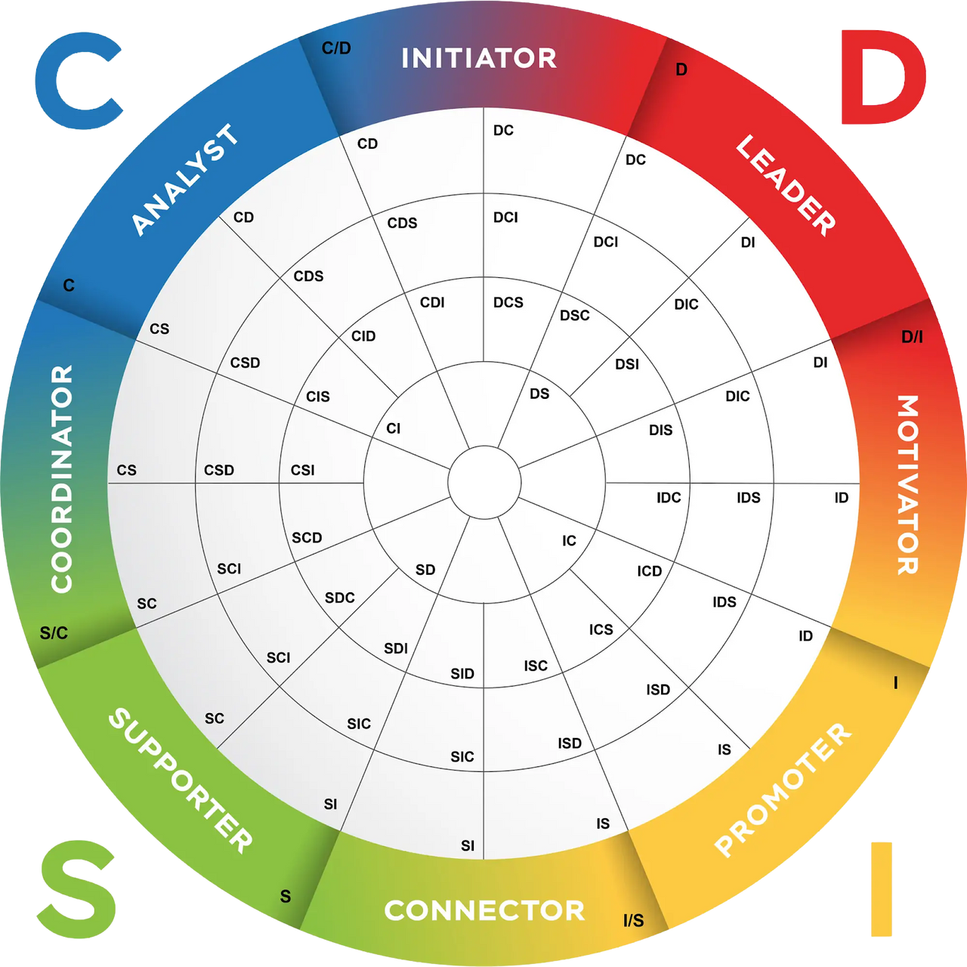
DISC Team
Team Members Style

Slide 3







DISC at a Glance
Dominant D
Steady S
direct, fast-paced, results-oriented
patient, supportive, relationship-oriented
Influencing I
Conscientious C
expressive, enthusiastic, people-oriented
analytical, precise, quality-oriented

Slide 4
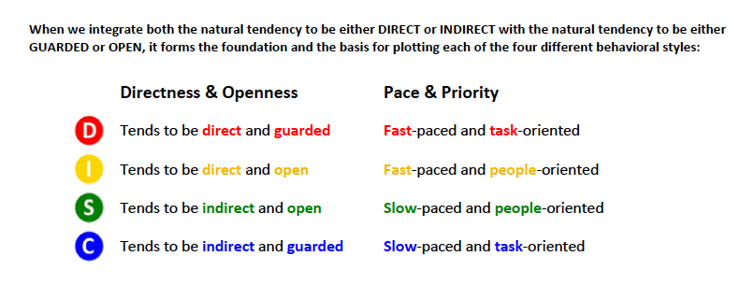
DISC at a glance
Most people show a blend; secondary styles add nuance

Slide 5
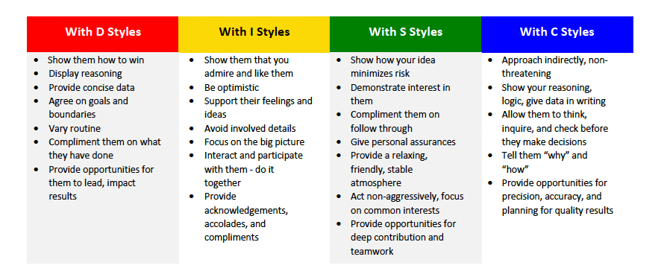
Communicating
with each style

Slide 6





Communicating
with each style
Get to the point; lead with outcomes, options, next steps
  D
  I
Connect first; use energy and stories; highlight impact on people
  S
Provide context; go steady; invite questions; avoid sudden changes
  C
Share data; be specific; give time to analyze; avoid ambiguity

Slide 7
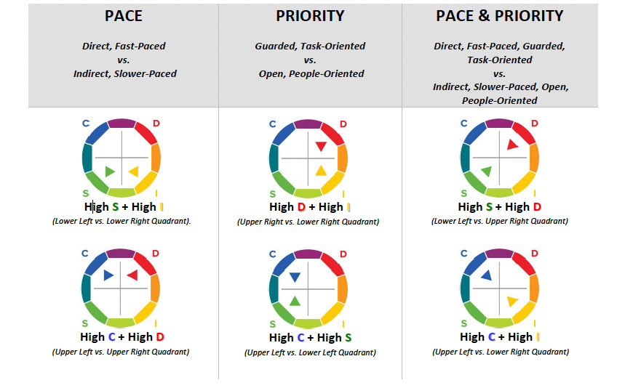

When styles clash
Agree on decision rules, timelines, and review points
I ↔ C spontaneity vs. precision
D ↔ S
speed vs. stability

Slide 8

DISC is a
starting point
In a remote-first setting, it's essential to remain flexible and adjust to diverse communication styles and evolving situations.

Slide 9










Learning and Using
digital body language
01
02
03
04
  Value Visibly
  Communicate Carefully
  Collaborate Confidently
  Trust Totally
assume good intent; create safety
make appreciation and effort obvious
be explicit and audience aware
make appreciation and effort obvious

Slide 10

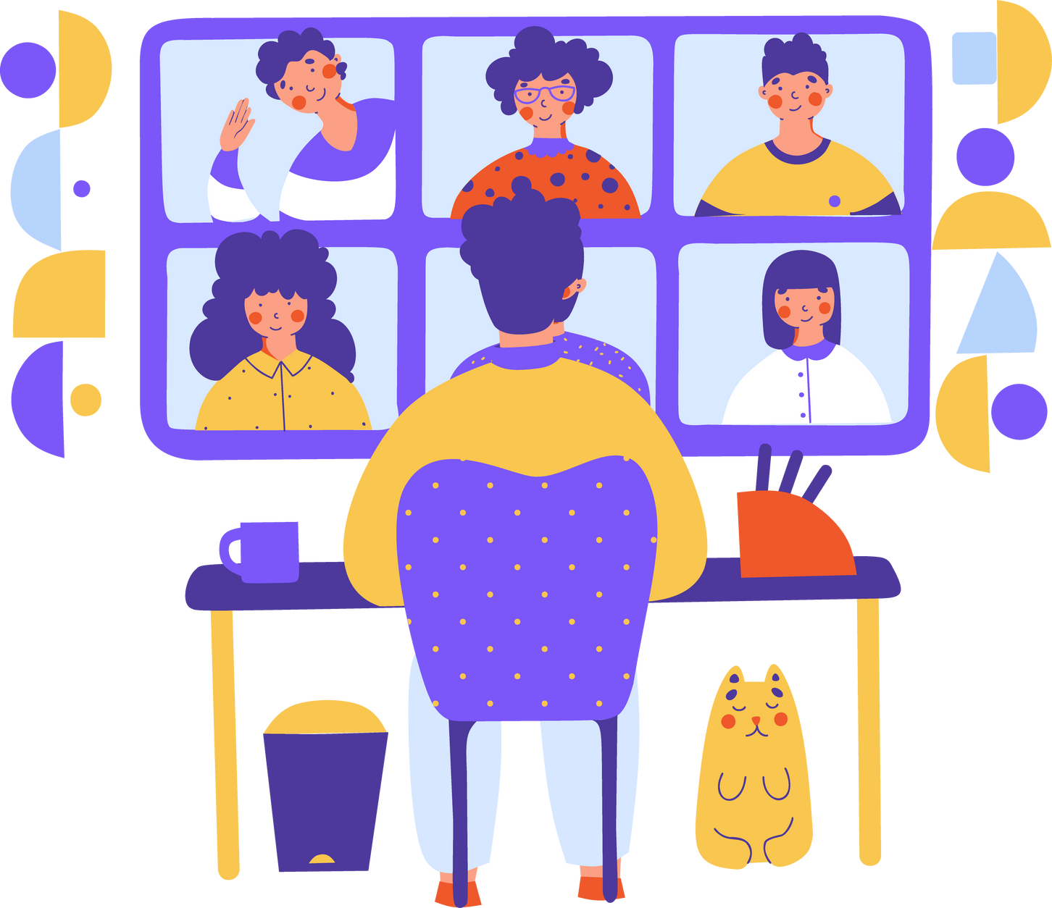

Check List
before you type
  Who needs to be included? What do I want them to do?
  What context do they need? What tone fits?
  When should I send it? What’s the right channel?
  Would I be comfortbale if this were forwarded or screenshotted?

Slide 11










Email Clarity
essentials
  Action-oriented subject lines
  Be Direct but friendly
  Close with clear next steps
  Choose sign-offs intentionally
e.g. “Review by EOD Wed”
use bullet points;
highlight WINFY
(What I need from you)
realistic deadlines
e.g. “Thanks in advance“ can boost responses

Slide 12



Meetings
State the purpose and probable issues IN the agenda
essentials
1
Check calendars before scheduling.
  Make sure each meeting has an explicit reason & the right people are there
Who needs to be in this meeting? Is the whole team needed?
2
Begin with quick social check-in to build safety
3
Send notes and actions after; audit recurring meetings regularly
4

Slide 13










Asking for requests
etiquette
  What do I need from you?
  Is this informational?
  Do I need you to respond?
  What are the timeline expectations?

Slide 14

Asking for requests
suggestions
  Do we agree as a company?
Tool | When to use | Target Response Time | Norms / Tips
Slack | Time-sensitive, short questions | Within a few hours | Keep to <4 people; avoid complex topics.
Email | Directional, important info; attachments | < 24 Hours | Use action subjects; avoid when immediate response is needed.
Video | Meetings, intros, complex topics | Scheduled | Have an agenda; use a camera when possible; record if helpful.
Text | Urgent; only when other channels fail | ≤ 30 Minutes | Use sparingly; respect boundaries.

