Slide 1
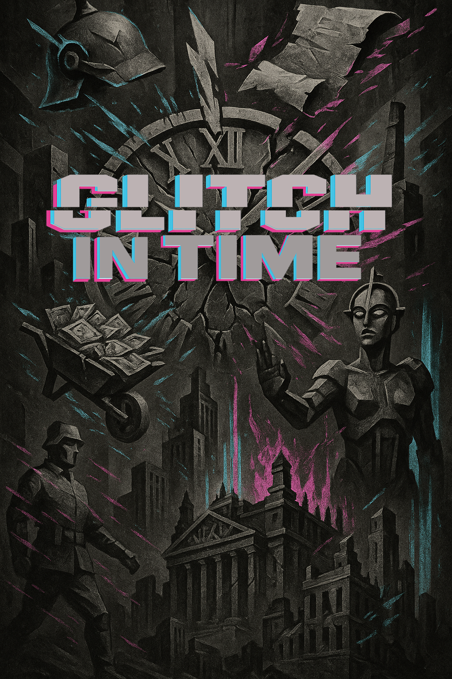

A set of observation and recall questions exploring the impact of German politics on everyday life
Aligned to the AQA Spec: Democracy & Dictatorship: 1890–1945.

Slide 2

Most of what I make are short, bingeable videos – the revision equivalent to the latest true crime drama. There’s also a growing collection of printables and downloadables: Knowledge Organisers, quirky revision tools, flashcards, wall displays, and “copy-and-paste” PowerPoint slides for quick lesson tasks.
This PowerPoint is part of the Glitched Germany series and is designed to reduce teacher workload while still hitting the mark for teaching students observational skills, knowledge recall and deeper evaluative thinking.
So, use this however works for you — highlight it, scribble on it, stick it on the wall, or fold it into a Tudor-themed paper aeroplane.
But if you want more, here’s where to find me:
My name’s Laura — former Head of History with fifteen years of classroom experience. And I’m looking to start a revision revolution with Socraflix.
What is Socraflix? Right now, it’s one woman and her two cats. But it’s also my vision for what revision could be. I believe:
Revision shouldn’t be boring.
You don’t need a mountain of facts to succeed.
It should make you understand more, not just remember more.
Over the 2025/26 academic year, I’m building a subscription-based platform for History teachers, offering KS4 and KS5 resources designed to support both teacher workload and student wellbeing — all for just £12.99 a month (the same as a Standard Netflix subscription!)
www.socraflix.com/
tudortwistory
@socraflix
on TikTok, Instagram, and YouTube

Slide 3
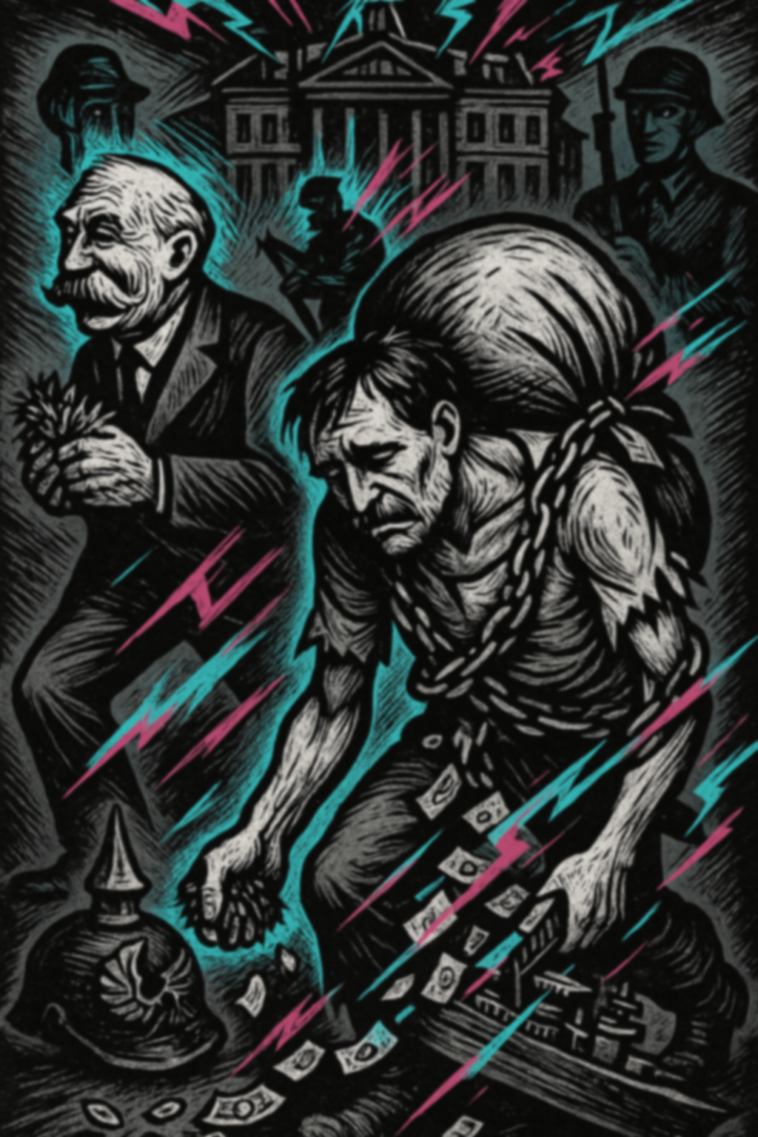

1919
Who is the shabby, chained man shown carrying a heavy sack?
What is spilling from the sack on his back?
Which building looms in the background of the image?
Which defeated military symbol lies on the ground in the lower left?
The man on the left with a moustache is running off clutching land. Who does he represent?
Why might the German man be shown in chains?
Which Allied leader wanted to weaken Germany militarily to prevent future invasions?
Why are there soldiers shown in the shadows of the background?
How does the lightning/glitch-like energy in cyan and magenta reflect German feelings about the treaty?
How does the image capture the idea of Germany as a “scapegoat” in 1919?

Slide 4
Who is the shabby, chained man shown carrying a heavy sack?
Answer: He represents Germany after WWI, burdened by reparations.
What is spilling from the sack on his back?
Answer: Money/banknotes, symbolising reparations.
What building looms in the background of the image?
Answer: A grand government-style building, representing Versailles or authority imposing the treaty.
Which defeated military symbol lies on the ground in the lower left?
Answer: A broken spiked helmet (Pickelhaube), representing the fall of Imperial Germany.
The man on the left with a moustache is running off clutching land. Who does he represent?
Answer: Georges Clemenceau/France, gaining land such as Alsace-Lorraine.

Slide 5
6. Why might the German man be shown in chains?
Answer: To symbolise loss of freedom and forced compliance under the treaty.
7. Which Allied leader wanted to weaken Germany militarily to prevent future invasions?
Answer: Clemenceau of France.
8. Why are there soldiers shown in the shadows of the background?
Answer: To suggest Allied enforcement and Germany’s loss of military independence.
9. How does the lightning/glitch-like energy in cyan and magenta reflect German feelings about the treaty?
Answer: It symbolises anger, shock, and chaos unleashed by the treaty’s terms.
10. How does the image capture the idea of Germany as a “scapegoat” in 1919?
Answer: The solitary, shackled man represents Germany being forced to bear all blame and punishment alone.

Slide 6
How might this visual metaphor of a chained man dropping money help explain why Germans called the Treaty a “Diktat”?
Does this image suggest the Treaty of Versailles was fair or unfair? Justify your answer with reference to both symbolism in the picture and historical arguments.

Slide 7
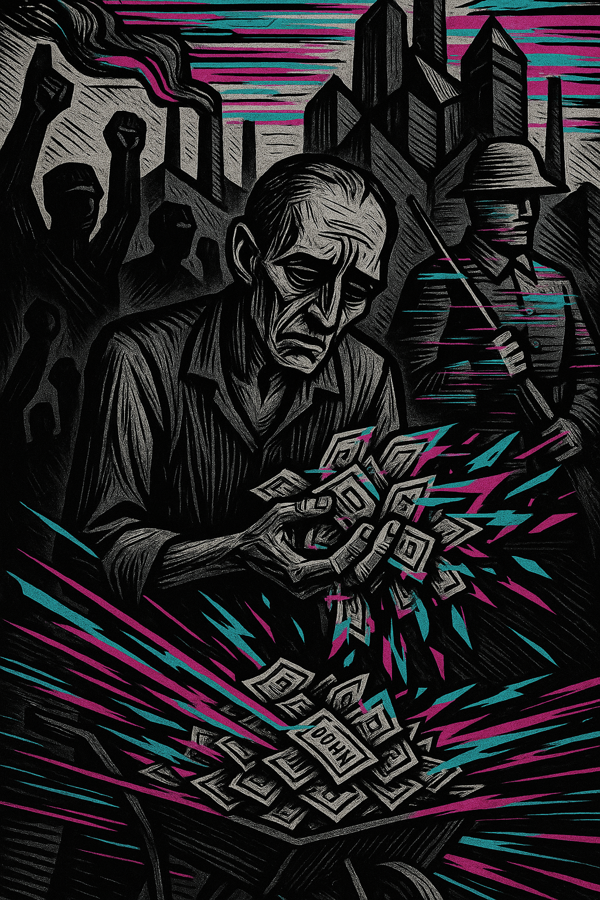
1923
What year is the image representing?
What economic crisis does the man with the banknotes symbolise?
Which industrial region of Germany was occupied by French and Belgian troops in 1923?
Why did France and Belgium occupy the Ruhr?
What key natural resource made the Ruhr such an important region?
What action did the German government encourage Ruhr workers to take in response to the French occupation?
How did the German government support the striking workers?
What impact did this have on the value of the German mark?
Give an example of how hyperinflation affected ordinary Germans.
Which clause of the Treaty of Versailles linked directly to this crisis?

Slide 8
What year is the image representing?
Answer: 1923.
What economic crisis does the man with the banknotes symbolise?
Answer: Hyperinflation in Germany.
Which industrial region of Germany was occupied by French and Belgian troops in 1923?
Answer: The Ruhr.
Why did France and Belgium occupy the Ruhr?
Answer: Germany had fallen behind on reparations payments from the Treaty of Versailles.
What key natural resource made the Ruhr such an important region?
Answer: Coal (also steel production).

Slide 9
6. What action did the German government encourage Ruhr workers to take in response to the French occupation?
Answer: Passive resistance (strikes and refusing to work).
7. How did the German government support the striking workers?
Answer: By printing more money to pay them.
8. What impact did this have on the value of the German mark?
Answer: It collapsed — leading to hyperinflation.
9. Give an example of how hyperinflation affected ordinary Germans.
Answer: Savings became worthless, people carried money in wheelbarrows, bread cost billions of marks.
10. Which clause of the Treaty of Versailles linked directly to this crisis?
Answer: The reparations clause (Article 231 ‘war guilt’ and financial penalties).

Slide 10
How did the crisis of 1923 undermine German faith in the Weimar Republic?
To what extent was the crisis of 1923 an unavoidable consequence of the Treaty of Versailles?

Slide 11
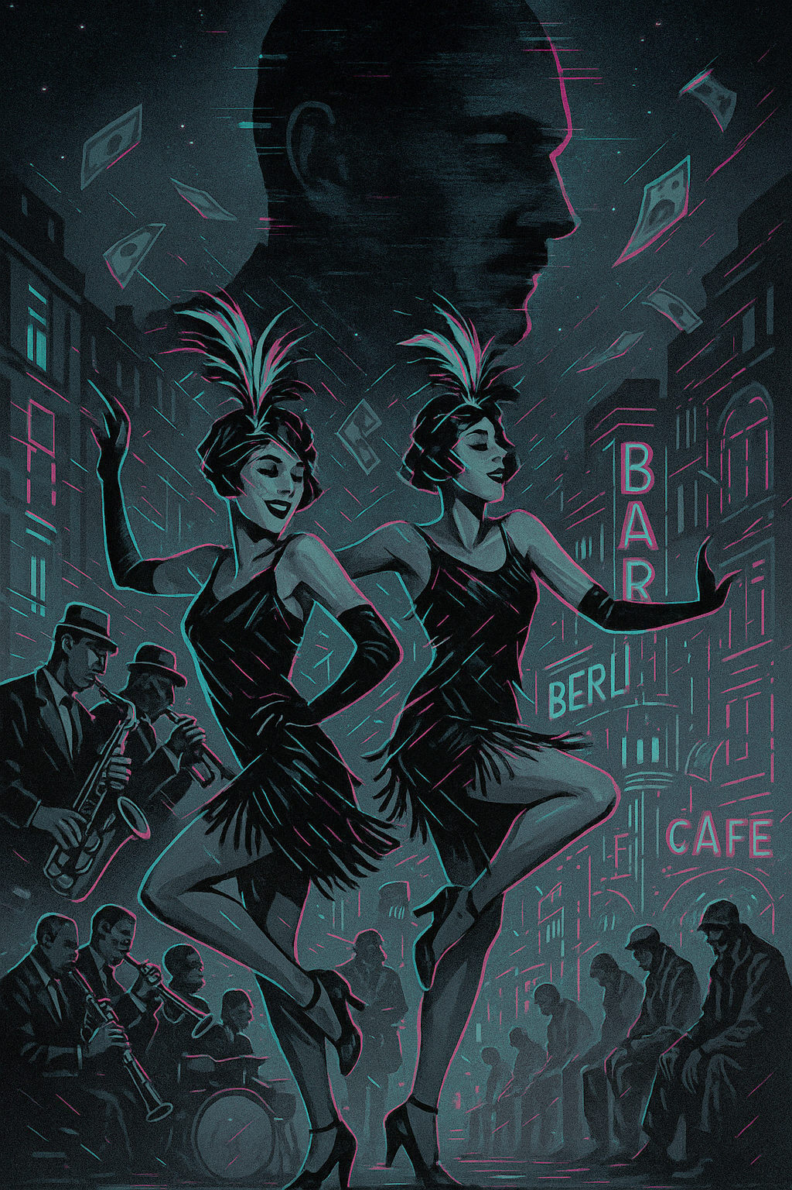
1924-1929
What city is the image set in, based on the neon signs?
What type of entertainment is being shown in the centre of the picture?
What style of music is being played by the band?
Whose silhouette looms in the background of the picture?
Why is Stresemann associated with the “Golden Years” of Weimar Germany?
What symbol in the picture suggests prosperity during the mid-1920s?
Why did Berlin become famous in the 1920s?
What social groups particularly benefited from the cultural explosion of the 1920s in Weimar Germany?
How does the image show the contrast between prosperity and hardship in 1920s Germany?
Why might some traditional Germans and right-wing groups have opposed what is shown in this image?

Slide 12
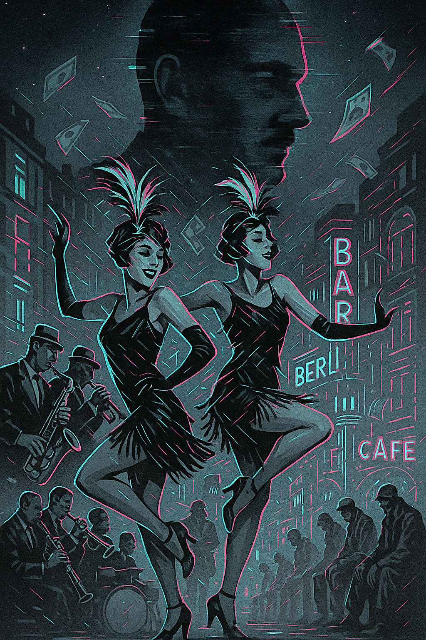
What city is the image set in, based on the neon signs?
Answer: Berlin
What type of entertainment is being shown in the centre of the picture?
Answer: Cabaret dancing
What style of music is being played by the band?
Answer: Jazz
Whose silhouette looms in the background of the picture?
Answer: Gustav Stresemann
Why is Stresemann associated with the “Golden Years” of Weimar Germany?
Answer: He helped stabilise the economy and improved international relations from 1924–29.

Slide 13
6. What symbol in the picture suggests prosperity during the mid-1920s?
Answer: Banknotes floating in the air.
7. Why did Berlin become famous in the 1920s?
Answer: For its vibrant nightlife, cabaret culture, and reputation for freedom and experimentation.
8. What social groups particularly benefited from the cultural explosion of the 1920s in Weimar Germany?
Answer: Artists, writers, musicians, and women (with more freedoms and visibility).
9. How does the image show the contrast between prosperity and hardship in 1920s Germany?
Answer: The dancers and nightlife show wealth and glamour, while the men seated at the bottom right symbolise unemployment and poverty.
10. Why might some traditional Germans and right-wing groups have opposed what is shown in this image?
Answer: They saw cabaret culture, jazz, and social liberalism as immoral, unpatriotic, and un-German.

Slide 14
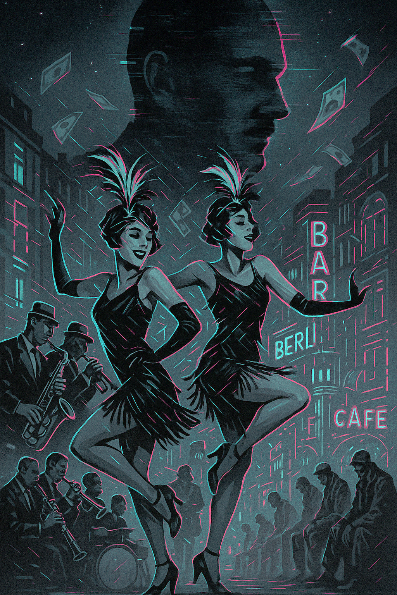
To what extent did Weimar cultural freedom strengthen or weaken the stability of the Republic?
How far did Stresemann’s policies solve Germany’s problems or simply mask them temporarily?

Slide 15
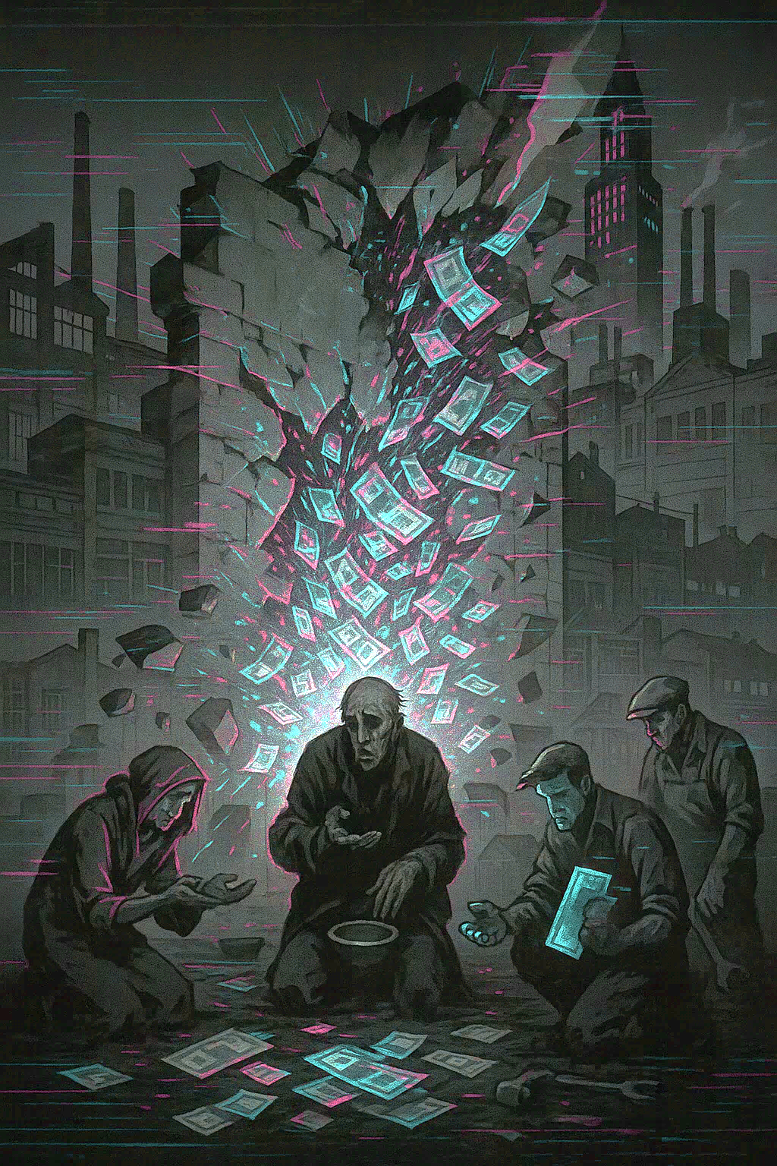
1929-1933
What year did the Wall Street Crash take place?
Why was Germany particularly vulnerable to the effects of the Crash?
What happened to unemployment in Germany after the Crash?
Which groups of people were hit hardest by the economic collapse in Germany?
How did the Wall Street Crash affect German banks?
What effect did the economic crisis have on German industrial production?
Which political parties gained support during the economic crisis caused by the Crash?
Why did the Weimar government struggle to deal with the crisis effectively?
How did the Depression affect ordinary Germans’ faith in democracy?
What link can be made between the Wall Street Crash and Hitler’s rise to power?

Slide 16
What year did the Wall Street Crash take place?
Answer: 1929.
Why was Germany particularly vulnerable to the effects of the Crash?
Answer: Because its economy relied heavily on US loans from the Dawes Plan.
What happened to unemployment in Germany after the Crash?
Answer: It rose sharply, reaching around 6 million by 1932.
Which groups of people were hit hardest by the economic collapse in Germany?
Answer: Industrial workers, who were laid off from factories
How did the Wall Street Crash affect German banks?
Answer: American loans were recalled, leading to bank failures and financial collapse.

Slide 17
6. What effect did the economic crisis have on German industrial production?
Answer: Industrial output fell drastically, leaving factories idle and millions without work.
7. Which political parties gained support during the economic crisis caused by the Crash?
Answer: Extremist parties like the Nazis (NSDAP) and Communists (KPD).
8. Why did the Weimar government struggle to deal with the crisis effectively?
Answer: Coalition governments were weak and divided, relying on emergency decrees rather than united policies.
9. How did the Depression affect ordinary Germans’ faith in democracy?
Answer: Many lost faith in democratic parties and turned to radical alternatives promising strong leadership.
10. What link can be made between the Wall Street Crash and Hitler’s rise to power?
Answer: The crisis boosted Nazi support as they promised jobs, stability, and national revival.

Slide 18
To what extent was the Wall Street Crash the key turning point in the collapse of Weimar democracy?
Could Weimar leaders have done more to protect Germany from the impact of the Wall Street Crash?

