Slide 1
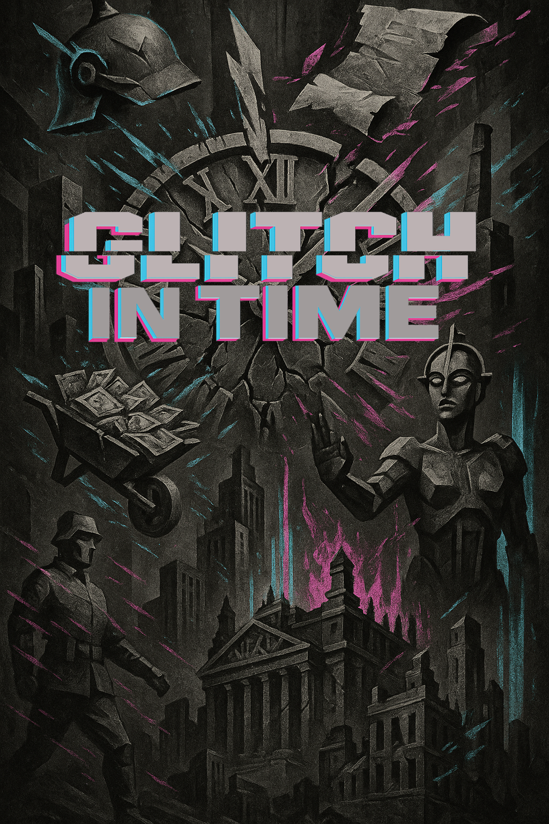

A set of observation and recall questions exploring the impact of German politics on everyday life
Aligned to the AQA Spec: Democracy & Dictatorship: 1890–1945.

Slide 2

Most of what I make are short, bingeable videos – the revision equivalent to the latest true crime drama. There’s also a growing collection of printables and downloadables: Knowledge Organisers, quirky revision tools, flashcards, wall displays, and “copy-and-paste” PowerPoint slides for quick lesson tasks.
This PowerPoint is part of the Glitched Germany series and is designed to reduce teacher workload while still hitting the mark for teaching students observational skills, knowledge recall and deeper evaluative thinking.
So, use this however works for you — highlight it, scribble on it, stick it on the wall, or fold it into a Tudor-themed paper aeroplane.
But if you want more, here’s where to find me:
My name’s Laura — former Head of History with fifteen years of classroom experience. And I’m looking to start a revision revolution with Socraflix.
What is Socraflix? Right now, it’s one woman and her two cats. But it’s also my vision for what revision could be. I believe:
Revision shouldn’t be boring.
You don’t need a mountain of facts to succeed.
It should make you understand more, not just remember more.
Over the 2025/26 academic year, I’m building a subscription-based platform for History teachers, offering KS4 and KS5 resources designed to support both teacher workload and student wellbeing — all for just £12.99 a month (the same as a Standard Netflix subscription!)
www.socraflix.com/
tudortwistory
@socraflix
on TikTok, Instagram, and YouTube

Slide 3
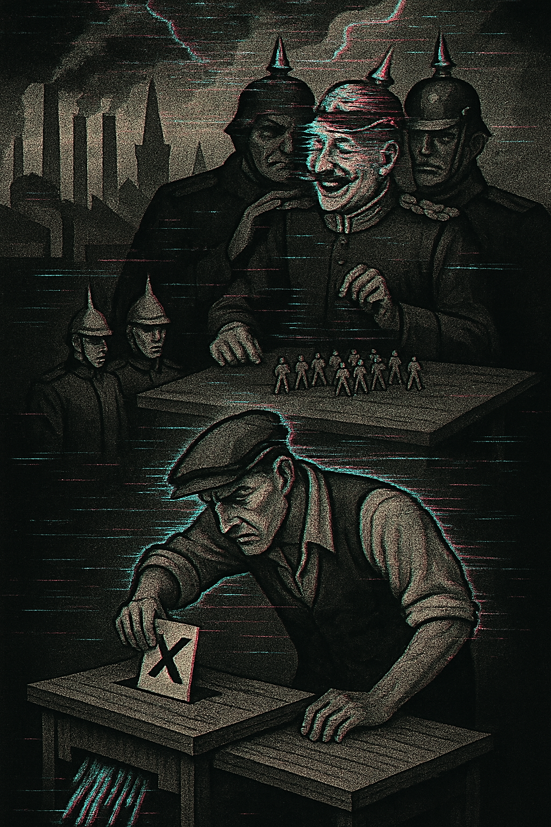

1890-1914
1. What object is the man at the bottom placing into a box?
2. What is happening to the ballot paper?
3. Who is the smiling man at the top?
4. What type of warship is shown?
5. What do factories symbolise?
6. What policy expanded Germany’s navy and empire?
7. Why were Dreadnoughts important?
8. Why might shredded votes represent democracy in Imperial Germany?
9. How did industrialisation change society?
10. How does the image reflect tensions before WW1?

Slide 4
1. What object is the man at the bottom placing into a box?
Answer: A ballot paper.
2. What is happening to the ballot paper?
Answer: It is shredded, symbolising meaningless votes.
3. Who is the smiling man at the top?
Answer: Kaiser Wilhelm II.
4. What type of warship is shown?
Answer: A Dreadnought battleship.
5. What do factories symbolise?
Answer: Industrialisation.

Slide 5
6. What policy expanded Germany’s navy and empire?
Answer: Weltpolitik.
7. Why were Dreadnoughts important?
Answer: They rivalled Britain’s navy and showed power.
8. Why might shredded votes represent democracy in Imperial Germany?
Answer: Because the Kaiser had more power than the Reichstag.
9. How did industrialisation change society?
Answer: It created a large working class and social tensions.
10. How does the image reflect tensions before WW1?
Answer: It shows militarism, Kaiser’s power, industry, and weak democracy.

Slide 6
How far was Weltpolitik responsible for tensions before 1914?
This image shows battleships and shredded votes. How far do you agree militarism was more important than democracy before 1914?

Slide 7
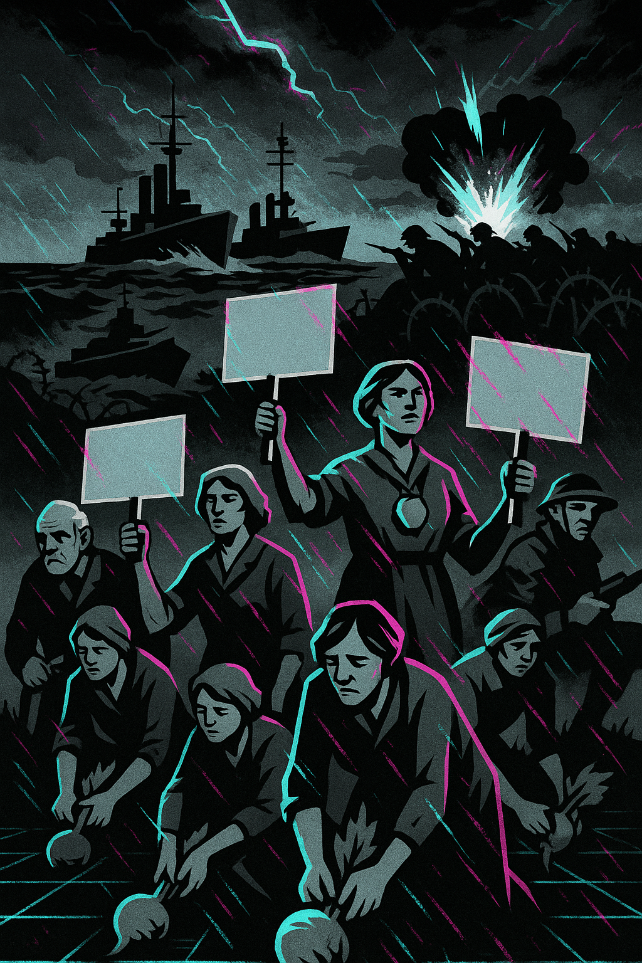
1914-1918
1. What food are the people holding?
2. What are some people holding up?
3. What do the ships represent?
4. What is happening to the right with soldiers?
5. Why were Germans forced to eat turnips in 1916–17?
6. What effect did the blockade have?
7. What did civilians do to show anger?
8. What was the reaction of workers and soldiers in 1918?
9. What major event happened in Nov 1918?
10. How does this image reflect ordinary Germans’ experience?

Slide 8
1. What food are the people holding?
Answer: Turnips.
2. What are some people holding up?
Answer: Protest signs.
3. What do the ships represent?
Answer: The British naval blockade.
4. What is happening to the right with soldiers?
Answer: An explosion at the front line.
5. Why were Germans forced to eat turnips in 1916–17?
Answer: Because of the blockade Germany could not import food – they also needed to prioritise sending food to the Front for soldiers.

Slide 9
6. What effect did the blockade have?
Answer: Shortages of food, fuel, supplies.
7. What did civilians do to show anger?
Answer: They protested and went on strike.
8. What was the reaction of workers and soldiers in 1918?
Answer: Mutinies and strikes.
9. What major event happened in Nov 1918?
Answer: Kaiser Wilhelm II abdicated.
10. How does this image reflect ordinary Germans’ experience?
Answer: It shows hunger, protests, and war alongside the blockade.

Slide 10
How far was the suffering of civilians (ordinary people) caused by Britain’s naval blockade?
This image shows protests. How far do you agree that home front conditions were the main reason for the Kaiser’s abdication?

