Slide 1
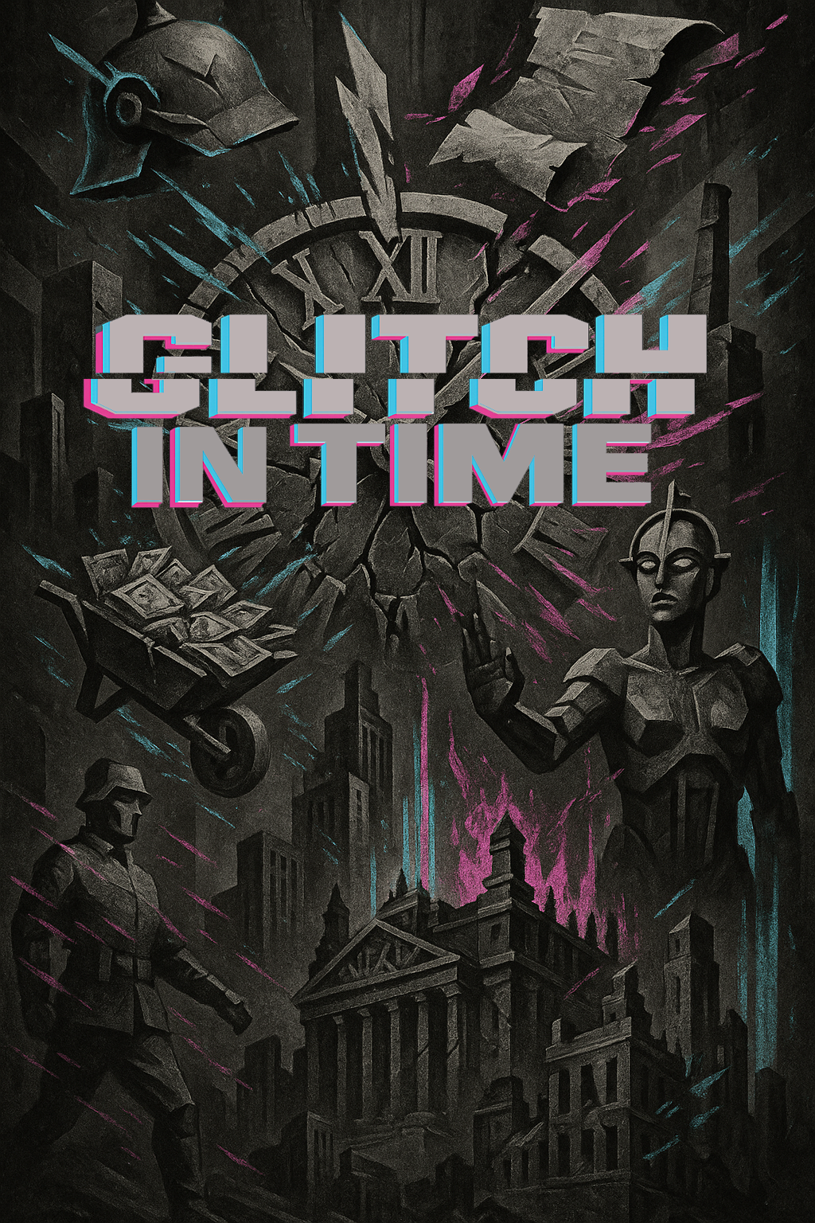

A set of observation and recall questions exploring the impact of German politics on everyday life
Aligned to the AQA Spec: Democracy & Dictatorship: 1890–1945.

Slide 2

Most of what I make are short, bingeable videos – the revision equivalent to the latest true crime drama. There’s also a growing collection of printables and downloadables: Knowledge Organisers, quirky revision tools, flashcards, wall displays, and “copy-and-paste” PowerPoint slides for quick lesson tasks.
This PowerPoint is part of the Glitched Germany series and is designed to reduce teacher workload while still hitting the mark for teaching students observational skills, knowledge recall and deeper evaluative thinking.
So, use this however works for you — highlight it, scribble on it, stick it on the wall, or fold it into a Tudor-themed paper aeroplane.
But if you want more, here’s where to find me:
My name’s Laura — former Head of History with fifteen years of classroom experience. And I’m looking to start a revision revolution with Socraflix.
What is Socraflix? Right now, it’s one woman and her two cats. But it’s also my vision for what revision could be. I believe:
Revision shouldn’t be boring.
You don’t need a mountain of facts to succeed.
It should make you understand more, not just remember more.
Over the 2025/26 academic year, I’m building a subscription-based platform for History teachers, offering KS4 and KS5 resources designed to support both teacher workload and student wellbeing — all for just £12.99 a month (the same as a Standard Netflix subscription!)
www.socraflix.com/
tudortwistory
@socraflix
on TikTok, Instagram, and YouTube

Slide 3
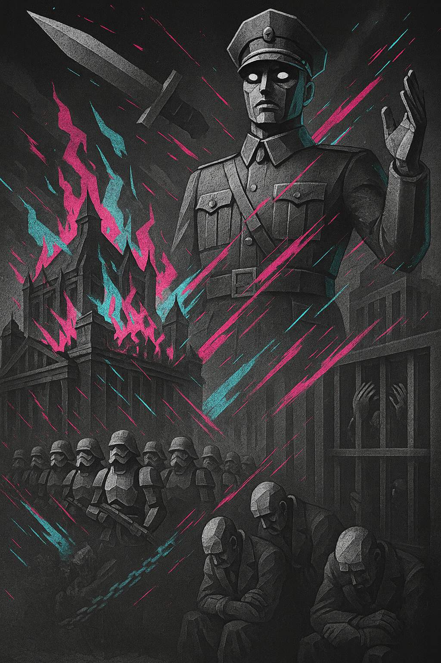

1933-1934
What building is shown burning in the picture?
What paramilitary (non official army) group is marching at the bottom of the image?
Who is the commanding figure pointing in the image meant to represent?
What are the men doing on the right-hand side of the image?
How did the Reichstag Fire help Hitler consolidate power?
What law passed in March 1933 gave Hitler dictatorial powers?
Who did the Nazi party imprison first?
Why was the SA important to Hitler’s rise to power before 1933?
What event in 1934 showed Hitler turning on the SA?
Why did Hitler feel it was necessary to eliminate SA leaders like Ernst Röhm?

Slide 4
What building is shown burning in the picture?
The Reichstag
What paramilitary (non-official army) group is marching at the bottom of the image?
The SA/Brownshirts/Stormtroopers
Who is the commanding robotic figure in the image meant to represent?
Adolf Hitler
What are the men doing on the right-hand side of the image?
Cowering in defeat and imprisoned
How did the Reichstag Fire help Hitler consolidate power?
Allowed him to ban the Communist Party from March elections

Slide 5
5. What law passed in March 1933 gave Hitler dictatorial powers?
The Enabling Act
6. Who did the Nazi Party imprison first?
Political opponents
7. Why was the SA important to Hitler’s rise to power before 1933?
They disrupted the meetings of their political opponents and engaged in street warfare with rival paramilitary groups
8. What event in 1934 showed Hitler turning on the SA?
Night of the Long Knives
9. Why did Hitler feel it was necessary to eliminate SA leaders like Ernst Röhm?
He was very popular especially among the Brownshirts

Slide 6
To what extent did the Nazi Party use terror and fear to gain power?
How significant was the Reichstag Fire to Hitler’s rise to power?

Slide 7
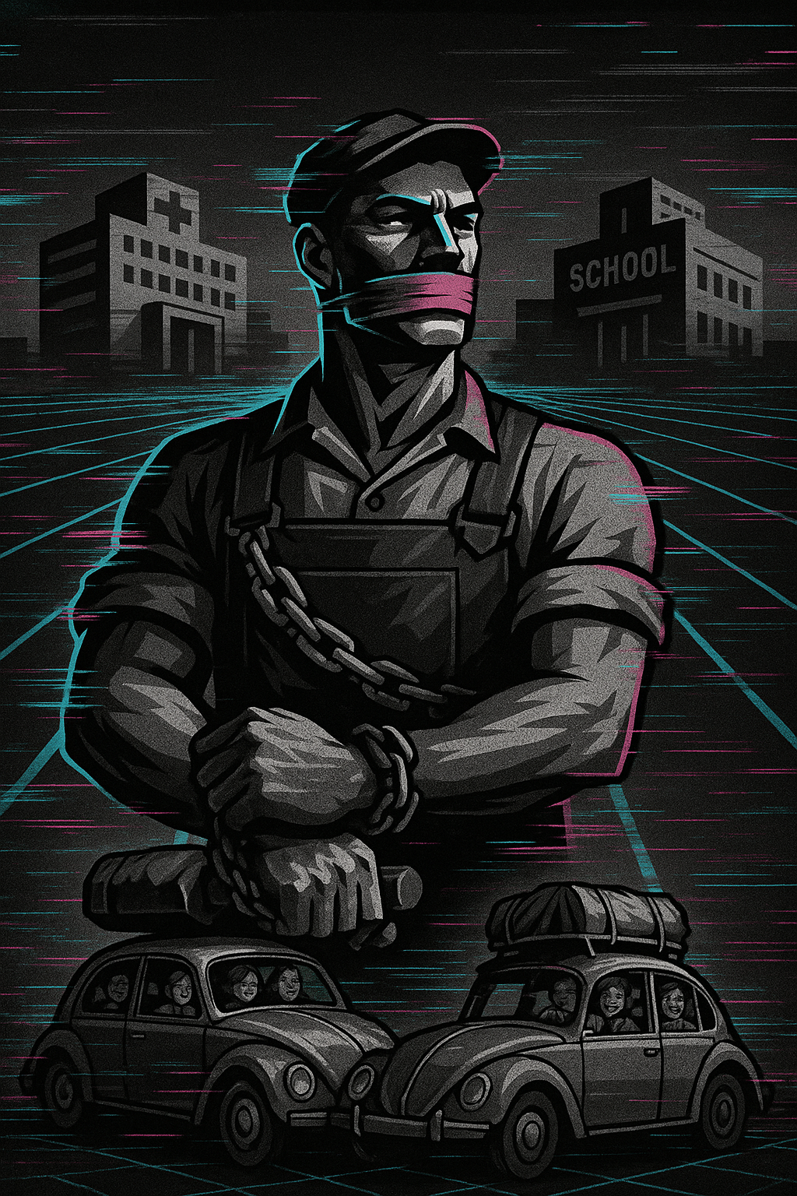
Nazi Germany
Workers in
What is the man in the centre of the image wearing that shows he is a worker?
Why is the worker gagged and chained in the image?
What two buildings appear in the background?
What policy did the Nazis introduce to improve welfare and public facilities?
What popular car, shown at the bottom, symbolised Nazi promises to improve living standards?
What organisation replaced trade unions in 1933?
What programme provided leisure and holidays for workers in Nazi Germany?
Why were workers’ wages and conditions tightly controlled by the Nazis?
How does the image suggest a contrast between workers and families under Nazi rule?
How did rearmament contribute to reducing unemployment in Nazi Germany?

Slide 8
What is the man in the centre of the image wearing that shows he is a worker?
Answer: Overalls/work clothes
Why is the worker gagged and chained in the image?
Answer: To symbolise the loss of workers’ rights and free speech under the Nazis
What two buildings appear in the background?
Answer: A hospital and a school
What policy did the Nazis introduce to improve welfare and public facilities?
Answer: Building schemes such as hospitals, schools, and infrastructure (e.g., autobahns)
What popular car, shown at the bottom, symbolised Nazi promises to improve living standards?
Answer: The Volkswagen “People’s Car”

Slide 9
6. What organisation replaced trade unions in 1933?
Answer: The German Labour Front (DAF)
7. What programme provided leisure and holidays for workers in Nazi Germany?
Answer: Strength Through Joy (KdF)
8. Why were workers’ wages and conditions tightly controlled by the Nazis?
Answer: To keep strikes and protests impossible, and ensure loyalty to the regime
9. How does the image suggest a contrast between workers and families under Nazi rule?
Answer: The worker is chained and silenced, while families in cars appear happy, showing propaganda promises versus workers’ reality
10. How did rearmament contribute to reducing unemployment in Nazi Germany?
Answer: It created jobs in the arms industry and military service, hiding real unemployment levels

Slide 10
How far did Nazi labour policies genuinely improve the lives of ordinary workers, and how far were they more about control and propaganda?
To what extent did Nazi labour policies prepare Germany for war rather than improve everyday life?

Slide 11
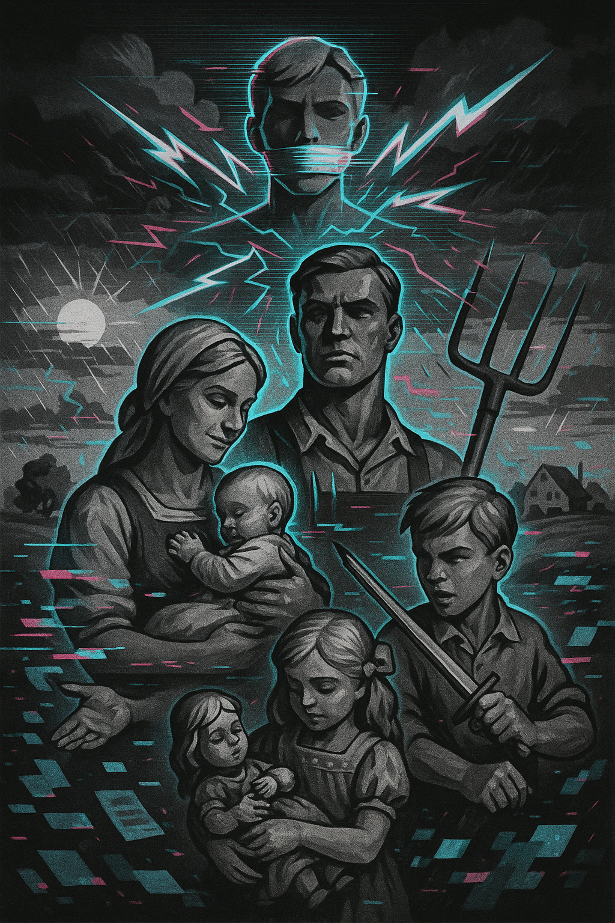
Rural Life in
Nazi Germany
What type of tool is the man holding?
What does the woman appear to be doing?
How many children are shown in the image?
What weapon is the boy holding?
What kind of landscape is faintly shown in the background?
Which family role is emphasised most in the centre of the composition?
How does the image suggest the importance of children?
Which Nazi ideology about family life does this image reflect?
Why might the Nazis have promoted farming families as ideal citizens?
Why did the Nazi party create posters showing content rural family?.

Slide 12
What type of tool is the man holding?
Answer: A pitchfork.
What does the woman appear to be doing?
Answer: Holding and caring for a baby.
How many children are shown in the image?
Answer: Three.
What weapon is the boy holding?
Answer: A sword.
What kind of landscape is faintly shown in the background?
Answer: A rural/farming landscape with fields and a farmhouse.

Slide 13
6. Which family role is emphasised most in the centre of the composition?
Answer: The father as strong and serious.
7. How does the image suggest the importance of children?
Answer: They are shown in the foreground being cared for.
8. Which Nazi ideology about family life does this image reflect?
Answer: The ideal of the traditional Aryan family working and raising children on the land.
9. Why might the Nazis have promoted farming families as ideal citizens?
Answer: They represented hard work, purity, self-sufficiency, and a connection to German soil (“blood and soil”).
10. Why did the Nazi party create posters showing content rural family?
Answer: To persuade Germans that life under Nazi rule was stable, healthy, and rooted in tradition.

Slide 14
Why did farmers vote for the Nazi Party in 1933?
How might images like this have influenced both rural and urban Germans’ perceptions of the Nazi regime?

Slide 15
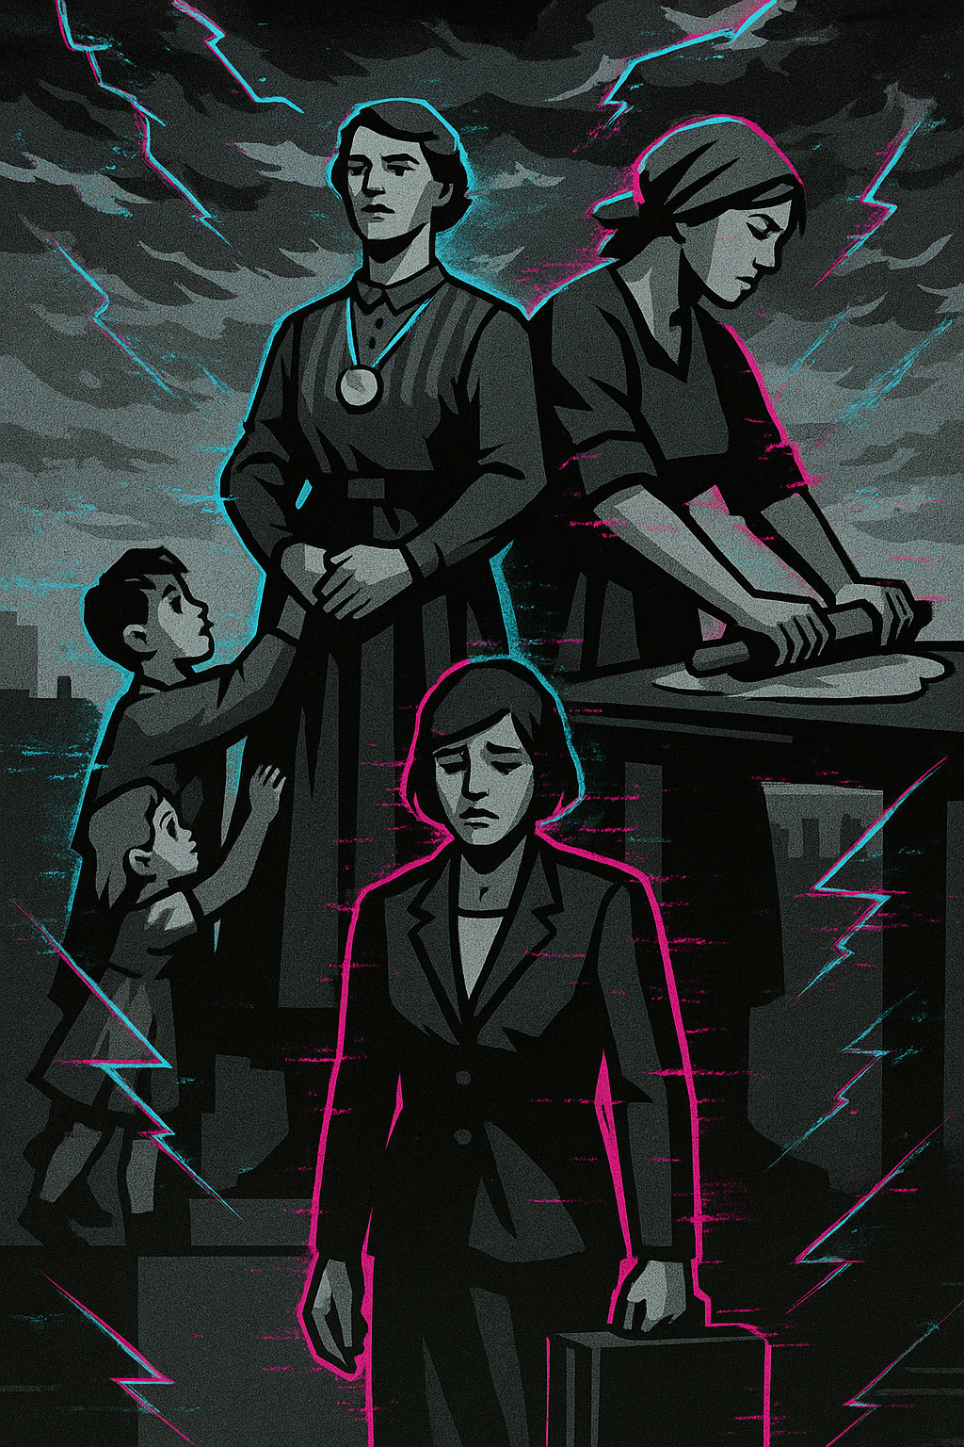
Nazi Germany
Women in
1. What object is the woman on the right using?
2. What are the two children doing with the central woman?
3. What is the medal on the central woman’s neck?
4. What is the facial expression of the woman at the bottom?
5. What is she holding?
6. Which slogan summed up Nazi expectations for women?
7. What roles did Nazis encourage women to prioritise?
8. What incentives did Nazis give to increase childbirth?
9. How does the sad woman with a briefcase suggest contrast with Weimar Germany?
10. How does the image reflect Nazi social policy?

Slide 16
1. What object is the woman on the right using?
Answer: A rolling pin.
2. What are the two children doing with the central woman?
Answer: Clinging to her as a mother figure.
3. What is the medal on the central woman’s neck?
Answer: The Mother’s Cross.
4. What is the facial expression of the woman at the bottom?
Answer: She looks sad.
5. What is she holding?
Answer: A briefcase.

Slide 17
6. Which slogan summed up Nazi expectations for women?
Answer: Kinder, Küche, Kirche.
7. What roles did Nazis encourage women to prioritise?
Answer: Motherhood, domestic work.
8. What incentives did Nazis give to increase childbirth?
Answer: Marriage loans, Mother’s Cross, tax benefits.
9. How does the sad woman with a briefcase suggest contrast with Weimar Germany?
Answer: Weimar gave women more freedoms to work and vote.
10. How does the image reflect Nazi social policy?
Answer: It glorifies mothers and discourages careers for women.

Slide 18
How far did Nazi policies for women succeed in their aims?
This image contrasts an honoured mother with a sad career woman. How far do you agree life for women under Nazis was worse than under Weimar?

Slide 19
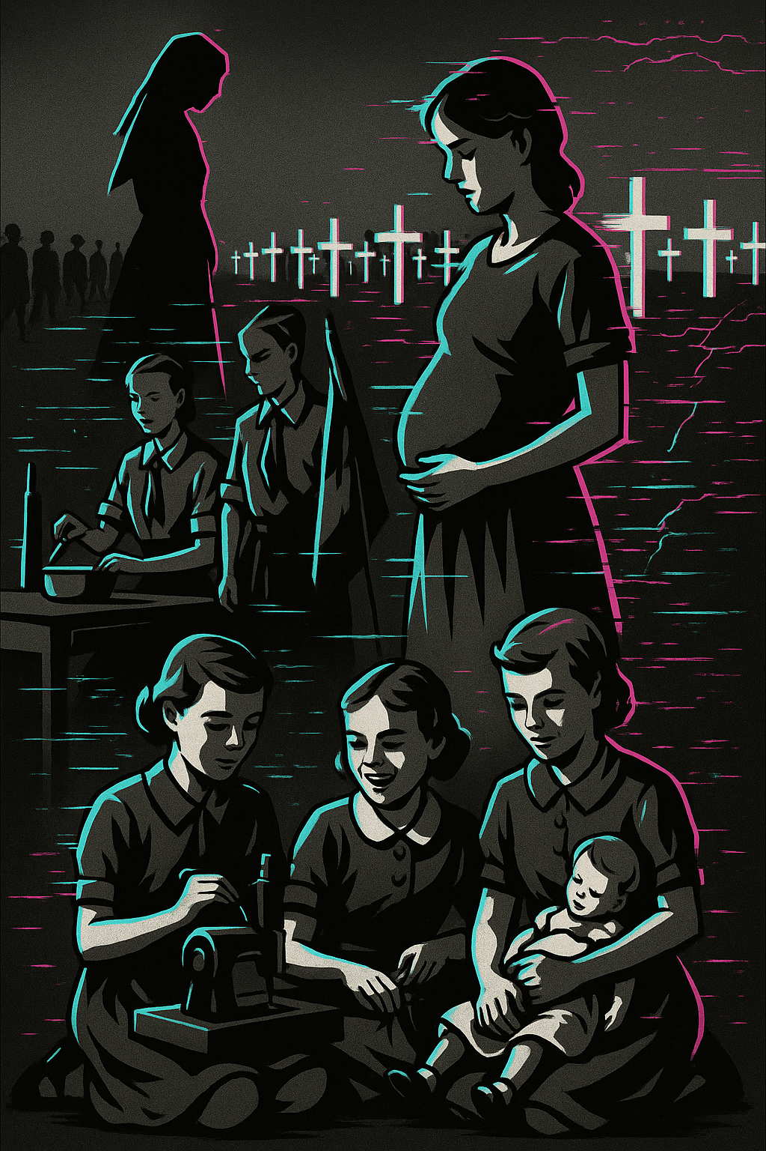
Nazi Germany
Girls in
1. What is the woman in the centre of the image doing?
2. What objects appear in the background?
3. What activity are the girls at the bottom left doing?
4. What object is the girl on the right holding?
5. What are the two girls in the background doing?
6. What Nazi organisation for girls might these activities represent?
7. What skills did the Nazis encourage girls to learn?
8. What kind of training did young women receive in Nazi youth organisations?
9. Why did the Nazis want women to focus on motherhood?
10. What is the significance of the graves in the background?

Slide 20
1. What is the woman in the centre of the image doing?
Answer: She is heavily pregnant.
2. What objects appear in the background?
Answer: Rows of white crosses.
3. What activity are the girls at the bottom left doing?
Answer: Using a sewing machine.
4. What object is the girl on the right holding?
Answer: A baby doll.
5. What are the two girls in the background doing?
Answer: Cooking/mixing ingredients.

Slide 21
6. What Nazi organisation for girls might these activities represent?
Answer: The BDM.
7. What skills did the Nazis encourage girls to learn?
Answer: Cooking, sewing, childcare, and fitness.
8. What kind of training did young women receive in Nazi youth organisations?
Answer: Training for motherhood and domestic life.
9. Why did the Nazis want women to focus on motherhood?
Answer: To increase the Aryan population.
10. What is the significance of the graves in the background?
Answer: They symbolise sacrifice and the cost of war.

Slide 22
1. How successful were Nazi policies towards women in achieving their aims?
2. This image shows smiling girls and mothers but also graves. How far do you agree Nazi policies for women were more about serving the state than improving women’s lives?

Slide 23
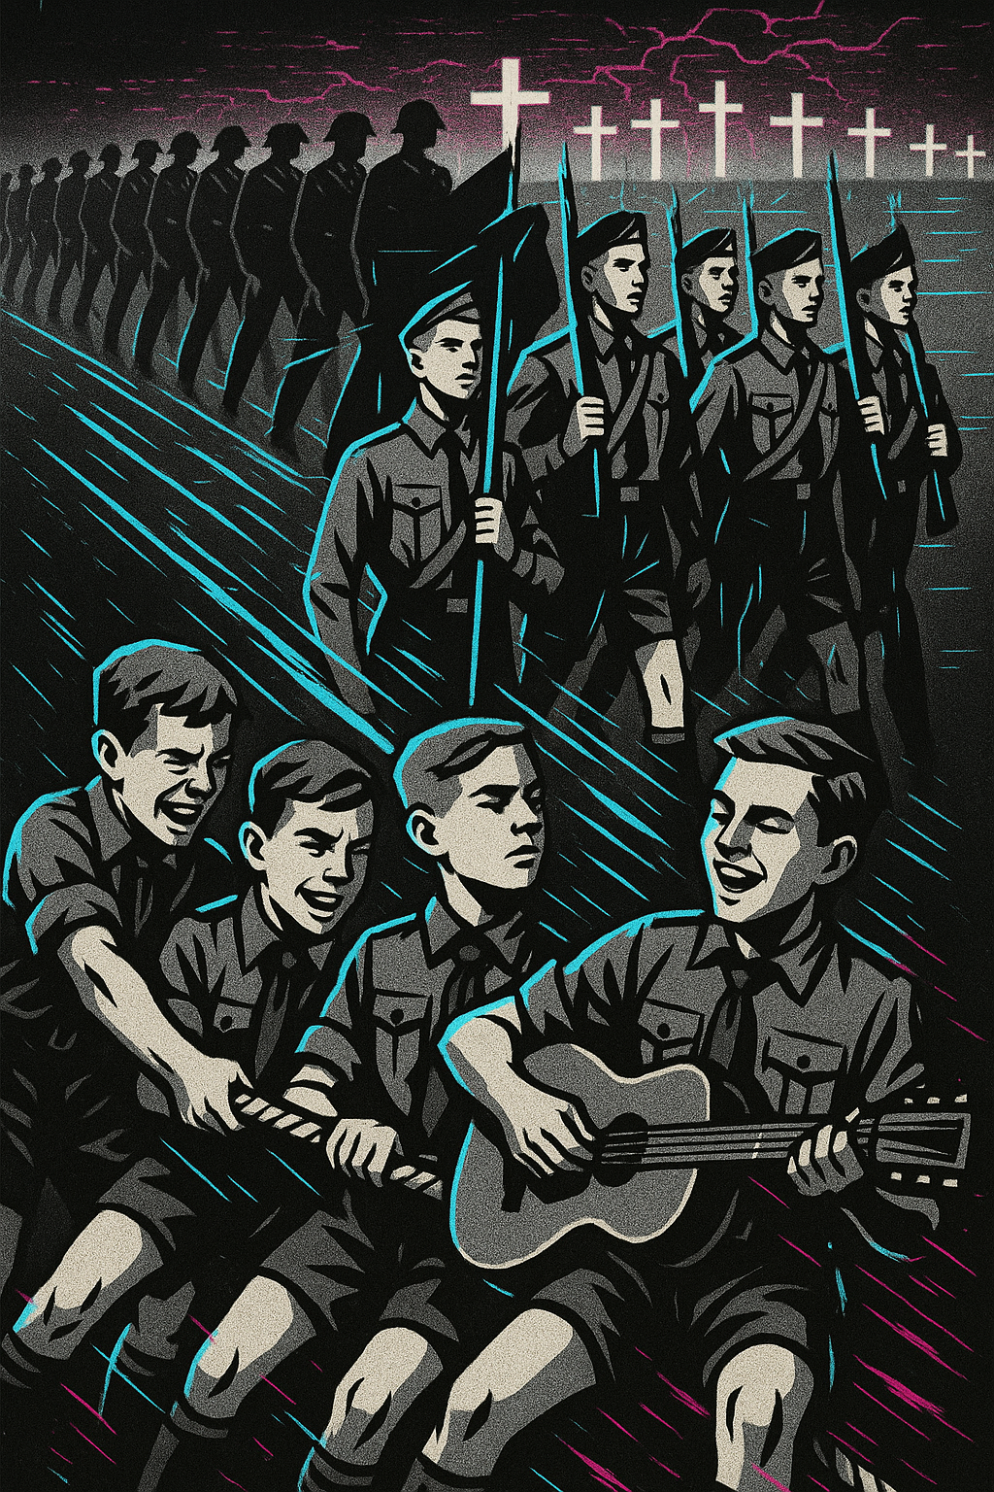
Nazi Germany
Boys in
1. What activity are the boys in the foreground doing together?
2. What musical instrument is one boy playing?
3. What objects are the boys in the background carrying?
4. What organisation for boys does this image most likely represent?
5. What was the Nazi equivalent organisation for girls?
6. What activity are the boys in the foreground doing together?
7. What musical instrument is one boy playing?
8. What objects are the boys in the background carrying?
9. What organisation for boys does this image most likely represent?
10. What was the Nazi equivalent organisation for girls?

Slide 24
1. What activity are the boys in the foreground doing together?
Answer: They are playing tug-of-war.
2. What musical instrument is one boy playing?
Answer: A guitar.
3. What objects are the boys in the background carrying?
Answer: Flags and rifles.
4. What organisation for boys does this image most likely represent?
Answer: The Hitler Youth (Hitlerjugend).
5. What was the Nazi equivalent organisation for girls?
Answer: The League of German Maidens (BDM).

Slide 25
6. Why did the Nazis want to organise leisure activities for young people?
Answer: To control their free time and prevent opposition.
7. How did the Hitler Youth prepare boys for military service?
Answer: Through camping, marching, and weapons training.
8. How did the BDM prepare girls for their future roles?
Answer: By teaching domestic skills, fitness, and preparing for motherhood.
9. What is the significance of the rows of crosses in the background?
Answer: They represent death and sacrifice in war.
10. How does this image contrast the cheerful activities of Nazi youth with the darker reality suggested in the background?
Answer: The foreground shows fun, but the background reveals war and death.

Slide 26
How effective were Nazi youth organisations in winning the loyalty of young people?
This image shows an idealised vision of Nazi youth, but also hints at darker consequences. How far do you agree that Nazi youth policies prepared children more for sacrifice and war than for enjoyment?

