Slide 1







A welcoming and accessible community event celebrating inclusive entrepreneurship in Kelowna
Bringing together local creators, makers, and small business owners to showcase their diverse talent, share their work, and connect with the community
Made possible through collaboration from

Slide 2
Program Agenda – 8:05 – 9:00 AM
Indigenous Welcome
Self-Advocate & Entrepreneur Speaker
Inclusive Employer Spotlight
MentorAbility Canada Presentation
Community Partner Remarks
Employer Resources
Community Appreciation and Feeback Request
Exclusive Inclusive Market VIP Preview

Slide 3


Slide 4

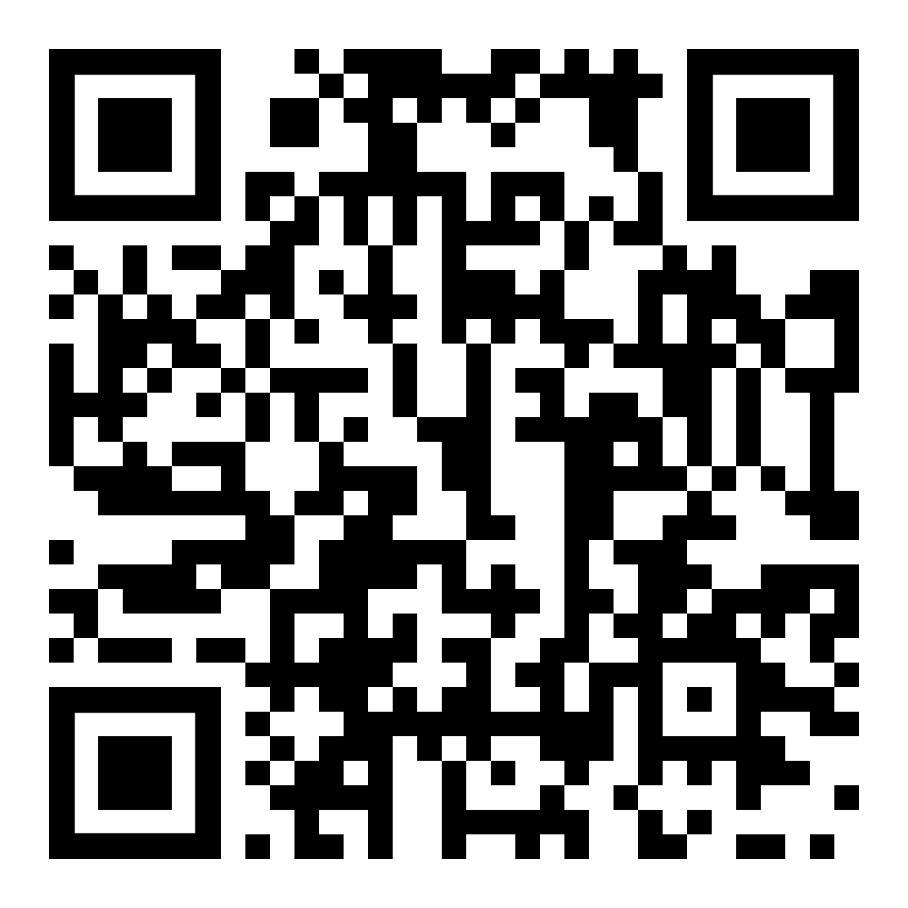
Inclusive Hiring Resources Online
Scan the QR code or visit InclusiveMarketKelowna.ca
to access practical tools and programs
supporting inclusive hiring.

Slide 5
Thank you for attending!
Please complete a feedback form before you leave.
Enjoy the market!

