Slide 1
Further support in the Implementation of the Reforms in the Water Sector Project overview Update April 2026

Slide 2
Sector Reform Challenges
Territorial fragmentation of water services provision which is unsustainable on the long term
Lack of technical capacity, poor financial health, high water loss, aged infrastructures
Pricing of WSS services is below cost recovery levels

Slide 3
Project objective, outcomes and results
Overall objective: To improve access to and quality of water and wastewater services, in line with the EU Acquis
Outcome 1: Municipal water service provision reorganised in clusters at river basin level
A strategy for the reorganisation of municipal drinking water and wastewater services is operationalized
The overseeing functions for inter-municipal cooperation in water service provision are strengthened
Outcome 2: Reviewing and adjusting the water pricing approach
The water tariff mechanism and enforcement is upgraded nation-wide
The National benchmarking system is established
MAKBIS is operationalised
Outcome 3: Support implementation of reform measures in pilot areas
Inter-municipal water service provision in pilot areas is established
Financial and operational performance of water service provision in pilot areas is improved

Slide 4
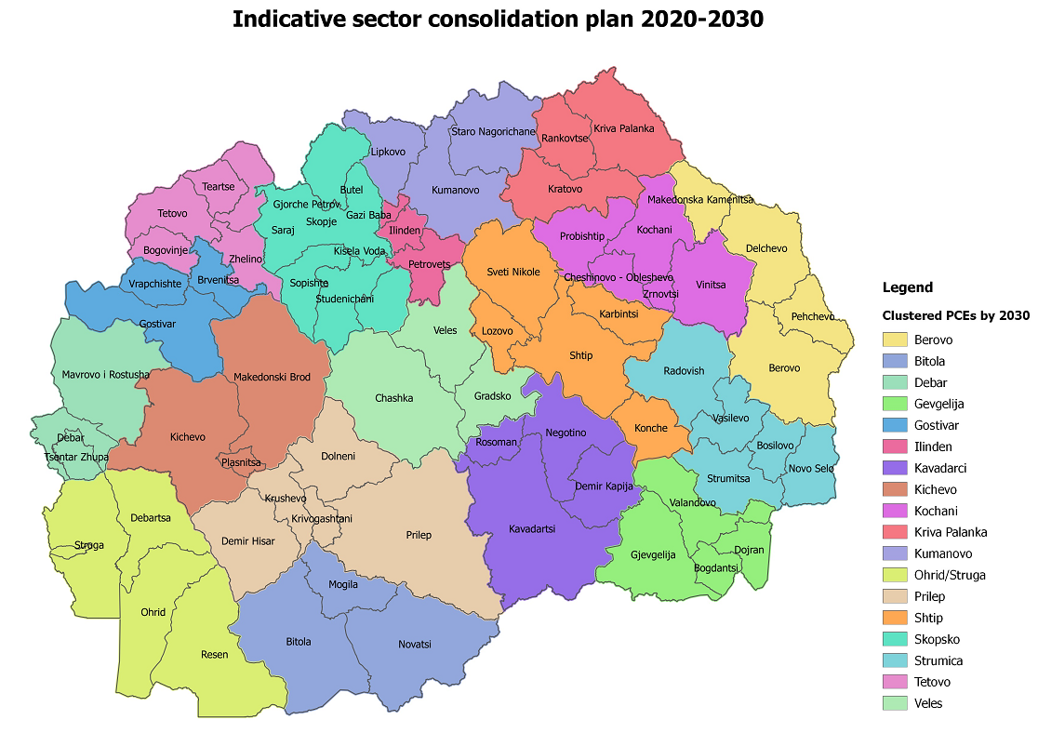
3 pilot areas

Slide 5
Project Plan
Phases | 1. Inception | 2. Planning | 3. Piloting
Duration | Months 1-4 | Month 5-14 | Month 15-30
Period | May -Sept 2025 | Oct 25 – July 2026 | Aug 26 – Nov 2027
Events | Inception/validation workshop | Workshops and conferences | Workshops, trainings and conferences
Outputs | Inception Report | 3 Detailed clustering studies Sector reorganization strategy and action plan Clustering toolkit Capacity development ADKOM and ZELS Upgrading the tariff setting methodology and platform | 3 clustering pilots, asset inventories, FOPIPs, BPs and TAPs Software development for digital management Cost & Profit Centre accounting Upgraded MAKBIS and National benchmarking system Final Report

Slide 6
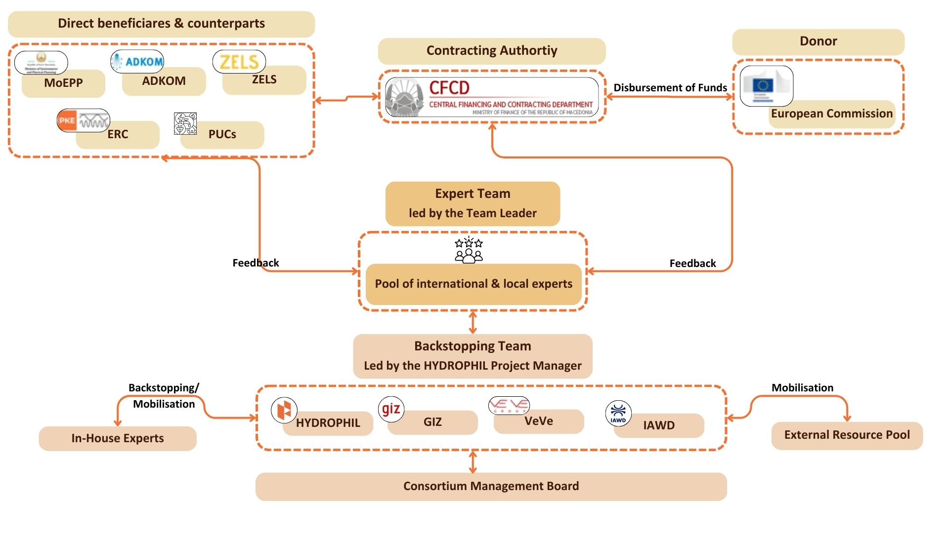
Project Organization

