Slide 1


Slide 2

Our vision
Leading Supplier:
To be the leading supplier of sustainable packaging solutions.
Industry Leader:
To become the leader in recycled packaging for consumer goods.
Strategic Partner:
To become a trusted and strategic partner to our customers, providing innovative packaging solutions for all their needs.
Our Method:
We achieve this by living our values every day.

Slide 3
ABOUT US
Ecoversal Plast is one of the largest manufacturer of Corrugated box and Offset Printed Cartons & Plastic in India.
Ecoversal Plast operates three independent manufacturing units in Ahmedabad, Bhavnagar, Ankleshwar Gujarat, India.
Our competitive team is the leading force which has drived our organization on the part of success we have with us a hard-working and sincere team of professionals, who helps us in serving our clients with world-class products.
Due to our professionals' innovative approach, we have managed to make a strong mark in the industry. Further, we also provide them skills development training on regular intervals, so that they can manufacture a range that exceeds the expectations of our reputed clients.

Slide 4
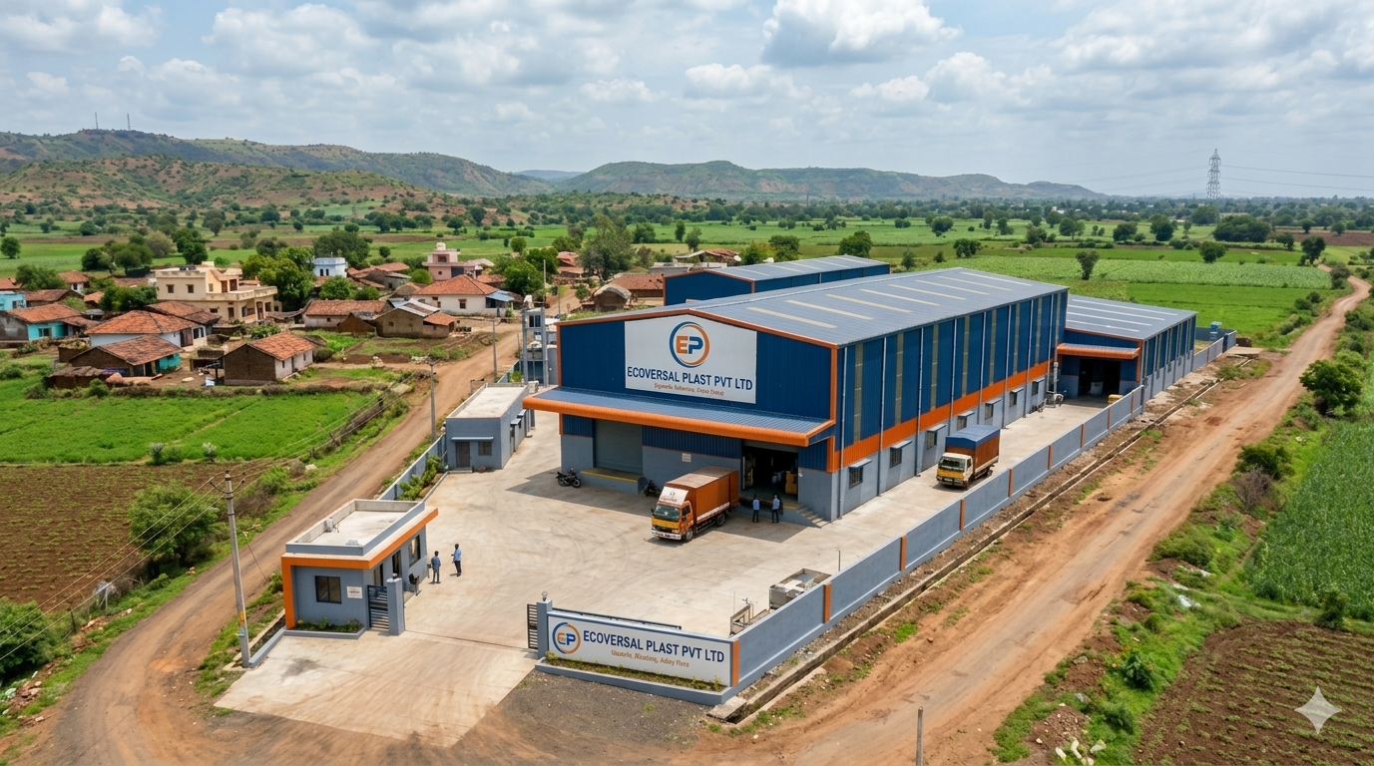

Slide 5
Corrugated Box Division
Our Machinery
Printing & Coating
5 Colour + Coater Offset Printing Machine
6 Colour + UV Coater Offset Machine
Flexo printer Slotter (5 Machines)
Production Lines
Full Auto Corrugation Line
Semi-Auto Corrugation Machine (13 Machines)
Finishing & Assembly
Fully Auto Lamination with Hot Knife Automatic Folder Gluer
High Speed Flute Laminator (3 Machines)
Stitching Machine (6 Machines)
Die-Cutting & Preparation
Flat Bed Auto Die Punching (4 Machines)
Platten Punching Machine (5 Machines)

Slide 6
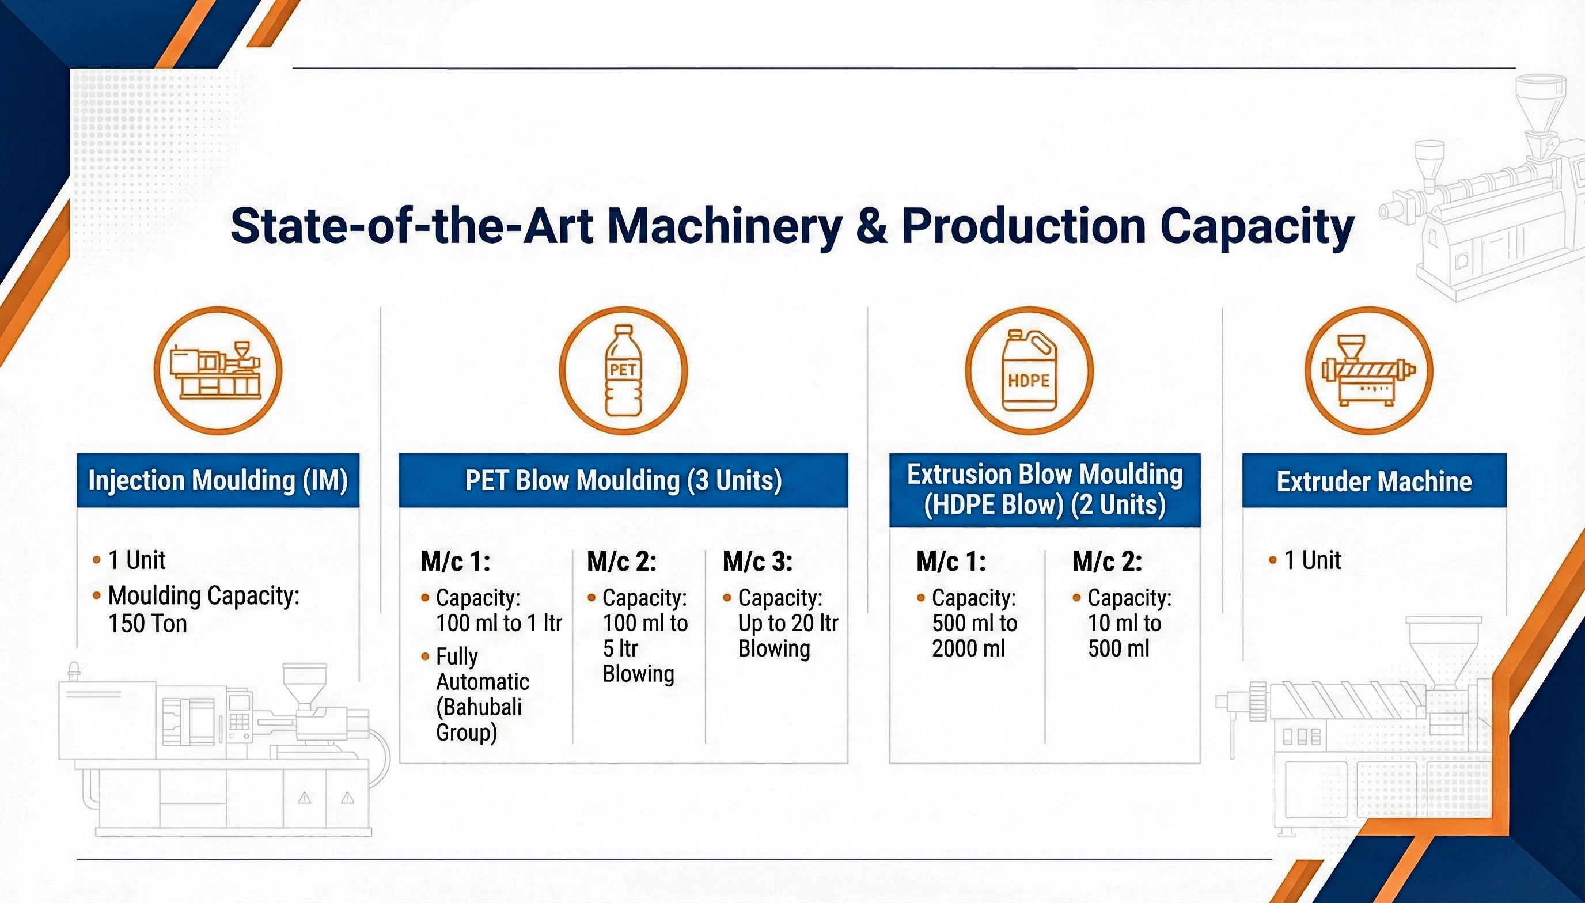
Plastic Division

Slide 7
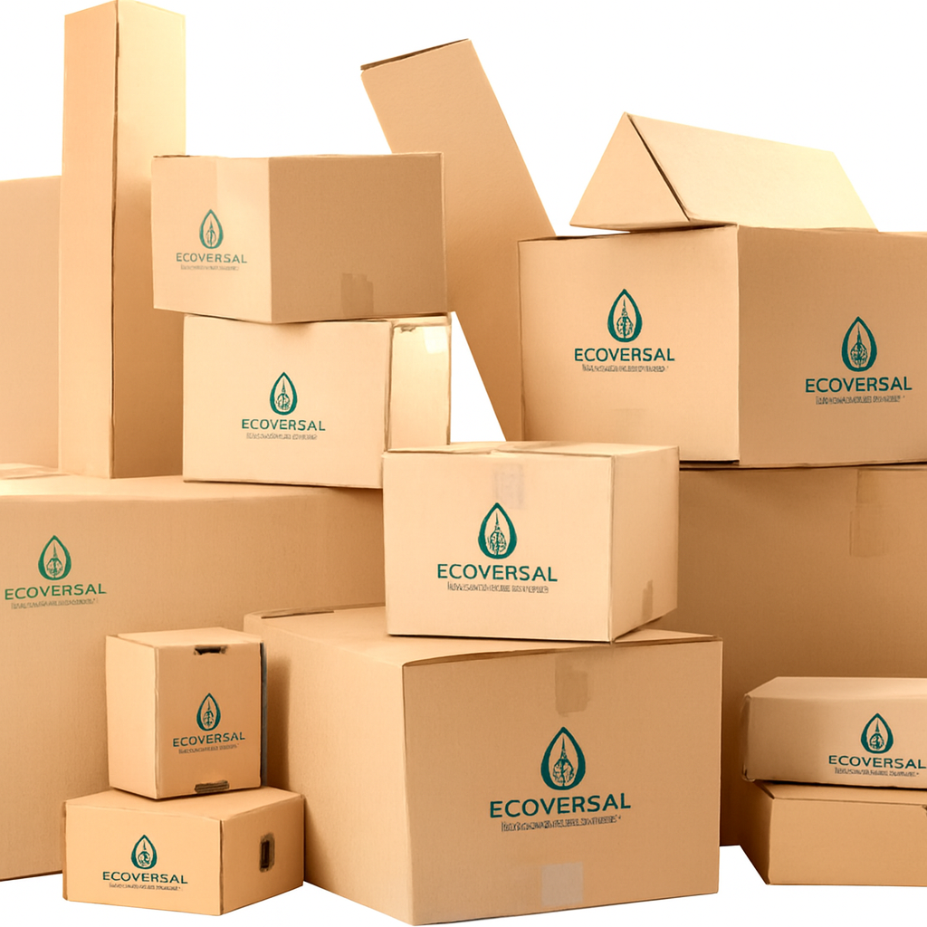
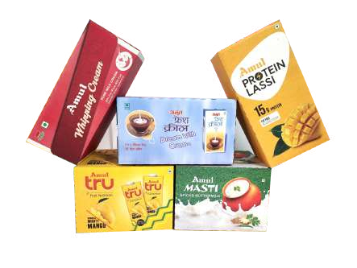
Corrugated Cartons / Box / Shipper
3Ply, 5Ply & 7Ply
Automatic & Semi-Automatic Lines
HD Flexo Printing
100% Recyclable & Eco-Friendly
Wraparound Tray
Suitable for high speed automatic packing lines
Easily transform to Point of Sale or Purchase
HD Offset or Flexo Printing
100% Recyclable & Eco-Friendly

Slide 8
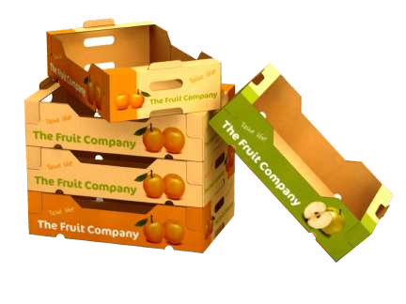
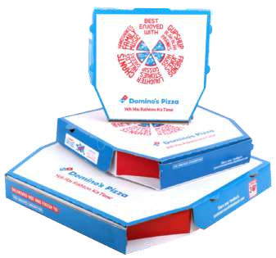
Fruit & Vegetable Tray
Suitable for manual and high speed auto packing lines
Water-Resistance and barrier coating available
HD Offset or Flexo Printing
100% Recyclable & Eco-Friendly
Pizza Box
Standard sizes available
Customized Offset Printing
Ventilation holes to remove moisture & flame
100% Recyclable & Eco-Friendly

Slide 9
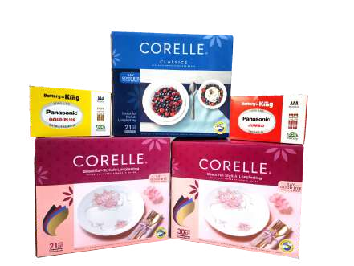
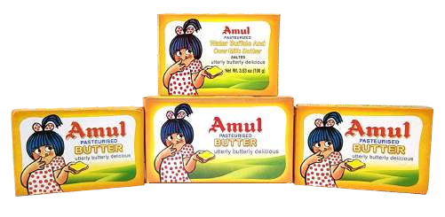
Litho Laminated Carton/Box
B, C, E & G Flute Cartons
BOPP Film Lamination
HD Flexo Printing
100% Recyclable & Eco-Friendly
Folding Cartons
Printing upto 8 Colour with Varnish / UV / Drip off
High Quality FBB, Duplex, White Back, Art Paper
Innovative Design & Graphics
100% Recyclable & Eco-Friendly
RTI, 4& 6 Corner, Tri-edges
Blister Card for Skin Packaging

Slide 10

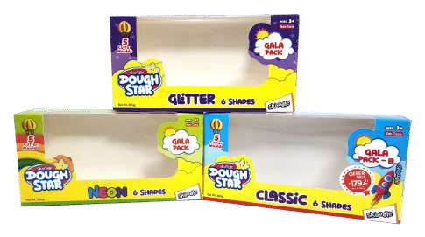
Hot Foil Cartons
Elegant looks and high visibility carton
Rich and luxurious feel
Foil in varied colours
100% Recyclable & Eco-Friendly
Window Patching Carton
Enhance the product visibility
Innovative design and graphics
Printing upto 7 colours with UV and Drip-off
100% Recyclable & Eco-Friendly
V Notch and face panel window options

Slide 11
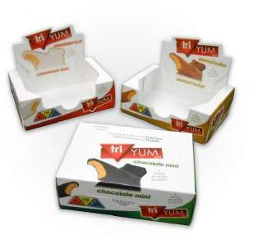
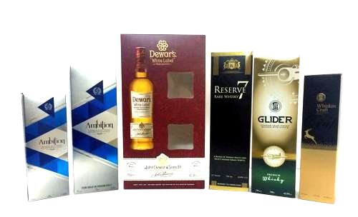
Counter Display
Retail pack & Self pack also in supermarket
Easily transforms to counter display
Varied design concepts
100% Recyclable & Eco-Friendly
Met-Pet Printed Carton
Auto Lamination Met Pet for high bonding
Rich & Premium look of Gold & Silver Colour
Printing upto 6 Colour with UV / Drip off
Innovative Design & Graphic Concepts

Slide 12
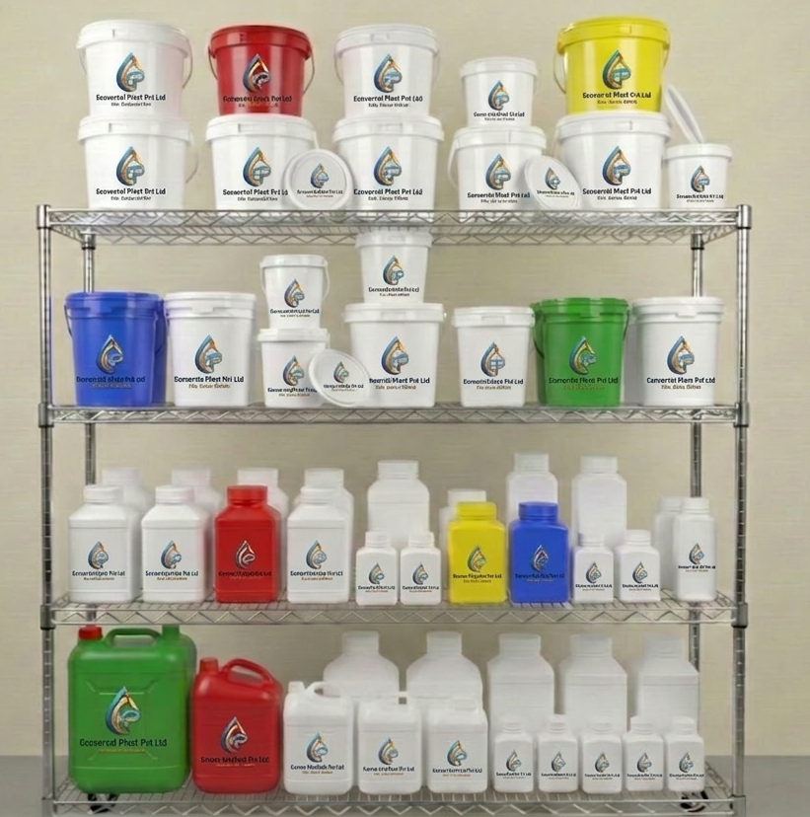
Plastic Division
Buckets (with lids)
1L, 2L, 5L, 10L, 20L, 25L
Paints, chemicals, food storage
Medium Containers
1L, 2L, 5L, 10L, 20L, 25L
Household liquids, adhesives
Small Bottles & Jars
100ml, 200ml, 500ml,1L, 5L
Pharmaceuticals, cosmetics, lab use
Large Jugs & Canisters
5L, 10L, 20L, 30L
Industrial liquids, oils, water storage
Colored Variants (Red, Blue, Green, Yellow, etc)
Same sizes as above
Easy identification, segregation of contents

Slide 13
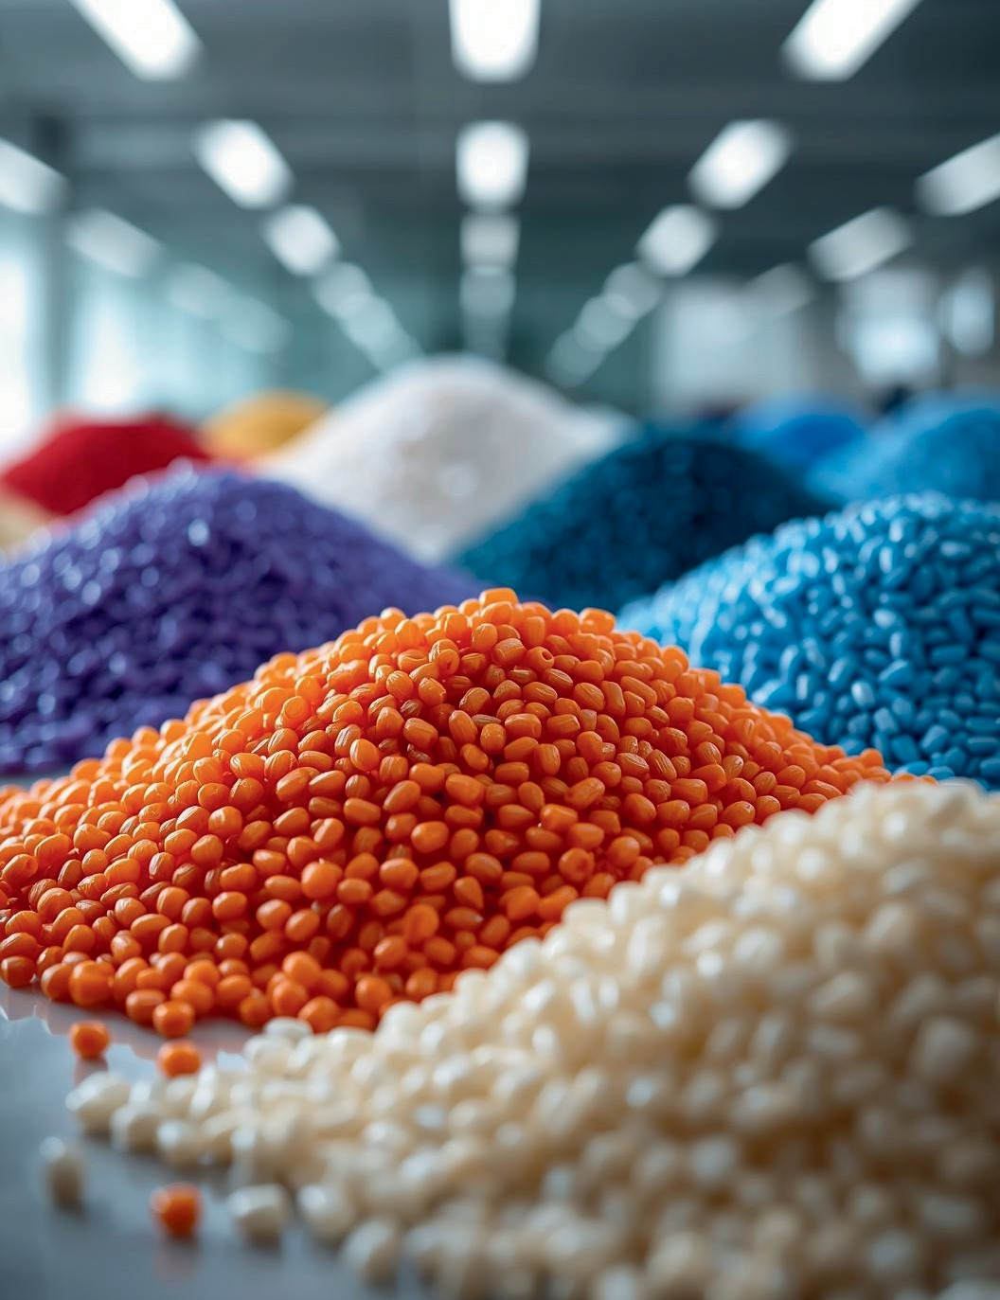
Raw Materials
Understanding the Importance of HDPE (High‑Density Polyethylene) and PET (Polyethylene Terephthalate)Materials
From precision‑engineered polymers to eco‑smart packaging — every Ecoversal product begins with high‑quality HDPE & PET granules, ensuring durability, safety, and sustainability.
Pellet Size: ~2–5 mm uniform granules
Density: HDPE ~0.94–0.97 g/cm³ PET ~1.38 g/cm³
Melting Point: HDPE ~130–137 °C PET ~250–260 °C
Applications:
Buckets, jugs, bottles, and canisters
Corrugated box coatings and laminations
Food‑grade and pharma packaging
Eco Features: 100% recyclable, low environmental footprint, customizable with non‑toxic colorants

Slide 14
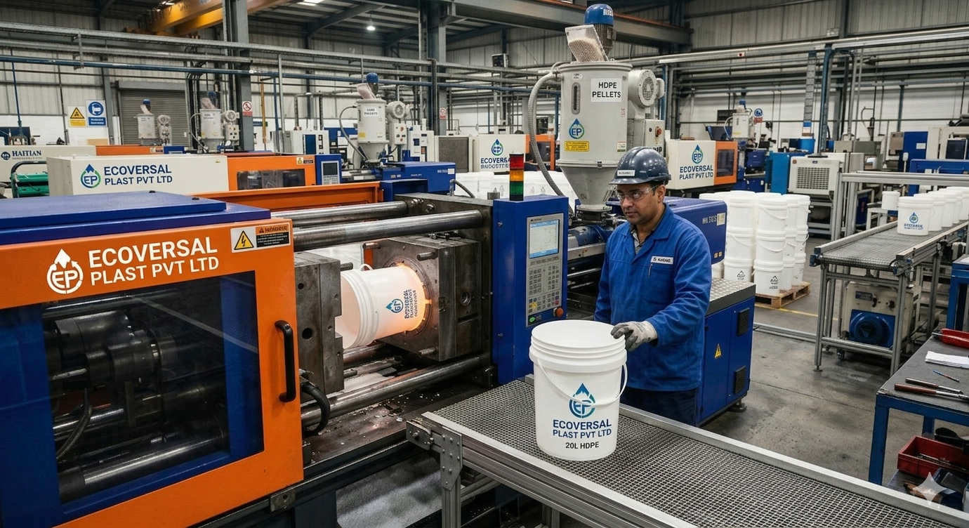
🏭 Infarstructure & Technology
Ecoversal Plast Pvt Ltd utilizes cutting‑edge technology in our advanced manufacturing unit, ensuring efficient production of durable HDPE and PET containers tailored to diverse industrial needs.

Slide 15
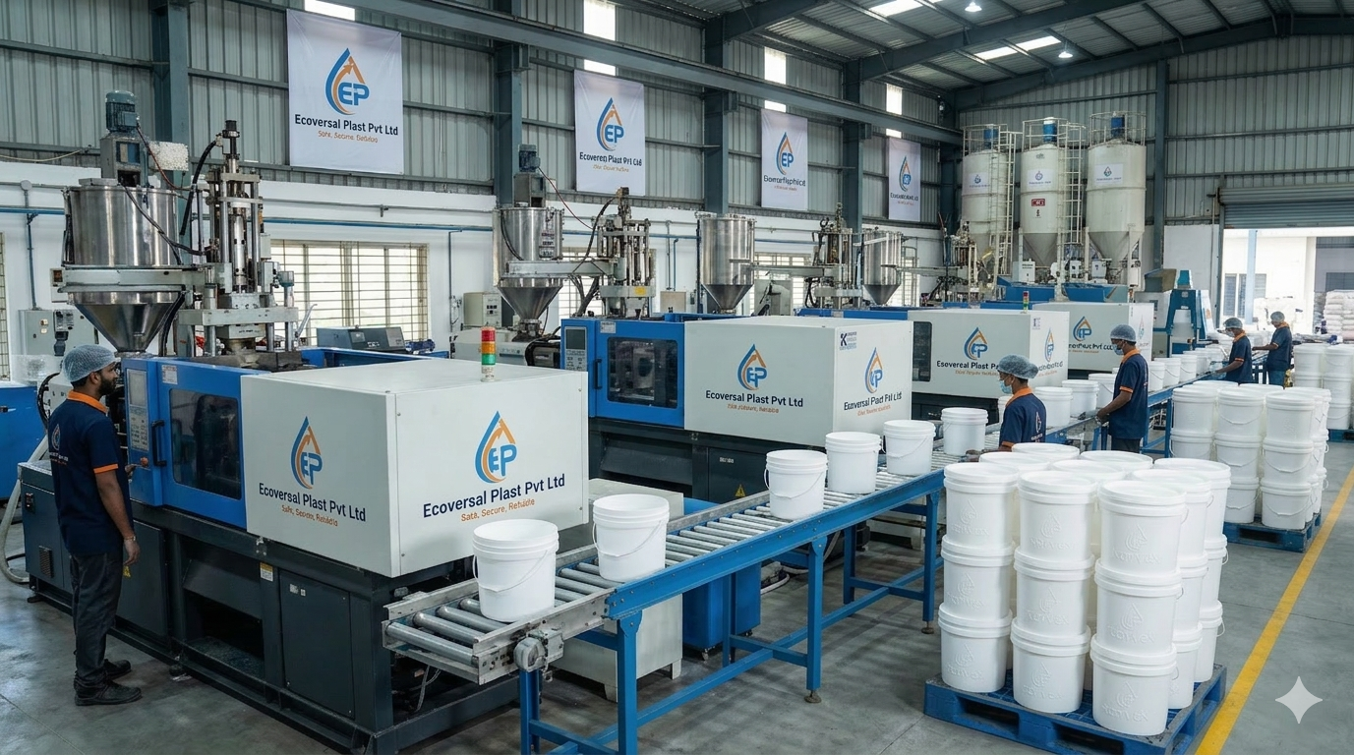
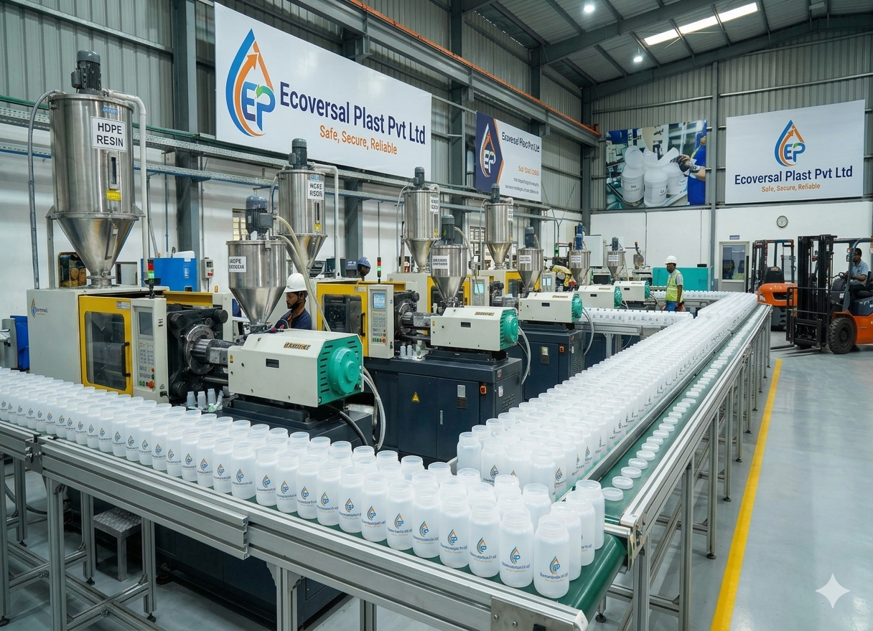
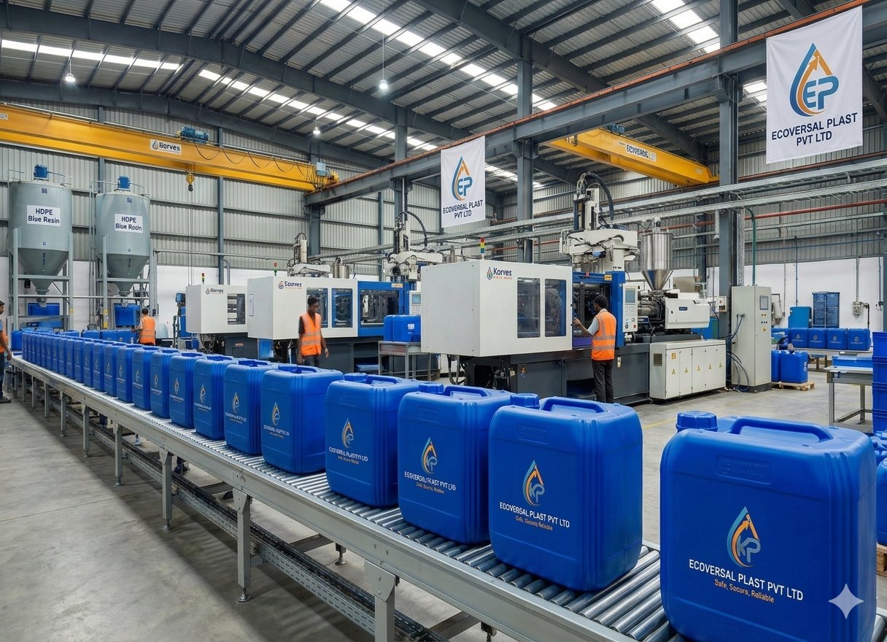
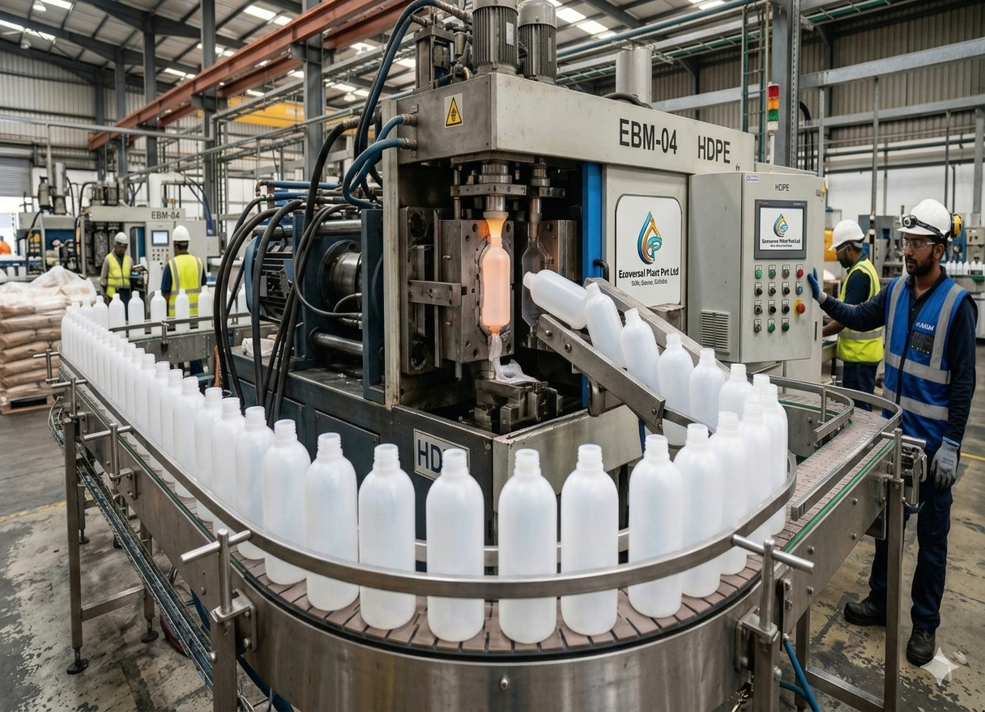

Slide 16
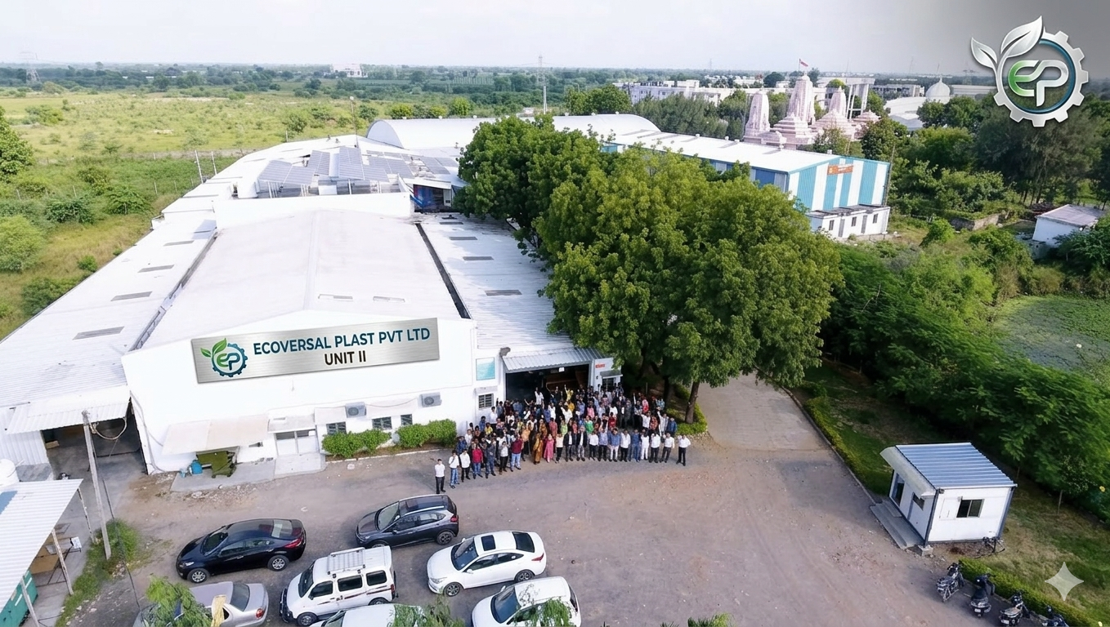

Slide 17
Our Quality
QUALITY IS NOT AN ACT, IT IS A HABIT
At Ecoversal Plast, we are committed to manufacture printed cartons which adhere to the highest standards of quality on a global level.
Stringent in-process testing and inspection ensure that we deliver a quality product that consistently meets and exceeds all our clients' requirements. We have a documented quality policy and are committed to continuous improvement and perfection.
We have also implemented several productivity improvement programs and stringent training programs for all our personnel across various functions.
Our ultra modern QC labs at each of our manufacturing locations, inhouse the most up-to-date test equipment capable of carrying out all the relevant tests required to ensure that we fully conform to our client's specifications.
The QC labs, along with online quality control systems deployed on the production lines, ensure that the quality of the cartons is impeccable and that they run most efficiently on the clients' production and packing lines.
To manufacture our range in compliance with international TAPPI And ISO Quality standards, we conduct strict quality checks.

Slide 18
Why Us ?
As your strategic partner, we:
Offer high levels of service, quality, and technical expertise.
Drive ahead with advanced technology plant set up
Are at the forefront of Corrugated & Mono Carton packaging material development.
Have a strong commitment to operate sustainably.
Richly experienced, dedicated, and professional team.
24 Hours 365 Days we work with the customer, for the customer.
Offers highly durable, stable, strong, and cost-efficient products.
Wide distribution network with own container transport vehicles along with GPS system installed and have more networks for exports.
Innovative designs
Experienced team

Slide 19


