Slide 1
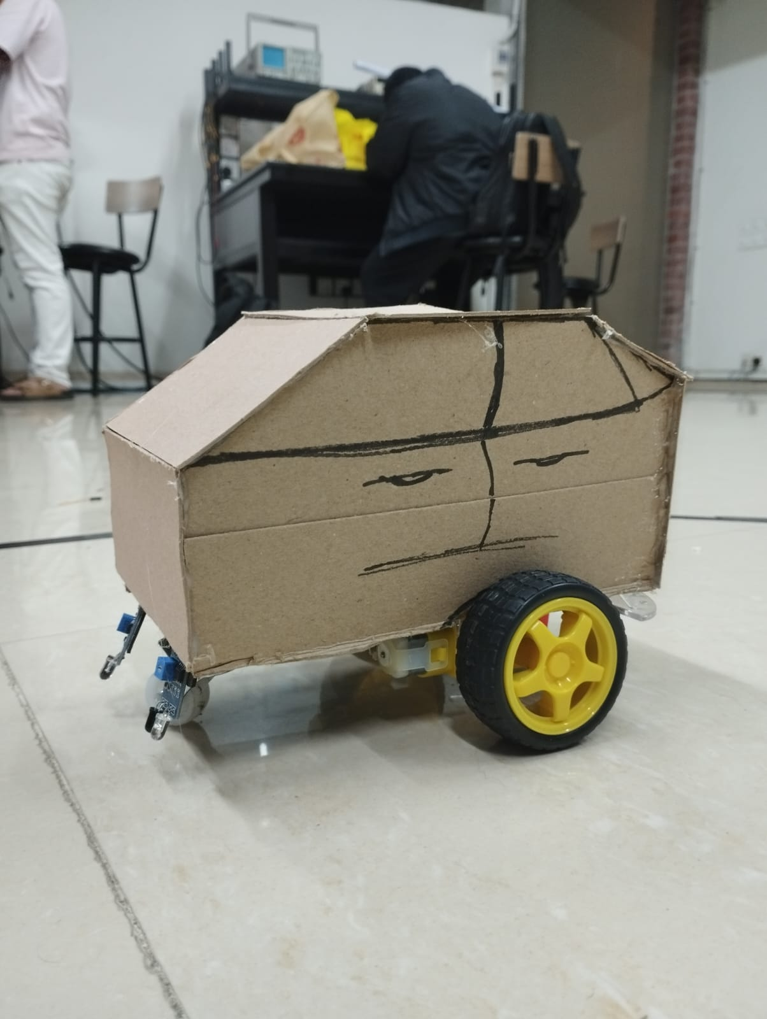

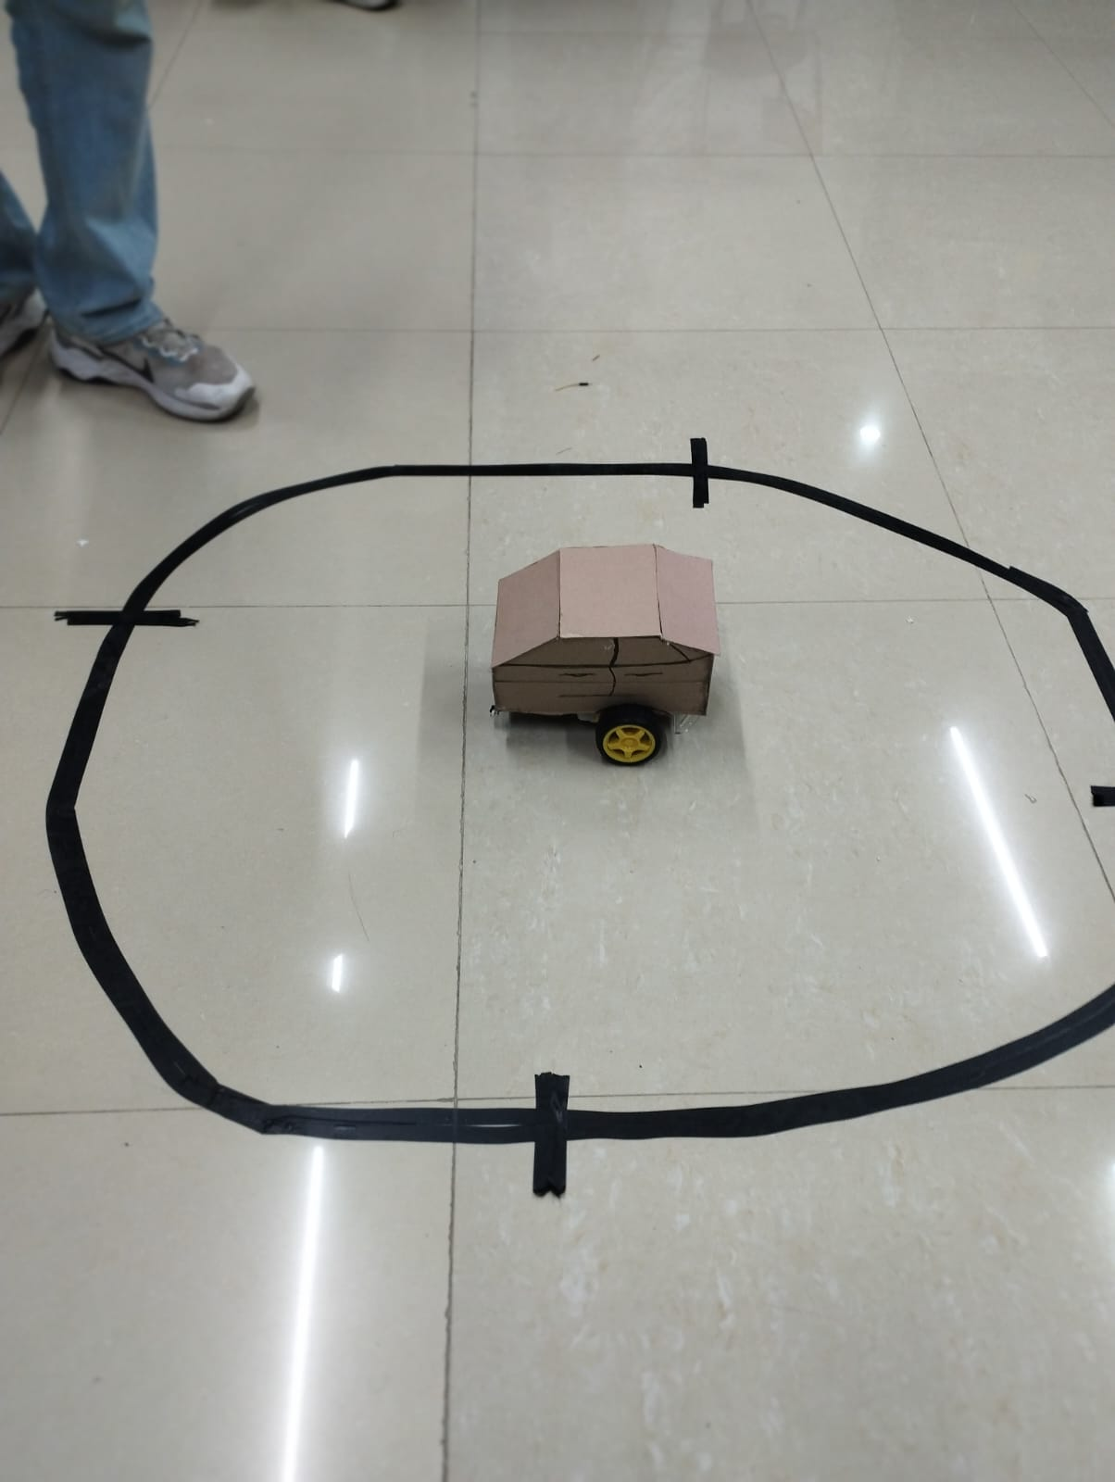
LFR Based Food Serving Waiter
Group 4 Members
Nissan Biswas (021213001)
Syed Shihab Rahman (021213019)
Pallab Paul (021213024)
Mohammad Shiamul Islam Fahim (021213038)
Mushfiqul Alam (021213041)

Slide 2

Introduction
In modern restaurant automation, robotic systems are being used to improve efficiency and service quality. Our project, LFR-based Food Serving Waiter, is designed to autonomously deliver food to customers using a Line Follower Robot (LFR) mechanism.

Slide 3
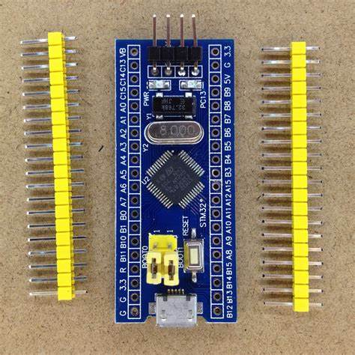
Components
STM32 Microcontroller
DC Motor
IR Sensor
Motor Driver
Jumper Wires
Wheels

Slide 4
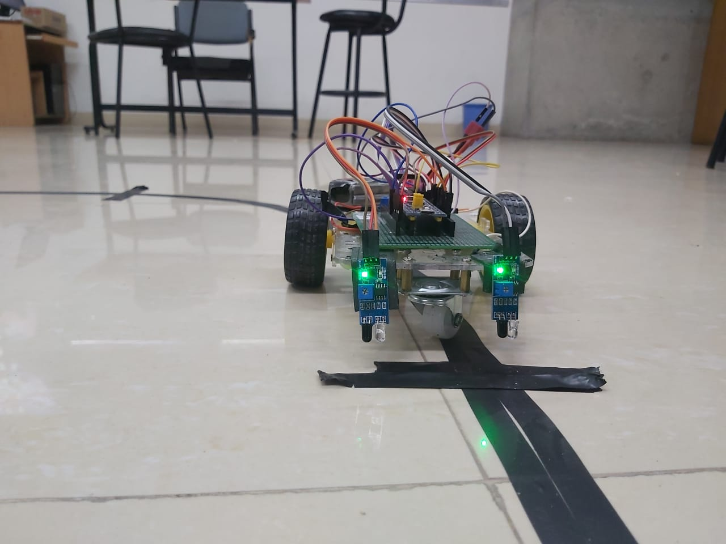
Working Principle
The robot is built using an STM32 microcontroller, IR sensors, and DC motors, ensuring smooth navigation and precise stopping at designated tables. The movement of the robot is controlled using Pulse Width Modulation (PWM), which adjusts the motor speed based on sensor feedback.

Slide 5
Code Explanation
Sensor Reading
Code
The IR sensors detect the black line and send data to the STM32.
The sensor values determine whether the robot should move straight, turn left, or turn right.
if (left_sensor == BLACK && right_sensor == WHITE) {
turnLeft();
} else if (left_sensor == WHITE && right_sensor == BLACK) {
turnRight();
} else {
moveForward();
}

Slide 6
Code Explanation
Table Detection and Stopping
Code
When the table marker (or sensor trigger) is detected, the robot stops for 5 seconds.
The HAL_Delay(5000); function is used to pause the movement before continuing.
if (table_sensor == DETECTED) {
stopMotors();
HAL_Delay(5000); // Wait for 5 seconds
moveForward();
}

Slide 7
Code Explanation
PWM Generation for Motor Control
Code: For PWM start.
The STM32 uses PWM to regulate motor speed by changing the duty cycle of the signal. For PWM generation we are using Timer-3, Channel-1,2,3. Channel -1&2 for the Right & Left Motor and Channel-3 for additional Motor.
HAL_TIM_PWM_Start(&htim3, TIM_CHANNEL_1);
HAL_TIM_PWM_Start(&htim3, TIM_CHANNEL_2);
HAL_TIM_PWM_Start(&htim3, TIM_CHANNEL_3);

Slide 8
Code Explanation
PWM Generation for Motor Control
Code
For the left and right motor speed control.
TIM3->CCR1 = 27000;
TIM3->CCR2 = 27000;

Slide 9
Code Explanation
IR Sensor Working
Code
int rightIRSensorValue = HAL_GPIO_ReadPin(IR_SENSOR_RIGHT_PORT, IR_SENSOR_RIGHT_PIN);
int leftIRSensorValue = HAL_GPIO_ReadPin(IR_SENSOR_LEFT_PORT, IR_SENSOR_LEFT_PIN);
if (rightIRSensorValue == GPIO_PIN_RESET && leftIRSensorValue == GPIO_PIN_RESET) {
rotateMotor(MOTOR_SPEED, MOTOR_SPEED);
}
else if (rightIRSensorValue == GPIO_PIN_SET && leftIRSensorValue == GPIO_PIN_RESET) {
rotateMotor(-MOTOR_SPEED, MOTOR_SPEED);
}
The IR sensors are used to detect the black line on the surface.
Each IR sensor consists of an IR LED and a photodiode. The IR LED emits infrared light, and the photodiode detects the reflection.
A black surface absorbs IR light, giving a low output signal, while a white surface reflects IR light, giving a high output signal.

Slide 10
Code Explanation
IR Sensor & PWM Working
Code: For Additional Motor.
else if (rightIRSensorValue == GPIO_PIN_SET && leftIRSensorValue == GPIO_PIN_SET) {
rotateMotor(0, 0);
HAL_Delay(2000);
TIM3->CCR3=30000;
HAL_Delay(1000); // Let the additional motor work for 10 seconds
TIM3->CCR3=0;
HAL_Delay(2000);

Slide 11
Code Explanation
Code
Motor Driver (L298N) Working
The L298N motor driver is used to control the speed and direction of the DC motors.
The STM32 microcontroller cannot directly drive DC motors, so the L298N acts as an interface.
It has two input pins (IN1 and IN2 for each motor) that determine the direction of rotation.
For Right motor.
void rotateMotor(int rightMotorSpeed, int leftMotorSpeed) {
// Control the right motor direction
if (rightMotorSpeed > 0) {
// Move forward: IN1 = HIGH, IN2 = LOW
HAL_GPIO_WritePin(RIGHT_MOTOR_IN1_PORT, RIGHT_MOTOR_IN1_PIN, GPIO_PIN_SET);
HAL_GPIO_WritePin(RIGHT_MOTOR_IN2_PORT, RIGHT_MOTOR_IN2_PIN, GPIO_PIN_RESET);
}

Slide 12
Code Explanation
Code
Motor Driver (L298N) Working
else if (rightMotorSpeed < 0) {
// Move backward: IN1 = LOW, IN2 = HIGH
HAL_GPIO_WritePin(RIGHT_MOTOR_IN1_PORT, RIGHT_MOTOR_IN1_PIN, GPIO_PIN_RESET);
HAL_GPIO_WritePin(RIGHT_MOTOR_IN2_PORT, RIGHT_MOTOR_IN2_PIN, GPIO_PIN_SET);
} else {
// Stop the motor: IN1 = LOW, IN2 = LOW
HAL_GPIO_WritePin(RIGHT_MOTOR_IN1_PORT, RIGHT_MOTOR_IN1_PIN, GPIO_PIN_RESET);
HAL_GPIO_WritePin(RIGHT_MOTOR_IN2_PORT, RIGHT_MOTOR_IN2_PIN, GPIO_PIN_RESET);}
For Right motor.

Slide 13
Code Explanation
Motor Driver (L298N) Working
Code
For left motor.
// Control the left motor direction
if (leftMotorSpeed > 0) {
// Move forward: IN1 = HIGH, IN2 = LOW
HAL_GPIO_WritePin(LEFT_MOTOR_IN1_PORT, LEFT_MOTOR_IN1_PIN, GPIO_PIN_SET);
HAL_GPIO_WritePin(LEFT_MOTOR_IN2_PORT, LEFT_MOTOR_IN2_PIN, GPIO_PIN_RESET);

Slide 14
Code Explanation
Code
Motor Driver (L298N) Working
else if (leftMotorSpeed < 0) {
// Move backward: IN1 = LOW, IN2 = HIGH
HAL_GPIO_WritePin(LEFT_MOTOR_IN1_PORT, LEFT_MOTOR_IN1_PIN, GPIO_PIN_RESET);
HAL_GPIO_WritePin(LEFT_MOTOR_IN2_PORT, LEFT_MOTOR_IN2_PIN, GPIO_PIN_SET);
} else {
// Stop the motor: IN1 = LOW, IN2 = LOW
HAL_GPIO_WritePin(LEFT_MOTOR_IN1_PORT, LEFT_MOTOR_IN1_PIN, GPIO_PIN_RESET);
HAL_GPIO_WritePin(LEFT_MOTOR_IN2_PORT, LEFT_MOTOR_IN2_PIN, GPIO_PIN_RESET);}
For Left motor.

Slide 15
Code Explanation
DC Motor Working
The DC motors control the movement of the robot.
The speed of each motor is adjusted using Pulse Width Modulation (PWM).
Higher PWM duty cycles → Faster motor speed.
Lower PWM duty cycles → Slower motor speed.

Slide 16
Final Demonstration

Slide 17
Thank you

