Slide 1
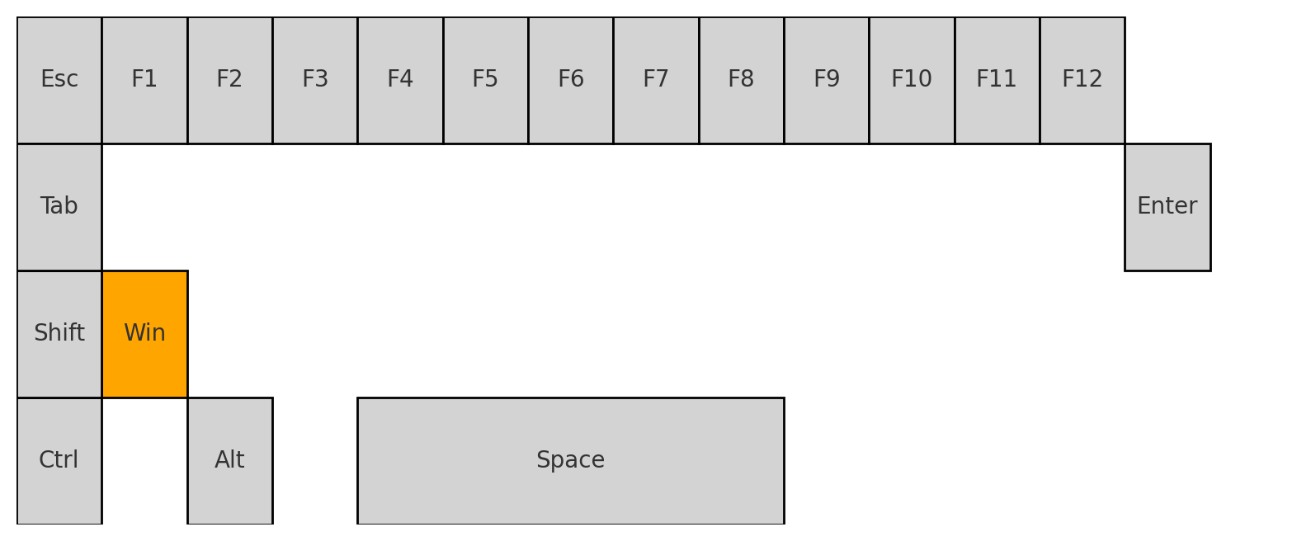
Windows Shortcuts Mastery
Save Time. Reduce Clicks. Work Smarter.
Presented by Marc Silver

Slide 2
Why Learn Shortcuts?
The average worker wastes 64 hours/year on extra mouse clicks.
Keyboard shortcuts save time and reduce strain.
🕒 64 Hours Saved

Slide 3
How We’ll Learn
• Basics to advanced
• Easy memory tricks
• Practice = Muscle memory

Slide 4
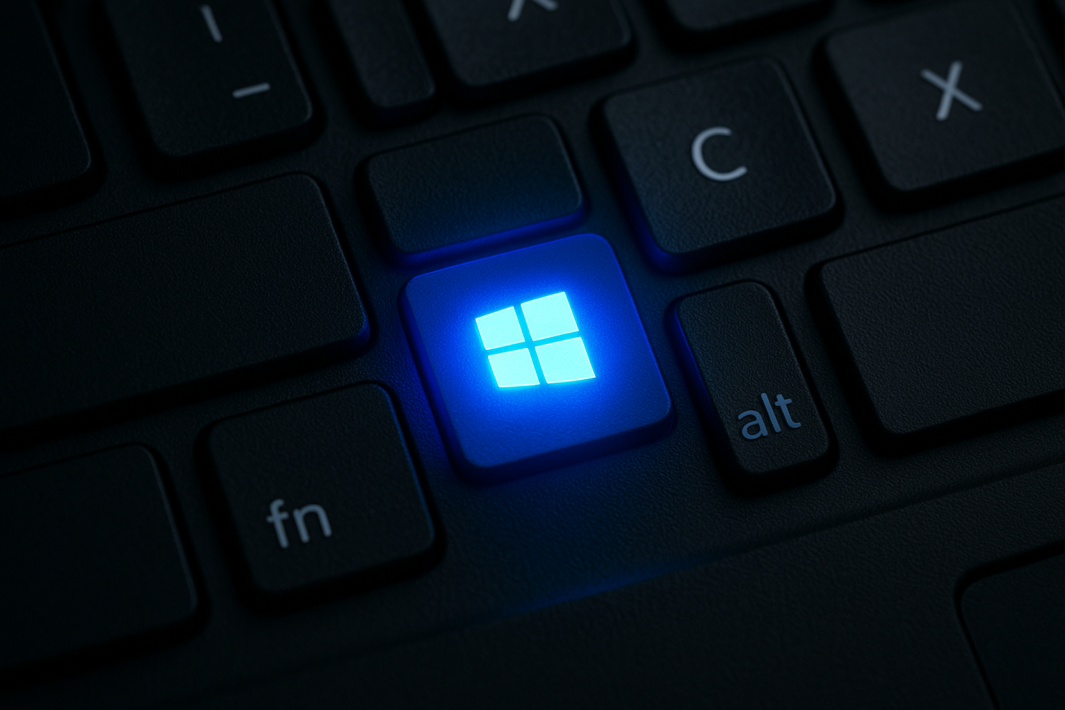
Meet Your New Best Friend: Windows Key
Visualize the Windows key glowing on your keyboard.

Slide 5
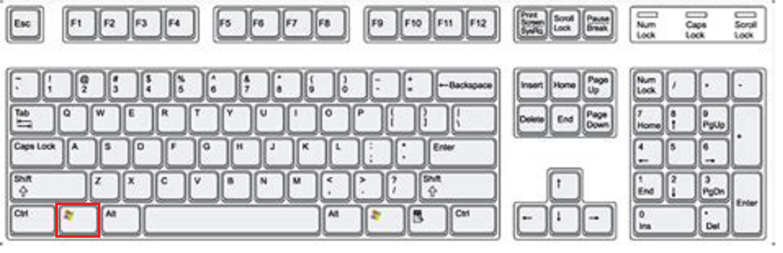
Everyday Essentials
• Win: Start Menu

Slide 6
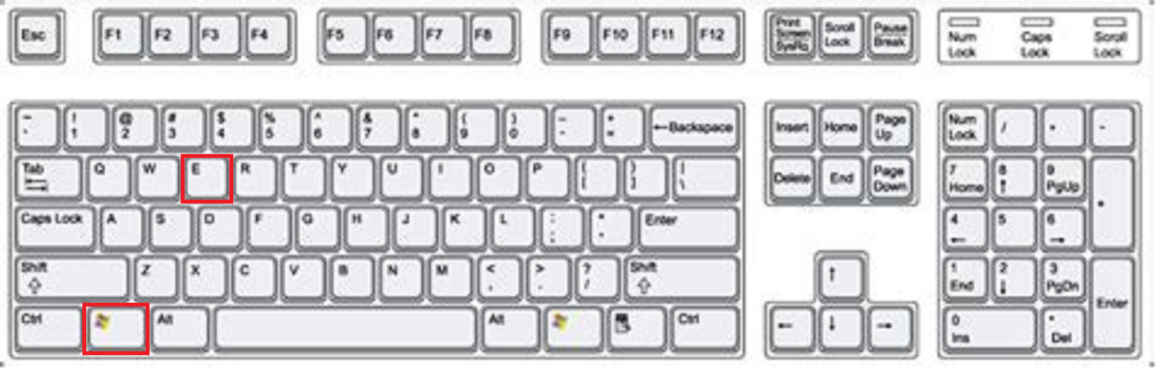
Everyday Essentials
• Win + E: File Explorer (E for Explorer)

Slide 7
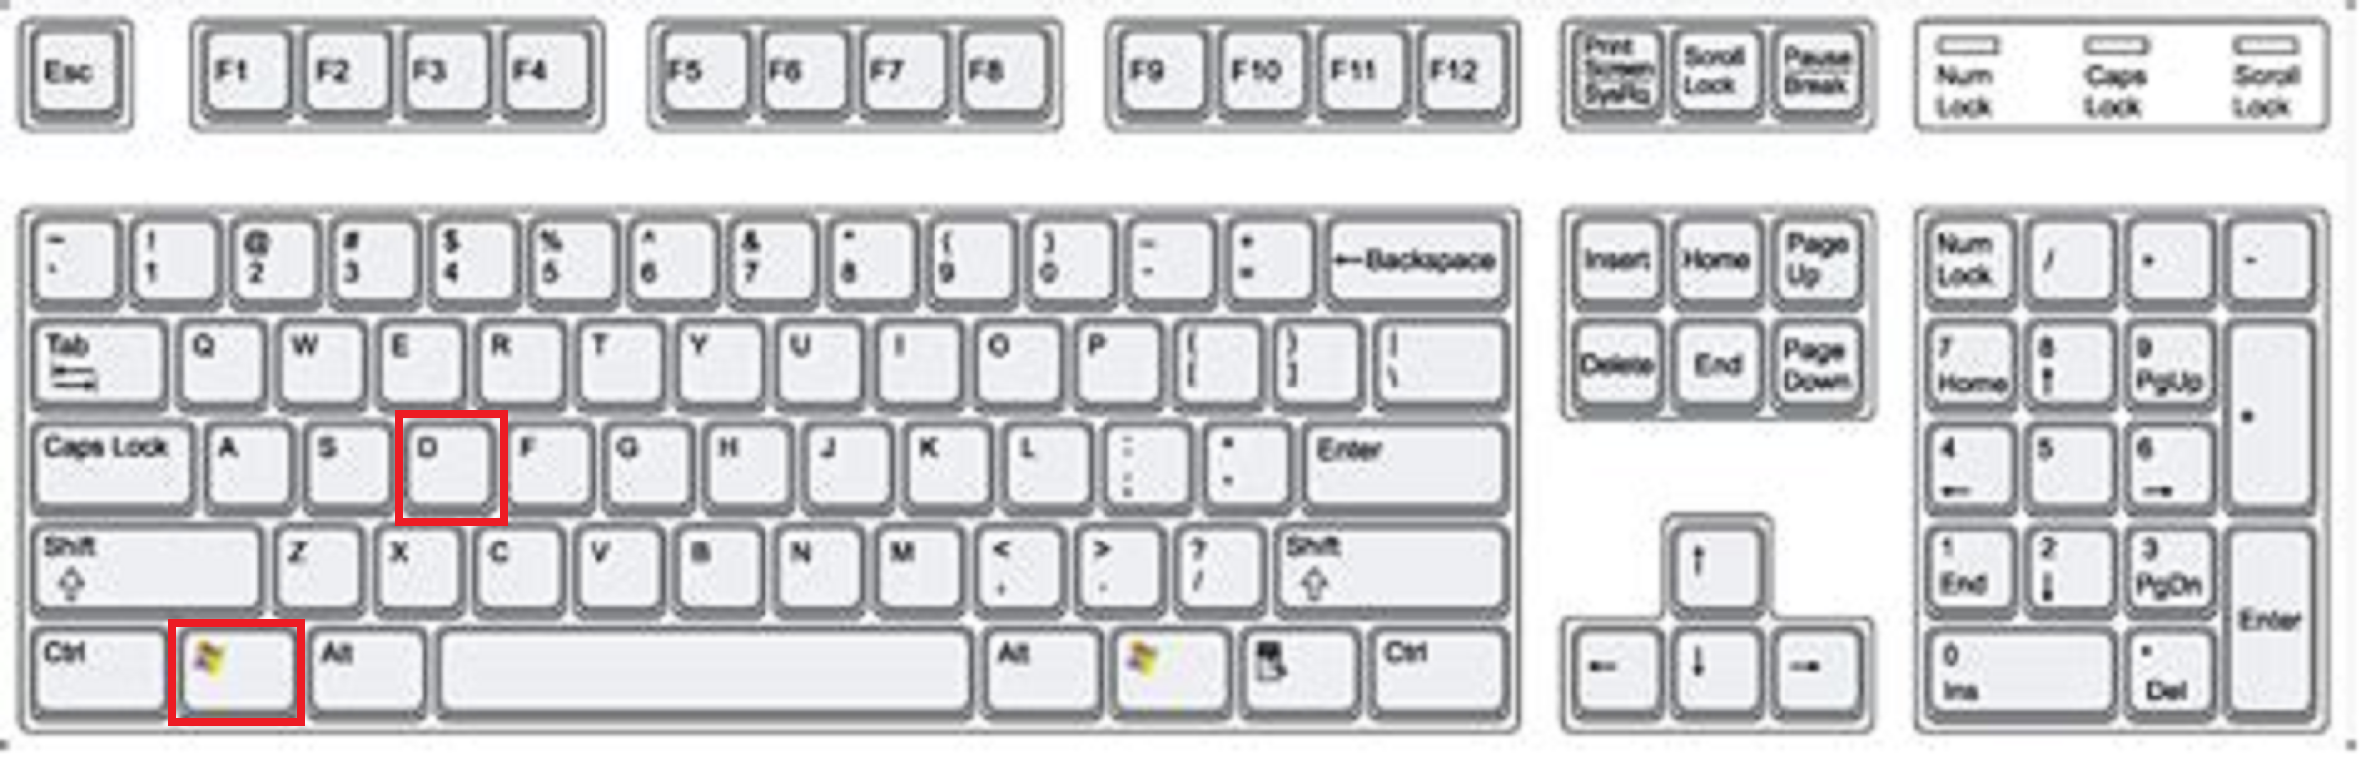
Everyday Essentials
• Win + D: Show Desktop (D for Desktop)

Slide 8

Manage Windows Like a Pro
• Alt + Tab: Switch apps (Cycle tabs)

Slide 9
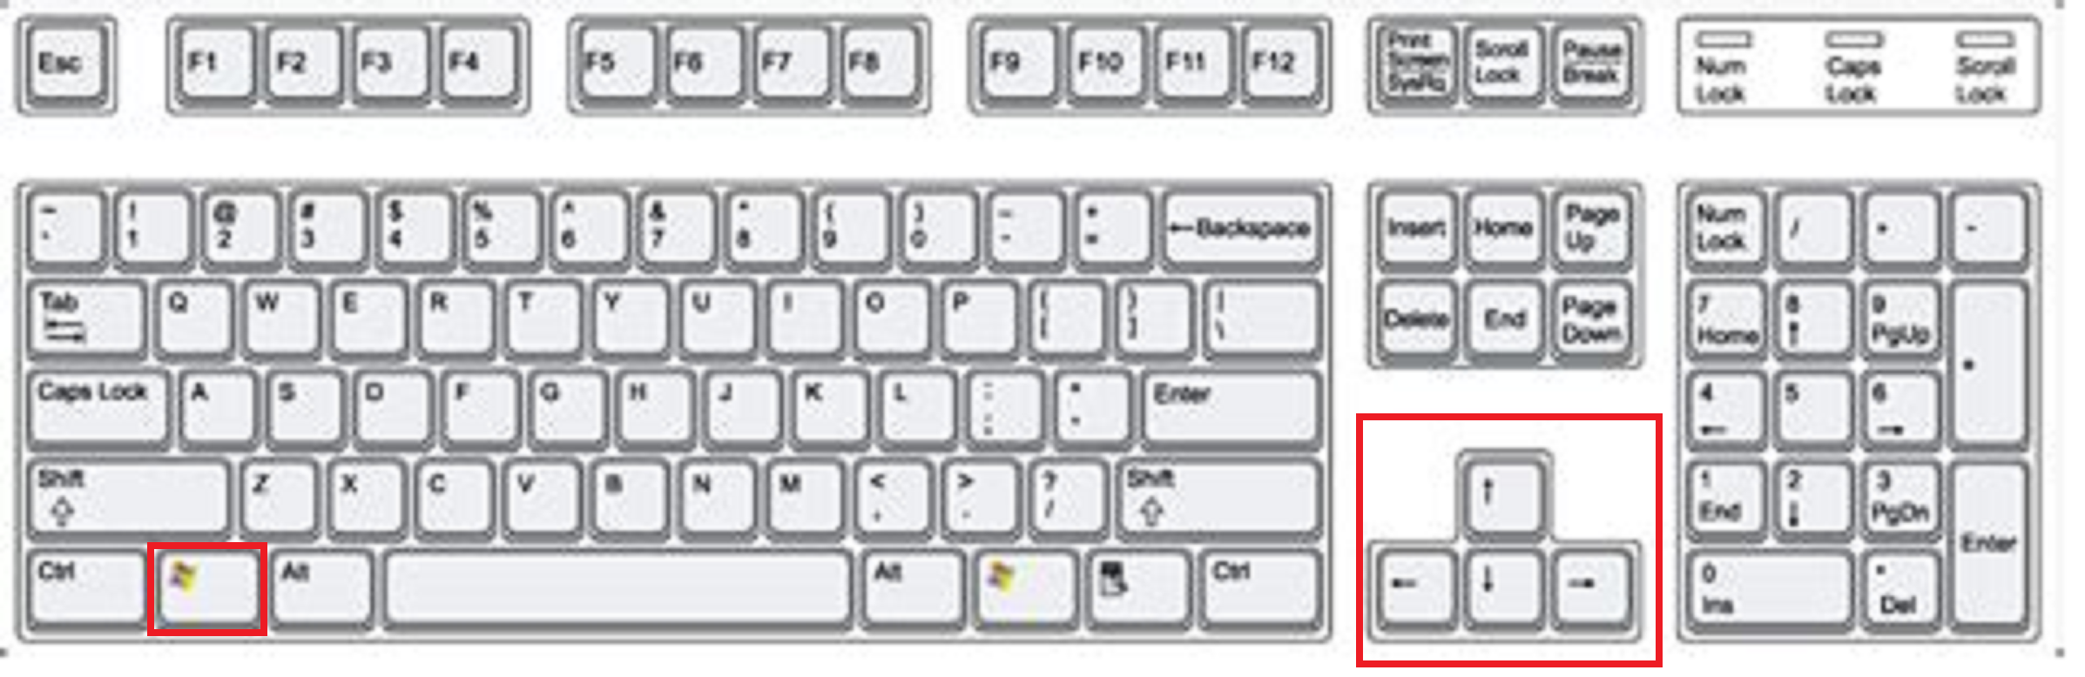
Manage Windows Like a Pro
• Win + ← / →: Snap left/right (Arrow points direction)

Slide 10
Manage Windows Like a Pro
• Win + ↑ / ↓: Maximize/Minimize

Slide 11

Ctrl Command Center
Visualize the Ctrl key highlighted on your keyboard.

Slide 12
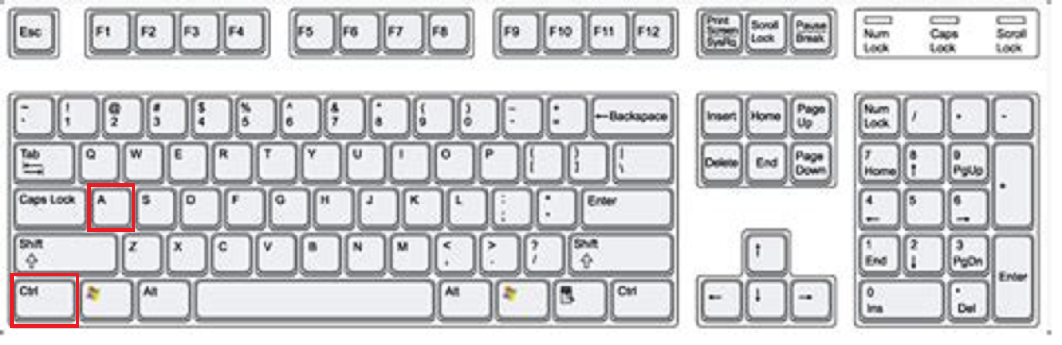
Select. Copy. Paste.
• Ctrl + A: Select All
• Ctrl + C: Copy
• Ctrl + X: Cut (X = Scissors)
• Ctrl + V: Paste (V = Glue)

Slide 13
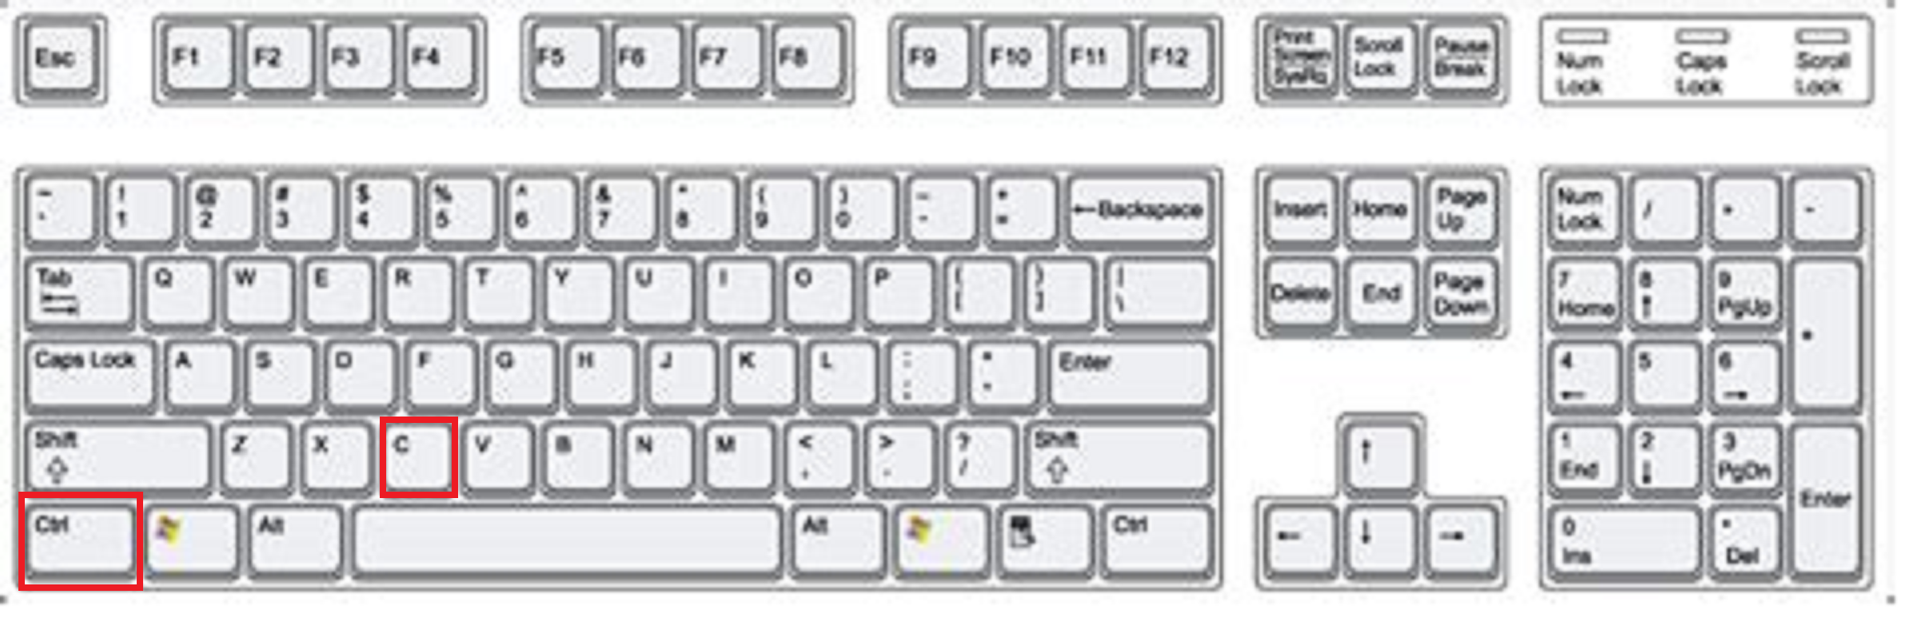
Select. Copy. Paste.
• Ctrl + C: Copy
• Ctrl + X: Cut (X = Scissors)
• Ctrl + V: Paste (V = Glue)

Slide 14
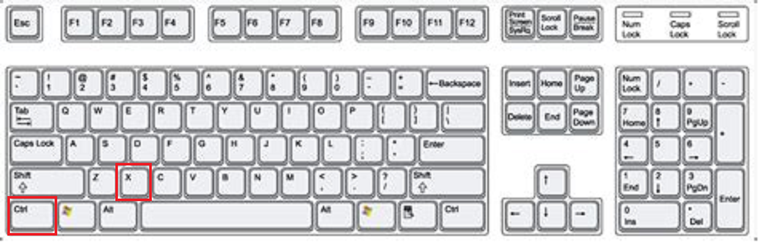
Select. Copy. Paste.
• Ctrl + X: Cut (X = Scissors)
• Ctrl + V: Paste (V = Glue)

Slide 15
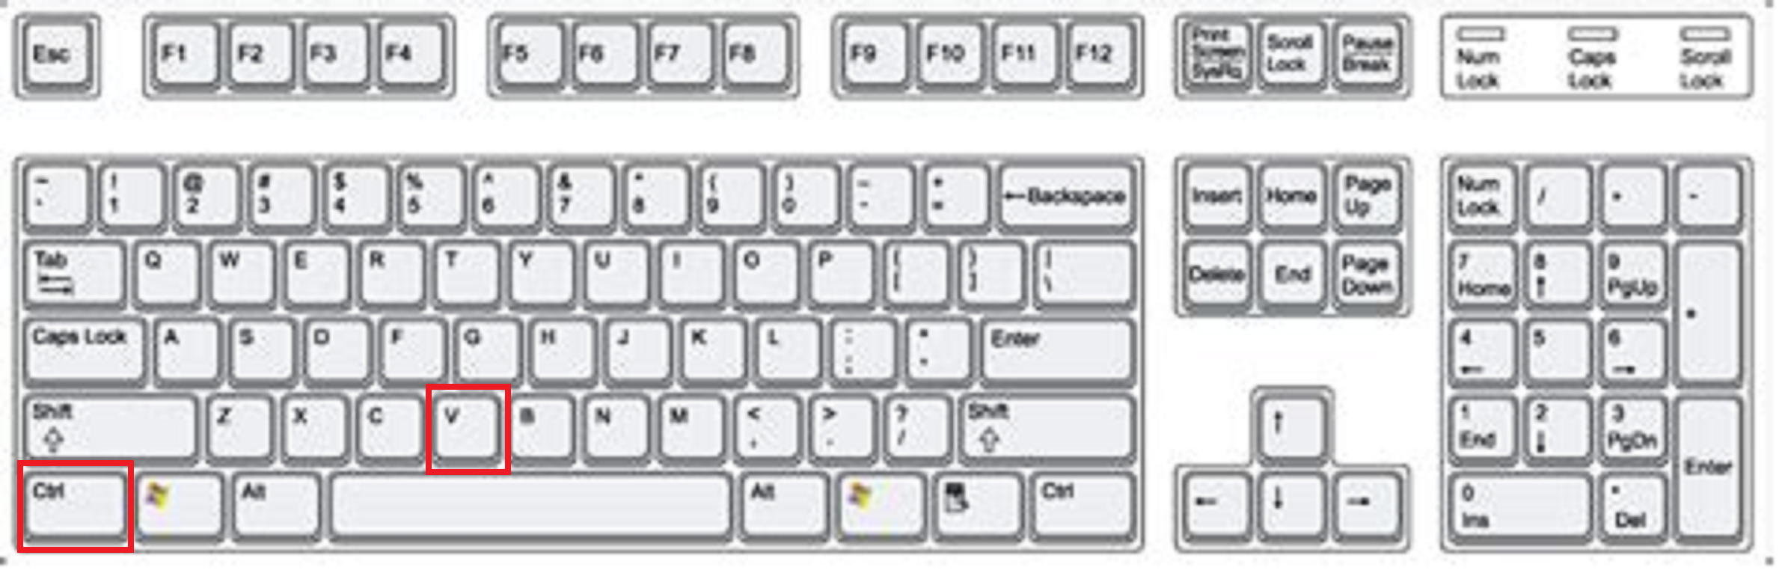
Select. Copy. Paste.
• Ctrl + V: Paste (V = Glue)

Slide 16
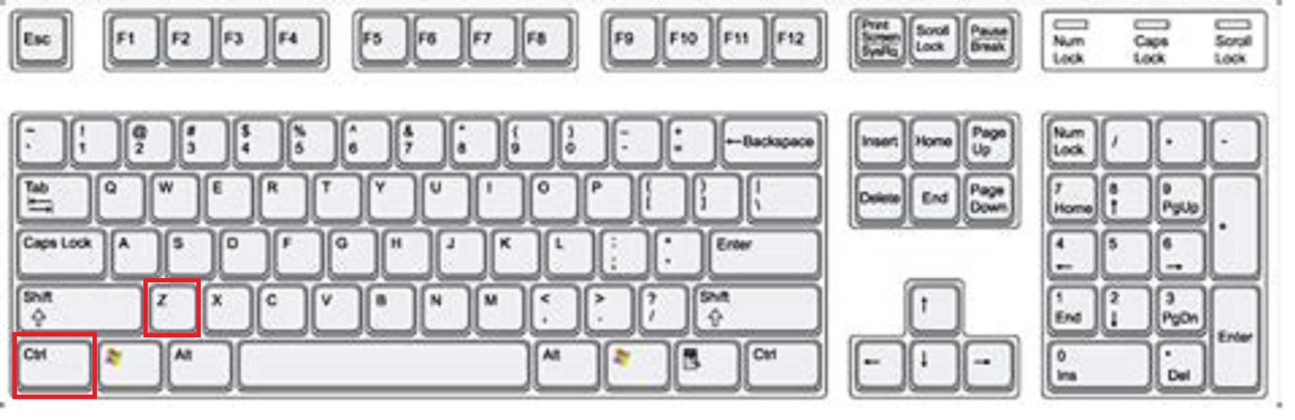
Fix and Navigate Quickly
• Ctrl + Z: Undo (Zigzag mistakes)
• Ctrl + Y: Redo
• Ctrl + Arrows: Move by word (Jump words)

Slide 17
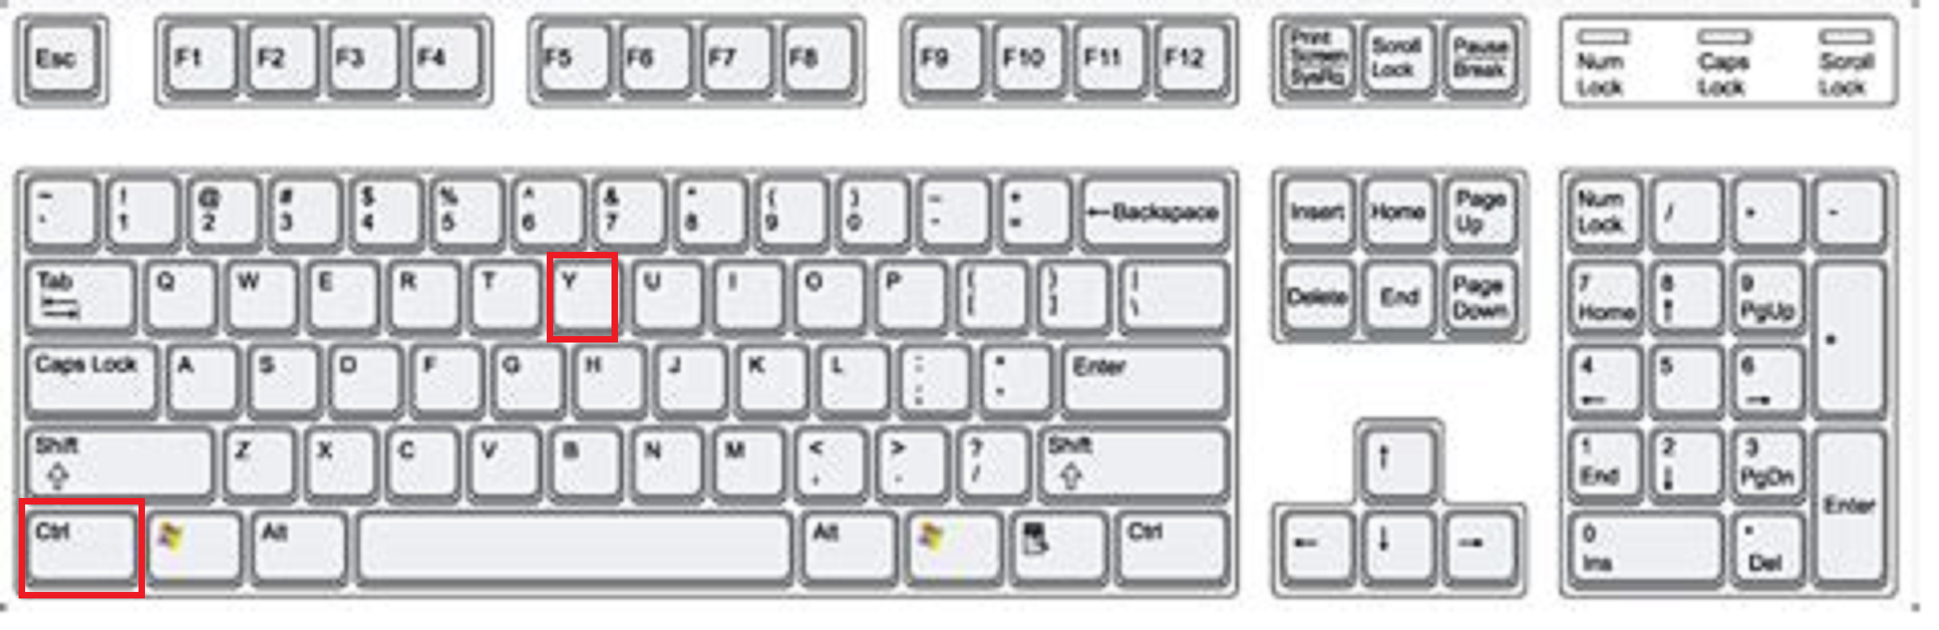
Fix and Navigate Quickly
• Ctrl + Y: Redo

Slide 18
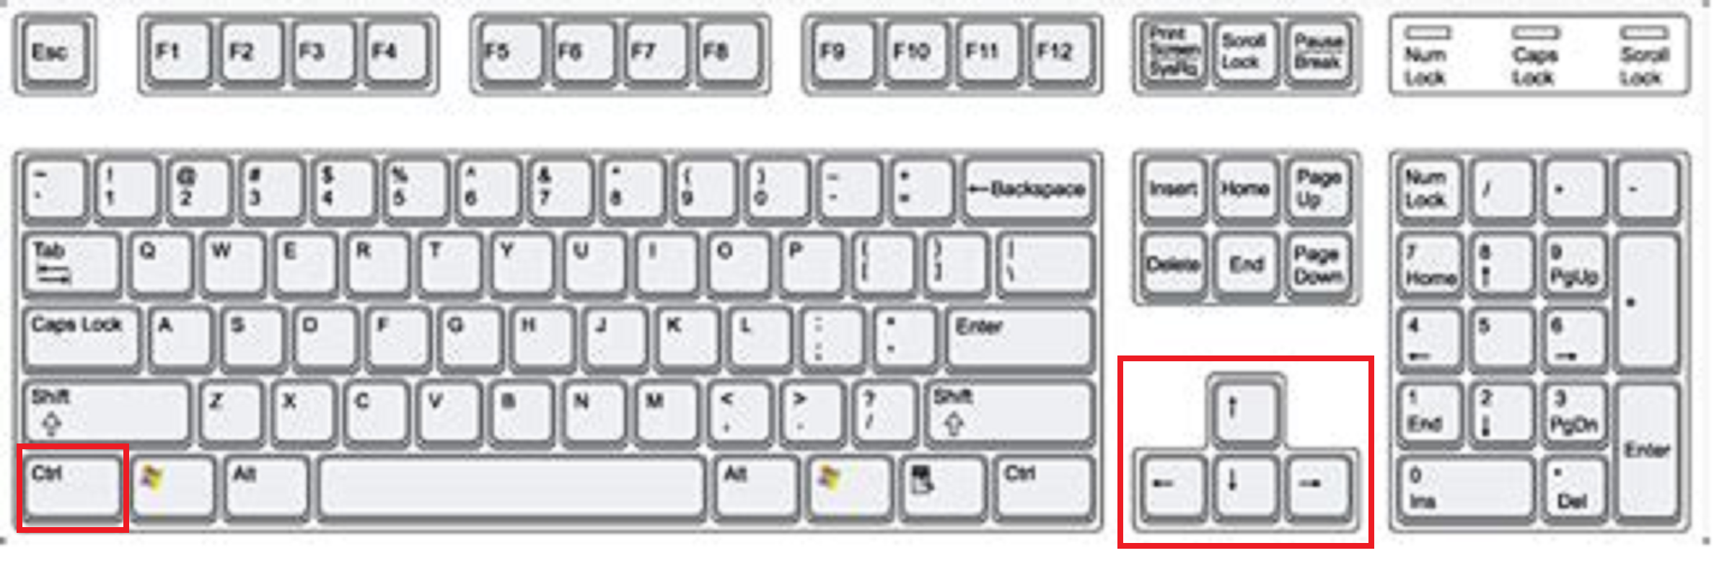
Fix and Navigate Quickly
• Ctrl + Arrows: Move by word (Jump words)

Slide 19

Lock and Recall
• Win + L: Lock (L = Lock)

Slide 20
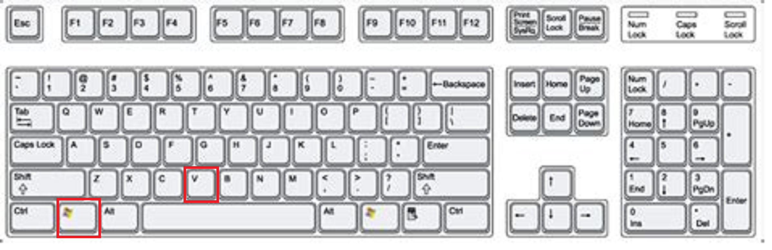
Lock and Recall
• Win + V: Clipboard history (V = Vault)

Slide 21
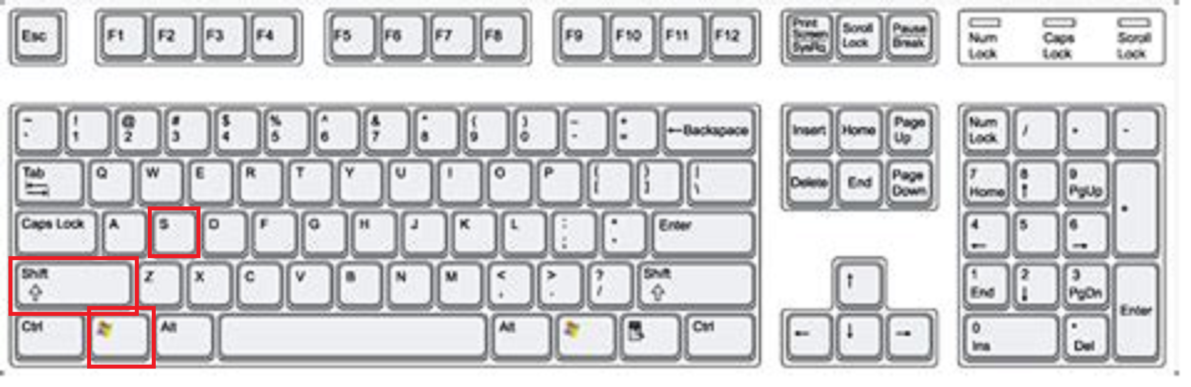
Snap and Share
• Win + Shift + S: Snipping Tool (S for Snip)

Slide 22
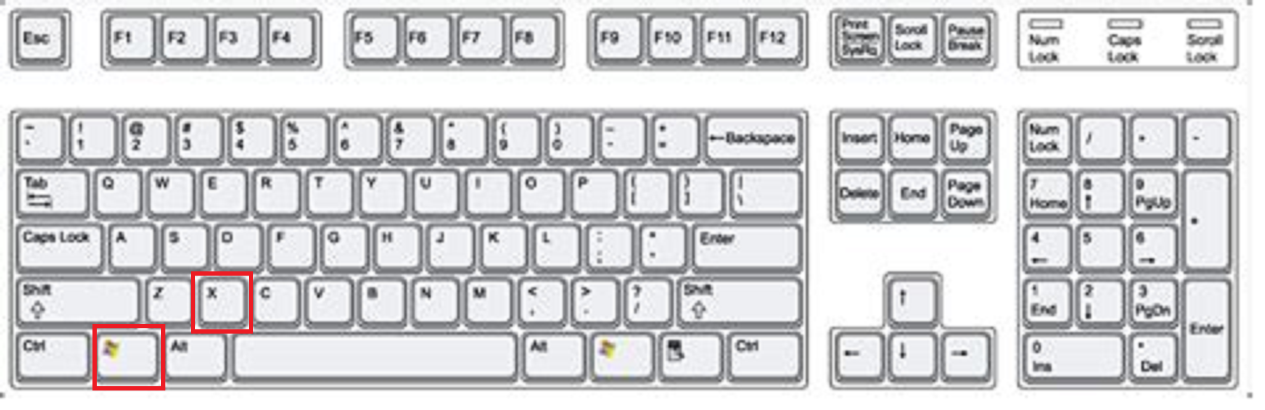
Take Control
• Win + X: Power Menu (X marks expert)

Slide 23
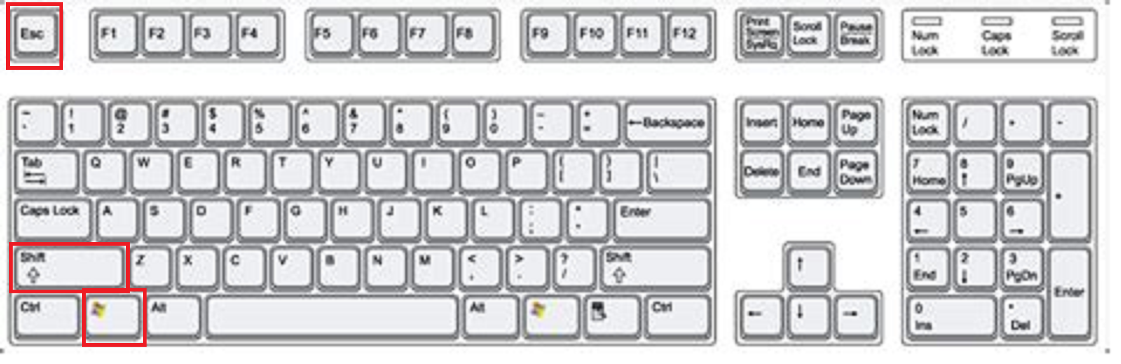
Take Control
• Ctrl + Shift + Esc: Task Manager (Escape crashes!)

Slide 24
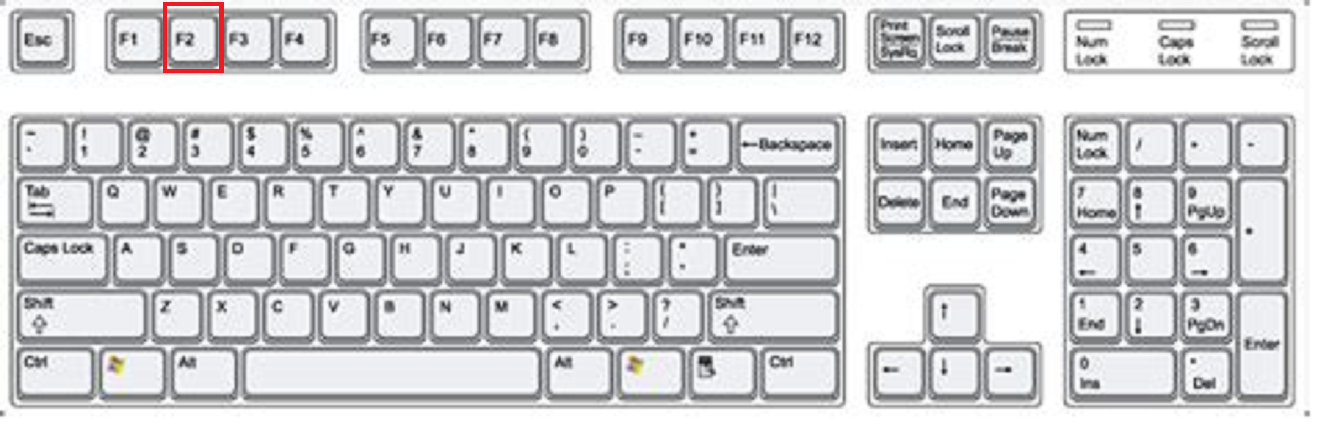
Name and Delete Smartly
• F2: Rename (Fix the name)

Slide 25
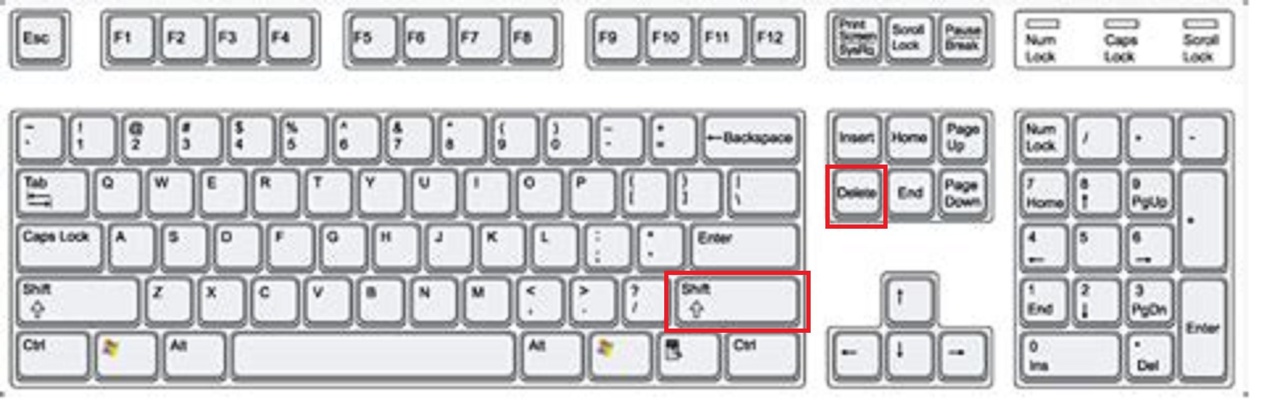
Name and Delete Smartly
• Shift + Delete: Permanent delete (No undo!)
* Be Very Careful with this!

Slide 26
Your No-Mouse Mission
• Create a folder
• Rename it
• Open Task Manager
• Return to Desktop

Slide 27
Practice 5 Shortcuts Per Week
• Start small
• Build muscle memory
• Become a power user

Slide 28
Your Next Steps
• Printable cheat sheet
• Online resources
• Microsoft’s official shortcut list

Slide 29
Questions?
Open the floor for participant questions

Slide 30
Thank You!
• Practice daily
• Distribute reference cards
• Contact info for follow-up
I hope this has been interesting and informative.

