Slide 1
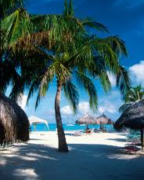
Willemstad, Curaçao
Presented by
Fellow Cruiser
Marc Silver

Slide 2
What I Will Cover
My Port Philosophy
Don’t Miss the Ship
Money
Curaçao History
Curaçao Today
Map of Curaçao
Map of Willemstad
Willemstad Transportation
Places to see or at least consider
Conclusion

Slide 3
My Port Philosophy
I have been cruising for over 45 years and have taken over 200 cruises.
So, I consider myself an experienced cruiser.
The information I will present is based on those many years of
experience.
When I am on a cruise where the city, I want to visit is not the port city,
I always recommend taking a ship’s tour.
But when I am in a port with multiple attractions nearby and easy to see
on my own - I will do it on my own.
This presentation is for that type of port.

Slide 4

Don’t Miss the Ship
How to Avoid Missing Your Ship
Pay attention to the time. - Ship time and local time are
often different.
Put a return-to-ship reminder on your phone.
Choose excursions wisely.
If a ship-sponsored excursion is late returning to port, the
ship will wait for you. If you are on your own.
Be Prepared
Have your Passport, Credit Card, and phone numbers for
your ship port agent.
What to Do If You Miss the Ship
Most cruise lines have port agents stationed in the port area to assist if your ship has left without you. If your are lucky, when cruisers are late returning to the vessel, the ship’s crew will often remove the passengers’ essential items – passports, cell phones, and medication -- from the ship to leave with the port agents.
The Port Officials can help you with contacting your ship
and making necessary travel arrangements.

Slide 5
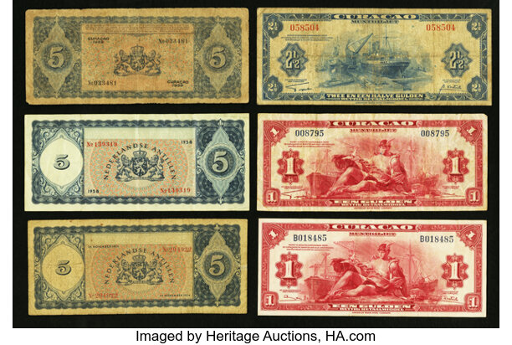
Curaçao Money
The Netherlands Antillean guilder is the currency of Curaçao and Sint Maarten, which until 2010 formed the Netherlands Antilles along with Bonaire, Saba, and Sint Eustatius. It is subdivided into 100 cents.
The currency exchange
rate $1.00 USD = 1.79 ANG
 | ANG | EUR | USD | CAD | GBP
ANG | - | 0,513 | 0.562 | 0.754 | 0.442
EUR | 1.948 | - | 1.095 | 1.470 | 0.861
USD | 1.780 | 0,914 | - | 1.343 | 0.786
CAD | 1.326 | 0,681 | 0.745 | - | 0.586
GBP | 2.263 | 1,162 | 1.272 | 1.707 | -

Slide 6
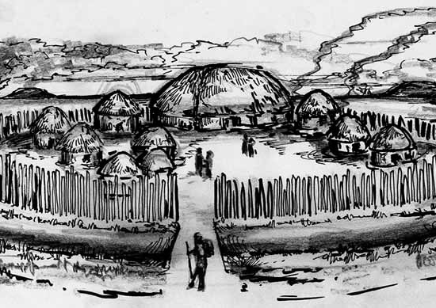
Curaçao History
3400BC-2400BC
OLDEST ARCHEOLOGICAL SITES
The three oldest archeological sites are at "Seru Boca"," Sint Joris Baai" and Rooi Rincon". The site of Rooi Rincon was the first to be discovered in 1949 by A.D. Ringma.
Radiocarbon dating produced a date that ranges between 3400 BC and 2400 BC. The site of Rooi Rincon is a shell midden situated in an abri with two rock drawings on its walls.
The shell midden consists of shells and food remnants from the archaic pre-Columbian people who lived here.

Slide 7
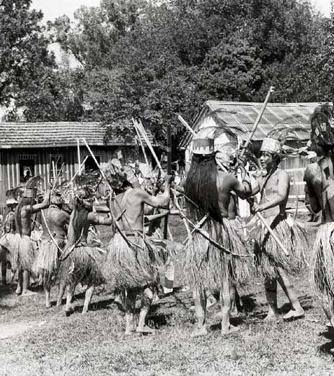
Curaçao History Cont.
600 A.D.
THE EARLY HISTORY OF CURAÇAO
The oldest human remains found in Curaçao are those of the first inhabitants who came from South America to our previously uninhabited island. These remains were found at the “St. Michielsberg” site. The dates range from about 1900 to 1730 B.C. and were derived from marine shells directly associated with ancient burials.
To 1730

Slide 8
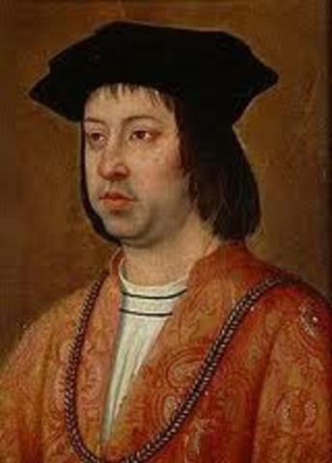
Curaçao History Cont.
1499 THE DISCOVERY OF CURAÇAO
In 1499 Curaçao was discovered by the Spanish Commander Alonso de Ojeda. He traveled with the Italian navigator Amerigo Vespucci.
Ojeda had traveled to the Americas before. In 1493 he accompanied Christopher Columbus on his second voyage to the New World.
The continent was named after Amerigo Vespucci because he proved it was indeed a new world and not Asia’s eastern outskirts like Christopher Columbus believed until his death in 1506.
Vespucci took part in the Spanish expedition under
the command of Alonso de Ojeda in 1499.
It was during this voyage that the island of Curaçao was discovered by
Europeans.
THE FIRST GOVERNOR
On 6 June 1508 the king of Spain appointed Alonso De Ojeda as governor
of Nueva Andalucía, which included the three islands of Curaçao, Bonaire,
and Curaçao.

Slide 9
Curaçao History Cont.
1634 JOHAN VAN WALBEECK AND THE CONQUEST OF CURAÇAO
On 6 April 1634, the directors of the “West Indische Compagnie” (West India Company or WIC) approved the plan of conquest of the island of Curaçao. An expedition force was formed, led by Johan van Walbeeck and Pierre Le Grand. The expedition consisted of 180 sailors and 225 soldiers. On 29 July 1634, they conquered Curaçao. The Spaniards surrendered with the agreement that the majority of Indians, about 400 in numbers, and 32 Spaniards would be free to leave. They were sent to Coro, Venezuela. On 21 August the capitulation was a fact.
1634 WILLEMSTAD "DE PUNT"
In 1634, at the time of the conquest of the island of Curaçao by the Dutch and the capitulation of the Spaniards, "Punda” (De Punt -The Point) was no more than a flat surface, a peninsula of 7 acres, covered with cacti and shrubs.

Slide 10
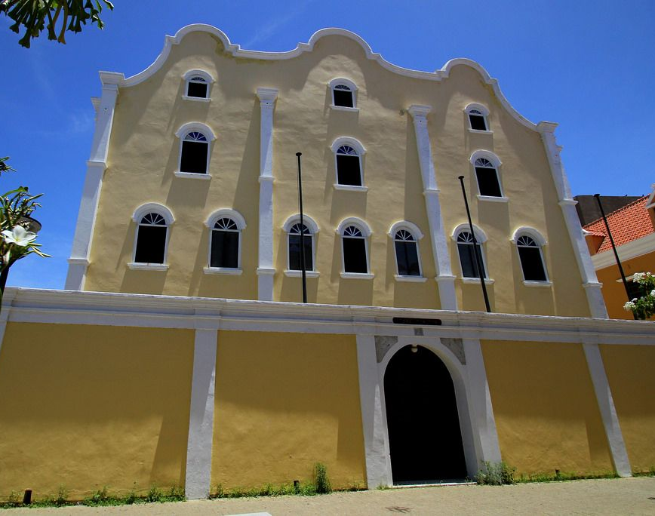
Curaçao History Cont.
1651 THE FIRST JEWISH IMMIGRANTS
In 1651 the Dutch West India Company permitted
João de Illan to bring fifty Jewish settlers to
Curaçao. With these settlers, De Illan formed the
Jewish community Mikvé Israël (Hope Israëls).
1657 DUTCH THE SLAVE TRADE IN CURAÇAO
The Transatlantic slave trade took place from the
16th century through to the beginning of the 19th
century. The vast majority of those enslaved were
transported from the west coast of Africa to the
New World.
Curaçao played an important role in the slave trade because of the Dutch West India Company. The first slave ship, the "Bontekoe," entered the St. Annabaai with 191 Africans on board in 1657.

Slide 11
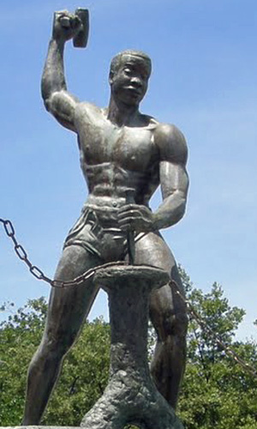
Curaçao History Cont.
1795 TULA, CURAÇAO'S NATIONAL HERO - THE REVOLT
Tula was a slave in Curaçao and leader of the revolt that
lasted for over a month in 1795. He is revered in Curaçao
today as a fighter for human rights and independence.
The Netherlands was placed under French rule from 1795 to
1801, it was Tula's conviction that slavery would soon be
abolished here, in Curaçao, as well.
"We have been abused too much, we do not seek to harm
anyone, and we are just seeking our freedom. French Negroes
gained their freedom, Holland was occupied by the French,
then we must be free here“.
After the revolt was quelled Tula was sentenced to death. The
execution took place on 3 October 1795 at “Rif” (the Reef) on
the south coast of the island in Otrabanda. The monument that
honors him as a warrior for freedom can be found here.

Slide 12

Curaçao Today
1863 THE ABOLITION OF SLAVERY
By the proclamation of King Willem III, slavery
was officially abolished in the Dutch colonies
on 1 July 1863. In the Netherlands Antilles,
11,634 slaves got their freedom on this date.
Universal suffrage was achieved on March
27th, 1949.
1937 FIRST ELECTIONS
The introduction of partial suffrage in 1936 led to the first elections in Curaçao in 1937. During these elections, political parties made their debut and the political elite tried for the first time to win the support of the voting population.

Slide 13
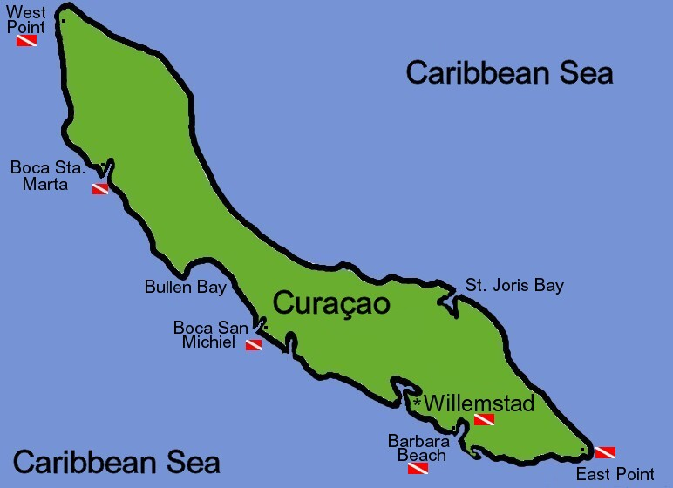
Area
Map of Curaçao

Slide 14
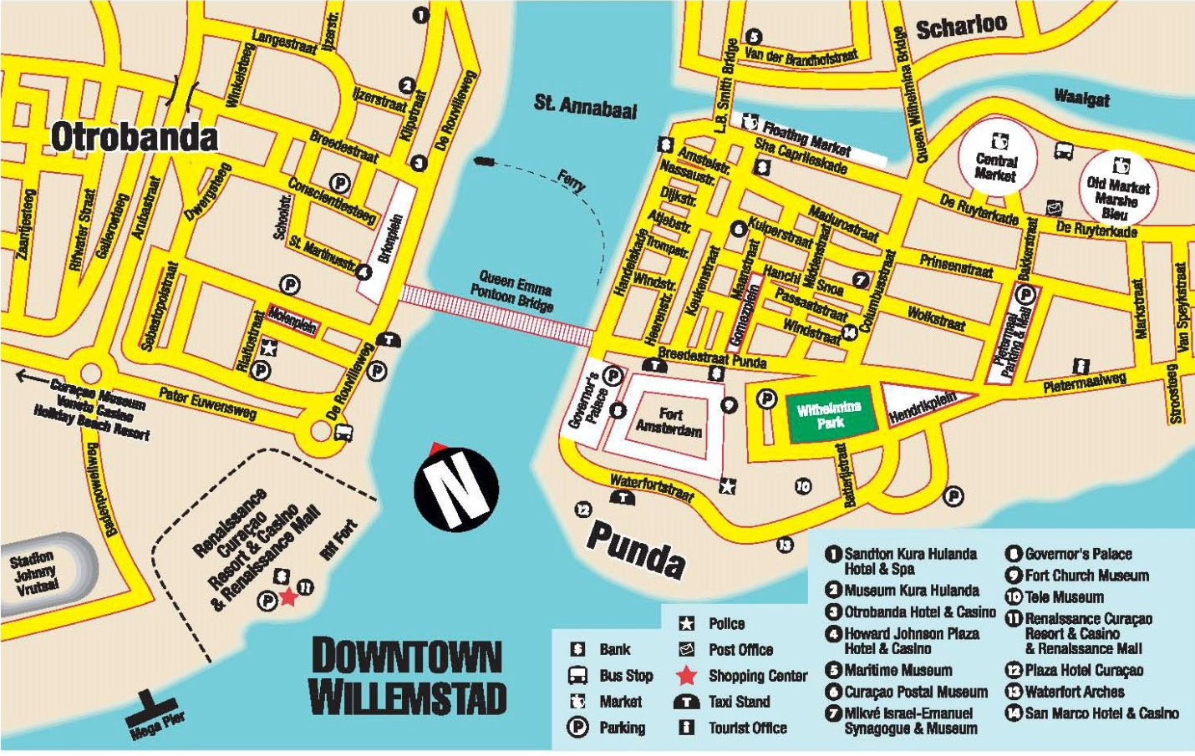
Map of Willemstad

Slide 15
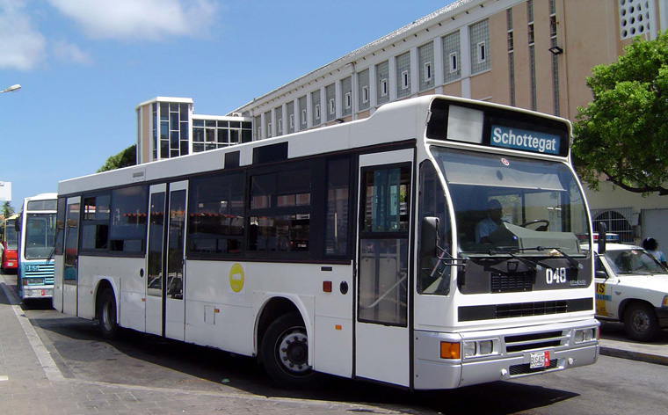
Willemstad Buses
Public transportation is a convenient and inexpensive method to visit the beautiful island of Curaçao. The bus system, operated by the Curaçao Transit Company (CTC), is the island’s primary mode of public transit.
The bus routes cover most major areas of the island, including popular tourist destinations. The buses are dependable, friendly, and air-conditioned, making them an excellent choice for travelers on a tight budget.
A ride on the routes through the city and the eastern side of the island costs ANG 2.00 or $ 1.11
Seniors 65+ can use the routes covering the city and the eastern side for ANG 1.75 and ANG 2.25 for the routes covering the western side, Tera Kora, Lagun and Westpunt.

Slide 16

Willemstad Transportation
Taxis in Curaçao are plentiful. Taxis can be very reasonable, as long as you ask the price BEFORE you get in.
Additionally, some taxi drivers offer island tours, providing you with a unique opportunity to explore Curaçao with a knowledgeable local guide. Taxis are a convenient option for short trips or when you prefer to sit back, relax, and enjoy the scenery while someone else handles the driving.
Cruise passengers can find the taxi stand at the end of the pier.
Blue Bay, Piscadera, Mariott, Dreams etc. is about $30 USD.
Willemstad, Mambo Beach, Avila and Sunscape area is approximately $40 USD.
Jan Thiel or Sandals cost around $50 USD.

Slide 17
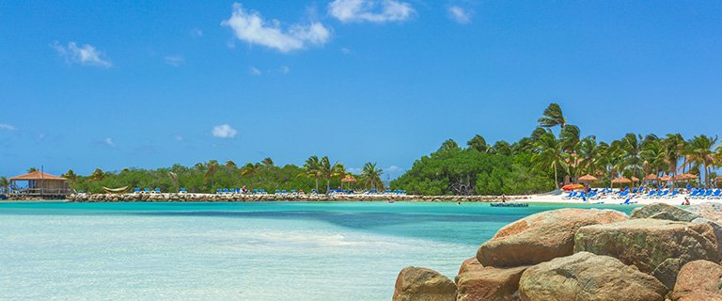
Willemstad Tour Companies
Several independent tour companies in Curaçao offer various tours of the island. They cover just about any activity and interest you may have. You can contact any of them online or just wait and see what is offered when you disembark in Willemstad.
Or as I just said, take a Taxi.

Slide 18
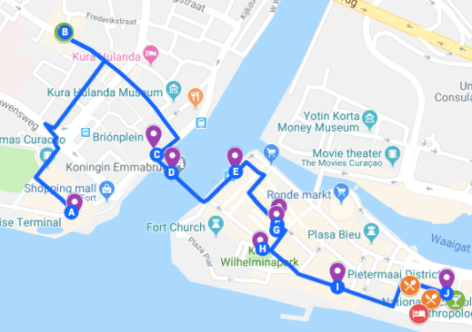
Self Guide Walking Tour
A self-guided walking tour of Willemstad promises a colorful mix of character and charm. You’ll start in western Otrobanda, then cross the bridge to pastel-colored Punda, and end the tour in vibrant Pietermaai. At a slow pace, this itinerary should take less than 8 hours.
Stroll through Rif Fort & Renaissance Mall
Sample the island’s famous “green rum” at Netto Bar
People-watch at Brion Plaza
Admire Queen Juliana Bridge from afar
Cross the floating Queen Emma Bridge on foot
Wander along the pastel Punda waterfront
Visit Mikvé Israel-Emanuel Synagogue
Explore the local art scene
Pick a letter in Queen Wilhelmina Park
Venture beyond the crowds into the vibrant Pietermaai District
Enjoy the hippest walking street in town: Nieuwestraat
Grab a bite to eat
Kick back with a jazzy nightcap (and maybe a cigar)
Where to stay in Willemstad: review of Pietermaai Boutique Hotel

Slide 19
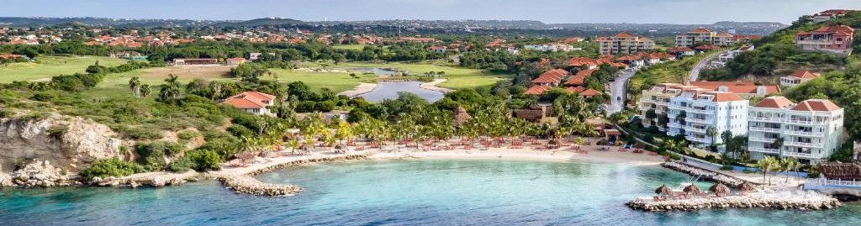
Beaches
The beaches of Curaçao are not located in the city and that is why many cruise passengers book a tour or shore excursion to the beaches. You can also take a taxi to some nice beaches near the Cruise Port. The 3 beaches I am recommending are a maximum of 15 15-minute drive from the Cruise Port.
Blue Bay Beach
Blue Bay Beach is a private resort just a 15-minute drive from the Curaçao Cruise Port.
The entrance fee is $12.00 for adults. Children $6.00. This fee includes the use of beach chairs, showers, and restrooms.
At Blue Bay beach you can find a bear bar, beach restaurant coast, and bistro Lemongrass.

Slide 20
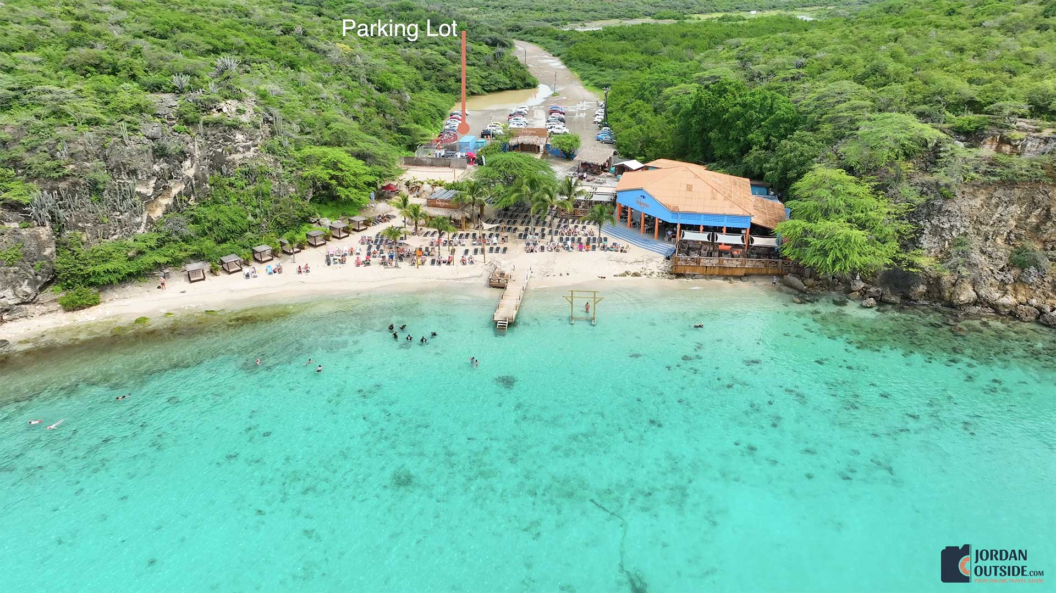
Beaches Cont.
Kokomo Beach
Kokomo Beach is only 15 minutes from the Cruise Terminal and is a popular beach among many passengers probably because it is close to the Port. This may not be your best option. The beach and facilities are fine, but there are much nicer beaches to choose from when visiting the island.
A plus is that you don’t have to pay an entrance fee to access the beach. For lunch and drinks, you can go to the beach restaurant.

Slide 21
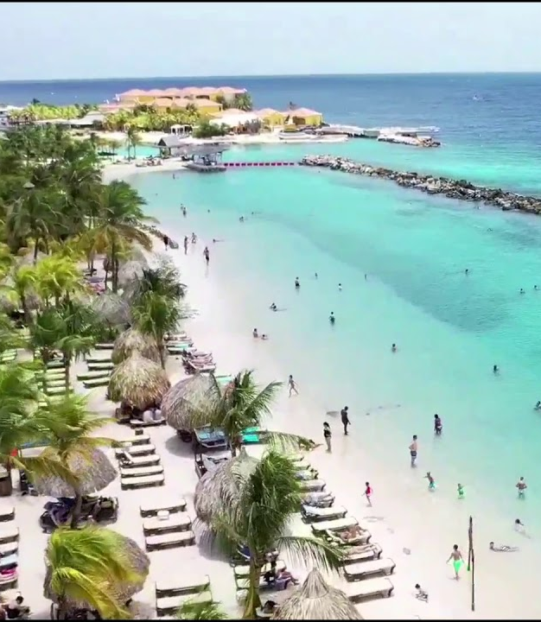
Beaches Cont.
Mambo Beach
Mambo Beach is a commercial beach with many facilities.
The fee to enter Mambo Beach is $3.50. Not including beach chair rental available at the beach clubs.
Madero Ocean Club offers a full day of relaxing at their pool or the beach. Bonita Beach Club is a cozy laidback beach where you can get a taste of the real Caribbean lifestyle.
Mambo Beach is about a 15-minute drive south of the Curaçao Cruise Port.

Slide 22
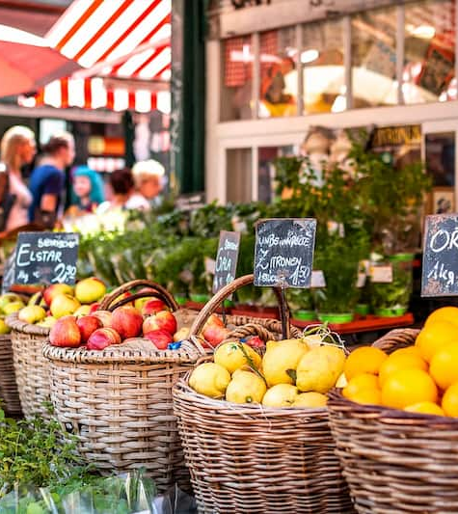
The Local Market Curaçao
Want to get a feel of the Curaçaon culture; The Local Market is the place to be!
Traditional Dutch-style market stalls fill up the marketplace with vendors offering a huge selection of products at bargain prices.
With 40 buzzing stalls—all with permanent coverings to shield them from the elements—it’s an ideal spot to find locally made items and affordable Curaçaon souvenirs.
You’ll also find excellent local fare on-site, including BBQ and fresh fruit shakes, and there’s free parking as well.

Slide 23
Conclusion
Willemstad is a beautiful City with a rich history and numerous attractions. Regardless of what you're looking for, Willemstad has something for everyone.
I hope this presentation will help when we visit Willemstad!

Slide 24
Thanks For Coming
If you have any more questions, please ask.
I will do my best to answer them for you.
Have a great visit to Willemstad!

