Slide 1
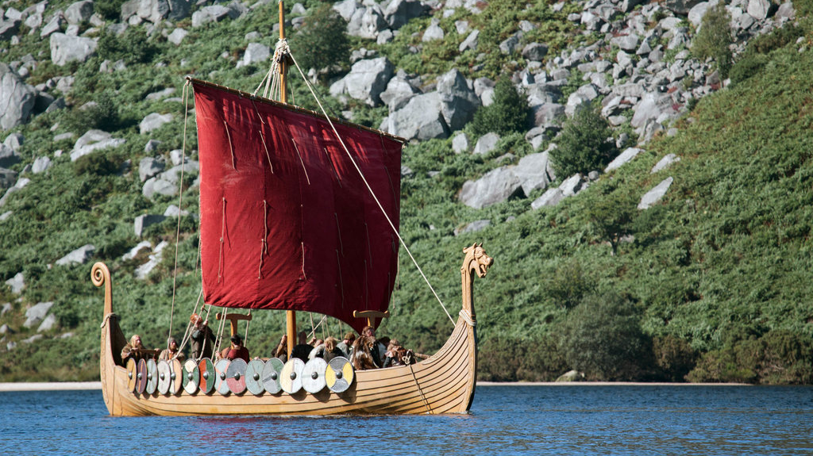
Who Were the Vikings?
Presented By
Marc Silver

Slide 2
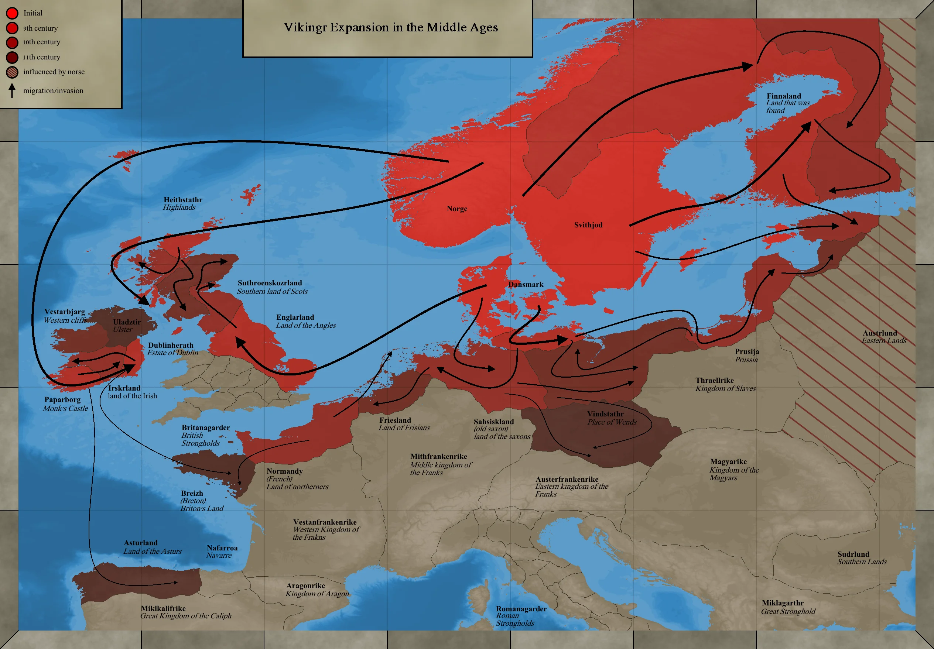
The Viking Age
Historically the Vikings first appeared in history from around A.D. 800. In the 11th century, a vast number of Scandinavians left their homelands in what is now Denmark and Norway and Sweden, to seek their fortunes elsewhere.
These seafaring warriors collectively became to be known as Vikings or Norsemen (People of the North), began by raiding coastal sites, especially undefended monasteries, in the British Isles.
Over the next three centuries, they would leave their mark as pirates, raiders, traders, settlers and farmers on much of Britain and the European continent, as well as parts of modern-day Russia, Iceland, Greenland, and Newfoundland.

Slide 3
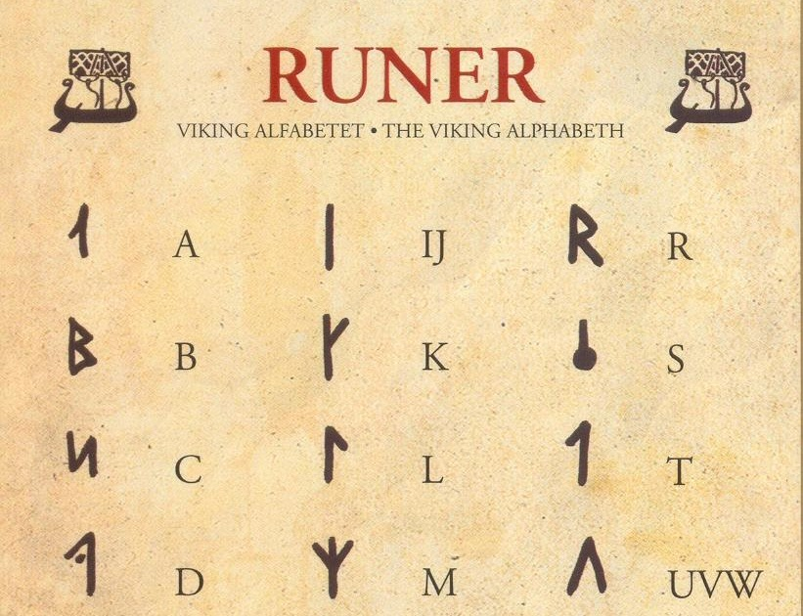
Why are they called Vikings?
The etymology of the word Viking is uncertain. There are many theories about its origins. The Old Norse word víkingr generally meant “pirate” or “raider.”
The name Viking came from the Scandinavians
themselves, from the Old Norse word "vik" (bay
or creek) which formed the root of "vikingr".
Vikingr in the Old Norse language literally
means "a man from Vík," which is believed to be
a bay in southern Norway. This term was perhaps
applied as the first Viking raiders believed to have
come from this area.

Slide 4
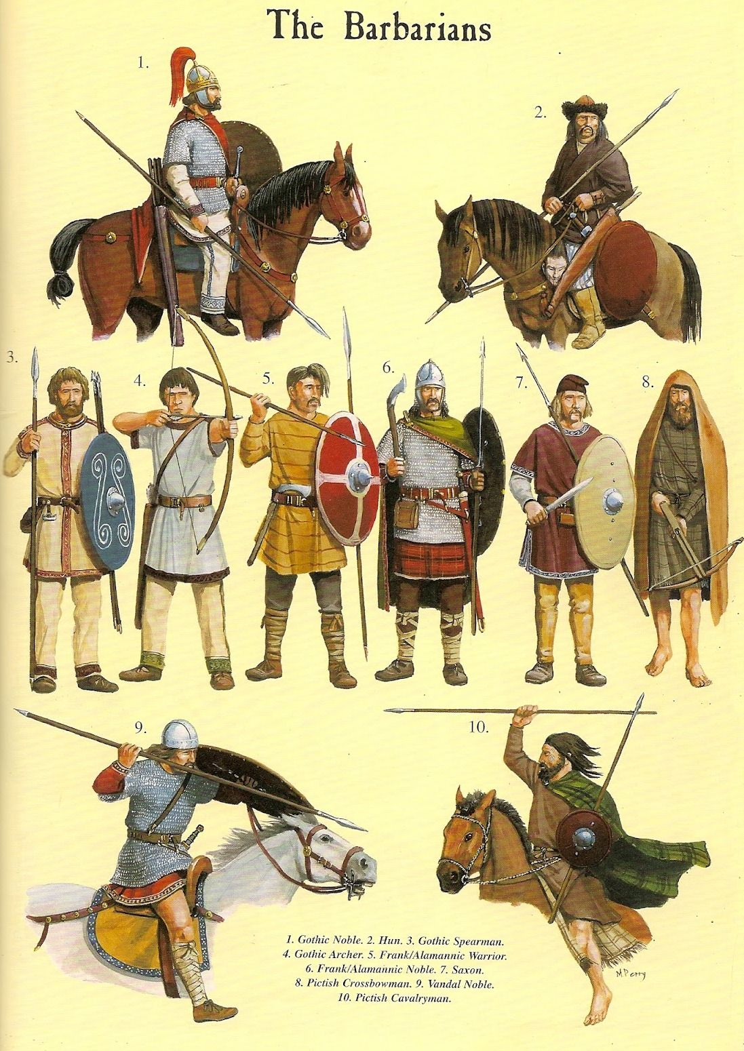
Who Were the Vikings?
Contrary to some popular conceptions of the Vikings, they were not a “race” linked by ties of common ancestry or patriotism and could not be defined by any particular sense of “Viking-ness.”
Their roots are believed to be made up from different Northern Germanic ethnic group. What is agreed to is they were expert sailors and navigators.

Slide 5
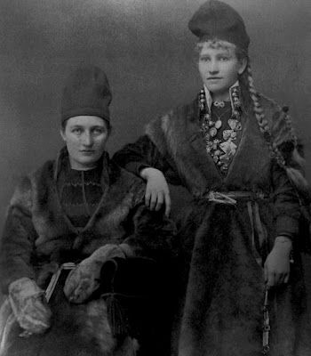
Who Were the Vikings? Cont.
Most of the Vikings whose activities are best known come from the areas now known as Denmark, Norway, and Sweden, though there are mentions in historical records of Finnish, Estonian and Saami Vikings as well.
Their common ground–and what made them different from the European peoples they confronted–was that they came from a foreign land, they were not “civilized” in the local understanding of the word and, most importantly, they were not initially Christian.

Slide 6
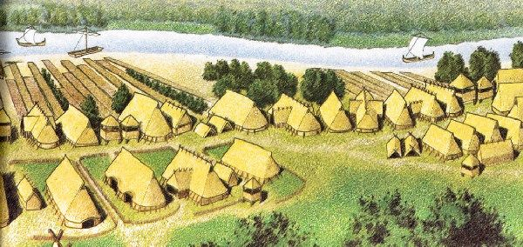
Who Were the Vikings?
Cont.
The exact reasons for Vikings venturing out from their homeland are uncertain; some have suggested it was due to overpopulation of their homeland, but the earliest Vikings were looking for riches, not land. In the eighth century A.D., Europe was growing richer, fueling the growth of trading centers such as Dorestad and Quentovic on the Continent and Hamwic (now Southampton), London, Ipswich, and York in England.
Scandinavian furs were highly prized in the new trading markets; from their trade with the Europeans, Scandinavians learned about new sailing technology as well as about the growing wealth and accompanying inner conflicts between European kingdoms.
The Viking predecessors–pirates who preyed on merchant ships in the Baltic Sea–would use this knowledge to expand their fortune-seeking activities into the North Sea and beyond.

Slide 7
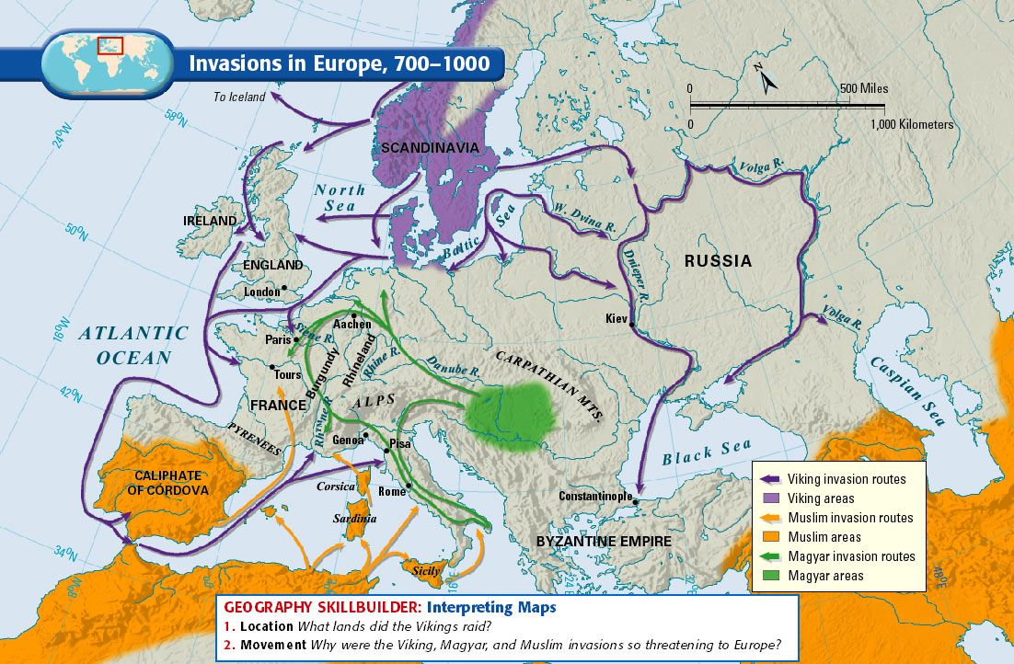
Early Viking Raids
In A.D. 793, an attack on the Lindisfarne monastery off the coast of Northumberland in northeastern England marked the beginning of the Viking Age.
The culprits, probably Norwegians who sailed directly across the North Sea, did not destroy the monastery completely, but the attack shook the European religious world to its core.
Unlike other groups, these strange new invaders had no respect for religious institutions such as the monasteries, which were often left unguarded and vulnerable near the shore.
Two years later, Viking raids struck the undefended island monasteries of Skye and Iona (in the Hebrides) as well as Rathlin (off the northeast coast of Ireland).
The first recorded raid in continental Europe came in 799, at the island monastery of St Philibert’s on Noirmoutier, near the estuary of the Loire River.

Slide 8
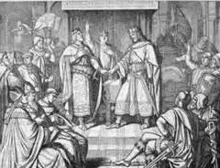
Early Viking Raids Cont.
For several decades, the Vikings confined themselves to hit-and-run raids against coastal targets in the British Isles (particularly Ireland) and Europe (the trading center of Dorestad, 80 kilometers from the North Sea, became a frequent target after 830).
They then took advantage of internal conflicts in Europe to extend their activity further inland: after the death of Louis the Pious, emperor of Frankia (modern-day France and Germany).
In 840, his son Lothar actually invited the support of a Viking fleet in a power struggle with brothers.
Before long other Vikings realized that Frankish rulers were willing to pay them rich sums to prevent them from attacking their subjects, making Frankia an irresistible target for further Viking activity.

Slide 9
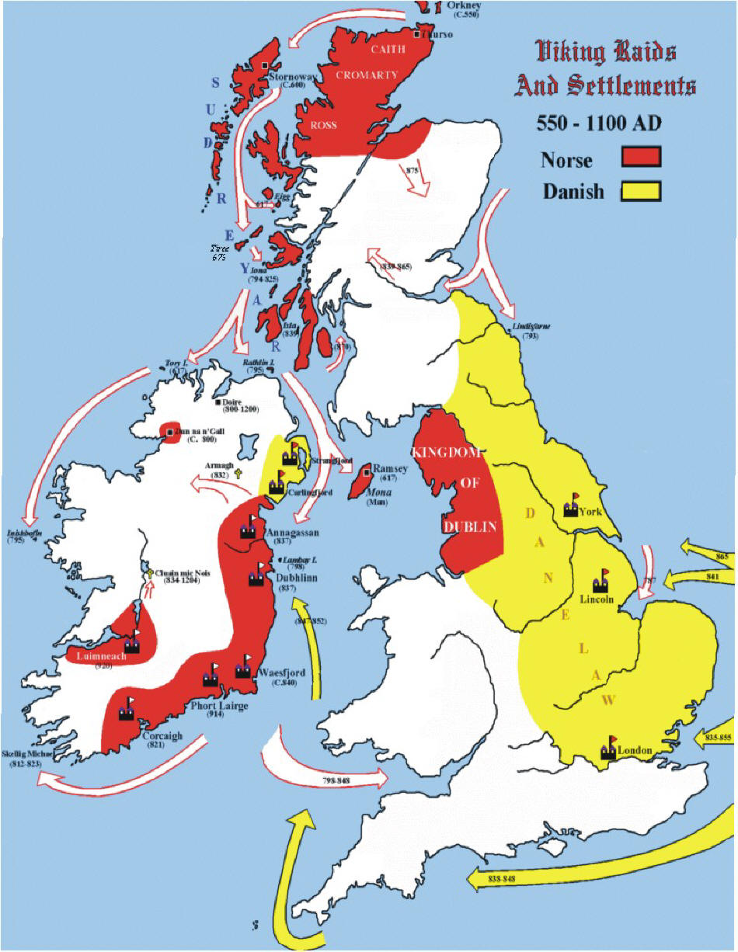
British Isles Conquests
By the mid-ninth century, Ireland, Scotland and England had become major targets for Viking settlement as well as raids. Vikings gained control of the Northern Isles of Scotland (Shetland and the Orkneys), the Hebrides and much of mainland Scotland.
They founded Ireland’s first trading towns: Dublin, Waterford, Wexford, Wicklow and Limerick, and used these towns as a base on the Irish coast to launch attacks within Ireland and across the Irish Sea to England.
When King Charles the Bald began defending West Frankia more energetically in 862, fortifying towns, abbeys, rivers and coastal areas, Viking forces began to concentrate more on England than Frankia (Kingdom of the Franks or what we today know as France).

Slide 10
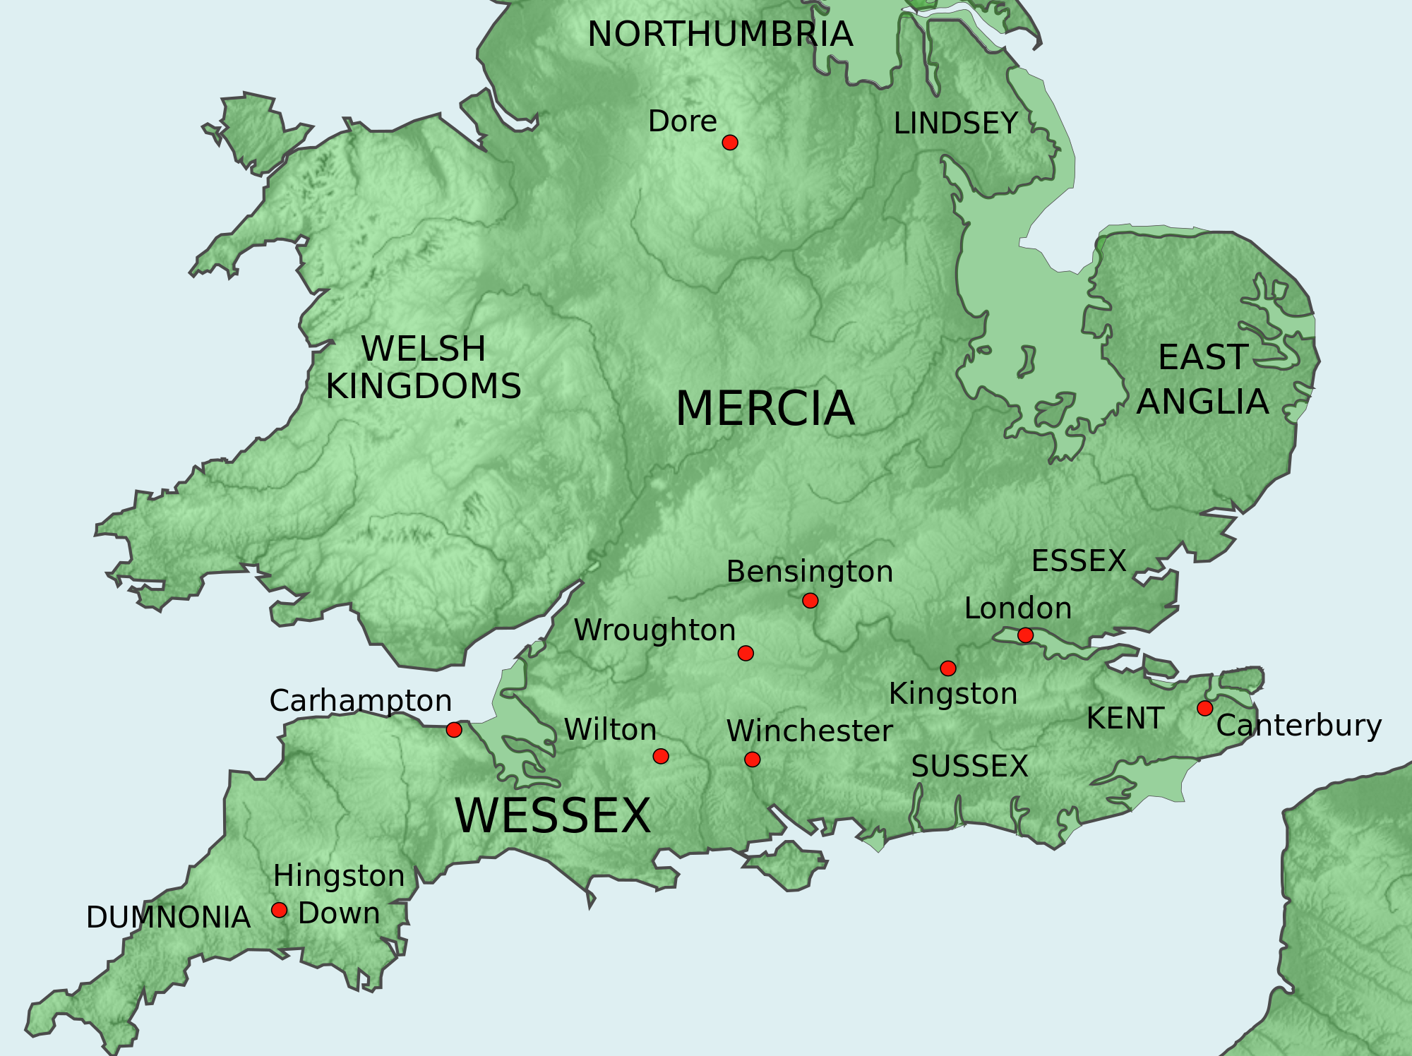
Conquests in the British Isles Cont.
In the wave of Viking attacks in England after 851, only one area, the Kingdom of Wessex was able to defend themselves against the Viking raids.
The Kingdom of Wessex, also known as West Saxons was an Anglo-Saxon kingdom in the south of Great Britain, from around 519 until England was unified in 927.
The Anglo-Saxons believed that Wessex was founded by Cerdic and Cynric of the Gewisse, though this is considered by some to be a legend.

Slide 11
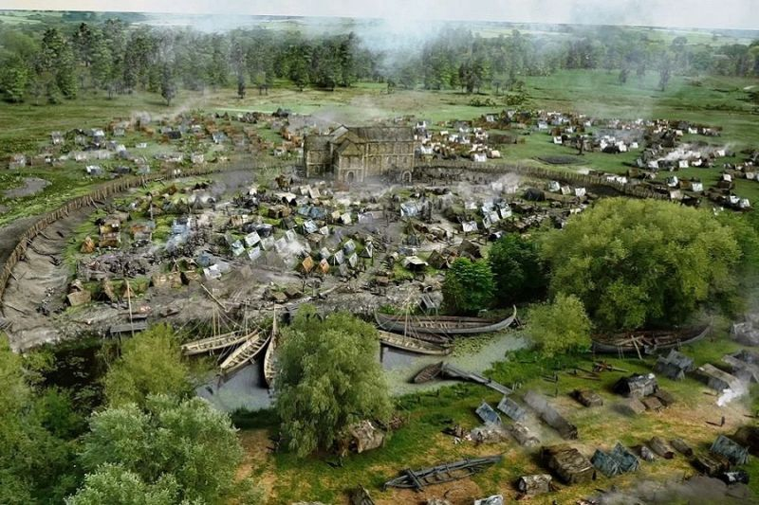
Conquests in the British Isles Cont.
Viking armies (mostly Danish) conquered East Anglia and Northumberland and dismantled Mercia, while in 871 King Alfred the Great of Wessex became the only king to decisively defeat a Danish army in England.
As a result, the Danes left Wessex, and settled
to the north, in an area known as “Danelaw.”
Many of them became farmers and traders and
established York as a leading mercantile city. In
the first half of the 10th century, English armies
led by the descendants of Alfred of Wessex
began reconquering Scandinavian areas of
England; the last Scandinavian king, Erik
Bloodaxe, was expelled and killed around 952,
permanently uniting English into one kingdom.

Slide 12
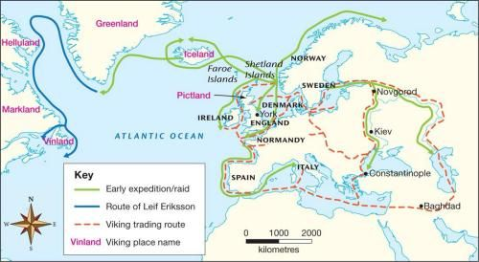
Viking Settlements: Europe and Beyond
Meanwhile, Viking armies remained active on the European continent throughout the ninth century. ) In 842 they brutally sacked Nantes (on the French coast and attacking towns as far inland as Paris, Limoges, Orleans, Tours and Nimes.
In 844, Vikings stormed Seville (then controlled by the Arabs).
Then in 859, they plundered Pisa, though an Arab fleet battered them on the way back north.
In 911, the West Frankish king granted Rouen and the surrounding territory by treaty to a Viking chief called Rollo in exchange for the latter’s denying passage to the Seine to other raiders.

Slide 13
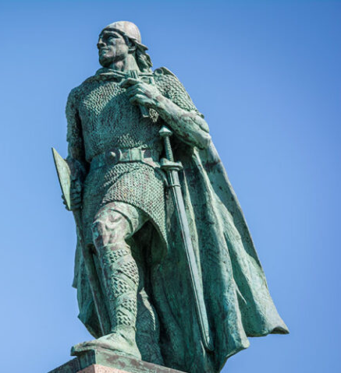
Viking Settlements: Europe and Beyond
In the ninth century, Scandinavians (mainly Norwegians) began to colonize Iceland, an island in the North Atlantic where no one had yet settled in large numbers.
By the late 10th century, some Vikings (including the famous Erik the Red) moved even further westward, to Greenland. According to later Icelandic
histories, some of the early Viking settlers in Greenland
(supposedly led by the Viking hero Leif Eriksson, son of Erik the
Red) may have become the first Europeans to discover and
explore North America.
Calling their landing place Vinland (Wine-land), they built a
temporary settlement at L’Anse aux Meadows in modern-day
Newfoundland. Beyond that, there is little evidence of Viking
presence in the New World, and they didn’t form permanent
settlements.

Slide 14
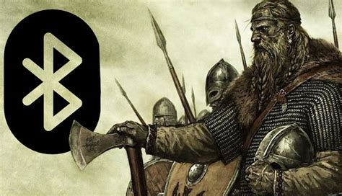
Danish Dominance
The mid-10th-century reign of Harald Bluetooth as king of a newly unified, powerful and Christianized Denmark marked the beginning of a second Viking age.
Large-scale raids, hit the coasts of Europe and especially England, where the line of kings descended from Alfred the Great was faltering.
Harald’s rebellious son, Sven Forkbeard, led Viking raids on England beginning in 991 and conquered the entire kingdom in 1013, sending King Ethelred into exile.
Sven died the following year, leaving his son Knut (or Canute) to rule a Scandinavian empire (comprising England, Denmark, and Norway) on the North Sea.

Slide 15
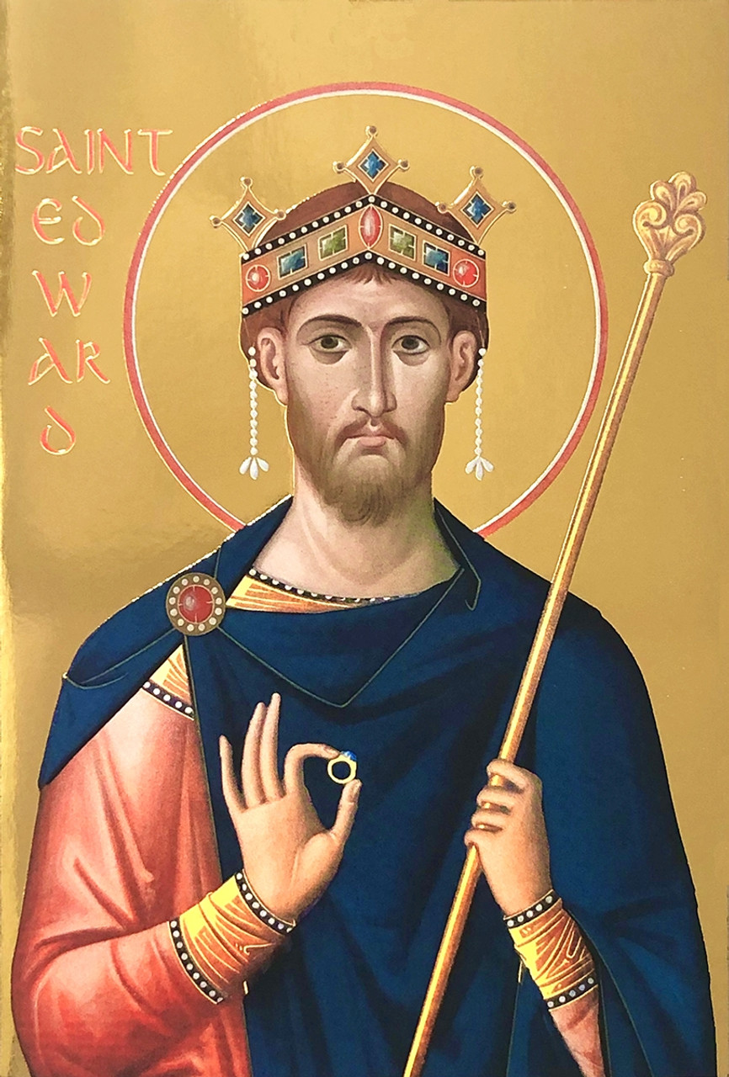
Danish Dominance Cont.
After Knut’s death, his two sons succeeded him, but both were dead by 1042 and Edward the Confessor, son of the previous (non-Danish) king, returned from exile and regained the English throne from the Danes. Upon his death (without heirs) in 1066, Harold Godwinesson, the son of Edward’s most powerful noble, laid claim to the throne.
Harold’s army was able to defeat an invasion led by the last great Viking king, Harald Hardrada of Norway, at Stamford Bridge, near York, but fell to the forces of William, Duke of Normandy (himself a descendant of Scandinavian settlers in northern France) just weeks later. The crown remained English fending off further Danish challenges.

Slide 16
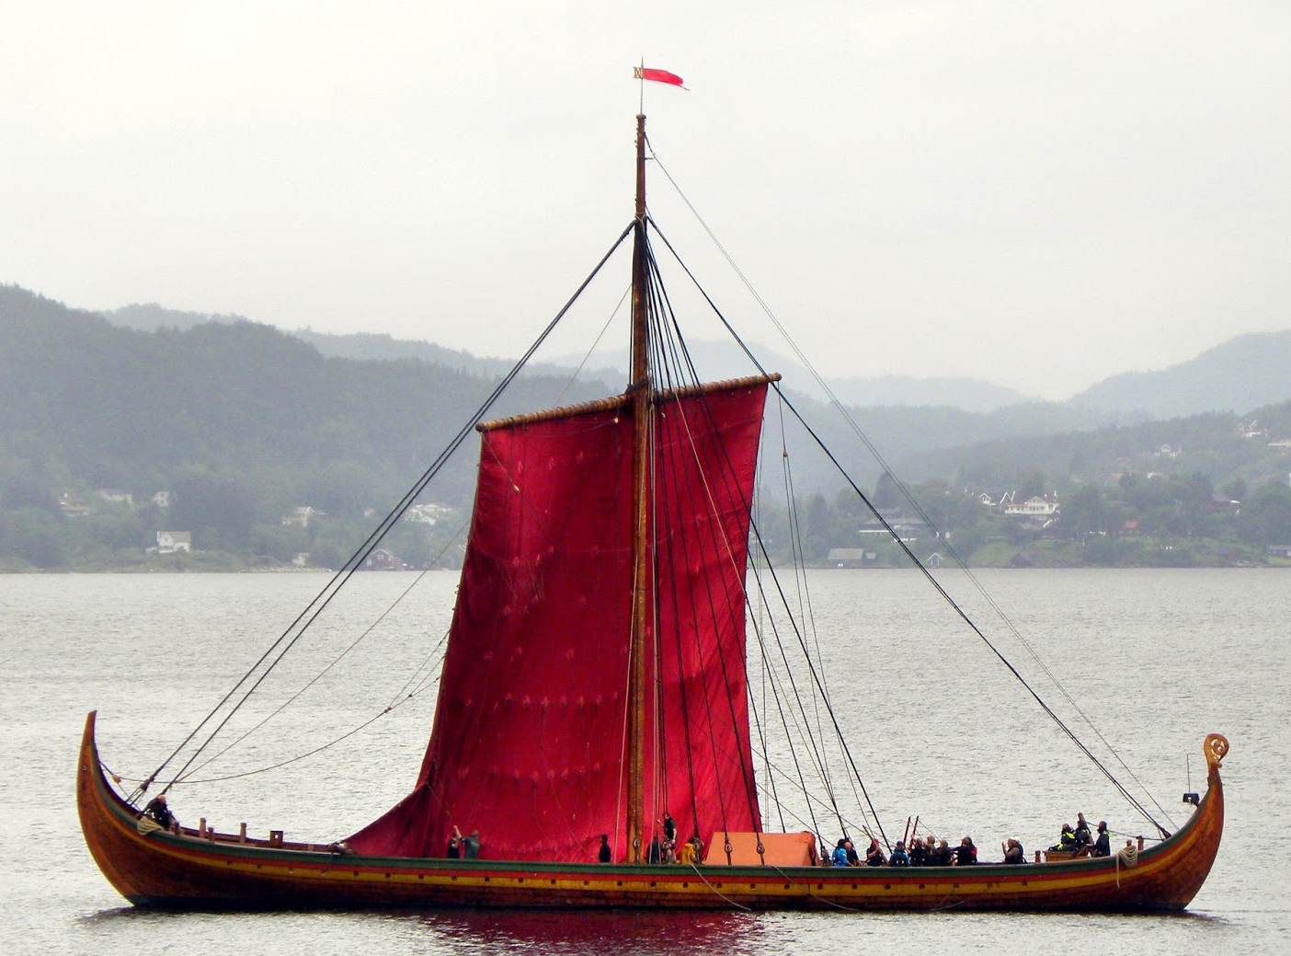
Viking Technology
Viking Ships
One key to their success as raiders were their ships. The drakkar, their name for what we know as Long ships, was technically superior to those of their rivals.
The Vikings’ longships did follow the guidelines of general shipbuilding shape of being long and narrow. Their general term was langskip (longship) and were opposed to the wider merchant ships called Knarr or Kaupskip, often maintaining a 7:1 length/wide ratio.
These vessels were shallow, great for navigating up shallow rivers, they were also fast and maneuverable.

Slide 17
Viking Technology Cont.
The well-known term Drekar or Drakkar does not correspond to a separate class of ship. It simply describes the largest of the Viking fleet's warships, which bore the shape of a dragon, indicating that they belonged to a king or nobleman.
Their bow and aft of the vessel, typically were sculpted to look like animals. In addition to the dragon, the snake, the eagle, the ram and the hawk were common in Viking ships.
When comparing the Viking long ship to merchant vessels, merchant ships were shorter in length, but wider than warships. Their keel was deeper and heavier in order to increase their capacity for commercial products. They had few or no oars, which were used for maneuvering near the shores. For their movement they relied on sails and their masts were permanently placed on the ship.

Slide 18
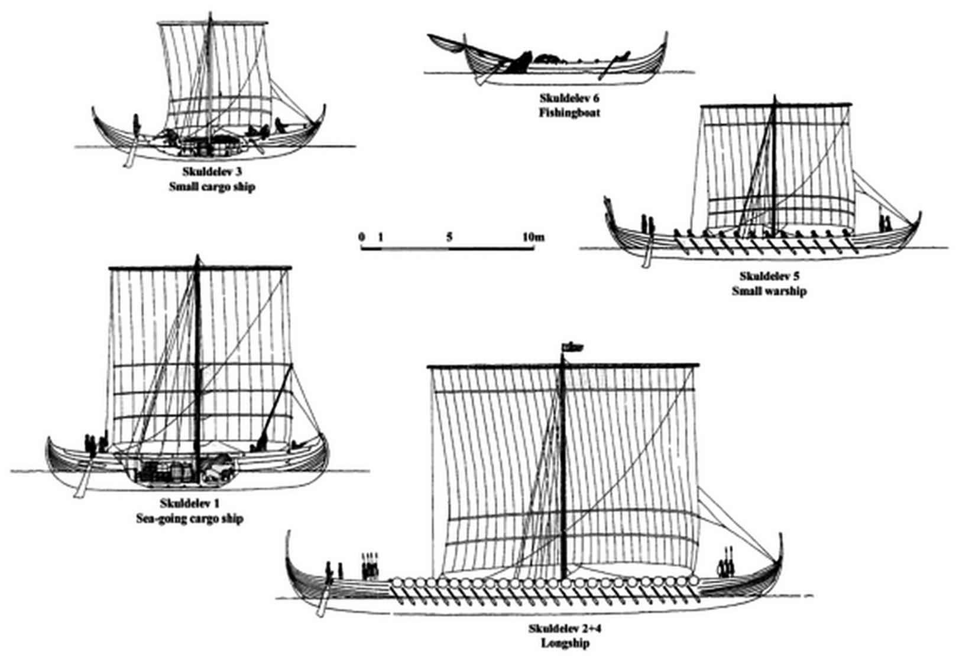
Viking
Ships
The types of Scandinavian ships were shaped following the evolution of a long shipbuilding tradition.

Slide 19
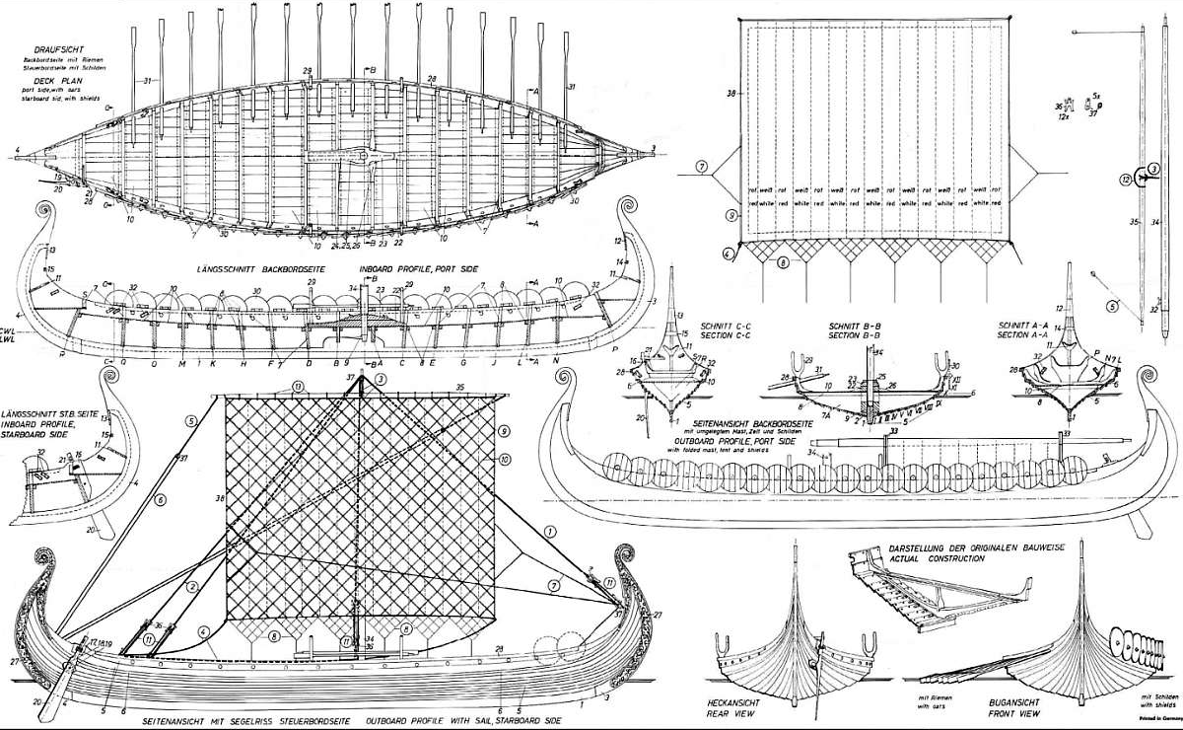
Viking Technology Cont.
Material and Sail Construction
The hull of the ships were made of locally hewn timbers. Ranging from 45 to 75 feet in length, clinker-built (with overlapped planks), and carrying a single square sail, the longship was exceptionally sturdy in heavy seas.
The boats also had duplicate, identical ends at the bow and stern. This structural peculiarity allowed Viking ships to sail with ease, especially in rivers and with minimal changes of course.
Another feature was the one-sided rudder, always on the right side of the ship, as well as a mast with a square sail.

Slide 20
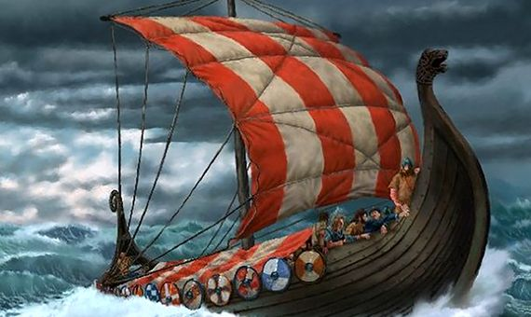
Viking Technology Cont.
The basic material for making sails was wool. The woolen cloth could isolate the cold and absorb large amounts of moisture without getting wet. For this reason, the rest of the accessories, clothes, gloves, etc. were also made of wool, a custom that is followed faithfully to this day.
Large quantities of wool were collected to make the sail. In general, a warship including 65-70 men could require more than 1.5 tons of wool for sailing and complete equipment.
The square sail was not a single piece but consisted of several pieces of woolen fabric which were sewn together. The fabric was fluffy, rough and exposed to the sprays of the sea or the rain, it got wet and started dripping.
Most sails used to be red was believed to create fear in their enemies.
Finally, the ropes were made of fiber, whale or seal skin, and horsehair.

Slide 21
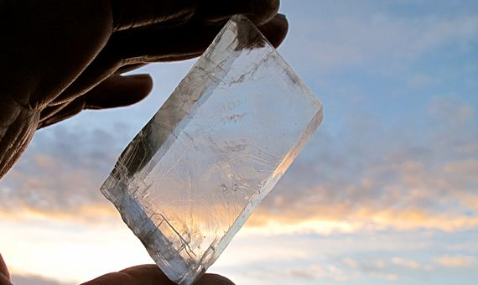
Viking Technology Cont.
SOLAR STONES FOR ORIENTATION
In addition to the advantage that their ships gave them,
the Vikings reached their objectives quickly because they
knew how to orient themselves by the sun even on cloudy
days. “The use of a solar stone (or Sun Stone) is known
from the writings of monks, who mention it when talking
about the Vikings. This stone reflects sunlight and, depending on the direction, indicates one’s location.”
I recall an episode on the discovery channel about the Viking’s Sun Stone, where the host was able to recreate one. The solar stone used when there were clouds out at sea but could also be used when walking between mountains or through a forest on overcast days.”
Thanks to their technology and their zeal for conquest, the Vikings reached the coasts of almost all of Europe, North Africa, the Middle East, Central Asia and the northeast of North America and would also colonize Iceland and Greenland.

Slide 22

End of the Viking Age
The events of 1066 in England effectively marked the end of the Viking Age.
By that time, all of the Scandinavian kingdoms were Christian, and what remained of Viking “culture” was being absorbed into the culture of Christian Europe.
Today, signs of the Viking legacy can be found mostly in the Scandinavian origins of some vocabulary and place-names in the areas in
which they settled, including northern England,
Scotland and Russia.
In Iceland, the Vikings left an extensive body of
literature, the Icelandic sagas, in which they
celebrated the greatest victories of their glorious
past.
Today we have elevated the Vikings through
tradition, legend, song and of course Film.

Slide 23
Thank You for Coming
I hope I’ve educated
and entertained you today.
I can be contacted by e-mail at
marcs@sonic.net

