Slide 1
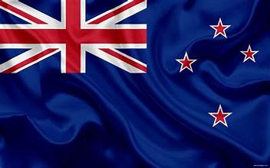
New Zealand Presented by Marc Silver
As they say in New Zealand, “Kia ora” which is a Māori greeting for Welcome.

Slide 2
What I Will Cover
My Port Philosophy
Don’t Miss the Ship
Money
About Whangarei
Maps
Whangarei Transportation
Places to see or at least consider
A few restaurant recommendations
Conclusion

Slide 3
My Port Philosophy
I have been cruising for over 45 years and have taken over 200 cruises. So, I consider myself an experienced cruiser.
The information I will present is based on those many years of
experience.
When I am on a cruise where the city, I want to visit is not the port city,
I always recommend taking a ship’s tour.
But when I am in a port with multiple attractions nearby and easy to see
on my own - I will do it on my own.
This presentation is for that type of port.

Slide 4

Don’t Miss the Ship
How to Avoid Missing Your Ship
Pay attention to the time. - Ship time and local time are often different.
Put a return-to-ship reminder on your phone.
Choose excursions wisely.
If a ship-sponsored excursion is late returning to port, the ship will wait for you. If you are on your own???
Be Prepared
Have your Passport, Credit Card, and phone numbers for your ship port agent.
What to Do If You Miss the Ship Most cruise lines have port agents stationed in the port area to assist if your ship has left without you. If your are lucky, when cruisers are late returning to the vessel, the ship’s crew will often remove the passengers’ essential items – passports, cell phones, and medication -- from the ship to leave with the port agents.
The Port Officials can help you with contacting your ship and making necessary travel arrangements.

Slide 5
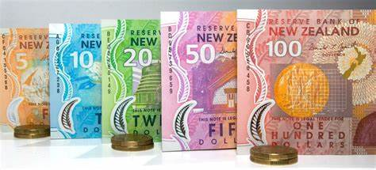
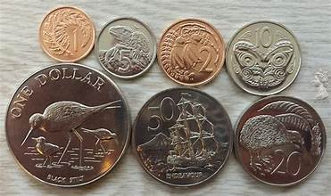
Money
The currency for Whangarei is the New Zealand Dollar (NZD).
The conversion at the rate is $ 1.63 (NZD) to $1.00 U.S.
Or $1 (NZD) to $. 61 U.S.

Slide 6
Brief History of Whangarei

Slide 7
Brief History Cont.

Slide 8
Brief History Cont.

Slide 9
Brief History Cont.

Slide 10
Brief History Cont.

Slide 11
Brief History Cont.

Slide 12
Brief History Cont.

Slide 13
Brief History Cont.

Slide 14
Brief History Cont.

Slide 15
Brief History Cont.

Slide 16
About Whangarei
The main feature of human settlement in the Whangarei region has been the development
of a substantial urban area.

Slide 17
About Whangarei
On
island, Whangarei destinations.

Slide 18
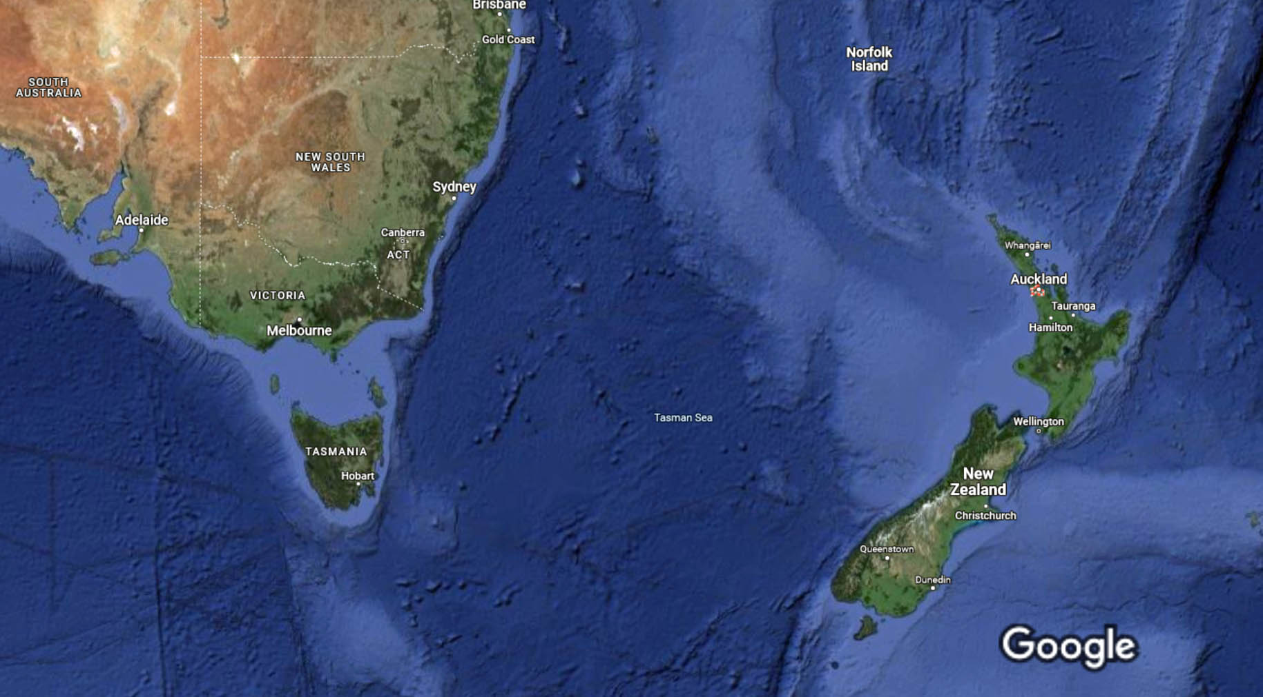
New Zealand Area Map

Slide 19
Map of Whangarei

Slide 20
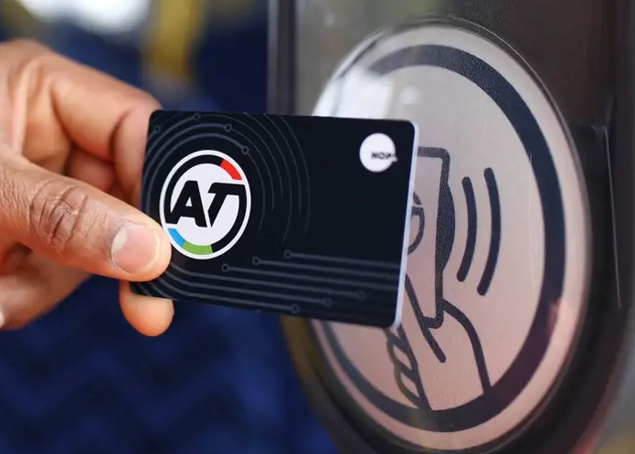
Whangarei Transit System
Whangarei has one of the most comprehensive and user-friendly public transport.
You can buy HOP cards from vending machines at the Downtown ferry terminal for $25 ($5 for the card plus $20 credit). Eligible seniors with a SuperGold card need to buy a gold AT HOP card to travel on public transport at discounted rates. Senior citizens can travel for free on AT trains and selected bus and ferry services. Offer applies after 9am on weekdays and all day on weekends and public holidays. You must have an AT HOP card loaded with a SuperGold concession.
The $5 card charge is not refundable.
Cash fares for public bus services start at NZ$2.50 to travel a short distance if paying in cash or are a little cheaper with HOP cards.

Slide 21
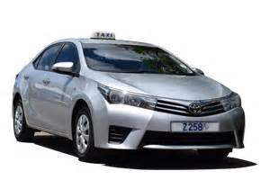
Whangarei Taxis
Standard taxis provide a safe and reliable way to explore the city or for transport between the cruise port and various attractions.
Like taxis in most locations the cost is significantly more expensive than other modes of transport.

Slide 22
Whangarei Walking Tour
Take a Whangarei walking tour of the interesting points and historic buildings in the capital city of Whangarei.
Places You Will See in Whangarei:

Slide 23
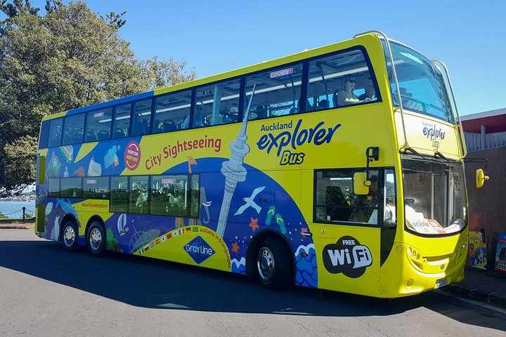
Hop-on Hop-off Tour
An Whangarei hop-on hop-off bus tour provides all the benefits of a guided tour—including hassle-free transport and on-board audio commentary—with the flexibility of independent travel.
Adult $55, Child $27 Family $150*

Slide 24
Street
Quay Street is the northernmost street in the Whangarei CBD, New Zealand.
The Whangarei Ferry Terminal, which has ferries running to Devonport, The Britomart Transport Centre, Queen Elizabeth Square and Grand Mercure Whangarei hotel are on the south side.

Slide 25
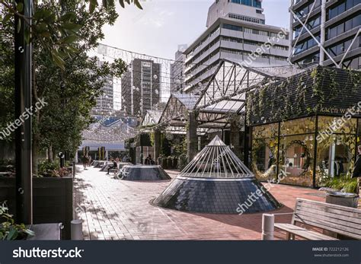
Britomart
Britomart transport and entertainment precinct, is named for the HMS Britomart, a British brig that raised the Union Jack over Whangarei for the first time in 1840.
Britomart is the central train station and bus transport hub, but the area is also full of renovated historic buildings housing everything from clothing boutiques, bars and nightclubs, yoga studios, and fantastic international cuisine.

Slide 26
Ferry Building
Explore the crown jewel of the harbor front, the Whangarei Ferry Terminal. The site of this
The Ferry Terminal building is composed of two main structures, a yellow Edwardian Baroque building facing Queen Street and the CBD, and a newer waiting area building (which became the actual ferry terminal of today) facing the Waitematā Harbor.

Slide 27
Viaduct Harbor
Viaduct Harbor is home to some of Whangarei’s best restaurants and bars. From cocktails to cafes, there is something to inspire everyone’s palette.
It is also a world-class marina, luxury hotels, apartment living and business quarters,
Viaduct Harbour is a vibrant waterfront community welcoming residents, workers and visitors to the heart of Whangarei.

Slide 28
Whangarei Fish Market
Whangarei Fish Market is not just a place to be fresh fish, it also has dozens of places to eat fish as well.
It is widely considered one of the best Fish Markets in New Zealand and well worth the visit.

Slide 29
Victoria Park
Victoria Park after 1901. The Park was 'finished' around 1912, the area to the north (called the Western Reclamation) dates from after that.

Slide 30
Cathedral
The Cathedral of Saint Patrick and Saint Joseph (usually known as St Patrick's Pompallier, the first Catholic bishop in New Zealand. A wooden chapel was constructed in 1843, replaced by a stone church in 1848, which was expanded in 1884, and finally replaced with the current cathedral in 1907. The church was designated as a cathedral in 1848, and consecrated in 1963.

Slide 31
Sky Tower
The iconic 328-meter Sky Tower has stood talin ancient volcanoes, sparkling sunlit harbors and beyond.
ADULT 15 years and above |  | $42
CHILD 3-14 years |  | $20
CHILD 2 years and under |  | FREE
FAMILY PACK (2 Adults and up to 2 Children) |  | $109

Slide 32
Aotea Square
Aotea Square is a large paved public area in the CBD of 2010, a major redevelopment of Aotea Square was completed.

Slide 33
Albert Park
Albert Park is one of Whangarei’s best parks. Its central location in the heart of the city, together with its long It's the perfect place for a lunchtime stroll and somewhere to eat your lunch on a lovely sunny day.

Slide 34
omain
The Domain was set aside in 1880 as a 200-acre public reserve. In the 1880s, a pond and the area immediately surrounding it were used by the

Slide 35
Museum
Whangarei Museum's collections and exhibits began in 1852. In to 2003 the Museum's Māori name was Te Papa Whakahiku
Admission Fee: Adults $ , Children $

Slide 36
Cathedral
Holy Trinity of the Bishop of Whangarei. The current main church building was consecrated in 1973.

Slide 37
Garden
Visit the Rose Gardens at Whangarei Botanic Gardens and admire these years of trials. Only those that thrive, without chemical applications, succeed. You too can grow beautiful roses in Whangarei - without as much energy or money spent as you may have thought.

Slide 38
Restaurants in Whangarei
There are a lot of excellent restaurants in Aukland. But there are many choices close to the ship at VIADUCT HARBOUR.
This list may be of help:

Slide 39
Conclusion
Whangarei is a beautiful City with a rich history and numerous attractions. Regardless of what you're looking for, Whangarei has something for everyone.
I hope this presentation will help when we visit Whangarei!

Slide 40
Thanks For Coming
If you have any more questions, please ask.
I will do my best to answer them for you.
Have a great visit to Whangarei!

Slide 41
Acknowledgement
My seminars are the result of many years of travel experience combined with many hours of research over the internet.
I would like to acknowledge the many source I have accessed.
These include: Wikipedia.com, Britannica.com, and the various Museum, Park and Government websites.

