Slide 1
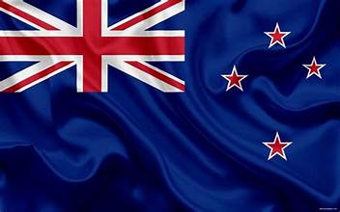
Wellington Australia Presented by Marc Silver

Slide 2
What I Will Cover
My Port Philosophy
Don’t Miss the Ship
Money
About Wellington
Area Map of Wellington
Map of Wellington
Wellington Transportation
Places to see or at least consider
A few restaurant recommendations
Conclusion

Slide 3
My Port Philosophy
I have been cruising for over 45 years and have taken over 200 cruises. So, I consider myself an experienced cruiser.
The information I will present is based on those many years of
experience.
When I am on a cruise where the city, I want to visit is not the port city,
I always recommend taking a ship’s tour.
But when I am in a port with multiple attractions nearby and easy to see
on my own - I will do it on my own.
This presentation is for that type of port.

Slide 4

Don’t Miss the Ship
How to Avoid Missing Your Ship
Pay attention to the time. - Ship time and local time are often different.
Put a return-to-ship reminder on your phone.
Choose excursions wisely.
If a ship-sponsored excursion is late returning to port, the ship will wait for you. If you are on your own???
Be Prepared
Have your Passport, Credit Card, and phone numbers for your ship port agent.
What to Do If You Miss the Ship Most cruise lines have port agents stationed in the port area to assist if your ship has left without you. If your are lucky, when cruisers are late returning to the vessel, the ship’s crew will often remove the passengers’ essential items – passports, cell phones, and medication -- from the ship to leave with the port agents.
The Port Officials can help you with contacting your ship and making necessary travel arrangements.

Slide 5
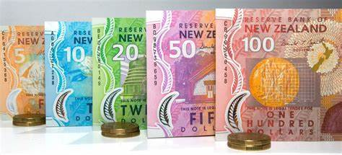
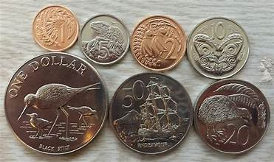
Money
The currency for Auckland is the New Zealand Dollar (NZD).
The conversion at the rate is $ 1.63 (NZD) to $1.00 U.S.
Or $1 (NZD) to $. 61 U.S.

Slide 6
Historical Wellington
evidence of permanent settlement.

Slide 7
About Wellington
Wellington is

Slide 8
About Wellington
On
island, Wellington destinations.

Slide 9
Wellington Area Map

Slide 10
Map of Wellington

Slide 11
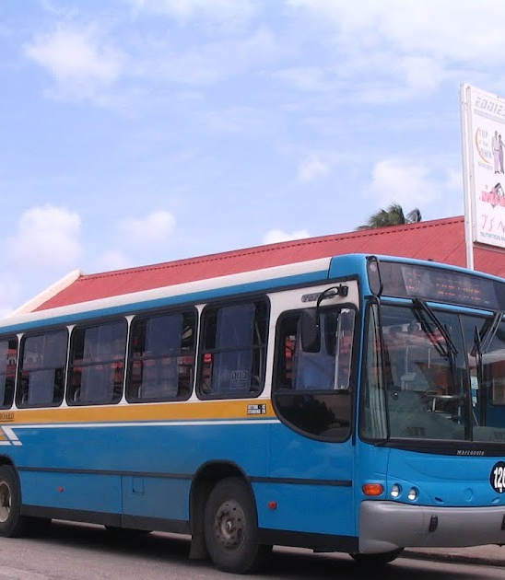
Wellington Buses
Wellington has one of the most comprehensive and user-friendly public transport Pay with cash in exact change.

Slide 12
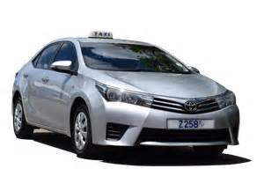
Wellington Taxis
Standard taxis provide a safe and reliable way to explore the city or for transport between the cruise port and various attractions.
Like taxis in most locations the cost is significantly more expensive than other modes of transport.

Slide 13
Wellington Walking Tour
Take a Wellington walking tour of the interesting points and historic buildings in the capital city of Wellington.
Places You Will See in Wellington:
St. Mary's Church
The Jewish Synagogue
St. Michael's Cathedral
Queen's Park
Heroes Square
Parliament Buildings

Slide 14
Church
Church

Slide 15
The
The tours are guided by a volunteer Docent from the community.
ADULTS: $12.50 USD / $25.00 BBD
CHILDREN 5 -12: $6.25 USD / $12.50 BBD
CHILDREN UNDER 5 - FREE

Slide 16
St. Cathedral
XXX

Slide 17
Queen's Park
Queen's Park is located in the capital city of Wellington. This historic site dates back to the 1780's when it was purchased by the British Government as the residence of the commanding General of the British troops in the West Indies.
Today the area is a designated park, and it is lovely to stop by if you are visiting Wellington. The park is run by the National Conservation Commission and includes washroom facilities and a children's play park.

Slide 18
Heroes Square
Wellington, known for its stunning beaches and vibrant culture, holds a significant historical landmark known as National Heroes Square otherwise known as Wellington National Monument. This iconic monument stands as a testament to the nation’s rich heritage and pays tribute to the remarkable individuals who have shaped its history.
National Heroes Square holds immense cultural and historical significance for the people of Wellington. It serves as a reminder of the nation’s resilience and the struggles endured by its heroes.

Slide 19
Andromeda Botanic Gardens
The Oldest and the Largest Garden in Wellington this 8 acres of cultivated gardens with over 500 plant species – the oldest Barbadian garden and the largest garden in Wellington, both in terms of acreage and number of plant species.
Amazing trees, beautiful individual but connected gardens, outstanding biodiversity including monarch butterflies – all in this organic, historic, botanical landscape. Visiting Andromeda is a truly authentic Wellington experience.
The creator of Andromeda Botanic Gardens, Iris Bannochie, created a garden with dual roles – a pleasure garden and a botanic garden

Slide 20
Wellington Wildlife Reserve
Wellington Wildlife Reserve is a walk-through zoo opposite Farley Hill, with short paths that meander through a mahogany forest containing green monkeys and loads of sluggish red-footed turtles. Other creatures include brocket deer, iguanas, and agoutis.
Despite presenting itself as a sanctuary, the animal welfare credentials of the place are suspect, to say the least considering one of its major businesses is the exportation of live monkeys for experiments to laboratories in Europe and the US.
Admission Fee: Adults US$15, Children US$7.50

Slide 21
Farley Hill National Park
Farley Hill National Park is located in the parish of St. Andrew, on the east coast of Wellington. The park is a forest of Mahogany Trees, which sits high up on a hill overlooking The Atlantic Ocean.
The park is set around the ruins of an old estate home. Climb to the top and sit on one of the benches in front of the pagoda for a fresh breeze and phenomenal views down to the Atlantic.
If you arrive in a taxi, you pay admission, but if you walk up from the public bus, it's free.

Slide 22
Restaurants in Wellington
There are a lot of excellent restaurants in Hokkaido. Especially for seafood.
Here are some recommendations: Restaurants in Wellington:

Slide 23
Conclusion
Wellington is a beautiful City with a rich history and numerous attractions. Regardless of what you're looking for, Wellington has something for everyone.
I hope this presentation will help when we visit Wellington!

Slide 24
Thanks For Coming
If you have any more questions, please ask.
I will do my best to answer them for you.
Have a great visit to Wellington!

Slide 25
Acknowledgement
My seminars are the result of many years of travel experience combined with many hours of research over the internet.
I would like to acknowledge the many source I have accessed.
These include: Wikipedia.com, Britannica.com, and the various Museum, Park and Government websites.

