Slide 1
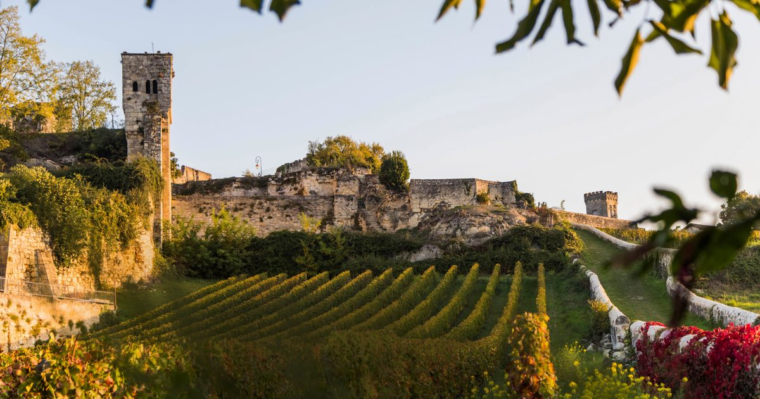
Wine Regions of the World
The Wines of Wales
Presented by
Marc Silver

Slide 2

The Wines of Wales
Introduction
A Storied Beginning
The Regions of Welsh Wine
Wales’s Unique Terroir
Grape Varietals of Wales
Notable Welsh Wineries
The Cultural Connection
Final Thoughts
References

Slide 3
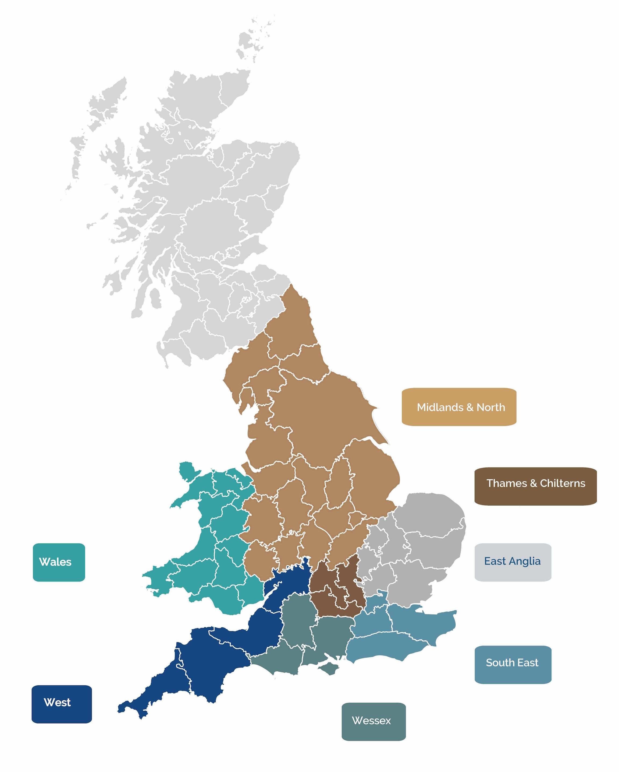
Wales an unusual wine region and a Hidden Gem
Wales might not boast the centuries-old reputation of France’s famed vineyards or the vast production of California’s valleys, but it’s precisely this difference that sets its wine story apart.
Nestled within the stunning landscapes of the United Kingdom, this small but mighty nation has quietly been making waves in the world of viticulture.
Wales’s unique terroir, passionate producers, and growing recognition make it a fascinating destination for wine enthusiasts.

Slide 4

A Storied Beginning
Ancient Roots
The history of Welsh wine dates back to Roman times, when the conquering legions brought vines to the British Isles.
These early vineyards were planted to support the Romans’ dietary and cultural habits, and evidence of their influence can still be found in archaeological sites across Wales.
While their wine production was modest, it laid the groundwork for a tradition that would re-emerge centuries later.

Slide 5
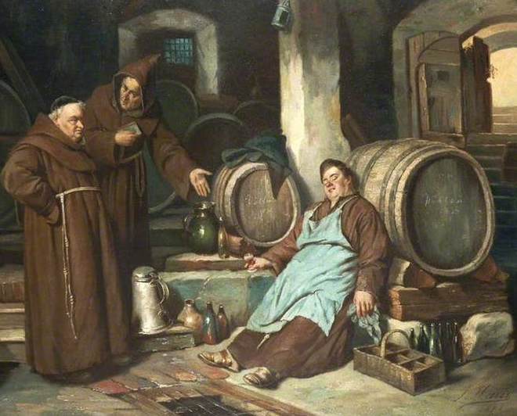
A Storied Beginning
The Medieval Shift
As the Roman Empire waned, so did viticulture in Wales.
During the medieval period, monastic communities took up winemaking, using it primarily for religious purposes.
Monasteries in Wales, like those throughout Europe, cultivated vines as part of their agricultural practices.
However, the cooler climate and the rise of ale as a preferred drink led to a decline in wine production.

Slide 6
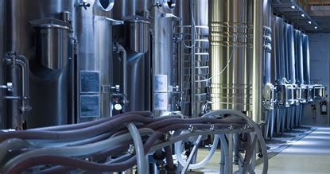
A Storied Beginning
Modern Revival
It wasn’t until the mid-20th century that Welsh winemaking began to re-establish itself.
The modern revival can be traced to the 1970s, when enthusiasts started experimenting with grape varieties suited to Wales’s cool climate.
By the 21st century, a new generation of winemakers embraced both innovation and tradition, crafting wines that earned recognition beyond the borders of the United Kingdom.
Today, Wales is home to over 30 vineyards, each contributing to a growing reputation for quality and uniqueness.

Slide 7
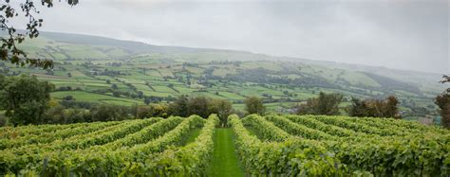
The Regions of Welsh Wine
Wales’s wine production is scattered across picturesque landscapes, with vineyards thriving in the southern and western parts of the country.
These regions not only offer ideal conditions for viticulture but also provide a glimpse into the natural beauty and cultural heritage of Wales.

Slide 8
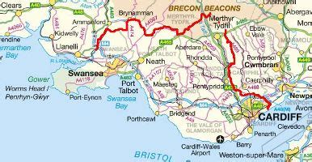
The Regions of Welsh Wine
South Wales
The vineyards of South Wales are set against a
backdrop of rolling hills and charming villages.
The region’s proximity to the Bristol Channel ensures
a relatively mild climate, which, combined with well
-draining soils, creates an excellent environment for growing high-quality grapes.
Notable areas like Monmouthshire, particularly the Wye Valley, are celebrated for their picturesque landscapes and productive vineyards.
This area is home to renowned wineries such as Ancre Hill Estates, which focuses on biodynamic methods and sparkling wines.
The gentle slopes and temperate conditions also make South Wales a hub for still wines, with refreshing whites and complex reds crafted from grape varieties like Pinot Noir and Bacchus.

Slide 9
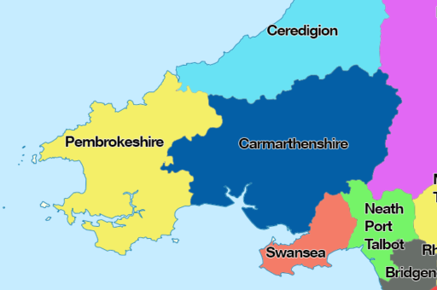
The Regions of Welsh Wine
West Wales
West Wales showcases a different side of Welsh viticulture, with smaller, family-run vineyards nestled amid lush fields and rugged coastlines.
This region’s vineyards benefit from cool sea breezes, which contribute to the distinctive freshness found in their wines.
Sparkling varieties dominate here, their crispness mirroring the brisk coastal air. Vineyards such as those near Pembrokeshire often experiment with
innovative techniques to adapt to the cooler climate.
Ortega and Rondo are popular grape choices, yielding wines
with bright acidity and unique flavor profiles that capture the
essence of this wild and unspoiled region.

Slide 10
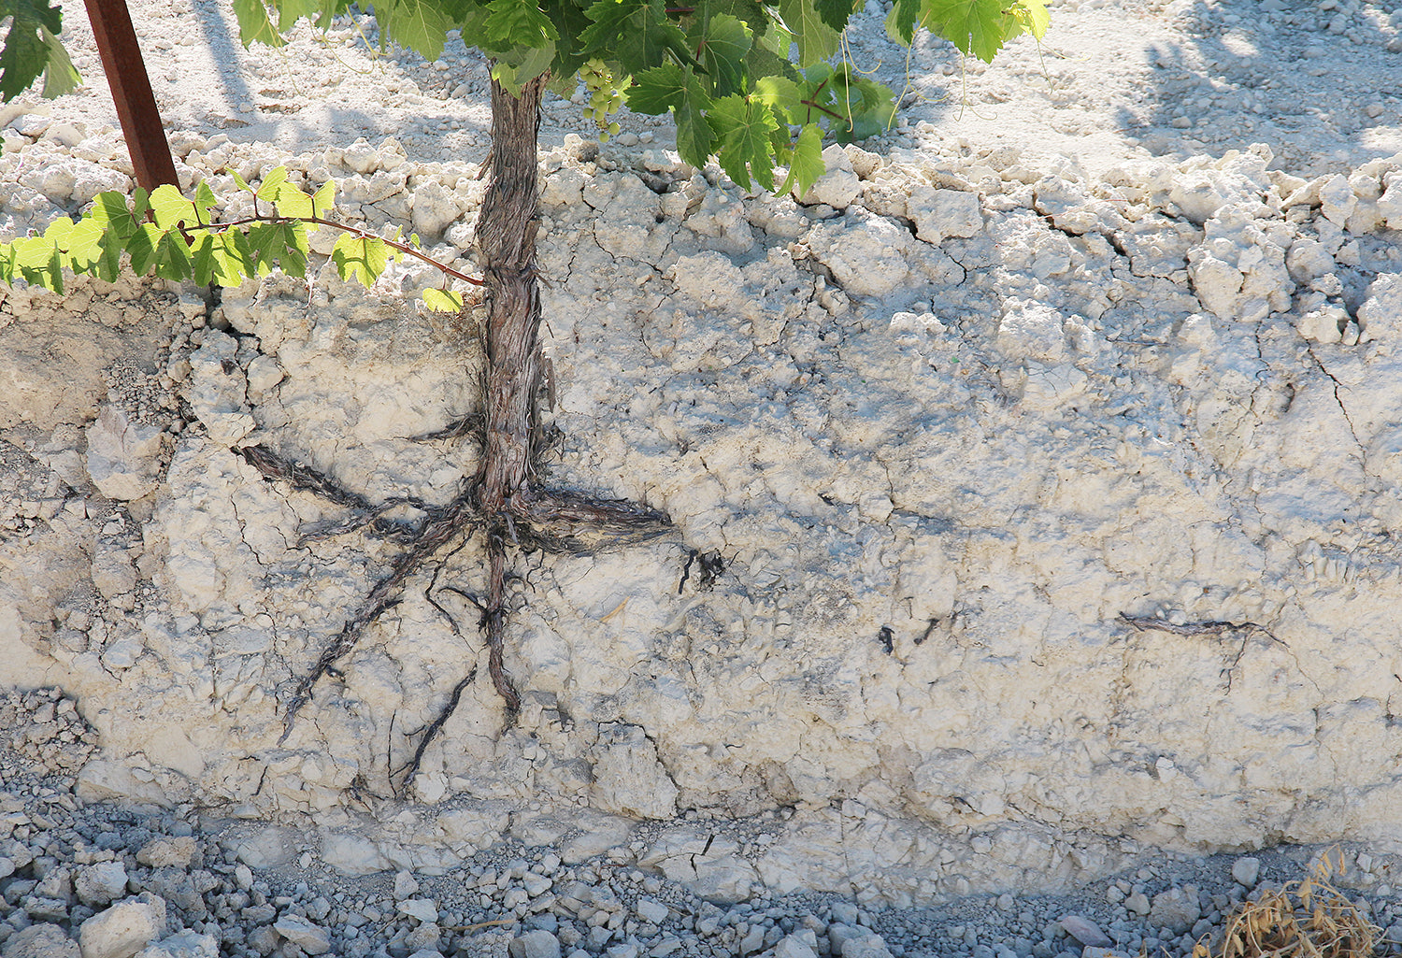
Wales’s Unique Terroir
What sets Welsh wine apart is its unique terroir. The country’s cool climate, combined with a patchwork of soil types—from limestone to clay—creates wines of striking acidity and vibrant minerality.
The long, cool growing season allows grapes to develop complex flavors while retaining freshness.
Welsh vineyards, often small and family-run, take great care in cultivating their vines, ensuring each bottle reflects the character of its environment.
Limestone Soil

Slide 11
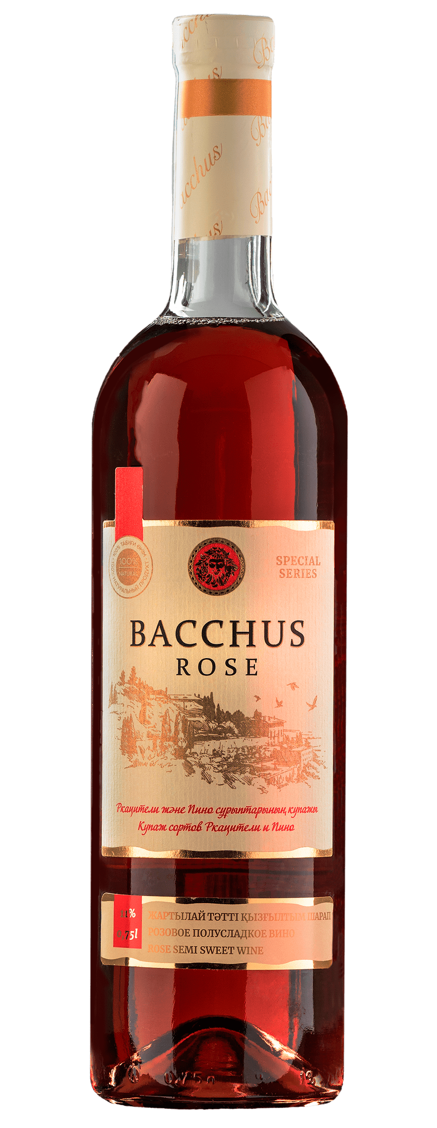
Grape Varietals of Wales
The grape varieties grown in Wales reflect both its climate and the adventurous spirit of its winemakers. Among the most notable are:
Bacchus: Often dubbed the “Sauvignon Blanc of England and Wales,” Bacchus thrives in cooler climates and produces aromatic white wines with notes of elderflower, citrus, and grass.
Bacchus is also often used for Rose wines.

Slide 12
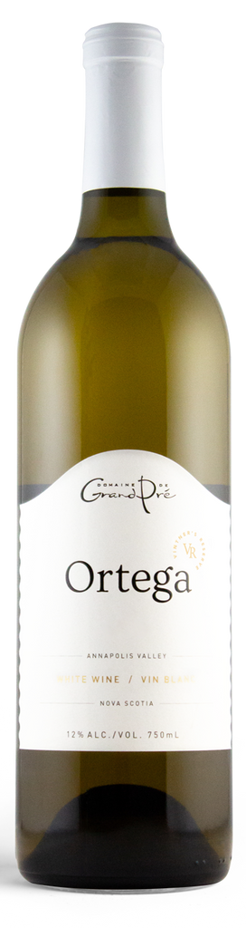
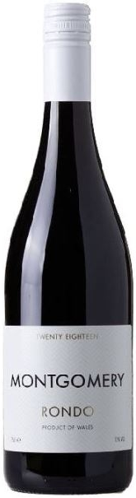
Grape Varietals of Wales
Rondo: This robust red grape is well-suited to the Welsh climate, yielding deeply colored wines with flavors of dark fruit and spice.
Ortega: A reliable performer in cool climates, Ortega is known for its floral and tropical fruit notes, often crafted into refreshing white wines.
Pinot Noir: While challenging to grow, Pinot Noir has gained traction in Wales, producing elegant red and sparkling wines.

Slide 13
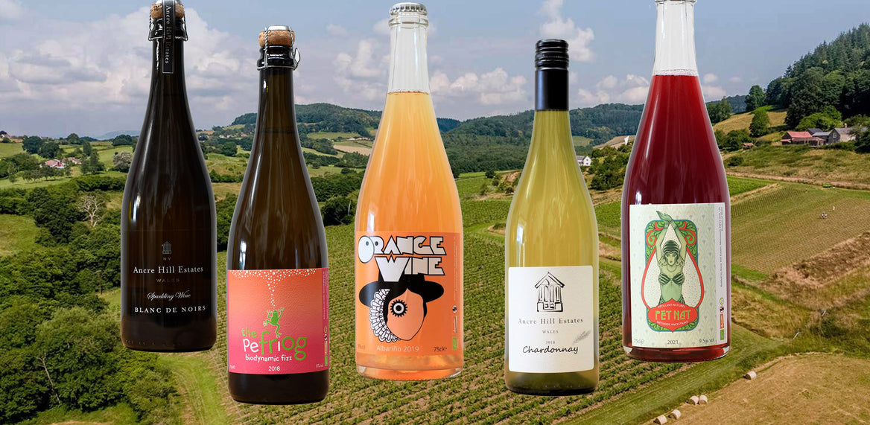
Notable Welsh Wineries
Ancre Hill Estates
Located near Monmouth, Ancre Hill Estates
is one of Wales’s most celebrated wineries.
Their commitment to biodynamic practices
and minimal intervention winemaking has garnered international acclaim. Ancre Hill’s sparkling wines, in particular, have received numerous accolades, showcasing the potential of Welsh terroir.

Slide 14
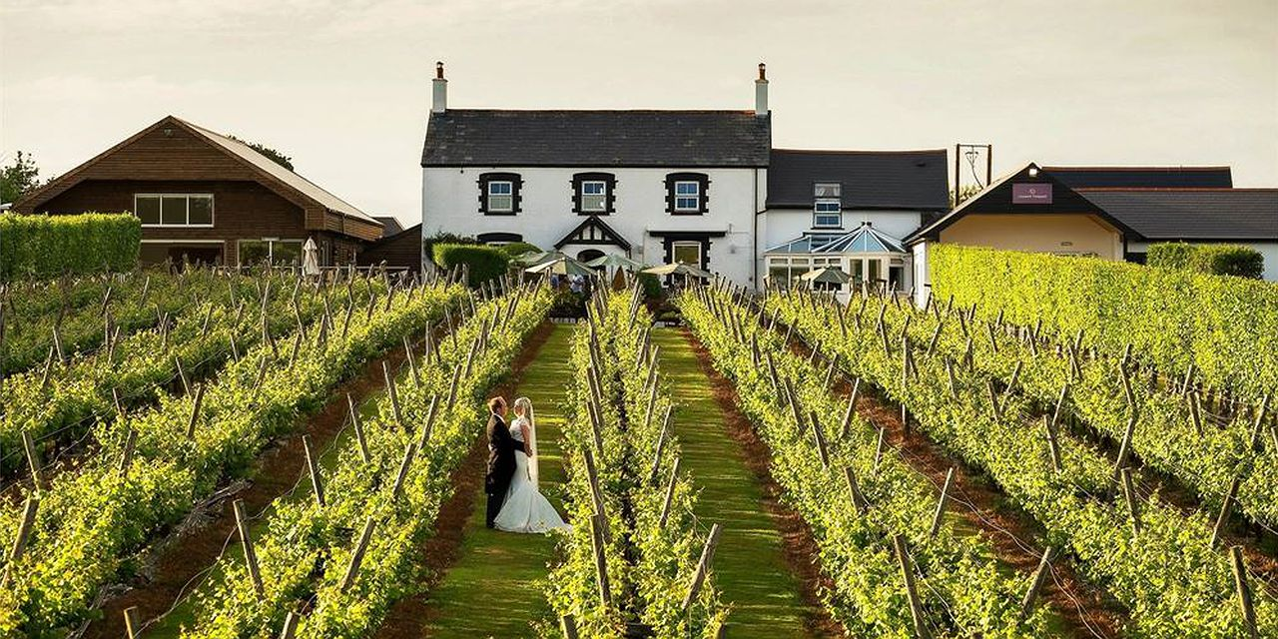
Notable Welsh Wineries
Llanerch Vineyard
As one of the oldest commercial vineyards in Wales, Llanerch Vineyard offers a charming blend of tradition and innovation.
Their range of wines, including still and sparkling options, highlights the versatility of Welsh grapes.
The vineyard also houses a luxury hotel and restaurant, making it a must-visit destination.

Slide 15
Notable Welsh Wineries
White Castle Vineyard
Situated in the heart of Monmouthshire, White Castle Vineyard produces award-winning wines from a variety of grapes, including Regent and Pinot Noir.
Their dedication to quality and
attention to detail is evident in every
bottle, with a focus on showcasing
the character of Welsh-grown fruit.

Slide 16
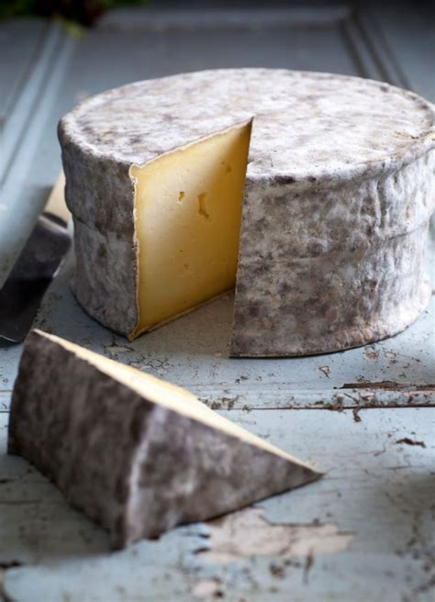
The Cultural Connection
Welsh wine is more than just a beverage; it’s a reflection of the nation’s rich heritage and vibrant culture.
Many vineyards embrace sustainable practices, emphasizing a deep connection to the land.
Pairing Welsh wines with local specialties, such as Caerphilly cheese or laverbread, creates an unforgettable culinary experience that speaks to the heart of Wales.

Slide 17

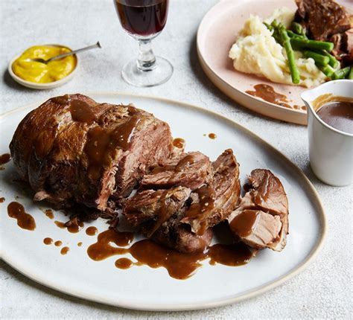
Final Thoughts
Wales may be a small player in the global wine scene, but its dedication to quality and authenticity sets it apart.
From the rolling hills of Monmouthshire to the rugged coastlines
of Pembrokeshire, Wales offers an inspiring journey for wine
enthusiasts eager to explore beyond traditional regions.
Welsh wines are more than just beverages; they are a celebration
of local culture and heritage.
Pairing these wines with the nation’s culinary delights, such as hearty lamb dishes or artisanal cheeses, enhances the experience, creating a connection to the heart of Wales.
As the industry continues to grow, Welsh winemakers are not only producing exceptional wines but also carving out a distinct identity on the world stage.

Slide 18
Acknowledgement
My seminars are the result of many years of experience combined with many hours of research over the internet.
I would like to acknowledge the many source I have accessed.
These include Wine Spectator, Wine Enthusiast, BKWine Magazine, Wine & Spirits Magazine, American Vineyard Magazine, The Grapevine Magazine, Wikipedia.com, Britannica.com, and the
various Government websites.

Slide 19
References
Wikipedia contributors. "Wine from the United Kingdom." Wikipedia, The Free Encyclopedia. (https://en.wikipedia.org/wiki/Wine_from_the_United_Kingdom)
Welsh Holiday Cottages. "Welsh Wines and Vineyards." (https://www.welshholidaycottages.com/food/welsh-wines/)
Welsh Holiday Cottages. "Welsh Grape Varieties." (https://www.welshholidaycottages.com/welsh-grape-varieties/)
Wikipedia contributors. "Ancre Hill Estates." Wikipedia, The Free Encyclopedia. (https://en.wikipedia.org/wiki/Ancre_Hill_Estates)
The Drinks Business. "13 Welsh Vineyards You Can Visit After Lockdown." (https://www.thedrinksbusiness.com/2020/04/13-welsh-vineyards-you-can-visit-after-lockdown/)
Wine Trail Wales. "Welsh Vineyards Association." (https://www.winetrailwales.co.uk/homecopy)

