Slide 1
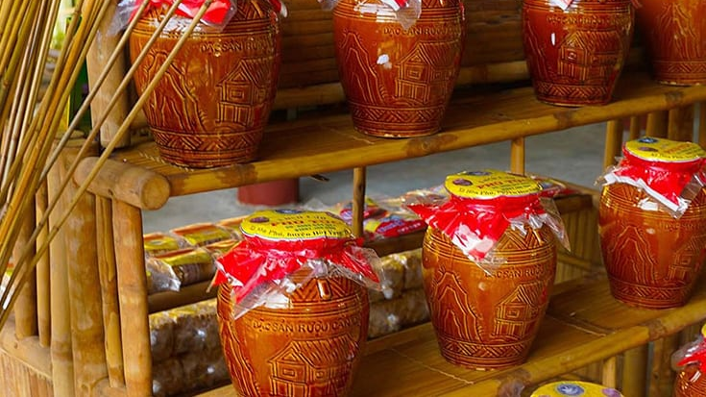
Wine Regions of the World The Wines of Vietnam Presented by Marc Silver

Slide 2
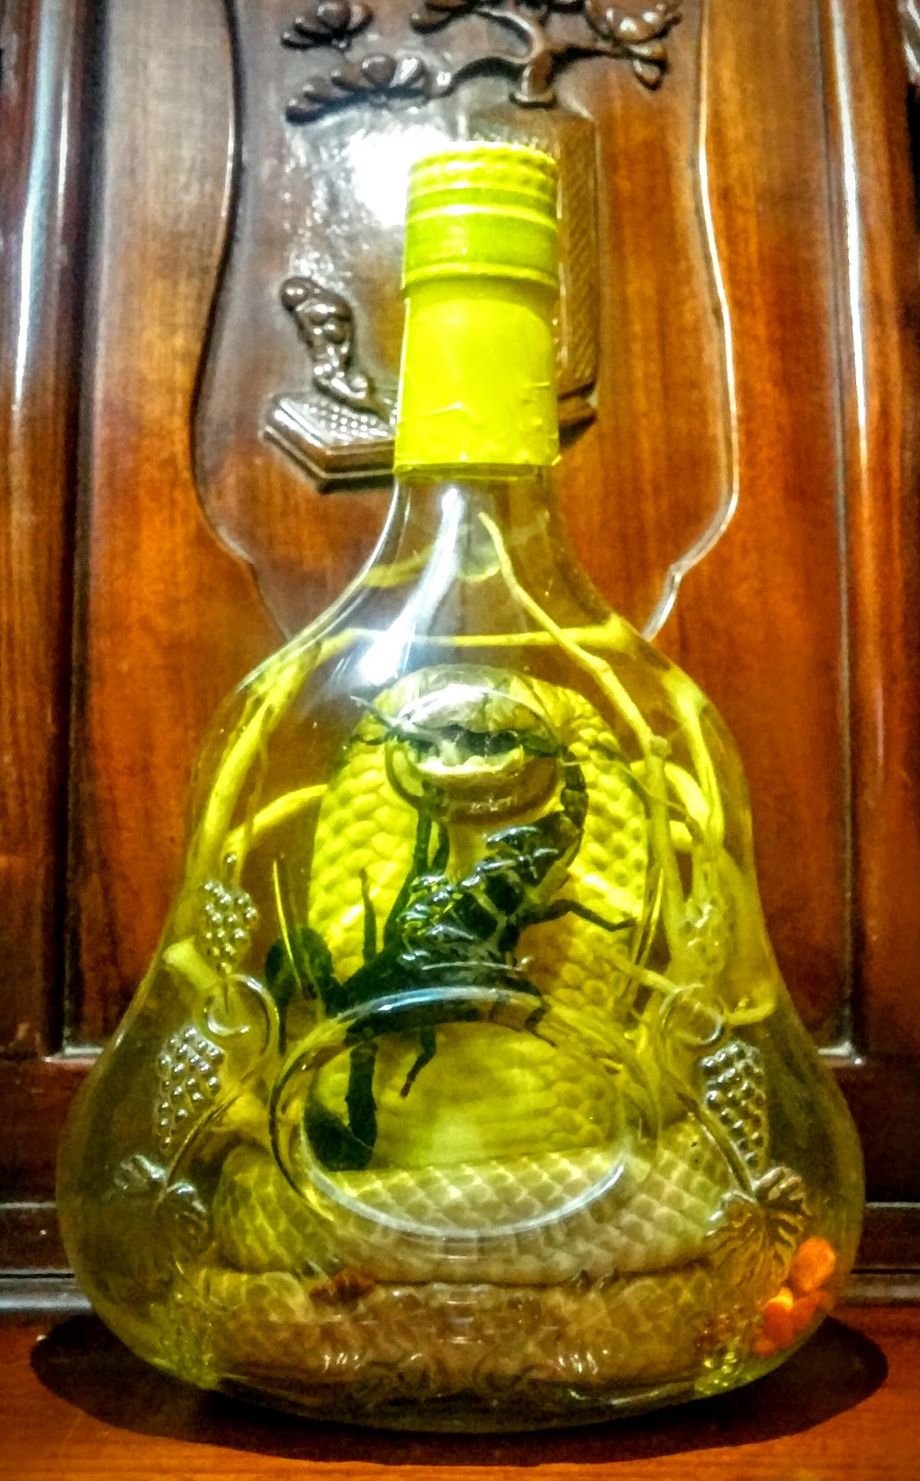
The Wines of Vietnam
Introduction
Overview of Vietnam's Wine Economy
History of Wine in Vietnam
Vietnam's Wine Classification System
Introduction to Vietnam's Wine Regions
The Cultural Significance of Wine in Vietnam
Major Varietals of Vietnam
Notable Wineries in Vietnam
Vietnam's Wine Culture and Traditions
Sustainable Winemaking Practices in Vietnam
Final Thoughts
Citations & References
Rượu Rắn Vĩnh Sơn: Snake wine vietnamese

Slide 3
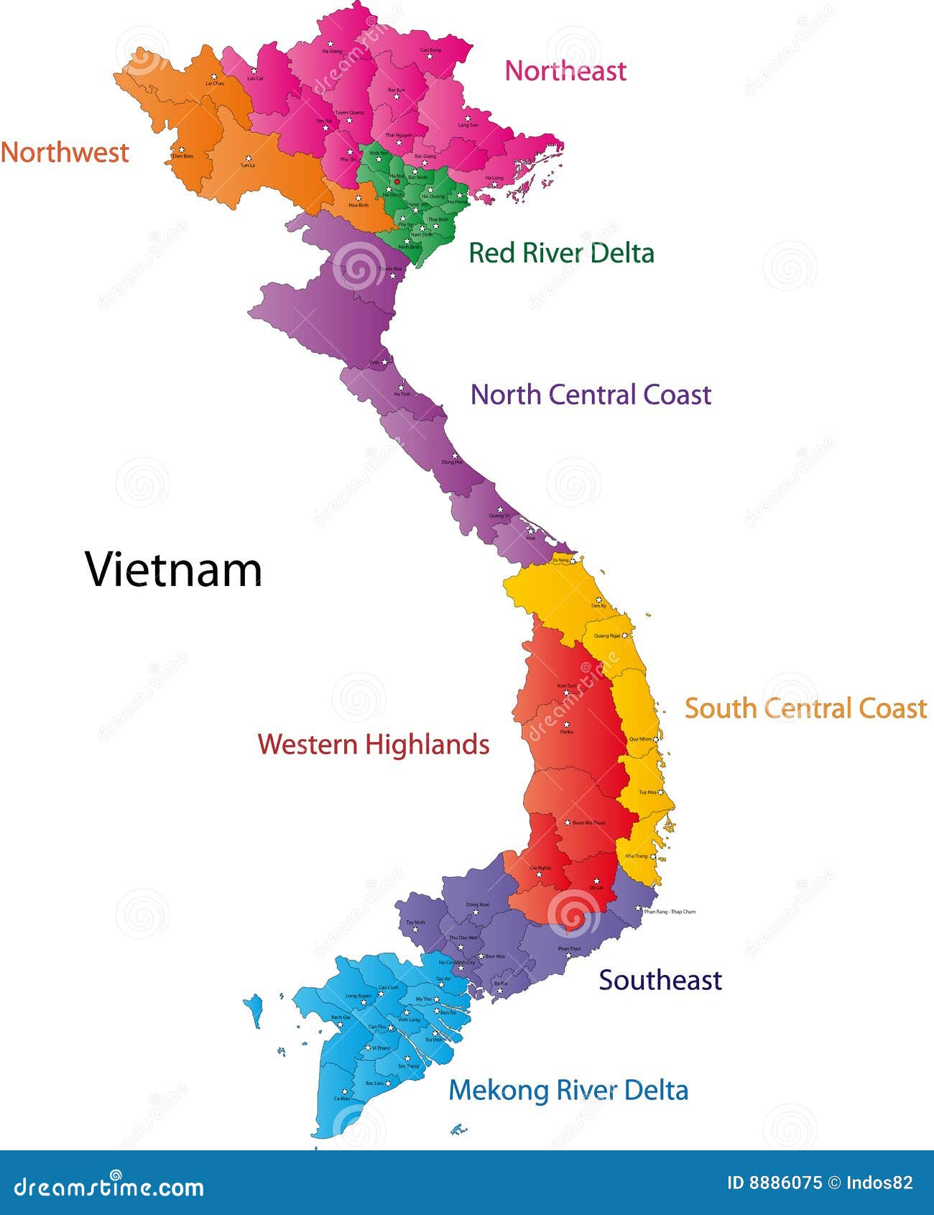
A Hidden Gem in Southeast Asia
An Unusual Wine Region At first glance, Vietnam might seem an unlikely contender in the world of fine wines, but its journey from tropical landscapes to burgeoning vineyards is nothing short of extraordinary.
Picture rolling vineyards nestled in misty highlands, where tradition meets innovation in crafting wines as dynamic as the country itself.
From the bustling markets of Hanoi to the serene coastlines of Ninh Thuan, Vietnam offers a wine experience shaped by its diverse landscapes and bold ambitions.

Slide 4
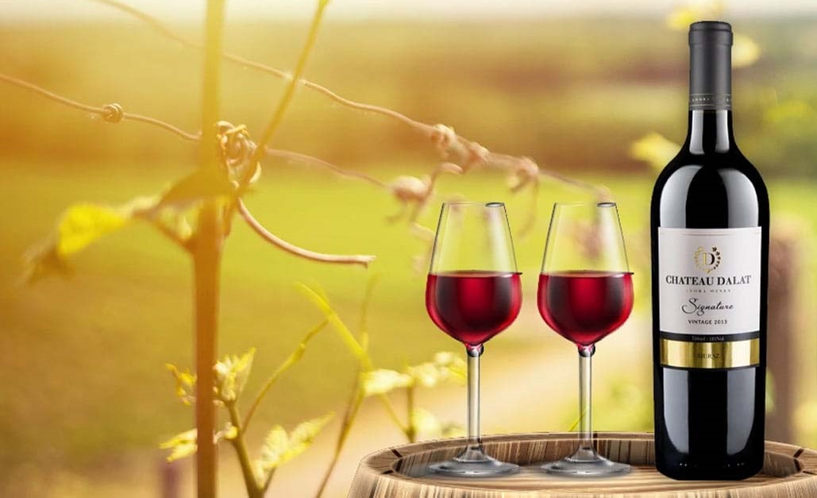
Overview of Vietnam's Wine Economy
Vietnam’s wine industry, while still emerging, is becoming a dynamic player in Asia.
The country produces wines primarily for domestic consumption, with a growing emphasis on exports to neighboring markets like China, Japan, and South Korea.
The industry is increasingly targeting wine enthusiasts in Europe and the United States, offering something different from traditional Old and New World wines.
As the local palate grows more sophisticated, wine tourism is gaining traction, bolstering both the economy and global recognition.

Slide 5

The Renaissance of Vietnamese Wine
The Renaissance of Vietnamese Wine By the late 20th century, Vietnam’s wine industry was at a crossroads.
Political and economic challenges had stalled its growth for decades, leaving grape wine production overshadowed by traditional rice wine.
However, the tides began to shift in the 1990s, driven by increased foreign investment and a burgeoning middle class with a taste for global trends.

Slide 6
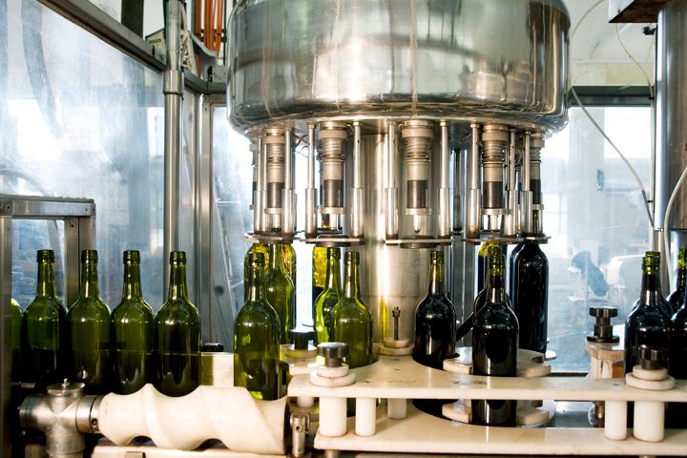
The Renaissance of Vietnamese Wine
International partnerships played a pivotal role in this revival. French and Australian experts collaborated with local producers to introduce modern viticulture techniques such as precise canopy management and advanced pruning methods, ensuring optimal sun exposure and airflow for the vines.
They also implemented innovative disease prevention strategies and introduced hybrid varietals designed to thrive in tropical climates.
Advanced winemaking technologies like temperature-controlled fermentation tanks and state-of-the-art bottling systems were introduced, dramatically improving the consistency and quality of the final product.
This period saw the establishment of experimental vineyards in regions like Dalat, where the cooler climate proved ideal for growing quality grapes.

Slide 7
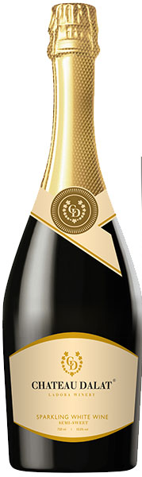
The Renaissance of Vietnamese Wine
The Renaissance wasn’t just about adopting foreign practices; it also embraced Vietnam’s unique character.
Winemakers began to experiment with hybrid grape varieties suited to the tropical climate, producing wines that blended international influences with local flair.
For example, Dalat vineyards pioneered blends combining traditional European varietals with tropical hybrids, creating wines with bold, unexpected flavor profiles.
This renewed focus on quality and innovation has transformed Vietnamese wine from a curiosity into a promising contender on the global stage.

Slide 8
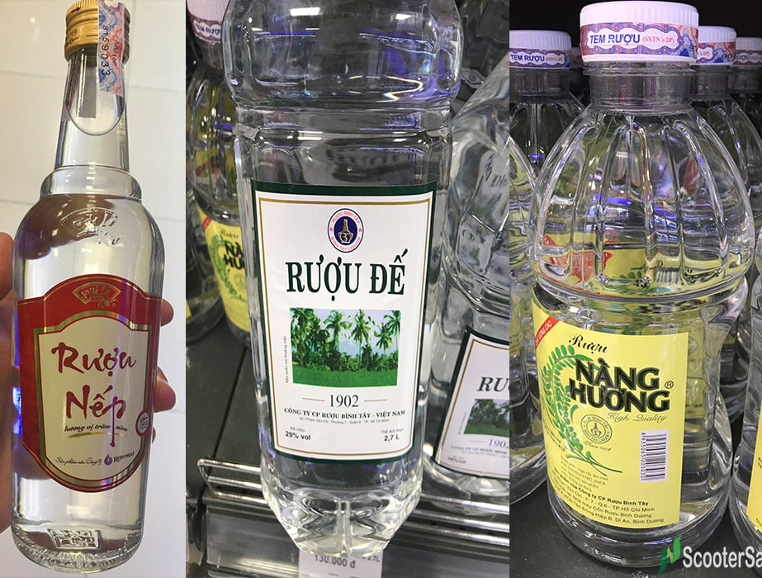
Vietnam’s Wine Classification System
Unlike the complex classification systems of France or Italy, Vietnam takes a more accessible approach to regulating wine production.
There is no rigid hierarchy of appellations or strict regional designations. Instead, Vietnamese winemaking focuses on innovation and quality, allowing producers to experiment with grape varieties and techniques that suit the country’s tropical climate.
This straightforward system emphasizes quality over bureaucracy, letting wines earn recognition through merit, such as international awards and consumer acclaim, rather than predefined labels.
Vietnamese wineries prioritize crafting wines that appeal to both local and global palates, fostering creativity and accessibility.

Slide 9
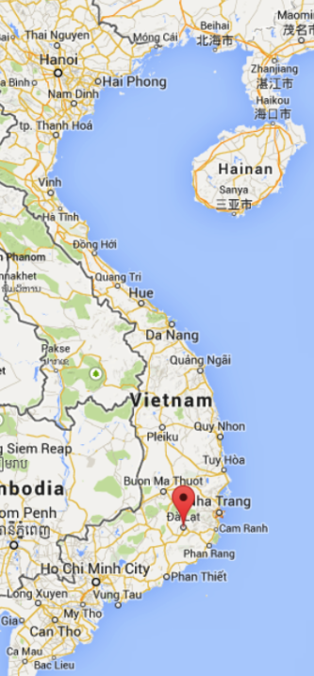
Vietnam’s Wine Regions
Dalat
The Highland Haven Nestled in the Central Highlands, Dalat is Vietnam’s premier wine region.
Its cool climate and fertile soils make it ideal for growing grapes.
Predominantly producing table wines and sparkling varieties, Dalat wineries are celebrated for their creative use of both international grapes like Cabernet Sauvignon and local hybrids.
The region’s volcanic soils contribute distinct mineral notes to its wines.

Slide 10
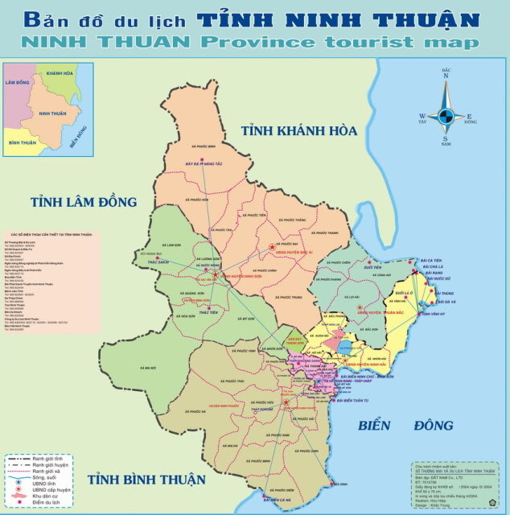
Vietnam’s Wine Regions
Ninh Thuan
Coastal Character Along the south-central coast, Ninh Thuan benefits from maritime influences and abundant sunshine.
The region specializes in full-bodied reds and mineral-driven whites.
Sea breezes and sandy soils shape the character of these coastal wines, offering robust flavors and a refreshing finish.

Slide 11
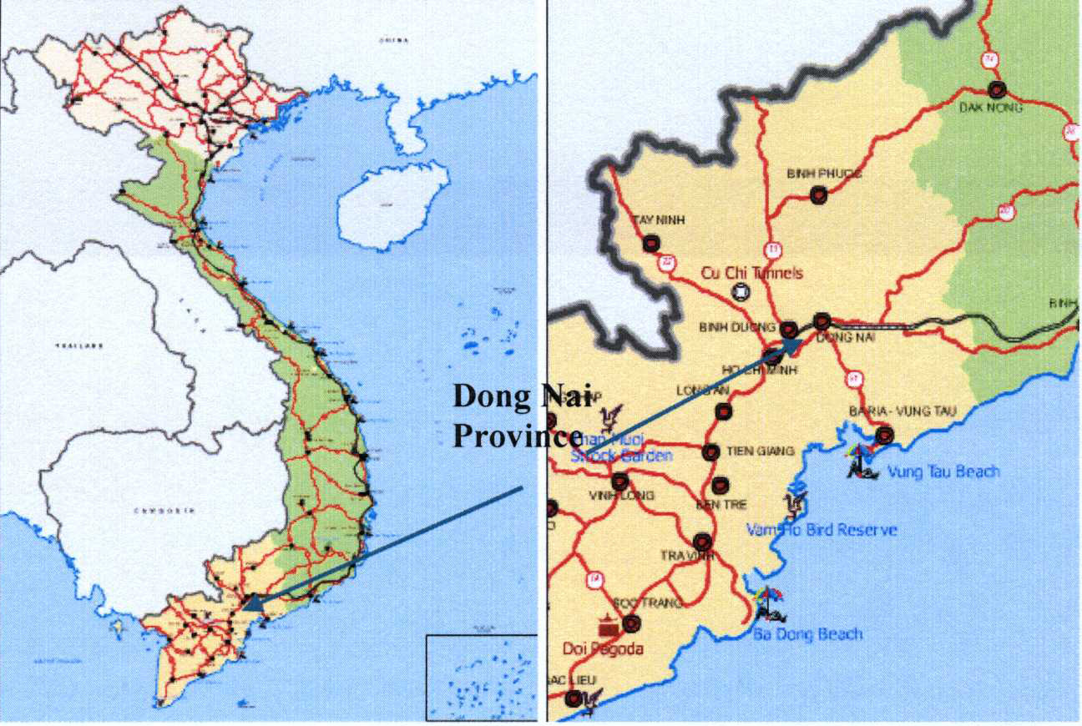
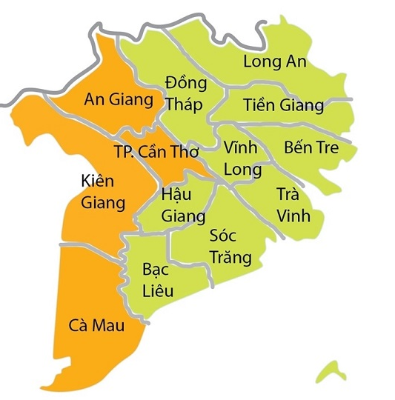
Vietnam’s Wine Regions
Binh Thuan
Volume and Value Neighboring Ninh Thuan, Binh Thuan focuses on larger-scale production.
While perhaps less prestigious than its neighbors, the region plays a vital role in meeting domestic demand and introducing new consumers to Vietnamese wine.
Lesser-Known Regions
Smaller vineyards are emerging in areas like Hanoi’s outskirts and the Mekong Delta, contributing experimental wines that add depth to Vietnam’s offerings

Slide 12
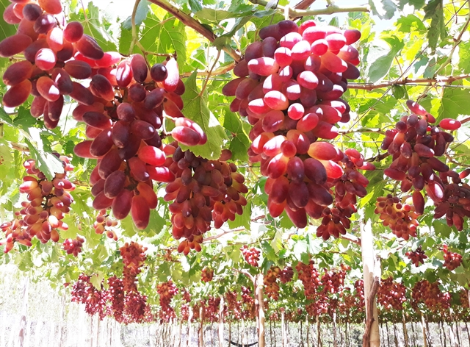
Major Varietals of Vietnam
Indigenous Grapes
Vietnam has no indigenous grapes but their hybrid grapes showcase local ingenuity in tropical viticulture.
These varieties combine disease resistance with unique flavor profiles suited to the climate.
You’ll taste tropical fruit notes and distinctive spice characteristics unique to Vietnamese terroir.

Slide 13
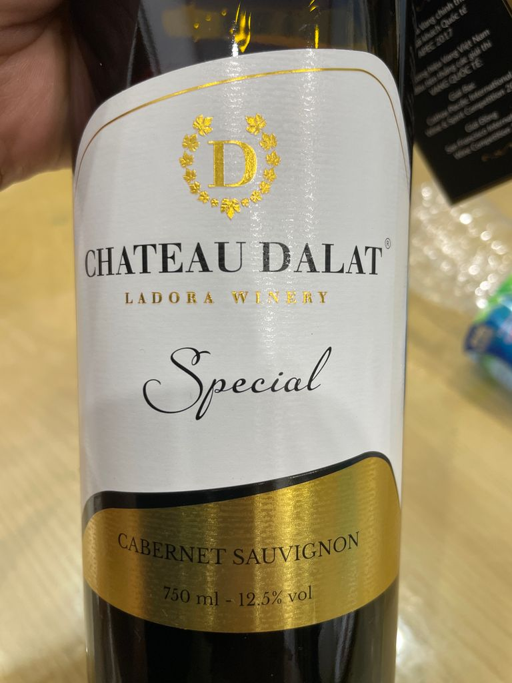
Major Varietals of Vietnam
International Varieties with a Twist
Classic varieties like Cabernet Sauvignon, Syrah, and Chardonnay thrive in Vietnam’s cooler regions.
These wines express familiar characteristics while incorporating subtle local influences, creating distinctive interpretations of international styles.

Slide 14
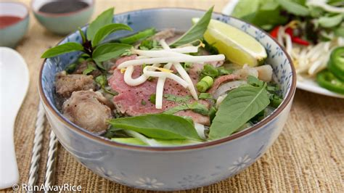
Tasting Notes and Food Pairings
Vietnamese wines pair exceptionally well with local dishes, offering a sensory journey that enhances both the wine and the cuisine.
For instance, a crisp Dalat white, with its bright acidity and hints of tropical fruit, perfectly complements the fresh herbs and delicate flavors of spring rolls.
Meanwhile, a bold Ninh Thuan red, rich with smoky undertones and robust tannins, elevates the hearty, savory depth of beef pho.
These pairings highlight the harmonious interplay between Vietnam’s culinary traditions and its emerging wine culture, showcasing how each sip and bite brings out the best in the other.

Slide 15
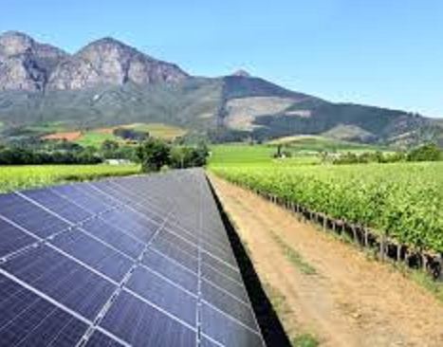
Sustainable Winemaking Practices in Vietnam
Vietnamese wineries are increasingly turning to sustainable methods to ensure the longevity and health of their vineyards.
Among these, Dalat stands out as a leader in eco-conscious initiatives.
Known for its picturesque highland vineyards, Dalat has adopted solar-powered facilities to minimize its carbon footprint.
Many wineries in this region also prioritize water conservation, utilizing innovative irrigation systems that reduce waste while maintaining optimal soil health.

Slide 16
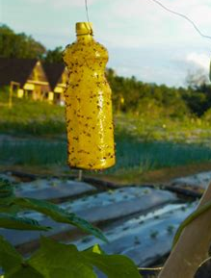
Sustainable Winemaking Practices in Vietnam
Additionally, Dalat’s winemakers are experimenting with organic and biodynamic viticulture, avoiding synthetic chemicals to create wines that reflect the true character of the region.
One notable example is the use of natural pest control methods, such as introducing beneficial insects to maintain ecological balance.
For example, some vineyards employ natural composting methods and plant cover crops like clover to enrich the soil and support biodiversity.
This approach not only fosters healthier vines but also enhances the unique terroir expression in their wines.
This commitment not only enhances the quality of the wine but also preserves the delicate ecosystem of the highlands, ensuring future generations can continue to enjoy the fruits of Vietnam’s winemaking evolution.

Slide 17
Notable Wineries in Vietnam
Dalat Winery As the most famous winery in Vietnam, Dalat Winery produces a wide range of wines, including the award-winning Vang Dalat line. Its dedication to quality and innovation has made it a pioneer in the industry.
Ninh Thuan Estate This winery is celebrated for its Syrah blends, which have garnered attention for their balance and depth. Visitors can enjoy guided tours showcasing the region’s winemaking process.
Smaller Producers Emerging boutique wineries, like Hanoi Vineyards, are gaining traction for their experimental wines, highlighting the potential of lesser-known regions.

Slide 18

Vietnam’s Wine Culture and Traditions
Vietnam hosts annual wine festivals, particularly in Dalat, which attract locals and tourists alike.
These events celebrate the fusion of traditional Vietnamese culture and modern winemaking, creating a vibrant atmosphere of discovery and enjoyment.

Slide 19

Final Thoughts
Vietnam’s wine industry is a compelling story of transformation and ambition.
It reflects the country’s determination to innovate, combining tropical resilience with global expertise to craft wines as distinctive as Vietnam itself.
What began as a colonial curiosity has evolved into a unique expression of the country’s resilience, creativity, and deep respect for the land.
The innovation seen in Vietnam exemplifies the balance between honoring tradition and embracing modernity, crafting wines that are as distinctive as the culture they come from.

Slide 20
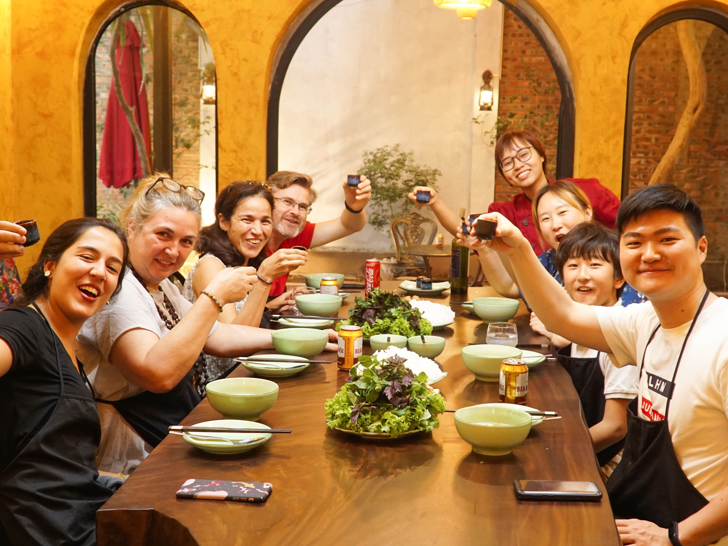
Final Thoughts
As the global wine community takes notice, Vietnam stands poised to redefine expectations, offering experiences and flavors that rival more established regions.
From the smoky undertones of Ninh Thuan’s reds to the zesty tropical hints of Dalat’s whites, each bottle tells a story of a nation redefining its place in the world of wine.
Whether it’s a glass of bold red from Ninh Thuan with its deep, smoky undertones or a refreshing white from Dalat brimming with hints of tropical fruit and crisp citrus, Vietnam invites you to sip, savor, and explore a world of wine that’s just beginning to reveal its potential.

Slide 21
Acknowledgement
My seminars are the result of many years of experience combined with many hours of research over the internet.
I would like to acknowledge the many source I have accessed.
These include Wine Spectator, Wine Enthusiast, BKWine Magazine, Wine & Spirits Magazine, American Vineyard Magazine, The Grapevine Magazine, Wikipedia.com, Britannica.com, and the various Government websites.

Slide 22
Citations and References
My research relies on a variety of trusted sources to provide a comprehensive overview of Vietnam’s wine industry, its history, and its unique characteristics.
International Wine Review. (2023). "Emerging Wine Regions: Vietnam's Promise."
Nguyen, T. (2023). The Rise of Vietnamese Wines. Hanoi Publishing.
Tran, M. (2022). "Exploring Dalat's Wine Regions." Wine Enthusiast Asia.
Vietnam Wine Association. (2023). Annual Report on Winemaking Trends.
Personal Interviews with Dalat Winery Representatives (2024).
Le, V. (2023). "Sustainable Viticulture in Southeast Asia." Asian Agricultural Journal.

