Slide 1

Victoria, British Columbia Presented by Fellow Cruiser Marc Silver

Slide 2
What I Will Cover
My Port Philosophy
Don’t Miss the Ship
Money
About Victoria
Victoria History
Getting around Victoria
Points of Interest
Places to see or at least consider
Conclusion

Slide 3
My Port Philosophy
I have been cruising for over 45 years and have taken over 100 cruises. So, I consider myself an experienced cruiser.
The information I will present is based on those many years of
experience.
When I am on a cruise where the city, I want to visit is not the port city,
I always recommend taking a ship’s tour.
But when I am in a port with multiple attractions nearby and easy to see
on my own - I will do it on my own.
This presentation is for that type of port.

Slide 4
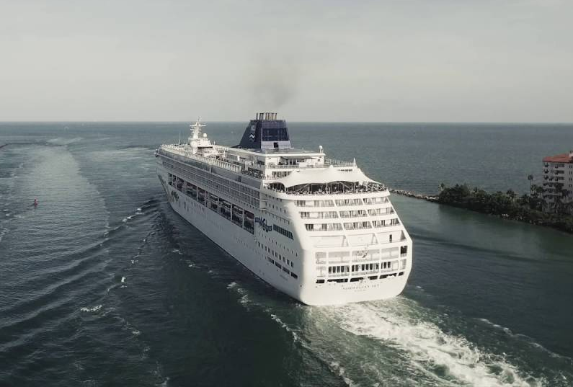
Don’t Miss the Ship
How to Avoid Missing Your Ship
Pay attention to the time. - Ship time and local time are often different.
Put a return-to-ship reminder on your phone.
Choose excursions wisely.
If a ship-sponsored excursion is late returning to port for, the ship will wait for you. If you are on your own???
Be Prepared
Have your Passport, Credit Card and phone numbers for your ship port agent.
What to Do If You Miss the Ship Most cruise lines have port agents stationed in the port area to assist if your ship has left without you. If you’re lucky, when cruisers are late returning to the vessel, the ship's crew will often remove the passengers' essential items -- passports, cell phones, and medication -- from the ship to leave with the port agents.
The Port Officials can help you with contacting your ship and making necessary travel arrangements.

Slide 5
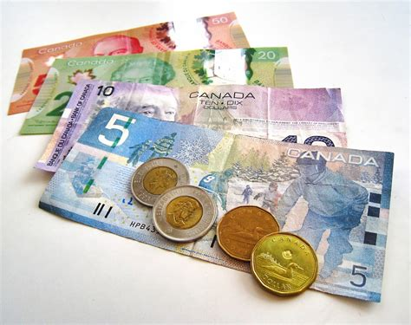
Money
The Canadian dollar is the official currency of Canada
Official Exchange is $1 CAD to $.072 US
Or $1.39 CAD to $1 US

Slide 6
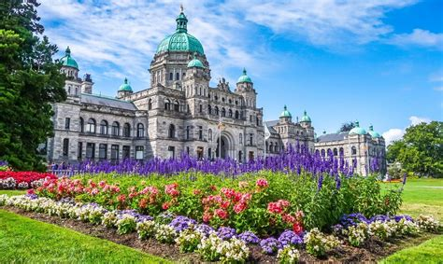
About Victoria
Victoria, city, capital of British Columbia, Canada, located on the southern tip of Vancouver Island, approximately 60 miles south-southwest of the province’s largest city, Vancouver.
Victoria is the largest urban area on the island. It has the mildest winter climate of any city in Canada, and its many parks and green spaces have inspired its description as a “garden city.”
Above all, Victoria is a city whose British heritage and colonial past can be seen clearly in its architecture, gardens, museums, urban squares, place-names, and English-style pubs.

Slide 7
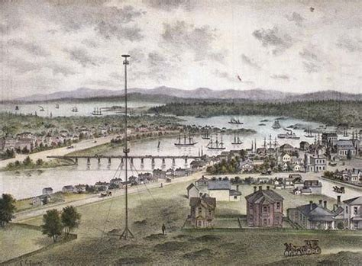
Victoria’s History
Both the Spanish and British claim the first explorations of the Northwest, with Juan Perez and James Cook as excursion leaders in the year 1774.
In the year 1841 James Douglas was commissioned to find an area in which a fur trading post could be built to coincide with the signing of the 1846 Oregon Treaty.
Hit by the discovery of gold along the coast in 1858 and acting as port, supply base and outfitting center for the miners headed to Fraser Canyon, Victoria boomed from 300 to 5,000 people in just a matter of days.
Although Victoria became the provincial capital when British Columbia joined the Canadian Confederation in 1871, it lost its commercial center title to Vancouver in 1886 with the construction of the transcontinental railway.

Slide 8
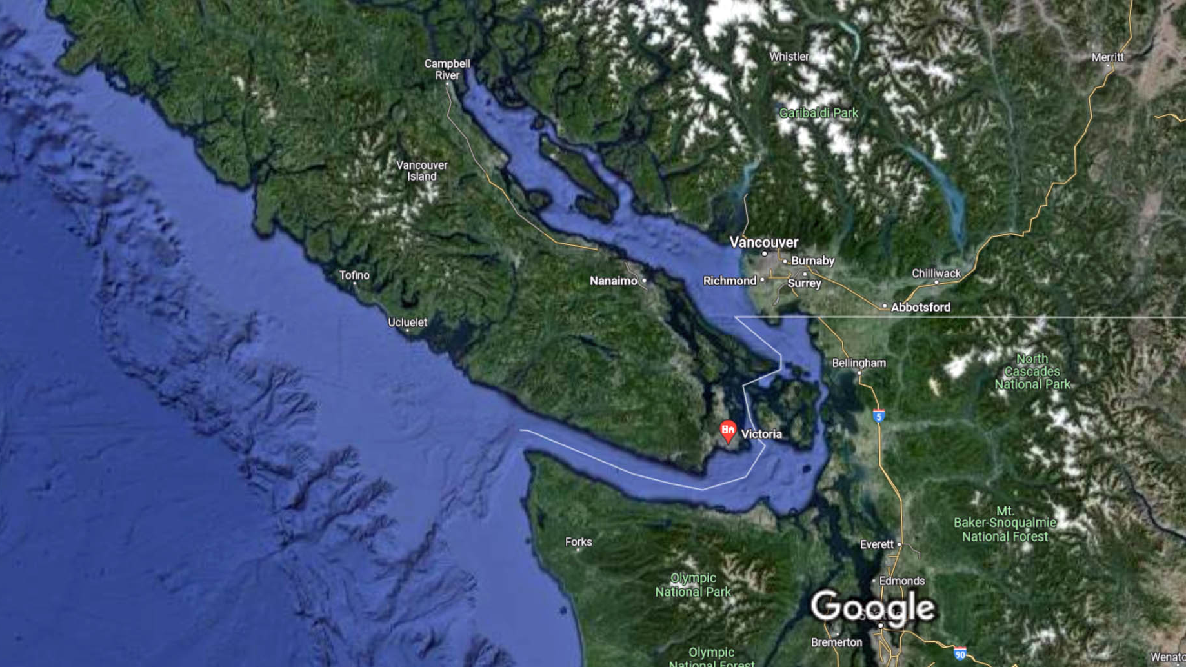
Victoria

Slide 9
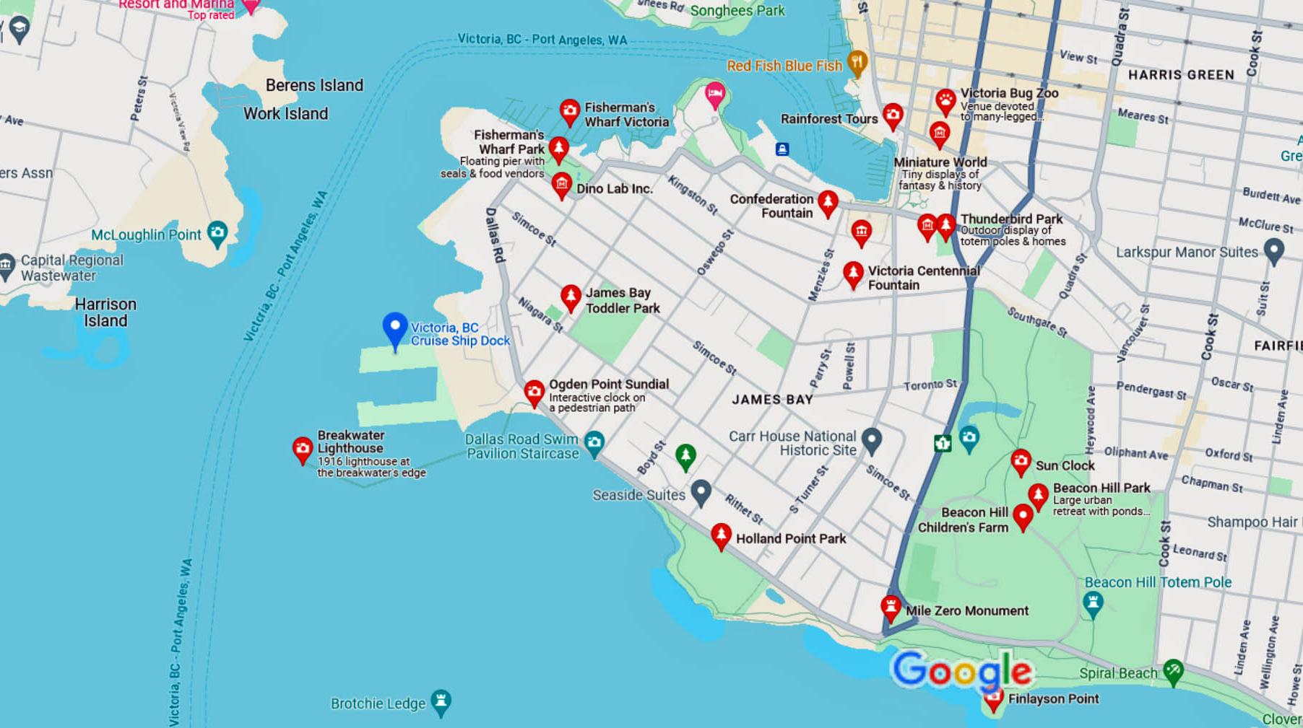
Cruise Ship Port
Victoria Map

Slide 10
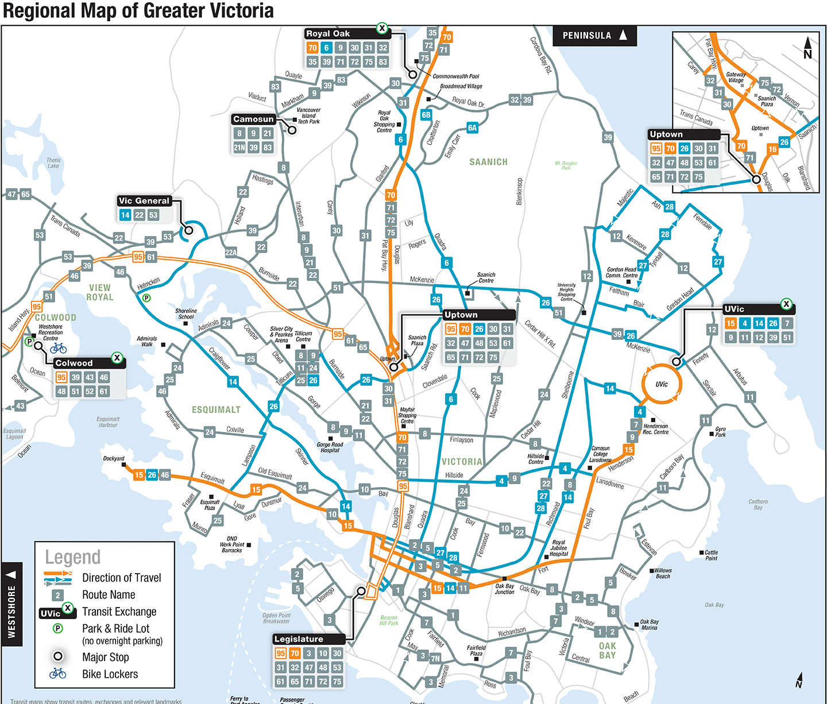
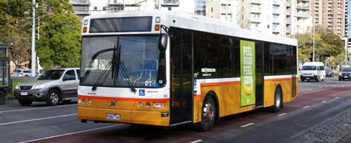
Getting Around Victoria
The BC Transit offers a DayPASS for use on city busses. The pass gives a discount for unlimited travel throughout the day in the transit system it was purchased in.
A paper DayPASS can be purchased onboard a bus with $5 cash or two tickets.
Please note that drivers do not carry change.
To pay using a paper DayPASS, show the front of the pass to the driver and retain your DayPASS for future trips that day.
Adult fare is $2.50
CHILD (6 TO 12) Free Unlimited day pass is $5.00

Slide 11
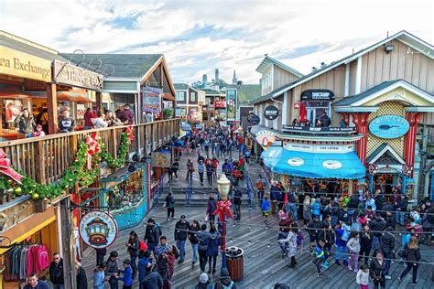
Fisherman's Wharf Victoria
Just around the corner from Victoria's Inner Harbor, Fisherman's Wharf is a hidden treasure waiting to be discovered.
This unique marine destination offers food kiosks, unique shops and eco-tour adventures in the heart of the working harbor.
Wander down the docks with your lunch, buy seafood fresh off the boat, see moored pleasure vessels and float homes, and watch as fishing vessels unload.
The Fisherman’s Wharf is a leisurely 10-minute stroll from The Breakwater District at Ogden Point cruise ship terminal.

Slide 12
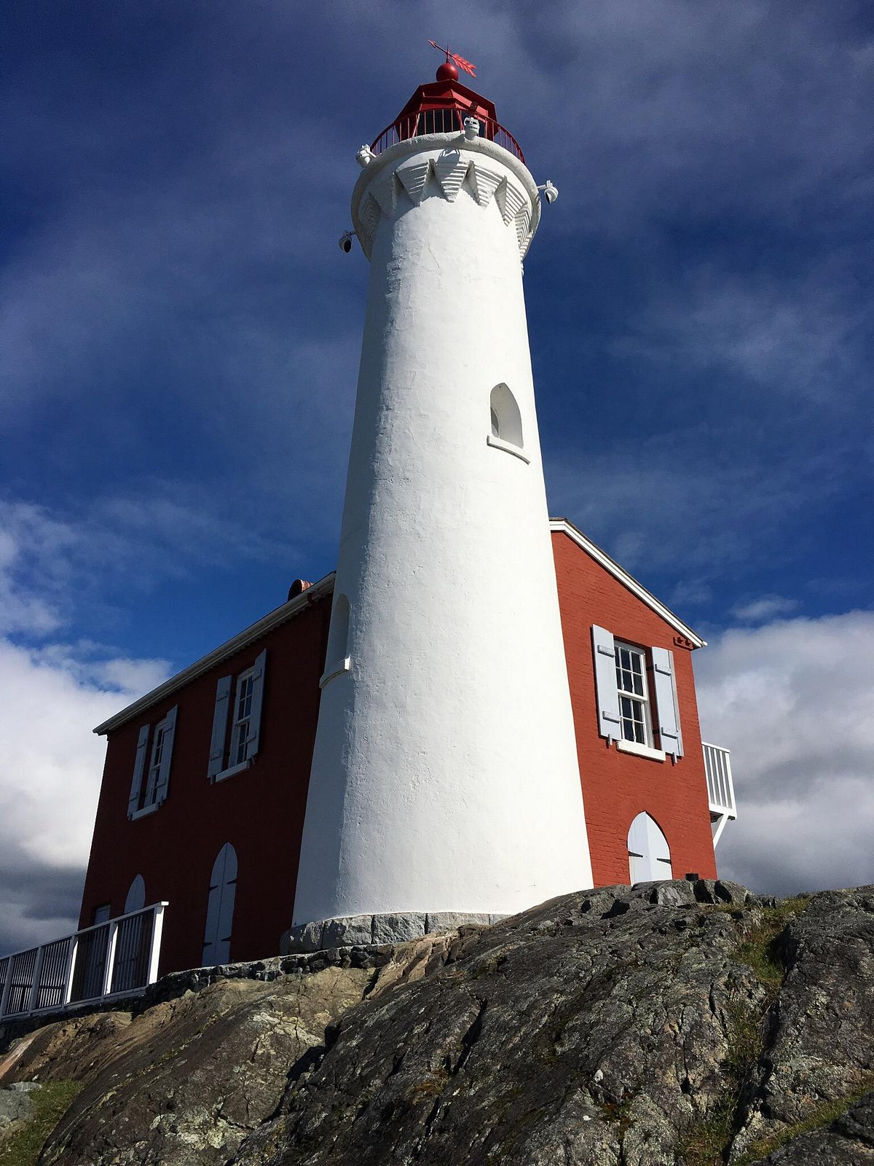
Fisgard Lighthouse
A 20-minute drive from downtown Victoria, Fort Rodd Hill and Fisgard Lighthouse National Historic Sites offer abundant ways to spend a fascinating half or full day exploring historic battlements, weapons and displays.
Stroll through a restored Garry oak meadow. Take the 10-minute walk to Fisgard Lighthouse.

Slide 13
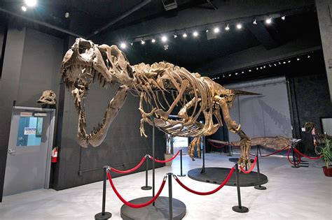
Dino Lab Inc.
Dino Lab Inc. offers a museum and education center where participants can touch real fossils.
If you book one of Dino Lab’s 90-minute tours you get a guided tour of the museum and 30-minutes of hands-on work helping to extract real dinosaur fossils in a specialized lab.
The fossils are usually fragments from more common dinosaurs, but they’re real parts of history.
The Dino Lab has been in operation for eight years as a private restorative lab, working on extracting and preserving prehistoric fossils of dinosaurs, mammoths, ammonites and more.
The Dinosaur Experience -$40.00 Individual tickets (Visitors must be 4 years or older to attend the tour)

Slide 14
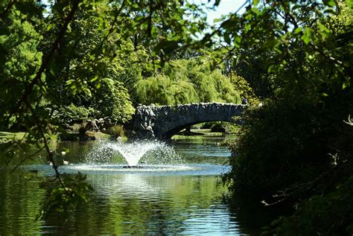
Beacon Hill Park
With roughly 740,000 square meters of parkland, Beacon Hill Park is the crowning jewel in Victoria’s park system.
There are natural areas, manicured flower beds, footpaths and many sports and play features for the whole family to enjoy.
A number of environmentally sensitive areas have been identified within the park and are protected through local, provincial and federal law to preserve these threatened and endangered species and ecosystems.
In addition to the Garry oak ecosystem, an example of a threatened species is the Yellow Montane Violet, Viola praemorsa.

Slide 15
British Columbia Parliament Buildings
The British Columbia Parliament Buildings are historic buildings, located along the inner harbor in the heart of the city.
The buildings are open to the public, and visitors can take free guided interior tours on weekdays or stroll along the beautiful grounds.
The Parliament Buildings were built between 1893 and 1898 based on designs created by Francis Rattenbury, then a 25-year old architect.
Explore these buildings for a sense of the amazing architecture behind them and also to learn about the Legislative Assembly.

Slide 16
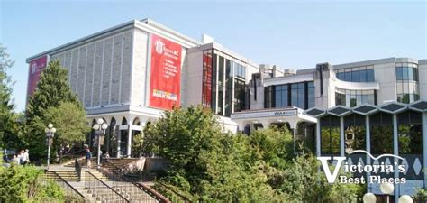
Royal BC Museum
The Royal BC Museum was founded in 1886 and is considered one of the greatest treasure troves of Canadian culture ever.
The Archives of the museum are ancient too and were founded in 1894. This museum showcases extensively a unique range of exhibits that help you learn about the natural and human history of British Columbia.
There are a staggering 7,00,00,000 million exhibits to go through at the Royal BC Museum.
Visit the three permanent galleries at the Royal BC Museum – natural history, modern history, and the history of the local First Nations.
Adult $29.95
Senior 65+ $19.95
Youth 6-18 $16.95
Child (<5) Free

Slide 17
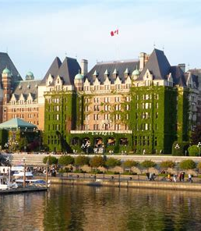
Inner Harbor
The Inner Harbor is a part of the Victoria Harbor, which is said to be among the world’s most beautiful harbors.
The scenic Inner Harbor is where much of the action is centered and where many of the tourist attractions are located.
The historic Fairmont Empress, one of Victoria's landmark buildings, looks over the Inner Harbor. Built in 1908, this hotel has hosted visiting royalty throughout the decades.
High Tea at the Empress has become a popular thing to do in Victoria, where visitors can sip tea and enjoy sandwiches, scones, and desserts in a lovely old room filled with antique furnishings.

Slide 18
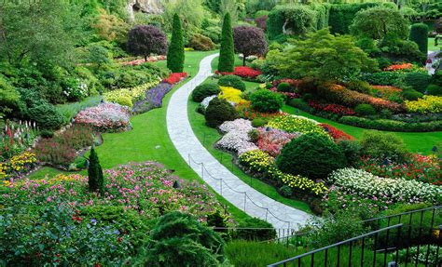
Butchart Gardens
For those with a love of gardening, a visit to Butchart Gardens will be one of the highlights of Vancouver Island.
Set in an old quarry outside Victoria, these fabulous gardens provide a year-round opportunity to step into a peaceful natural setting with flowers, trees, and pathways.
Begun in 1904 by Jennie Butchart, the grounds have been over a century in the making. In the evening, the gardens are illuminated with creative lighting and on Saturday nights you can enjoy a firework display set to music.
Every evening in July and August live music performances take place at Butchart Gardens.
Adult (18+) 41.50
Youth (13–17) 20.75
Child (5–12) 5.00

Slide 19
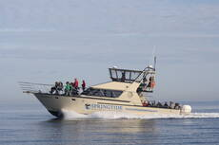
Whale Watching Tour
Whale watching tours are one of the top things to do on Vancouver Island. Two popular places for these tours are in Nanaimo and Tofino.
In Nanaimo, boats take visitors out on the Salish Sea, between Vancouver Island and mainland British Columbia. Commonly spotted here are orcas, humpback whales, sea lions, porpoises, and other marine life.
Tour operators avoid viewing endangered southern resident orcas. Tours are in zodiacs or larger semi-covered tour boats.
In Tofino, you can spot orcas and humpback whales, but the main species is gray whales, which can be seen regularly between March and November.
Tour Prices Adult $139
Child (2-12) $99

Slide 20
Conclusion
Victoria is a beautiful City with a rich history and numerous attractions. Whether you're looking for stunning views, historic sites, or unique attractions, Victoria has something for everyone.
I hope this presentation will help when we visit Victoria.

Slide 21
Thanks For Coming
If you have any more questions, please ask.
I will do my best to answer them for you.
Have a great visit in Victoria!

Slide 22
Acknowledgement
My seminars are the result of many years of travel experience combined with many hours of research over the internet.
I would like to acknowledge the many source I have accessed.
These include: Wikipedia.com, Britannica.com, Trip Advisor and the various Museum, Park and Government websites.

