Slide 1

Valletta Malta
Port Presentation
Presented by
Marc Silver

Slide 2
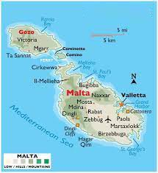
Valletta Malta
Valletta (or Il-Belt) is the tiny capital of the Mediterranean island nation of Malta. The walled city was established in the 1500s on a peninsula by the Knights of St. John, a Roman Catholic order. It’s known for museums, palaces and grand churches.
Baroque landmarks include:
St. John’s Co-Cathedral, who's opulent
interior is home to the Caravaggio master-piece "The Beheading of Saint John.
Valletta is inextricably linked to the history of the military and charitable Order of St John of Jerusalem. It was ruled successively by the Phoenicians, Greeks, Carthaginians, Romans, Byzantines, Arabs and the Order of the Knights of St John. Valletta's 320 monuments make it one of the most concentrated historic areas in the world."

Slide 3
What I Will Cover
My Port Philosophy
Don’t Miss the Ship
Money
Best way to get around Valletta
Hop on Hop off
History of Valletta
Where is the Tourist Office?
Map of Valletta
Places to see or at least consider
A few restaurant recommendations

Slide 4
My Port Philosophy
I have been cruising for over 45 years and have taken over 100 cruises. So, I consider myself an experienced cruiser.
The information I will present is based on those many years of experience.
When I am on a cruise where the city I want to visit is not the port city, I always recommend taking a ship’s tour.
But when I am in a port with multiple attractions nearby and easy to see on my own - I will do it on my own.
This presentation is for that type of port.

Slide 5
Don’t Miss the Ship
How to Avoid Missing Your Ship
Pay attention to the time. - Ship time and local time are often different.
Put a return to ship reminder on your phone.
Choose excursions wisely.
If a ship-sponsored excursion is late returning to port for, the ship will wait for you. If you are on your own???
Be Prepared
Have your Passport, Credit Card and phone numbers for your ship port agent.
What to Do If You Miss the Ship Most cruise lines have port agents stationed in the port area to assist if your ship has left without you. If your lucky, when cruisers are late returning to the vessel, the ship's crew will often remove the passengers' essential items -- passports, cell phones and medication -- from the ship to leave with the port agents.
The Port Officials can help you with contacting your ship and making necessary travel arrangements.

Slide 6
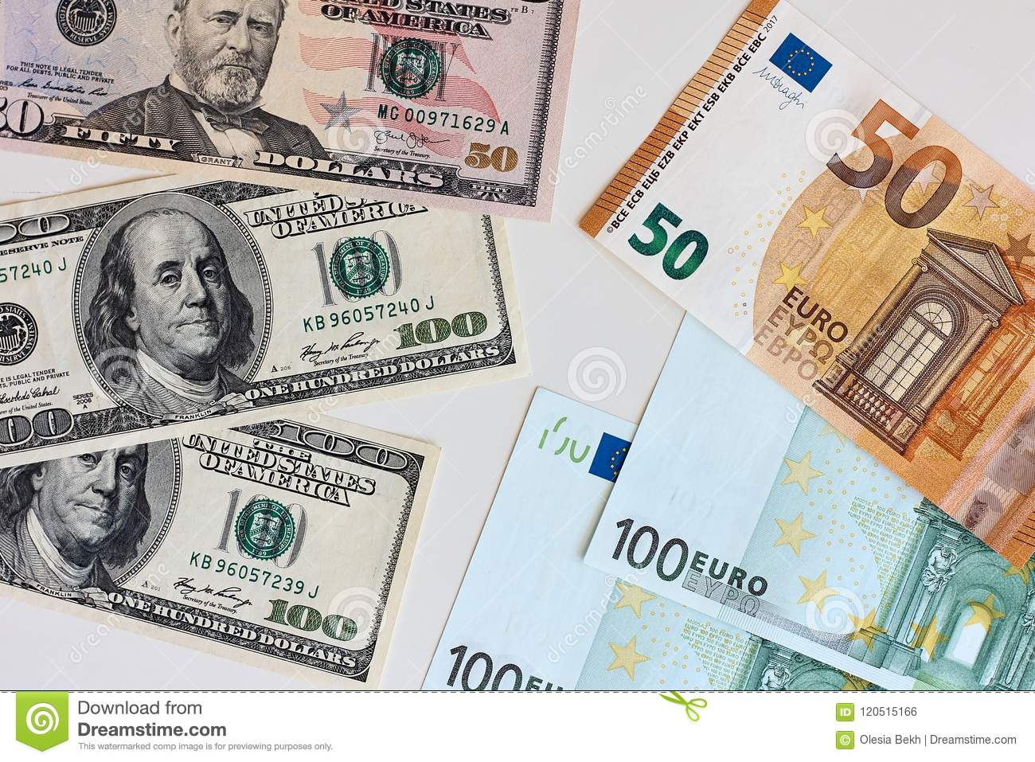
Money
The euro is the official currency of 20 European Union countries which collectively make up the euro area, also known as the eurozone.
Official Exchange is €1 to $1.079 US

Slide 7
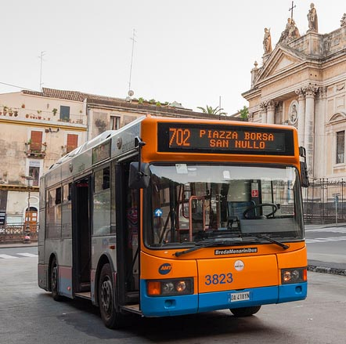
Getting Around Valletta
For the most part Valletta is an easy city to walk. you need to go further, ATM buses (tel. 090-22851; www.atmValletta.it) is the bus and tram company that departs from the transportation hub, Piazza della Repubblica.
Bus tickets can be purchased at tabacchi (tobacco shops) or news kiosks throughout the city.
€1.20 for a ticket valid for 1 1/2 hours
€2.60 for an all-day ticket.

Slide 8
Hop on Hop Off Valletta
.
The City Sightseeing® Valletta service includes two different routes to explore this historic and welcoming city:
The Red Line
St. John’s Co-Cathedral – A masterpiece of Baroque architecture.
Upper Barrakka Gardens – Offers stunning panoramic views of the Grand Harbour.
Valletta Waterfront – A promenade lined with restaurants, shops, and historical buildings.
National Museum of Archaeology – Home to fascinating artifacts dating back to Malta’s Neolithic period.
Fort St. Elmo – A star-shaped fortress that played a key role in the Great Siege of 1565.
The Blue Line
Lascaris War Rooms – A secret underground complex used during WWII.
Manoel Theatre – One of the oldest working theatres in Europe.
Grandmaster's Palace – Now home to the Office of the President and a museum.
Casa Rocca Piccola – A 16th-century palace still privately owned by a noble Maltese family.
Single Line €15
Both Lines €20

Slide 9
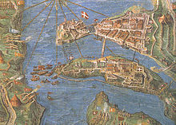
Valletta Early History
After the Great Siege of 1565, the Knights city built by gentlemen for gentlemen set about an ambitious project, the building of Valletta, the so-called ‘’. Pope Pius IV sent his foremost engineer, Francesco Laparelli, to build the city both as a fortress to defend Christendom and as a cultural masterpiece. A unique example of the Baroque, Valletta has been designated a World Heritage City.
Historical affiliations
Order of Knights of the Hospital of Saint John of Jerusalem Hospitaller Malta 1566–1798
France French Republic 1798–1800
United Kingdom Protectorate of Malta 1800–1813
Malta Crown Colony of Malta 1813–1964
Malta State of Malta 1964–1974
Malta Republic of Malta 1974 to present.
The city of Valletta was mostly completed by the early 1570s, and it became the capital on 18 March 1571 when Grand Master Pierre de Monte moved from his seat at Fort St Angelo in Birgu to the Grandmaster's Palace in Valletta.

Slide 10
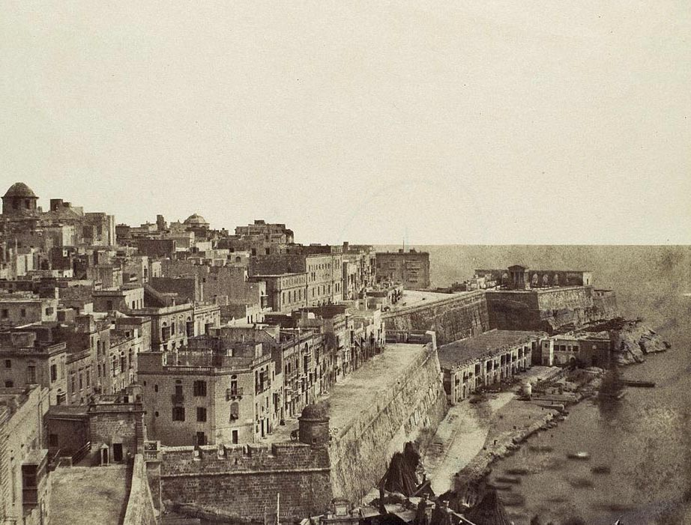
French Occupation and British Rule
In 1798, the French invaded the island and expelled the Order. After the Maltese rebelled, French troops continued to occupy Valletta and the surrounding harbour area, until they capitulated to the British in September 1800.
Eventually building projects in Valletta resumed under British rule. These projects included widening gates, demolishing and rebuilding structures, widening newer houses over the years, and installing civic projects. The Malta Railway, which linked Valletta to Mdina, was officially opened in 1883, but was closed down in 1931.

Slide 11
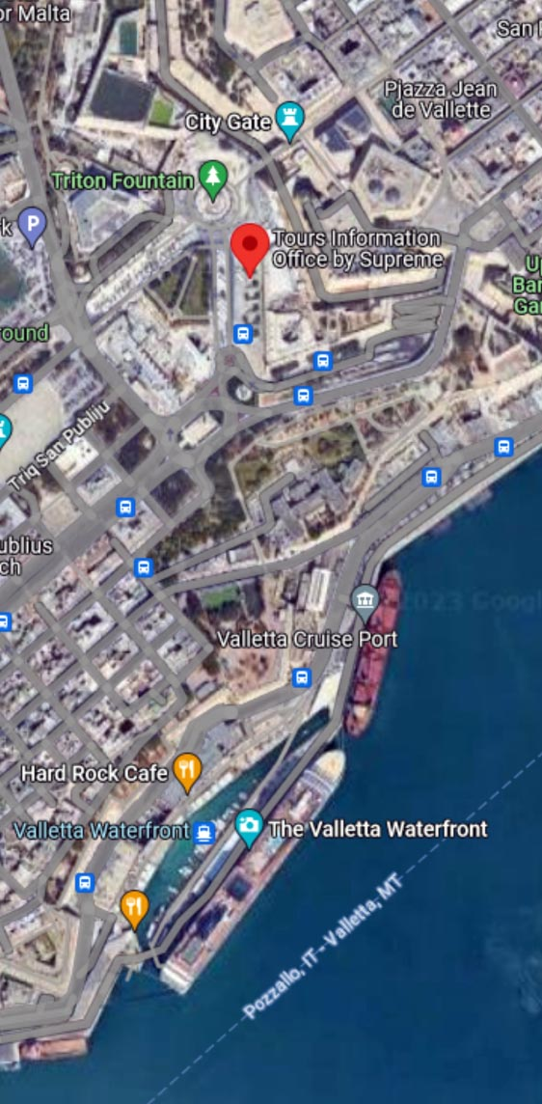
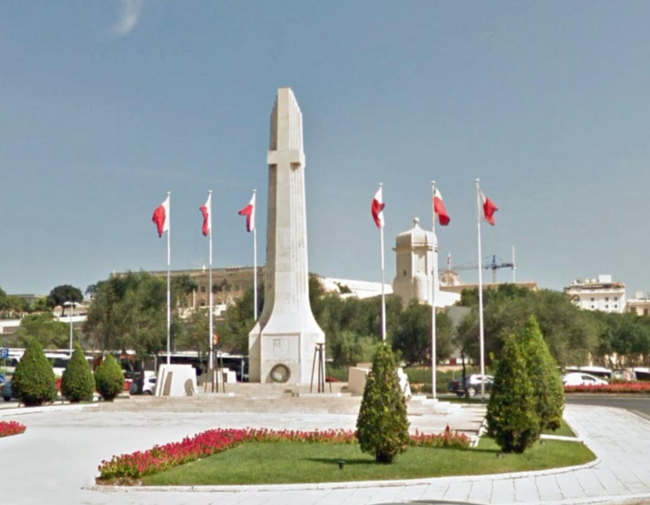
Tourist Office
Tourism Office provides a tourist information service and attention to the city's visitors.
Located in the Bus terminal, not far from the City Gate.
It is about 1.5km from the ship. About a 20-minute walk.
On your walk you will pass by the King George Recreational Grounds and the War Memorial. .

Slide 12
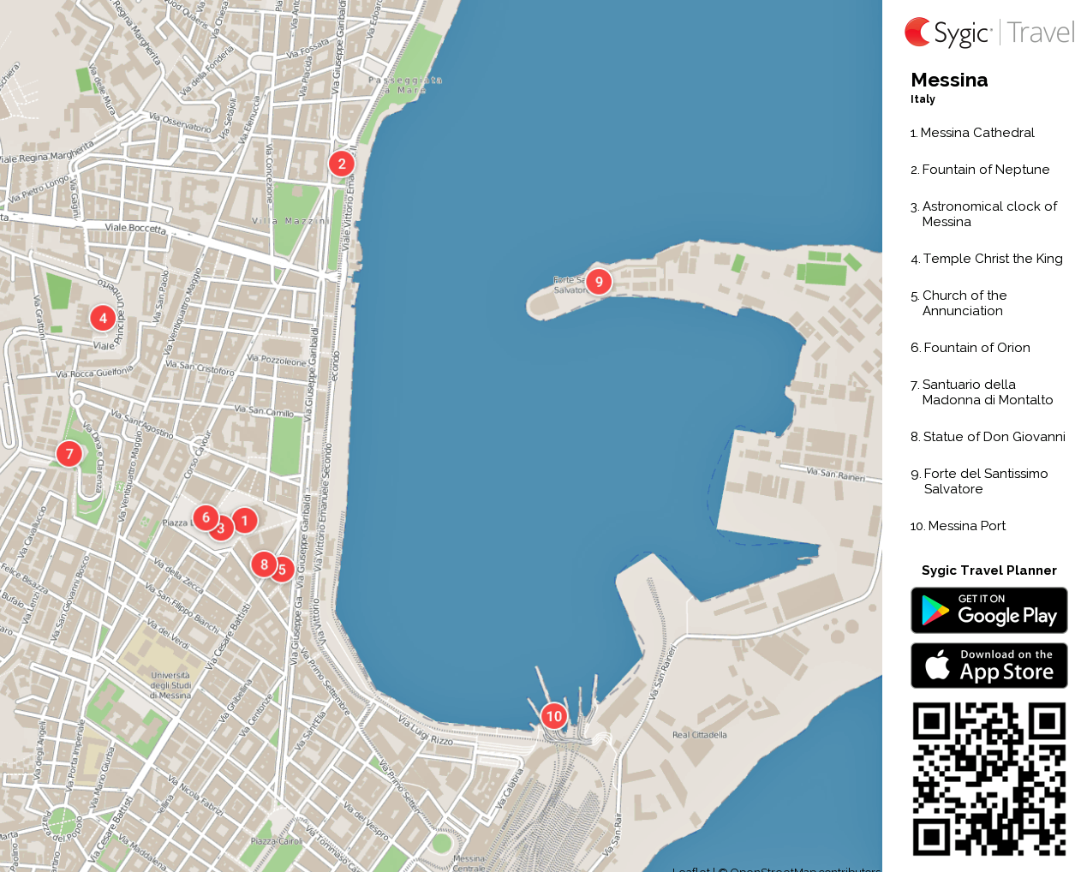
Map Of Valletta

Slide 13
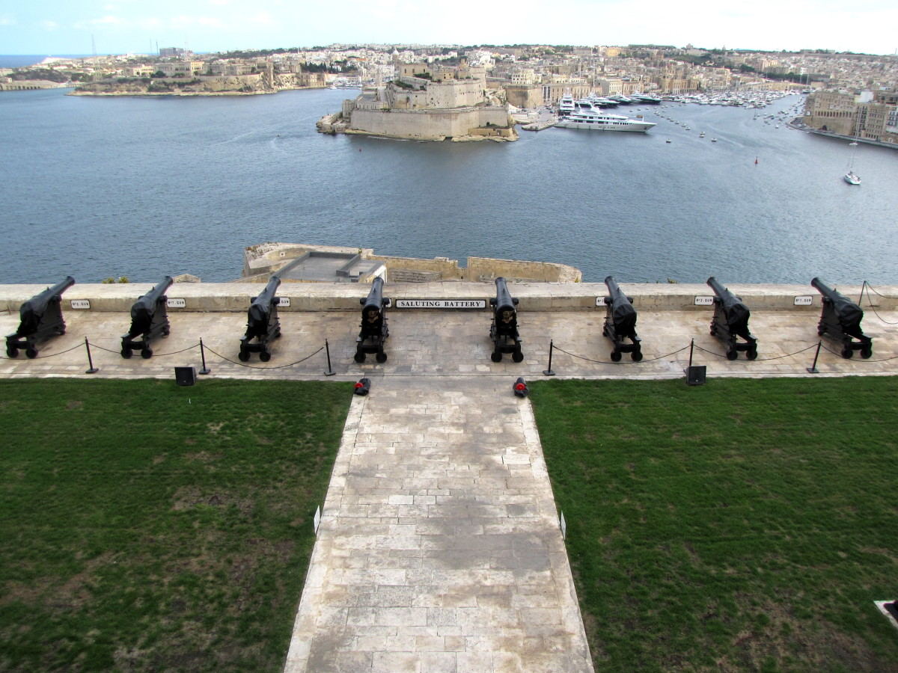
Upper Barrakka Gardens
On the Southeastern part of Valletta near the Castille Palace, you will come across the gates of Upper Barrakka Gardens. Here, you'll find some of the most breathtaking views the islands offer. views that the islands present. These colonnaded gardens came into existence in the year 1661 and are above the Great Harbor, with the best vantage point. An interesting fact is that these gardens were initially the practice grounds for
Knights of the Langue of Italy.
The private gardens were thrown open to the public only in 1824. As is with most of the structures and locations in Valletta, Upper Barrakka Gardens was also hit by WWII. However, it has since been restored to its former splendor.

Slide 14
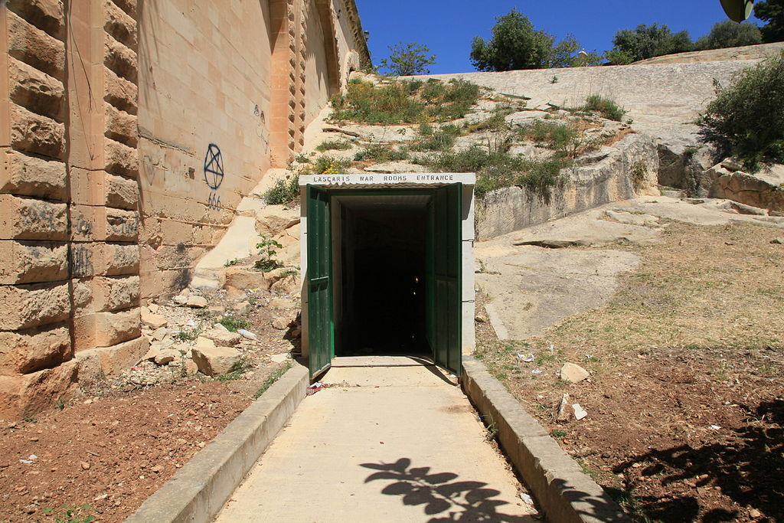
Lascaris War Rooms
The Lascaris War Rooms consist of an underground complex of tunnels and chambers that housed the War Headquarters from where the defence of Malta was conducted during the Second World War.
This secret complex contained operations rooms for each of the fighting services from where not only the air defence of Malta was coordinated, but also some of the greatest battles fought in the Mediterranean during the war.
Adult €14.00 - Senior 60 + €12.00 - Child (<16 years old) € 7.00

Slide 15
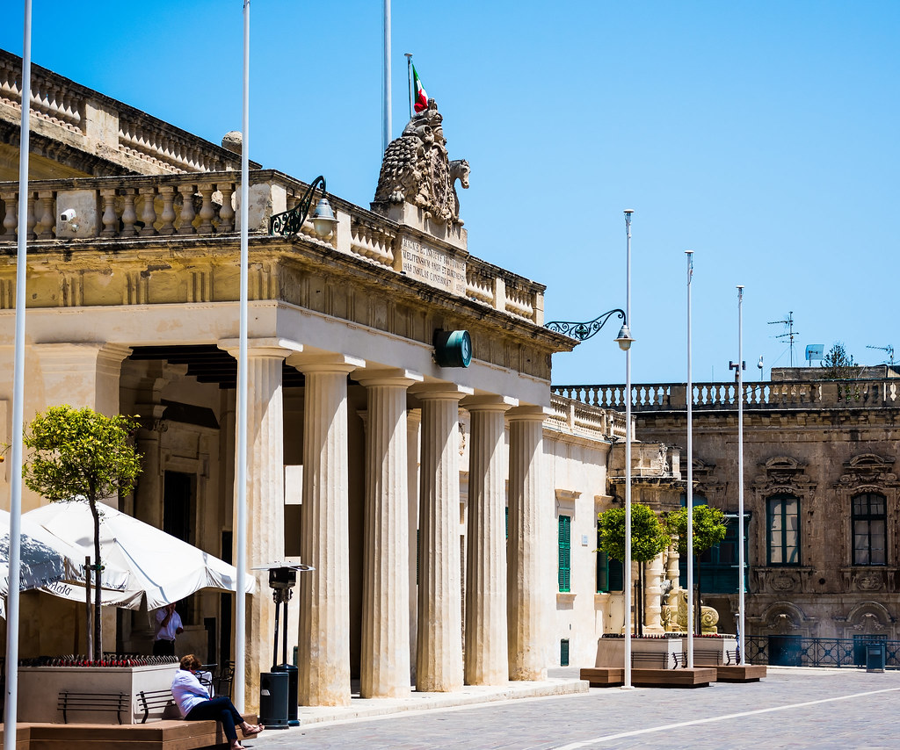
National Museum Of Archaeology
The National Museum of Archaeology is yet another gem that is housed in Auberge de Provence, in Valletta. This beautiful museum is home to numerous artifacts.
The museum now showcases the life of people from the Neolithic period all the way to the Phoenician age that dates back to 400 BC. You will see the earliest prehistoric tools used by the Maltese people during the Neolithic. Phoenician amulets and beautifully modeled prehistoric figurines such as the Sleeping Lady, which is believed to be around 5000 years old, are also some of the noteworthy elements
Admission: Adults (18+): €5.00 ; Senior Citizens (60+): €3.50 ;
Youths (12-17): €3.50 ; Children (6-11): €2.50

Slide 16
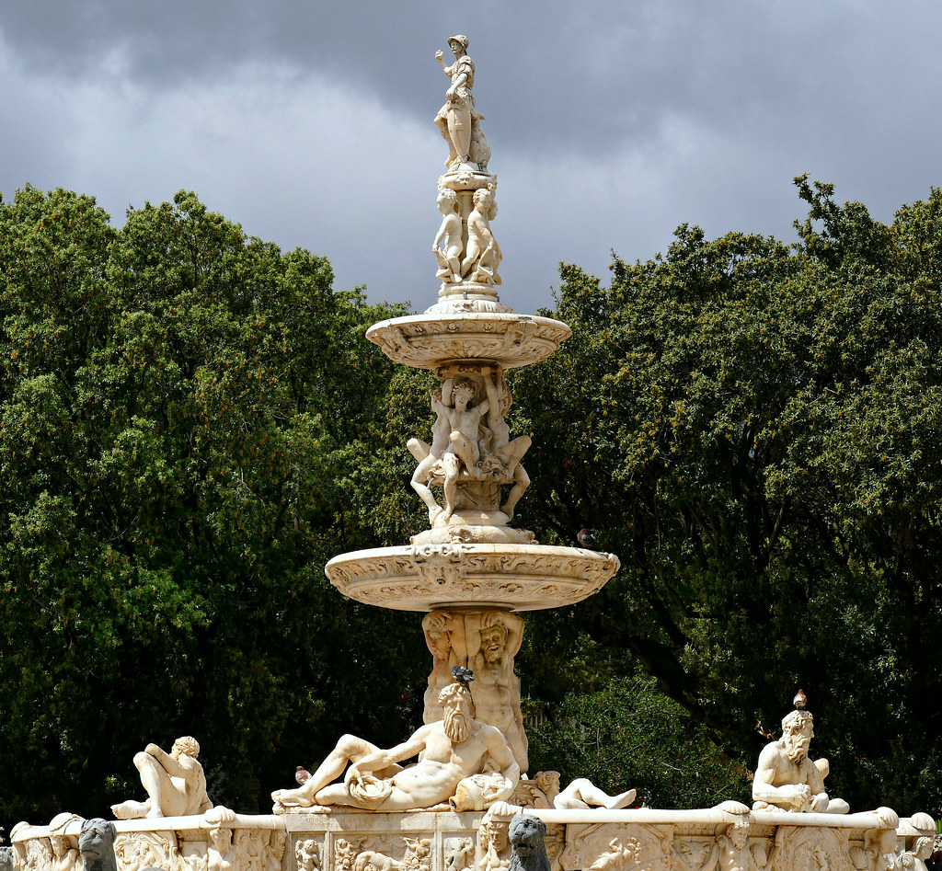
St. John's Co-Cathedral
St John's Co-Cathedral is located in the center of Valletta on the Malta Island. It was built in the 16th century by the Order of St. John and designed by the famous architect Girolamo Cassar. Besides having a significant religious heritage, the cathedral and its museum are considered as one of the finest examples of high Baroque architecture in all Europe. The church was dedicated to the patron saint of the Order, St John the Baptist. The sheer scale and grandeur of the church reflects the artistic patronage and the power of the Order.

Slide 17
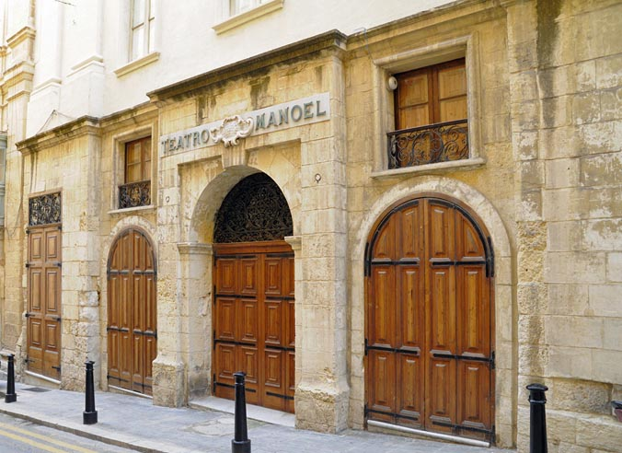
Teatru Manoel
Teatru Manoel was commissioned to be used as a public theater in 1731 by Antonio Manoel de Vilhena who was the Grandmaster of the Knights of Malta.
Theater was the main form of entertainment for the royals but eventually was also opened up for the public too. The whole theater is a beautiful rendition of the baroque style, with its opulent design elements, high
pillars, beautiful acoustics and the most amazing galleries in the theatre. It has 623 seats and the galleries are three-tiered, completely wooden with gold leaf-like motifs. The auditorium is oval shaped and the roof is pale blue and resembles a round cupola.
.
€8 entrance fee. Allow at least 2 hours.

Slide 18
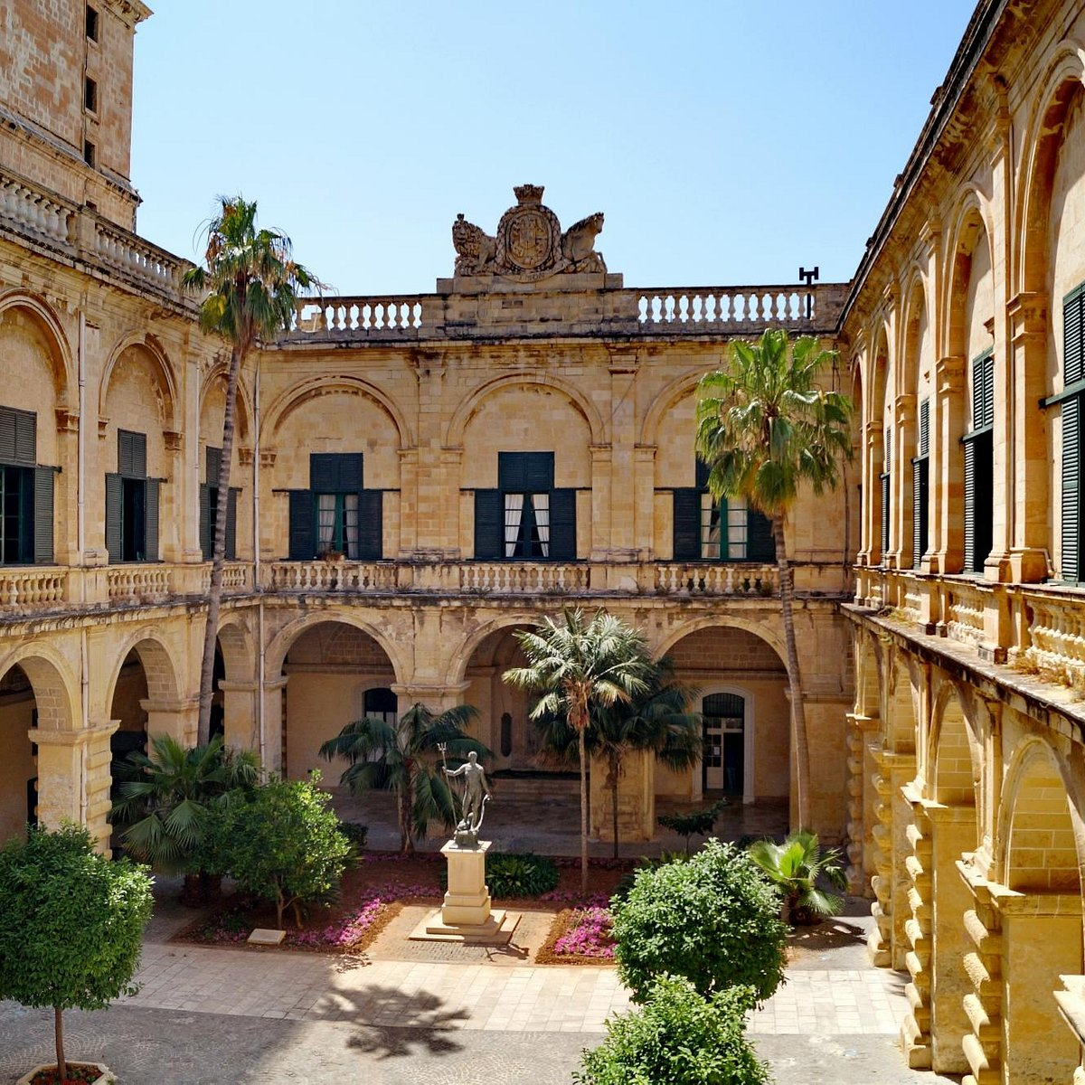
Grand Master's Palace
The Grandmaster’s Palace in Valletta is commonly referred to as ‘The Palace’ by the locals. It was built between 16th and 18th centuries as the administrative center from where the Grand Master of the Order of St. John ruled Malta. During the British reign, it served as the governor’s palace. Presently, this stately palace houses the office of the President and the House of Representatives of the Republic of Malta. It’s also used to
host state functions. Some parts of the building have been converted into a museum and are open for public viewing.
Adults 18-59 years € 10.00 / Senior 60+ € 7.00 / Children 6-11 years € 5.00 / Infants Free

Slide 19
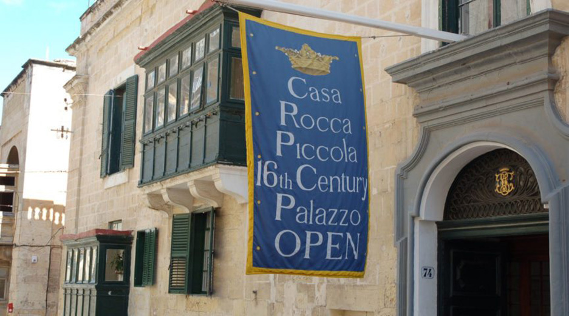
Casa Rocca Piccola
Casa Rocca Piccola is an imposing 16th century palace situated in Valletta. The palace is a privately owned residence of the Maltese Noble family de Piro and is often described as a 'living museum'. The 430 years old palace is a maze of rooms. One can visit about twelve magnificent rooms such the Chapel, the Archive Room, the Four Poster Bedroom, a summer and a winter dining room, the Library and the bomb shelters.
Admission tickets
Adults US $10.30
Children <14 FREE

Slide 20
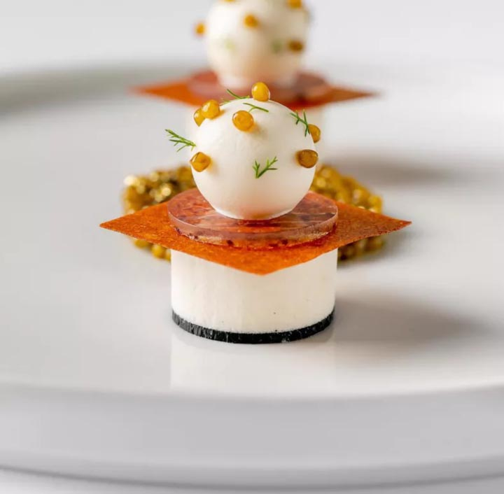
Michelin Star Restaurants
Valletta is the home of two Michelin Star restaurants. Many of us on the ship are foodies, so naturally we’re always on the hunt to eat at the most exclusive spots anytime we travel.
AKI
Corner of Strait Street & Santa Lucia Street, Valletta, VLT 1455, €€ · Japanese
Legligin
Triq Santa Lucia 116/119, Valletta, € · Regional
Rubino
53 Old Bakery Street, Valletta, €€ · Traditional
Guzé
22 Old Bakery Street, Valletta, €€ · Traditional
Aaron´s Kitchen
107 Archbishop Street, €€ · Traditional
Noni
211 Republic Street, Valletta, €€€ · Modern
For those of you that just like good food, you can’t go wrong just about anywhere you go in Cannes. After all this is Malta!
GOOD EATING

Slide 21
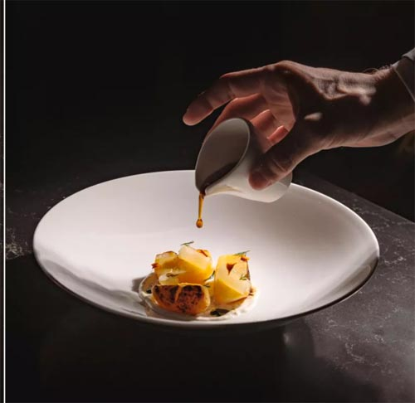
More Michelin Restaurants
59 Republic
St George's Square, Valletta, €€ · Classic
Under Grain
167 Merchants Street, Valletta, €€€ · Modern
Grain Street
167 Merchants Street, Valletta, € · Modern
ION - The Harbour
11 St Barbara Bastion, Valletta, VLT 1961, Malta
€€€€ · Mediterranean
The Harbour Club
4/5 Barrierra Wharf, Liesse Hill, Valletta
€€ · Modern
For those of you that just like good food, you can’t go wrong just about anywhere you go in Valletta. After all this is Malta!
GOOD EATING

Slide 22
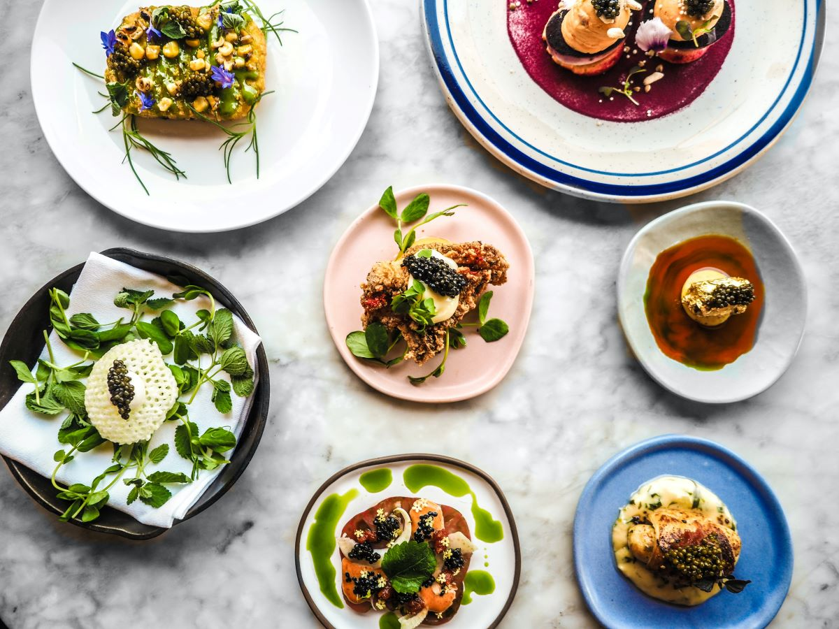
Home to Amazing Restaurants
Many of us on the ship are foodies, so naturally we’re always on the hunt to eat at the most exclusive spots anytime we travel. There are many creative restaurants to choose from that have Michelin stars, both in the city and in the surrounding area. Valletta is home to several Michelin-starred restaurants, perfect for those looking to enjoy fine dining. Here are a few recommendations:
Noni - 211 Republic Street, Valletta Cuisine: Modern Mediterranean €€€
Under Grain - 167 Merchants Street, Valletta Cuisine: Modern European €€€
ION - The Harbour - 11 St. Barbara Bastion, Valletta Cuisine: Mediterranean €€€€
Grain Street - 167 Merchants Street, Valletta Cuisine: Modern, Casual €€
59 Republic - St. George's Square, Valletta Cuisine: Classic European €€
These restaurants showcase the best of local and international culinary traditions, making Valletta a top destination for foodies. Whether you crave regional Maltese dishes or innovative modern cuisine, Valletta offers plenty of options to satisfy your palate.

Slide 23
Thanks For Coming
If you have any more questions, Please ask.
I will do my best to answer them for you.
Have a great visit in Valletta!

