Slide 1


Valencia Spain
Port Presentation
Presented by
Marc Silver

Slide 2
What I Will Cover
My Port Philosophy
Don’t Miss the Ship
Money
About Valencia
Valencia Points of Interest
24 Hour Tourist Card
Hop On – Hop Off
Places to see or at least consider
A few restaurant recommendations
Conclusion

Slide 3
My Port Philosophy
I have been cruising for over 43 years and have taken over 100 cruises. So I consider myself an experienced cruiser.
The information I will present is based on those many years of
experience.
When I am on a cruise where the city I want to visit is not the port city,
I always recommend taking a ship’s tour.
But when I am in a port with multiple attractions nearby and easy to see
on my own - I will do it on my own.
This presentation is for that type of port.

Slide 4
Don’t Miss the Ship
How to Avoid Missing Your Ship
Pay attention to the time. - Ship time and local time are often different.
Put a return to ship reminder on your phone.
Choose excursions wisely.
If a ship-sponsored excursion is late returning to port for, the ship will wait for you. If you are on your own???
Be Prepared
Have your Passport, Credit Card and phone numbers for your ship port agent.
What to Do If You Miss the Ship Most cruise lines have port agents stationed in the port area to assist if your ship has left without you. If your lucky, when cruisers are late returning to the vessel, the ship's crew will often remove the passengers' essential items -- passports, cell phones and medication -- from the ship to leave with the port agents.
The Port Officials can help you with contacting your ship and making necessary travel arrangements.

Slide 5
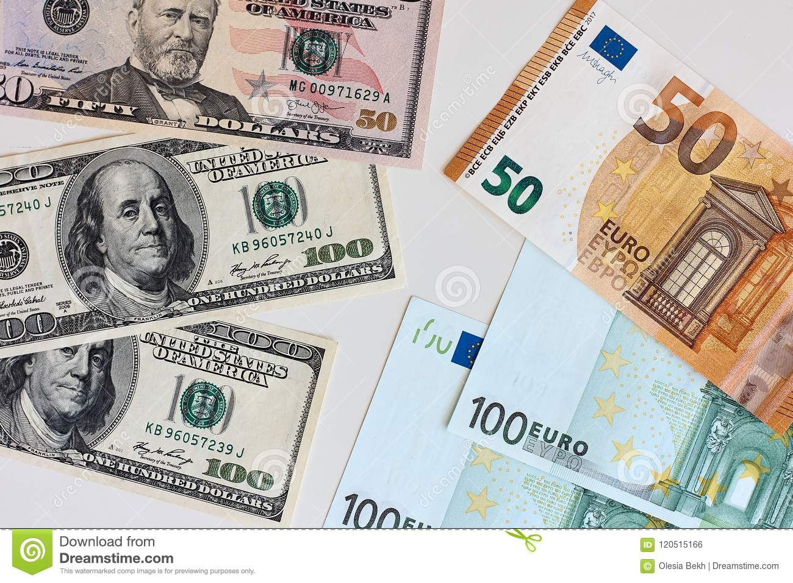
Money
The euro is the official currency of 20 European Union countries which collectively make up the euro area, also known as the euro-zone
Official Exchange is $1.079 US to €1

Slide 6
About Valencia
Valencia, one of the biggest cities in Spain, is a great place to visit. Located on the southern coast – in Costa Blanca – it offers a beautiful mix of modern and old buildings, fun street art, a bustling city center, lovely parks, beautiful beaches, palm and orange trees.
Valencia is rather compact, and you can see almost everything by just walking. You can also take either the Hop-On Hop-Off bus or use the Municipal Bus system.

Slide 7
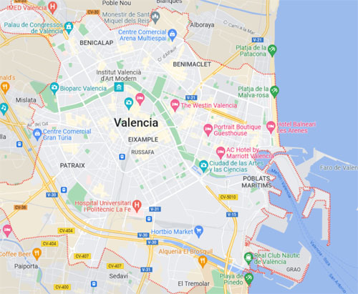
Valencia Points of Interest

Slide 8
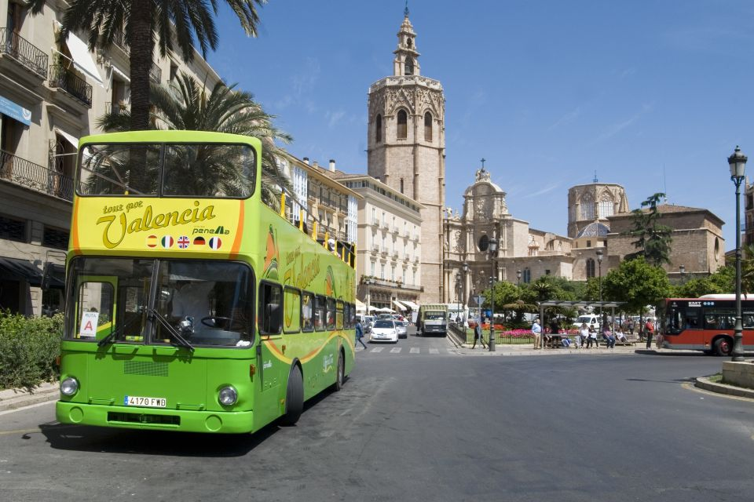
24 HourTourist Card
The Valencia Tourist Card is your key to the city. For 12 Euros it Includes:
Free public transport
Free entry to public museums and monuments
Discounts of up to 50% on 130 participating tourist and leisure services and in shops and restaurants
2 tapas & 2 drinks
Valencia Tourist Bus tickets are available to buy in the reception of most of the hotels in Valencia.

Slide 9
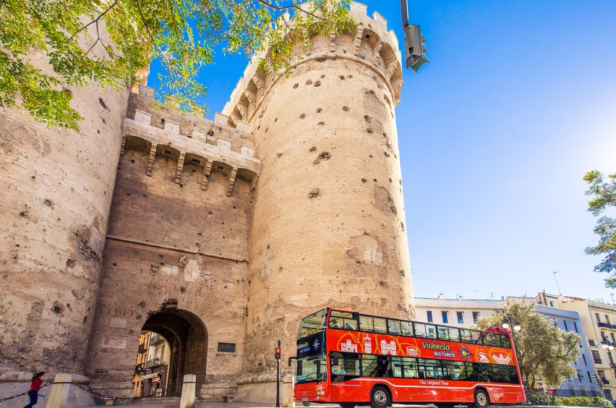
24 Hour Hop-on Hop-off Bus Ticket
I have to admit I rarely use the Hop-on Hop-off Bus, but in Valencia it's one of the easiest ways to see a lot. Tickets are available to see the sights at your leisure. The audio guide they provide talks about the landmarks of the city on each of their 17 stops.
Tickets From
€20
US$ 20.78 per person

Slide 10
Hop-on Hop-off Bus Stops
Here is a list of the Stops:
El Puerto. ...
Hotel Rey Don Jaime.
Plaza de la Reina.
Museo Fallero.
Plaza Monteolivete.
Ciudad de las Artes y las Ciencias. Autopista de El Saler nº 6.
Oceanografico. Camino de las Moreras. Centro Comercial Aqua.
Calle Menorca.
Playa de Las Arenas

Slide 11
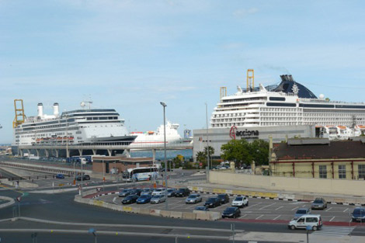
El Puerto
El Puerto is where we dock. A great area of the city to visit is Puerto De Valencia, lots of interest here,of course, the great looking boats and yachts, the architecture here is so interesting and there are some interesting statues, being a popular tourist area there are lots of pubs, bars, and restaurants around this area and of course the ubiquitous fast food outlets.

Slide 12
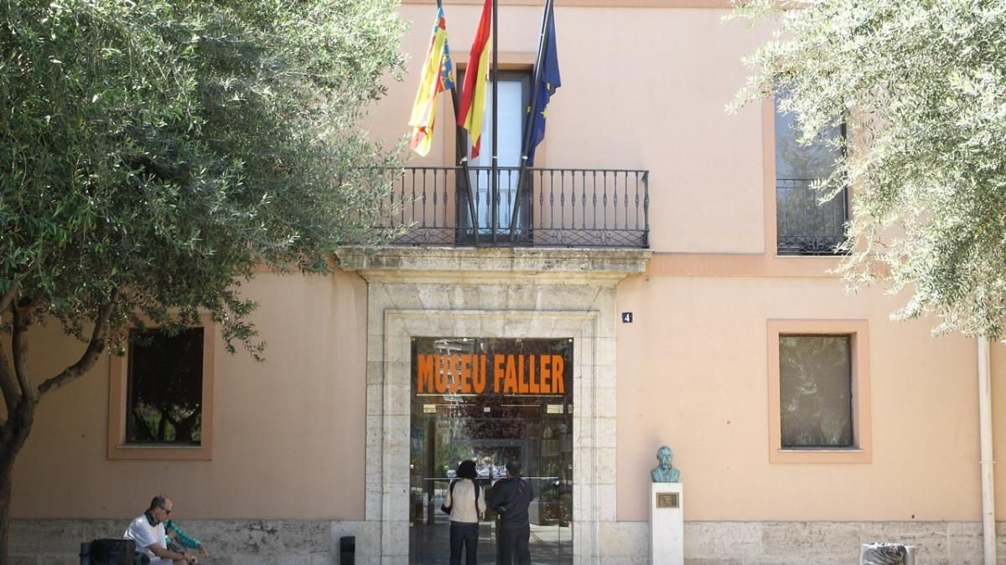
Museo Fallero

Slide 13
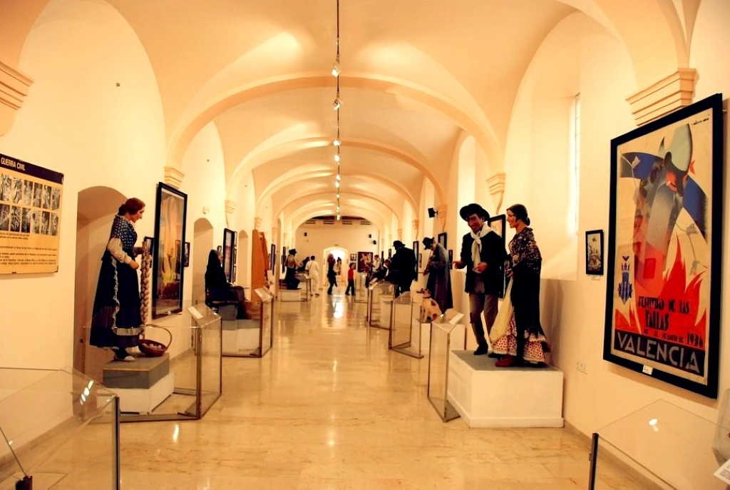
Museo Fallero
The Museo Fallero de València is the perfect opportunity to get to know the Fallas Festival.
The Fallas is a traditional celebration held annually in commemoration of Saint Joseph in the city of Valencia, Spain.
The origin of las Fallas comes from the old carpenter’s tradition who, when celebrating the arrival of spring on 19th March, used to burn pieces of wood (parots) that were used to prop up their lights during the winter.

Slide 14
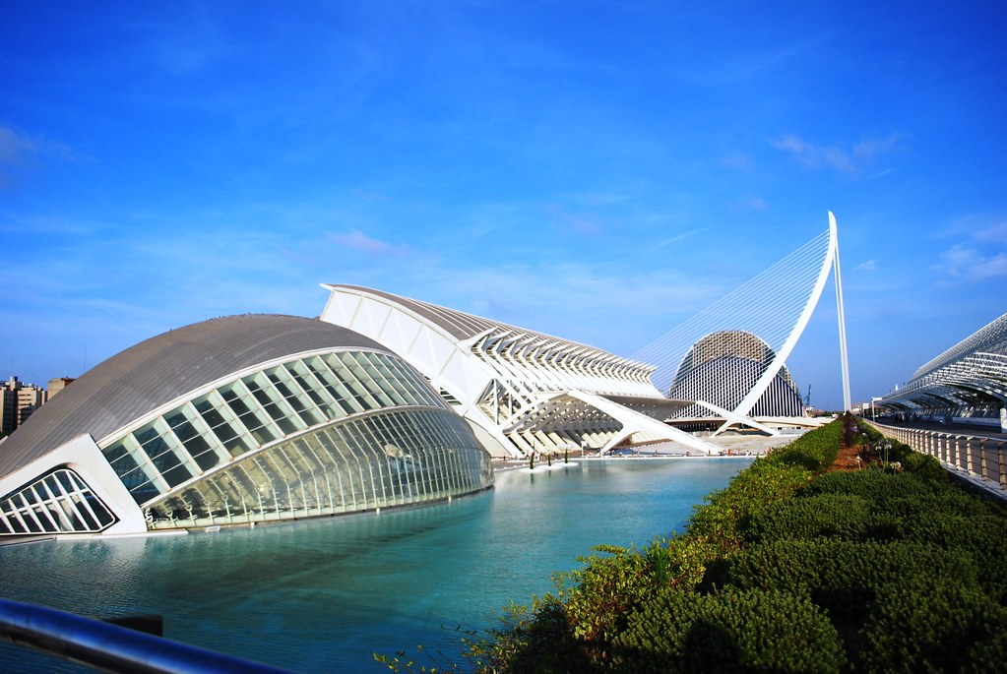
Ciudad de las Artes y las Ciencias.
Ciudad de las Artes y las Ciencias or The City of Arts and Sciences. It is considered the most important modern tourist destination in the city of Valencia and one of the 12 Treasures of Spain.
Addmission is: 6,70€

Slide 15
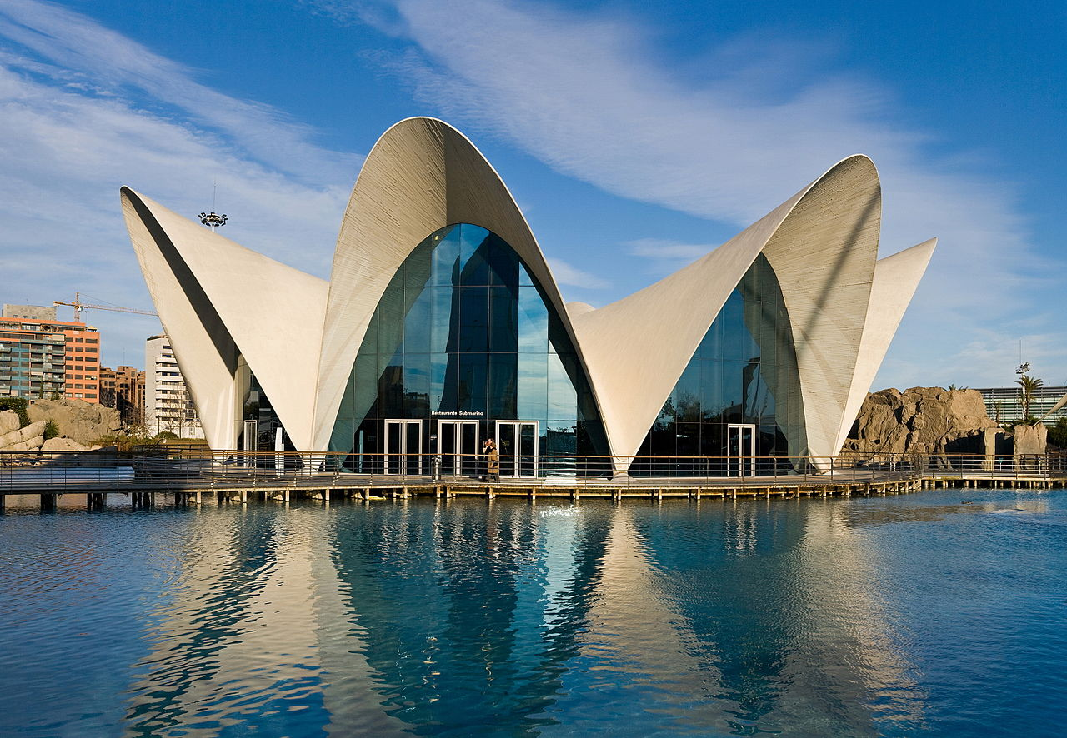
Oceanografico
The Oceanographic is one of
the worlds best Aquariums.
A visit there is like visiting
the seven seas and oceans.
More than 45,000 examples
of 500 different marine
species – among which can be
found sharks, Beluga whales,
walruses, sea lions, and more
inhabit 9 underwater towers.
Admission Prices Adults € 33.70

Slide 16
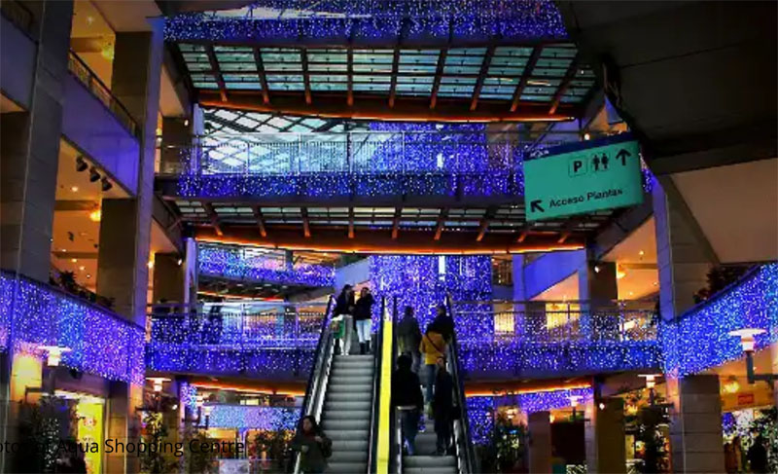
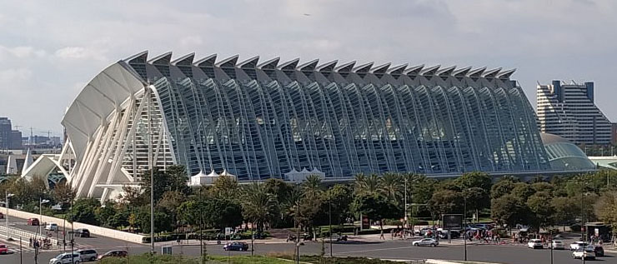
Centro Comercial Aqua
Aqua Shopping Centre is located near
the City of Arts and Sciences in
Valencia. The five floors of the mall
include local fashion and accessories,
services, restaurants, cafes , 10
Cinemas and even a sports club.
For shoppers, this is the Paradise you
have been looking for.

Slide 17
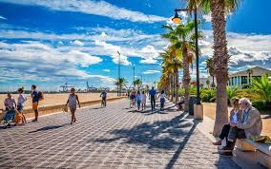
Playa de Las Arenas
Stretching north from the marina, this is the beginning of Valencia’s beach, the closest to the center and the focal point of seaside life. Backed by hotels and restaurants, it's a lively, busy strip that's also a major zone for summer nightlife. The beach is over 100m wide and a great place to walk and people-watch.

Slide 18
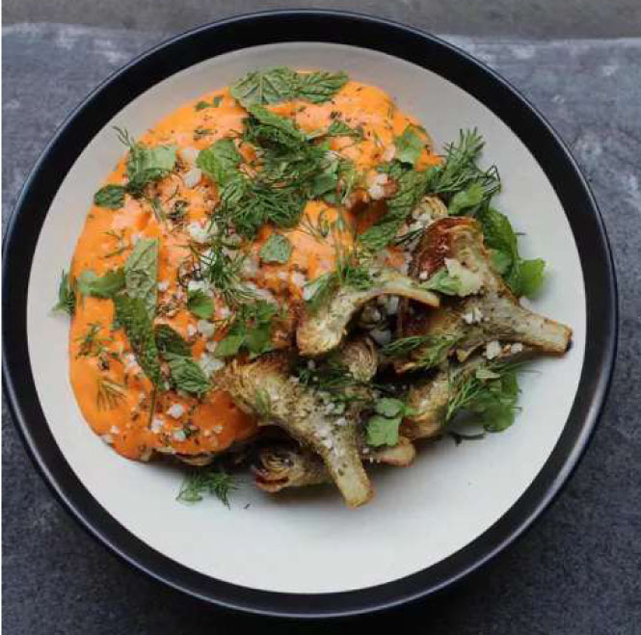
Valencia Michelin Star Restaurants
Valencia has 20 Michelin-star restaurants. Many of us on the ship are foodies, so naturally, we’re always on the hunt to eat at the most exclusive spots anytime we travel.
Here are a few of the Michelin Star Restaurants to consider.
El Poblet - Correos 8-1º, Valencia, €€€€ · Creative
Riff - Conde de Altea 18, Valencia, €€€€ · Creative, Modern Cuisine
Karak - Músico Peydró 9, Valencia, €€€ · Fusion
Llisa Negra - Pascual y Genís 10, Valencia, €€€ · Market Cuisine Habitual - Jorge Juan 19, Valencia, €€ · International
Nozomi Sushi Bar - Pedro III El Grande 11, Valencia, €€ · Japanese
Goya Gallery - Burriana 3, Valencia, €€ · Traditional Cuisine, Rice Dishes
Canalla Bistro - Maestro José Serrano 5, Valencia, €€ · Fusion
2 Estaciones - Pintor Salvador Abril 28, Valencia, €€ · Mediterranean
For those of you that just like good food, you can’t go wrong just about anywhere you go in Spain.
GOOD EATING

Slide 19
Conclusion
Valencia is a beautiful City with a rich history and numerous attractions. Whether you're looking for stunning beaches, historic sites, or unique attractions, Valencia has something for everyone.
I hope this presentation will help when we visit Valencia!

Slide 20
Thanks For Coming
If you have any more questions, please ask.
I will do my best to answer them for you.
Have a great visit in Valleencia!

