Slide 1
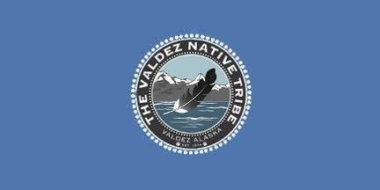
Valdez Alaska Presented by Fellow Cruiser Marc Silver

Slide 2
What I Will Cover
My Port Philosophy
Don’t Miss the Ship
About Valdez
Getting around Valdez
Points of Interest
Places to see or at least consider
Conclusion

Slide 3
My Port Philosophy
I have been cruising for over 45 years and have taken over 100 cruises. So, I consider myself an experienced cruiser.
The information I will present is based on those many years of
experience.
When I am on a cruise where the city, I want to visit is not the port city,
I always recommend taking a ship’s tour.
But when I am in a port with multiple attractions nearby and easy to see
on my own - I will do it on my own.
This presentation is for that type of port.

Slide 4
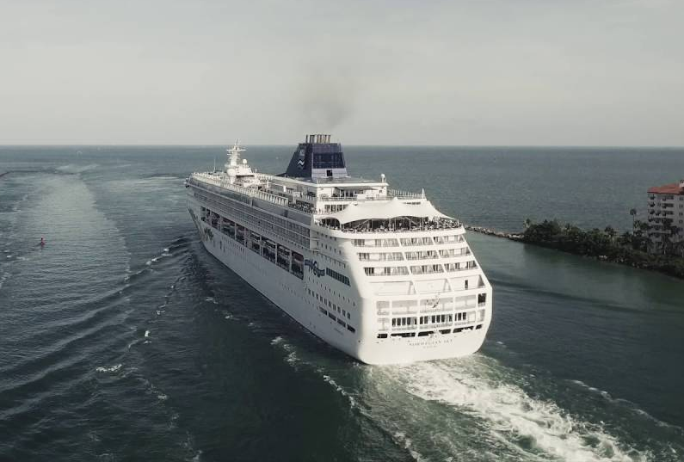
Don’t Miss the Ship
How to Avoid Missing Your Ship
Pay attention to the time. - Ship time and local time are often different.
Put a return-to-ship reminder on your phone.
Choose excursions wisely.
If a ship-sponsored excursion is late returning to port for, the ship will wait for you. If you are on your own???
Be Prepared
Have your Passport, Credit Card and phone numbers for your ship port agent.
What to Do If You Miss the Ship Most cruise lines have port agents stationed in the port area to assist if your ship has left without you. If you’re lucky, when cruisers are late returning to the vessel, the ship's crew will often remove the passengers' essential items -- passports, cell phones, and medication -- from the ship to leave with the port agents.
The Port Officials can help you with contacting your ship and making necessary travel arrangements.

Slide 5
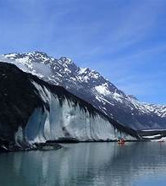
About Valdez
The Valdez deepwater port, at the head of a long, dramatic fjord, was first developed with the 1898 Klondike gold rush and an ill-fated attempt to establish an alternative route to the gold fields from here.
The area around Valdez was never permanently inhabited before the founding of the town by white settlers, although Natives did use the land for hunting and fishing.
The City was founded just prior to the turn of the 20th century as a gateway to the "All-American Route" to interior gold and copper fields.

Slide 6
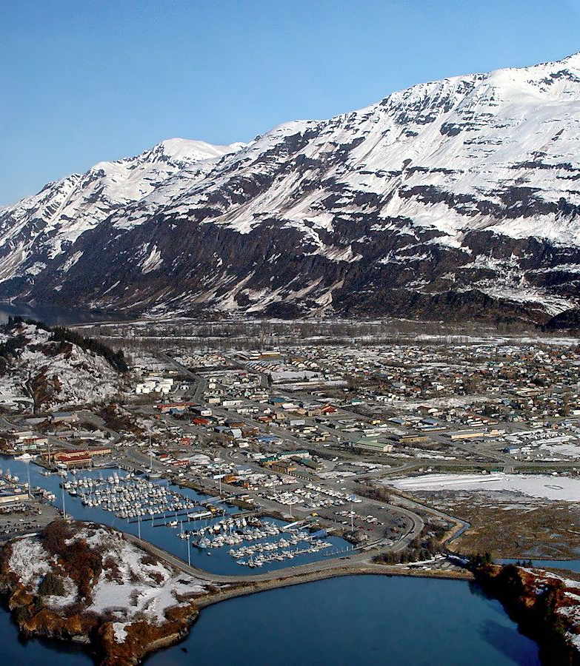
About Valdez
Incorporated in 1901, the community's first hundred years have been marked by a number of significant events the most notable of which are: The 1964 Alaska Earthquake, being chosen as the terminus of the trans-Alaska Pipeline, and the 1989 Exxon Valdez Oil Spill.
Valdez has a friendly, Alaskan small-town feel. Not only do they enjoy a myriad recreational opportunities, but they also take pride in a quality of life provided by mountain coastal living at its best.
You can enjoy the endless open space and wilderness; surrounded by the Chugach national forest, with over 30 miles of recreation paths and trails.

Slide 7
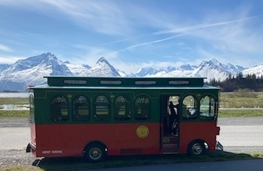
Getting Around Valdez
The main part of the town and boat harbor are compact enough to walk, but you will need wheels for the attractions on Dayville Road, most of the hiking trails.
Rental cars are available at the airport, but not near the port.
Taxis are available from Valdez Yellow Cab (tel. 907/835-2500).
Trolley Town Tour
Hop on the vintage trolley and learn the layout of the town. You will be show downtown and the best spots to explore on your own, shop, eat and drink.
This trip includes a 15-minute stop at the waterfall and viewing area, stop at Kelsey or Dock Point for pictures and option to get off the Trolley at the beginning of the Brewery Row for a refreshing drink or bite to eat or continue to the starting point at the Visitor Center.
This trip is narrated with interesting and fun info about Valdez.
Adult fare is $30

Slide 8
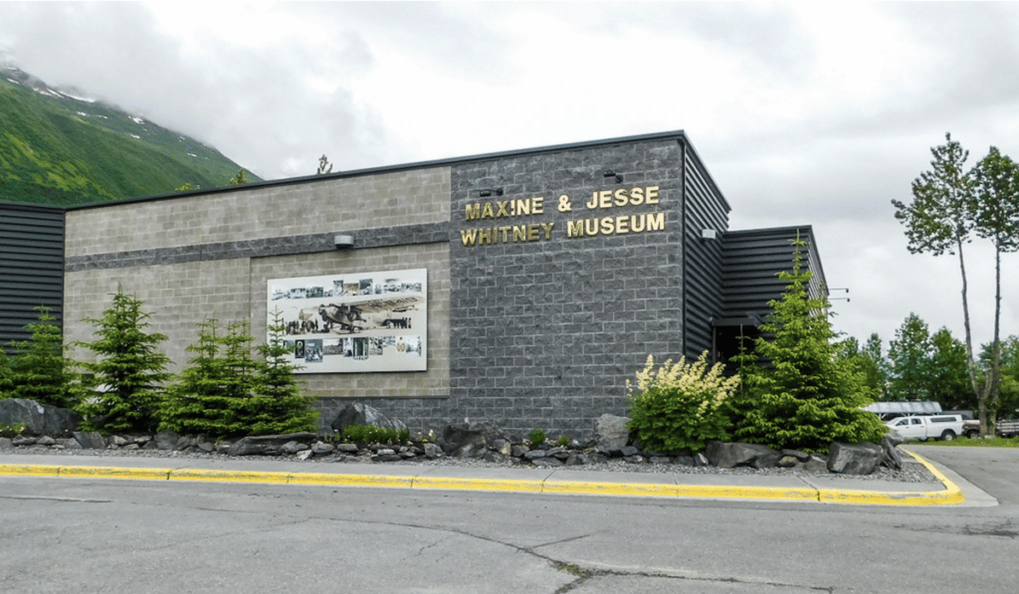
Maxine & Jesse Whitney Museum
The Maxine & Jesse Whitney Museum contains one of the largest collections of Native Alaskan art and artifacts in the world.
The Whitneys came to Alaska in 1947, and Maxine traveled to Native villages throughout the territory, buying items directly from the artists to sell in her gift shop.
In 1969, Maxine assumed ownership of the Eskimo Museum in Fairbanks and continued collecting until the mid-1980s.
The collection was donated by Ms. Whitney to Prince William Sound Community College in 1998. The artifacts were housed in a climate-controlled facility at the Valdez Airport for ten years and now finds a permanent home in the new state-of-the-art museum adjacent to the college.
Admission is free, but donations are always gratefully accepted.

Slide 9
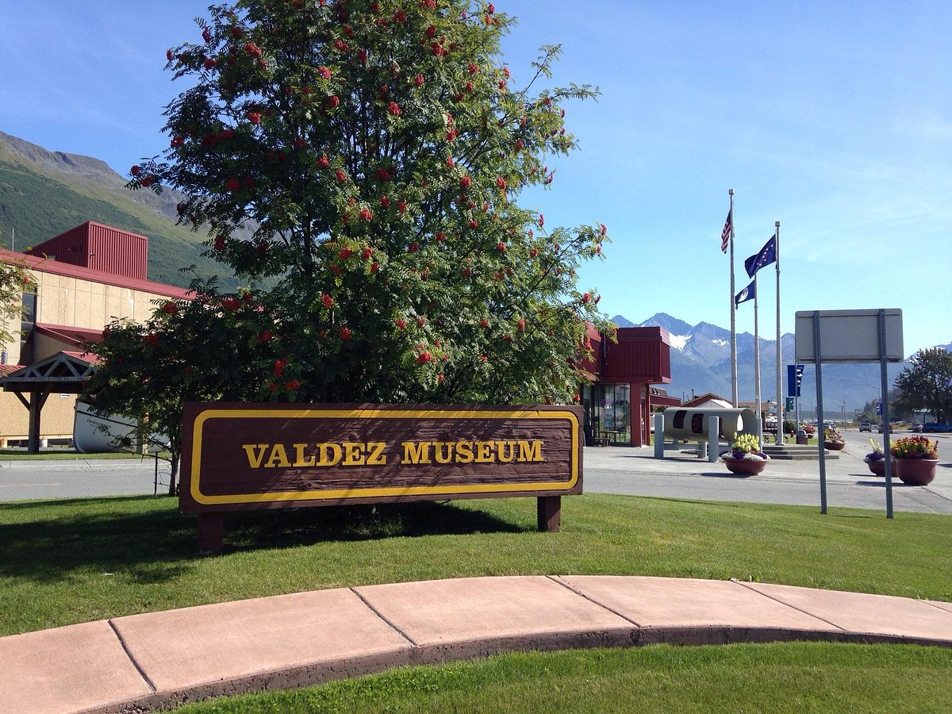
Valdez Museum
The Valdez Museum’s permanent historical exhibits reflect the history of Valdez, the Copper River Valley, and Prince William Sound from the earliest days, when Native Alaskans first occupied the area, to the present day.
Exhibits are located in two buildings that are four blocks apart. They recommend that visitors come to the Valdez Museum on Egan first for an overview of area history and then visit the Valdez Museum on Hazelet location to gain a broader understanding of the period of time surrounding the 1964 Good Friday Earthquake.
In 2007, the Valdez Museum opened up a a 600 square-foot portion of its space dedicated to Alaska Natives, for the interpretation of the history and culture of the Natives of Prince William Sound and the Copper River Basin.
Adults-$12.00
Senior (62 +)-$9.00
Active Military – $9.00
Youth(14 -17)-$7.00
Youth (13 and younger)-Free
Adults:$12.00 / Senior (62 +): $9.00
Active Military: $9.00
Youth (14 -17): $7.00 / Youth (13 and younger): Free

Slide 10
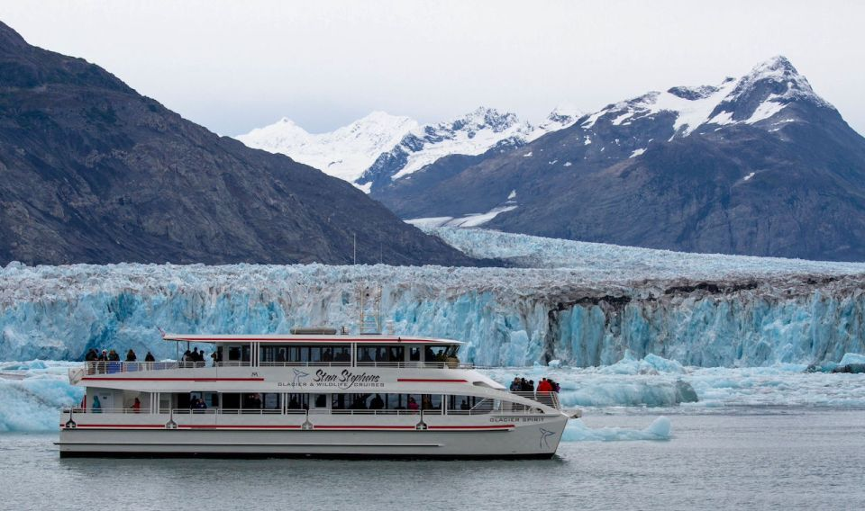
Columbia Glacier Cruise
Visit the Columbia Glacier area and view history in the making as Columbia Glacier retreats into the Chugach Mountains.
Take the chance to see otters, seals, whales, sea otters, and more. Duration 6 hours
Tour Pricing: From $167.00 per person

Slide 11
Conclusion
Valdez is a beautiful City with a rich history and numerous attractions. Whether you're looking for stunning views, historic sites, or unique attractions, Valdez has something for everyone.
I hope this presentation will help when we visit Valdez.

Slide 12
Thanks For Coming
If you have any more questions, please ask.
I will do my best to answer them for you.
Have a great visit in Valdez!

Slide 13
Acknowledgement
My seminars are the result of many years of travel experience combined with many hours of research over the internet.
I would like to acknowledge the many source I have accessed.
These include: Wikipedia.com, Britannica.com, Trip Advisor and the various Museum, Park and Government websites.

