Slide 1
Ushuaia, Argentina
The End of the World
Presented by
Marc Silver

Slide 2
What I Will Cover
My Port Philosophy
Don’t Miss the Ship
Money
About Ushuaia
Maps
The Indigenous People
Ushuaia History
The Landscape
Getting around Ushuaia
Walking Tour
Places to see or at least consider
Practical Tips
Conclusion

Slide 3
My Port Philosophy
I’ve been cruising for over 46 years and have taken more than
100 cruises, so I consider myself an experienced cruiser.
The information I’m sharing comes from all those years at sea.
When the city I want to visit isn’t the same as the port city,
I always recommend taking a ship’s tour.
But when a port has plenty to see nearby and it’s easy to explore,
I’ll do it on my own.
This time, it’s worth letting the ship handle the logistics.

Slide 4

Don’t Miss the Ship
How to Avoid Missing Your Ship
Pay attention to the time. - Ship time and local time
are often different. Ship time doesn’t always match
local time. Put a return-to-ship reminder on your phone.
Choose excursions wisely.
If a ship-sponsored excursion is late returning to port,
the ship will wait for you. If you are on your own.
Be Prepared
Have your Passport, Credit Card, and phone numbers for your ship port agent.
What to Do If You Miss the Ship
Most cruise lines have port agents stationed in the port area to assist if your ship has left without you. If you are lucky, when cruisers are late returning to the vessel, the ship’s crew will often remove the passengers’ essential items – passports, cell phones, and medication -- from the ship to leave with the port agents.
The Port Officials can help you with contacting your ship
and making necessary travel arrangements.

Slide 5
Money
The Argentine Peso
The official exchange rate is:
$1.00 US = 1,400 Argentine Pesos (ARS$)
100 Argentine Peso = 0.07 US Dollar
As of 2025, the rate hovers around 1,400 ARS to 1 USD,
but it changes daily.

Slide 6
About Ushuaia
Ushuaia lies at the southern tip of South America on the island of Tierra del Fuego.
Known as El Fin del Mundo—“The End of the World”
It’s the world’s southernmost city and gateway to Antarctica. Snow-capped mountains rise behind a colorful harbor filled with fishing boats and expedition ships.
Visitors come for its dramatic scenery, wildlife, and rugged charm. From here, you can sail the Beagle Channel, spot penguins and sea lions, or take the scenic train once used by prisoners who helped build the city.

Slide 7
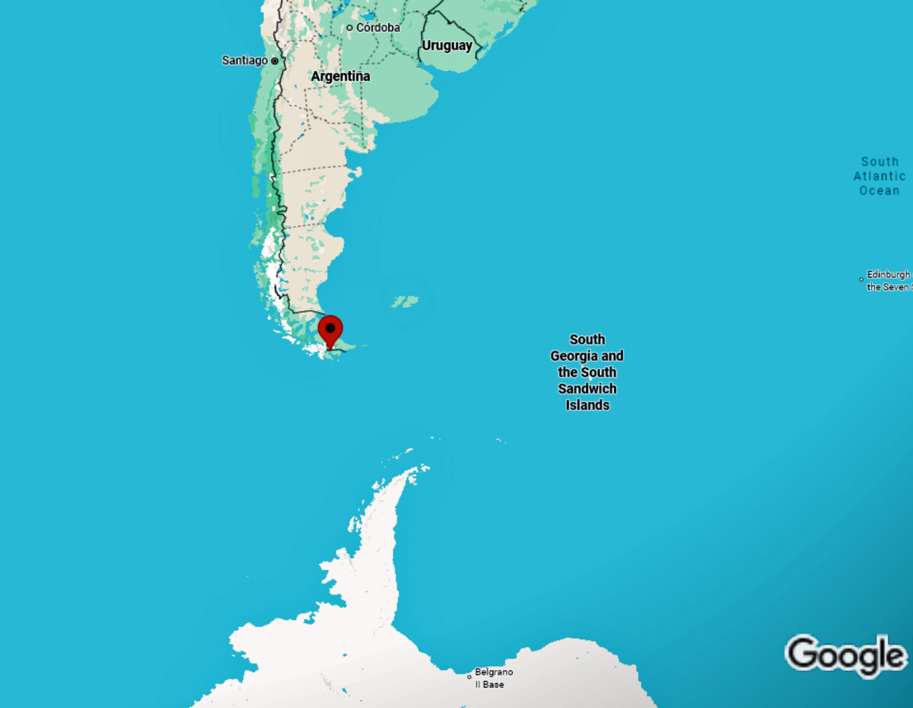
Puerto Madryn

Slide 8
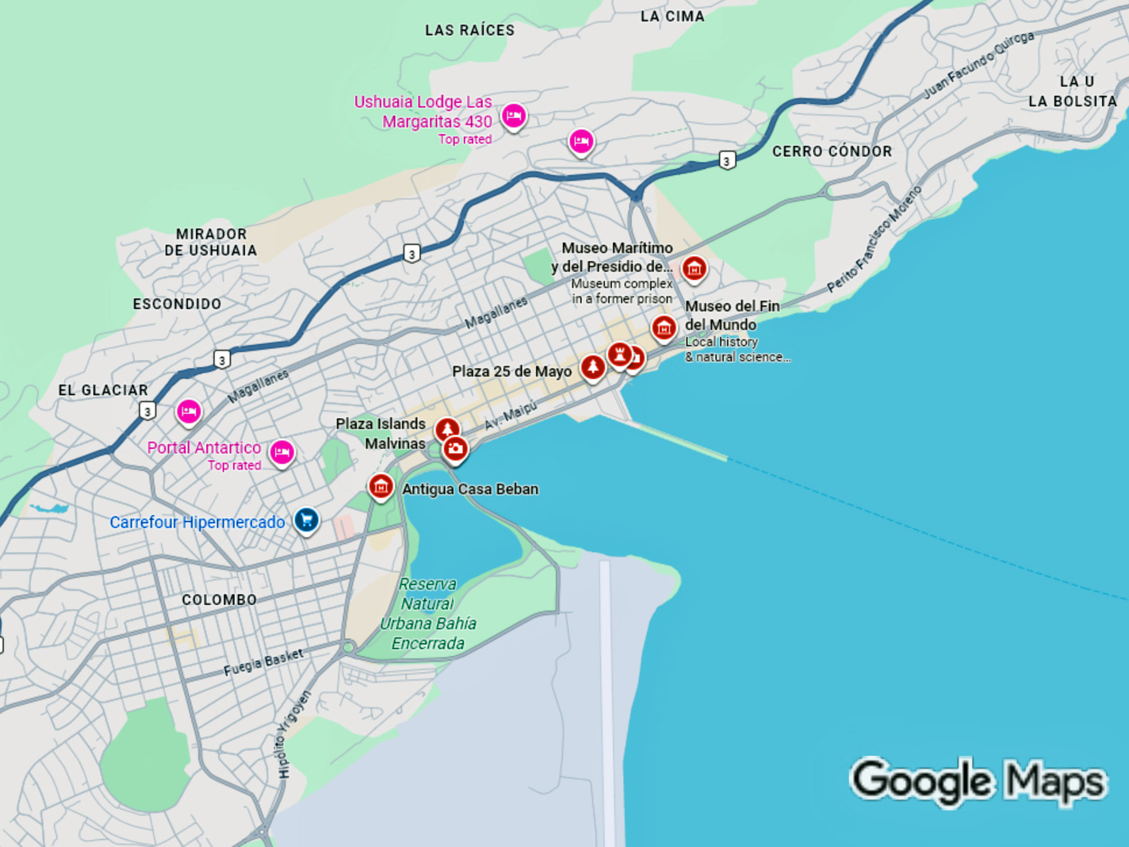
Puerto Madryn
Cruise Port

Slide 9
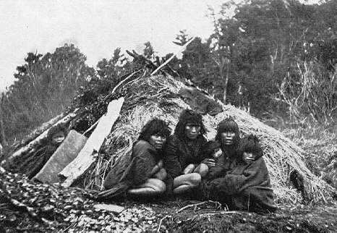
The Indigenous People
The Indigenous Yámana, also known as
Yaghan or Yahgan, were the original
inhabitants of Ushuaia and the wider
Tierra del Fuego archipelago.
For thousands of years before European
contact, they lived along the cold
southern channels, mastering one of the harshest environments on earth.
Expert seafarers, the Yámana built canoes from bark, hunted sea lions, and gathered shellfish, relying on the sea for nearly every aspect of life.
Their deep bond with the water shaped their language, spirituality, and traditions. Today, a few Yaghan descendants remain in southern Chile and Argentina, keeping their remarkable heritage alive.

Slide 10
A Brief History
In 1833, HMS Beagle visited with Charles Darwin.
Argentina established a penal colony here in 1884.
The prison closed in 1947; now it’s a maritime and prison museum.
Ushuaia began as a small settlement for missionaries and explorers in the late 1800s. Argentina later established a penal colony there, and prisoners helped build much of the town’s early infrastructure.
Over time, it grew from an isolated outpost into a key naval base and port. Today, Ushuaia is known not for its prison but as a gateway to Antarctica and Patagonia, blending rugged history with stunning natural beauty.

Slide 11
The Landscape
Ushuaia is framed by the Martial Mountains and the Beagle Channel.
Dramatic scenery includes glaciers, peat bogs, and beech forests.
Subpolar climate:
brisk winds, rain,
and occasional
summer snow.

Slide 12
Getting Around Ushuaia
Ushuaia is compact and easy to explore. Most attractions are within walking distance of the cruise port, though taxis are plentiful and affordable.
Taxis charge about 800 pesos base fare plus 100 pesos per kilometer; a typical ride across town costs 3,000–4,500 pesos ($3–$4.50 USD).
Rideshare options like Uber and DiDi operate intermittently, often at similar rates.
Local buses serve nearby neighborhoods for around 300–400 pesos ($0.30–$0.40 USD) per ride, paid with a SUBE card.
For out-of-town excursions—like Tierra del Fuego National Park—organized tours or private shuttles are the most convenient choice.

Slide 13
Walking Tour
Start: Ushuaia Cruise Port
1. Avenida Maipú - Exit the port and stroll along this waterfront street lined with shops and cafés. The harbor views are excellent, and you’ll spot fishing boats and Antarctic vessels.
2. Plaza Cívica 12 de Octubre - short walk inland brings you to this small plaza, where the Argentine flag marks the country’s southernmost administrative point.
3. Museo del Fin del Mundo - Just a few minutes away, this small museum tells the story of early explorers, the Yámana people, and Ushuaia’s growth as a penal colony.
4. St. Christopher Shipwreck - Return to the waterfront to see this photogenic 1940s ship resting just offshore—one of Ushuaia’s best-known landmarks.
5. End: Cruise Port - Follow the waterfront back toward the terminal, stopping for souvenirs or a coffee at one of the nearby cafés overlooking the Beagle Channel.
This walk should take Approx. 2 hours

Slide 14
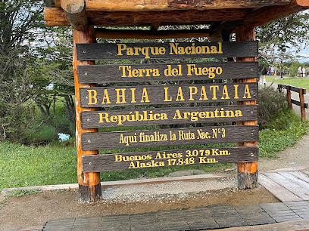
Tierra del Fuego National Park
Tierra del Fuego National Park lies just west of Ushuaia, where the Andes meet the sea.
It’s a landscape of forests, rivers, and glaciers framed by the Beagle Channel.
Visitors can hike scenic trails, ride the End of the World Train, and spot foxes, condors, and beavers while taking in some of Argentina’s most dramatic scenery.

Slide 15
End of the World Train
The End of the World Train, or Tren del Fin del Mundo, follows the route once used by prisoners from Ushuaia’s penal colony to haul wood in the early 1900s.
Today, it’s a scenic heritage railway that winds through forests, rivers, and mountains on the edge of Tierra del Fuego National Park. Steam locomotives and vintage carriages recreate the past while offering travelers breathtaking views of Patagonia’s rugged southern frontier.

Slide 16
Beagle Channel Cruise
Sea lions and penguins.
A Beagle Channel cruise is one of Ushuaia’s most popular excursions, offering stunning views of snow-capped mountains and remote islands.
Boats glide past colonies of sea lions and cormorants, and many trips stop near Les Éclaireurs Lighthouse, often called the “Lighthouse at the End of the World.”
Beagle Channel Cruises run about $150 USD/person
Some cruises venture farther to penguin rookeries or small settlements, giving visitors a close look at the wild beauty that defines Patagonia’s southernmost waters.

Slide 17
Maritime & Prison Museum
Ushuaia’s Maritime and Prison Museum is housed in the former penitentiary that once held Argentina’s most notorious criminals.
The museum preserves original cells and corridors, offering a glimpse into prison life at the “End of the World.” Exhibits also highlight maritime exploration, Antarctic expeditions, and the region’s naval history, making it one of Ushuaia’s most fascinating cultural stops.
Admission (as of 2025) is approximately ARS 36,000 for adults, ARS 28,000 for students (with ID), and free for children under 12.
Notes:
$25.70 for adults
$20 for Students

Slide 18
Laguna Esmeralda
Emerald glacial lake
Laguna Esmeralda is a glacial lake nestled in the Fuegian Andes, about 12 miles from Ushuaia.
Its name, meaning “Emerald Lagoon,” comes from the brilliant turquoise color created by mineral-rich glacial meltwater.
A popular half-day hike leads through forests and peat bogs to the lagoon, surrounded by snow-capped peaks.
It’s a peaceful spot that captures the rugged beauty of Tierra del Fuego’s wilderness.
Tours run about $190 USD + Including: picks from hotels, lunch, and transportation.
Notes:
Beagle Channel Cruises: ~ USD 150
Half-day tours (e.g. Tierra del Fuego park + train): USD 60–125
Full-day combined tours: USD 150–175
Private/custom tours: USD 400–800

Slide 19
Wildlife and Nature
Rich ecosystems: sea lions, seals, Magellanic and gentoo penguins.
Offshore islands teem with seabirds and whales.
Key departure point for Antarctic expeditions.

Slide 20
Gateway to Antarctica
Ushuaia is the main port for Antarctic cruises, with over 90% of expeditions departing from its harbor.
From here, ships cross the 600-mile Drake Passage to reach the White Continent. Adventure tourism drives much of Ushuaia’s economy, making it a vital hub for explorers, scientists, and travelers heading to the end of the world.

Slide 21
Local Life and Culture
Population: About 80,000 Ushuaienses.
Known for their resilient, independent spirit, residents have built a thriving city at the edge of the world.
Ushuaia’s architecture blends modern design with alpine charm, reflecting its mountain setting.
Local cuisine highlights fresh king crab, Patagonian lamb, and fine Argentine wines, offering visitors a true taste of Tierra del Fuego.

Slide 22
Day Trip Ideas
Beagle Channel Cruise – Spot sea lions, cormorants, and Les Éclaireurs Lighthouse.
Tierra del Fuego National Park – Easy hikes, lakes, and the world’s southernmost post office.
End of the World Train – Ride the historic narrow-gauge railway built by prisoners.
Martial Glacier – Scenic chairlift ride and panoramic views over the city and Beagle Channel.

Slide 23
Practical Tips
Currency: Argentine Peso (ARS).
Language: Spanish.
Weather: unpredictable; bring layers.
Souvenirs: wool goods, penguin carvings, Antarctic memorabilia.
Best season: November to March.

Slide 24
Reflection & Closing
“Here, nature rules — vast, unspoiled, and magnificent.”
Ushuaia is Patagonia’s frontier — where land meets sea and wildlife reigns free.

Slide 25
Q&A
Questions & Curiosities
Let’s explore Patagonia together.

Slide 26
Thanks For Coming
If you have any more questions, please ask.
I will do my best to answer them for you.
Have a great visit to!

