Slide 1
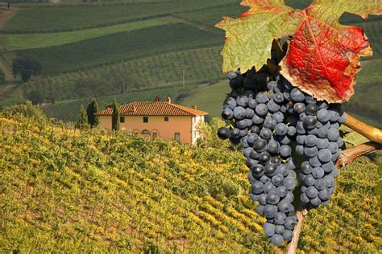
The Wine Regions of Tuscany
Presented by
Marc Silver

Slide 2
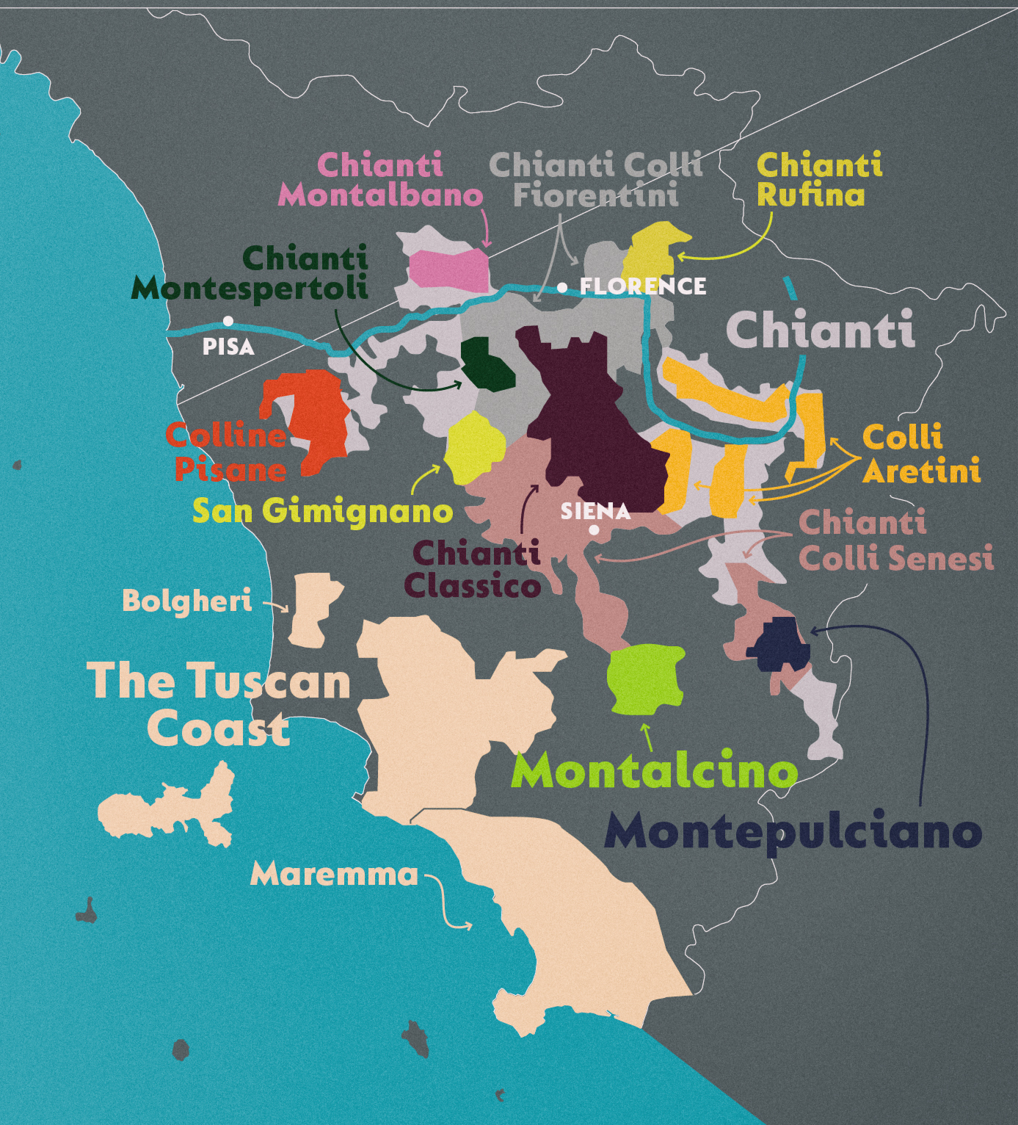
Wine of Tuscany
Tuscany: (Toscana) is a region in central Italy, bordered by the Tyrrhenian Sea to the west, Liguria, and Emilia-Romagna to the northwest and northeast, respectively, and Umbria to the south.
The capital of Tuscany is Florence, but the region is also home to the cities of Arezzo, Livorno, Lucca, Pisa, Prato, and Siena.
Tuscan wines have long held a reputation for producing some of the best wines in Italy.
As a prolific central region encompassing many notable subregions like Chianti, Montalcino, and Montepulciano, Tuscany is the fifth-largest region in Italy. It ranks third in total DOC and DOCG appellations, just behind Piedmont and Veneto.

Slide 3
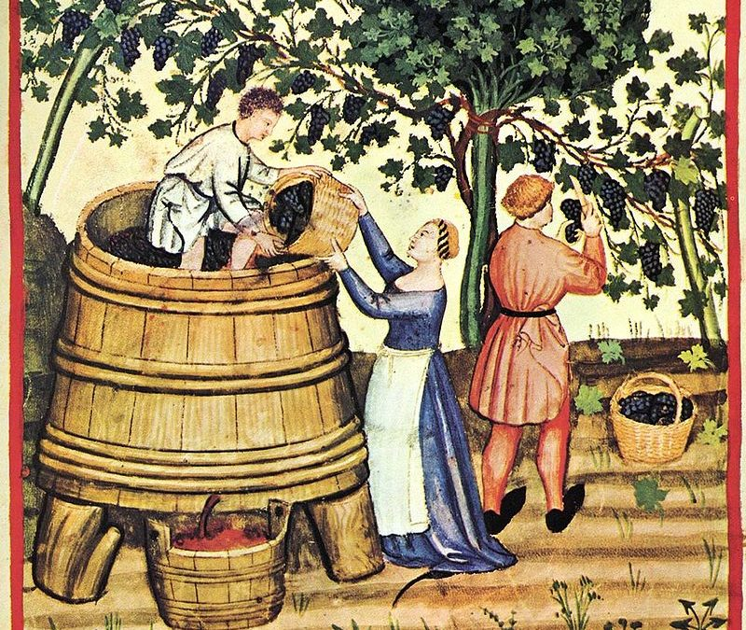
Winemaking History in Tuscany
Winemaking in Tuscany can be traced back to the settlement of the area by the ancient Etruscans in the eighth century BC.
Archaeological evidence points to wine being exported to southern Italy and the surrounding regions of what would become France, Switzerland, and Germany a century later, and a few hundred years after that, references to Tuscan wine had begun to pop up in Greek literary texts.
After a brief renaissance in the aftermath of the Napoleonic Wars, the region’s wine production suffered when a bacterial fungus destroyed many of
the vineyards in the 1850s, causing many vintners to leave the area
or emigrate abroad.
In the 1970s, winemakers in Tuscany, inspired by their visits to
Bordeaux, began experimenting with international varieties as well
as barriques and extended macerations. They began to believe that
Italy could also produce fine wine, and so the ‘Super Tuscan’
phenomenon was born—bold wines made from blends of
Sangiovese with grapes like Cabernet Sauvignon and Merlot.

Slide 4
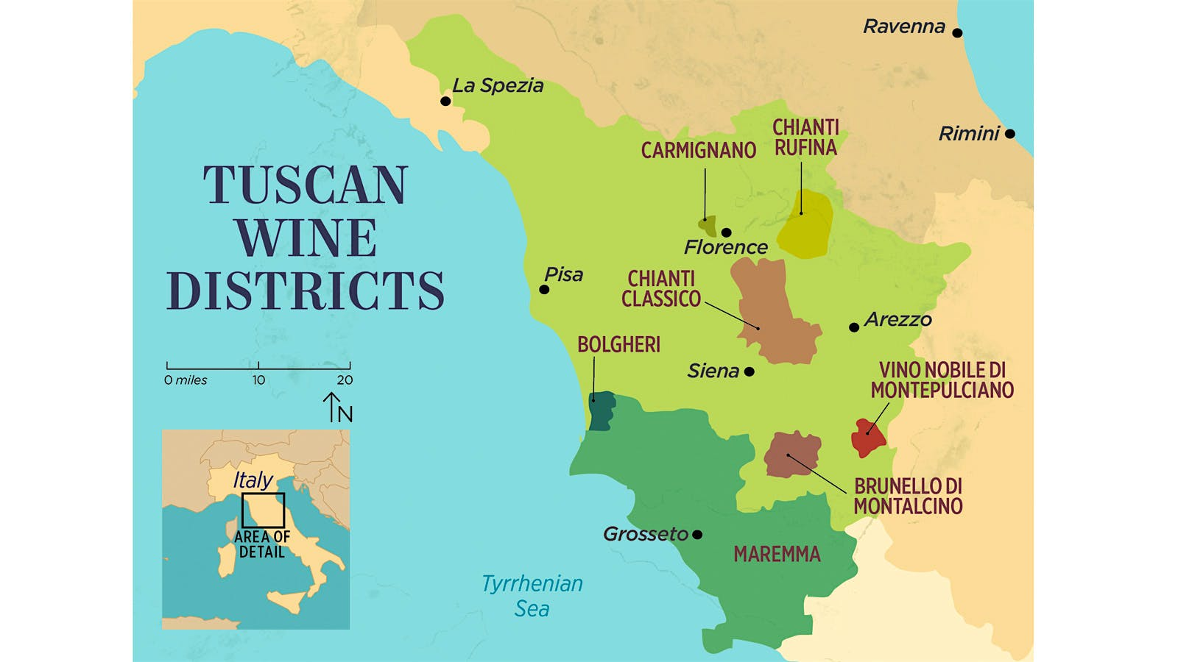
The Wine Regions of Tuscany
As a prolific central region encompassing seven main notable wine subregions like Chianti, Montalcino, and Montepulciano. Tuscany the fifth-largest region in Italy.
It ranks third in total DOC (Denominazione di origine controllata) and DOCG (Denominazione di origine controllata e garantita) appellations, just behind Piedmont and Veneto.
Typically, dry wines are produced in the Tuscany wine region, which appears rather light in the body. A freshly opened and not long-aged Tuscan wine reminds the nose of cherries, sometimes also sour cherries and red currants. On the palate,
you can feel the racy acidity of young wines, which are
reminiscent of red berries and have a more herbal character.
More concentrated wines can be found among the more
highly classified Tuscan wines such as from Chianti and
among the best riservas from Brunello and Vino Nobile.
These combine a richer, fuller aroma with balanced tannins.

Slide 5
The Wine Regions of Tuscany
Montalcino: Montalcino, located in the province of Siena, is the warmest and driest area in Tuscany, which allows the Sangiovese grapes planted there to achieve maximum ripeness.
A cooling air current from the Tyrrhenian Sea brings the temperature down at night, which contributes to a balance of fruit ripeness and acidity in the grapes.
Brunello di Montalcino (known as Brunello for short), is
a red wine from this region. Brunello was granted DOCG
status in 1980 and must be made from 100 percent
Sangiovese grapes. It has a savory herbal quality, with
notes of cranberry, strawberry, espresso, and sundried
tomato.

Slide 6
The Wine Regions of Tuscany
Carmignano: Located in the province of Prato on the eastern face of Monte Albano, Carmignano is known for dry, light-bodied red wines made from a blend of Sangiovese, Canaiolo Nero, Cabernet Sauvignon, and Cabernet Franc.
Despite garnering fame as a wine-growing region as far back as the fourteenth century, Carmignano wines were typically absorbed by the trendier Chianti region until the later half of the twentieth century, after a successful campaign landed the area its own DOC and DOCG classifications.
Thanks to a noted history of growing Cabernet Sauvignon and Cabernet Franc throughout the region, Carmignano was also one of the first in Tuscany to win approval to include the non-native grapes in their appellation blends.

Slide 7
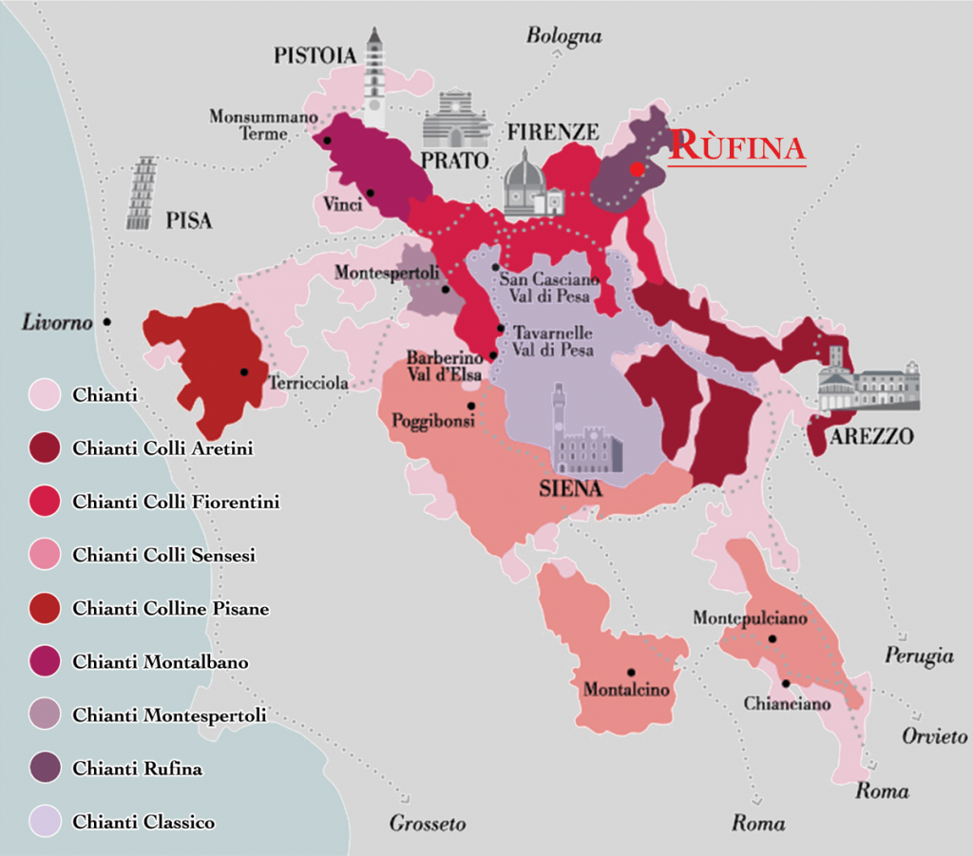
The Wine Regions of Tuscany
Chianti: The Chianti wine region is probably the best-known of all Italian wine districts, closely associated with red wines based on the Sangiovese grape.
It is a vast area divided into seven sub-zones, each one producing its own Chianti wine with a distinctive name and label: Chianti Colli Aretini, Chianti Colli Fiorentini,
Chianti Colli Senesi (an area that also includes Montepulciano
and Montalcino), Chianti Colline Pisane,
Chianti Montalbano, Chianti Montespertoli, Chianti Rufina
In 1932, the wine designation specified the production limits
for Chianti Classico, which is a DOCG.
There are several categories of “Chianti.” There’s Chianti,
which is the catchall appellation at the bottom of the quality
pyramid; Chianti Classico, which has its own appellation;
and Chianti Rufina and Chianti Colli Senesi, subzones of
Chianti known for their high-quality bottlings.

Slide 8
The Wine Regions of Tuscany
Bolgheri: Bolgheri’s reputation is built on Sassicaia, an iconic local wine made from Cabernet Sauvignon and Cabernet Franc grapes that trumped a selection of Bordeaux wines in a 1974 competition.
Located in the province of Livorno in the Maremma, a coastal
region that includes the islands off the coast of western Tuscany.
Bolgheri and its vineyards full of Bordeaux-style grapes is the
newest of the DOC classified wine regions in Tuscany and
emblematic of the Super Tuscan IGT tradition.
Bolgheri is a relatively young, yet prestigious Italian appellation located in the Maremma on the Tuscan coast just to the south of Livorno, and named after a town in the north of the region.
The area had little reputation for wine production, regarded elsewhere in Tuscany as something of a swampy zone producing fairly nondescript white wines and rosés.

Slide 9
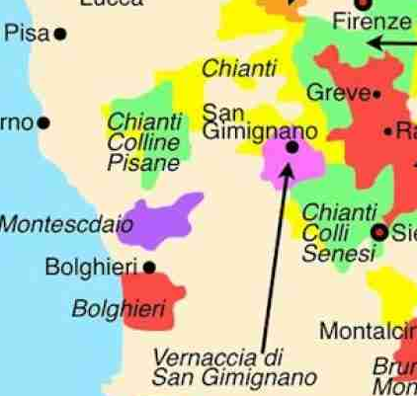
The Wine Regions of Tuscany
San Gimignano: San Gimignano, a walled, medieval town in the hills of Siena, is home to Tuscany’s flagship white wine Vernaccia di San Gimignano, beloved since the 1200s and the very first Italian wine to be granted DOC status. It’s also the only white wine in Tuscany to have reached DOCG status.
San Gimignano is a DOC title covering red, rosé and
sweet vin santo wines made in a zone dominated by the
production of white Vernaccia di San Gimignano DOCG.
Most of the vineyards surrounding this medieval town are
devoted to the production of this much-lauded white wine.
The production area and volumes of other wines permitted
in the region have shrunk. In 2019, the region reportedly
produced San Gimignano DOC wines from only 32 acres
of vineyard

Slide 10
The Wine Regions of Tuscany
Montepulciano: In southeastern Tuscany in the province of Siena, the rolling hills of Montepulciano sit perched between the Ocria and the Chiana rivers.
The region is synonymous with Vino Nobile di Montepulciano, a Sangiovese-based wine redolent with dark fruit like plum, cherry, and strawberry, with tannins not unlike roasted tea.
San Gimignano reds cover two broad categories: San
Gimignano rosso (red) and varietally-labeled San
Gimignano. The former blend must comprise at least 50
percent Sangiovese with up to 40 percent of Cabernet
Sauvignon, Cabernet Franc, Syrah, Merlot and/or Pinot
Nero.

Slide 11
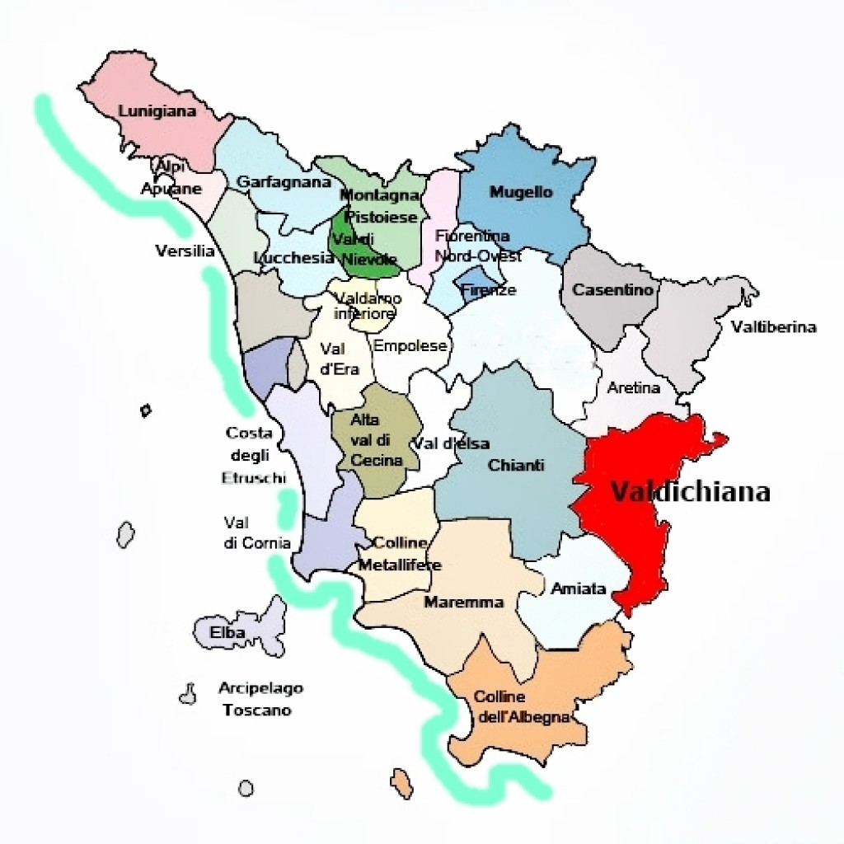
The Wine Regions of Tuscany
Valdichiana: The Valdichiana is an alluvial valley connecting the provinces of Siena and Arezzo with the northern reaches of Umbria.
It is well known for its “Bianco Vergine” white blend (a mix of at least 20 percent of Trebbiano Toscano, and filled out with Chardonnay, Pinot Bianco, Pinot Grigio, and Grechetto), but it is also one of the rare regions in Tuscany that produces a sparkling wine, Valdichiana Spumante.
The name Valdichiana is a contracted form of Val di Chiana ("the Chiana Valley").
The Chiana Valley connects Siena and Arezzo in Tuscany with northern Umbria (specifically, the northern end of the Orvieto viticultural area), where the river connects with the Paglia, itself a tributary of the famous Tiber. Valdichiana is perhaps better known for its retail outlet village, than for its wines.

Slide 12
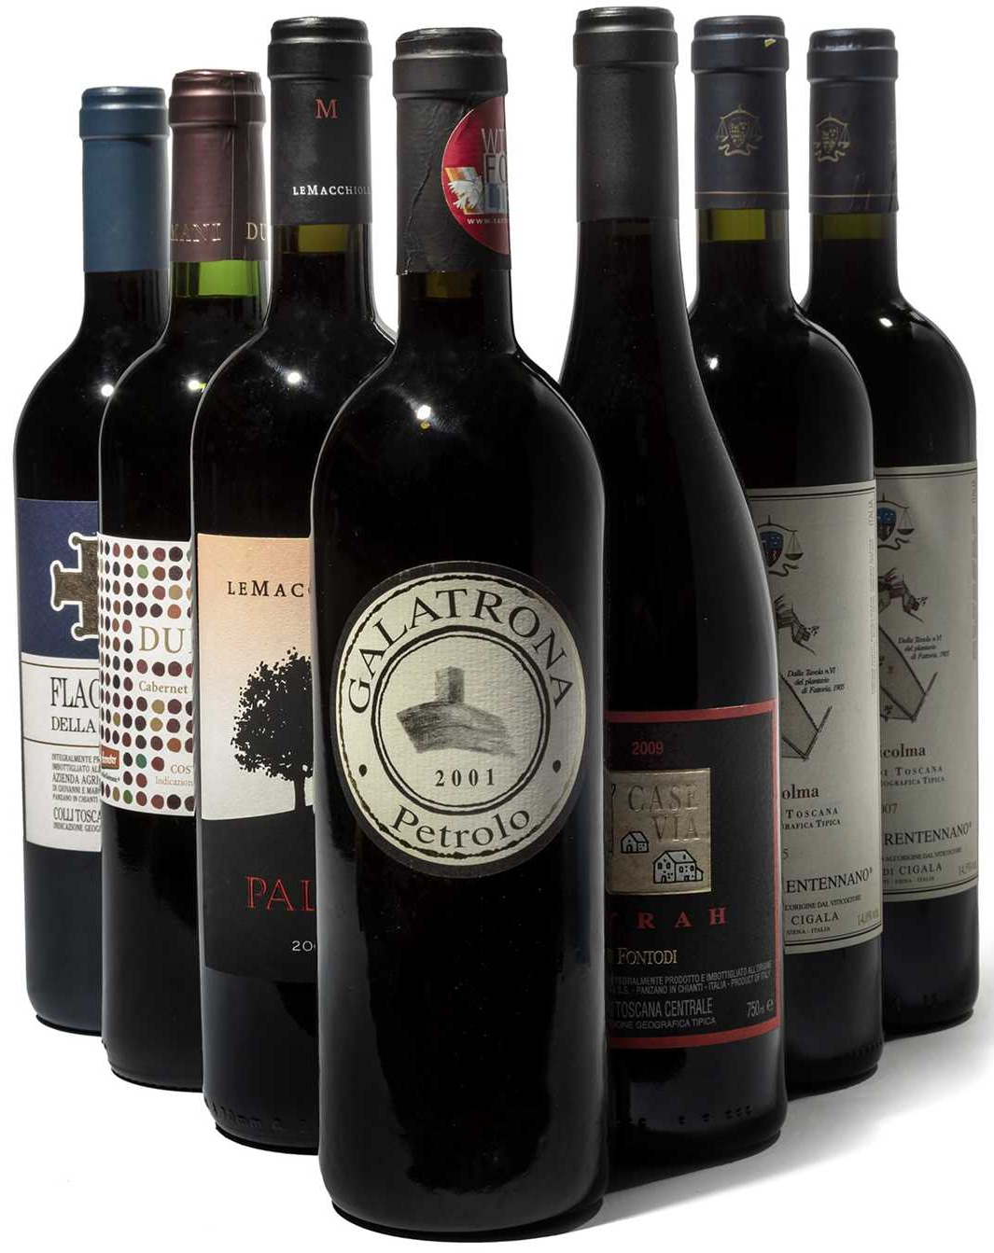
Tuscany’s Key Grape Varietals
Tuscan wine production revolves around a multitude of grape varieties, each contributing unique characteristics to the wines.
What Grapes Are Grown in Tuscany?
Thanks to the tradition of Super Tuscans, Tuscan winemakers don’t shy away from internationally popular grapes like cabernet sauvignon, syrah, pinot noir, and sauvignon blanc; instead, they blend them with indigenous Italian grape varietals.
While 80 percent of wine production in Tuscany is dedicated to red wine, its white wines have also garnered worldwide acclaim throughout viticultural history.

Slide 13
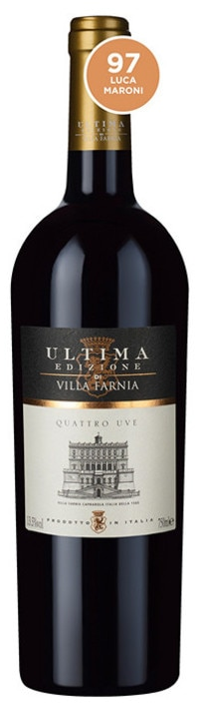
Tuscany’s Key Red Grape Varietals
Sangiovese: The queen of Tuscan grape varieties is undoubtedly Sangiovese, with more than 24710 acres planted, it occupies more than 10% of the Italian vineyards. Italy’s best known and most widely planted type of grape, Sangiovese, is native to Tuscany.
Tuscan Sangiovese wines contain a lot of tannin and acid, but relatively little color. It is the main grape variety for Chianti or for Brunello di Montalcino, one of the most prestigious wines in Italy.
Sangiovese grapes have thin skins, a light color, fine tannins, and a long growing season. Wines made from Sangiovese grapes are medium to full-bodied, dry, and highly acidic, with fruity and savory flavors.
Common Sangiovese wine flavors and aromas include plum, cherry, violets, tobacco, and leather. In Montalcino, the local Sangiovese variety is known as Brunello.

Slide 14
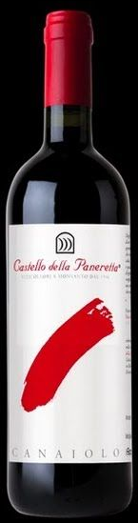
Tuscany’s Key Red Grape Varietals
Canaiolo: Canaiolo is a mellow red wine grape thought to be native to the Tuscany region and has historically been a dominant grape in the production of chianti and a crucial component of Vino Nobile di Montepulciano, accenting the more herbaceous notes in Sangiovese with its ripe strawberry and savory dried spice flavor.
Canaiolo (Nero) is a black-skinned wine grape variety that was the main constituent of the Chianti blend up until the late 19th Century. It is still grown today throughout central Italy, though around 90 percent of the total (around 1,050 hectares / 2,600 acres) plantings are found in Tuscany. It is used as a blending grape in a wide range of Sangiovese-based wines.
Just a handful of varietal Canaiolo wines are produced, although interest in the variety is increasing.

Slide 15
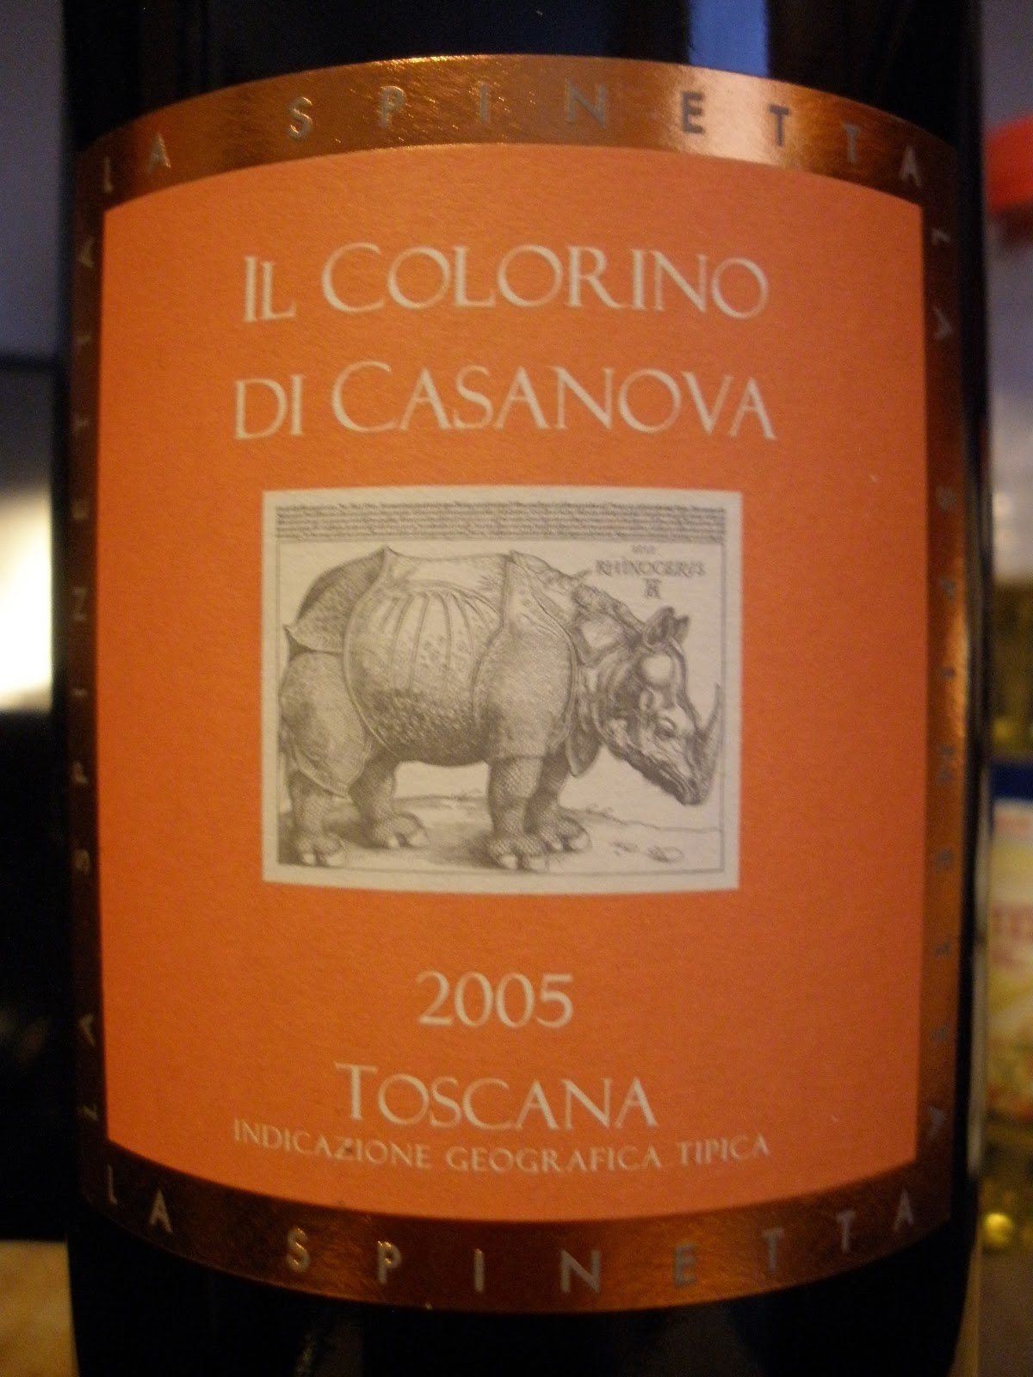
Tuscany’s Key Red Grape Varietals
Colorino: Colorino is an obscure Italian black-skinned grape variety from Tuscany. As the name suggests, its main use is as a blending ingredient to add color to wines. As well as being deeply pigmented, Colorino's small berries have elevated tannin levels. Aromatically, the variety is somewhat muted.
Its flavor is correspondingly dark and jammy, with primary notes of boysenberry and huckleberry.
During the 1990s, Colorino became very popular with producers for "correcting" the lighter-hued Sangiovese-based wines of Chianti and Vino Nobile di Montepulciano.
More recently, improvements in winemaking techniques and better vineyard practices have resulted in Sangiovese fruit that is far superior to that produced in the past, and Colorino has lost much of its reason to exist.

Slide 16
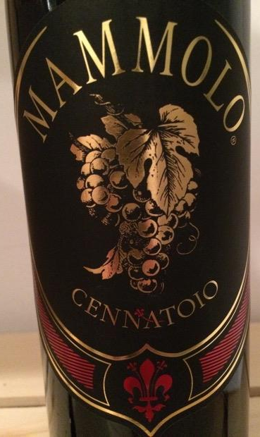
Tuscany’s Key Red Grape Varietals
Mammolo: Known as Sciaccarello in Corsica, France, red Mammolo grapes are soft and light, with distinct peppery notes that bring a floral tone—specifically, violets—to blends like Chianti and Vino Nobile di Montepulciano.
Sciaccarello is thought to have originated in Tuscany, as DNA profiling has shown close relationships with local Tuscan grape varieties.
In Tuscany, it plays a supporting role to Sangiovese in Chianti blends, as well as in the famed Vino Nobile di Montepulciano wines. Here, it offers up fragrance to the wines – the Italian word mammole means "violets", which is the variety's signature aroma.

Slide 17
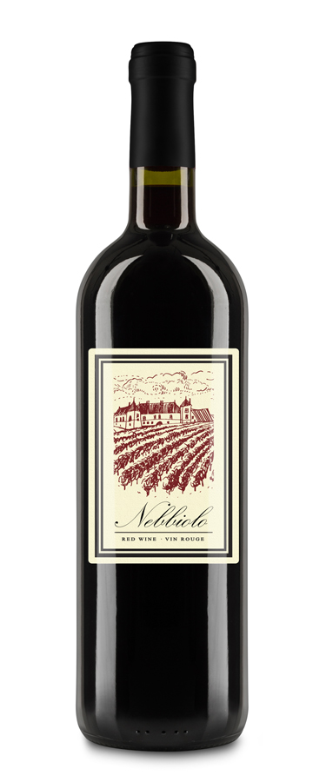
Tuscany’s Key Red Grape Varietals
Nebbiolo: A noble grape from Piedmont, Nebbiolo is known for its complex aromas of rose, tar, and truffle, and its ability to age gracefully.
If you like your wines big, bold, and red, Nebbiolo needs to be on your radar. Originally, hailing from Northern Italy’s Piedmont region, this grape is known for producing powerful, full-bodied, and mercilessly tannic wines, while looking as pale as Pinot Noir!
Most famously, it’s the grape that goes into Barolo and Barbaresco, two of the world’s most revered (and more expensive) wines.

Slide 18
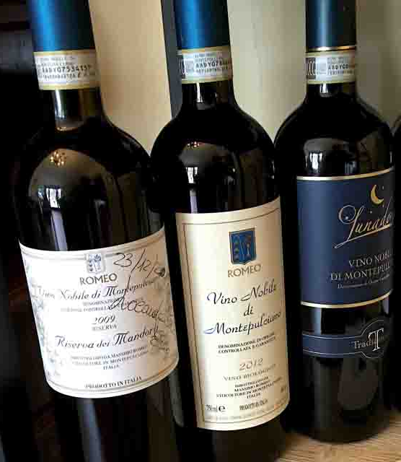
Tuscany’s Key Grape Varietals
Montepulciano: Predominantly grown in Abruzzo, Montepulciano produces full-bodied reds with dark fruit flavors and a robust structure.
Montepulciano is the 2nd most planted red grape in Italy (after Sangiovese) and has had a reputation for low-priced juicy “pizza-friendly” red wines.
Fortunately, there are several producers in Abruzzo that have shown the amazing potential of this grape by producing inky, black-fruit driven, chocolatey wines best enjoyed after 4 or more years of aging.

Slide 19
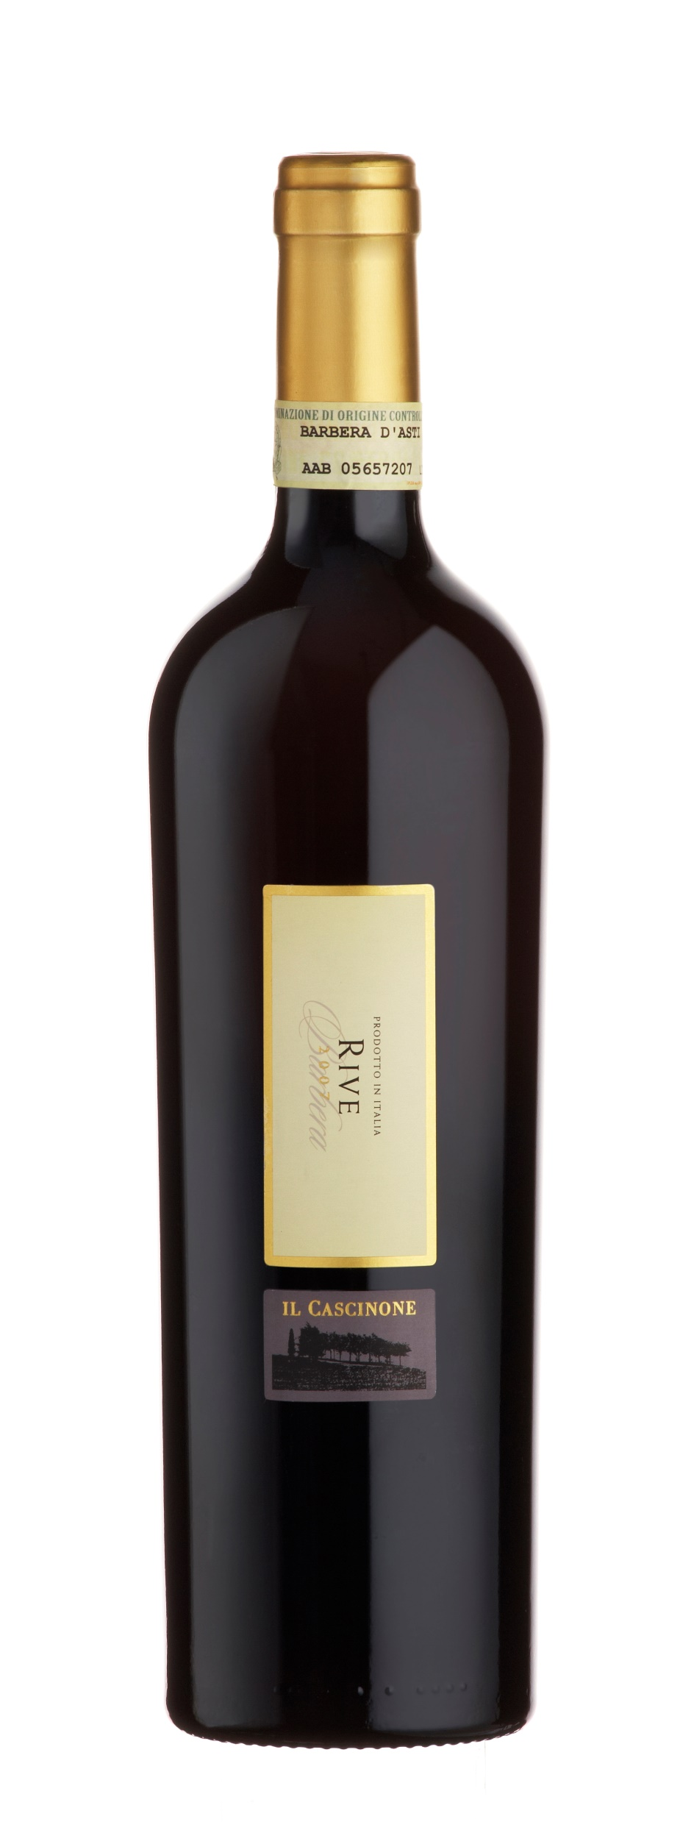
Tuscany’s Key Red Grape Varietals
Barbera: A versatile grape from Piedmont, Barbera produces wines with high acidity and flavors of red fruit and spice.
Since Barbera is a grape variety, as opposed to a particular place, Barbera wine can theoretically be produced around the world. And, indeed, it is: There are noteworthy expressions of Barbera from Paso Robles and Lodi in California, McLaren Vale in Australia and is used in Tuscan Blends.
You’ll often find Barbera wine from the Piedmont region of Italy, where the most beloved ones are labeled Barbera d'Asti, Barbera d'Alba, or Barbera del Monferrato.
Barbera wine possesses mouthwatering acidity, which keeps it fresh and cuts through fat and protein with ease. Its fruit skews in the direction of brambly berries, wild strawberries, and fresh cherries; there's often an underpinning of sweet and woodsy spices and a touch of something more savory, like mushrooms or minerals.

Slide 20
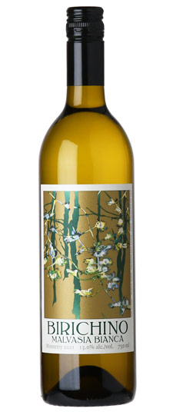
Tuscany’s Key White Grape Varietals
Malvasia: Malvasia refers to a group of related grape varieties, including Malvasia nera, and Malvasia bianca, the most widely planted type of Malvasia in Italy.
While some regions like Piedmont does produce varietal wines using the red Malvasia nera, in Tuscany it plays more of a supporting role; Malvasia bianca, with its notes of ripe, honeyed pear, is used to make vin santo, a dessert wine.
The vine is of clear Greek origin and has come to Italy on several occasions. For example, Malvasia Delle Lipari arrived with the first Greek conquerors and has since remained confined to these Sicilian islets, embarking on a unique and particular evolution.

Slide 21
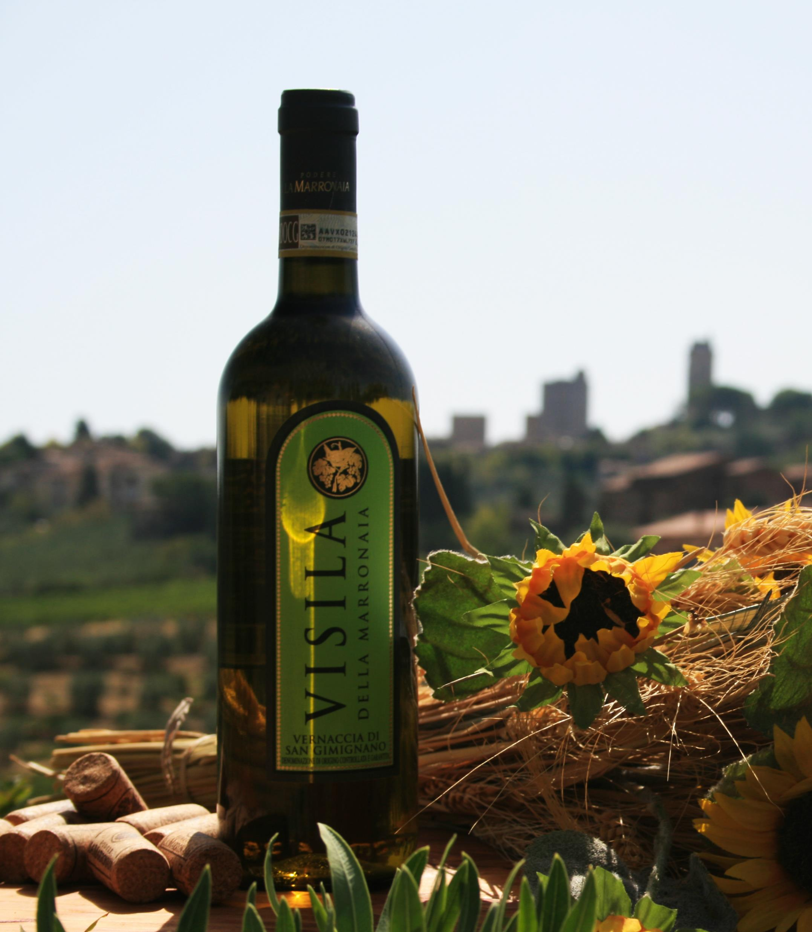
Tuscany’s Key White Grape Varietals
Vernaccia: Vernaccia is an ancient white wine grape used to make Vernaccia di San Gimignano. It has a fairly acidic profile, with softer notes of yellow apple and almond underlying its crisp, citrus-forward character.
Arguably Tuscany's greatest white wine, Vernaccia di San Gimignano is the region's only DOCG-titled white wine, producing often golden-hued, beautifully aromatic and sumptuously dry white wines.

Slide 22
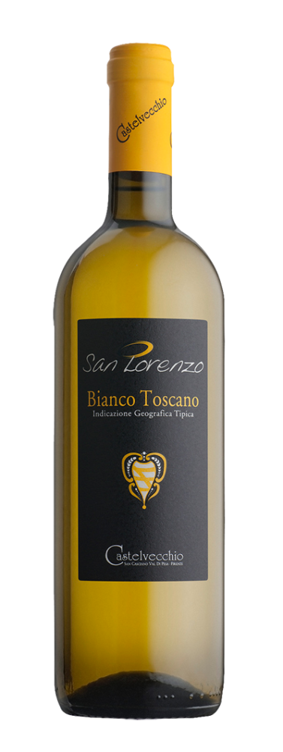
Tuscany’s Key White Grape Varietals
Trebbiano: Trebbiano is an all-purpose grape in Tuscany, and regional variations of the grape account for a third of all white wine in Italy. Trebbiano Toscano is even included in some red blends, thanks to its neutral flavors and high levels of bright acidity.
Trebbiano Toscano, or simply Trebbiano, is one of the most planted grapes in the world. It is used for producing table wine and brandies like Armagnac and Cognac. Keep in mind that Trebbiano has many different names depending on the country and the region of its production, including Brucanico, Santoro, and Procanico.
Trebbiano seems to derive from the name of the Trebbia river in Emilia-Romagna in Northern Central Italy or from Italian villages with similar-sounding names. It is one of the four main right-bank branches of the River Po.
Trebbiano was first used as a word in 1860, in the meaning of a cultivated Italian white grape used in making white wine and brandy.

Slide 23
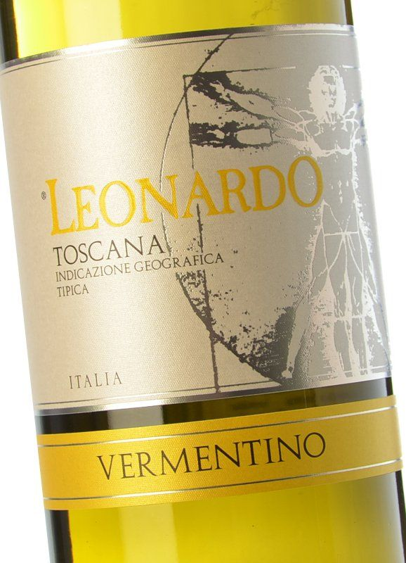
Tuscany’s Key White Grape Varietals
Vermentino: White wine grape Vermentino carries a similar flavor profile to Vernaccia, with salty minerality and soft hints of almond weaving through the main note of floral, bitter citrus, like grapefruit.
It is more common in places like Sardinia, but it is used in the Tuscan region of Bolgheri.
Vermentino is found primarily in three regions of Italy: Liguria, Sardinia and Tuscany, and in each of those territories, the plantings are very close to the sea. Simply stated, producing a Vermentino from seaside vineyards gives the wines a special character that you don’t find from a warmer, inland area.

Slide 24
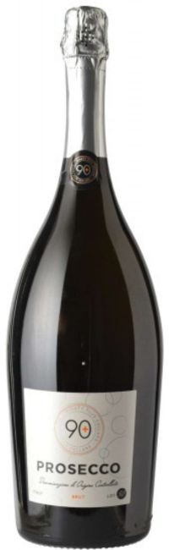
Tuscany’s Key White Grape Varietals
Prosecco (Glera): A sparkling white wine from Veneto, Prosecco is known for its bright, fruity flavors and effervescence.
Prosecco may not have been formally named until the 1700s, but its vineyards have deep and ancient roots. Like much of Italy, the viticulture of Veneto can be traced back to the Romans. Since the mid-13th century, the name ‘Proseco’ or ‘Prosech’ referred to a small town off the coast of the Gulf of Trieste. This town still exists today and is widely considered the namesake of the popular sparkling wine.
Prosecco comes in three levels of fizz, or to use the correct term “perlage” The most bubbly is “spumante,” then a step down is “frizzante” and the entirely still is called “tranquillo.”

Slide 25
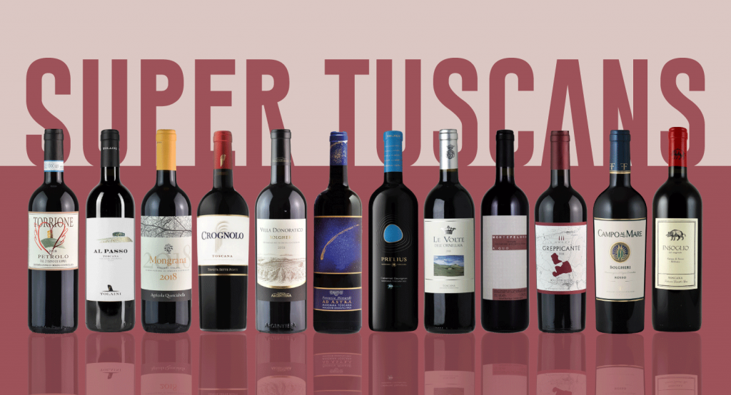
Tuscan Wine Styles
Super Tuscans
What was so special about Super Tuscan wines? Winemakers went against the regulations and traditions by using international grape varieties in Super Tuscan wines, and even though the wines had superior quality, they were still classified as table wines (Il vino da Tavola).
When international press had to write about these unlawful wines, describing them as table wines did not do them justice and the "Super Tuscan" was born.
Super Tuscan wines commonly blend these wine varieties: Sangiovese, Cabernet Sauvignon, Cabernet Franc, Merlot, and Syrah.
Currently, there are around 100 wineries experimenting around different international and local grape varieties.

Slide 26
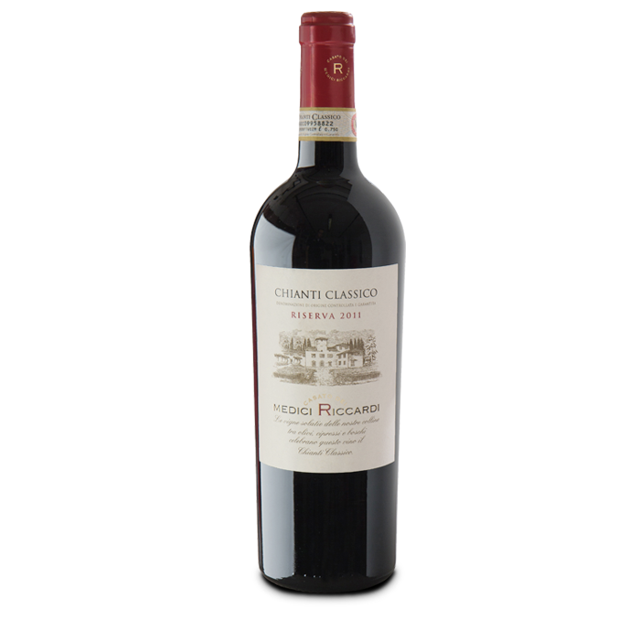
Tuscan Wine Styles
Chianti Classico
Among the best known and most important wines is the Chianti Classico. Chianti Classico is slightly denser than simple Chianti and usually fuller in flavor, yet still lively and drinkable.
Originally served in its well-known straw-wrapped wine bottle, the fiasco, which had fallen out of favor but is now making a bit of a come-back.
The grapes all come from the same region in Tuscany and are grown only in a strictly limited area between Siena and Florence.
Sangiovese which forms most of the Chianti blend. Because of it’s thin-skinned grape, it makes translucent Tuscan wines.
Since 1996, Chianti DOCG wines must contain a minimum of 70 percent Sangiovese. At the same time producers were allowed for the first time to to release pure Sangiovese Chianti wines and not be obliged to include inferior or international varieties in the blend.
Chianti Classico wine can vary from light-bodied to full-bodied according to the producer and the terroir where it is produced. It is a robust yet fruity wine that displays among other things an aroma of sour cherries.

Slide 27
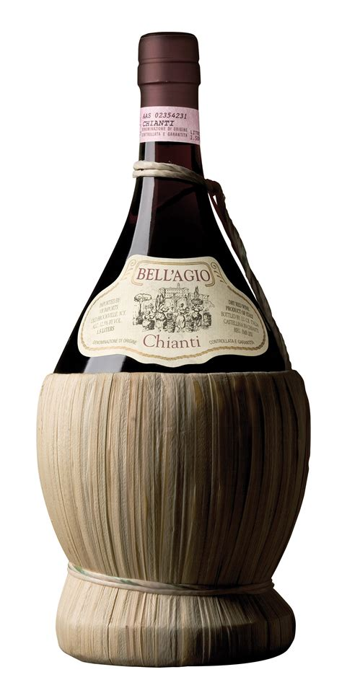
Tuscan Wine Styles
Chianti
A generic Chianti must reach at least 11.5 percent alcohol by volume. For Chianti Superiore and Chainti Riserva this rises to 12 percent.
In comparison Chianti Classico figures are 12, 12.5 and 13 percent for the "normale", Riserva and Gran Selezione, respectively.
Ageing: A standard Chianti must be aged for a minimum of four months before release.
This compares with the following: (Minimum) 7 months: Chianti Montesportoli, 10 months: Chianti Superiore, Rufina, Colli Fiorentini, 2 years: Chianti Riserva, 2 years with at least 6 months in barrel: Rufina Riserva, Colli Fiorentini Riserva, 2 years with at least 6 months in barrel and 4 in bottle: Colli Senesi Riserva

Slide 28
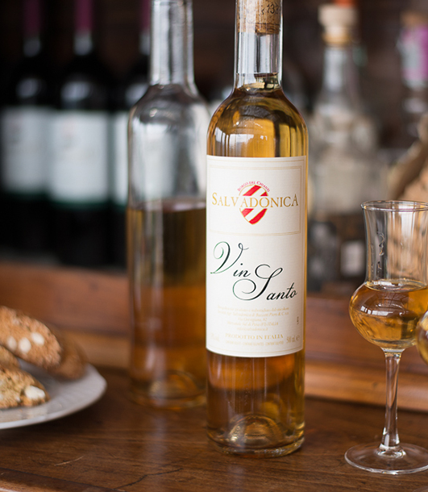
Tuscan Wine Styles
Vin Santo is the typical dessert wine of Tuscany wine region.
These wines are often made from white grape varieties such as Trebbiano and Malvasia, although Sangiovese may be used to produce a rosé style known as "Occhio di Pernice" or eye of the partridge.
The grapes are hung on roof beams and dried. After pressing, the wine matures for at least three years in small oak barrels. Typically they give you almond biscuits called Cantucci to dip into the wine and taste it like this.

Slide 29
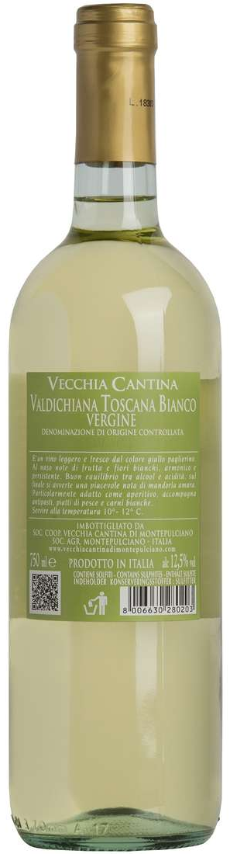
Tuscan Wine Styles
Valdichiana Toscana is a DOC in Tuscany wine region, in central Italy. The title was established as Bianco Vergine Valdichiana DOC in 1972 for white wine only. It took its current name in 2011, when the portfolio was extended.
The Bianco blend may still be labelled as Bianco Vergine ("Virgin White"). It has only one obligatory component: a 20 percent minimum of Tuscany's favorite white wine grape, Trebbiano Toscano.
Up to 80 percent may be composed of Chardonnay, Pinot Bianco, Pinot Grigio and Grechetto, individually or in combination. Up to 15 percent may be any other white grape authorized in the region.

Slide 30
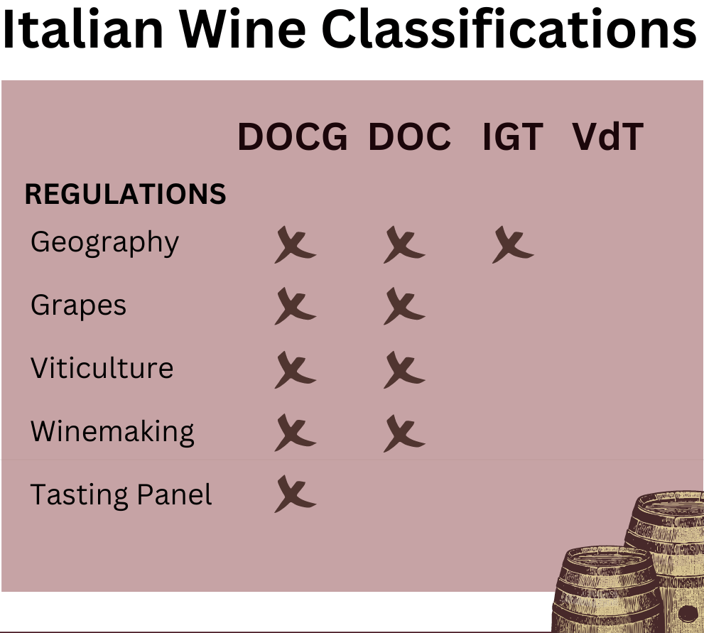
Wine Classifications
Italian wines are classified under various designations that indicate their quality and origin.
DOCG (Denominazione di Origine Controllata e Garantita) in English -Ccontrolled and Guaranteed Designation of Origin.
This is the highest classification, guaranteeing the wine’s origin and quality. Examples include Barolo, Brunello di Montalcino, and Chianti Classico.
DOC (Denominazione di Origine Controllata): A step below DOCG, DOC wines still adhere to strict regulations but do not have the additional guarantee of quality.
IGT (Indicazione Geografica Tipica or Typical Geographical Indication): Allows for more flexibility in grape varieties and winemaking techniques. Tuscan and Super Tuscan blends often fall under this classification.
VdT (Vino da Tavola or Table Wine): The most basic classification, indicating table wine without specific geographic or quality designations.

Slide 31
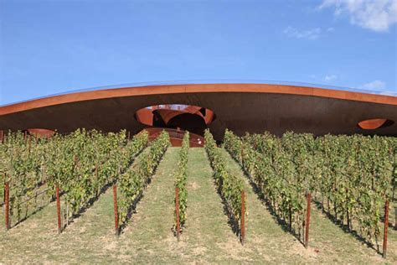

Notable Tuscan Wineries
Italy is home to numerous prestigious wineries and producers, each contributing to the country’s rich wine heritage.
Antinori: A leading Tuscan producer known for its innovative Super Tuscans and traditional Chianti Classico.
Antinori has a total of 9 estates spread across Tuscana and Umbria primarily producing Very high-quality Chiantis.

Slide 32
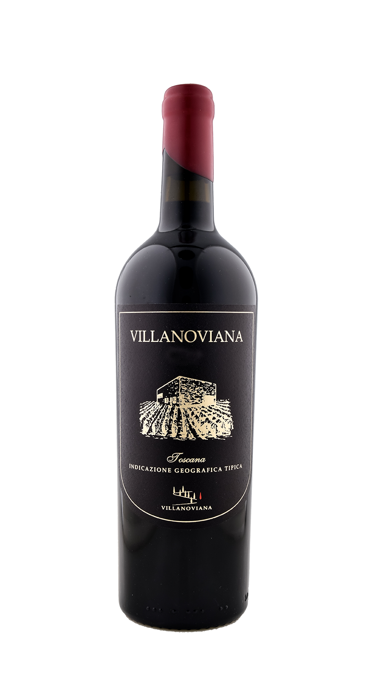
Notable Tuscan Wineries
Azienda Agricola Villanoviana
Committed to produce one of the newest but prestigious wine appellation in Italy, Azienda Agricola Villanoviana has been operating since the mid-2000s in Bolgheri near Livorno in Tuscany.
The inspiration for the name of the winery came as a tribute to the Villanovian civilization, believed to be the ancestors of the Etruscans and the first people to have settled here.
The owners are very hands on with the management of the winery, cultivation of grapes, and production of the wines. They are always happy to have anyone who wants to visit and experience the wine traditions of the winery.

Slide 33
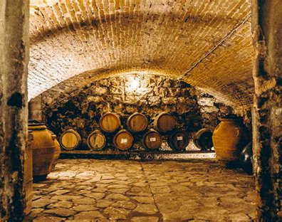
Notable Tuscan Wineries
Azienda Agrico la Malenchini
Located in the heart of Chianti, Colli Fiorentini, the Malenchini Farm is managed by Diletta Malenchini. The Malenchini Family has owned and managed the company since 1830 in the Medici Villa of Lilliano.
Camigliano Castle is One of the Oldest Wineries in the Region
Camigliano is located in Montalcino. The historical castle extends up to an area of 530 hectares, surrounded by lush vineyards and a beautiful countryside.
The vineyards cover 93 hectares of land. The owner has built a new underground cellar, along with the adoption of modern vinification practices. The estate has a long history of traditions and cultures that trace back to the time of crusades. The picturesque olive plantation expands over a land of 25 hectares, surrounded by the scenic landscapes.

Slide 34
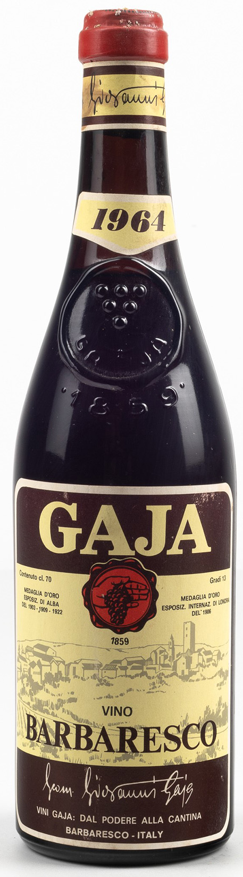
Notable Tuscan Wineries
Gaja: Barbaresco winery, founded in 1859 and now run by the fifth generation of the Gaja family.
Renowned for its Barbaresco and Barolo wines, Gaja is a historic name in Piedmont.
Castello di Verrazzano: Famous for its Chianti Classico and contributions to the Tuscan wine renaissance.
The current 128.5 Acres of vineyards are divided into individual vineyards located on the most suitable terrain and with the best microclimatic characteristics. The vines used are mostly red grapes, among which Sangiovese obviously stands out, accompanied by other varieties including Merlot, Canaiolo, Cabernet Sauvignon and Colorino and, only in a small percentage, white grapes such as Trebbiano Toscano, Traminer and Malvasia Lunga del Chianti.

Slide 35
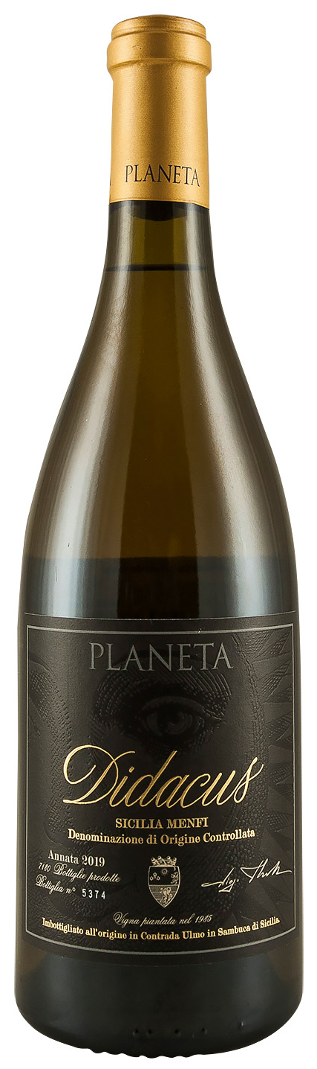
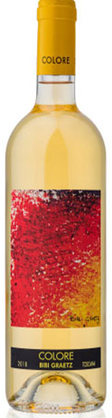
Notable Tuscan Wineries
Planeta: A prominent producer in Sicily, known for its Nero d'Avola and fine whites. The entire cultivated area including their vineyards, olive groves, almond orchards, and grains is certified organic.
Bibi Graetz: A boutique producer in Tuscany celebrated for its lively and artisanal wines. The winery was founded in 2000, but Bibi has purchased a vast collection of Old Vine Estates. The varietals include Sangiovese, Canaiolo and Colorino.

Slide 36
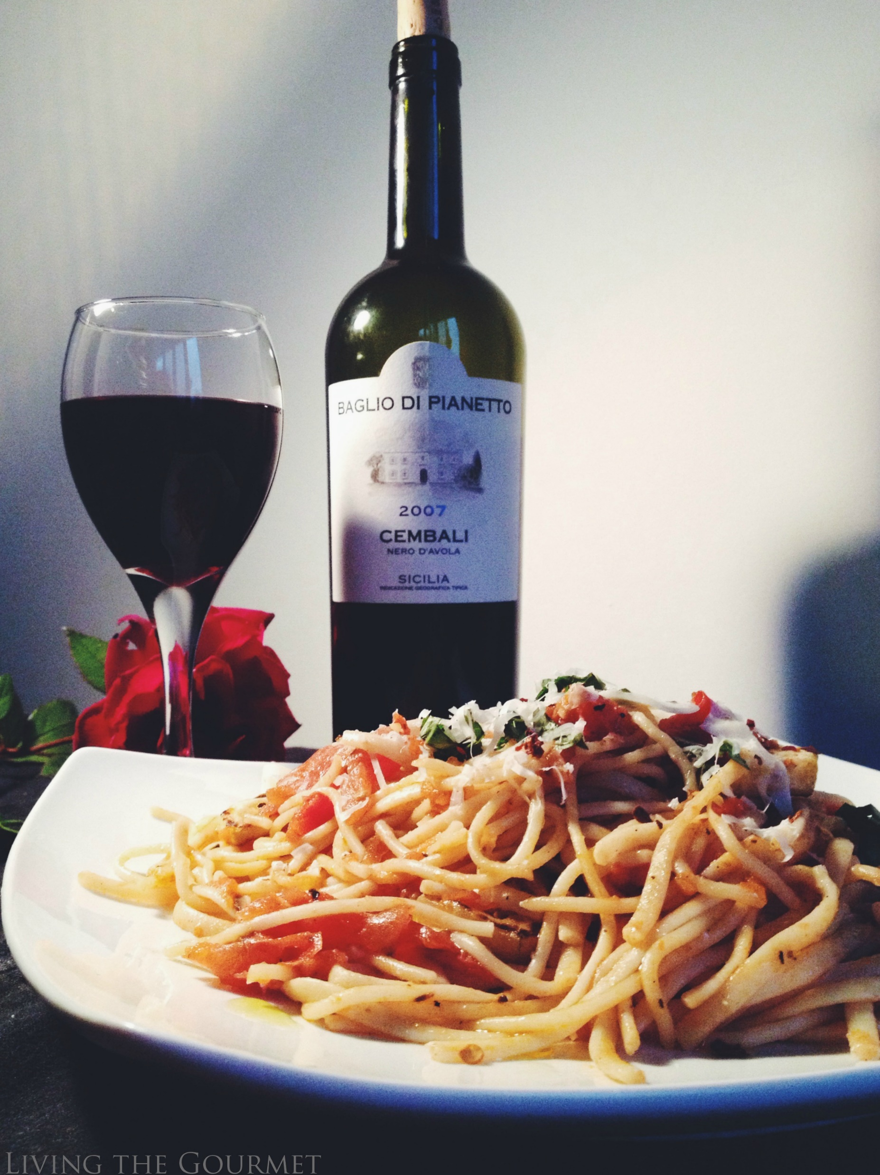
Wine and Food Pairings
Italian wines are deeply integrated into the country’s culinary traditions. Here are some classic pairings:
Chianti: Pairs well with traditional Italian dishes such as pasta with tomato sauce, pizza, and grilled meats.
Barolo: Complements rich dishes like truffle risotto, braised beef, and aged cheeses.
Prosecco: Ideal as an aperitif or paired with light appetizers, seafood, and fresh salads.

Slide 37
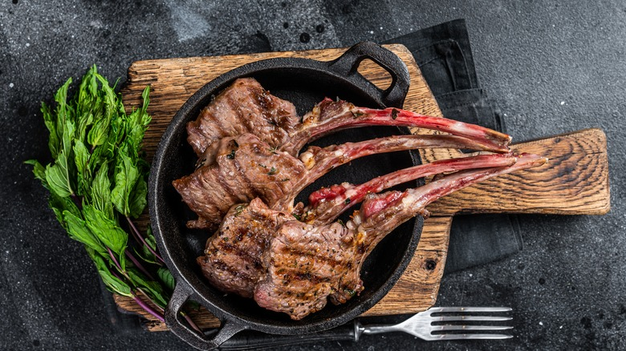
Wine and Food Pairings
Nero d'Avola: Matches well with hearty dishes like grilled lamb, barbecue, and rich pasta sauces.
When pairing wine what matters more than pairing white wine with fish and red wine with meat is pairing wine you like to drink with your food of choice.

Slide 38
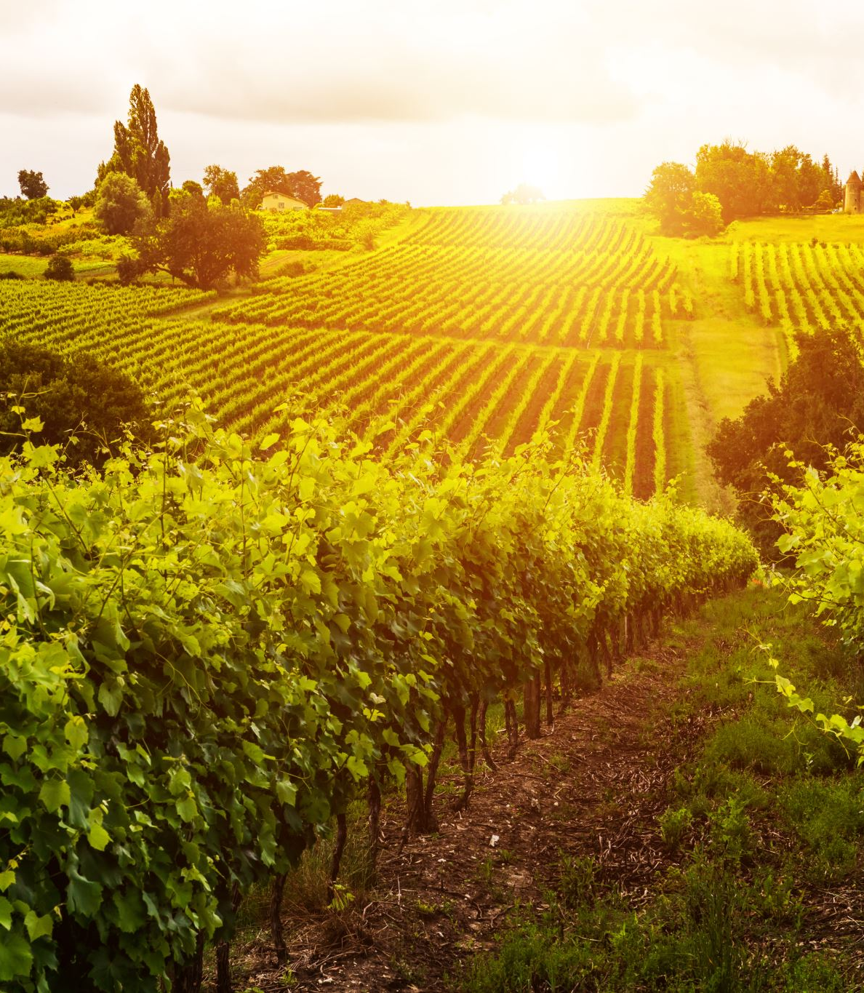
Conclusion
Tuscan wines offer a rich tapestry of flavors, styles, and traditions, reflecting the diverse terroirs and cultural heritage of the country.
Whether you’re exploring the bold reds, the crisp whites, or the sparkling delights of Prosecco, Tuscan’s wine regions provide a treasure trove of experiences for enthusiasts and connoisseurs alike.
Understanding the regions, grape varieties, and classifications can enhance your appreciation of Italian wines and guide you in discovering the perfect bottle to enjoy.

Slide 39
Acknowledgement
My seminars are the result of many years of travel experience combined with many hours of research over the internet.
I would like to acknowledge the many source I have accessed:
These include: Wikipedia.com, Britannica.com, Wine Spectator, Wine Enthusiast, The Great Atlas of Italian Wines by Author Alessandro Avataneo and Vittorio Manganelli, The Essential Guide to Real Italian Wine Kindle Edition, by Joe Campanale and Joshua David Stein, The Everyday Guide to Wines of Italy, Vino Italiano: The Regional Wines of Italy by Joseph Bastianich with Mario Batali, VinoDelVida.com, Wines of Italy by Burton Anderson, Wines of Italy: Il Gusto Italiano Del Vino by Patricia Guy, masterclass.com, wine-searcher.com

