Slide 1

Grand Turks Island Presented by Marc Silver

Slide 2
What I Will Cover
My Port Philosophy
Don’t Miss the Ship
Money
About Turks and Caicos
About Grand Turk Island
Maps
Getting Around Grand Turk
Places to see or at least consider
Conclusion

Slide 3
My Port Philosophy
I have been cruising for over 45 years and have taken over 100 cruises. So, I consider myself an experienced cruiser.
The information I will present is based on those many years of
experience.
When I am on a cruise where the city, I want to visit is not the port city,
I always recommend taking a ship’s tour.
But when I am in a port with multiple attractions nearby and easy to see
on my own - I will do it on my own.
This presentation is for that type of port.

Slide 4

Don’t Miss the Ship
How to Avoid Missing Your Ship
Pay attention to the time. - Ship time and local time are often different.
Put a return-to-ship reminder on your phone.
Choose excursions wisely.
If a ship-sponsored excursion is late returning to port, the ship will wait for you. If you are on your own???
Be Prepared
Have your Passport, Credit Card, and phone numbers for your ship port agent.
What to Do If You Miss the Ship Most cruise lines have port agents stationed in the port area to assist if your ship has left without you. If your are lucky, when cruisers are late returning to the vessel, the ship’s crew will often remove the passengers’ essential items – passports, cell phones, and medication -- from the ship to leave with the port agents.
The Port Officials can help you with contacting your ship and making necessary travel arrangements.

Slide 5
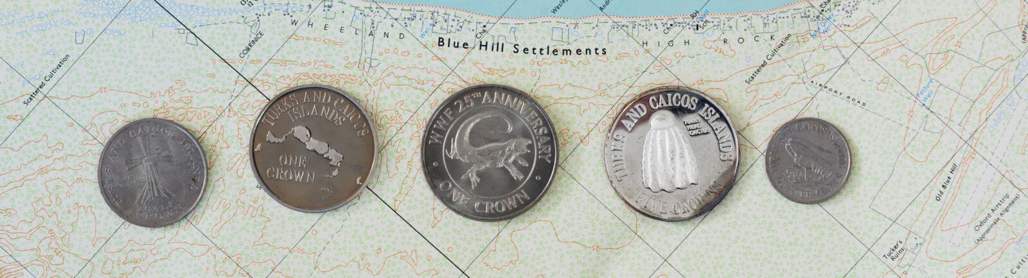
Money
The Turks and Caicos uses the U.S. Dollar as its official currency as of 1973 when the country switched to the U.S. Dollar.
There are no places anywhere to exchange money apart from local banks.
However, the Government does mint coins called Crowns, which feature various animals of the islands, or the national crest, on the reverse, and the Queen on the obverse.
These coins are redeemable at the Treasury on par with the dollar (1 crown = 1 U.S. dollar), however, they are generally purchased as tourist souvenirs and not used as actual currency.

Slide 6
About Turks and Caicos
The Turks and Caicos Islands are a British Overseas Territory consisting of the larger Caicos Islands and smaller Turks Islands.
They are known primarily for tourism and as an offshore financial center. The island’s population as of 2023 was estimated at 59,367, making it the third-largest of the British overseas territories by population, yet one of the smallest by land mass.
The islands are southeast of the Bahamas and north of Haiti and the Dominican Republic.
Cockburn Town on Grand Turk has been the capital since 1766 and our port of entry.
The total land area for the island chain is 170 sq mi.
In 2002 the islands were re-designated a British Overseas Territory, with islanders gaining full British citizenship.
The official language of the islands is English, but the population also speaks Turks and Caicos Islands Creole, which is similar to Bahamian Creole.

Slide 7
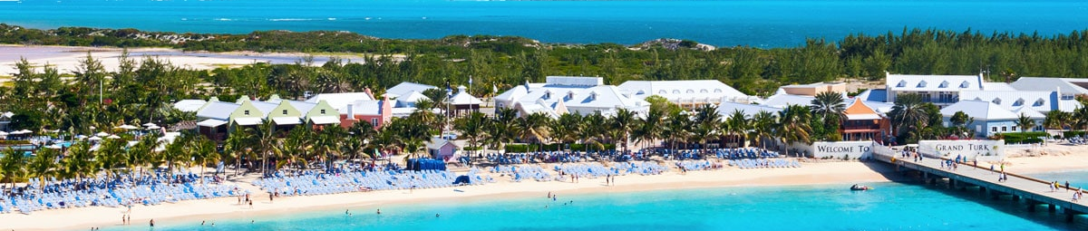
About Grand Turk
Unlike many other Caribbean vacation cruise ports, Grand Turk is a very small island and offers a completely different atmosphere than better-known destinations.
There isn’t a crowded city or waterfront, just a laid-back little town with great beaches and a little British Bermudian Colonial heritage.
A little-known fact is the island of Grand Turk played a part in the 1962 Mercury Space Mission. John Glenn’s first step on dry land after returning to Earth was on Grand Turk, and a U.S. Navy Base that was in operation on the island at the time, NAVFAC 104, helped in the recovery operations.

Slide 8
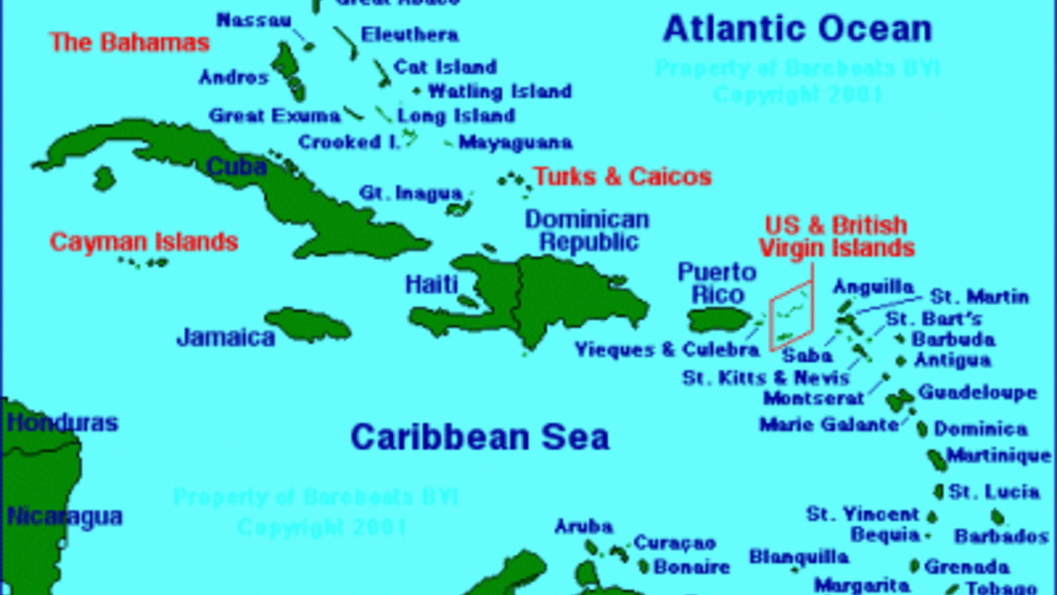

Slide 9
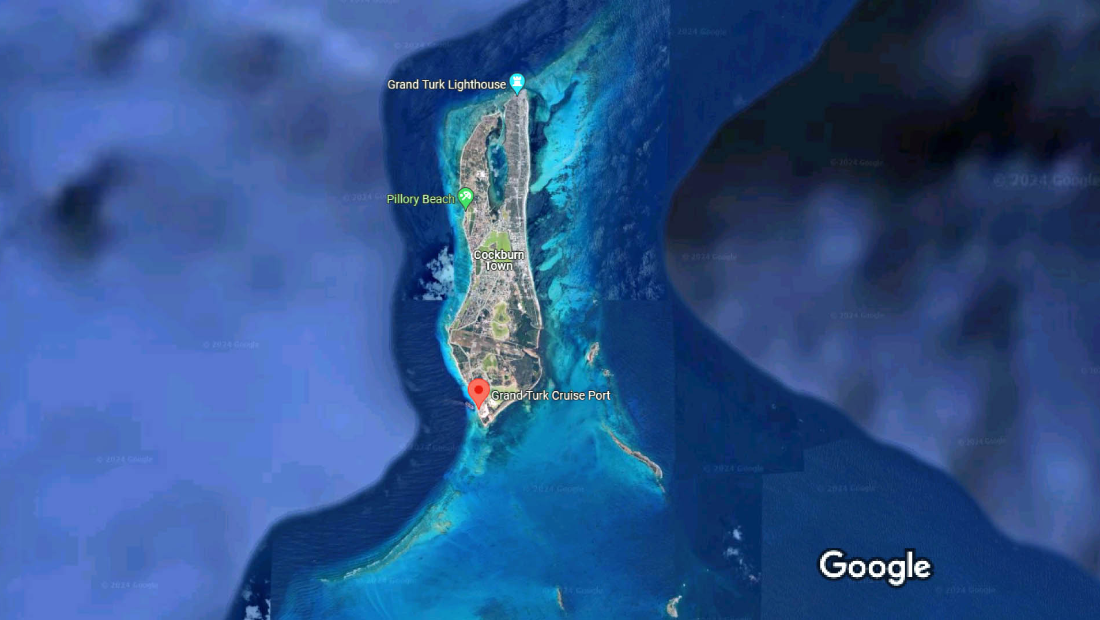
Area Map of Turks and Caicos
Turks and Caicos

Slide 10
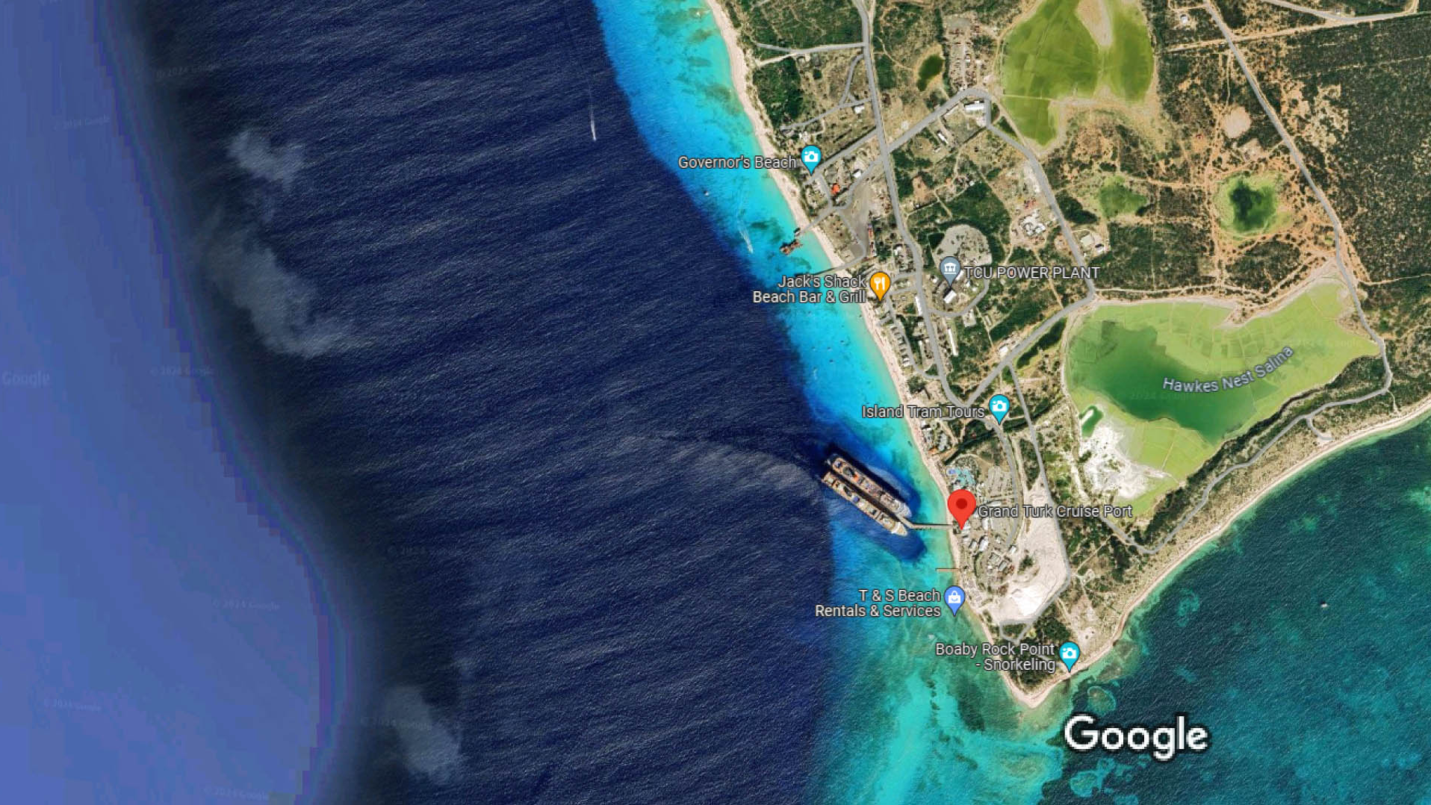
Turks

Slide 11
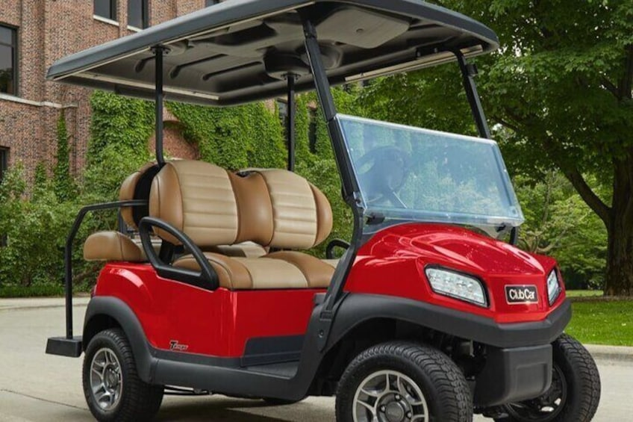
Getting around Grand Turk
Renting scooters, a golf cart, or a car and exploring Grand Turk on your own is my recommendation for those who want to get the most out of our brief stay.
Grand Turk is a small island and doesn’t have any crime-ridden areas, so explore freely.
Navigation is a breeze, and it’s almost impossible to get lost.
Book one before you get there.
Remember to drive on the left side.
Cart rentals start at about $100 per day

Slide 12
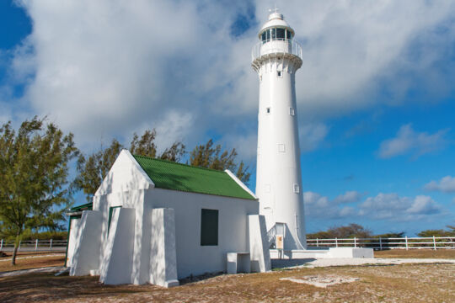
Grand Turk Lighthouse
Built in 1852, this lighthouse is Grand Turk’s most famous landmark and is the only lighthouse in the Turks and Caicos Islands.
In the early 19th century, many ships wrecked off the northern coast of Grand Turk, and it reached a point where shipping firms (primarily US and Bermudian) and the UK and US Governments insisted that a lighthouse be built to aid in navigation.
The lighthouse is no longer operational, yet the grounds are open for tourism. Access is not allowed into the lighthouse.
The lighthouse is located on the far northern tip of the island.
There’s a $3 admission charge per person for entry (which can be applied towards the cost of a beverage or item from the onsite shop), and some tours may include admission as part of a package.

Slide 13

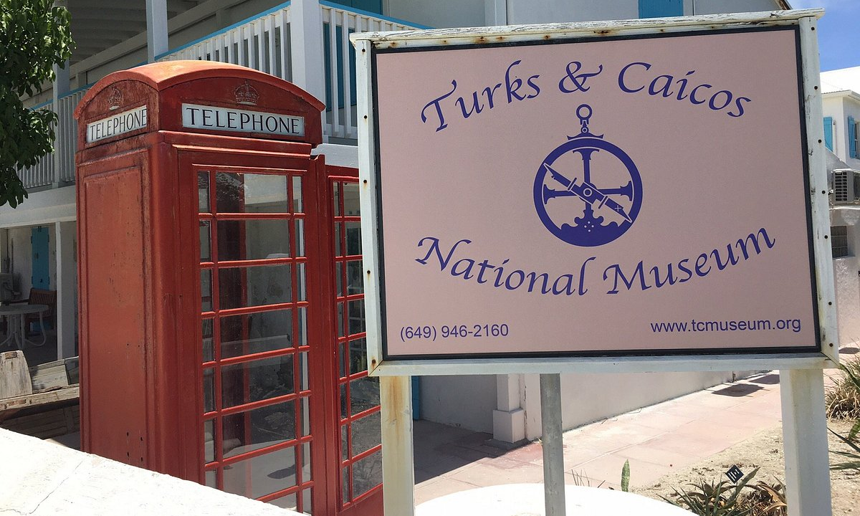
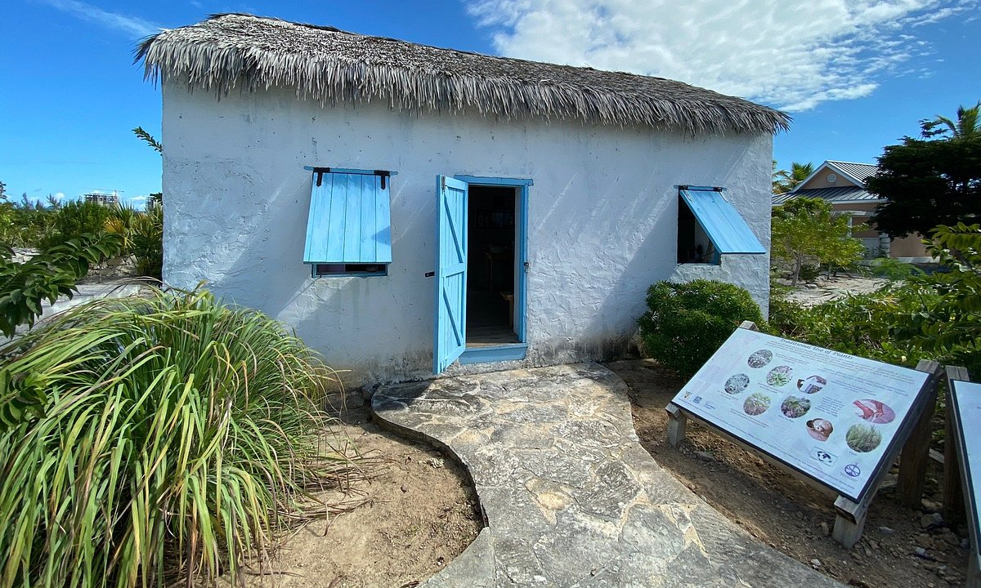
Turks & Caicos National Museum
A look into the rich history of the Turks & Caicos Islands: Two locations, Grand Turk, Front Street, Guinep House and Providenciales, Village at Grace Bay. Exhibits vary by location.
You can learn about historical events including a wrecked Spanish sailing ship from the early 1500s, the Salt Industry, John Glenn splash down, Lucayan artifacts, the Heritage House, and more!

Slide 14
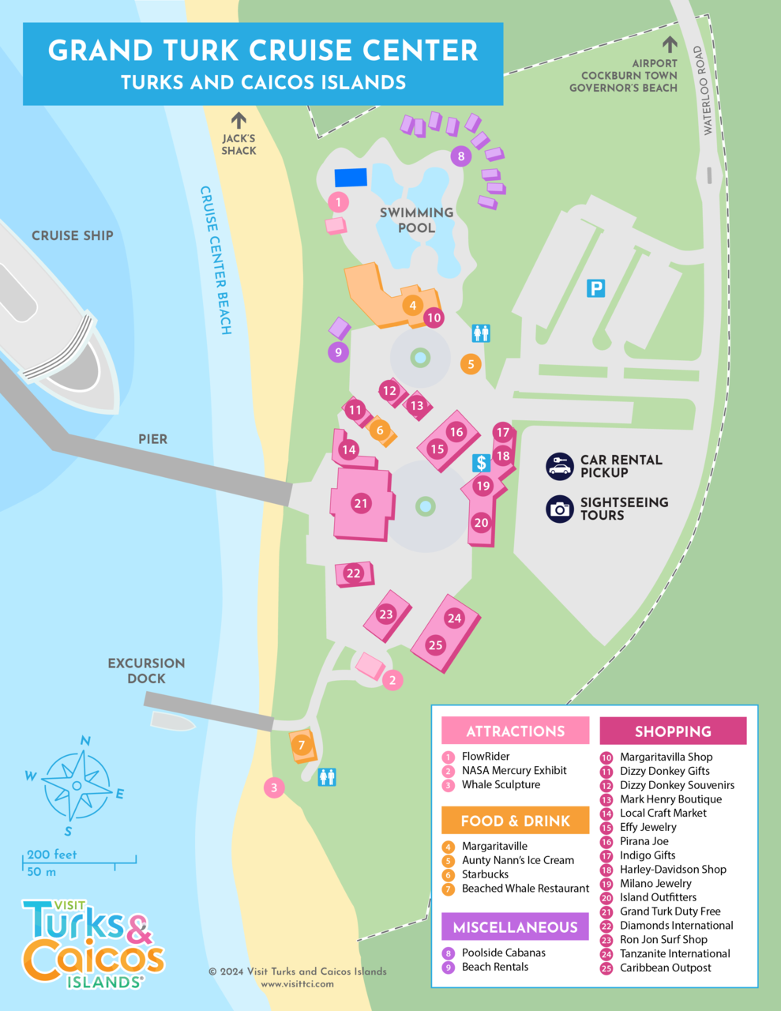
The Cruise Center
The Grand Turk Cruise Center is a 13-acre complex and cruise port right by the dock.
This site serves as the launch point for cruise ship shore excursions and offers onsite gift and jewelry shops, restaurants, and a spa, as well as the largest Margaritaville in the Caribbean.
The beautiful Cruise Center Beach fronts the complex and is one of the nicest cruise port beaches in the region.
The highlight of the Grand Turk Cruise Center is the huge, lagoon-like swimming pool. Private poolside cabanas with waiter service.
The cruise center is also home to the only Starbucks coffee shop in the Turks and Caicos

Slide 15
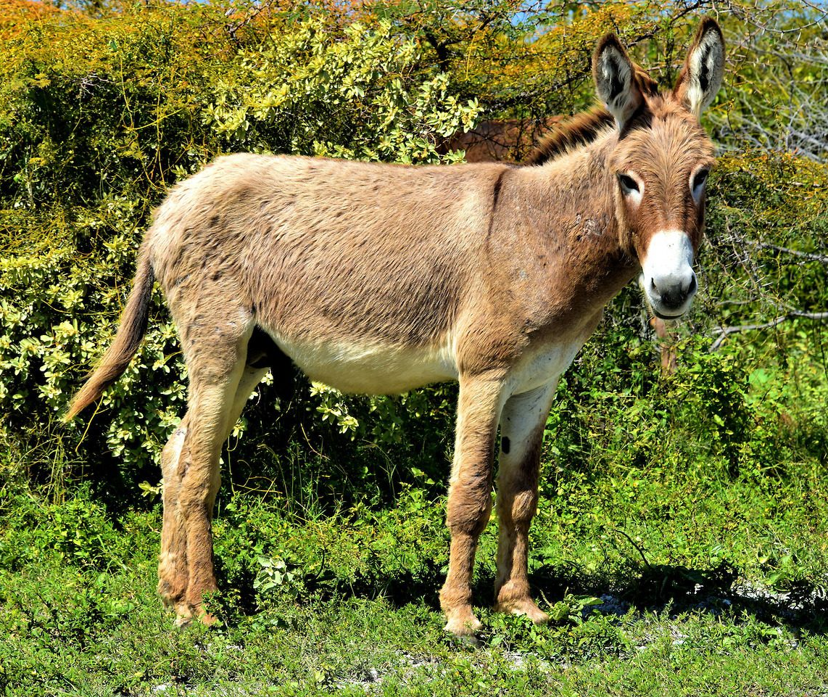
The Turks and Caicos Donkeys
The Turks and Caicos Islands Donkey Sanctuary rescues homeless and unwanted donkeys, giving them a loving and forever home in Grand Turk. They rely entirely on charitable donations, adoptions, and fundraising from the public.
They aim to prevent the suffering of donkeys island-wide through the provision of high-quality, professional advice, training and support on donkey welfare.

Slide 16
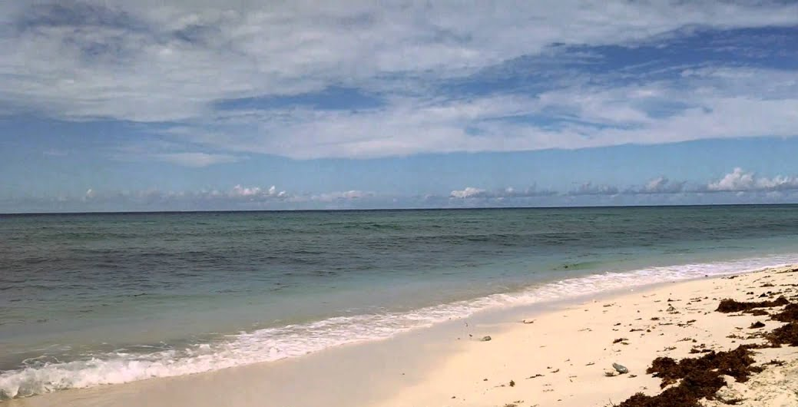
Bajari Beach
The white-sand Bajari Beach is one of the most picturesque and relaxing beaches in Grand Turk.
If you’re going to do it, you might as well do it right. That means getting exclusive VIP treatment like unlimited beer and rum punch, a local lunch, and your own beach lounge chair and umbrella to spend a lazy day in the sun or shade.
An a la carte restaurant, bar, and water sports are also available at additional cost.

Slide 17
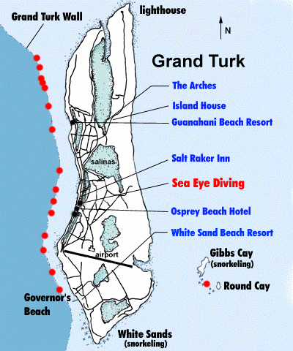
Reef Wall Snorkel
What's better than snorkeling through one of the world's most beautiful coral reefs? The 7,000-foot deep Wall is the 3rd largest and deepest barrier reef system in the world.
You will need to find a tour to guide you through the turquoise waters as you swim alongside tropical fish and coral formations.
You maybe even meet Lucky, the resident nurse shark.

Slide 18
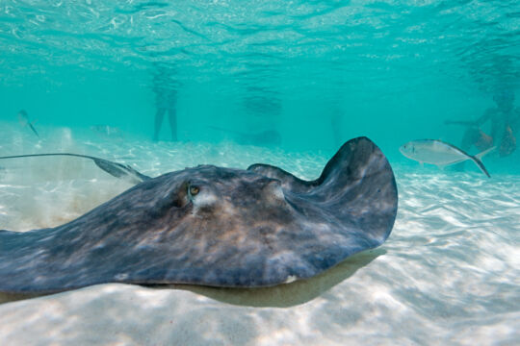
Gibbs Cay
Gibbs Cay is a small island off the east coast of Grand Turk. The Cay is quite scenic with a beautiful beach and sea oat-covered bluffs, but the main attraction is the friendly southern brown stingrays that swim up to meet any visiting boats. These stingrays interact with people and offer an opportunity to experience large wild sea animals close up.
A stop at a nearby reef for snorkeling is is recommended. The reefs around Gibbs Cay are far superior to what can be easily accessed from the shore on Grand Turk. Sights include plenty of colorful reef fish, sea fans, corals, turtles, and maybe even a small shark!
Although a great place to visit, be aware that this tiny island can get quite busy when cruise ships are in.

Slide 19
Conclusion
Turks and Caicos is a beautiful City with a rich history and numerous attractions. Regardless of what you're looking for, Turks and Caicos has something for everyone.
I hope this presentation will help when we visit Turks and Caicos!

Slide 20
Thanks For Coming
If you have any more questions, please ask.
I will do my best to answer them for you.
Have a great visit to Grand Turk

