Slide 1
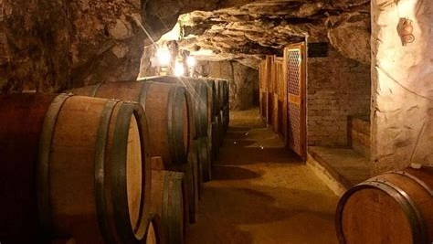
Wine Regions of the World
An Introduction to Wine in Tunisia
Presented by
Marc Silver

Slide 2
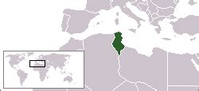
Sands, Seas, and Vines: The Story of Tunisian Wine
Nestled along the Mediterranean coast, Tunisia might not be the first country that comes to mind when you think of wine, yet this North African nation has a winemaking history as old as some of the most celebrated wine regions in Europe.
From its ancient roots in Carthaginian times, through periods of French influence, to the modern revitalization of its vineyards, Tunisia’s wine culture reflects a unique blend of tradition, resilience, and innovation.
Tunisia’s diverse terroir and
Mediterranean climate create
ideal conditions for a range
of grape varieties, producing
wines with a unique profile
that is starting to capture
international attention.

Slide 3
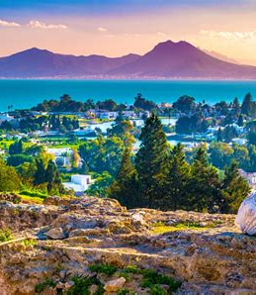
Sands, Seas, and Vines:
The Story of Tunisian Wine
In regions like the coastal Cap Bon Peninsula, mild temperatures and fertile soil yield fresh, aromatic wines, while the inland and mountainous areas provide bolder, concentrated flavors due to their more intense climate.
This seminar takes you on a journey through Tunisia’s wine history, its regional nuances, and the key varietals that set it apart.
You’ll also discover notable wineries dedicated to expressing the character of Tunisian terroir, and the ways this ancient wine culture is evolving to meet modern tastes while staying true to its roots.
Whether you’re a seasoned wine enthusiast or new to the world of North African wines, Tunisia’s story offers something intriguing, refreshing, and perhaps unexpected.

Slide 4
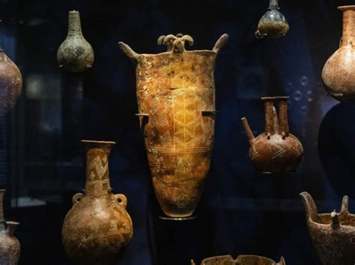
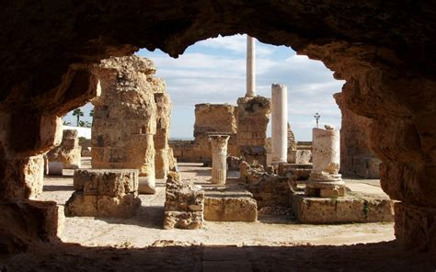
History of Tunisia’s Wine
Ancient Era
Tunisia’s winemaking history is among the oldest in
North Africa, dating back over 2,000 years to the ancient
Carthaginian civilization.
Winemaking here likely began with the Phoenicians, who founded Carthage and introduced viticulture as they expanded their trade across the Mediterranean.
Archaeological evidence shows that Carthaginian society not only produced wine but also exported it across the region, marking the early importance of Tunisia in the ancient wine trade.

Slide 5
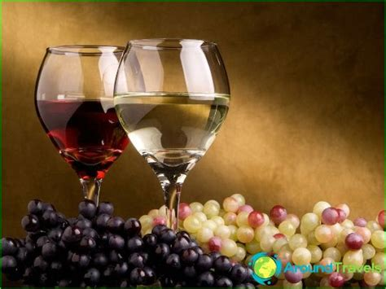
Colonial Influence
Tunisia’s modern wine industry was profoundly
influenced by French colonization, starting in
the late 19th century.
When French settlers arrived, they brought with
them established European winemaking
techniques, grape varieties, and a structured
approach to viticulture.
The industry flourished under colonial rule as Tunisia’s vineyards supplied the French market, especially when phylloxera devastated European vines. By the 1950s, Tunisia’s wine production had reached its peak, largely catering to French tastes, with varieties like Carignan and Grenache becoming central to local vineyards.

Slide 6
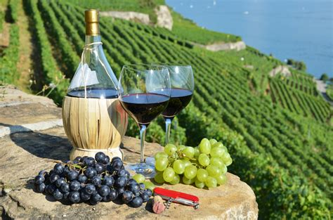
Modern Times
Post-independence, Tunisia saw a period of decline in wine production as national priorities shifted.
Recent decades have seen a renaissance in Tunisian winemaking, with modernized vineyards and a renewed focus on quality rather than quantity.
Wineries have introduced innovative techniques and invested in both indigenous and international grape varieties.
Today, Tunisia’s wine industry is evolving with an eye on both local and international markets, emphasizing its unique terroir and cultural heritage.

Slide 7
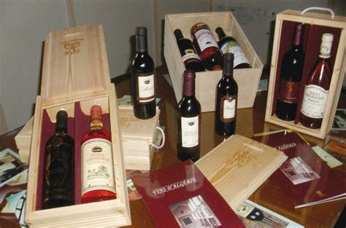
Tunisia's Wine Classification System
Tunisia’s wine classification system is influenced by French traditions but does not strictly follow an Appellation d'Origine Contrôlée (AOC) model.
Wines are generally categorized by quality and region, with the highest quality wines bearing the designation "Vin de Qualité Supérieure."
This system aims to ensure consistency
and quality, though the lack of strict
controls has allowed Tunisian winemakers
flexibility in experimenting with varieties
and methods.
Similar to Germany’s Qualitätswein
categories, Tunisia’s system provides a
broad quality assurance while encouraging
producers to explore new viticultural approaches.

Slide 8
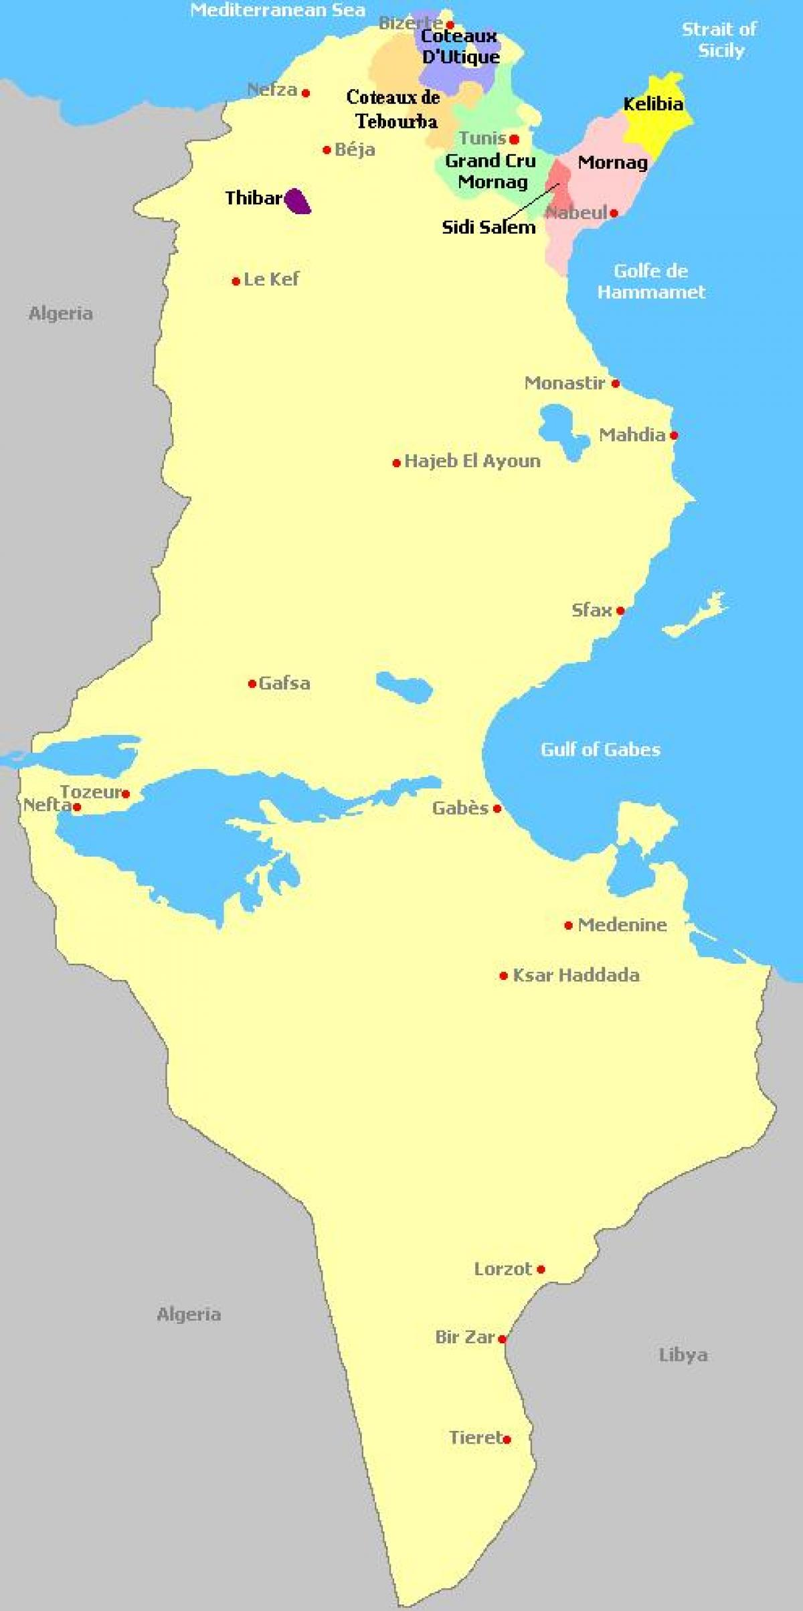
Wine Regions in Tunisia
Tunisia’s wine regions offer a fascinating combination of historical significance and unique terroirs that shape the character of its wines.
Each region has distinct features and viticultural strengths that add to the diversity of Tunisian wine, from coastal influences in the north to the harsher inland climates in the south.
Tunisia’s wine regions can be broadly classified into three primary areas: the North, Central, and Cap Bon Peninsula regions.

Slide 9
Significant Wine Regions
Cap Bon Peninsula: Often regarded as the heart of Tunisia’s wine production, the Cap Bon Peninsula is known for its fertile coastal plains and cooling sea breezes that help create ideal growing conditions.
The region produces a significant share of Tunisia’s wine and is particularly known for light, aromatic whites and rosés, as well as red wines with balanced acidity.
Cap Bon's mild climate and alluvial soils are perfect for Mediterranean grape varieties like Muscat and Cinsault, which thrive here and develop bright, fresh flavors.

Slide 10
Significant Wine Regions
Northern Region: Tunisia’s northern wine region is characterized by its proximity to the Mediterranean Sea, which has a moderating influence on the climate, keeping it milder and less arid than inland areas.
Here, the terroir is shaped by limestone-rich soils and relatively high humidity, allowing for the production of elegant, fruit-forward wines with good structure.
This region specializes in red varietals, such as Syrah and Carignan, which develop complexity due to the slower ripening process enabled by cooler nights.

Slide 11
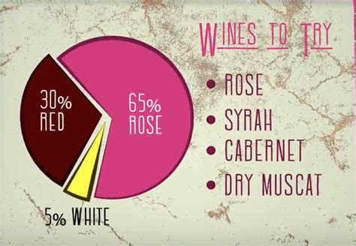
Lesser-Known Regions
While lesser-known regions may not produce as much volume as Cap Bon or the North, they add valuable diversity to Tunisia’s overall wine profile.
These regions experiment
with grape varieties, different
vineyard management
practices, and winemaking
techniques, contributing a
unique, artisanal quality to
the nation’s wine landscape.

Slide 12

Lesser-Known Regions
Central Region: The central wine region is inland, marked by its more continental climate, which experiences hotter temperatures and more pronounced seasonal variation than coastal areas.
This climate produces wines with concentrated flavors and bolder profiles, often achieved through techniques that encourage vine stress and enhance flavor intensity.
Grapes like Mourvèdre and Merlot are well-suited to this region, yielding robust reds with notes of dark fruit, leather, and spice.

Slide 13
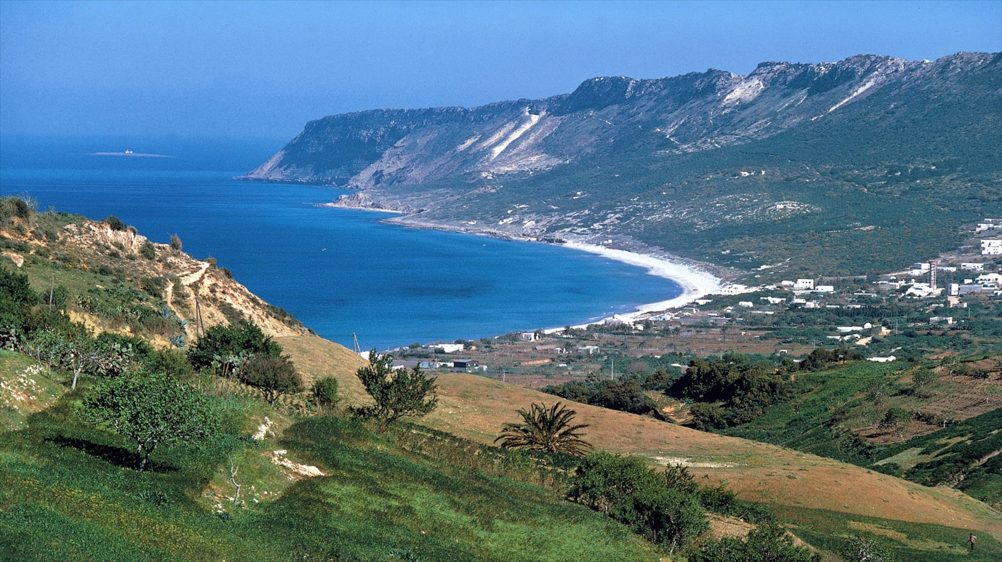
Lesser-Known Regions
Mountainous Foothills: Some vineyards in the northern foothills near Tunisia’s mountain ranges explore unique microclimates that combine altitude with the Mediterranean's influence.
This area is still relatively experimental in terms of viticulture, with vintners testing the potential of both indigenous and international grape varieties.
The wines from these higher altitudes
often have vibrant acidity, bright fruit
characteristics, and complex minerality.

Slide 14
Lesser-Known Regions
Coastal Plains:
The coastal plains are influenced by the Mediterranean's cooling breezes, which slow grape maturation and create wines with balanced acidity and freshness.
This area also supports the production of crisp, aromatic whites, particularly from grape varieties like Muscat and Chardonnay, which retain their floral notes and minerality.
Coastal wines here are often enjoyed young and have become popular locally as table wines that pair well with Tunisia’s seafood-rich cuisine.

Slide 15
Emerging Trends and Experimental Regions
Tunisia’s wine regions are increasingly focused on producing premium wines, and the industry is seeing a trend toward sustainable viticulture and experimentation.
Some vineyards are beginning to implement organic practices, while others are experimenting with biodynamic principles to further refine their wine quality.
This shift is especially prevalent in the northern and Cap Bon regions, where wineries are exploring natural winemaking techniques that enhance the expression of Tunisia’s terroir.
By focusing on distinctive, regional characteristics and prioritizing quality over quantity, Tunisia’s wine regions are gaining international recognition, proving that this North African nation has much to offer the global wine scene.

Slide 16
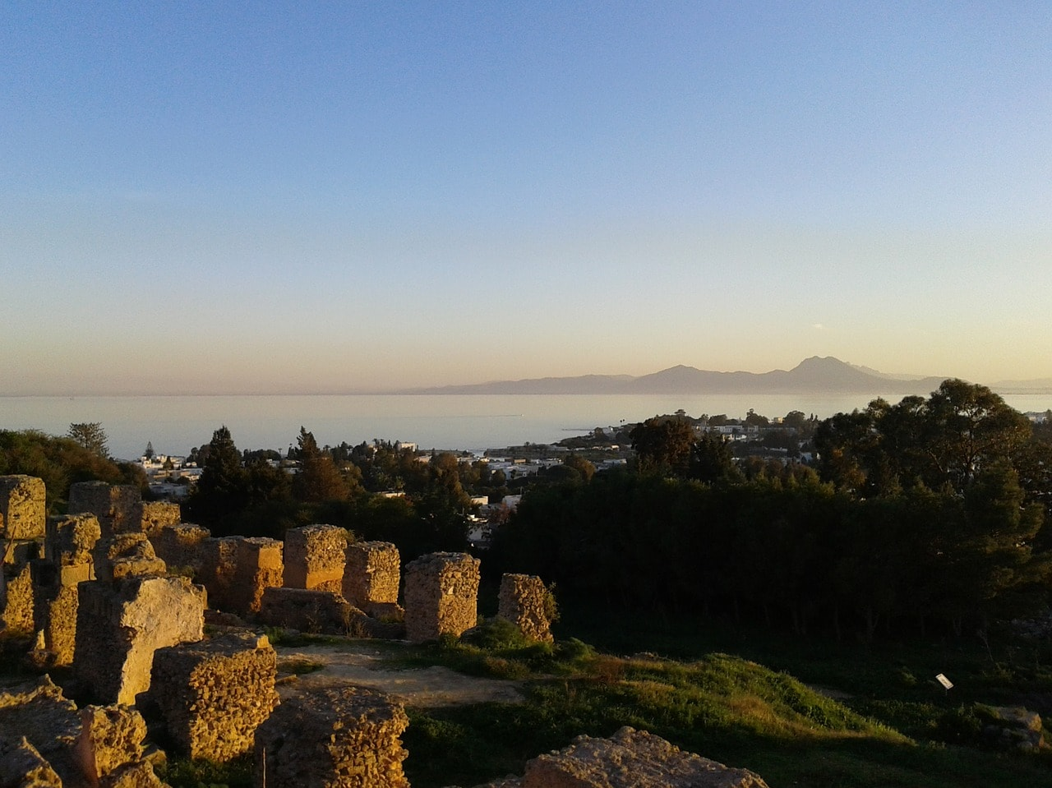
Tunisia's Terroir
Geological Factors
Tunisia’s terroir is shaped by a diverse landscape that includes
mountains, fertile plains, and coastal regions.
The northern areas benefit from rich, alluvial soils, while other
regions have limestone and clay compositions, providing a
variety of terroirs that can accommodate a wide range of grape
varieties.
Climatic Influences
Tunisia’s Mediterranean climate, with its warm, dry summers and mild, wet winters, is highly conducive to grape cultivation.
The sea’s moderating effect reduces temperature extremes, allowing grapes to ripen gradually and develop balanced acidity and flavor.
Geographical Characteristics
The geographical diversity of Tunisia, from coastal plains to elevated inland areas, allows for a range of microclimates. These variations support different grape varieties, enhancing the complexity and diversity of Tunisian wines.

Slide 17
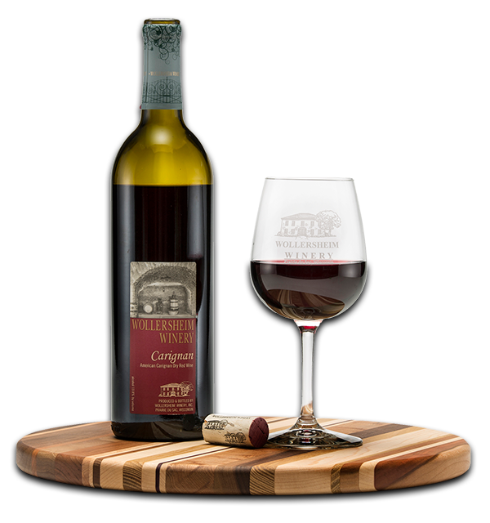
What's in the Bottle?
Carignan
Description: Carignan is one of Tunisia’s most prominent grape varieties, often producing wines with medium to full body, vibrant acidity, and rich fruit flavors such as raspberry and blackberry.
Regional Varieties: Tunisian Carignan has its unique profile, influenced by local terroir, often with hints of Mediterranean herbs and spices that distinguish it from Carignan found in other wine regions.
This variety pairs well with lamb dishes and Mediterranean cuisine, complementing bold flavors and spices.

Slide 18
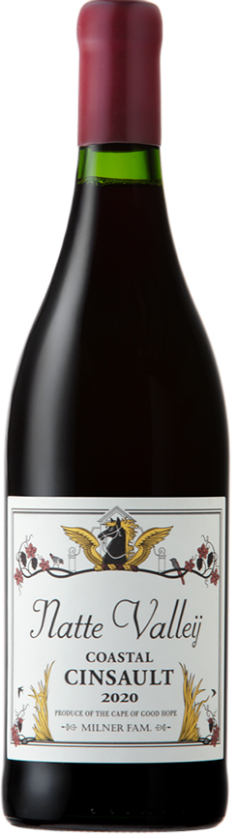
What's in the Bottle?
Cinsault
Description: Cinsault is a lighter-bodied red grape that’s well-suited for rosé wines. Tunisian Cinsault produces fresh, fruity wines with aromas of red berries and delicate floral notes, making it a refreshing choice in the local heat.
Flavor Profile: Known for its soft tannins and flavors of strawberry and raspberry, it’s an approachable variety that pairs beautifully with Mediterranean cuisine.

Slide 19
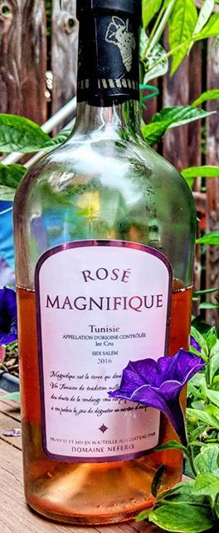
What's in the Bottle?
Grenache
Description: Grenache is versatile and often used in both blends and single-varietal wines. Tunisian Grenache typically showcases bold red fruit flavors, such as cherry and raspberry, with an underlying hint of spice and earthiness.
Tasting Notes: This grape brings warmth and fruitiness, creating wines that are vibrant yet balanced. It pairs well with lamb dishes and roasted vegetables.

Slide 20
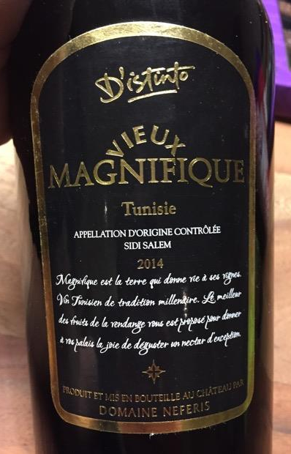
What's in the Bottle?
Syrah
Description: Syrah is popular in Tunisia’s northern regions, where the Mediterranean climate helps enhance its natural complexity. It’s known for its dark fruit flavors and signature peppery notes.
Flavor Profile: Tunisian Syrah offers a blend of blackberry, plum, and black pepper, often with a touch of smokiness. It’s a fantastic choice for pairing with robust dishes, like grilled meats or hearty stews.

Slide 21
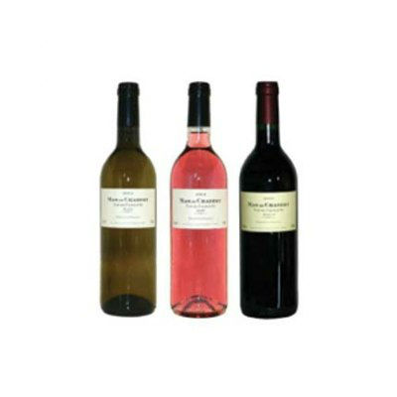
What's in the Bottle?
Merlot
Description: Though relatively new to Tunisia, Merlot has adapted well, particularly in the warmer inland areas.
Tunisian Merlot is often soft and round, with flavors of plum, black cherry, and subtle herbal notes.
Tasting Notes: Known for its smooth texture, Merlot pairs well with pasta dishes, mild cheeses, and roasted meats.

Slide 22
What's in the Bottle?
Chardonnay
Description: One of Tunisia’s primary white grapes, Chardonnay thrives in the coastal regions, where it benefits from cooling sea breezes. Tunisian Chardonnay often has a crisp, refreshing profile with a touch of minerality.
Tasting Notes: Expect flavors of green apple, pear, and citrus, with subtle floral notes. This wine pairs beautifully with seafood, salads, and lighter pasta dishes.

Slide 23
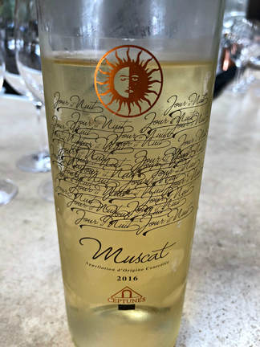
What's in the Bottle?
Muscat
Description: Muscat is prized for its aromatic qualities and is often used in both dry and dessert wines.
Tunisian Muscat captures intense floral and fruity aromas with hints of citrus and honey.
Flavor Profile: The wines are aromatic and slightly sweet, with notes of orange blossom, apricot, and honey, making Muscat ideal for pairing with desserts, cheeses, or spicy dishes.

Slide 24
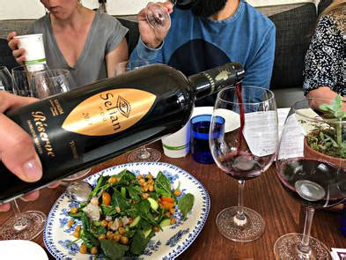
How to Enjoy Tunisian Wine
Try it Chilled for a Warm Day: Many Tunisian rosés and lighter reds, like Cinsault, can be enjoyed slightly chilled, especially on a warm day. This style of drinking brings out the wine’s refreshing fruit notes and makes it a perfect choice for al fresco dining, picnics, or barbecues.
Whether you’re new to North African wines or an enthusiast looking for something different, Tunisian wines offer a range of flavors and styles to suit any occasion. Don’t be afraid to experiment and discover how these unique wines can complement various meals and moments.
Experiment with Cheese Pairings: Tunisian wines also pair well with cheese, especially Mediterranean varieties like feta, goat cheese, and halloumi. The acidity and minerality of white wines like Chardonnay balance the creaminess of the cheese, while the fruit-forward reds enhance the rich, salty notes.
Savor as an Aperitif or Dessert Wine: Tunisian Muscat, known for its aromatic sweetness, makes an excellent choice for dessert or an aperitif. Try it with dried fruit, pastries, or even fresh, tangy cheeses. Muscat’s floral and citrus notes offer a refreshing end to a meal or a flavorful start to an evening.

Slide 25
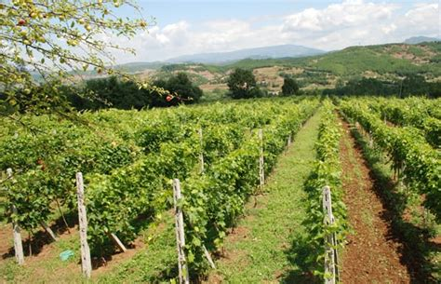
Tunisia’s Unique Terroir
What’s the secret behind Tunisia’s distinctive wines?
A mix of diverse soils, microclimates, and traditional
grape varieties. The country’s vineyards benefit from:
Hills and valleys that create ideal sun exposure.
Rich soils ranging from limestone to loam.
Microclimates that allow for a broad spectrum of
grape cultivation.
Tunisia’s major varietals reflect the country’s diverse terroir and winemaking potential. Whether it’s the bold, structured reds like Prokupac, the aromatic sweetness of Tamjanika, or the crisp elegance of Riesling, Tunisia offers a wide range of flavors for wine enthusiasts to explore.

Slide 26
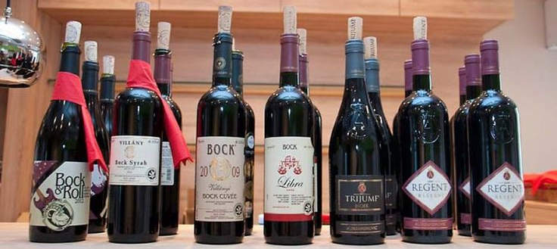
Tunisia’s Major Varietals
Tunisia’s rich winemaking tradition is anchored in both indigenous and international grape varieties, each bringing distinct qualities to the table. Here’s a deeper look into the major varietals that define Tunisia’s wine landscape:

Slide 27
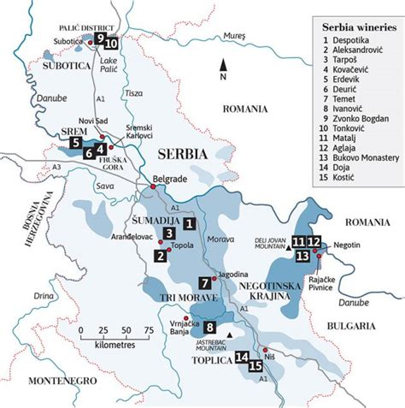
Notable Wineries
Domaine Neferis
Differentiation: Domaine Neferis stands out for its dedication to quality and tradition.
Located in the North Wine Region, the winery focuses on cultivating indigenous grape varieties alongside international ones, striking a balance between heritage and innovation.
Notable Wines: Domaine Neferis produces several highly regarded wines, including a Carignan-based red that has received acclaim for its depth and complexity.
The winery’s offerings highlight the rich, bold flavors of the Tunisian terroir, earning awards and recognition both locally and internationally.

Slide 28
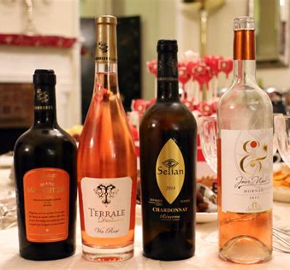
Why Tunisian Wine Deserves Your Attention
With a history of winemaking that dates back to Carthaginian times, Tunisia has a deep-rooted wine culture that is only recently being rediscovered.
The country’s diverse terroir—ranging from coastal Mediterranean climates to rugged inland landscapes—creates ideal conditions for a wide variety of grapes, each expressing distinct flavors shaped by Tunisia’s soil, sun, and sea.
In recent years, Tunisian winemakers have begun to focus on quality and experimentation, combining traditional techniques with contemporary practices.
This approach has led to wines with unexpected complexity, from bright, aromatic whites and rosés to robust reds with rich fruit and spice notes.
For adventurous wine lovers looking to expand their palate, Tunisian wine offers a fresh perspective on Mediterranean flavors, reflecting North African landscapes and traditions. It’s a region worth exploring for its originality, depth, and untapped potential in the global wine scene.

Slide 29
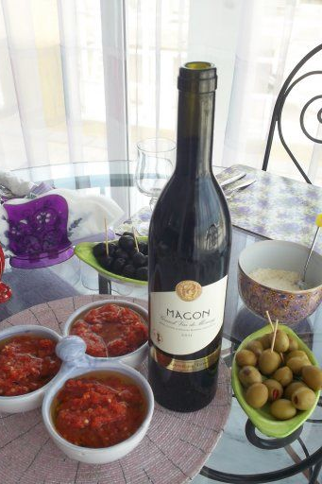
How to Enjoy Tunisian Wine
Tunisian wine is as versatile as it is unique, making it easy to enjoy in a variety of settings and with different cuisines. Here are a few tips to help you make the most of your Tunisian wine experience:
Pair with Mediterranean Cuisine: Tunisian wines are a natural fit for Mediterranean dishes. Pair a bright, crisp Tunisian Chardonnay or Muscat with fresh seafood, grilled fish, or mezze spreads. The wine’s acidity and fruitiness balance beautifully with the flavors of olive oil, herbs, and spices typical of Mediterranean cooking.
Explore with North African Flavors: Tunisia’s bold red wines, like Syrah and Carignan, pair excellently with North African dishes such as lamb tagine, couscous, and spiced meats. The wines' rich fruit and subtle spice complement the earthy, aromatic flavors of cumin, coriander, and harissa. This pairing creates a harmonious balance that highlights the complexity of both the food and the wine.

Slide 30
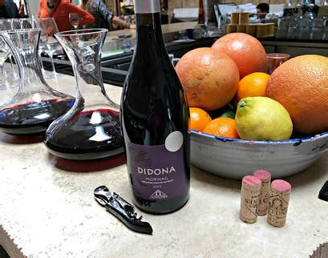
Final Thoughts
Tunisian wine is a remarkable fusion of ancient tradition and modern innovation, embodying the spirit of the Mediterranean with a North African twist.
From the coastal vineyards that produce fresh, aromatic whites and rosés to the sun-drenched inland regions yielding bold, spicy reds, Tunisia’s wines showcase a unique terroir that’s only beginning to gain recognition on the global stage.
For those seeking to expand their wine horizons, Tunisian wine offers an invitation to explore something different.
Its diverse varietals and distinctive flavors pair beautifully with a wide range of dishes, particularly those inspired by Mediterranean and North African cuisine.
Whether you’re enjoying a chilled Cinsault on a warm day or savoring a spicy Carignan with a hearty meal, Tunisian wine promises an experience that is both surprising and satisfying.
In short, Tunisian wine deserves a place on your table. With every glass, you’re not only tasting the vibrant flavors of the land but also savoring centuries of history, culture, and craftsmanship. So, take a step off the beaten path and let Tunisian wine open up a world of new tastes and stories—one sip at a time.

Slide 31
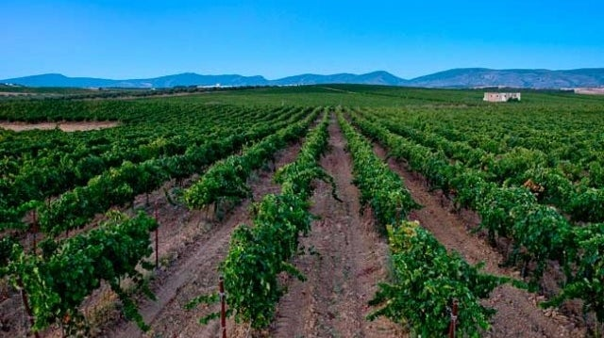
Conclusion
Tunisia’s wine industry is a testament to the country’s long-standing viticultural heritage and the recent resurgence of local winemaking.
With its unique terroir, diverse grape varieties, and notable wineries like Domaine Neferis, Tunisia is re-emerging on the global wine stage.
This ancient yet evolving wine
region offers a compelling blend
of tradition and innovation,
making Tunisian wine a
captivating choice for wine
enthusiasts around the world.

Slide 32
Acknowledgement
My seminars are the result of many years of experience combined with many hours of research over the internet.
I would like to acknowledge the many source I have accessed.
These include Wine Spectator, Wine Enthusiast, BKWine Magazine, Wine & Spirits Magazine, American Vineyard Magazine, The Grapevine Magazine, Wikipedia.com, Britannica.com, and the
various Government websites.

Slide 33
Citations and References
Historical overview of winemaking in Carthage
Impact of French colonization on North African viticulture
Tunisia’s unique terroir and geographical influences
Domaine Neferis winery details

