Slide 1

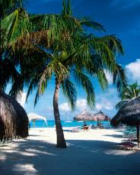




Port-of-Spain, Trinidad and Tobago
Presented by
Fellow Cruiser
Marc Silver

Slide 2
What I Will Cover
My Port Philosophy
Don’t Miss the Ship
Money
Trinidad and Tobago’s Today
Trinidad and Tobago’s History
Map of Trinidad and Tobago
Map of Port-of-Spain
Port-of-Spain Transportation
Places to see or at least consider
A few restaurant recommendations
Conclusion

Slide 3
My Port Philosophy
I have been cruising for over 45 years and have taken over 200 cruises.
So, I consider myself an experienced cruiser.
The information I will present is based on those many years of
experience.
When I am on a cruise where the city, I want to visit is not the port city,
I always recommend taking a ship’s tour.
But when I am in a port with multiple attractions nearby and easy to see
on my own - I will do it on my own.
This presentation is for that type of port.

Slide 4

Don’t Miss the Ship
How to Avoid Missing Your Ship
Pay attention to the time. - Ship time and local time are
often different.
Put a return-to-ship reminder on your phone.
Choose excursions wisely.
If a ship-sponsored excursion is late returning to port, the
ship will wait for you. If you are on your own.
Be Prepared
Have your Passport, Credit Card, and phone numbers for
your ship port agent.
What to Do If You Miss the Ship
Most cruise lines have port agents stationed in the port area to assist if your ship has left without you. If your are lucky, when cruisers are late returning to the vessel, the ship’s crew will often remove the passengers’ essential items – passports, cell phones, and medication -- from the ship to leave with the port agents.
The Port Officials can help you with contacting your ship
and making necessary travel arrangements.

Slide 5
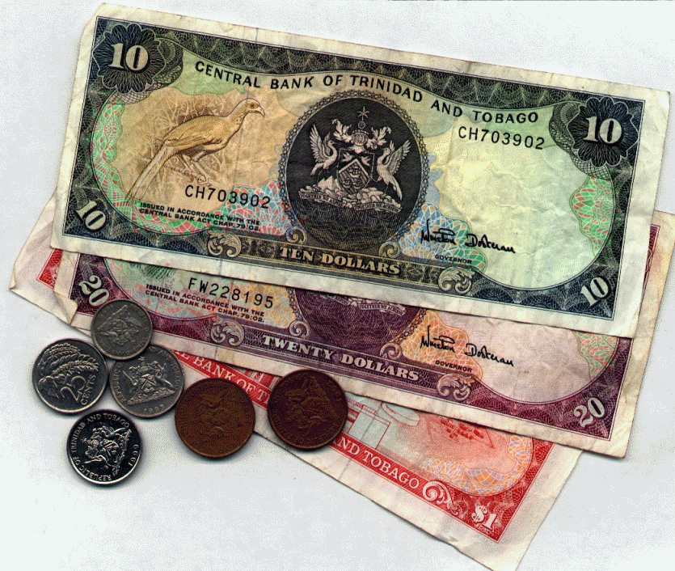
Trinidad and Tobago Money
The currency on the island is the TT Dollar.
You can exchange U.S. dollars, but it isn’t necessary. Using American money in Trinidad and Tobago is common and widely accepted.
You may receive Trinidad and Tobago currency as change.
The Trinidad and Tobago currency exchange rate is 6.74 TT Dollars for $1 U.S.

Slide 6
Trinidad and Tobago Today
Trinidad and Tobago is an island country in the southeastern West Indies. It consists of two main islands, Trinidad and Tobago, and several smaller islands. Forming the two southernmost links in the Caribbean chain, Trinidad and Tobago lie close to the continent of South America, northeast of Venezuela and northwest of Guyana.
Trinidad, by far the largest of the two main islands, has an area of about 1,850 square miles. It is 7 miles from the Venezuelan coast at its nearest point and is separated from it by the Gulf of Paria and two narrow channels, where there are several small islands and rocks.
Tobago, much smaller, with an area of about 115 square miles, lies 20 miles to the northeast of Trinidad. Extending diagonally from southwest to northeast, Tobago is about 30 miles long and more than 10 miles across at its widest point. Little Tobago lies about a mile off Tobago’s northeastern coast. Also called Bird of Paradise Island.

Slide 7
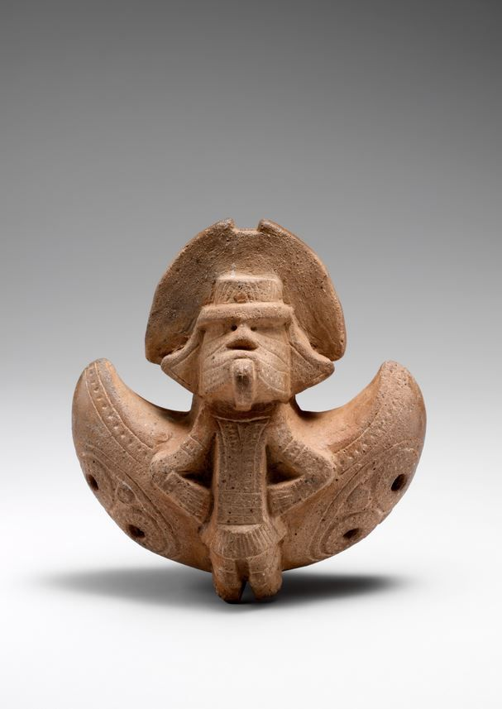
Trinidad and Tobago’s History
Pre-Columbian period
Human settlement in Trinidad dates back at least 7,000 years. The earliest settlers, termed Archaic or Ortoiroid, are believed to have settled Trinidad and Tobago around 4000 BCE.
Twenty-nine Archaic sites have been identified, mostly in southern Trinidad and Tobago; this includes the 7,000-year-old Banwari Trace site which is the oldest discovered human settlement in the eastern Caribbean.
Around 250 BCE the first ceramic-using people in the Caribbean, the Saladoid people, entered Trinidad and Tobago. The earliest evidence of these people comes from around 2100 BCE along the banks of the Orinoco River in Venezuela.

Slide 8
Trinidad and Tobago’s History Cont.
Arrival of Columbus
The first-ever contact with Europeans occurred when Christopher Columbus, who was on his third voyage of exploration, arrived on 31 July 1498. He landed at a harbor he called Point Galera, while naming the island Trinidad, before proceeding into the Gulf of Paria via the Serpent's Mouth and the Caribbean Sea via Dragon's Mouth.
Tobago was seen by Columbus on 14 August 1498. He did not land, but named the island Belaforme, "because from a distance it seemed beautiful".
Colonial settlement of Trinidad
Trinidad is reportedly densely populated at the beginning of the colonial period. Although in 1510, Trinidad was said to have the only "peaceful Indians" along the whole South American coast, demand for slaves to supply the pearl fisheries in nearby Isla Margarita led to them being declared "Caribs" (and thus, fair game for slavers) in 1511. As a consequence of this, Trinidad and Tobago became the focus of Spanish slaving raids, primarily to supply Margarita's pearl fisheries.

Slide 9
Trinidad and Tobago’s History Cont.
Colonial settlement of Tobago
In Tobago, the first Dutch colony of Nieuw-Walcheren was short-lived. 68 colonists established Fort Vlissingen ("Fort Flushing") near modern Plymouth in 1628.
They were reinforced by a few hundred more settlers from Zeeland in 1629 and 1632.
Attempted colonies by Courland in 1637, 1639, and 1642 and England in 1649, 1642, and 1647 all failed. In May and September 1654, the Courish and Dutch colonies were reestablished successfully.
In 1749, Britain and France agreed to keep the island neutral, but Britain took control after 1763, prompting France to capture the island in 1781, then Britain to recapture the island in 1793. The population in 1771 was 5,084, of which only 243 were white and 4,716 were slaves.

Slide 10
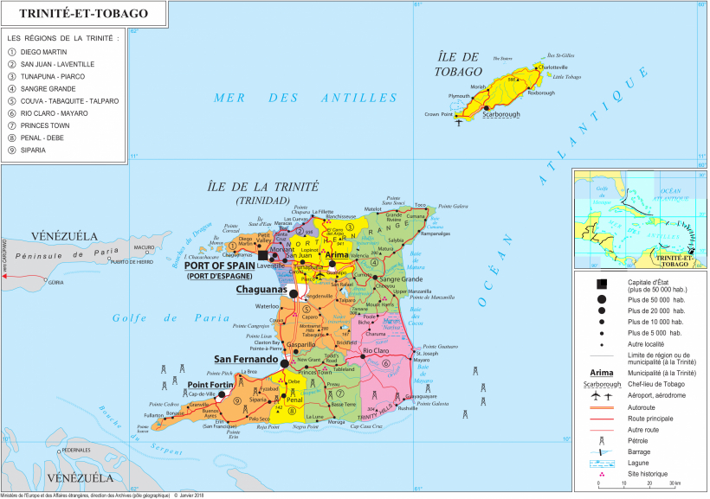
Map of Trinidad and Tobago

Slide 11
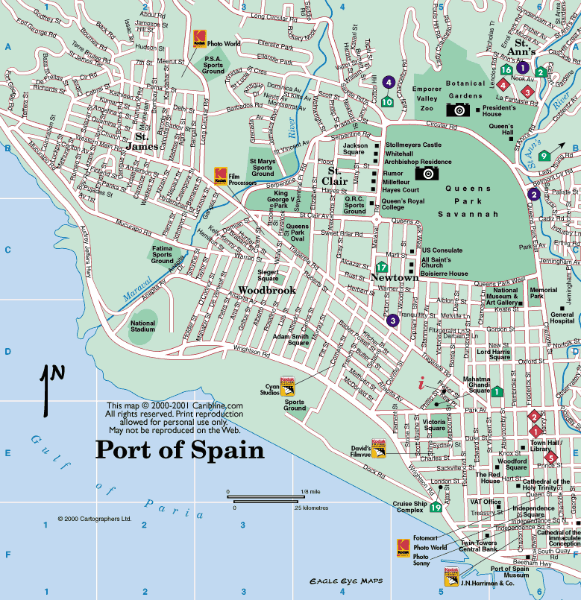
Port-of-Spain
Map

Slide 12

Port-of-Spain Buses
PTSC (Public Transport Service Corp.) is the major public transportation of Trinidad and Tobago owned by the Government of Trinidad and Tobago.
The main objective is the daily transportation of passengers throughout Trinidad and Tobago. Buses depart from the main stations, located in Port-of-Spain.
Bus tickets can only be purchased at conveniently located ticket trader outlets throughout Trinidad & and Tobago.
Fares run from
TT$2 to TT$8
Senior citizens ride for free on the PTSC bus with ID Card.

Slide 13
PTSC “Know Your Country” Tours
In addition to standard bus services, PTSC offers tours to some of Trinidad’s most popular attractions. The “Know Your Country” Tours are designed primarily for locals (though tourists are welcome) and are an excellent and very cheap way of getting to some of the more inaccessible parts of the island. Prices range from TT$50 to TT$150, not including entrance fees and meals. The most popular trips are listed below.
The Forts of Tobago;
Argyle Waterfall;
Speyside Estate;
Pitch Lake;
Caroni Bird Sanctuary;
Gasparee Caves;
Icacos Wetlands; and
Temple in the Sea.
These tours include:
Taste of Manzanilla;
Kelrosa Sanctuary and Tree House Roast
Taste of Debe
Tobago Crab and Dumpling

Slide 14

Port-of-Spain Taxis
Taxis in Trinidad and Tobago are plentiful. The cost of taking a taxi in Port of Spain will depend largely on your driver. There are no official fixed rates, nor will your driver have a taximeter fitted. However, Some Port of Spain taxi drivers may try to overcharge tourists, so negotiate with your driver BEFORE you get in.
The best way to work out your fare is to ask at a hotel reception for the average fares of well-known routes and go from there.
It’s normal for drivers to pick up other passengers along the way. If you don’t want this, be sure to let your driver know at the beginning of your journey as this may affect your fare.
Tipping your Port of Spain taxi driver isn’t expected or common.
Try to show your driver your destination on a GPS app such as Google Maps if they don’t speak English.

Slide 15
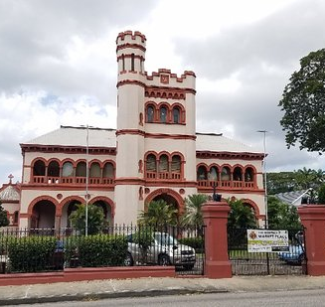
Queen’s Park Savannah
Once part of a sugar plantation, formerly home to a racecourse and Nestled in the heart of Port of Spain, the Queen’s Park Savannah stands as a testament to the rich tapestry of architecture, urban design, and history that defines this iconic landmark.
This expansive public space, is the hub of cultural and recreational activities and also a fascinating intersection of architectural brilliance, urban planning, and historical significance.

Slide 16
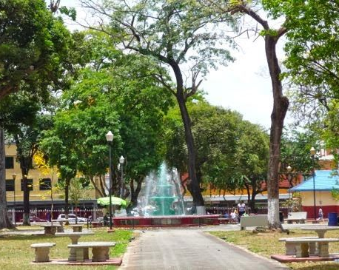
WOODFORD SQUARE
Situated in the heart of the city, Less than ½ mile from the cruise terminal, Woodford Square is renowned as a place of political and religious gatherings, entertainment, discussions, and craft markets.
Formerly known as Brunswick Square, it was renamed after Governor Sir Ralph Woodford, who was responsible for rebuilding the square and much of the city after the 1808 fire.
During it became a place of many political gatherings.
Surrounding Woodford Sq are some interesting edifices, including the Red House parliament buildings and the Old Public Library.

Slide 17
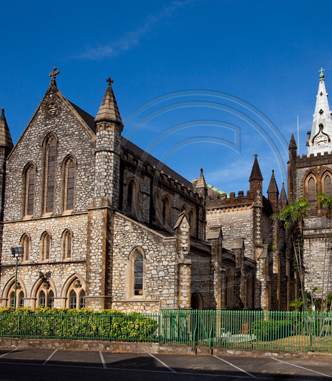
Holy Trinity Cathedral
The majestic, Gothic-designed Holy Trinity Cathedral, at the south side of Woodford Sq, dates from 1818, but sustained major earthquake damage in September 2018.
The cross atop its main spire was knocked askew and has since been removed, and the building itself is undergoing restoration and often closed up. The home of T&T's Anglican church, its interior boasts a mahogany hammer-beam ceiling, lovely stained-glass windows, and a marble monument to Sir Ralph Woodford, the British governor responsible for the cathedral’s construction.

Slide 18
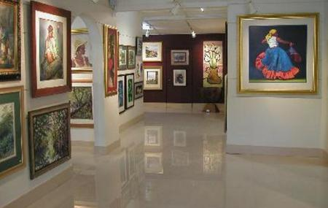
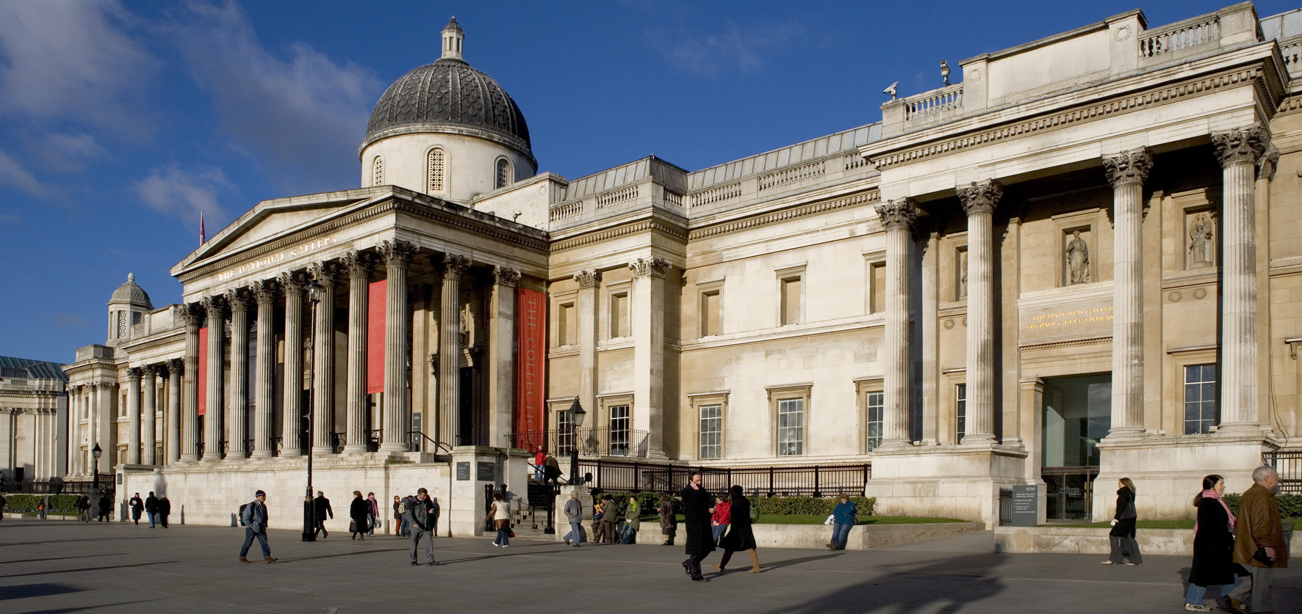
National Museum & Art Gallery
Housed in a classic colonial building, the rather dry historical exhibits range from the oil industry to Amerindian settlers, the colonial era, and indentured Indians. There are also geological and natural history displays – check out the tarantulas and fearsome-looking giant centipede. The rotating collection of artwork on the top floor is the highlight and gives an excellent introduction to the Trinbago art scene.
Don't miss the classic T&T films screened on a loop in the audio-visual room.
Admission is Free

Slide 19
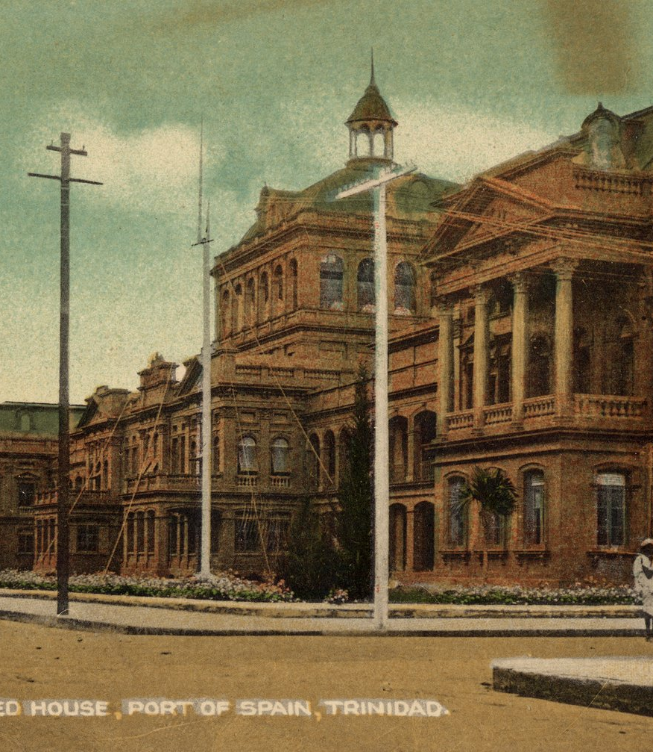
The Red House
The first Government Building on the site of the existing Red House was constructed between 1844 and 1848.
this imposing Renaissance-style parliament was constructed in 1906, having been rebuilt after it was destroyed by fire in the 1903 Water Riots.
Named for its burgundy paintwork, the buildings compromised two blocks as a concession to allow Prince Street, now Sackville Street, to remain open to St Vincent Street and Brunswick Square, now Woodford Square.
The Red House is currently being restored

Slide 20
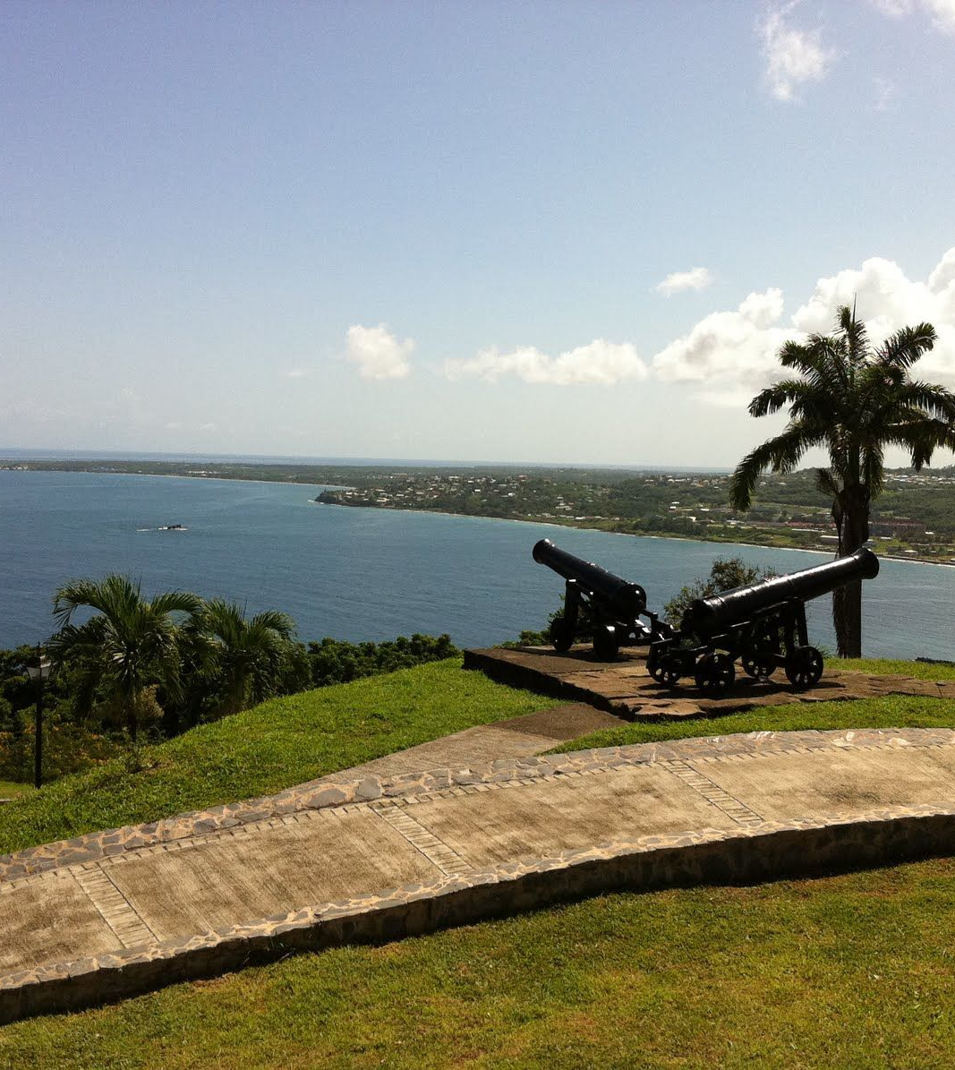
FORT GEORGE
Fort George is located about 5.5 miles from Port-of-Spain.
In 1804, under the direction of the then British Governor, Brigadier-General Sir Thomas Hislop, a series of complex military fortifications were built on the northwestern hills overlooking the stunning Gulf of Paria to protect the Port of Spain from any perceived military threats. The fort was decommissioned in 1846 the site ceased to be a military establishment.

Slide 21
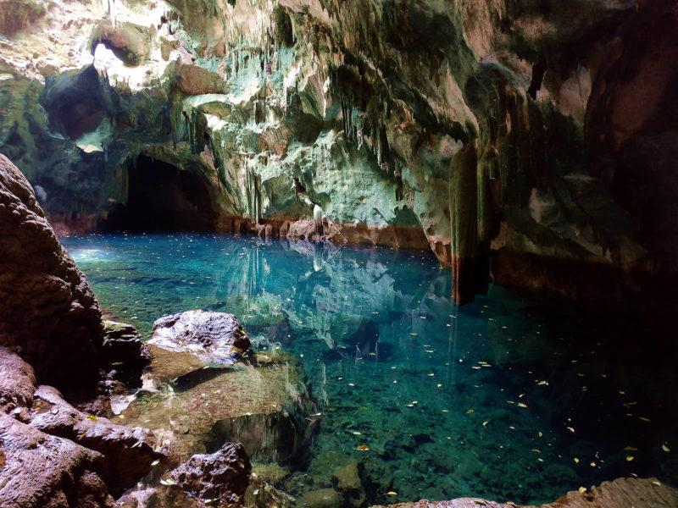
GASPAREE CAVES
Gasparee Caves is a natural system of limestone caverns and caves created by millions of years of wave action and rain on the island of Gaspar Grande. The largest of these caves is known as the Blue Grotto and was open to the public in 1981. The cave contains stalagmite and stalactite formations.
The Gaspar Grande is a 25-minute boat trip from Port of Spain or 15 minutes from Chaguaramas.
You will need to find a tour company to take you there.
Tours start at around US$75 (Adult)
US$61 (Child (10yrs and under)

Slide 22
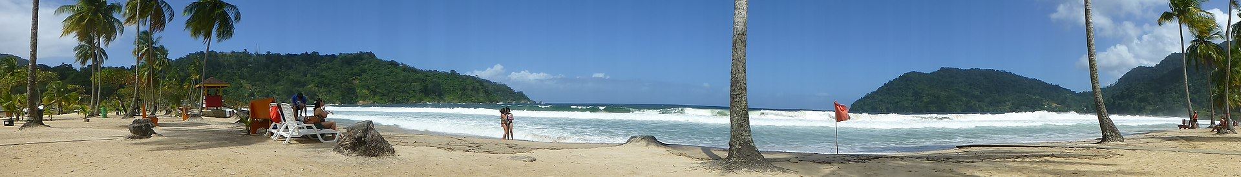
Maracas Bay
Most of the best beaches are on Trinidad's northern coast about 45 minutes away from Por-of-Spain. Maracas Bay is a bay with a sandy beach a little over an hour's mountainous drive from the capital city of Port of Spain via the North Coast Road.
Unlike many of the northern beaches of Trinidad, Maracas Bay is protected by a deep bay. It is one of the most well-known beaches on the island of Trinidad as it is considered by some to be the most beautiful beach of its size located relatively close to the capital city.
Lifeguards oversee weekend crowds. You won't be the only one on the beach and there's no shortage of provisions. Snack bars all claim to sell the best "bake and shark," the Trinidadian specialty. Restrooms are plentiful. Arrive via North Coast Road, a winding journey through the town of Maraval.

Slide 23
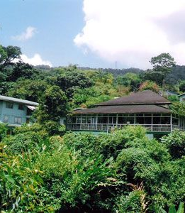
Asa Wright Nature Centre
A former cocoa and coffee plantation transformed into a 600-hectare (1,483 Acres) nature reserve. It is home to more than 400 species of native birds, plus 55 different reptile species, 25 amphibians, more than 600 butterflies, and more than 2,000 types of flowering plants.
Located amid the rainforest of the Northern Range, the center has a series of hiking trails, open to day visitors via guided tours.
The property's $10 Adult admission and $6 Child fee includes a guided tour at 10:30 a.m. or 1:30 p.m.

Slide 24

Restaurants
There are a lot of excellent restaurants in Port-of-Spain. Especially for Caribbean Seafood.
Here are some recommendations:
Waterfront Restaurant $$$$ Caribbean, International, Grill
Wrightson Road # 1 Hyatt Regency Trinidad, Port of Spain Trinidad
Hilton Herbs and Spices $$ - $$$Caribbean, International, Grill
Lady Young Road 1, Port of Spain
El Pecos $$ - $$$ Caribbean, International Vegetarian
Ariapita Avenue Woodbrook, Port of Spain
Lola's Food Company $ Caribbean, International, Grill
Tragarete Road # 82, Port of Spain $$$$ Indian, international, Fusion
Alcazar Street 3 St. Clair, Port of Spain
Svaada $ Indian, Vegetarian, Vegan, One Woodboork Place, Damien Street, Woodbrook, Port of Spain
For those of you who just like good food, I am sure you will enjoy Port-of-Spain

Slide 25
Conclusion
Trinidad is a beautiful island, with a rich history and many attractions. Regardless of what you're looking for Trinidad has something for everyone.
I hope this presentation will help when we visit Port-of-Spain, Trinidad!

Slide 26
Thanks For Coming
If you have any more questions, please ask.
I will do my best to answer them for you.
Have a great visit to Port-of-Spain!

