Slide 1
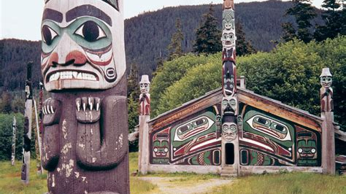
Totem Poles and Alaska Native Peoples
Presented by
Marc Silver

Slide 2
Topics
Early Totem Poles
The Golden Age of Totems
Smallpox Outbreak
Totem Heritage Center
Alaska Native Peoples
Design Inspiration
Different Clans - Different Styles
Totem Size
Tree Selection
Types of Totem Poles
Carving Process
The Moiety
Alaska Native People
Clan Animals
Totem Heritage Center

Slide 3
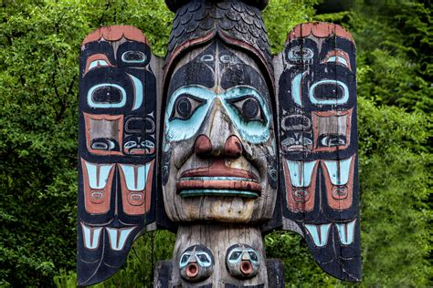
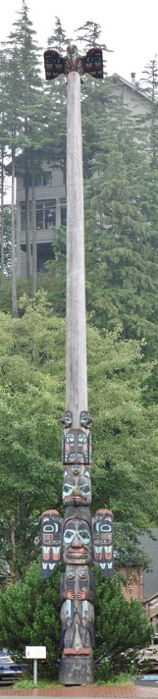
Early Totem Poles Were Billboards
The totem pole is the most well-known type of art made by Alaskan Natives. No Alaska vacation is complete without seeing a few totem poles. Since they were first noticed by European explorers in the 1700s, totem poles have been misunderstood.
Britain’s Captain James Cook, who encountered totem poles off the coast of British Columbia, called them “truly monstrous figures.”
Early missionaries thought the totem poles were worshiped as gods and encouraged them to be burned. And even today, when someone refers to the “low man on the totem pole,” they may not realize that the bottom figure was often the most important one – and usually, it wasn’t a man.

Slide 4
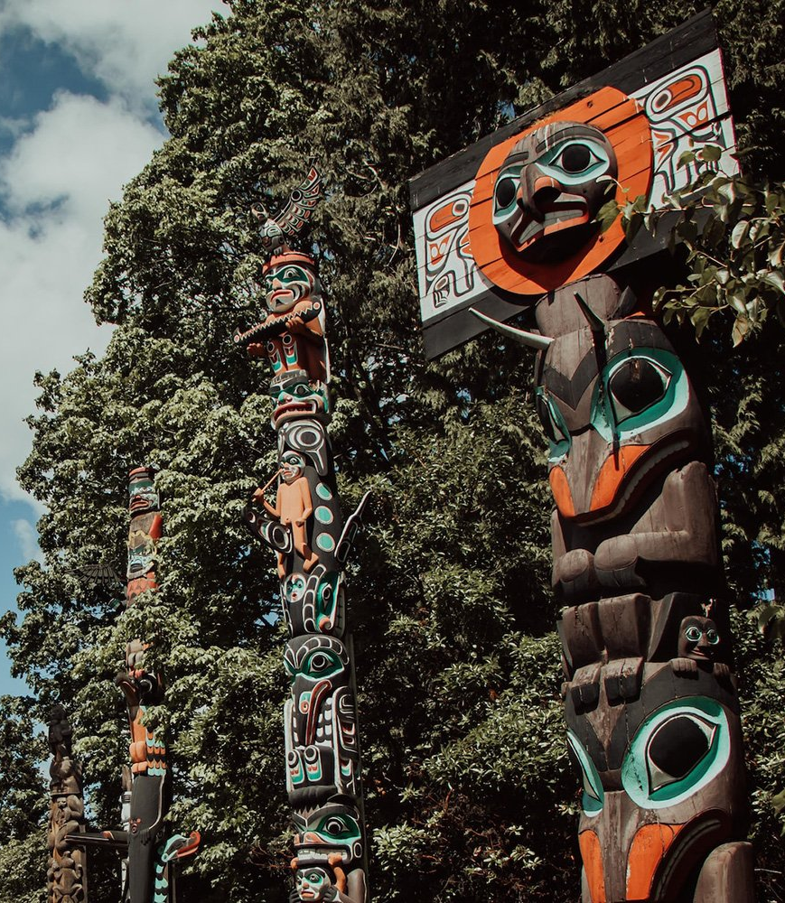
The Golden Age
The golden age of totem poles was during the mid-1700s to the late 1800s, when the fur trade created a sense of wealth that the Tlingit, Tsimshian, and Haida tribes had never experienced.
These native people invested in potlatch celebrations and the creation of totem poles which was made much easier with the arrival of iron tools from Europe.

Slide 5
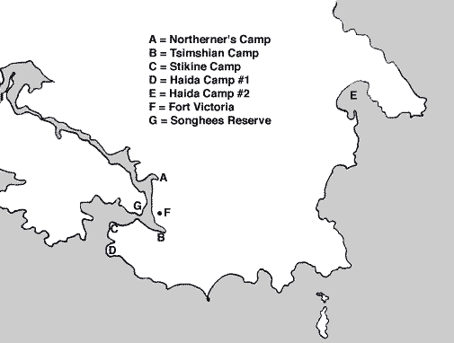
Smallpox Outbreak
In 1862 Alaska’s indigenous people were decimated by smallpox and tuberculosis. The Pacific Northwest smallpox epidemic started in Victoria on Vancouver Island and spread among the indigenous peoples of the Pacific Northwest Coast and into the indigenous peoples of the Northwest Plateau, killing a large portion of natives from the Puget Sound region to Southeast Alaska.
It is estimated that two-thirds (approximately 20,000) of native people died do to the disease.
While colonial authorities used quarantine, smallpox vaccine, and inoculation to keep the disease from spreading among colonists and settlers, it was largely allowed to spread among indigenous peoples.

Slide 6
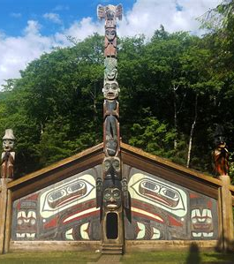
Smallpox Outbreak Cont.
By 1 April about half of the white colonists had been vaccinated. It is unclear how large a supply of the smallpox vaccine was available, while some sources stated that there was a shortage of vaccines.
Regrettably, as a result of the outbreak, many of the indigenous people moved into larger communities, leaving their villages and totems behind.
Throughout the 1930s most of these Totems were removed, and you can find their replicas at Totem Bight State Historical Park or Saxman Village Totem Park in Ketchikan.

Slide 7
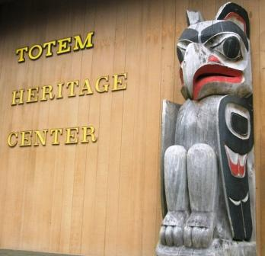
Totem Heritage Center
It wasn’t until the summer of 1970 that the last of the standing totems were recovered and brought to Ketchikan to be preserved at what is now the Totem Heritage Center.
Silvery-gray with age, they are still stunning, intricately carved works of art. Memorial poles, story poles, family poles and clan poles, each offers an individual design and explanation.
The Totem Heritage Center houses 33 poles in a climate-controlled environment, 16 of which are on permanent display.
Photos of the old village sites help you imagine these poles as they stood originally. Native artifacts such as baskets, masks, and regalia give additional insight into the artistry and cultural heritage of the Tlingit, Haida and Tsimshian.
Admission is $6 for adults, $5 for seniors (65 +), and children under 17 (and Active military!) are free of charge.

Slide 8
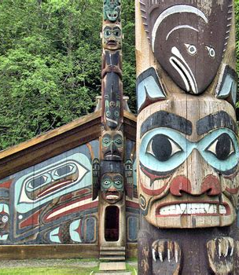
Alaska Native Peoples
Alaska Native cultures represent more than 10,000 years of human history. There are endless options for learning about Alaska indigenous people’s traditional lands, languages, and ways of life.
Traditionally stories are passed down from Elders.
The heartbeat of the people comes from the drums used in traditional dancing.
The sole can be found in totem carving techniques passed down from generation to generation.
The style comes from the regional and local Alaska Native functional and creative arts, ranging from carving and basket weaving to sewing and silversmithing.

Slide 9
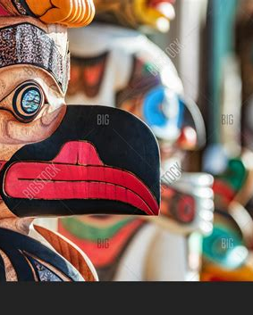
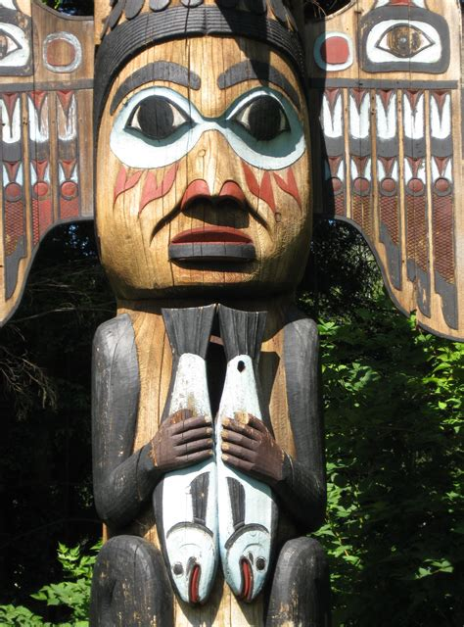
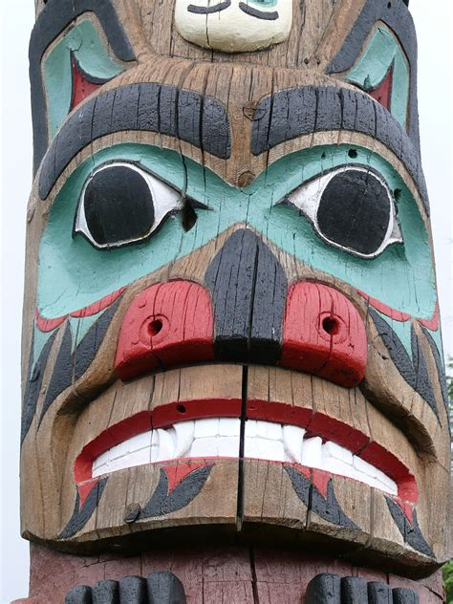
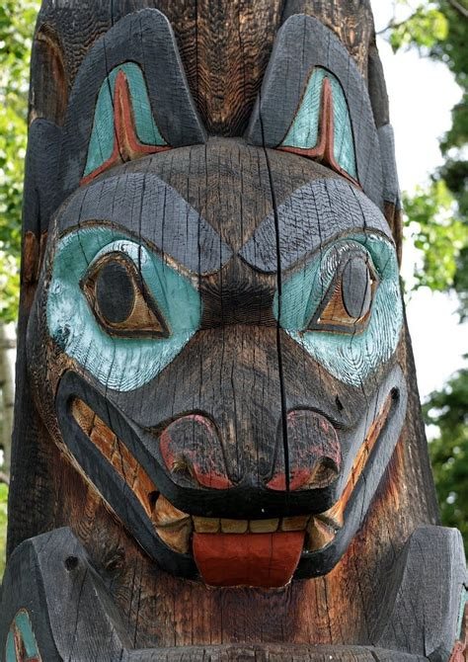
Design Inspiration
Alaskan Native communities heavily rely on animals for sustenance and inspiration, especially in regard to the bases of their social structure.
The tradition of stories being passed through families and communities spans generations, leading to much of the various clans’ unique identities.
Each animal holds its own story and spiritual meaning. These meanings have translated into the identities for several Alaskan Native clans in the Southeast region.

Slide 10
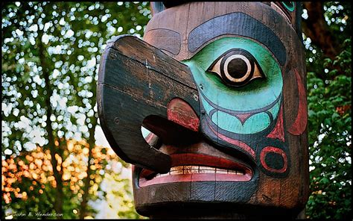
Design Inspiration Cont.
The spiritual representation of an animal is often embodied and eternalized through a totem pole. The word “totem” is actually a misnomer that stems from totemism, which “was thought to be the primordial religion” of the communities which create totem poles.
While this name provides an appealing mystery to the carvings, it is entirely inaccurate. These totem poles are symbols of a community's history, values, and traditions, but not the base of a religion.
Each aspect of a totem pole is as important and individualized as the animal it is based on. The four clans that have a particularly rich history involving the totem pole are the Eyak, Tlingit, Haida and Tsimshian cultures.

Slide 11
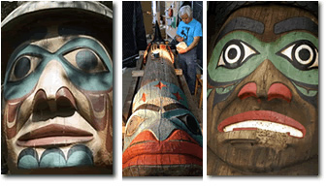
Different Clans - Different Styles
The use of animals in totem poles is not only traditional, but it is also highly important. The animals chosen to be in a specific totem pole carry great significance and demonstrate each culture’s interpretation of the spiritual meaning of the wildlife around them. The way a pole is constructed also holds importance.
Different clans and regions will carve different types of poles depending on their inter-clan traditions. For example, “The Coast Salish of the Lower Fraser tend to carve house posts rather than single stand-alone poles,” where most clans carve single poles that suit an occasion or family.

Slide 12
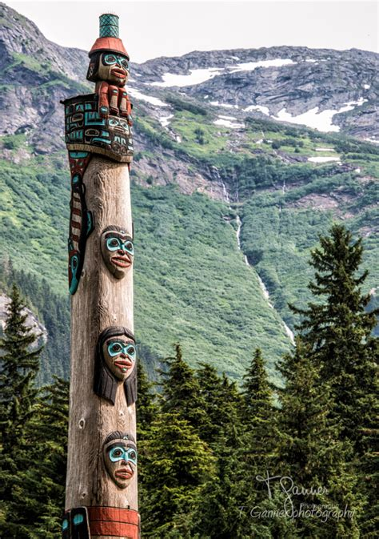
Totem Size
Most commonly, totem poles range from 9 to 59 feet tall, though height varies greatly depending on clan and culture. The Haida and Tsimshian generally carve taller poles, “often reaching over 100 feet.”
Every aspect of a totem pole holds cultural significance, even the wood it is carved from. Due to the coastal environment in which the Eyak, Tlingit, Haida and Tsimshian have made their homes, totem poles are usually “made from a large red cedar tree. Some totem poles were also made from yellow cedar.”

Slide 13
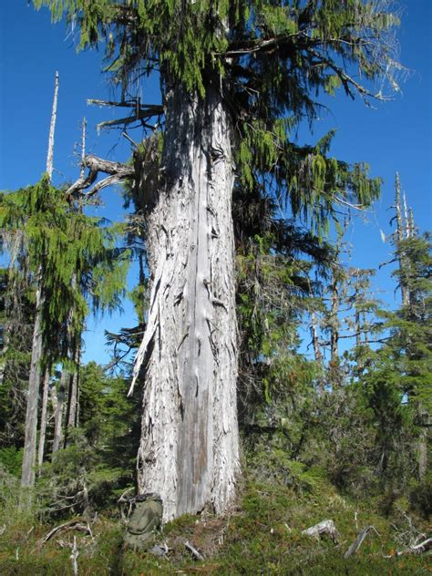
Tree Selection
The importance of the totem pole is marked before the carving even begins. After a careful selection process for discerning which tree is most suited for the particular totem pole, “many coastal First Nations and Tribal communities will perform a ceremony of gratitude and respect in honor of the tree.
Several trees may be inspected before a particular tree is chosen for its beauty and character.” The selection of trees is an honored and careful process, as it requires “an intimate understanding of cultural histories and forest ecology.” One area of trees cannot be overharvested, and balance must be maintained throughout the community and local vegetation.

Slide 14
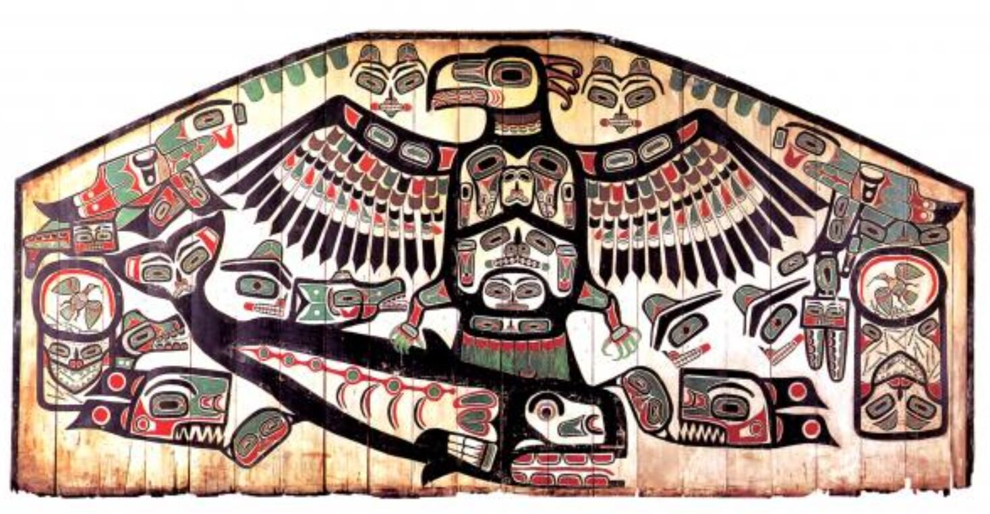
Types of Totem Poles
Crest Totem Poles: Usually part of a house, they portray a family’s ancestry and the emblems of its clan.
Story-telling Totem Poles: The most common type, these are made for a wedding, to preserve history or to ridicule bad debtors.
Mortuary Totem Poles: These totem poles are made to honor the dead. Cremation ashes are often kept in a compartment in the back. A single figure represents the deceased person or their clan.
Wooshkitaan Eagle Clan Crest Totem

Slide 15
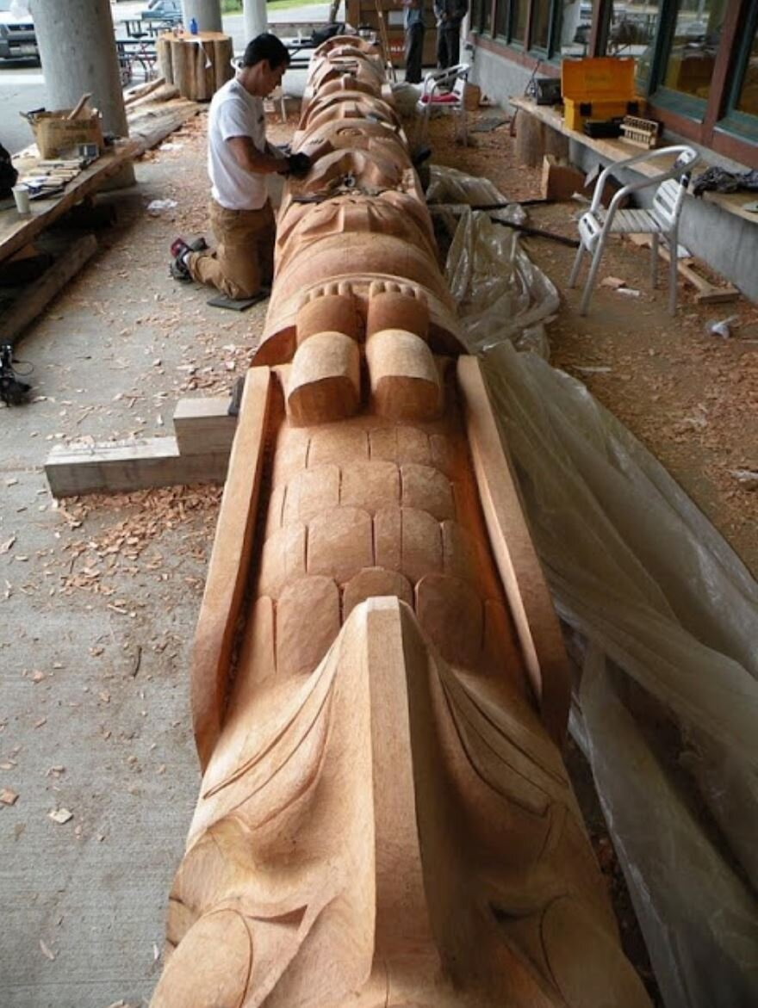
The Carving Process
The carving process is also unique among tribes. Carving has traditionally only been done by men. However, women have occasionally done carvings as well.
A totem carver begins honing their craft at a very young age, and it is seen as an honorable and important role in the community.
Each tribe has a specific style and process, with some carving “around the pole, and others would carve out the back of the pole.”
Eagle and Raven totem pole

Slide 16
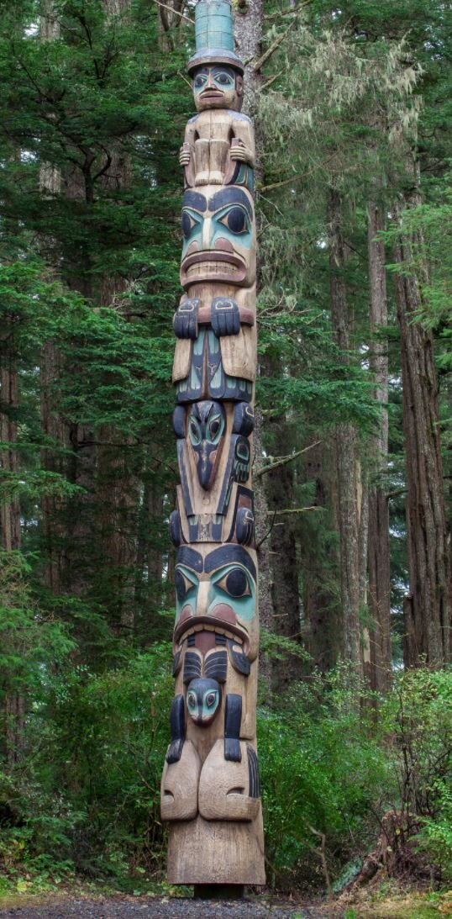
The Moiety
The general structure of a totem pole includes a main moiety, a clan animal, and passive and aggressive animals that are on the clan crest. They can communicate a narrative, but mostly they mark “a family’s lineage and validating the powerful rights and privileges that the family held.”
Each Alaskan moiety is represented by an animal, and the clans (and families within those clans) are represented as supporting animals to the main moiety.
The two main moieties in which a people is divided into are based on lineage; however, they are then divided into smaller clans based on location and more immediate family groupings. These divisions are based on maternal lineage, and “all people in a clan can trace their relatives to the same ancestor.”

Slide 17
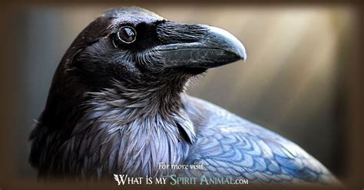
The Moiety Cont.
The Tlingits of Southeast Alaska are separated into the Raven Moiety and the Eagle Moiety (which was once the Wolf Moiety). The Haida moieties are represented by the same animals as the Tlingit moieties, but because they are a different people, they must be seen as an entirely separate unit.
Within both the Tlingit and Haida Tribes, The Raven is a symbol of “creation, transformation, knowledge[, and] prestige as well as the complexity of nature and the subtlety of truth.” The Eagle is seen as having the closest relationship with The Creator out of all the animals, and it represents “focus, strength, peace, leadership, and ultimate prestige.” 5 However, the Eagle can also be a symbol of the balance and coexistence of men and women, with its two wings representing the two genders in harmony.

Slide 18
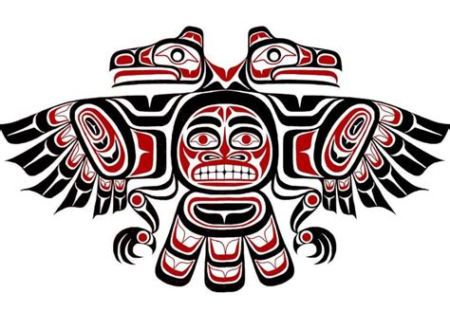
Alaska Native People
Each clan has its own crest which incorporates their clan animal as well as their moiety. Balance, above all else, is the focus when carving totem poles and pairing animals together. This sense of balance is maintained through the binding of “passive and aggressive animals.”
Passive and aggressive animals can be fairly intuitively identified by whether or not they are predators in the wild. For example, Wolf is an aggressive animal, while Beaver is a passive animal, meaning that the two could potentially be compatible to pair together.
The combination of moiety, clan animal, and a maintained equilibrium between passive and aggressive animals is usually how a totem pole is designed. However, the design differs depending on what, or who, it must represent.

Slide 19
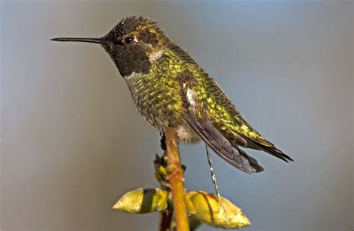
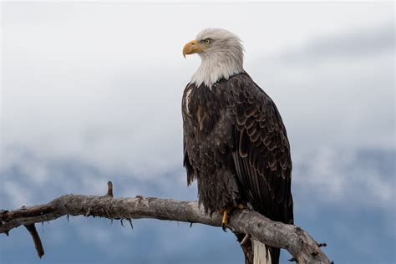
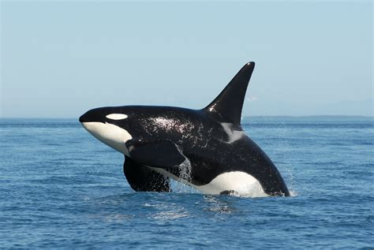
Clan Animals
The clan animals associated with the Tlingit’s Raven moiety are Frog, Beaver, and Salmon, while the Haida Raven’s crest animals are Wolf, Killer Whale, and Bear.
The clan animals associated with the Tlingit’s Eagle moiety are Wolf, Killer Whale, and Bear, and under the Haida’s Eagle moiety are Frog, Beaver, and Hummingbird.
The Tsimshian people are separated into four moieties: Raven, Wolf, Eagle, and Killer whale. Raven and Eagle maintain similar meanings as those of the Tlingit and Haida moieties. Wolf is renowned for its incredible supernatural powers and hunting abilities, and it represents “loyalty, strong family ties, good communication, education, understanding, and intelligence.”
Killer whale, or Orca, is a protector of travelers and “symbolizes family, romance, longevity, harmony, travel, community and protection.” Most Tsimshian people demonstrate their moiety through wearing a “button blanket,” that depicts their crest.

Slide 20
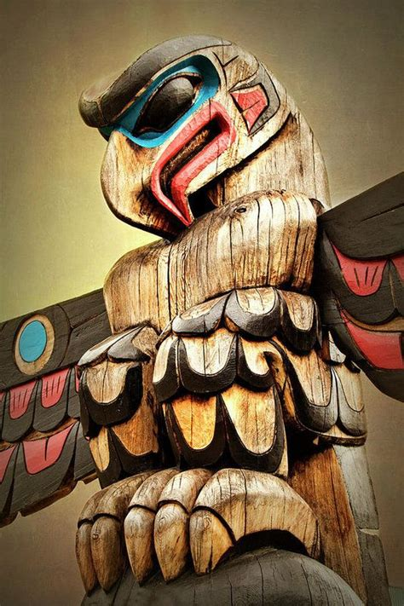
Clan Animals Cont.
The animals used in totem poles are incredibly significant in Alaskan Native culture, especially in regard to maintaining cultural and environmental balance. While not an act of religious discipline, the time and energy put into the carving of these huge structures demonstrates the significance specific animals have represented for Alaskan Native communities.
The variation and specification in meaning and origin story for the wildlife in each clan acts as a reminder that animals have changed human interactions since the beginning of community development in Alaska. Without the constant presence and the involvement that animals have with humans, totem poles would be empty creations.
With the ever-growing need for balance between humans and animal kingdoms, totem poles act as a constant reminder that humanity would be insignificant without their relationship to animals.

Slide 21
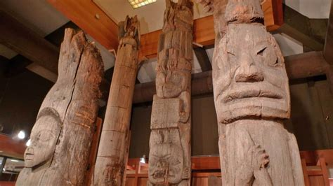
Totem Heritage Center
The Totem Heritage Center houses 33 poles in a climate-controlled environment, 16 of which are on permanent display. Photos of the old village sites help you imagine these poles as they stood originally.
Native artifacts such as baskets, masks, and regalia give additional insight into the artistry and cultural heritage of the Tlingit, Haida and Tsimshian.

Slide 22
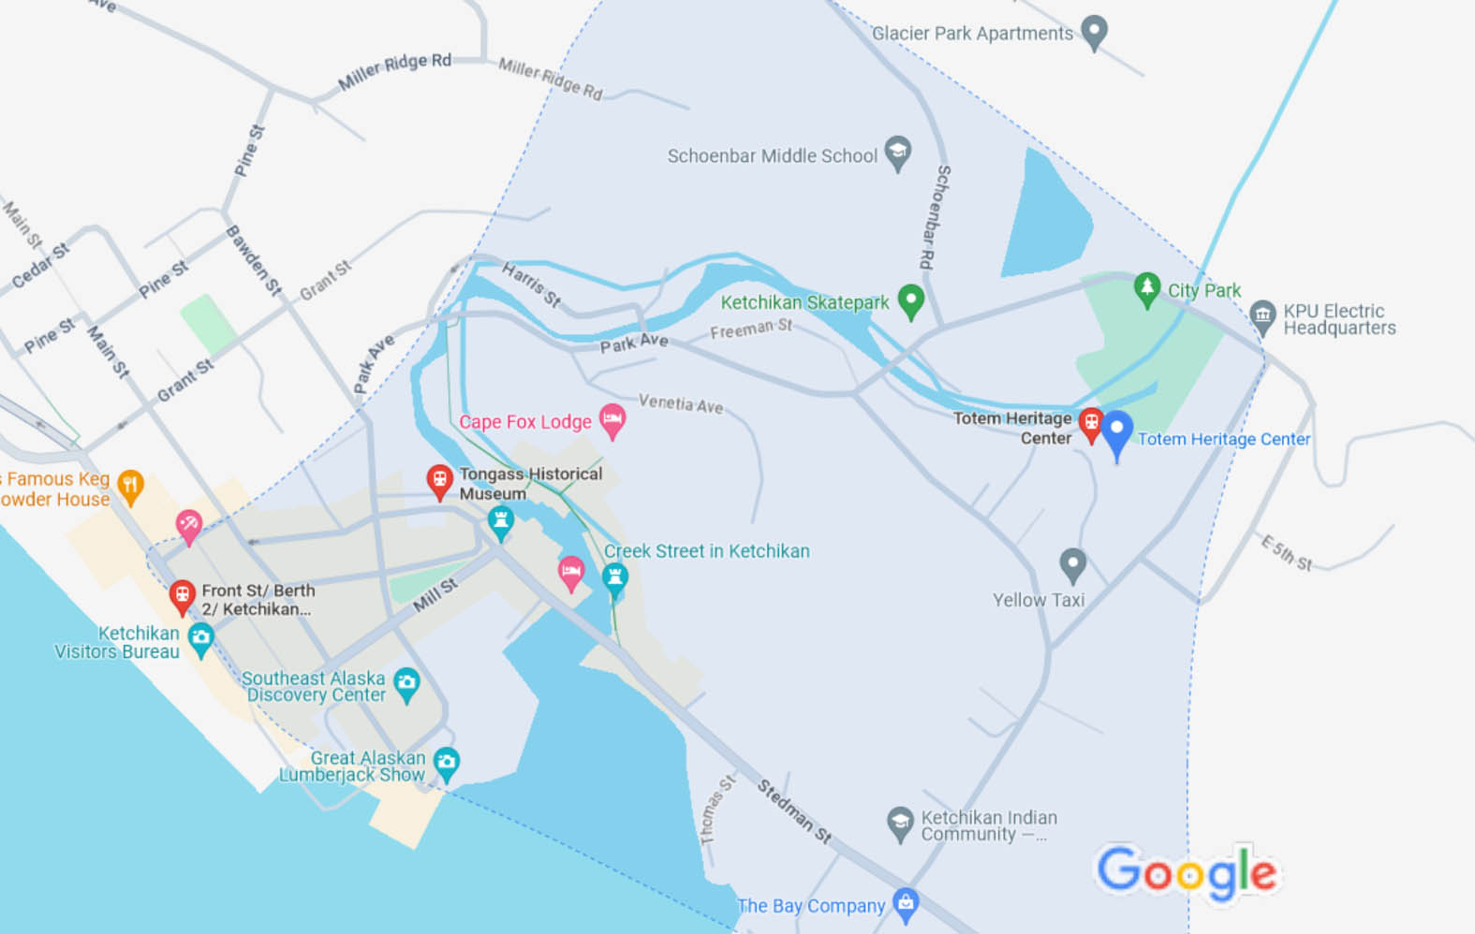
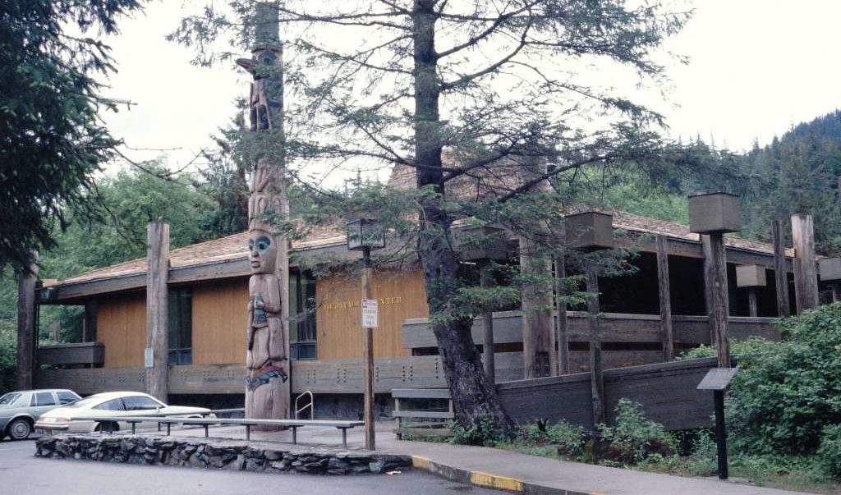
Getting to Totem Heritage Center
Take the free downtown shuttle or the city bus to get here or enjoy a 15 minute walk past the salmon ladder and across Ketchikan Creek to Deermount Street. Totem Heritage Center is open every day (8 a.m. to 5 p.m.) from May through September. In the winter months it’s open Monday through Friday (1 p.m. to 5 p.m.).

Slide 23
Thankyou for Coming!
I hope you enjoyed my talk!
If you have any more questions, please ask.
I will do my best to answer them for you.
I can be reached by e-mail at
marcs@sonic.net

Slide 24
Acknowledgement
My seminars are the result of many years of travel experience combined with many hours of research over the internet.
I would like to acknowledge the many sources I have accessed.
These include: Wikipedia.com, Britannica.com, and the various Museum, Park and Government websites.

