Slide 1

Topolobampo, Mexico Presented by Marc Silver

Slide 2
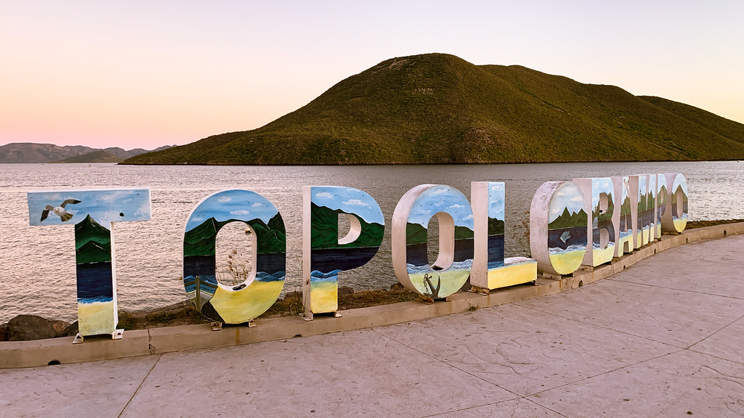
What I Will Cover
My Port Philosophy
Don’t Miss the Ship
Money
About Topolobampo
History of Topolobampo
Map of Topolobampo
Weather of Topolobampo
Taxis
Points of Interest
A few restaurant recommendations
Conclusion

Slide 3
My Port Philosophy
I have been cruising for over 45 years and have taken over 100 cruises. So, I consider myself an experienced cruiser.
The information I will present is based on those many years of
experience.
When I am on a cruise where the city, I want to visit is not the port city,
I always recommend taking a ship’s tour.
But when I am in a port with multiple attractions nearby and easy to see
on my own - I will do it on my own.
This presentation is for that type of port.

Slide 4
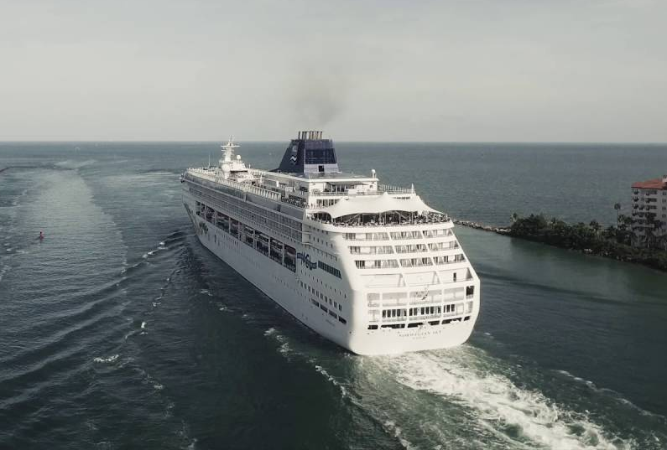
Don’t Miss the Ship
How to Avoid Missing Your Ship
Pay attention to the time. - Ship time and local time are often different.
Put a return-to-ship reminder on your phone.
Choose excursions wisely.
If a ship-sponsored excursion is late returning to port for, the ship will wait for you. If you are on your own???
Be Prepared
Have your Passport, Credit Card and phone numbers for your ship port agent.
What to Do If You Miss the Ship Most cruise lines have port agents stationed in the port area to assist if your ship has left without you. If you’re lucky, when cruisers are late returning to the vessel, the ship's crew will often remove the passengers' essential items -- passports, cell phones and medication -- from the ship to leave with the port agents.
The Port Officials can help you with contacting your ship and making necessary travel arrangements.

Slide 5
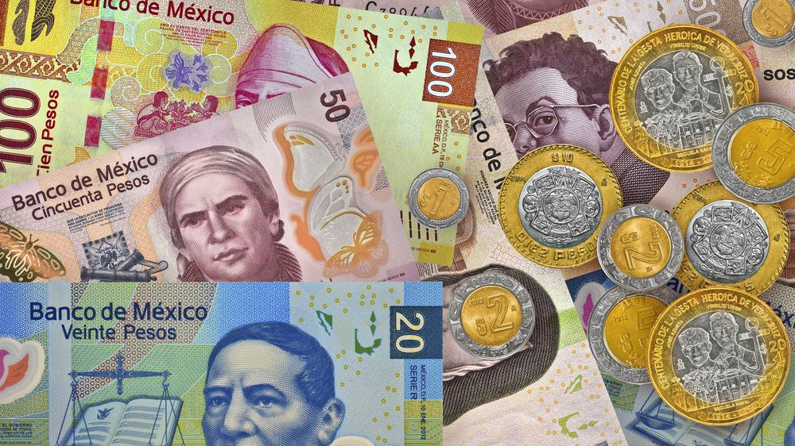
Money
The Peso is the official currency of Mexico
Official Exchange is 100 Pesos is $5.80 US
Or 17.35 Pesos to the US Dollar

Slide 6
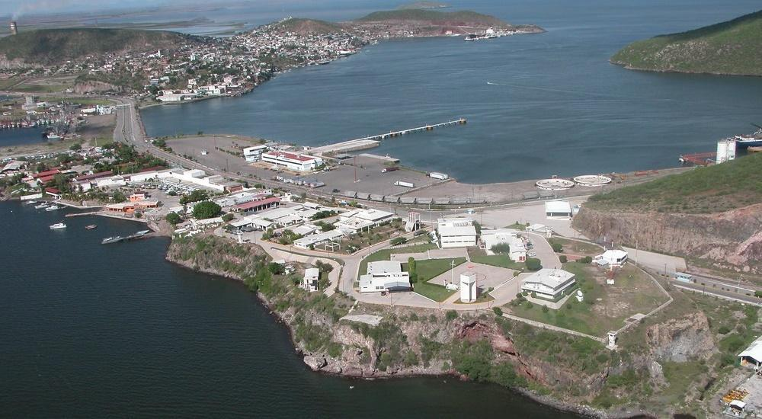
About Topolobampo Mexico
Topolobampo is the beginning of an international trade corridor called "La Entrada al Pacifico", which ends close to Midland-Odessa (Texas USA). Topolobampo was the site of a "utopian" colony experiment inspired by the economic ideas of Henry George (1839-1897). The utopian group published "The Credit Foncier of Sinaloa" (newsletter in English).
LOS MOCHIS This city may be a surprise for you. Los Mochis is a surprisingly modern city, with several shopping Malls and a Sam’s Club.

Slide 7
About Topolobampo Mexico
The masthead said, "Collective ownership and management for public utilities and conveniences - the community responsible for the health, usefulness, individuality, and security of each".
A 2-page copy of 1st edition (Sept. 1889) has been preserved in Cleveland (Ohio USA) at the Western Reserve Historical Society.

Slide 8
About Topolobampo Mexico
In January 2019, the UK-based company CMV (Cruise and Maritime Voyages) announced its plans to homeport in Puerto Penasco the 550-passenger liner Astoria. Shipping operations started on December 7 (2019) with voyages to Baja California and Mexican Riviera ports.

Slide 9
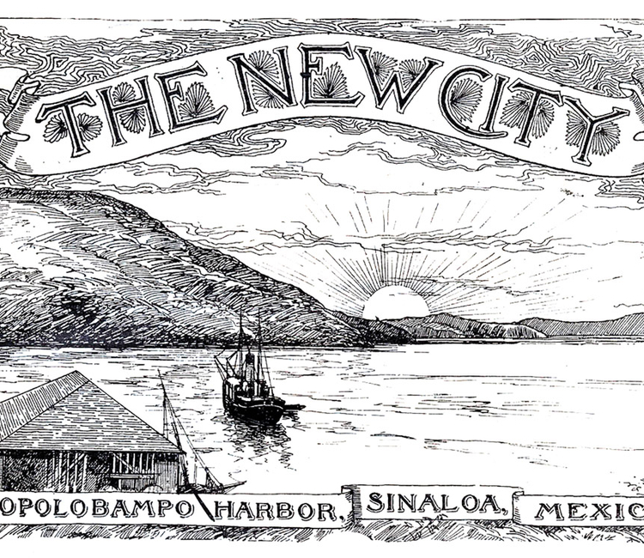
Historical Topolobampo
Topolobampo and Los Mochis were both founded by Americans in 1893. A civil engineer by the name of Albert Kimsey Owen saw a lot of potential for a Pacific trading port where Topolobampo sits today. He and a few followers originally founded Topolobampo as a utopian socialist community.

Slide 10
Historical Topolobampo
Shortly thereafter, a businessman by the name of Benjamin F. Johnston, attracted by Owen’s visions for a port, found himself in what is now Los Mochis. He too saw a lot of potential in the region, but more specifically in sugarcane cultivation.
By the turn of the century, Johnston had built a sugar mill in Los Mochis and the city grew rapidly around it.
To this day, Los Mochis’ economy depends heavily on agriculture, and is one of the top mango producers in all of Mexico.

Slide 11
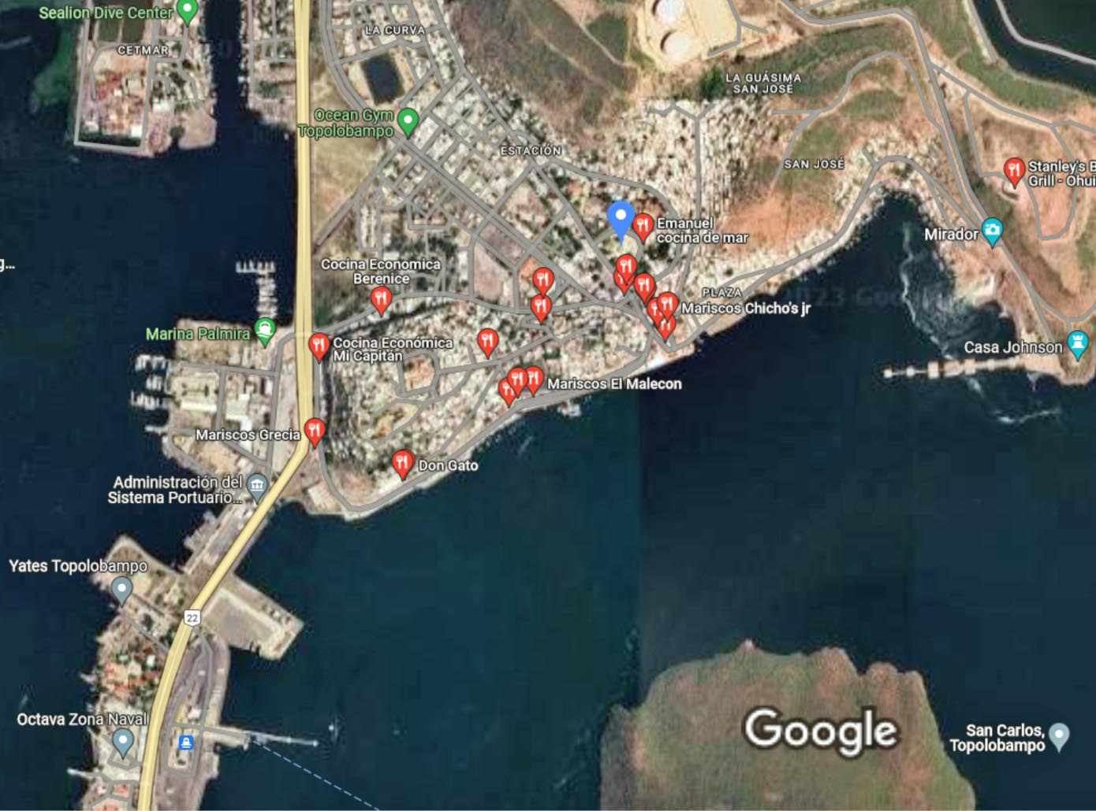
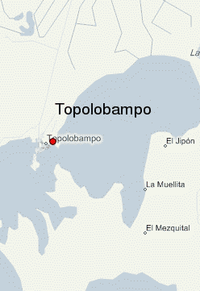
Map of Topolobampo

Slide 12
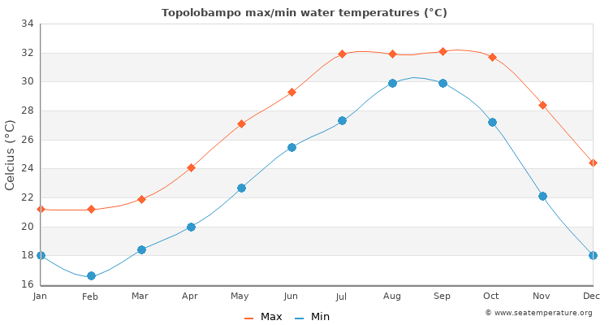
Weather in Topolobampo
Topolobampo sit at sea level and has a semi-arid climate. The temperature is usually warm or hot year-round.
April – October: daytime highs usually range from 32 to 38°C (90 to 100°F), night-time lows from 15 – 25°C (59 – 77°F). The rainy season is from July through September and the cities have occasionally been hit by hurricanes.
November – March: daytime highs range from 26 to 30°C (79 to 86°F), while nightly lows are
between 11 and 15°C (51 and 59°F).
The best time to go is in October as the landscape will be lush after the rain. However, as the weather is warm year-round, it’s easy to enjoy outdoor activities most of the year. It’s probably best to avoid July and August due to extreme temperatures and heavier rain.

Slide 13
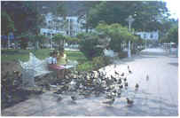

Topolobampo Taxis
Taxis in Topolobampo are plentiful. Taxis can be very reasonable, as long as you ask the price BEFORE you get in.
Be aware that Hotel taxis charge a premium rate because they've paid a higher union fee to sit in front of the hotel.
Make sure you have small change. Taxis will not carry change so they can keep yours.
You do not tip taxi drivers. The tip is included in the price.
Uber is also available if you have phone service and the app.

Slide 14
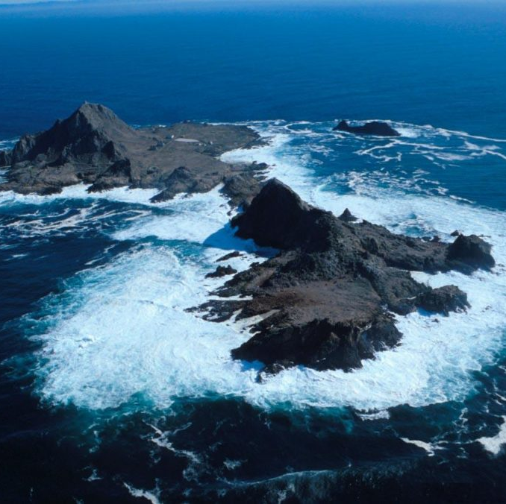
Isla Farallón
This rocky little island is situated about 15 km (9 mi) off the coast of Topolobampo. It’s well known for its sea lion inhabitants, which are usually lounging on the rocks between October and April.
You can hire a boat to take you out to the island to watch the sea lions or to swim or snorkel nearby. A boat tour lasting 6 hrs costs 5000 MXP ($288USD). That’s the total price and can be split between multiple people.

Slide 15
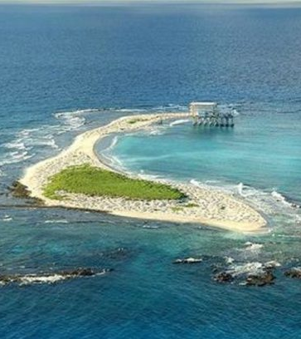
Isla de las Aves
The little island of Isla de las Aves, or Island of the Birds is home to many species of local and migratory birds. The best time to see this island is between mid-April and early August.
A 1.5-hour boat tour will cost about 900 MXP ($52UDS), split between your group.

Slide 16
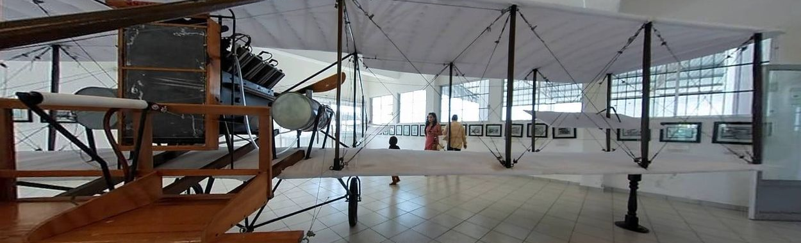
Museo Toolobampo
Visit the Topolobampo Museum which houses the replica of the Sonora Biplane and a photographic gallery of the First Aeronaval Combat.

Slide 17
Museo Toolobampo Cont.
The main attraction is a replica of the Sonora Biplane, an aircraft used in this historic air-naval combat that took place on April 14, 1914, in the waters of the Port of Topolobampo

Slide 18
The photographic exhibition narrates the step by step heroism of Captain Gustavo Salinas and naval mechanic Teodoro Madariaga, on board the biplane during the air attack against the ship Guerrero to prevent them from continuing to attack the ship Tampico.
You will enjoy this unique museum very close to the dock in Topolobampo.
Museo Toolobampo Cont.

Slide 19
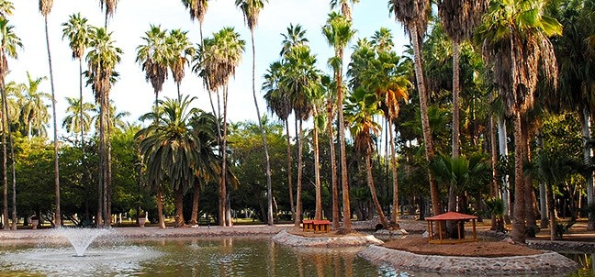
Jardín Botánico Benjamin Francis Johnston
The gardens are Located in downtown Los Mochis. The Botanical Gardens offer a peaceful place to sit and admire nature.
The gardens have many local and exotic flora and some local animals too, including a butterfly pavilion. You can even bring some food and have yourself a little picnic. If you have the this is definitely a great place to spend it.
The Taxi from Topolobampo to Los Mochis takes about 25 min and costs between $7 - $10 US each way.

Slide 20
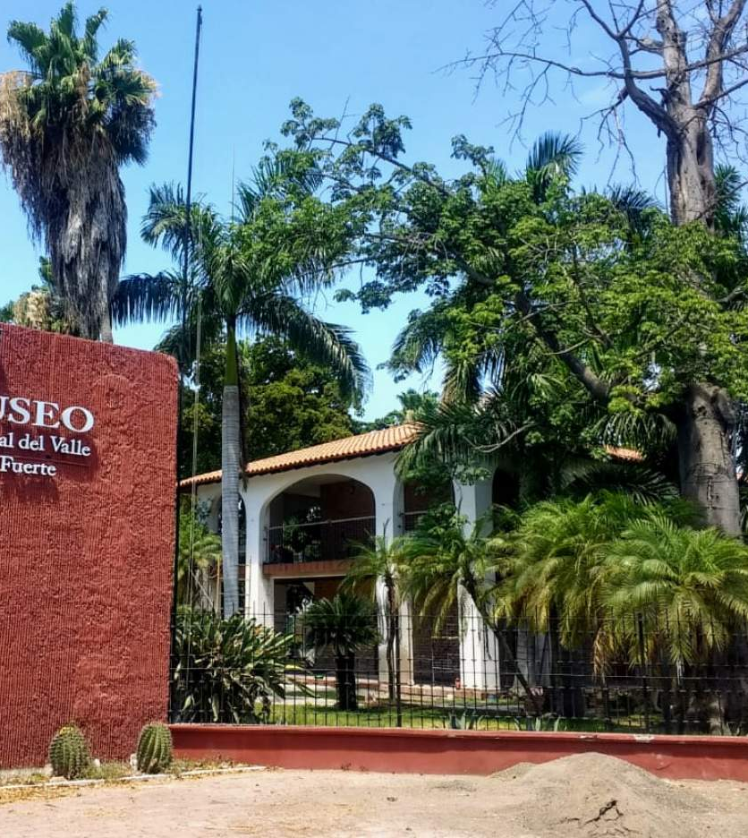
Museo Regional del Valle del Fuerte
Located in Los Mochis. If it’s history and heritage that you seek, then this little museum will make an excellent stop. You can learn more about the Sinaloan region and its history, and how Los Mochis got its start as a city. They also hold special exhibitions on some weekends.
You can take an uber to the museum from the port will for about 200-250 pesos.
The museum is closed on Mondays and that the signage throughout the museum is in Spanish only. They hold special exhibitions on most weekends.

Slide 21
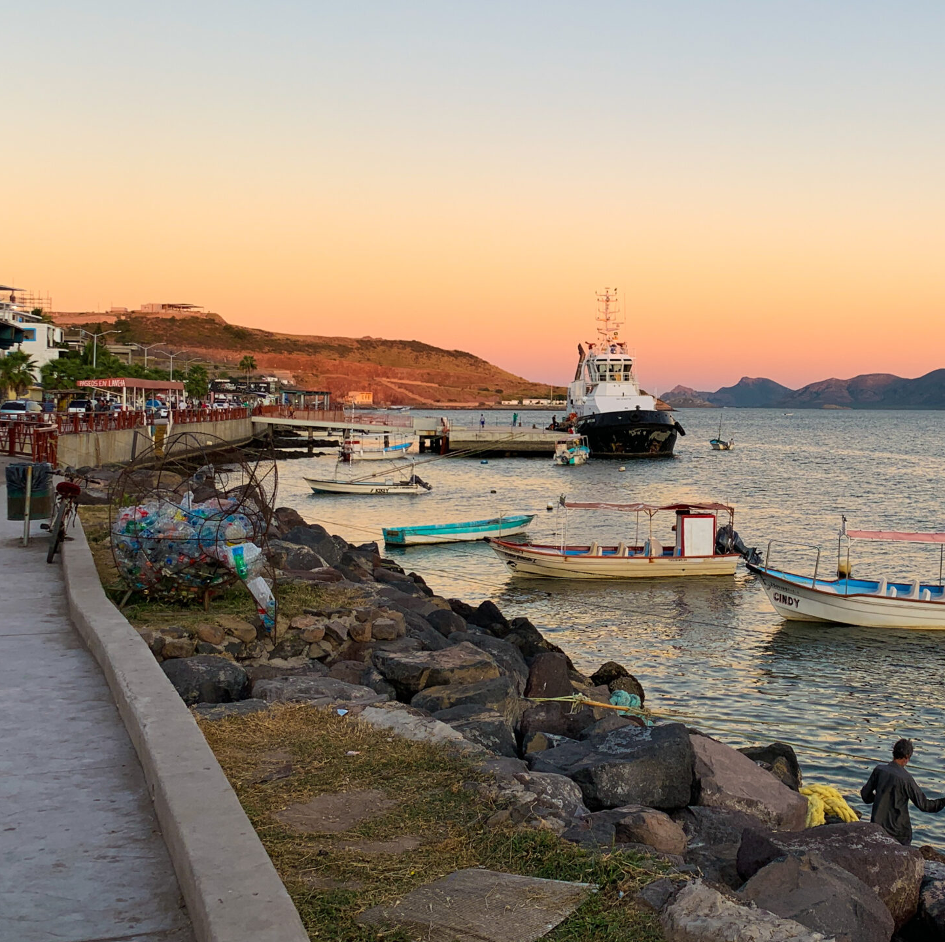
Stroll the Malecon
One enjoyable activity is to take a walk along the seafront Malecon. Topolobampo has made significant effort to beatify the entire area.
You will find an abundance of food trucks selling tacos, seafood, snacks and drinks. One local favorite is the “Crazy Coconut” which is a fun and refreshing drink.
If you are an Oyster fan, you can purchase 12 for about 80 Pesos 9 ($4.60 USD) Don’t forget to ask for Hot Sauce.

Slide 22
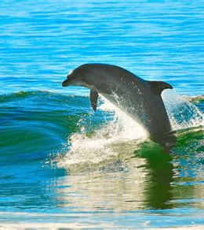
El Pechocho
Pechocho is the name of a wild dolphin that hangs out in a nearby fishing port. He’s not captive but it’s likely that local fishermen have been feeding him for years and so he sticks around. He’s been known in the area for over 20 years.
You can book a boat tour to see El Pechocho, but as he is wild, it’s not guaranteed that you’ll see him. Either way, you can go for a swim while you’re out on the water. El Pechocho will sometimes come up to swimmers to interact with them.

Slide 23
El Pechocho
Feeding and interacting with wildlife is often not a good idea. It can be risky for yourself but also for the animals. If you do go to see Pechocho, try to encourage your guide or captain not to feed him, and to only interact with him on his terms.
A 1.5-2 hr. boat ride to see El Pechocho will cost 600 to 1000 Pesos ($35 to $58) and can accommodate a group of up to six people.

Slide 24
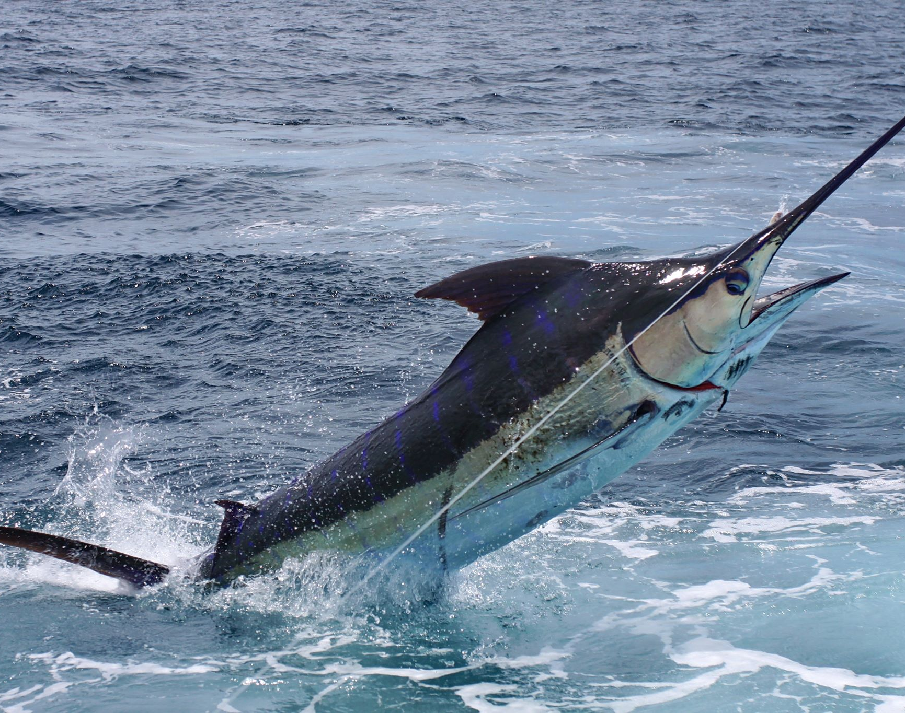
Sport Fishing
Fish for game fish with lines set for trolling offshore. Fishing species include marlin, sailfish, snook, and red snapper.
Marlin fishing is done in the Sea of Cortez, with boats from Topolobampo Bay, and includes sports yachts and all fishing equipped with a professional team.
Snook and snapper are caught around the inlets of the bay formed at the mouth of the river El Fuerte.

Slide 25
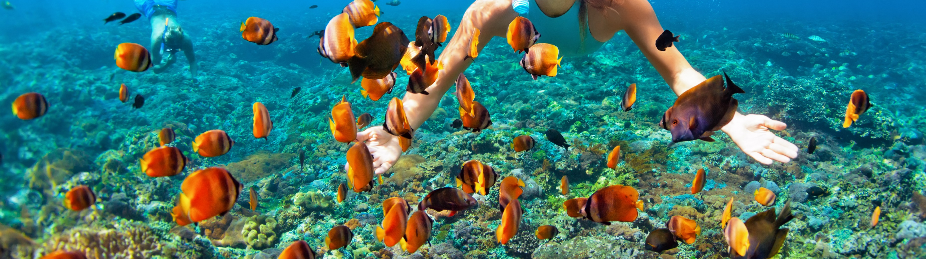
Go Snorkeling
The town’s beaches are renowned for their sparkling water and soft sand. Visitors can enjoy snorkeling in Topolobampo’s waters, where they will be able to see a variety of colorful fish and other marine life. There are tons of places to snorkel around Topolobampo. The warm, calm waters make snorkeling a joy and most of the reefs can be reached directly from the shore.
Just so you are aware the water temperature will be around 65 degrees.

Slide 26
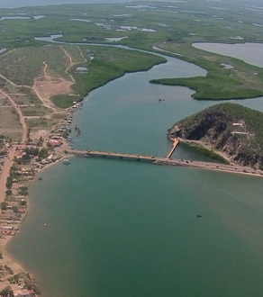
Topolobampo Bay
If you’d like to get a good look at the unique landscapes surrounding Topolobampo, you can book a boat tour around the bay. In addition to the natural landscapes, you’re likely to see different seabird species and maybe even dolphins.
A 1 hour boat trip around the bay will cost around 500 MXP ($29 USD) split amongst a group.

Slide 27
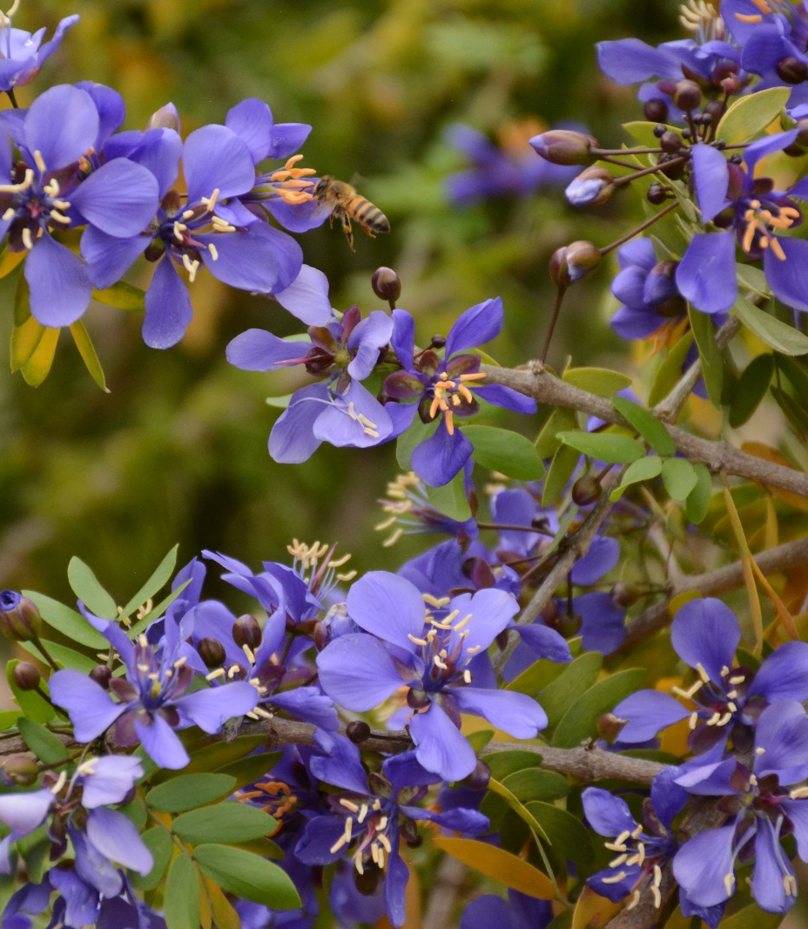
Jardín Botánico
The Benjamin Francis Johnston Botanical Garden is a natural jewel with beautiful landscapes located in the middle of Los Mochis..
They have collected plant specimens from all over the world for the sustainable management of flora and fauna species.
They also offer guided tours.
The Botanic Garden relies on donations for its support.

Slide 28
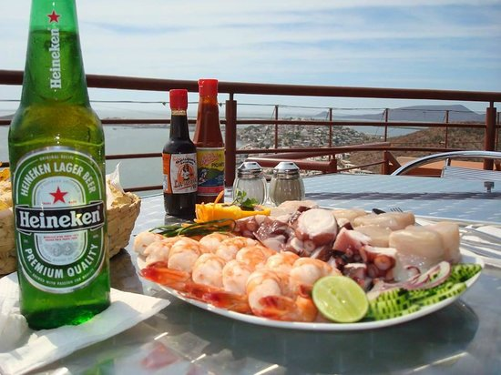
Topolobampo Restaurants
Topolobampo has many excellent restaurants, especially seafood restaurants. Many of us on the ship are foodies, so naturally, we’re always on the hunt to eat at the most exclusive spots anytime we travel.
Here are a few of the best restaurants to consider in downtown.
Stanleys Bar & Grill $$ - $$$ Mexican Seafood - Thomas Hays 23, Topolobampo
Don Gato $ Mexican Seafood - Calle Norte 6 hoy Blvd. Malecón Sur Barrio La Pesquera, Topolobampo
Restaurante Mi Costa $$ - $$$ Seafood - Playa El Maviri Entrando Por El Puente, Topolobampo
Cocina Economica Berenice $ Mexican - Francisco Labastida Ochoa Pesquera, Topolobampo
Ni Hao Restaurante $ Chinese - Blvd. Adolfo Lopez Mateos, Topolobampo
Ohuira Bay Marina & Resort $$ - $$$ Seafood - Ohuira Bay, Topolobampo
Also consider trying many of the street vendors.
For those of you who just like good food, you can’t go wrong just about anywhere you go in Topolobampo.
GOOD EATING

Slide 29
Conclusion
Topolobampo is a beautiful town with a rich history and numerous attractions. Whether you're looking for stunning beaches, historic sites, or unique attractions, Topolobampo has something for everyone.
I hope this presentation will help when we visit Topolobampo!

Slide 30
Thanks For Coming
If you have any more questions, please ask.
I will do my best to answer them for you.
Have a great visit to Topolobampo!

