Slide 1
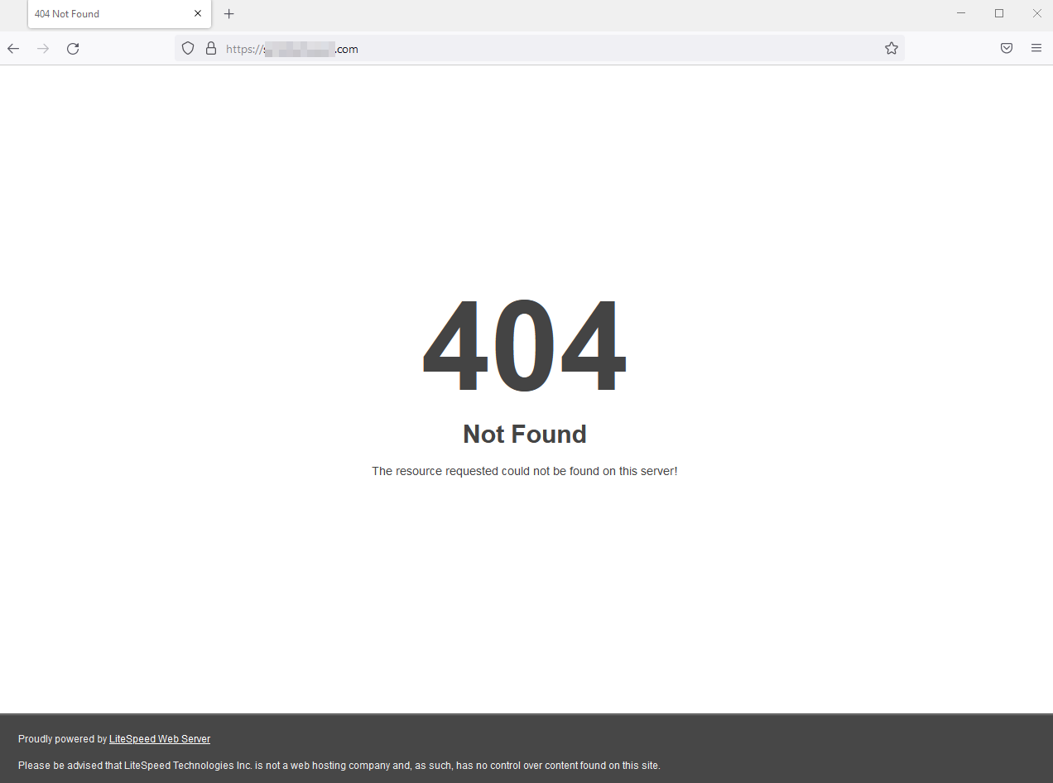
The Secret Life of Tech Terms
Presented by
Marc Silver

Slide 2
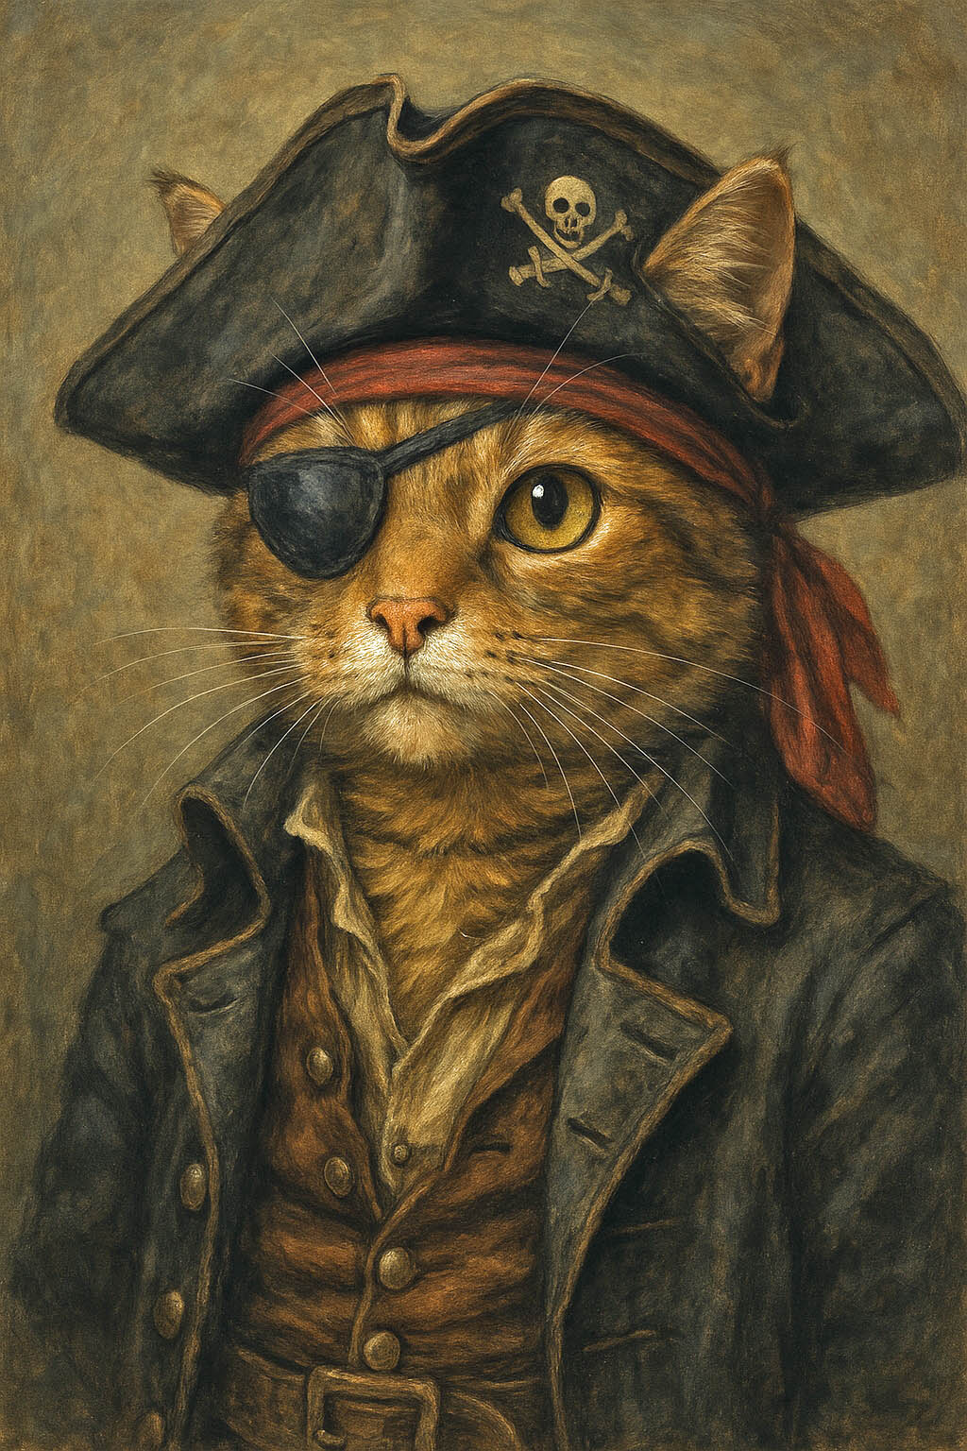
The Secret Life of Tech Terms
Picture this: you turned on your computer and found a video of a cat dressed as a pirate.
You click the link, excited for whiskers in a tiny eye patch, and instead, you get a grumpy message that says, "404 Error: Page Not Found." What happened to my Pirate Cat? Where did it go?
Turns out, the internet has its own way of saying, “I lost your stuff,” and some of these messages, like “404,” “spam,” or “bug”, have surprisingly quirky backstories.
Let’s unpack a few of them, so the next time your screen throws weird terms at you, you’ll know the human story behind the tech.

Slide 3

Lost in the Digital Library
The 404 Error
The most famous error on the internet has roots in a very real place, Room 404 at CERN in Geneva, Switzerland. Back in the 1990s, when folks were still figuring out how this new “World Wide Web” thing worked, Room 404 was where Tim Berners-Lee and his team stored many of their early server files.
If something went missing, they'd joke, “Must be in 404.”
That internal shorthand somehow made its way into global internet language, and now every time you try to find a pirate cat video that no longer exists, your browser shrugs and says, “404, I got nothing.”

Slide 4
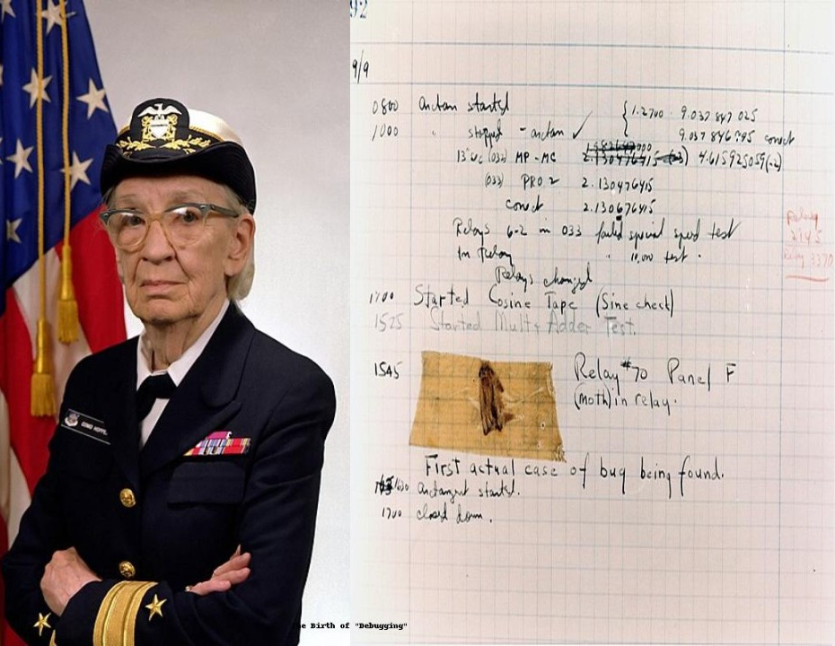
When A Moths Broke the Machine
The First “Bug”
So, your computer isn’t working how you expected it to and you say your computer’s buggy? Here’s the story.
As far back as 1947, computer pioneer Grace Hopper and her team were working on a room sized computer at Harvard when it started misbehaving.
Turns out, a real moth had gotten stuck in the machinery.
Hopper took the insect and taped it into her logbook and wrote, “First actual case of bug being found.”
Grace wasn’t just the woman who coined the term, she also helped invent COBOL, one of the earliest programming languages. She was also a Navy admiral.
Imagine your great aunt baking pies and fixing warships. That was Grace.

Slide 5
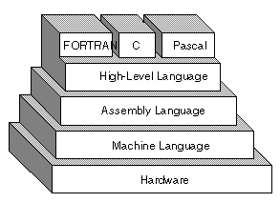
Hello, World
The First Thing Computers Learn to Say
If coders had baby showers, their onesies would say “Hello, World.” That’s because the first program anyone writes when learning to code usually prints out those two words.
This tradition started in the 1970s, thanks to Brian Kernighan, who used it as a simple example in a book about the B programming language.
B later evolved into C, then C++, and eventually C#, a family of powerful languages still widely used in software, apps, and game development today. It all started with that humble line: “Hello, World.”

Slide 6
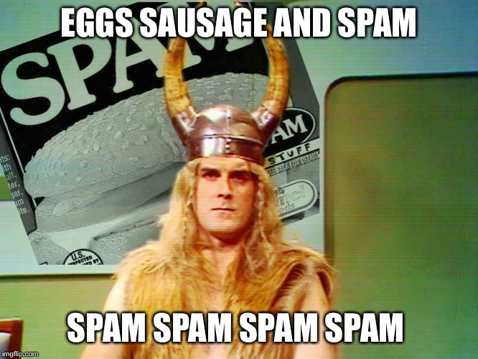
Spam
The Canned Meat That Took Over Your Inbox
Why do we call junk email “spam”? Thank you Monty Python.
First televised in 1970 (series 2, episode 12) The Monty Python's Flying Circus created, "Spam" one of their classic sketches, a group of Vikings in a diner chant “Spam, Spam, Spam” over and over, drowning out everyone else.
That’s exactly how junk email feels, loud, intrusive, and impossible to ignore.
The sketch became a cult favorite among early internet users, especially in forums and chat rooms where inside jokes and cultural references spread fast.

Slide 7
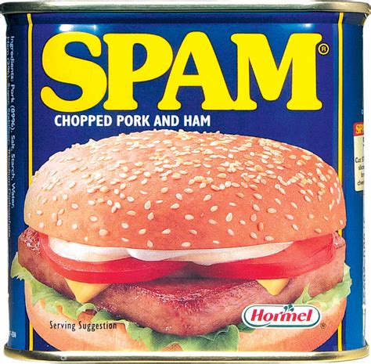
Spam
The Canned Meat That Took Over Your Inbox
So, when unwanted messages started clogging inboxes, tech folks called it "spam”, the digital equivalent of too much canned meat in your conversation.
The name stuck, and now spam doesn’t just mean email. It can be text messages, DMs, or even online comments, anything repetitive and unwanted. Ironically, the real SPAM (the meat) is still around, too.
It stands for “Spiced Ham,” and it’s a pantry staple in places like Hawaii, South Korea, and the Philippines.
While your inbox might hate it, your breakfast plate might not.

Slide 8
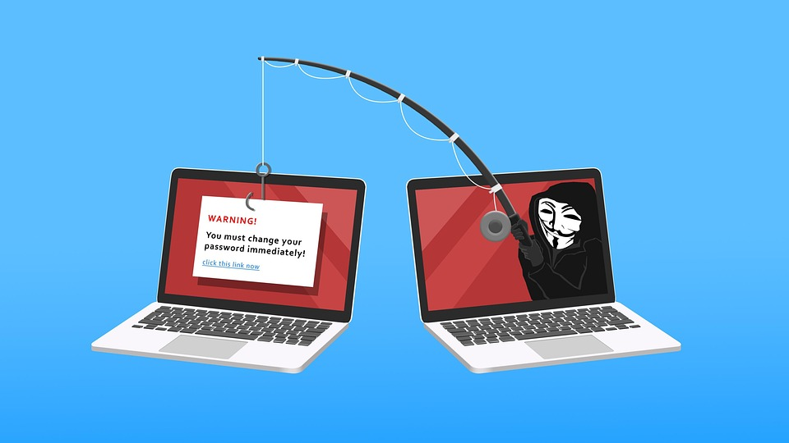
Phishing
Not the Kind with a Rod and Reel
“Phishing” is what scammers do when they try to hook your personal info, like passwords, credit card numbers, or logins.
The “ph” is a throwback to 1990s hacker lingo, when the cool kids swapped “f” for “ph,” just like in “phreaking,” which was slang for messing with telephone systems.
So, if you ever get a sketchy text pretending to be your bank that says, “Urgent! Click this link or your account explodes!”, that’s phishing. And no, it’s not your bank. It’s just some guy most likely in Africa, Russia or China with a computer, no sense of morality and way too much free time.

Slide 9

Ethernet
Digital Cords with a Sci-Fi Name
Ethernet might sound like something from Star Trek, but its roots are surprisingly old-school.
In the 1800s, scientists believed in a mysterious substance called “ether” that filled space and helped light travel. It turned out not to exist, but the name stuck around.
In 1973, engineer Robert Metcalfe borrowed the term “ether” to describe the invisible system that would carry data between computers.
Today, Ethernet is everywhere, in cables, routers, and the stuff that connects your cat’s pirate costume video to your screen.

Slide 10
Global Tech Slang
From Jugaad to Garakei
Tech lingo isn’t just an English-speaking thing. Around the world, people have created their own terms for digital life:
In India, jugaad means a clever, low-budget fix, like using a cereal box as a printer stand.
In Japan, garakei (short for “Galapagos keitai”) refers to old-school flip phones that survived long past their prime, evolving in isolation like creatures on the Galápagos Islands.
In China, dama refers to pixelating sensitive images online, a unique solution for the country’s digital censorship needs.
Tech culture may be global, but it still speaks with a local accent.

Slide 11

Bonus Round
Error 418 – I’m a Teapot
Not all error codes are serious. Back in 1998, a group of developers working on a joke proposal for a protocol called “HTCPCP” (Hyper Text Coffee Pot Control Protocol) invented Error 418: I’m a teapot, a tongue-in-cheek response for when someone tries to make a teapot brew coffee.
It was never meant to be functional, but it lives on as a fan-favorite Easter egg, a reminder that even in the world of code, there's room for humor and a little mischief.

Slide 12
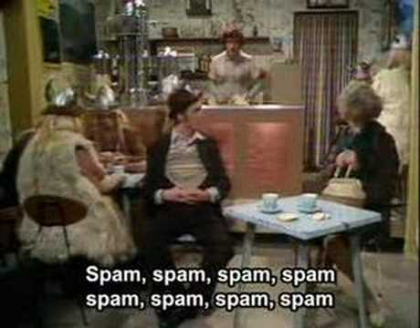
Why All This Matters
Final Thoughts
Behind every weird term is a story, a moth, a Monty Python sketch, a Swiss server room. These aren’t just dry bits of code; they’re windows into how human beings solve problems, crack jokes, and keep the digital world running.
Next time your screen throws up an error or some jargon you don’t understand, remember: it probably started with a person, someone just like you, who was trying to fix a glitch, tell a joke, or name a new idea.
And if you ever find out what happened to the cat in the pirate costume, let me know. That mystery haunts me.

Slide 13
Q&A
WHAT ELSE DO YOU WANT TO KNOW!
13
Presenter: Marc Silver - Soundscapeav.com
12/20/2025
Notes:
13

Slide 14
Thank You for Coming!
I hope I’ve educated and entertained you today.
I can be contacted by e-mail at:
marc@seminarsatsea.org
14
Presenter: Marc Silver - Soundscapeav.com
12/20/2025
Notes:
14

