Slide 1
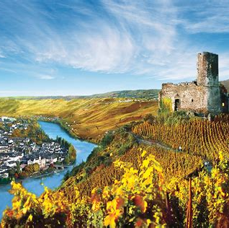
Exploring the Rhine and Mosel Wine Region With Marc Silver
A Journey Through France and Germany’s Wine

Slide 2
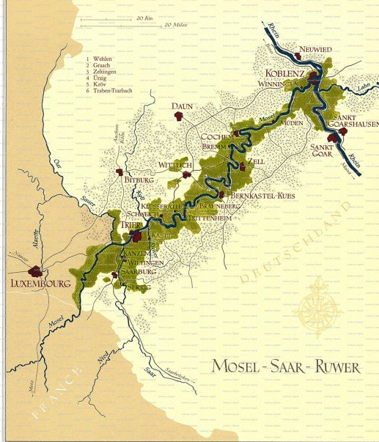
German Wine Regions
The Mosel is one of 13 German wine regions for and takes its name from the Mosel River. Prior to 1 August 2007 the region was called Mosel-Saar-Ruwer, but the name change was considered more consumer-friendly. The wine region is Germany's third largest in terms of production, but some consider it the leading region in terms of international prestige.
Nestled along the banks of the meandering Mosel River in Germany, the Mosel wine region boasts a rich viticultural heritage dating back over two millennia. Here, amidst the rugged terrain and slate-rich soils, lies a winemaking tradition as old as civilization itself.

Slide 3
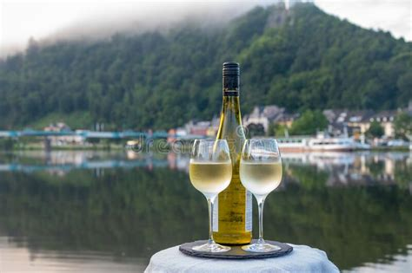
The Mosel wine region, is a place where nature’s grandeur and human ingenuity intertwine in a symphony of flavors.
Join me as we embark on a journey through time to uncover the history behind this remarkable terroir.
Nestled along the banks of the meandering Mosel River in Germany, the Mosel wine region boasts a rich viticultural heritage dating back over two millennia. Here, amidst the rugged terrain and slate-rich soils, lies a winemaking tradition as old as civilization itself.
Nestled along the banks of the Mosel River in Germany, the Mosel wine region boasts a rich viticultural heritage dating back over two millennia. Amidst the rugged terrain and slate-rich soils, lies a ancient winemaking tradition.

Slide 4
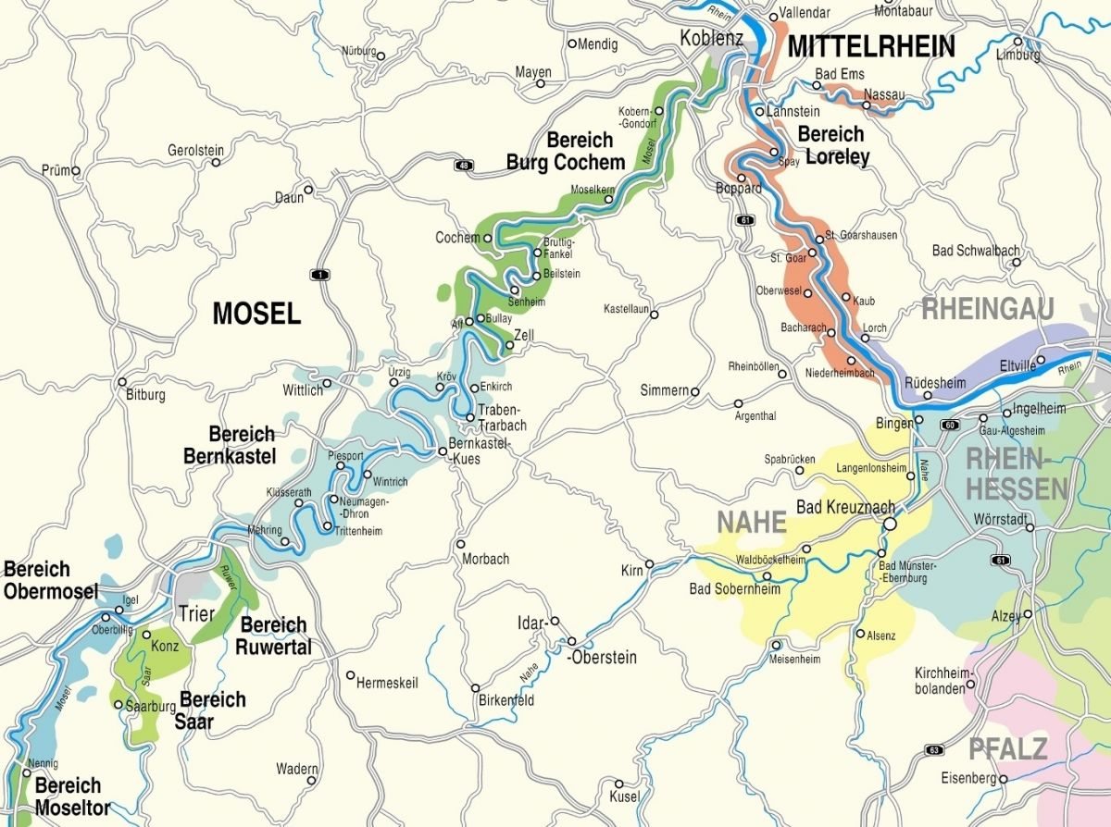

Slide 5
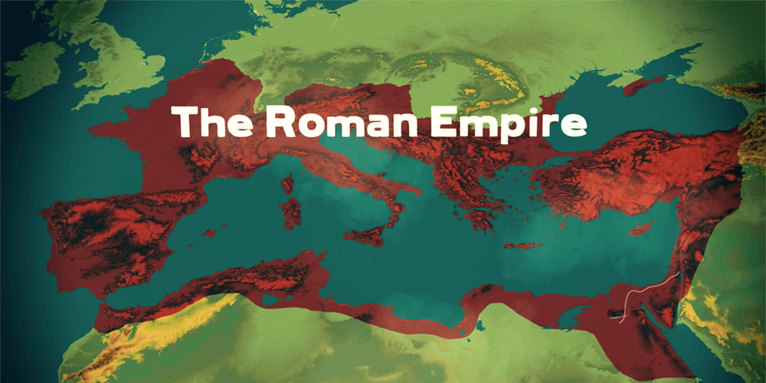
German Wine History
Historically with the arrival of the Romans in the first century AD, who recognized the potential of the Mosel's unique microclimate for viticulture. With their expertise in vine cultivation and winemaking, they transformed these verdant slopes into thriving vineyards, introducing grape varieties that would shape the region’s winemaking legacy for centuries to come.
Throughout the Middle Ages, it was the monastic orders that preserved and expanded the art of winemaking in the Mosel valley.
Monks meticulously tended to the vines, refining techniques passed down through generations and elevating winemaking to a sacred craft.

Slide 6
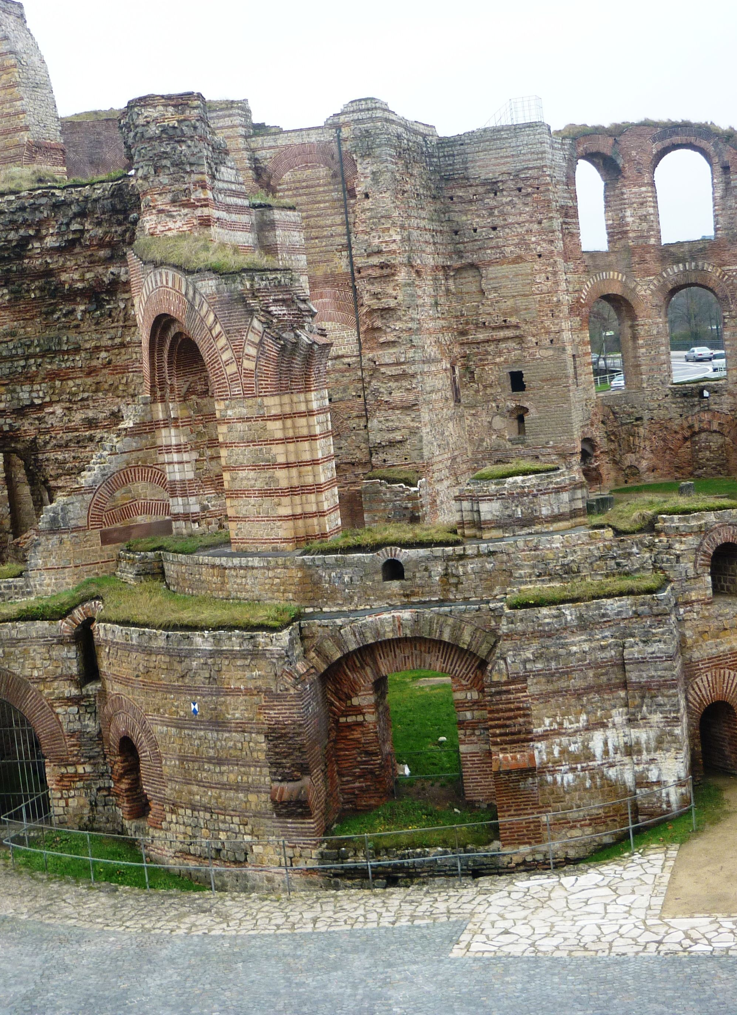
Historic Legacy
It is believed that viticulture was brought to this area by the Romans who planted vineyards along the Mosel and the Rhine to have a local source of wine for their garrisons.
The cost of transporting wine up from the Italian Peninsula or across the Vosges Mountains and the Roman vineyards in Gaul was very high and impractical. The Romans considered creating a canal between the Saône and the Rhine rivers before ultimately deciding to plant vines in the area.
Trier was a major Roman outpost founded 16 BC, and it is likely that the first Mosel vineyards were planted in the surrounding hillsides sometime in the 2nd century. Viticulture was certainly flourishing in the area by the 4th century when the Roman poet Ausonius wrote a poem about the beauty of the land at harvest time.

Slide 7
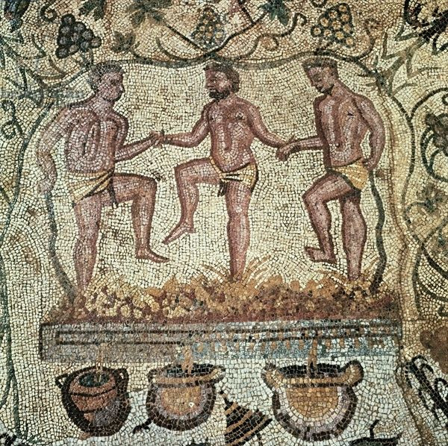
Wine History
The Mosel wine region boasts a rich winemaking heritage dating back to Roman times when vineyards were first planted along the riverbanks.
Over the centuries, monks and vintners meticulously tended the vines, refining their craft and elevating Mosel wines to international acclaim.
Today, many family-owned estates continue this tradition, blending age-old techniques with modern innovation to produce wines of unparalleled quality and finesse.
As the centuries passed, the Mosel wine trade flourished, fueled by the region's reputation for producing some of Europe's finest wines.
Merchants from far and wide flocked to bustling market- places, eager to procure casks of Riesling and other coveted varietals from the Mosel's cellars.

Slide 8
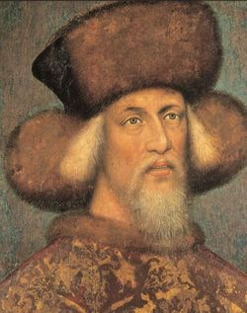
Wine History Cont.
In the Middle Ages, villages sprung up that were centered on the region's wine industry.
These "wine villages", known as "Winzerdörfer", included paths from the town center up to the area's vineyards.
At the center was a community wine cellar where all the area's growers could store their wines. Probably most well-known among the Winzerdörfer was the village of Bernkastel which was granted town rights in 1291.
In 1435 when Count Johann IV of Katzenelnbogen planted Riesling in the nearby town of Rüsselsheim the first time he owned vineyards in Winningen like the Destil, in Burgen and Kochem one half of the city and many vineyards more along the Mosel.

Slide 9
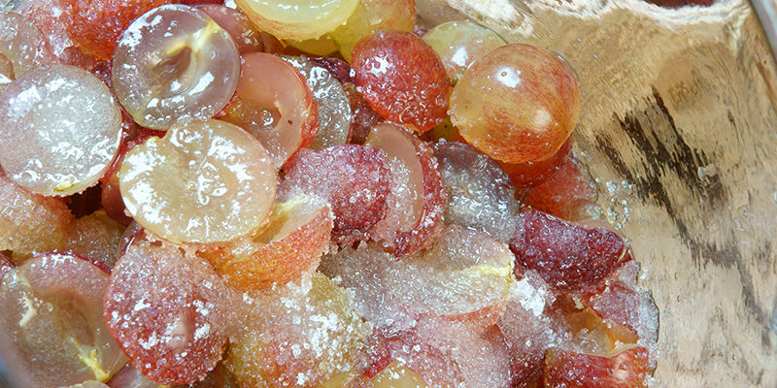
Wine History Cont.
To create more suitable land for vineyards, vineyard owners in the 16th century used explosives to break up the vertical spurs of rock along the rivers.
However, the 19th century brought both triumph and tribulation to the Mosel valley, due to wars and conflicts that ravaged the landscape, while the scourge of phylloxera devastated vineyards across Europe. Amid the turmoil, the resilient spirit of the Mosel winemakers endured, as they rebuilt their vineyards and revitalized their traditions.
By the 1850s, wine-makers in the Mosel had discovered the benefits of chaptalization in helping to compensate for bad weather vintages and under ripened grapes.
Chaptalization and acidification are two such methods of tweaking the winemaking process to ensure a better final product. More specifically, these techniques involve adding something to the mix: whether that be sugar (chaptalization) or acid (acidification).

Slide 10
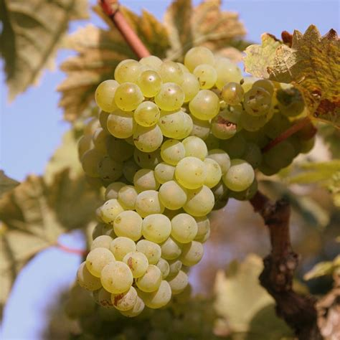
Wine History Cont.
Another significant boom came a couple decades later when the British Prime Minister William Ewart Gladstone lowered the duties on light wine which opened the British market to lower cost Mosel wines.
This increased prosperity had the net effect of encouraging more quantity in production rather than quality. Many areas not ideal for Riesling were soon planted with the easier to grow Müller-Thurgau and other Riesling crossings.
In the 20th century, a North American taste for sweet wines saw the prominence of Liebfraumilch and brands like Blue Nun dominate the German import wine market.
The entire German wine industry has dedicated itself to reversing this poor reputation.

Slide 11
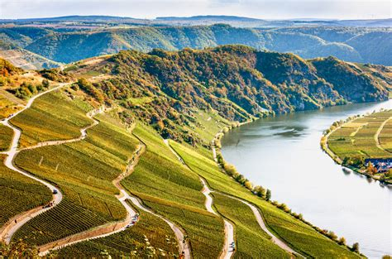
A Tapestry of Terroir
At the heart of the Mosel wine region lies its distinctive terroir, shaped by millennia of geological evolution and human ingenuity.
The region's steep slopes, primarily composed of Devonian slate, offer a perfect environment for grape cultivation, absorbing and radiating heat, and imparting a distinct minerality to the wines.
These challenging vineyard sites, often planted on vertiginous inclines, demand meticulous hand labor and exemplify the profound connection between the land and the wines it produces.

Slide 12
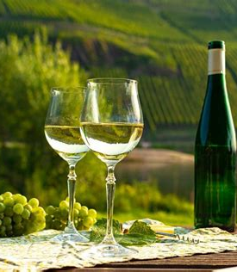
Riesling Reigns Supreme
The Mosel wine region is synonymous with Riesling, a noble grape variety that thrives in the cool climate and mineral-rich soils of the area.
Revered for its remarkable versatility and ability to reflect the terroirs, Mosel Rieslings captivate the senses with their ethereal aromas, brilliant acidity, crystalline purity and color.
From bone-dry to lusciously sweet, these wines span a spectrum of styles, each expressing the nuances of their vineyard of origin.

Slide 13
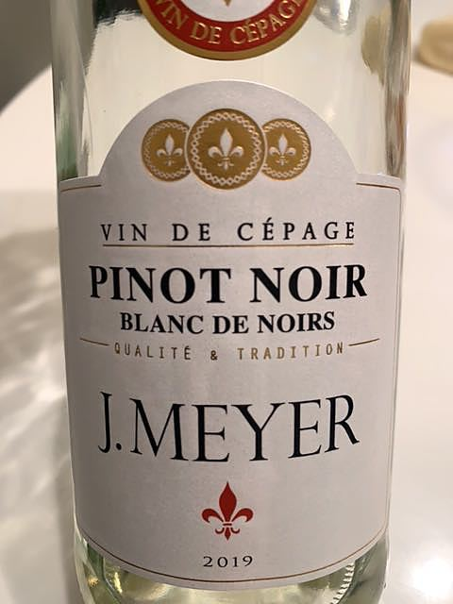
Beyond Riesling
The Riesling grape accounts for nearly 60% of the region's vineyards and is widely considered the most prestigious and highest quality wine grape of the Mosel but it cannot be planted on every vineyard site due to difficulties the grape has in ripening in particularly cool climates.
Factors such as altitude, aspect and sunlight exposure can have a pronounced effect not only one the resulting quality of the wine but also whether the Riesling grape will even ripen at all. While Riesling reigns supreme, the Mosel wine region also embraces a diverse array of grape varieties.
Muller-Thurgau, Pinot Blanc, and Pinot Noir thrive in the region's microclimates, producing wines of character and distinction.

Slide 14
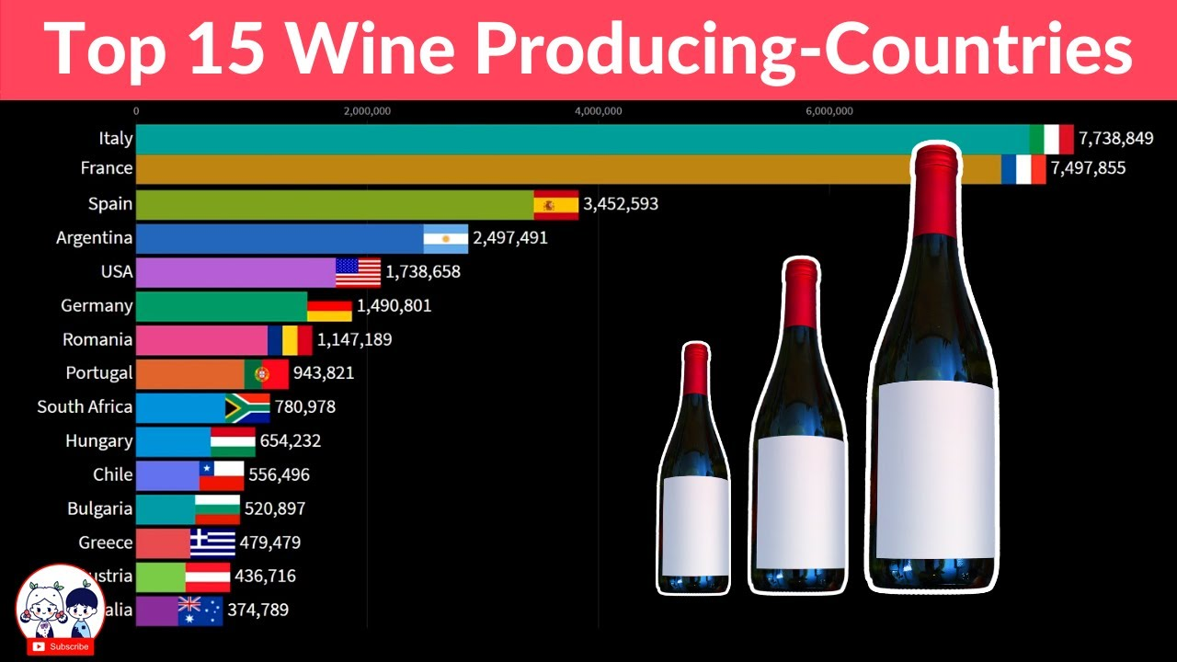

Slide 15
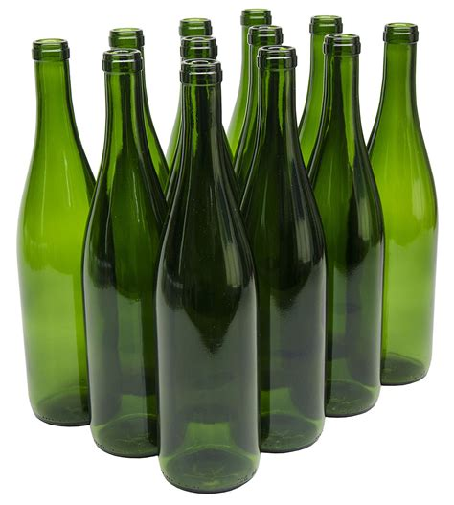
Beyond Riesling
The wines of the Upper Mosel, especially along the Saar and Ruwer tributaries, are characterized by their low alcohol content in the 6-9% range with intense fruity notes and high acidity. Once described as “The fire of the Sun, the gold of the stars, and cool moonlight”.
The wines of the Middle Mosel are considered the most complete examples of German wines with some of the finest examples being able to age gracefully for 50–100 years Mosel Rieslings rely on a strong presence of tartaric acid to balance the grape’s sugar and to help impart its fruity notes. A characteristic of all Mosel wines is their normally high acidity and transparency of clearly defined flavors.
The wines of the Mosel region are traditionally packaged in a long green colored "hock style" wine bottle. Historically the green color distinguished Mosel wines from the brown bottles of the Rheinhessen.

Slide 16
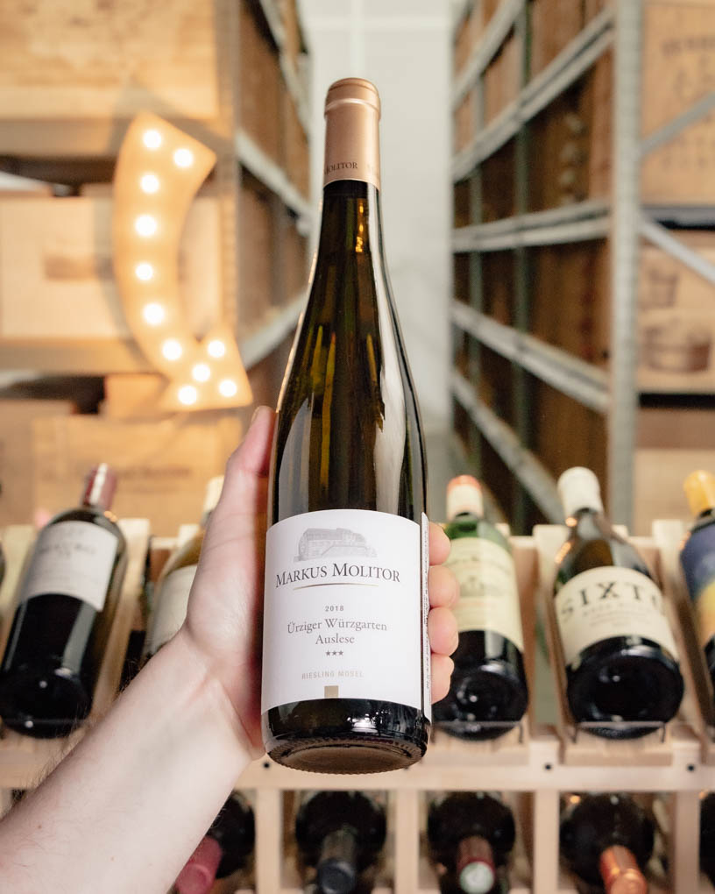
Vineyard Marvels
Exploring the Mosel wine region is a journey through a mosaic of vineyard sites, each with its own microclimate and distinct character.
From the iconic slopes of the Ürziger Würzgarten to the legendary Doctor vineyard in Bernkastel, every parcel tells a story of tradition, passion, and dedication.
The region's viticultural landscape is dotted with quaint villages, medieval castles, and terraced vineyards, offering a breathtaking views that unfolds with every twist and turn of the river.
Exploring the Mosel wine region is a journey through a mosaic of vineyard sites, each with its own distinct character and microclimate. Every parcel tells a story of tradition, passion, and dedication.
The region's viticultural landscape is dotted with quaint villages, medieval castles, and terraced vineyards, offering a breathtaking tableau that unfolds with every twist and turn of the river
Markus Molitor 2018 Riesling Urziger Wurzgarten Auslese Gold Capsule 99 Points by Robert Parker's Wine Advocate

Slide 17
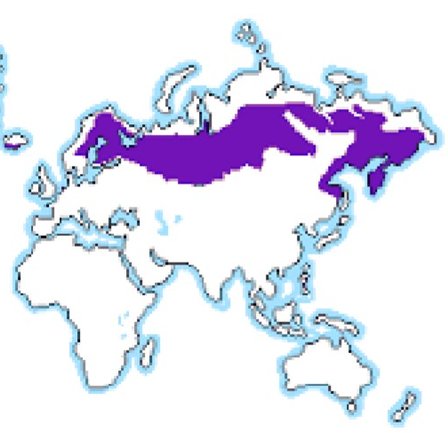
Climate and Geography
The Mosel wine region has northernly continental climate that is marked by cool temperatures. The best producing vineyard sites are located along the Mosel River and its tributary where the heat from the sun can be maximized by reflection up from the water.
South and southwest facing slopes are even more sought after because of the increased exposure to direct sunlight that can aid in ripening of the grapes.
The soil of the area is dominated by porous slate which has ideal drainage for the regions heavy rainfall and good heat retaining properties. Many of the best vineyards have no topsoil at all, just broken slate.
During the summer months the weather is warm with July's average temperatures around 64 °F.

Slide 18
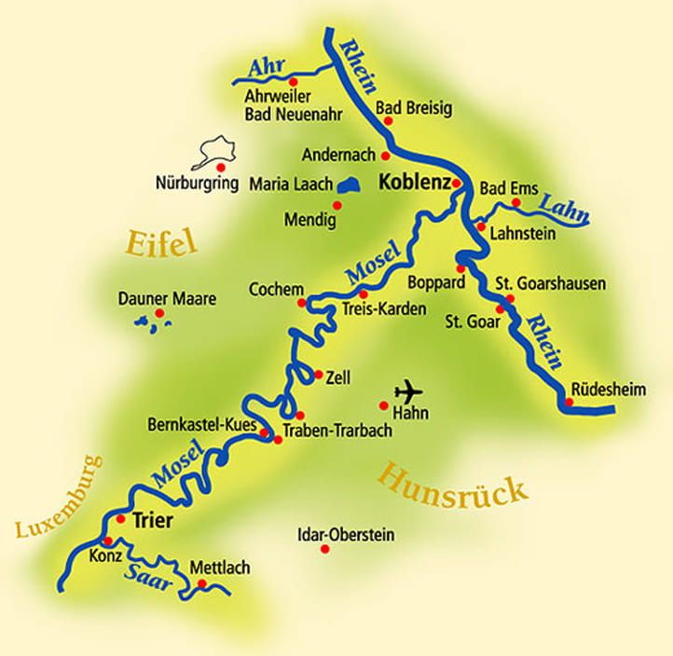
Climate
Global warmings affect on climate has caused change which modifies wine production conditions and requires adaptation from growers. Higher temperatures affects the stages in grape growing cycle, shifting grape ripening to a warmer part of the summer.
In most winegrowing regions around the globe, grape harvests have advanced by 2–3 weeks over the past 40 years. The resulting modifications in grape composition at harvest change wine quality and style.
Increased drought reduces yield and can result in sustainability losses. Supplementary irrigation is also an option when sustainable freshwater resources are available

Slide 19
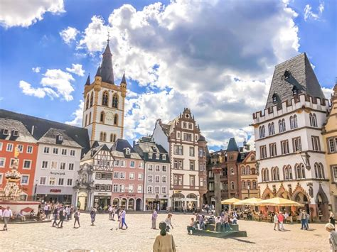
Cultural Charm
Beyond its vine-clad hills and world-class wines, the Mosel wine region is imbued with a rich tapestry of culture, history, and gastronomy. Charming towns such as Trier, the oldest city in Germany, and Cochem, with its majestic Reichsburg castle, offer a glimpse into the region's storied past.
Visitors can indulge in culinary delights ranging from hearty German fare to Michelin-starred cuisine, paired perfectly with the region's finest wines

Slide 20
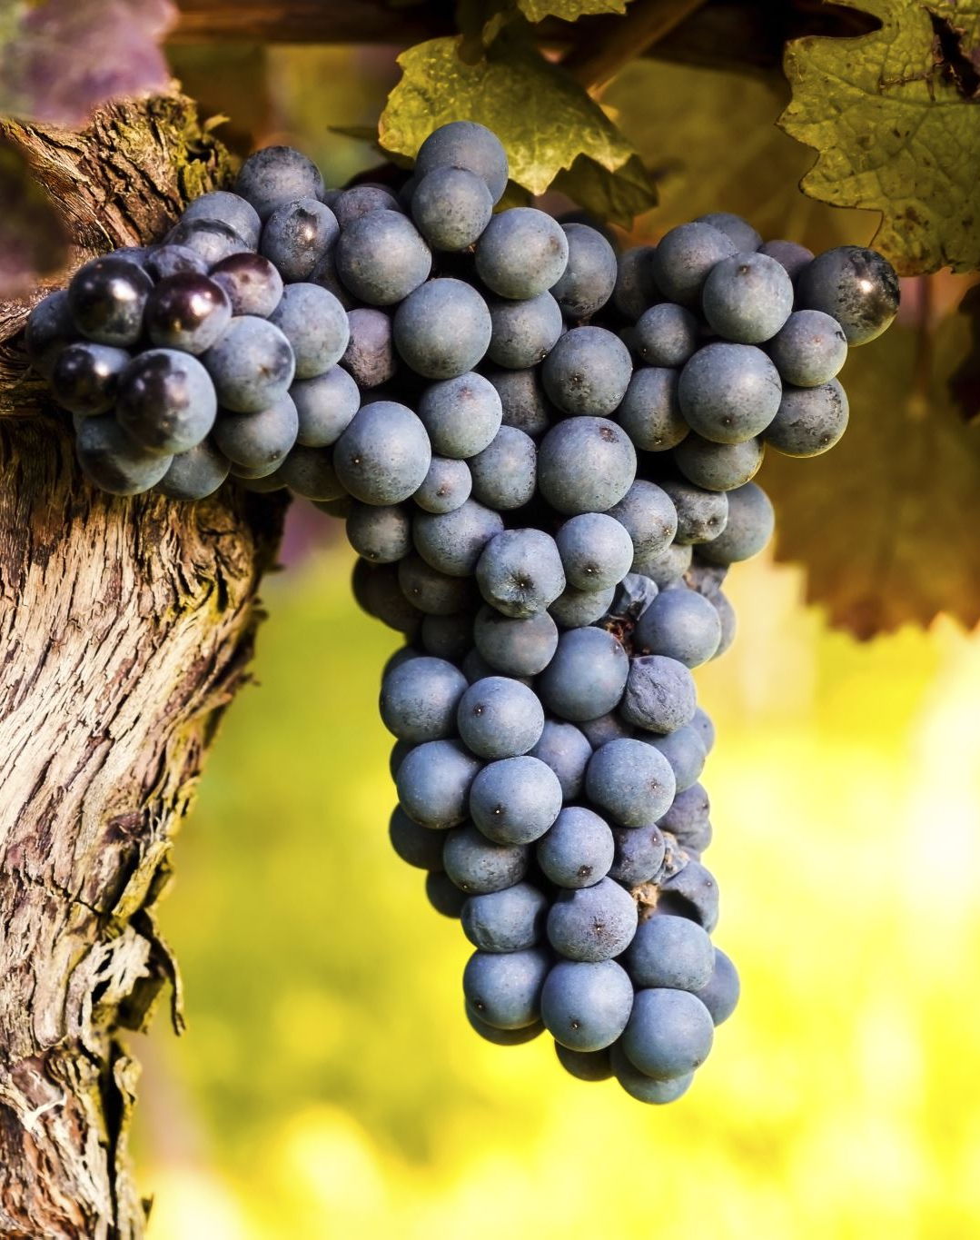
Conclusion
Today, the Mosel wine region stands as a testament to the resilience of the human spirit and the enduring allure of its terroir. Winemakers, inspired by centuries of tradition, continue to produce wines of unparalleled quality and distinction.
From the ethereal elegance of its Rieslings to the robust character of its Pinot Noirs, each bottle from the Mosel tells a story of the land, the people, and the centuries of craftsmanship that have shaped its legacy.
In every glass of Mosel wine lies a story – of ancient vineyards clinging to steep slopes, of passionate winemakers nurturing their craft, and of a region that embodies the timeless art of winemaking.
As you embark on a journey through the Mosel wine region, let each sip be a testament to its enduring legacy and unparalleled beauty, a toast to the spirit of exploration and discovery that defines this vinicultural gem.

Slide 21
Thankyou for Coming!
I hope you enjoyed my talk!
If you have any more questions, please ask.
I will do my best to answer them for you.
I can be reached by e-mail at
marcjsilver@gmail.com

Slide 22
Acknowledgement
My seminars are the result of many years of travel experience combined with many hours of research over the internet.
I would like to acknowledge the many source I have accessed.
These include: Wikipedia.com, Britannica.com, Trip Advisor and the various Museum, Park and Government websites.
winetraveler.com, ourtastytravels.com, madelineraeaway.com, auslanderblog.com, winetourism.com, theflashpacker.net, moonhoneytravel.com

