Slide 1
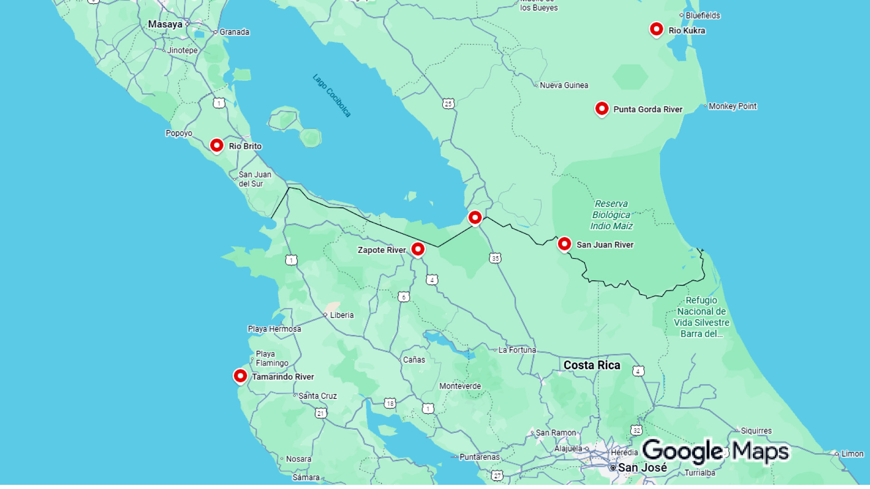
The Nicaragua Canal
By Marc Silver

Slide 2
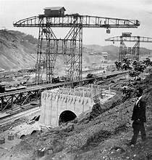
The Plan
Before Panama became inevitable, serious engineering commissions, U.S. senators, naval planners, and financiers spent years weighing an alternative route that appeared cleaner, shorter, and far more cooperative.
Instead of carving a canal entirely from scratch, ships would follow waterways that already existed.

Slide 3
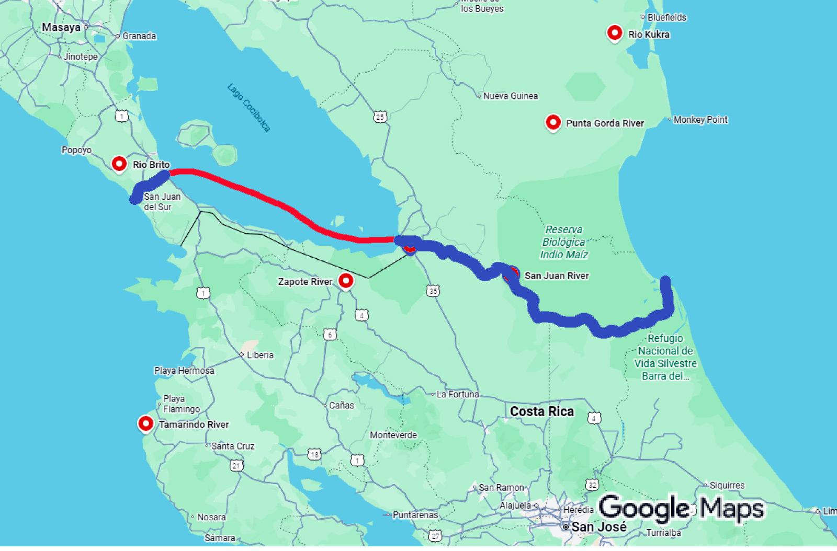
The Route
More than half the route was already
water. Lake Nicaragua could serve as a
massive natural reservoir.
The Pacific cut was shorter than Panama’s.
Early estimates suggested fewer locks and
less excavation. Compared to Panama’s
mountains and jungles, Nicaragua looked
restrained.
On a map, Nicaragua made sense.
Notes:
the U.S. Walker Commission, found the river shallow in long stretches, split into multiple shifting channels in others, and constantly burdened by sediment washed down from the interior. Tropical rainfall moved enormous amounts of silt every year, reshaping the river faster than dredging could stabilize it.

Slide 4
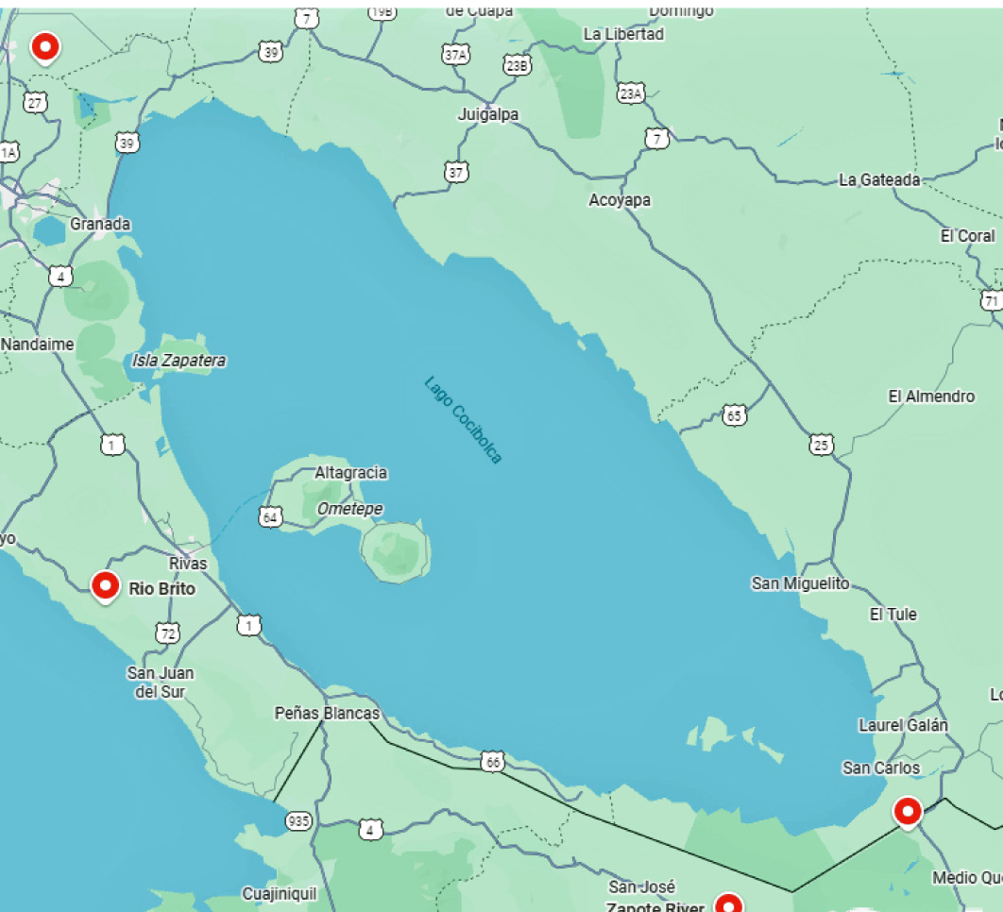
Both Asset and Liability
The lake is vast, over 3,000 square miles, which made it attractive as a transit basin.
But it is also shallow, averaging roughly forty-five feet deep.

Slide 5
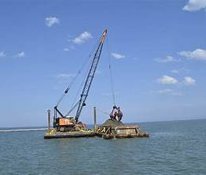
Dredging the Lake
Dredging a lake of that size introduced a different problem: sediment management.
Unlike a confined canal cut, disturbed lake sediment spreads. It clouds water, alters ecosystems, and does not conveniently return to place.

Slide 6
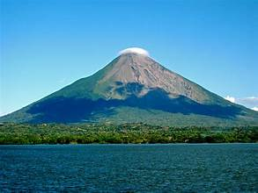
Volcanoes, Perception, and Politics
Nicaragua had volcanoes. Panama sat on seismic fault lines. Both regions faced landslides, flooding, and earthquakes.
What differed was perception.
Notes:
Momotombo Valcano

Slide 7
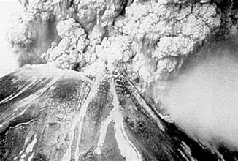
Momotombo erupted
In 1902, the steamship SS Orizaba was in port,when Momotombo erupted.
At the precise moment U.S. senators were being asked to choose between two canal routes, Nicaragua became visually and emotionally associated with volcanic activity.

Slide 8
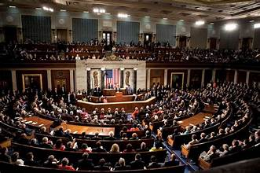
The Emotional Choice
From that point forward, Nicaragua
was no longer the elegant alternative.
It was the risky one.
Large infrastructure projects are
approved not only by engineers, but
by financiers, insurers, and politicians.
Those groups respond less to
technical nuance than to uncertainty.
Volcanoes, even distant ones, symbolize uncertainty.
The vote went for Panama.

Slide 9
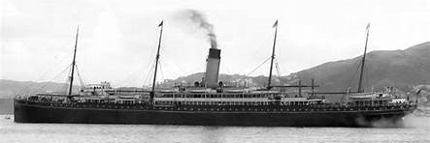
The Irony of Scale
In 1902, ships were smaller, drafts were shallower, and global trade volumes were modest. Panama’s lock dimensions were sufficient.
History did not choose the canal best suited for the future. It chose the canal best suited for the moment.

Slide 10
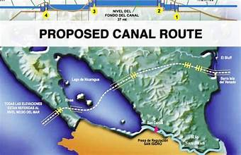
The Idea Keeps Returning
The Nicaragua Canal has resurfaced repeatedly, most recently in the 2010s with a Chinese-backed proposal.
That effort collapsed under financing challenges, environmental opposition, and political instability.

Slide 11
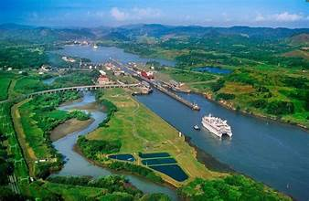
What This Story Actually Tells Us
Nicaragua did not lose because its canal concept was foolish.
Engineers took it seriously. Governments debated it earnestly.
It lost because infrastructure decisions are not made by logic alone. Some are emotional.
Once that choice was made, there was no going back.

