Slide 1
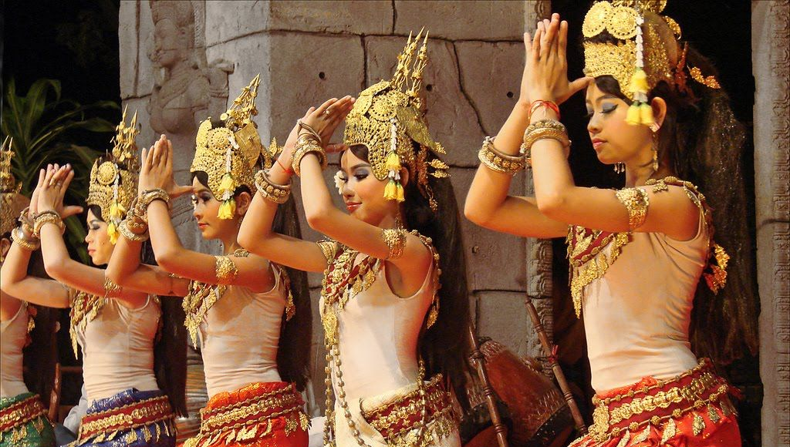
The Khmer People of Cambodia From Ancient Origins to Modern Resilience
Presented by: Marc Silver

Slide 2
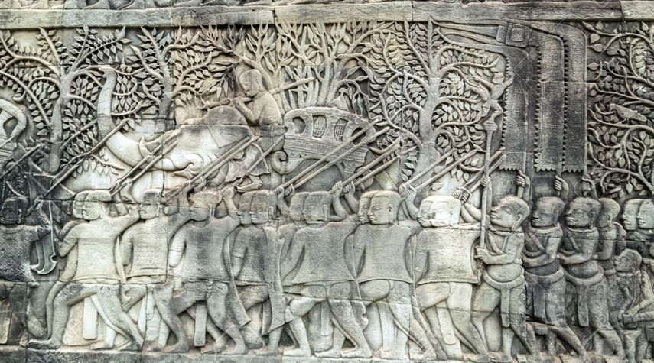
The Khmer People of Cambodia
The Khmer people are not merely a historical curiosity but a civilization shaped by myth and resilience
Notes:
The Khmer people are not merely a historical curiosity but a civilization shaped by myth and resilience, where the boundaries between divine intervention and human ingenuity blur.
From the serpentine legends of their origins to the enigma of Angkor’s collapse, their story is one of cosmic ambition, endurance, and cultural revival.
This presentation weaves archaeological fact with enduring folklore, inviting readers into the shadows of Cambodia’s past and the light of its cultural rebirth.

Slide 3
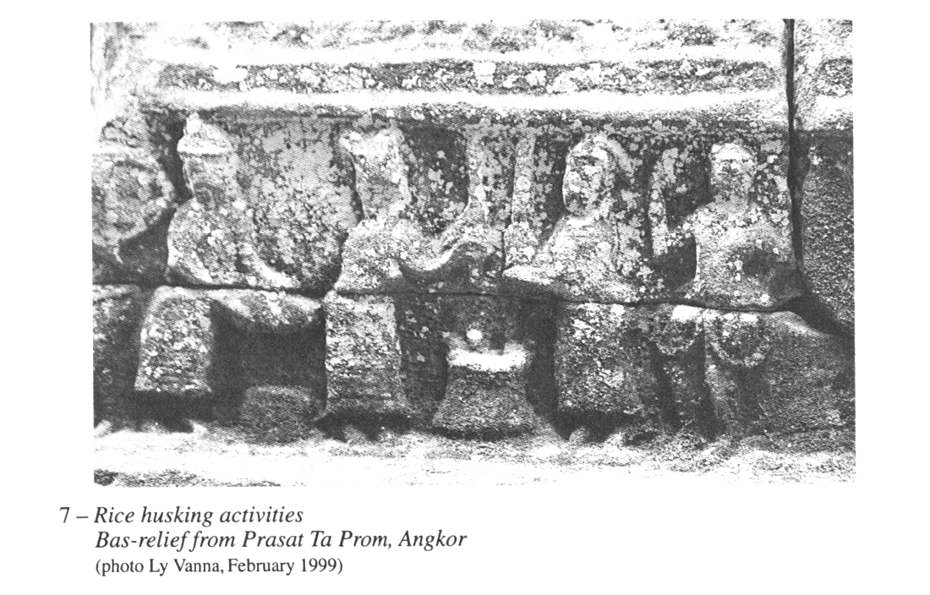
The Khmer People of Cambodia
Pre-Angkor Era: Foundations of Khmer Identity (1st–8th Centuries CE)
Early Archaeological Evidence
The roots of Khmer identity trace back to ancient sites like Samrong Sen, where Neolithic tools and burial sites reveal early spiritual practices.
Notes:
These traditions, centered around honoring ancestors, evolved into the neak ta (spirit) veneration seen today, reflecting an intimate connection with nature and the spiritual world.

Slide 4
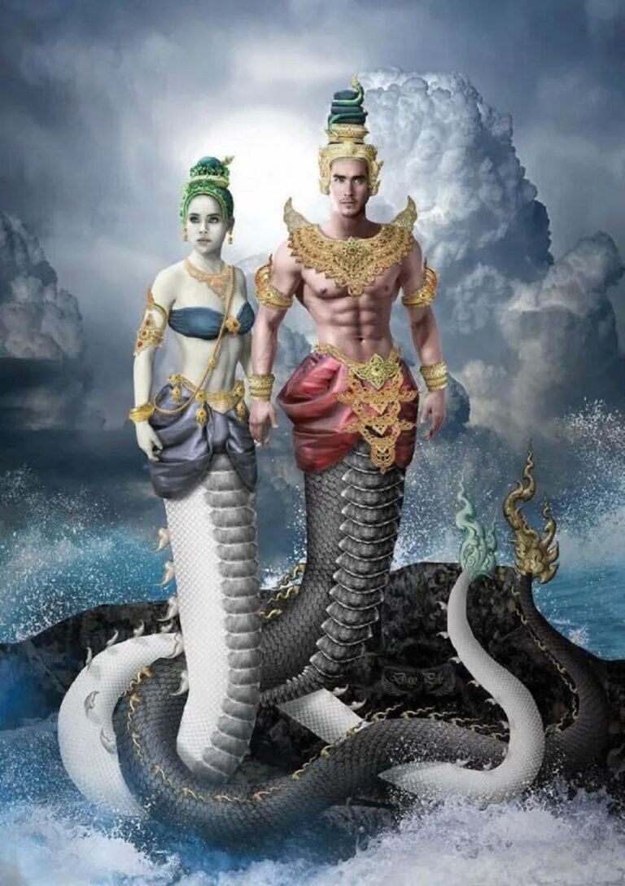
The Khmer People of Cambodia
Funan’s Maritime Mystique
Cambodian legend claims the first Khmer king, Kaundinya, married Soma, a nāga (serpent deity) princess, uniting Indian and indigenous bloodlines.
Notes:
This union symbolizes Cambodia’s deep spiritual ties to water and serpents and is immortalized in Angkor Wat’s intricate carvings and modern royal ceremonies.

Slide 5
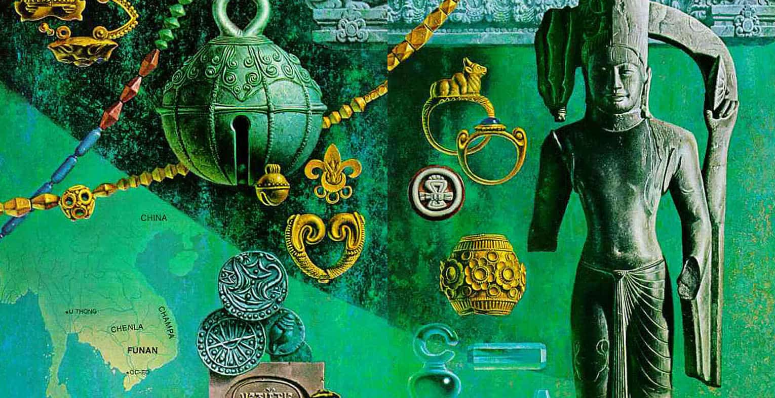
The Khmer People of Cambodia
Archaeological finds at Oc Eo, such as Roman gold coins, Persian ceramics, and Indian jewelry, highlight Funan's position as a significant hub in an extensive network of ancient trade routes.
Notes:
These routes connected Southeast Asia not only to neighboring regions like India and China but also indirectly to the Roman Empire through intermediary trading ports.
Despite these global connections, Oc Eo was mysteriously abandoned around 550 CE, leaving historians with an enduring puzzle about the causes of its decline.

Slide 6
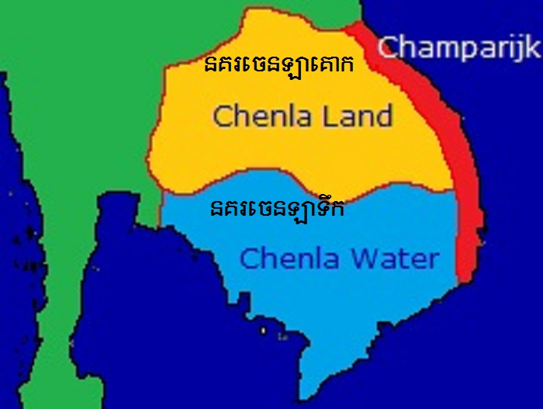
The Khmer People of Cambodia
The Splintering of Chenla: Governance, Geography, and Legacy
Following Funan’s decline, the Chenla Empire (6th–8th centuries CE) rose, consolidating power but facing the challenges of administrative complexity and cultural diversity. By the late 7th century, Chenla fragmented into two.
Notes:
Land Chenla (Zhenla of the Mountains): Centered in northern Cambodia and southern Laos, this region relied on rain-fed agriculture and controlled crucial trade routes connecting the Mekong to the Khorat Plateau.
Water Chenla (Zhenla of the Coast): Positioned along the Mekong Delta and coastal regions, Water Chenla thrived on wet-rice cultivation, salt production, and maritime trade, maintaining strong ties to the South China Sea.

Slide 7
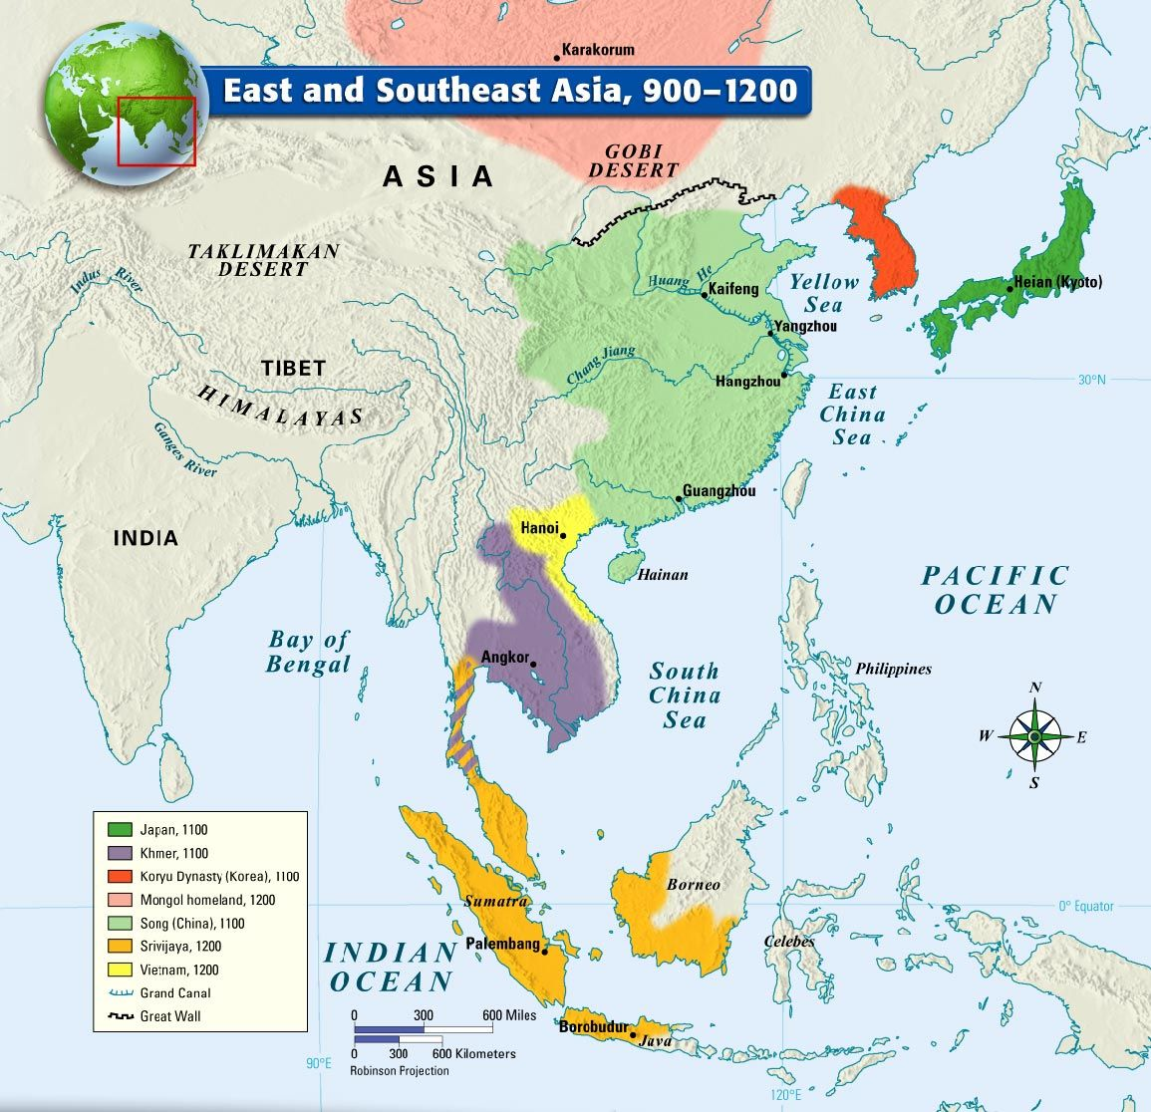
The Khmer People of Cambodia
Cultural and Social Dynamics
Chenla's development was marked by increasing interactions with neighboring regions like Champa and Java.
These cultural exchanges influenced Chenla's art, religious practices, and political alliances.
The spiritual landscape diversified as Hindu deities were localized, and animistic practices continued alongside Buddhist influences.

Slide 8
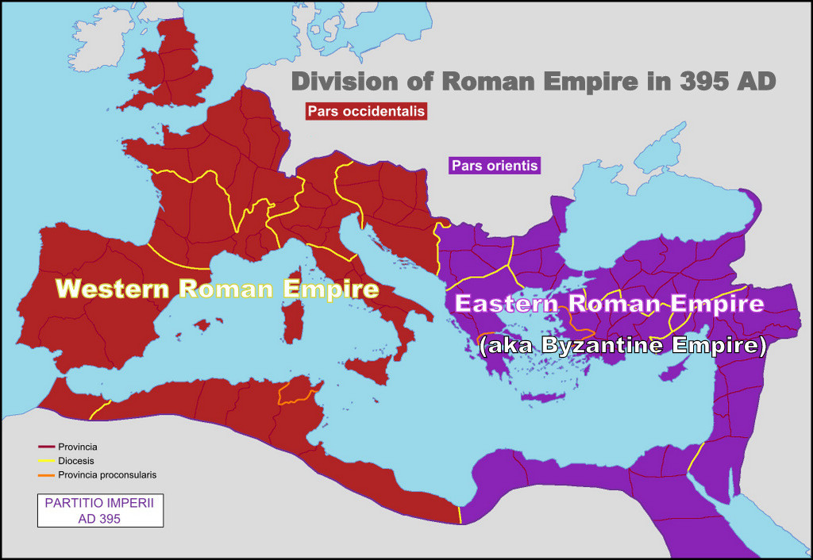
The Khmer People of Cambodia
Comparison to Rome
Chenla’s split is often compared to the division of the Roman Empire into Eastern and Western halves.
Notes:
While Rome’s split was administrative, Chenla’s was organic, influenced by geography, resource competition, and cultural dynamics.

Slide 9
The Khmer People of Cambodia
Distinct Emphases and Legacies
Aspect | Land Chenla | Water Chenla
Economy | Upland rice, cattle herding, iron mining | Wet-rice agriculture, salt production, maritime trade
Religion | Hindu Shaivism and local ancestor worship | Hindu-Buddhist syncretism, influenced by Java
Political Structure | Decentralized chiefdoms | Centralized monarchy with port-city alliances
Legacy | Provided militaristic strength for the Khmer Empire | Supplied Angkor with maritime trade networks

Slide 10
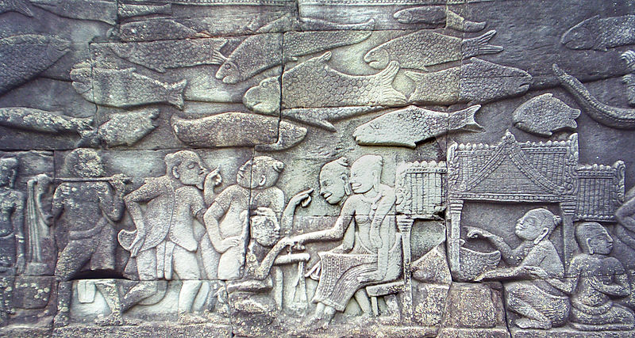
The Khmer People of Cambodia
Inscriptions: Land Chenla’s stele, such as the Vat Luong Kau inscription, emphasize warrior-kings and local deities.
Water Chenla’s inscriptions, like those at Ta Prohm, highlight trade relations with Champa and Java.
Notes:
Archaeological Discoveries: Sites like Sambor Prei Kuk showcase brick temples dedicated to Shiva, while Water Chenla’s Angkor Borei reveals a cosmopolitan mix of Persian glassware and Chinese ceramics.

Slide 11
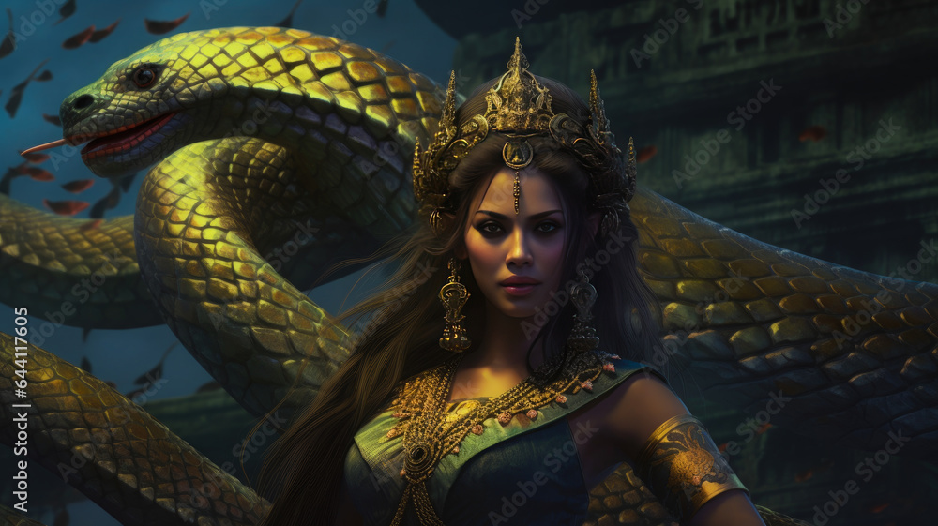
The Khmer People of Cambodia
Mysteries and Debates
Scholars continue to debate the causes of Chenla’s split:
Environmental Stress: Sediment analyses from Tonlé Sap suggest droughts intensified competition.
Notes:
Cultural Tensions: Diverging cultural values between Indianized elites and local traditions may have fueled discord.
Folklore: Cambodian legends speak of a curse by a nāga queen, symbolizing nature’s resistance to human ambition.

Slide 12
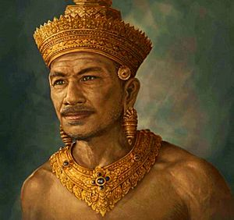
The Khmer People of Cambodia
The Angkor Empire: Zenith of Power (9th–15th Centuries)
Rise of the God-Kings
Jayavarman II’s coronation in 802 CE atop Phnom Kulen established him as devaraja (god-king).
Notes:
His reign laid the foundation for an empire that would achieve unparalleled architectural and spiritual achievements.

Slide 13
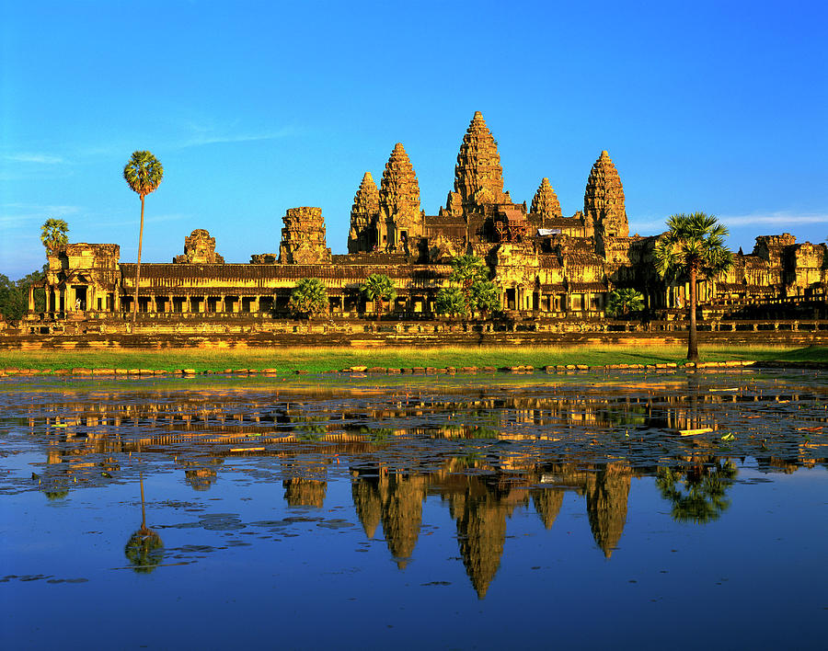
The Khmer People of Cambodia
Architectural and Spiritual Mastery
Angkor Wat: Built under King Suryavarman II, this temple represents a celestial model, with its westward orientation symbolizing Vishnu and the cosmic cycle.
Recent LiDAR scans suggest hidden chambers beneath the complex, sparking theories about lost treasures or esoteric rites.
Notes:
Bayon Temple: Jayavarman VII’s masterpiece features 216 enigmatic faces, possibly representing the king himself as a bodhisattva. The temple embodies Mahayana Buddhist principles interwoven with Khmer traditions.

Slide 14
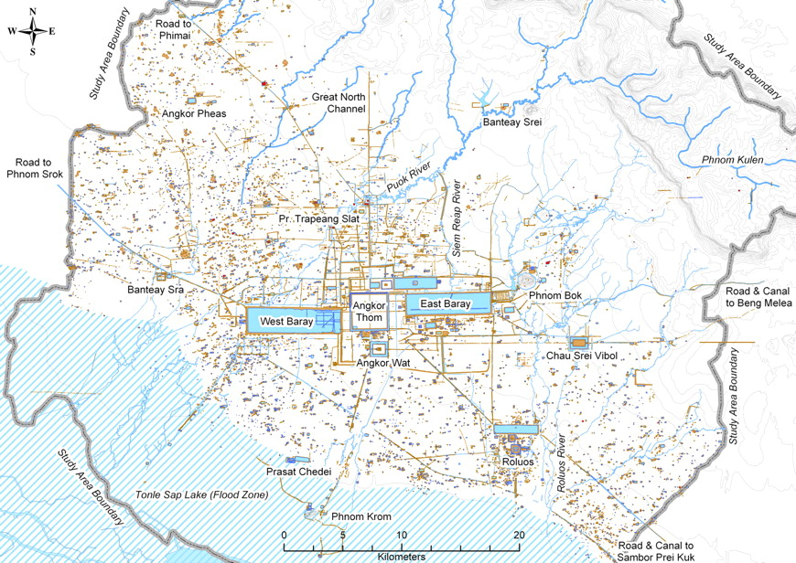
The Khmer People of Cambodia
Hydraulic Innovation and Agricultural Mastery
Angkor’s success relied on an intricate hydraulic system, featuring reservoirs (barays) and canals that supported rice cultivation.
Notes:
This engineering feat allowed Angkor to flourish despite seasonal droughts and contributed significantly to its economic strength.

Slide 15
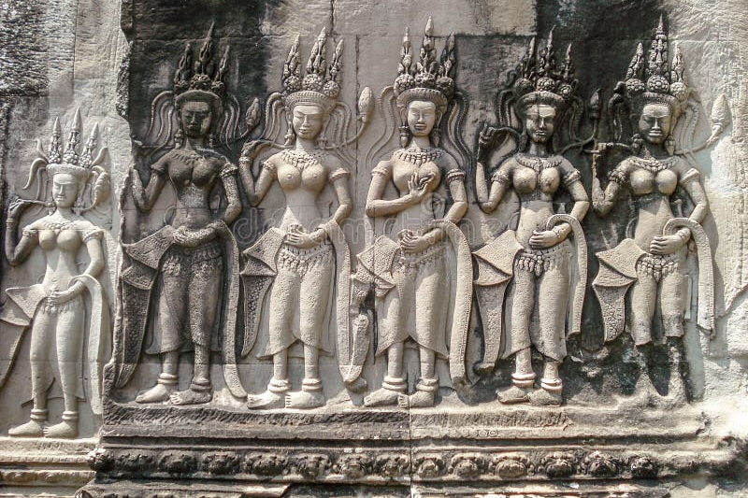
The Khmer People of Cambodia
Social Structure and Gender Roles
While the elite reveled in grandeur, millions of laborers, possibly war captives or religious devotees, built the empire’s monuments.
Notes:
Women played significant roles in trade, religion, and local governance, although their contributions are often understated in historical narratives.

Slide 16
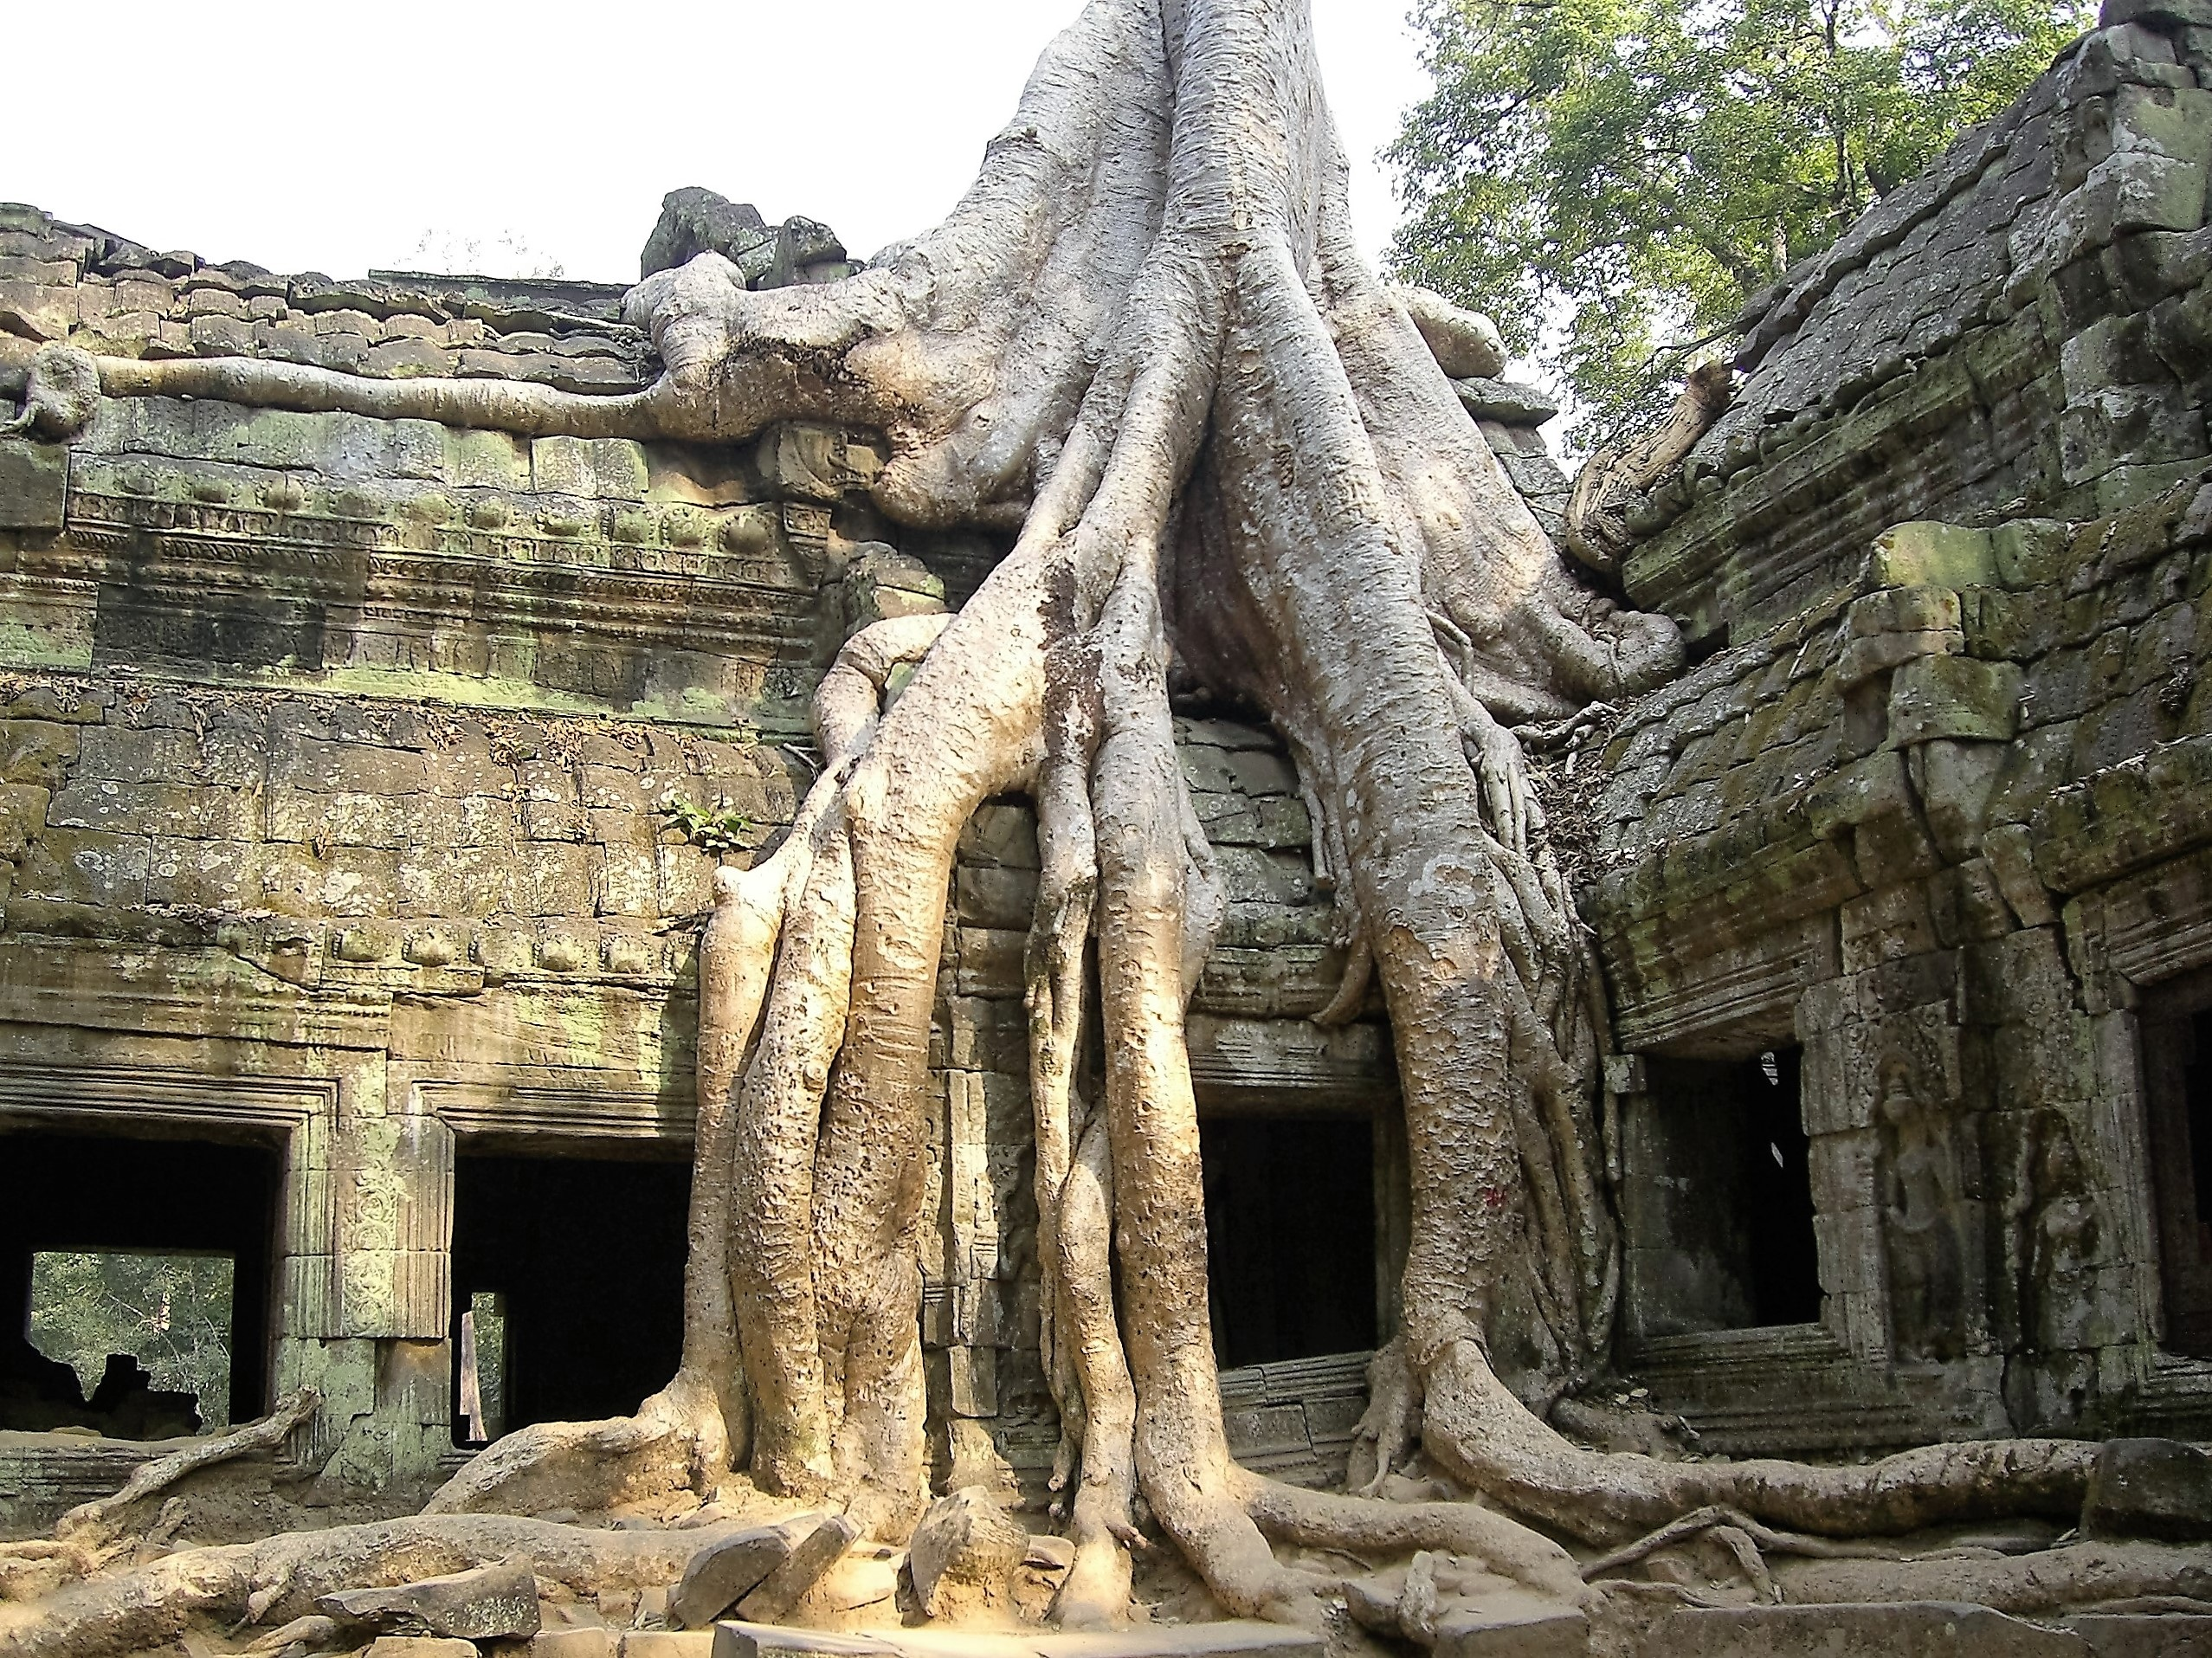
The Khmer People of Cambodia
Decline and Challenges
Angkor's gradual decline is attributed to:
Climate Change.
Religious Shifts
Military Conflicts
Notes:
Climate Change: Prolonged droughts, evidenced by pollen studies, impacted rice yields.
Religious Shifts: The rise of Theravada Buddhism challenged the god-king ideology.
Military Conflicts: Siamese invasions destabilized the region

Slide 17
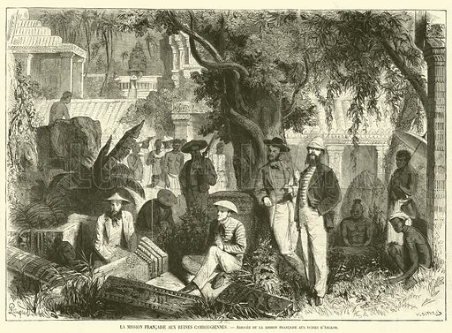
The Khmer People of Cambodia
Post-Angkor Cambodia: Survival and Adaptation (15th–19th Centuries)
Following Angkor’s decline, Cambodia’s capitals shifted to Longvek and Oudong.
Historical accounts highlight bronze-casting and Portuguese trade, while folklore tells of haunted ruins deterring exploration until French archaeologists arrived in the 19th century.
The environmental degradation that contributed to Angkor's fall also reshaped settlement patterns and agricultural strategies.

Slide 18
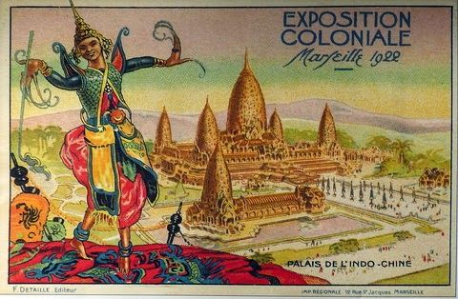
The Khmer People of Cambodia
Colonial Era and Modernization (1863–1953)
During French colonial rule, Angkor’s rediscovery captivated global imagination. Though credited to Henri Mouhot, locals had long revered the temples.
Notes:
Colonial looting fueled tales of curses, those who desecrated Angkor’s relics faced mysterious misfortunes, reinforcing beliefs in divine protection.

Slide 19
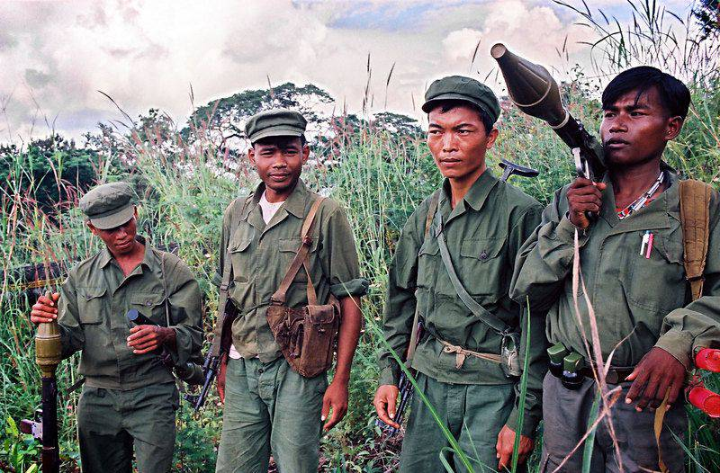
The Khmer People of Cambodia
Trauma and Recovery: Khmer Rouge to Present (1975–Today)
The Khmer Rouge era (1975–1979) left profound scars. Sites like Tuol Sleng, a former prison, bear silent witness to atrocities.
Notes:
Survivors describe spiritual unrest at these locations, reflecting unresolved national trauma.

Slide 20
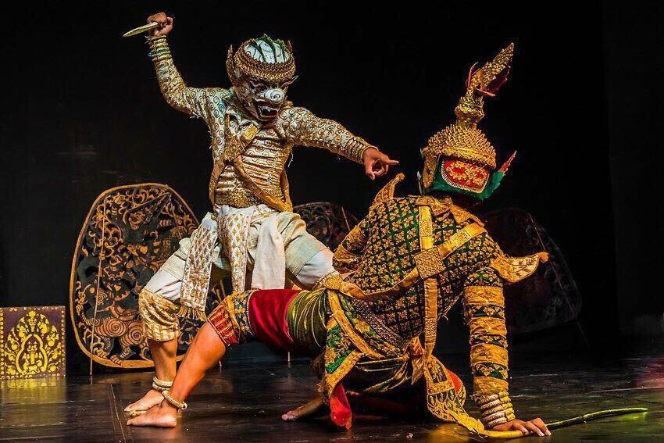
The Khmer People of Cambodia
Trauma and Recovery: Khmer Rouge to Present (1975–Today)
Despite loss, Cambodia is rebuilding its cultural identity.
Notes:
Modern artists are reviving traditional music, crafts, and dance forms, while organizations work to preserve oral histories and traditional knowledge.

Slide 21
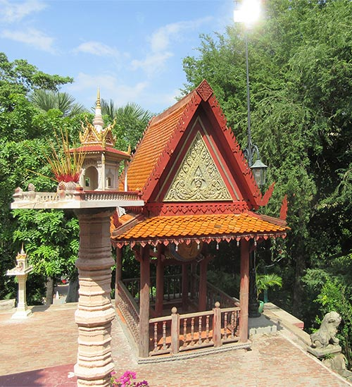
The Khmer People of Cambodia
The Khmer Today: Continuity and Change
Nāga Symbols
Spirit Shrines
Unsolved Mysteries
Notes:
Nāga Symbols: Modern infrastructure, like bridges in Phnom Penh, still features nāga motifs, echoing ancient myths.
Spirit Shrines: Roadside neak ta shrines remain common, blending animism with modern life.
Unsolved Mysteries: The burial site of Jayavarman VII and undeciphered 7th-century inscriptions continue to intrigue scholars.

Slide 22
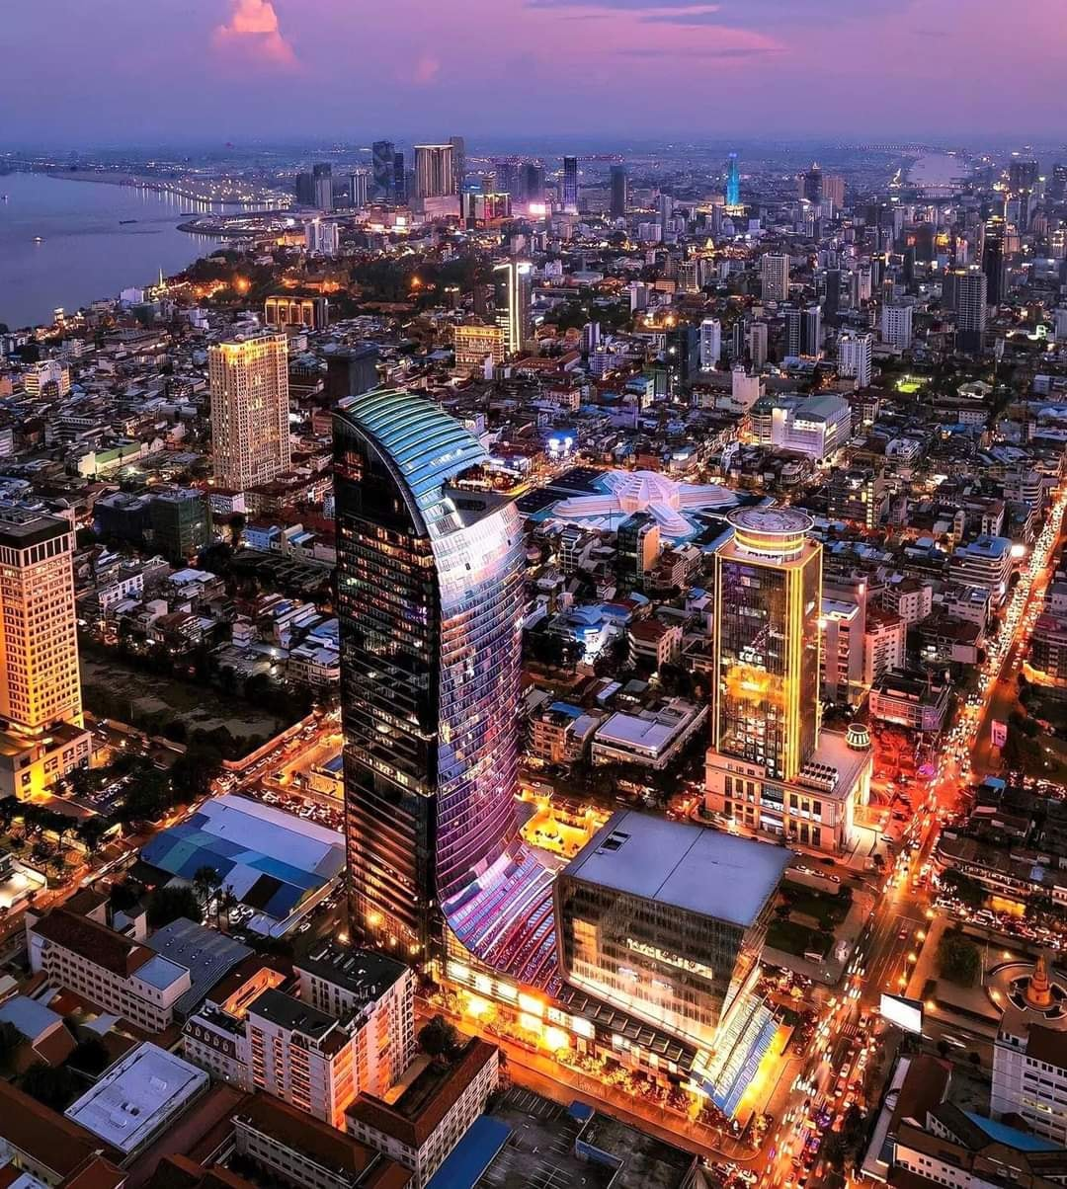
The Khmer People of Cambodia
Conclusion: Between Myth and Memory
Khmer history is a tapestry interwoven with fact and folklore.
From the sacred stones of Angkor to contemporary Phnom Penh, Cambodia’s culture has survived monumental challenges.
Notes:
To understand the Khmer is to embrace both mystery and resilience, acknowledging that some truths remain buried, while others shape the spirit of a nation.

Slide 23
The Khmer People of Cambodia
Resourses
Academic Books
A History of Cambodia by David Chandler, (4th ed., Westview Press, 2007).
The definitive English-language history of Cambodia, covering pre-Angkorian societies to modern politics.
Angkor and the Khmer Civilization by Michael D. Coe (Thames & Hudson, 2003).
Explores the rise and fall of the Khmer Empire, with detailed analysis of Angkor’s architecture and society.
Angkor: Cambodia’s Wondrous Khmer Temples, By Dawn F Rooney. (Odyssey Publications, 2011).
A comprehensive guide to Angkor’s temples, including architectural symbolism and historical context.
When the War Was Over: Cambodia and the Khmer Rouge Revolution By Elizabeth Becker, (PublicAffairs, 1998).
A harrowing account of the Khmer Rouge regime and its aftermath.
Cambodian Buddhism: History and Practice By Ian Harris,
(University of Hawaiʻi Press, 2008).
Examines the interplay between Buddhism, animism, and Khmer identity.

Slide 24
The Khmer People of Cambodia
Archaeological and Anthropological Studies
“Uncovering Archaeological Landscapes at Angkor Using LiDAR” By Damian Evans et al. (PNAS, 2013).
Groundbreaking LiDAR research revealing Angkor’s urban sprawl and hydraulic systems.
The Civilization of Angkor (University of California Press, 2001). By Charles Higham,
Traces the origins of the Khmer Empire using archaeological evidence from Funan and Chenla.
“Pre-Angkorian Settlement Trends in Cambodia’s Mekong Delta” By Miriam T. Stark,(Asian Perspectives, 2006).
Analysis of early Khmer settlements, including Oc Eo and Angkor Borei.
“The Demise of Angkor: Systemic Vulnerability to Climate Change?” By Roland Fletcher,et al. (Quaternary Science Reviews, 2017).
Argues that environmental stress contributed to Angkor’s decline.

Slide 25
The Khmer People of Cambodia
Mythology and Folklore
Les Êtres Surnaturels dans la Religion Populaire Khmère By Chouleán Ang, (CEDORECK, 1986).
Explores Khmer animism, neak ta spirits, and the nāga legend.
Lost Goddesses: The Denial of Female Power in Cambodian History By Trudy Jacobsen, (NIAS Press, 2008).
Discusses gender roles in Khmer mythology, including the Soma-Kaundinya myth.
Calling the Souls: A Cambodian Ritual Text By Ashley Thompson, (Center for Khmer Studies, 2005).
Analyzes Khmer rituals and their connections to ancient cosmology.

Slide 26
The Khmer People of Cambodia
Khmer Rouge and Modern Cambodia
First They Killed My Father: A Daughter of Cambodia Remembers By Loung Ung, (HarperCollins, 2000).
A memoir of survival under the Khmer Rouge.
Why Did They Kill? Cambodia in the Shadow of Genocide, By Alexander Laban, (University of California Press, 2005).
Anthropological study of the Khmer Rouge’s ideological violence.
Documentation Center of Cambodia (DC-Cam)
Archives of the Khmer Rouge regime, including prison records, photographs, and survivor testimonies.
www.d.dccam.org

Slide 27
The Khmer People of Cambodia
Documentaries and Films
The Missing Picture (2013).
Oscar-nominated documentary using clay figures to recount Khmer Rouge atrocities.
National Geographic
Angkor: Land of the Gods (2014).
Explores Angkor’s engineering marvels and spiritual legacy.
BBC
The Lost Temples of Cambodia (2020).
Covers recent archaeological discoveries using LiDAR technology.

Slide 28
The Khmer People of Cambodia
Online Resources
UNESCO Angkor Archaeological Park
UNESCO World Heritage: Angkor
Details preservation efforts and historical significance of Angkor.
École française d’Extrême-Orient (EFEO)
EFEO Angkor Database
Digitized archives of French colonial-era research on Angkor.
Cambodian Living Arts
www.cambodianlivingarts.org
Organization reviving traditional Khmer music, dance, and crafts.

