Slide 1
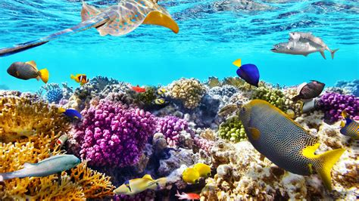
The Great Barrier Reef
Presented by
Marc Silver

Slide 2
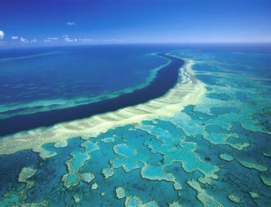
Australia’s Natural Landmark
The Great Barrier Reef is one of Australia’s best-known natural landmarks.
In this presentation I will be sharing many interesting facts about the Great Barrier Reef.

Slide 3
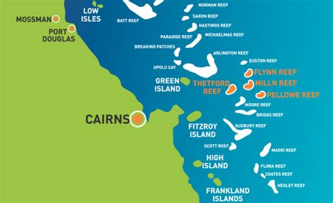
Great Barrier Reef Facts
The Great Barrier Reef is a popular tourist destination with over two million visitors each year.
Tourism to the reef generates approximately AU$6 billion per year to the Australian economy and over 60,000 full-time jobs.
The Great Barrier Reef is a great holiday destination for families and kids, attracting millions of visitors each year .

Slide 4
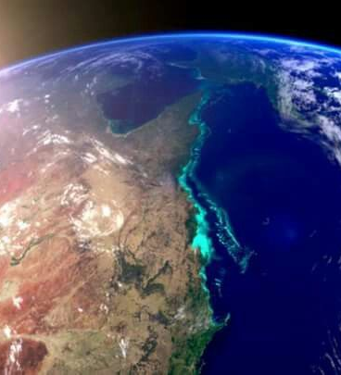
How big is the Great Barrier Reef?
The Great Barrier Reef is the world’s largest coral reef system and is composed of over 2,900 individual reefs.
Wrapping around the Northeast coast of Australia it extends for over 2,300 kilometers (1429 miles). at an offshore distance ranging from 10 to 100 miles.
Its width ranges from 37 to 155 miles. The Great Barrier Reef has an area of some 135,000 square miles (350,000 square km), and it has been characterized as the largest structure ever built by living creatures.
The Great Barrier Reef can be seen from outer space and is the world’s largest single structure made by living organisms.

Slide 5
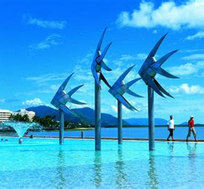
Tourism
There are likely many more—new discoveries are frequently being made, including a new species of branching coral discovered in 2017. This richness and uniqueness make the reef crucial for tourism and the Australian economy—it attracts at least 1.6 million visitors every year.
The reef’s true value, its biodiversity, extends far beyond economics. it is home to over 9,000 known species.

Slide 6
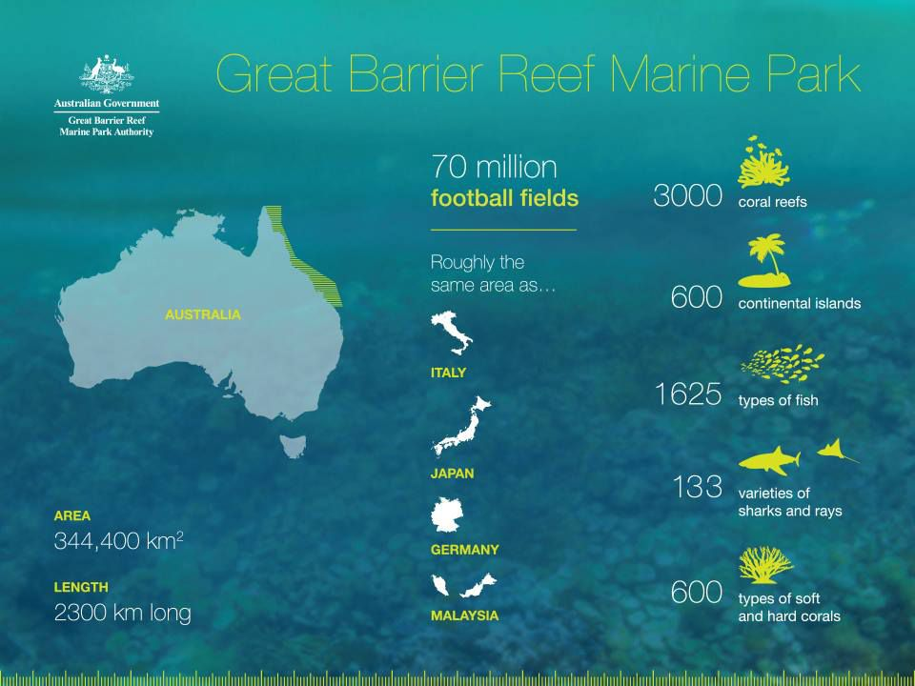
Great Barrier Reef Stats
Area: 348,700 km² (133,000 sq miles)
Width: The reef ranges between 60 and 250 kilometers in width
Length: The reef stretches over 2,300 kilometers from the northern tip of Queensland to just north of Bundaberg.
Depth: The has an average depth of 35 meters in waters close to shore, while on outer reefs, continental slopes extend down to depths of more than 2000 meters.
The Great Barrier Reef has around 3000 coral reefs and over 900 islands (made up of around 600 continental islands and 300 coral cays)

Slide 7
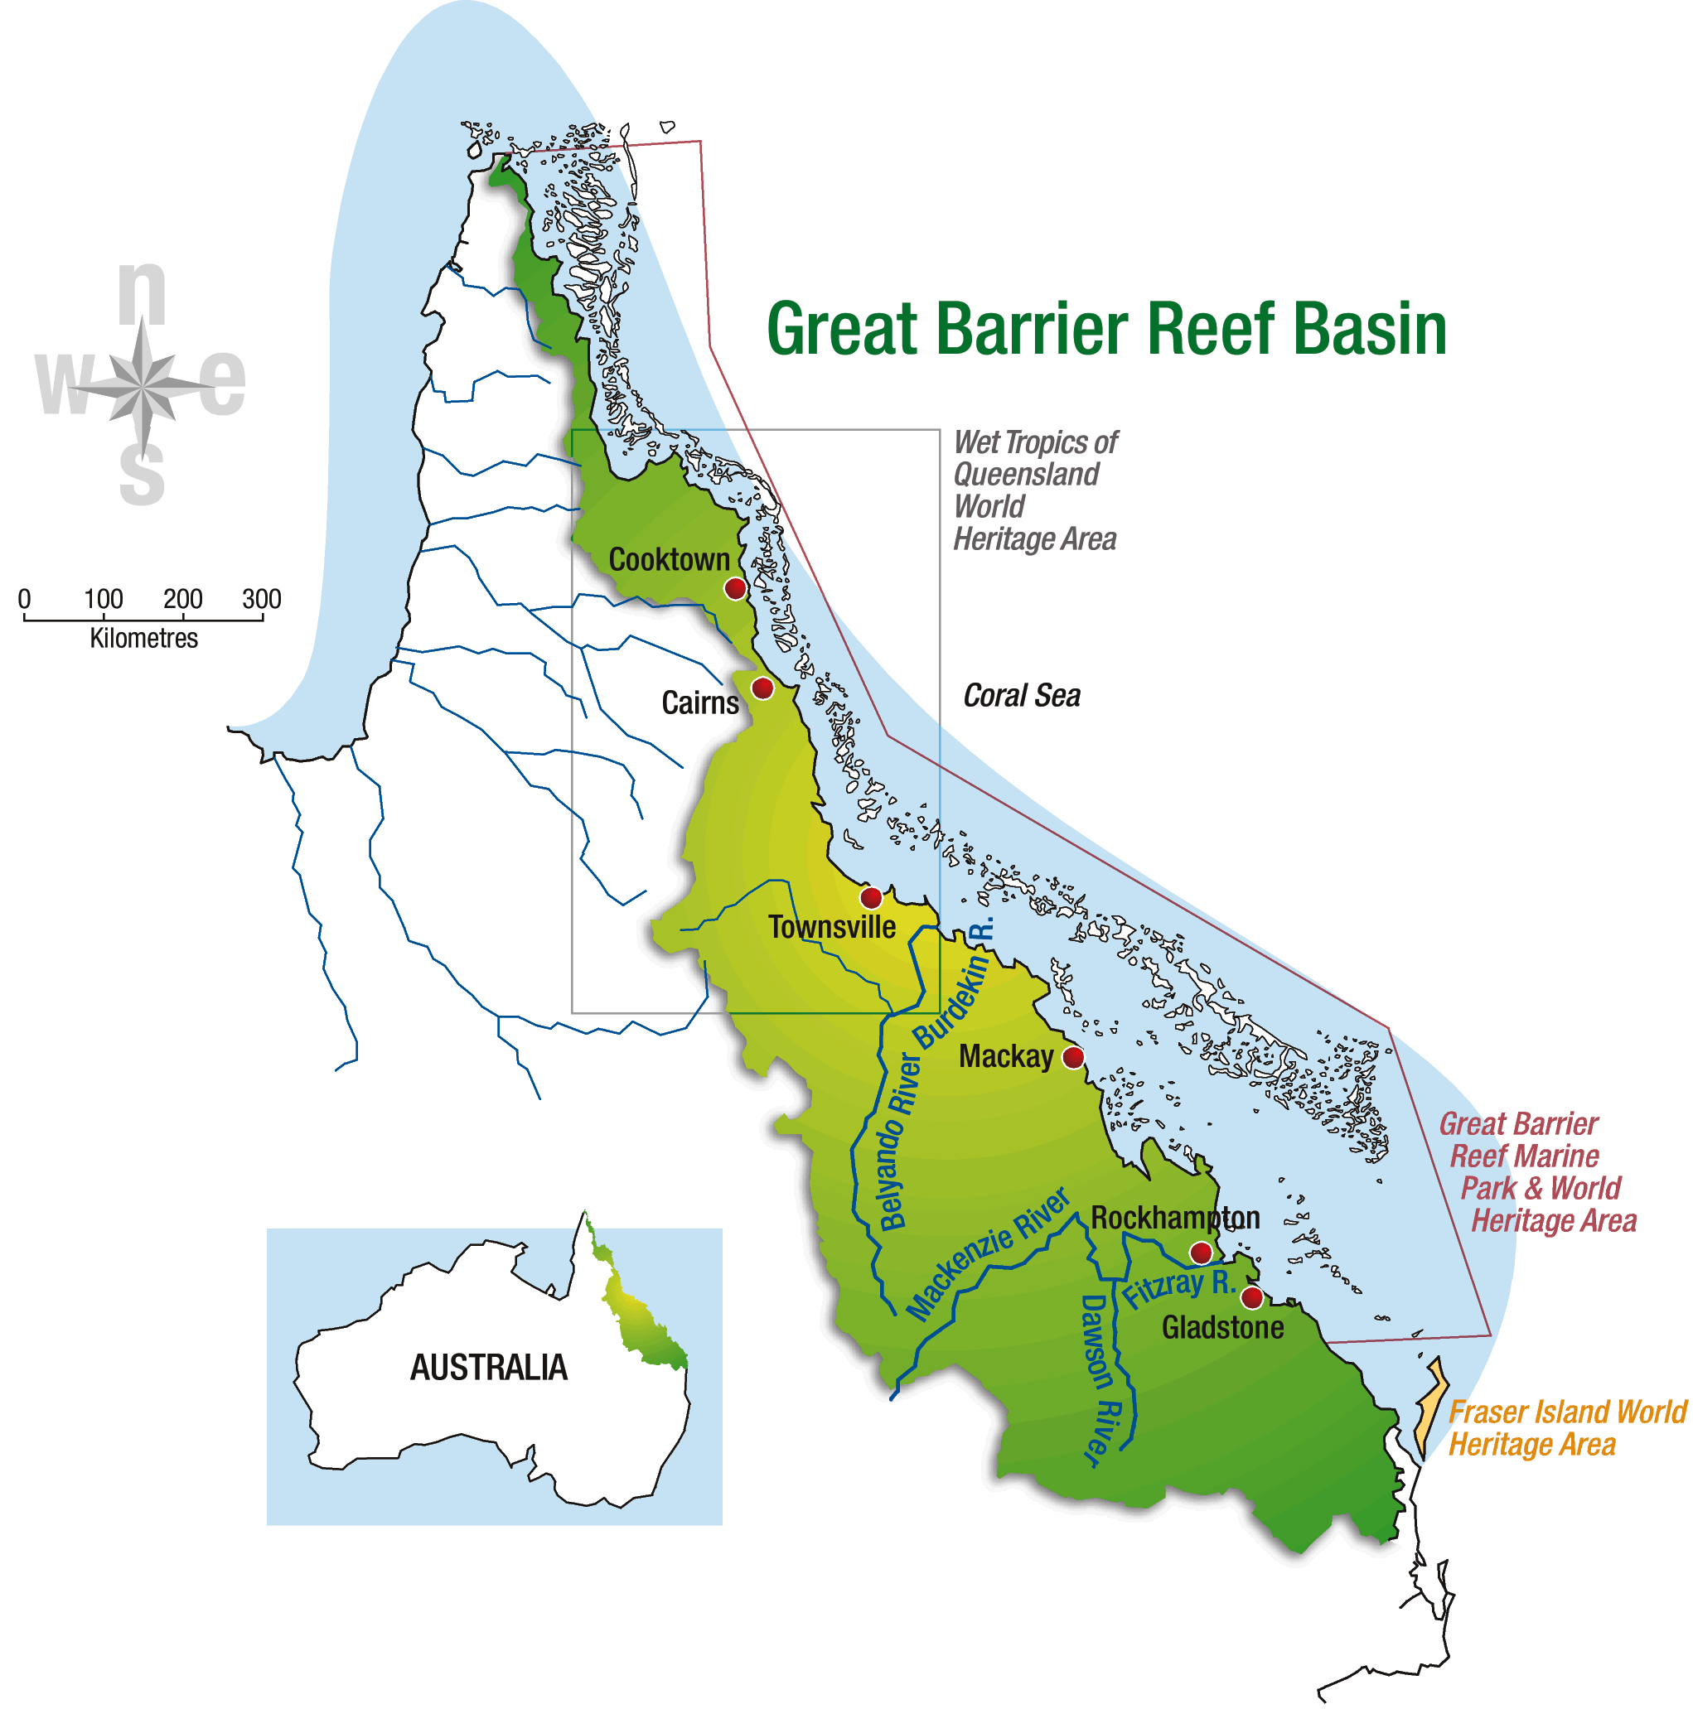
Geography
Many of the reefs are dry or barely awash at low tide; some have islands of coral sand, or cays; and others fringe high islands or the mainland coast.
The Great Barrier Reef biodiversity is remarkable.
There are animals you would probably recognize, such as dolphins, turtles, crocodiles, and sharks.
There are also venomous sea snakes, brightly colored worms, and large algae. These species interact to form a complex and delicate ecosystem dependent on the coral reef for survival.
Yet today the coral—and therefore all the organisms that depend on it—is gravely at risk.

Slide 8
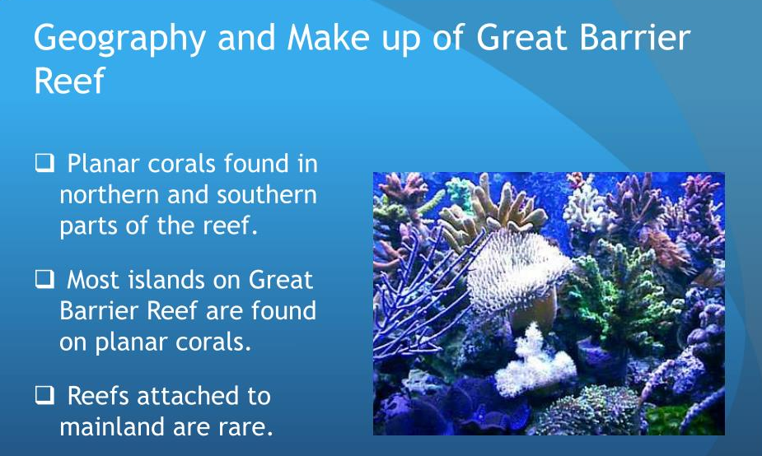
Geography
The reefs share a common origin: each has been formed, over millions of years, from the skeletons and skeletal waste of a mass of living marine organisms. The “bricks” in the reef framework are formed by the calcareous remains of the tiny creatures known as coral polyps and hydrocorals while the “cement” that binds these remains together is formed in large part by coralline algae and bryozoans.
The interstices of this framework have been filled in by vast quantities of skeletal waste produced by the pounding of the waves and the depredations of boring organisms.

Slide 9
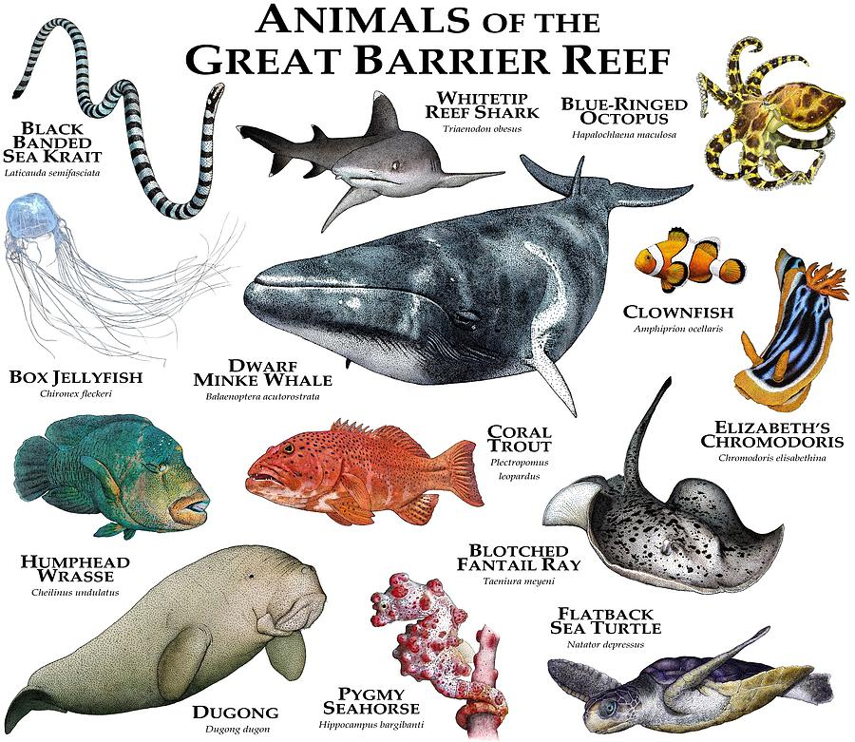
Species of the Great Barrier Reef?
The Great Barrier Reef has thirty species of sea mammals, including: whales, dolphins, and porpoises.
There are six species of sea turtles that come to the reef to breed.
215 species of birds (including 22 species of seabirds and 32 species of shorebirds) visit the reef or nest or roost on the islands.
Seventeen species of sea snake live on the Great Barrier Reef.
More than 1,500 fish species live on the reef.
Around 10 percent of the world’s total fish species can be found just within the Great Barrier Reef.
There are at least 330 species of ascidians on the reef system.

Slide 10
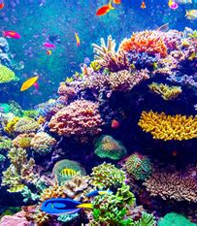
What is Coral?
Coral is made up of many small animals. These tiny animals build a hard external skeleton to make the vibrant structures that we recognize.
When healthy, coral has a symbiotic relationship with algae. The coral produces fluorescent chemicals that protect the algae from bright sun—almost like a sunscreen. The algae use photosynthesis to harness solar energy to make sugars. In this way, the algae provide food and oxygen (a byproduct of photosynthesis) for the coral, and the coral protects and provides nutrients for the algae. The coral’s many colors comes from the algae.
Coral are characterized by skeletons—external or internal—of a stonelike, horny, or leathery consistency. The term coral is also applied to the skeletons of those animals, particularly to those of the stonelike corals.

Slide 11
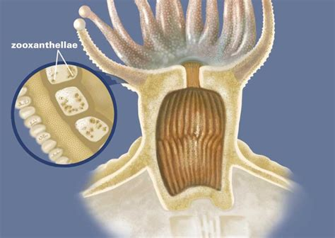
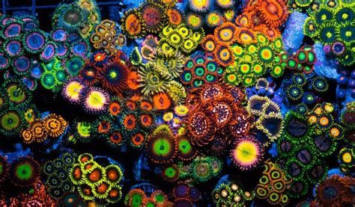
What is Coral? Cont.
Stony corals number about 1,000 species; black corals and thorny corals, about 100 species; horny corals, or gorgonians, about 1,200 species; and blue corals, one living species.
The body of a coral animal consists of a polyp—a hollow cylindrical structure attached at its lower end to some surface. At the free end is a mouth surrounded by tentacles. The tentacles, which gather food, are more or less extensible and are armed with specialized stinging structures, called nematocysts, that paralyze prey.
The water environment of the Great Barrier Reef is formed by the surface water layer of the southwestern Pacific Ocean. The reef waters show little seasonal variation: surface-water temperature is high, ranging from 70 to 100 °F (21 to 38 °C). The waters are generally crystal-clear, with submarine features clearly visible at depths of 100 feet (30 meters).

Slide 12
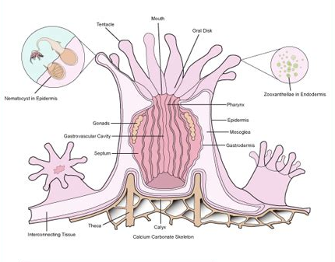
What is Coral? Cont..
The skeleton of stony coral is almost pure calcium carbonate and is deposited in a cup-shaped form with the polyp inside. The growth rate varies with age, food supply, water temperature, and species.
Atolls and coral reefs are composed of stony coral. Such formations grow at an average rate of about 0.5 to 2.8 cm per year. Common types of stony coral include brain coral, mushroom coral, star coral, and staghorn coral, all named because of their appearance.

Slide 13
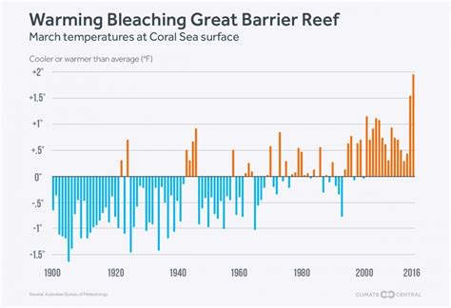
Coral Bleaching
In addition to its scientific interest, the reef has become increasingly important as a tourist attraction. Growing concern over the preservation of its natural heritage has led to increased controls on such potentially threatening activities as drilling for petroleum resources. The extensive use of tourist craft and the sustainability of commercial fishing were controversial matters in the late 20th and early 21st centuries.
The reef’s health, however, is threatened by other factors. It is susceptible to periodic coral bleaching events—that is, the “whitening” also of the coral skeleton, caused by breakdown of the coral’s symbiosis with algae called zooxanthellae.
At least six mass bleaching events caused by climate change have taken place since 1998, resulting in the loss of substantial coral coverage.
In 2016 and 2017, bleaching resulted in coral coverage declines by up to one-third in the northern part of the reef. Another severe bleaching event in 2020 extended to the southern areas of the reef.

Slide 14
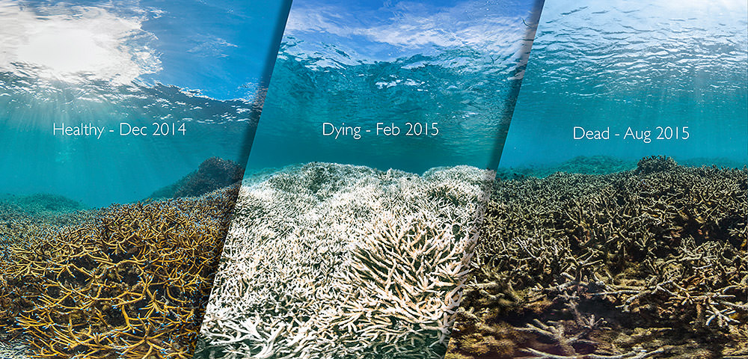
Coral Bleaching Cont.
Stony corals, the most familiar and most widely distributed forms, are both colonial and solitary in habit. They, as well as black and thorny corals, have more than eight septa and simple rather than feathery tentacles. Stony, black, and thorny corals differ from the related sea anemone chiefly in having an external skeleton.
Stony corals occur in all oceans from the tidal zone to depths of nearly 6,000 meters (about 20,000 feet). The polyps of colonial forms are 1 to 30 mm (0.04 to 1.2 inches) in diameter. Most living stony corals are yellowish, brownish, or olive, depending on the color of the algae living on the coral. The skeletons, however, are always white. The largest solitary form, a species of Fungia, grows to a diameter of about 25 cm (10 inches).

Slide 15
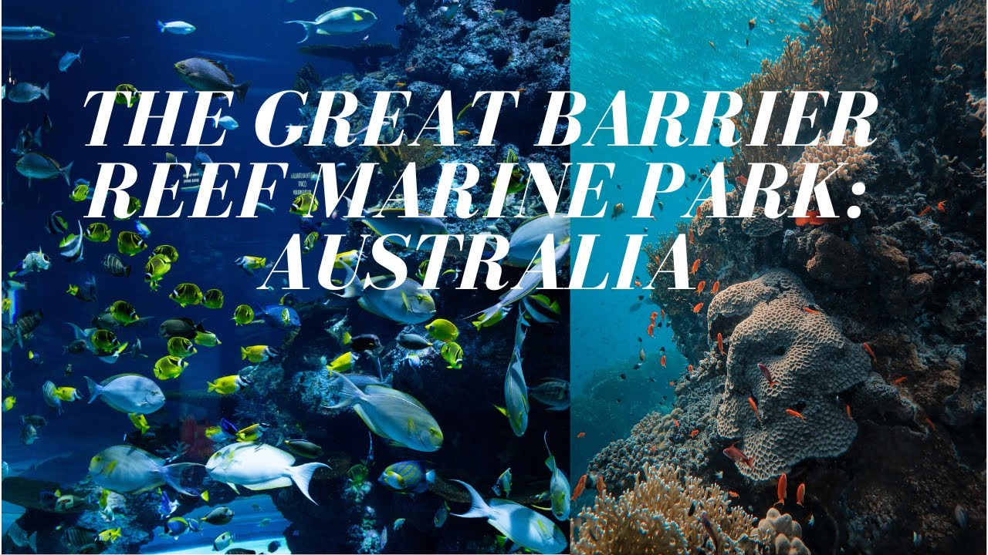
Coral Survival
The Barrier Reef resides on the shallow shelf f ringing the Australian continent, in warm waters that have enabled the corals to flourish. Biologists have established that reefs were growing on the continental shelf as early as the Miocene Epoch (23.0 million to 5.3 million years ago).
Supervision of the reef is largely the responsibility of the Great Barrier Reef Marine Park (declared in 1975), which encompasses the vast majority of the area. There are also smaller state and national parks. In 1981 the Great Barrier Reef was added to UNESCO’s World Heritage List.

Slide 16
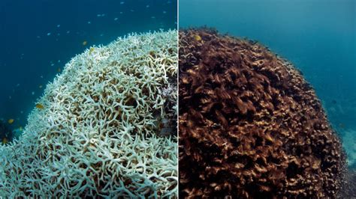
Climate Change
What threatens the Great Barrier Reef?
Fact: Climate change is perhaps the biggest threat to the Great Barrier Reef.
Fact: Warmer ocean temperatures put stress on coral and lead to coral bleaching.
Fact: The Great Barrier Reef has experienced several mass coral bleaching events in 1998, 2002, 2006, 2016, 2017 and 2020. Bleaching is expected to become an annual occurance, when aerial surveys showed that over 50% of reefs experienced some coral bleaching.
Fact: Sediment, nutrient and agriculture pesticide pollution from river catchment run-off is also affecting the health of the Great Barrier Reef.
Fact: Too much or poorly managed tourism could be a risk to the reef, fortunately tourism on the reef is very well managed at the moment.

Slide 17
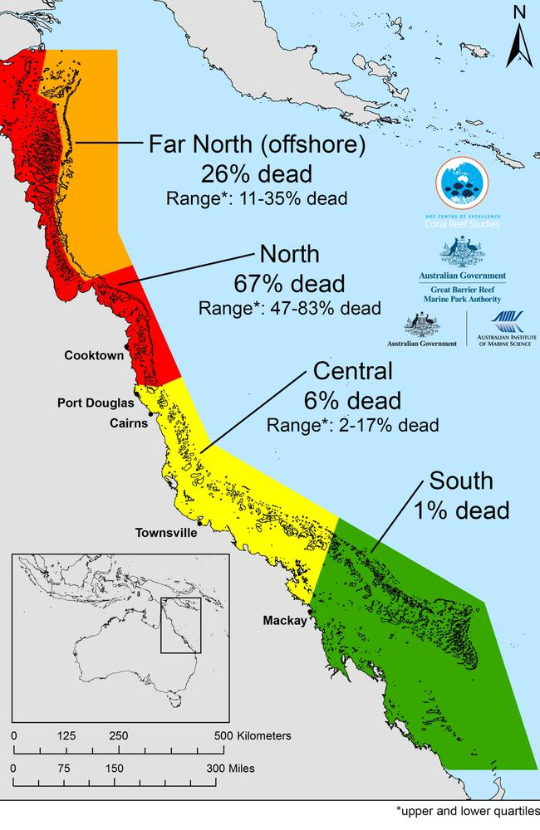
Climate Change Cont.
What threatens the Great Barrier Reef?
Climate change is perhaps the biggest threat to the Great Barrier Reef.
Warmer ocean temperatures put stress on coral and lead to coral bleaching.
The Great Barrier Reef has experienced several mass coral bleaching events in 1998, 2002, 2006, 2016, 2017 and 2020. Bleaching is expected to become an annual occurrence, when aerial surveys showed that over 50% of reefs experienced some coral bleaching.
Sediment, nutrient and agriculture pesticide pollution from river catchment run-off is also affecting the health of the Great Barrier Reef.
Too much or poorly managed tourism could be a risk to the reef, fortunately tourism on the reef is very well managed at the moment.

Slide 18
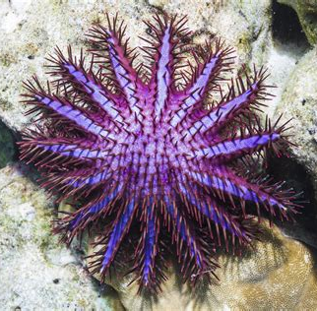
Climate Change Cont.
Climate change is not the only threat to the reef. Chemical runoff and other forms of pollution, coastal development, and overfishing all can harm coral and reduce biodiversity.
Large storms such as cyclones cause a lot of damage to Coral Reefs.
Species that live in the reef can also cause damage. One major pest species is the crown-of-thorns starfish. A starfish may sound harmless, but these venomous creatures voraciously eat coral.
Every so often, the Crown of Thorns numbers spike. Some scientists think these starfish caused over half of the reef damage from 1985 to 2012.

Slide 19
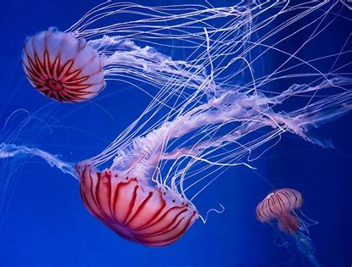
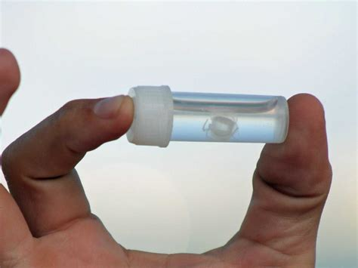
Jellyfish
Jellyfish, also known as sea jellies, are mainly free-swimming marine animals with umbrella-shaped bells and trailing tentacles, although a few are anchored to the seabed by stalks rather than being mobile. The bell can pulsate to provide propulsion for efficient locomotion.
Despite having no brains, no heart and no blood, jellyfish have survived for more than 500 million years, predating dinosaurs.
More than 100 species of jellies have been recorded along the Great Barrier Reef, including the notorious stinging blue bottles and box jellyfish. One of these, the infamous Irukandji jellyfish, is one of the smallest (roughly one cubic centimeters) and most venomous jellyfish in the world.
Irukandji jellyfish,

Slide 20
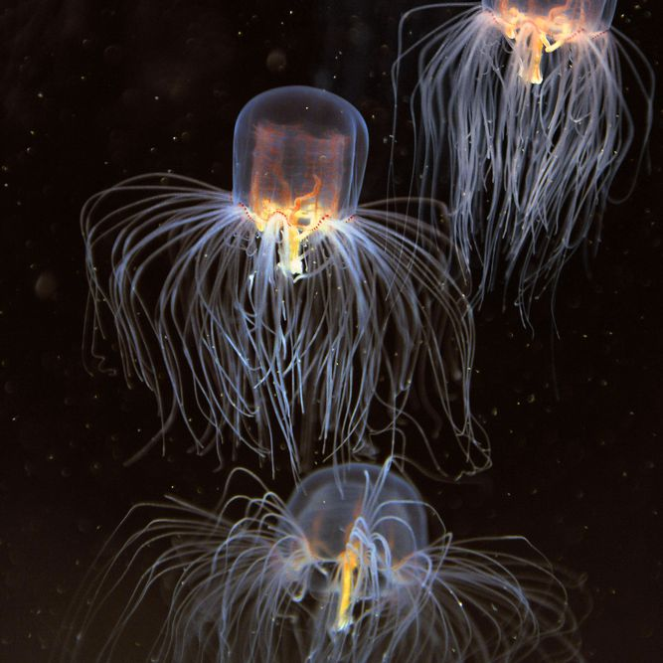
Best time to go?
The Great Barrier Reef is beautiful all year round.
The stinger season is from November to May. During this time, you need to swim inside the stinger enclosures at the beaches or wear stinger suits to minimize your chance of being stung by one of these deadly Jellies.
To avoid contact with a stinger is to always swim at beaches that are monitored by lifeguards. These beaches will often be marked with red and yellow flags. Be sure to swim within marked areas to best avoid stingers.
Alternatively, you can play it safe and swim in a lagoon. Cairns, Darwin, and other coastal cities have lagoons available for swimming. The lagoons are filtered from fish and other sea creatures.
Box jellyfish,

Slide 21
The Great Barrier Reef
I hope you found these facts about The Great Barrier Reef interesting and informative.
Hopefully, you all get the opportunity to visit the beautiful and historic country for yourselves.
Thank you for coming!

Slide 22
Acknowledgement
My seminars are the result of many years of travel experience combined with many hours of research over the internet.
I would like to acknowledge the many sources I have accessed.
These include: Wikipedia.com, Britannica.com, and the various Museum, Park and Government websites.

