Slide 1
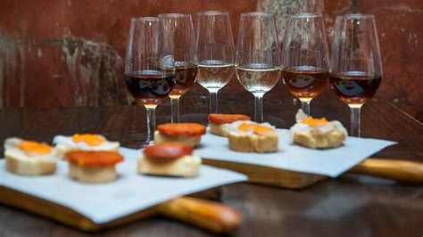
History Of Spanish Tapas
Presented by
Marc Silver

Slide 2
Topics
Tapas a Tradition
What are Tapas?
The Origins of the Tapa
The Sick King Theory
The Spanish Inquisition
Stinky Wine Theory
Literary Theory
The Sandy Wine Theory
Royal Inn
The Drunk Farmer Theory
Tapa in Filipino Cuisine
Original Tapas
Modern Spanish Tapas
World Tapa Day
Thank You

Slide 3
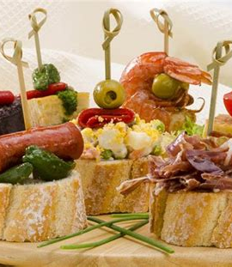
Tapas a Tradition
If there is one aspect of Spanish cuisine that is best known around the world, it is the custom of eating tapas. A fixture of Spanish society for centuries, tapas are a custom that has evolved since the late 20th century to become a world-famous gastronomical model, reaching far beyond Spanish borders.
The tradition of tapas has grown from the roots of Spain and extended all around the world, spreading popular Spanish tapas dishes as well as exploring the style of tapas in other cuisines as well.
Today, this culinary tradition is replicated in bars and restaurants across the globe, ranging from the traditional to the avant-garde.

Slide 4
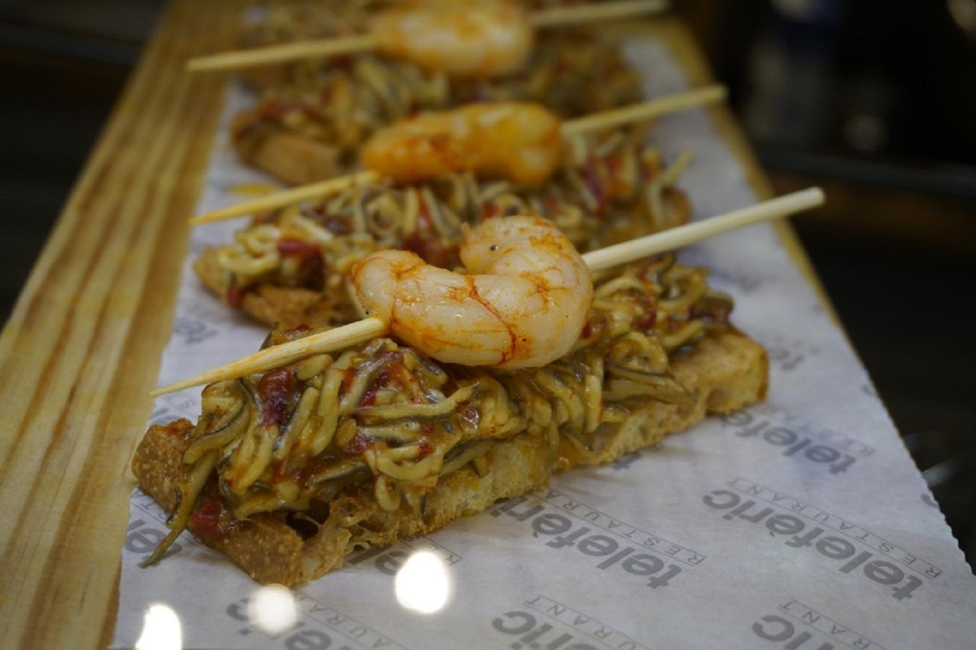
What are Tapas?
The word "tapas" is derived from the Spanish verb tapar, "to cover", derived from the English word "top". in Spain it has also become a term for this style of food. The origin of this new meaning is uncertain but there are several theories:
There are many myths and misconceptions surrounding iconic tapas, and many disagree on what is and what is not considered a tapa, today. The truth is that in Spain the customs surrounding the eating of tapas vary greatly between regions.
You would have a very different experience eating tapas in Barcelona than you would in Granada or Madrid. However, one thing that most people can agree on is that tapas usually refers to a small portion of food. In fact, size is one of the principal ways to define if something is or is not a tapa.

Slide 5
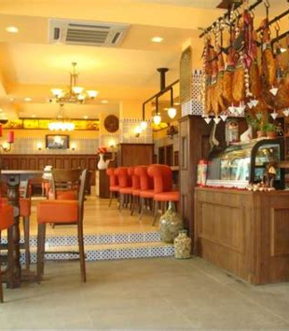
The Origins of the Tapa
In pre-19th-century Spain tapas were served by Inns (posadas), hostels (albergues) or wine bars (bodegas), many offering meals and rooms for travelers. Since few innkeepers could write and few travelers read, inns offered their guests a sample of the dishes available, on a "tapa" (the word for top in Spanish).
A widely accepted legend places the origins of the tapas tradition in Andalusia, where drinks would be covered with a piece of cheese or sausage to protect them from dust or flies during the hot summer weather.
According to Joy of Cooking, the original tapas were thin slices of bread or meat which sherry drinkers in Andalusian taverns used to cover their glasses between sips.

Slide 6

The Sick King & Drunk Peasants Theory
The oldest story in the history of tapas suggests that it was first invented in the 13th century. According to a popular account, the custom was started by King Alfonso X "The Wise" (1221–1284) during an illness, his doctor prescribed large quantities of wine, with small portions of food to diminish the effects of the alcohol as a remedy for his ailment.
After regaining his health, the king ordered that taverns would not be allowed to serve wine to customers unless it was accompanied by a small snack or "tapa” to prevent public drunkenness and it became a law.

Slide 7
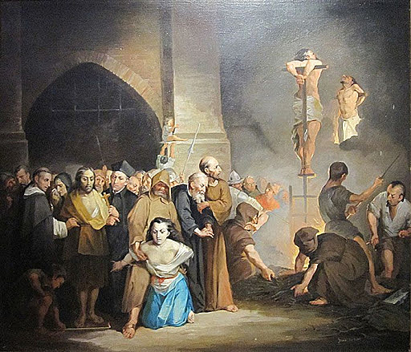
The Spanish Inquisition Porky Test Theory
One slightly off the wall theory is that small plate servings of pork-based dishes were used to test Jews who claimed to have converted to Christianity during the Spanish Inquisition (1478) period.
If they refused to eat, then it could be seen as a tacit admission that they were purposefully avoiding non-kosher food.

Slide 8
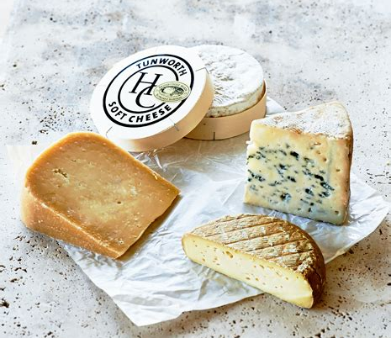
Stinky Wine Theory
Beginning in the Castile-La Mancha region of central Spain, sometime in the 16th century, tavern owners figured out a way to trick customers into drinking bad wine by placing a free slice of strong cheese on top of each glass sold, both the smell and flavor of the cheese would distract customers from the taste of the wine.
This had the secondary benefit of patrons thinking they were getting something for free from the generosity of the bar owner.

Slide 9

Literary Theory
This theory also has little to do with the name tapa but could have been a part of the small plate's tradition moving into popular culture.
Tapas may have first appeared in literature as a tradition featured in the 17th-century novel "Don Quixote," which mentioned herring and rabbit "empanadas" (pastries), among other snacks as Tapas.
In 1795, Tapas were mentioned in the book "Seville Banquets, Tapas, and Menus, 1863–1995: An Anthropology of Food," establishments where wine was served by the glass were granted a license to set out tables and chairs, and to serve cold or fried food, although stews were prohibited.
There are numerous other accounts of how the custom of eating tapas emerged, involving Medieval Kings or other historic figures.

Slide 10
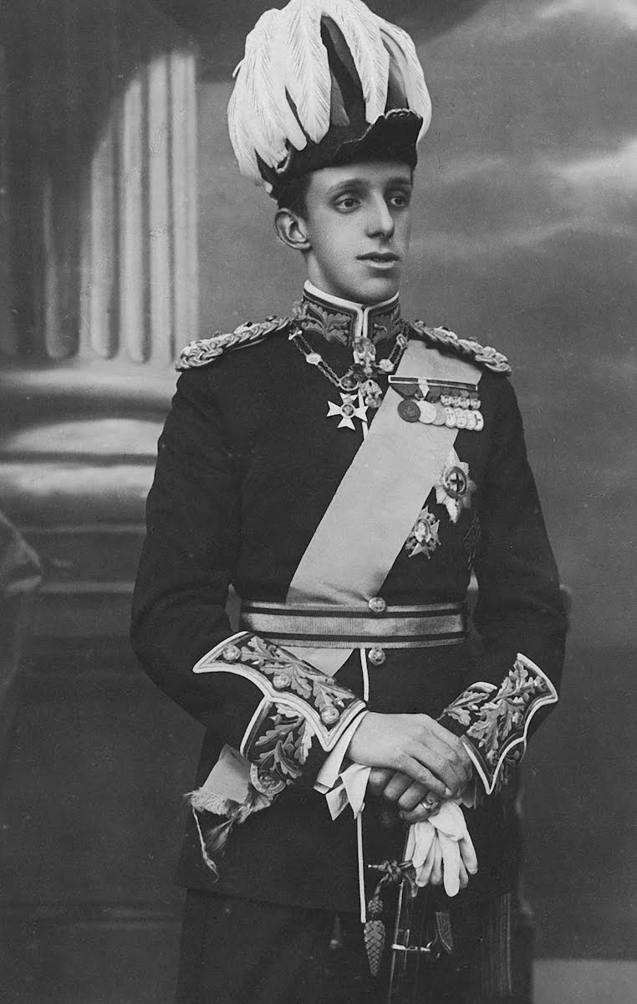
The Sandy Wine Theory
A popular and more modern explanation involves King Alfonso XIII (1886–1941). It is said that he stopped by a famous tavern in Cádiz where he ordered a glass of wine. The waiter covered the glass with a slice of sausage before offering it to the king, in order to protect the wine from the blowing beach sand, as Cádiz is a windy place.
The king, after drinking the wine and eating the ham, ordered another wine con la tapa ("with the cover"). Several taverns in Cádiz and Seville have claimed to be the setting for that event.

Slide 11
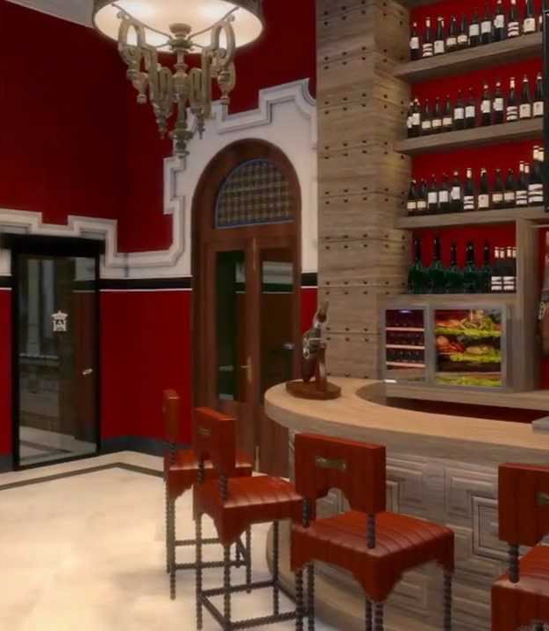
Royal Inn
A variant of that story recorded in the Seville visitors' book, is that King Alfonso XIII visited an inn on the outskirts of Seville in 1930, where he tried the homemade tapas known locally as "tonteo," which included cod sticks, fried squid, "aliños de hueva" (a roe dressing), and sausage.
He liked the place and the experience so much that he granted it the title of "Royal Inn."

Slide 12
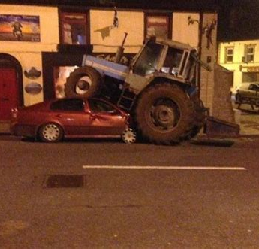
The Drunk Farmer Theory
A very simple Story is that farmers, who would drink all day, used to enjoy small meals with each drink to provide a constant level of energy for farm work and perhaps keep them from getting too drunk while working.
While this is probably true, I don’t see that it really fits with the essence of tapas bar culture. I don’t see it as related that people simply snack and drink at the same time!

Slide 13
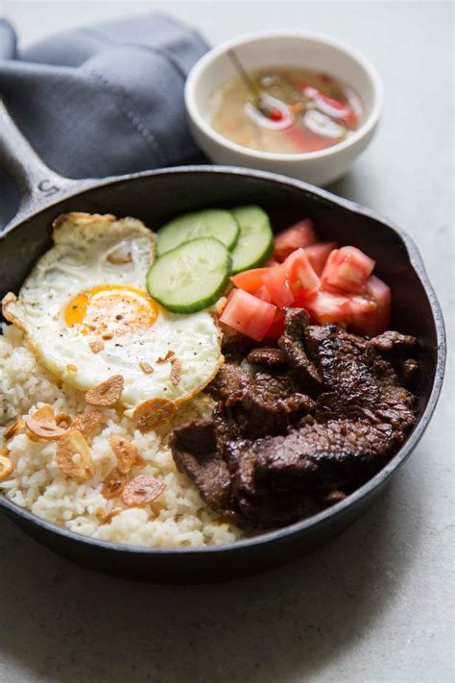
Tapa in Filipino Cuisine
The idea of Tapas is not just a Spanish think. In the Philippines they also serve a similar treat. Typically, Tapa is dried or cured beef, pork, mutton, venison or horse meat, although other meat or even fish may be used. Filipinos prepare tapa by using thin slices of meat and curing these with salt and spices as a preservation method.
Tapa is often cooked, fried or grilled. When served with fried rice and fried egg, it is known as tapsilog, a portmanteau of the Tagalog words tapa, sinangag (fried rice) and itlog (egg). It sometimes comes with atchara, pickled papaya strips, or sliced tomatoes as a side dish. Vinegar or ketchup is usually used as a condiment.

Slide 14
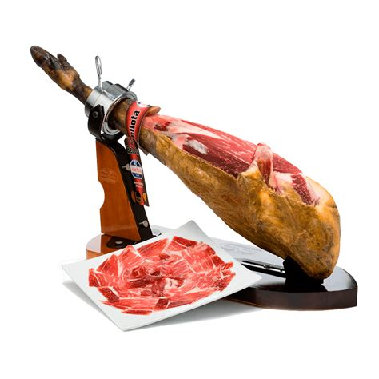
Original Tapas
The oldest/original Tapas dishes that started the tapas tradition are believed to be:
Jamon Iberico / Serrano – Cured Spanish Ham
Cheese
Bread
Aceitunas (Olives)

Slide 15
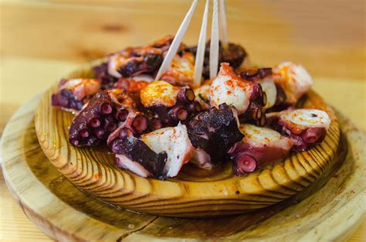
Modern Spanish Tapas
Modern Traditional Spanish Tapas Dishes you’ll find on a lot of menus across Spain:
Tortilla de patatas – the Spanish omelet.
Boquerones – White anchovies served in vinegar (boquerones en vinagre) or deep fried
Gambas al Ajillo – prawns flash fried in lots of garlic laced olive oil
Calamares Fritos – Fried calamari rings
Albondigas – Meatballs in sauce. Though the dish likely existed before tapas did, it became a taps favorite in small portions.
Patatas bravas – Chunky fried potatoes with a spicy
sauce
Croquetas – Spanish croquettes
Pimientos de Padrón – deep fried little spicy peppers
Pulpo a la gallega – Galician style boiled octopus with
potatoes and paprika
Solomillo al whiskey – Pork or beef medallions cooked
in a boozy sauce
Tortillitas de camarones – prawn cake fritters

Slide 16
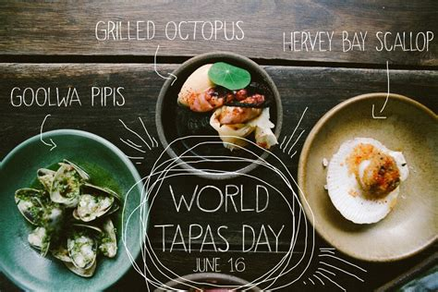
World Tapas Day
World Tapas Day is observed annually on the third Thursday of June, and this year will be celebrated by fans of tapas on June 20, 2024.

Slide 17
Thankyou for Coming!
I hope you enjoyed my talk!
If you have any more questions, please ask.
I will do my best to answer them for you.
I can be reached by e-mail at
marcs@sonic.net

Slide 18
Acknowledgement
My seminars are the result of many years of travel experience
combined with many hours of research over the internet.
I would like to acknowledge the many sources I have accessed.
These include: Wikipedia.com, Britannica.com, and the
various Museum, Park and Government websites.

