Slide 1

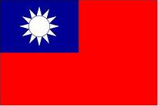
Taipei, Taiwan
Presented by
Marc Silver

Slide 2
What I Will Cover
My Port Philosophy
Don’t Miss the Ship
Money
About Hulien, Taiwan
Taipei ’s History
Getting Around
Points of Interest
Places to see or at least consider
A few restaurant recommendations
Conclusion

Slide 3
My Port Philosophy
I have been cruising for over 47 years and have taken over 100 cruises.
So, I consider myself an experienced cruiser.
The information I will present is based on those many years of
experience.
When I am on a cruise where the city, I want to visit is not the port city,
I always recommend taking a ship’s tour.
But when I am in a port with multiple attractions nearby and easy to see
on my own -
I will do it on my own.
This presentation is for that type of port.

Slide 4

Don’t Miss the Ship
How to Avoid Missing Your Ship
Pay attention to the time. - Ship time and local time are often
different.
Put a return-to-ship reminder on your phone.
Choose excursions wisely.
If a ship-sponsored excursion is late returning to port, the ship will
wait for you. If you are on your own???
Be Prepared
Have your Passport, Credit Card, and phone numbers for your ship
port agent.
What to Do If You Miss the Ship
Most cruise lines have port agents stationed in the port area to assist if your ship has left without you. If your are lucky, when cruisers are late returning to the vessel, the ship’s crew will often remove the passengers’ essential items – passports, cell phones, and medication -- from the ship to leave with the port agents.
The Port Officials can help you with contacting your ship
and making necessary travel arrangements.

Slide 5
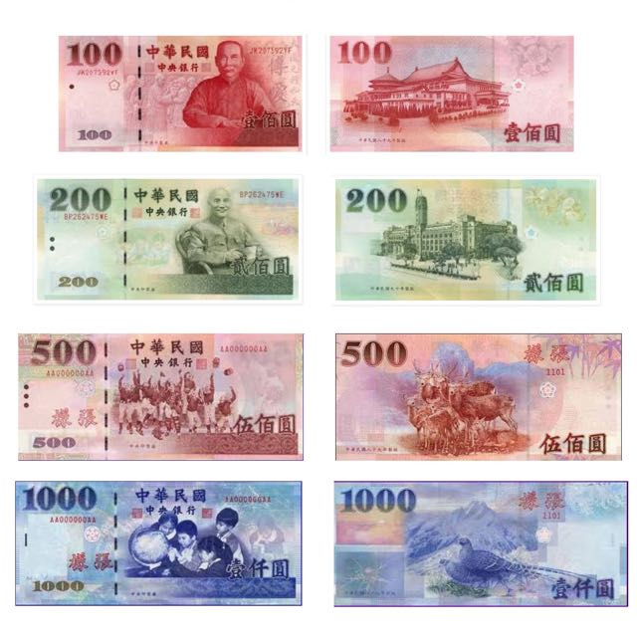
Money
The Taiwan Dollar is the official currency of Taiwan.
Sometimes called New Taiwan Dollar.
The official Exchange is
31.68 TWD to the US Dollar
100 TWD = $3.16

Slide 6
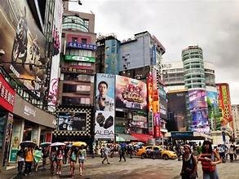
About Taipei
Taipei is a city that blends tradition, technology,
and everyday life with remarkable ease.
Modern towers rise beside historic temples, and
quiet parks sit just blocks from busy night markets.
Taipei 101 dominates the skyline, once the world’s
tallest building, while neighborhoods like Daan and
Ximending reveal the city’s softer, more local side.
Food is central to life here, from night-market dumplings and beef noodle soup to refined regional cooking.
Efficient public transportation makes Taipei easy to explore, and its friendly, relaxed pace often surprises first-time visitors expecting a hectic Asian capital.

Slide 7
Taipei ’s History
Taipei began as a small settlement in a river basin inhabited by Indigenous peoples, later attracting Han Chinese settlers in the 18th century.
Its growth accelerated during the Qing dynasty as trade expanded.
From 1895 to 1945, Japanese rule reshaped Taipei with modern infrastructure, railways, and public buildings that still influence the city’s layout today.
After World War II, Taipei became the capital of the Republic of China, transforming rapidly as waves of migrants arrived from mainland China.
In recent decades, Taipei has evolved into a democratic, forward-looking city while preserving layers of its complex past.

Slide 8
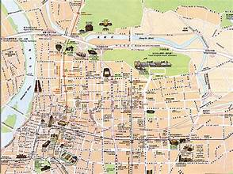
Taipei Map
Keelung Miaokou Night Market – Steps from the port, famous for street food and local atmosphere.
Heping Island Park – Coastal scenery, rock formations, and sea views.
Yehliu Geopark – Iconic rock formations like the “Queen’s Head.”
Jiufen Old Street – Historic hillside town with tea houses and narrow lanes.
Shifen Waterfall – Taiwan’s widest waterfall, often paired with lantern releases nearby.
Shifen Old Street – Railroad street famous for sky lanterns.
Chiang Kai-shek Memorial Hall – Monumental plaza and historic landmark.
Longshan Temple – One of Taipei’s oldest and most important temples.
Taipei 101 – Observation deck with sweeping city views.
National Palace Museum – World-class collection of Chinese imperial art.

Slide 9
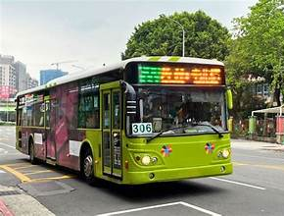
Getting Around
Getting around Taipei by bus is convenient and efficient.
The Taipei Joint Bus System offers a comprehensive network that includes general routes, trunk routes, and special services like mountain and recreational buses.
Fares: One-segment ticket, regular NT$15; Two-segment ticket, regular NT$30; Three-segment, NT$45. Most passengers will only need a One-segment ticket. The bus driver will notify you if you need to pay more for a Two or Three-segment ticket.
Tips for Travelers: Language: While many signs are in English, having a translation app can be helpful.

Slide 10
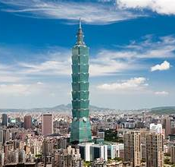
Taipei 101
Ride the high-speed elevator to the observation deck.

Slide 11
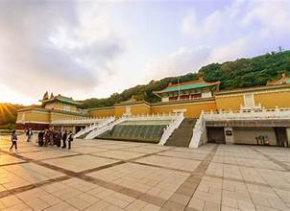
National Palace Museum
A must-see for history lovers, housing treasures once kept in Beijing’s Forbidden City.

Slide 12
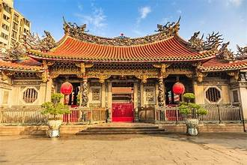
Longshan Temple
A richly decorated temple blending Taoist, Buddhist, and folk traditions.

Slide 13
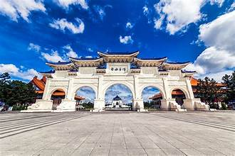
Chiang Kai-shek Memorial Hall
Monumental architecture and daily changing of the guard.
Chiang Kai-shek Memorial Hall is a significant landmark in Taipei, Taiwan. It was built to honor Chiang Kai-shek, the first president of the Republic of China, and symbolizes Taiwan's historical and political transformation.

Slide 14
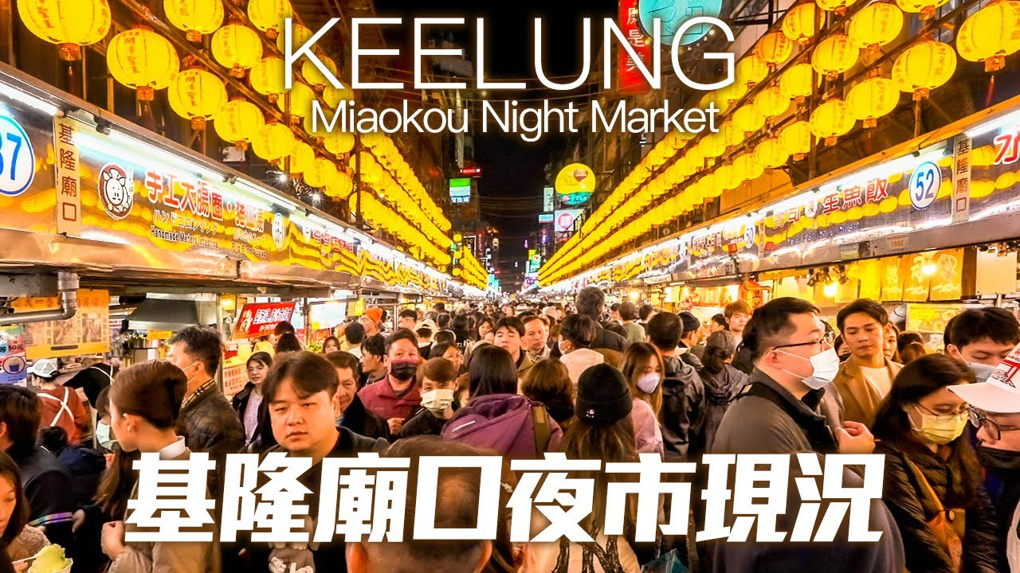
Keelung Miaokou Night Market
Keelung Miaokou Night Market – Steps from the port, famous for street food and local atmosphere.
Perfect for an evening snack and a slice of local culture.

Slide 15
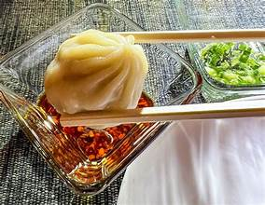
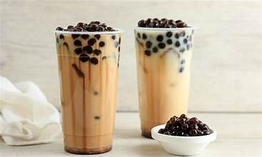
Food & Drink
Taipei is world-famous for its street food.
Try xiao long bao (soup dumplings), beef noodle soup, and gua bao (Taiwanese pork belly buns).
Bubble tea was invented in Taiwan, so sampling a cup here is almost required.
Don’t miss the stinky tofu—if you’re brave enough

Slide 16
Final Thoughts
Taipei is a city that feels welcoming from the moment you arrive—modern yet traditional, bustling yet relaxed.
Whether you’re gazing at priceless artifacts, slurping soup dumplings, or wandering through temple courtyards, you’ll experience a Taiwan that is proud of its past and confident about its future.
I hope this presentation will help when we visit Taipei !

Slide 17
Thanks For Coming
If you have any more questions, please ask.
I will do my best to answer them for you.
Have a great visit in Taipei!

