Slide 1

Sydney
Australia
Presented by
Marc Silver

Slide 2
What I Will Cover
My Port Philosophy
Don’t Miss the Ship
Money
About Sydney
Area Map of Sydney
Map of Sydney
Sydney Transportation
Places to see or at least consider
A few restaurant recommendations
Conclusion

Slide 3
My Port Philosophy
I have been cruising for over 45 years and have taken over 200 cruises.
So, I consider myself an experienced cruiser.
The information I will present is based on those many years of
experience.
When I am on a cruise where the city, I want to visit is not the port city,
I always recommend taking a ship’s tour.
But when I am in a port with multiple attractions nearby and easy to see
on my own - I will do it on my own.
This presentation is for that type of port.

Slide 4

Don’t Miss the Ship
How to Avoid Missing Your Ship
Pay attention to the time. - Ship time and local time are often
different.
Put a return-to-ship reminder on your phone.
Choose excursions wisely.
If a ship-sponsored excursion is late returning to port, the ship will
wait for you. If you are on your own???
Be Prepared
Have your Passport, Credit Card, and phone numbers for your ship
port agent.
What to Do If You Miss the Ship
Most cruise lines have port agents stationed in the port area to assist if your ship has left without you. If your are lucky, when cruisers are late returning to the vessel, the ship’s crew will often remove the passengers’ essential items – passports, cell phones, and medication -- from the ship to leave with the port agents.
The Port Officials can help you with contacting your ship
and making necessary travel arrangements.

Slide 5
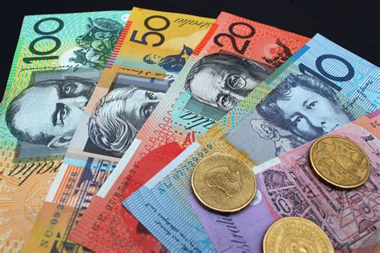
Money
The currency for Sydney is the Australian Dollar.
The conversion at the rate is $1.48 AUD to $1.00 U.S.
Or $1 AUD $.67 U.S.

Slide 6
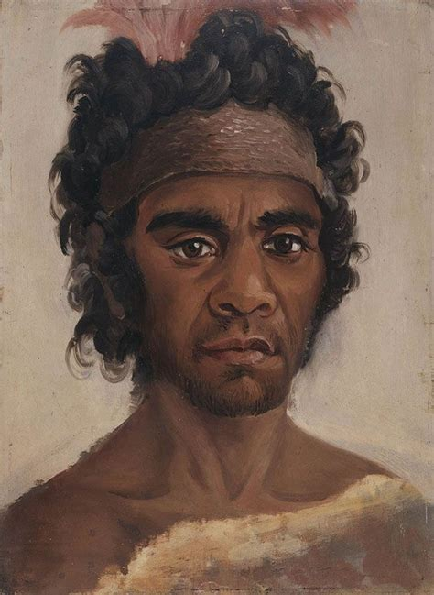
Historical Sydney
The Eora people – which means ‘here’ or ‘from this place’ – have called the Sydney area home for 40,000 years. It’s an important place and an important part of their culture, with spiritual sites, rock art and historic reminders of generations past just about everywhere you look – if you know where to look.
Much shorter is Sydney’s European history: in 1770 the HMS Endeavour moored at what is now Botany Bay, and 18 years later British settlement began in The Rocks, making it Australia's oldest colonial settlement.

Slide 7
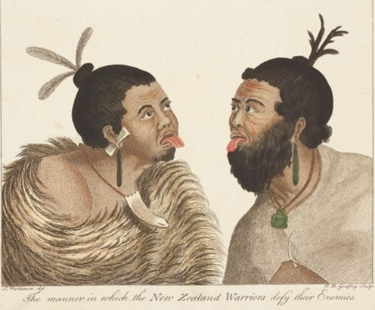
Historical Sydney Cont.
Aboriginal history: The first people to inhabit the area now known as Sydney were Aboriginal Australians who had migrated from northern Australia and before that from southeast Asia.
Flaked pebbles found in Western Sydney's gravel sediments might indicate human occupation from 45,000 to 50,000 years ago, while radiocarbon dating has shown evidence of human activity in the Sydney region from around 15,000 years ago.
Prior to the arrival of the British, there were 4,000 to 8,000 Aboriginal people in the greater Sydney region

Slide 8
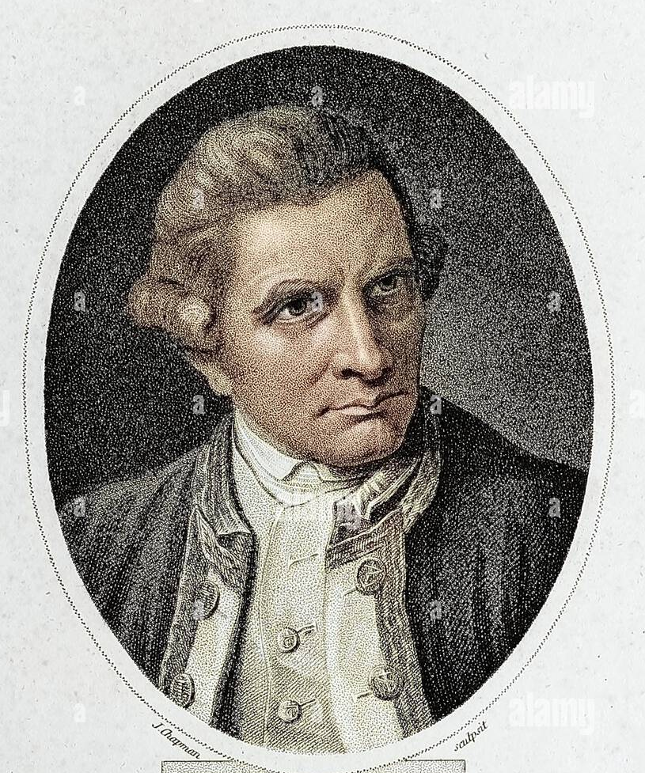
Historical Sydney Cont.
Colonial History
European settlement of Australia began back in 1788, when the colony chose The Rocks region of Sydney as the ideal place to live.
The first meeting between Aboriginal people and British explorers occurred on 29 April 1770 when Lieutenant James Cook landed at Botany Bay (Kamay) and encountered the Gweagal clan. Two Gweagal men opposed the landing party and in the confrontation one of them was shot and wounded.
Cook and his crew stayed at Botany Bay for a week, collecting water, timber, fodder and botanical specimens and exploring the surrounding area. Cook sought to establish relations with the Aboriginal population without success.

Slide 9
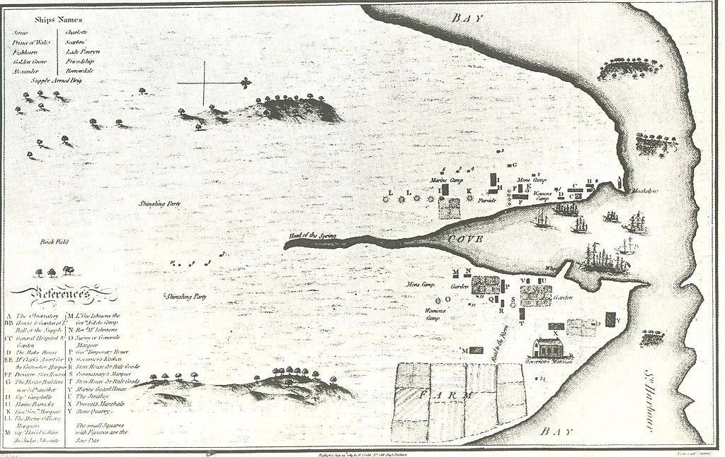
Historical Sydney Cont.
The First Fleet of 11 ships under the command of Captain Arthur Phillip arrived in Botany Bay in January 1788. It consisted of more than a thousand settlers, including 736 convicts.
The fleet soon moved to the more suitable Port Jackson where a settlement was established at Sydney Cove on 26 January 1788.
The colony of New South Wales was formally proclaimed by Governor Phillip on 7 February 1788.
Sydney Cove offered a fresh water supply and
a safe harbor, which Philip described as being,
'with out exception the finest Harbor in the
World [...] Here a Thousand Sail of the Line
may ride in the most perfect Security'.

Slide 10
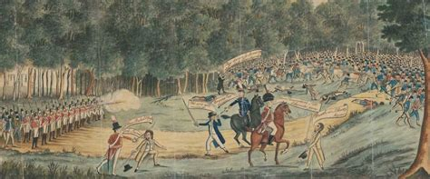
Historical Sydney Cont.
Sydney Town
After the departure of Phillip in December 1792, the colony's military officers began acquiring land and importing consumer goods obtained from visiting ships.
Former convicts also engaged in trade and opened small businesses. Soldiers and former convicts built houses on Crown land, with or without official permission, in what was now commonly called Sydney town.
In 1804, Irish convicts led around 300 rebels in the Castle Hill Rebellion, an attempt to march on Sydney, commandeer a ship, and sail to freedom.
Poorly armed, and with their leader Philip Cunningham captured, the main body of insurgents were routed by about 100 troops and volunteers at Rouse Hill.
At least 39 convicts were killed in the uprising and subsequent executions

Slide 11
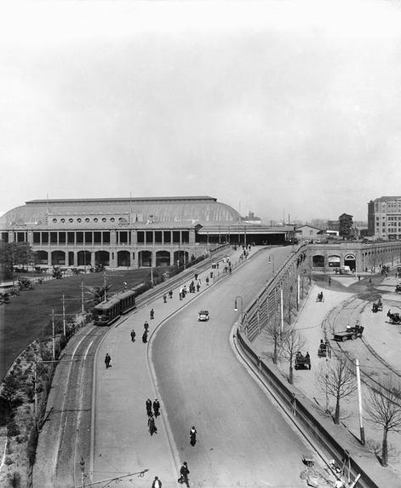
Historical Sydney Cont.
Modern Sydney
At the turn of the 20th century, Sydney was home to more than a million people, and its streets were bustling with commuters, horse-drawn wagons, and trams.
Many tramways, railways, and ferry routes linked the inner-city to an expanding network of suburban suburbs.
Sydney led the nation during rapid growth; the country was transitioning from steam power to electricity. The Commonwealth of Australia was proclaimed on January 1, 1901, making Sydney the capital of New South Wales, no longer a colonial capital.

Slide 12
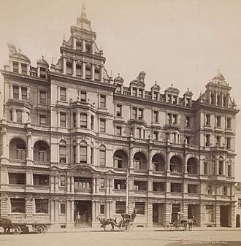
About Sydney
Over the course of the 19th-century Sydney established many of its major cultural institutions. Governor Lachlan Macquarie's vision for Sydney included the construction of grand public buildings and institutions fit for a colonial capital.
Macquarie Street began to take shape as a ceremonial thoroughfare of grand buildings.
He founded the Royal Botanic Gardens and dedicated Hyde Park to the "recreation and amusement of the inhabitants of the town and a field of exercises for the troops".

Slide 13
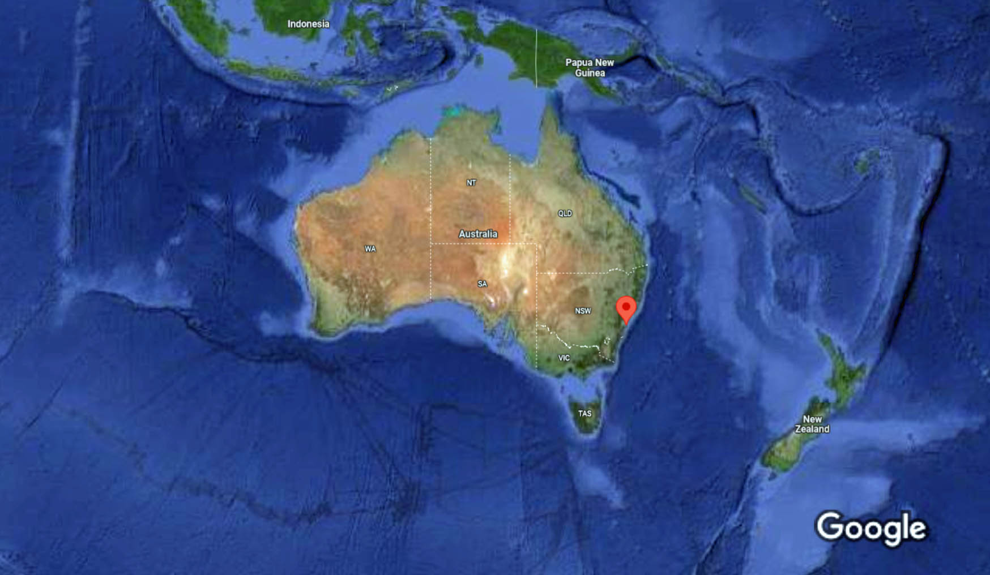
Australia
Sydney

Slide 14
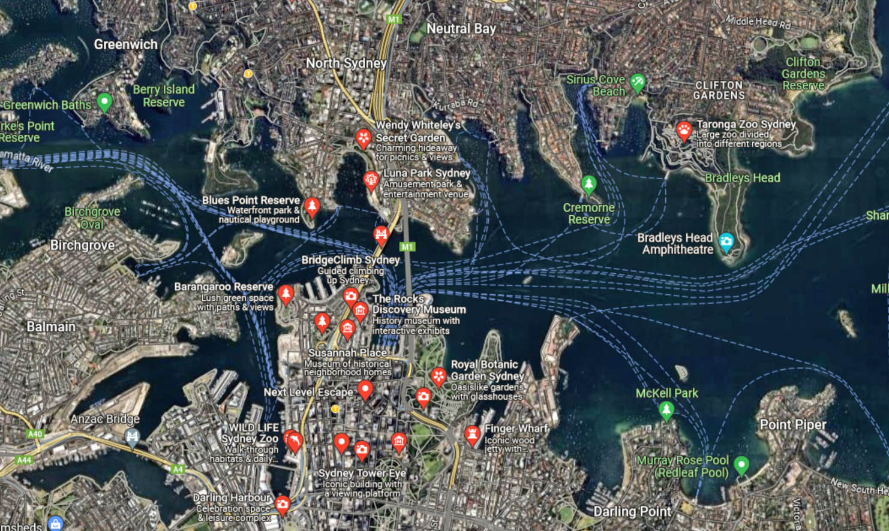
Sydney Area Map
Map of Sydney Harbor

Slide 15
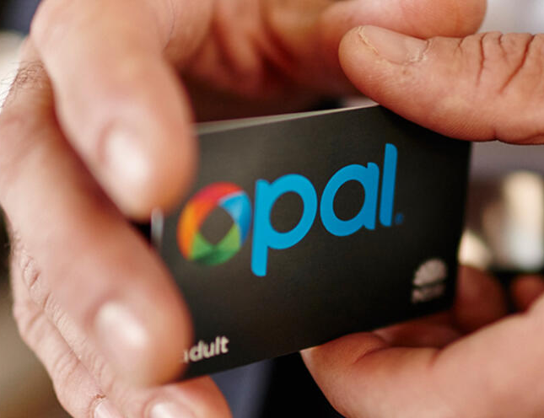
Sydney Rapid Transit
Sydney has one of the most comprehensive and user-friendly public transit systems. Transport for NSW provides a variety of ways to get around the city.
Travel as much as you want on metro, train, bus, ferry and light rail services within the Opal network and you never pay more than:
$18.70 a day (Mondays to Thursdays).
$9.35 on Fridays, Saturdays, Sundays and public holidays.
You can purchase your Opal card from the Customer Service Centre opposite Wharf 5 at Circular Quay on Alfred Street. They can also help with trip planning for all public transport.

Slide 16
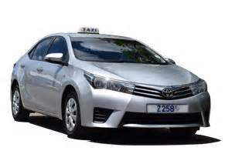
Sydney Taxis
Standard taxis provide a safe and reliable way to explore the city or for transport between the cruise port and various attractions.
Like taxis in most locations the cost is significantly more expensive than other modes of transport.
Rideshare is very popular in Sydney with several operators to choose from including: Uber, Didi, OLA, and Shebah.
Shebah uses women drivers who only pick up women and children.

Slide 17
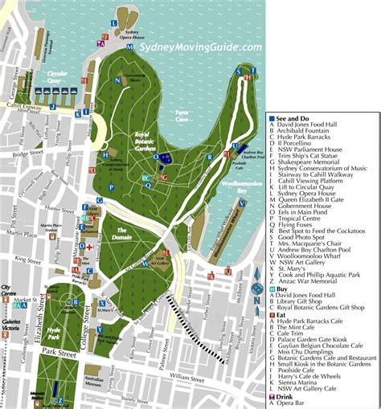
Sydney Walking Tour
Take a Sydney Walking Tour
The Sydney self-guided walking tour loops around the city and highlights the best sightseeing in Sydney for free.
The Free Walking Tour of Sydney is nearly 8 miles long and will take about 4-5 hours to complete. More time will be needed to enter any of the museums and attractions listed along the route.
The route is ideal as a Sydney one-day tour.
With a little planning first, you can make changes to fit you personal taste and physical ability.

Slide 18
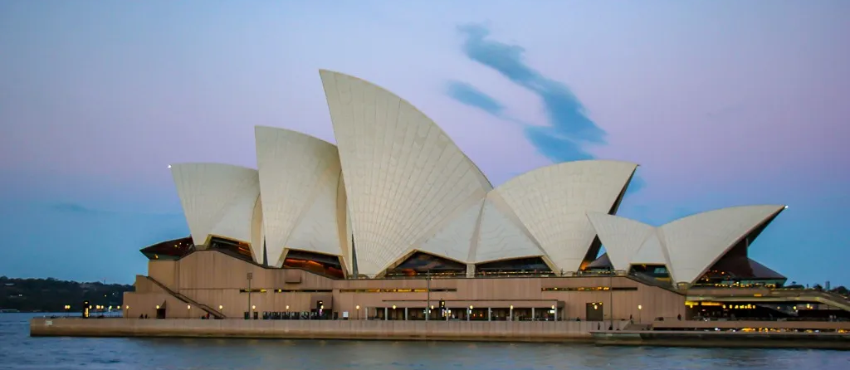
Sydney Opera House
The Opera House is Sydney’s most recognizable landmark. This iconic building took 14 years to complete (1959-1973) and stands today as a UNESCO World Heritage Site.
The massive staircase – nearly 100-meters-wide – leads to the entrance, but we recommend staying on the ground level and completely circling the structure to gain perspective before climbing the stairs.
Two halls of ‘stacked shells’ make up the award-winning structure that features amazing acoustics. The theaters inside
have hosted world-known
musical and theatrical talents.
The facilities can be toured
(for a fee), but it’s free to
walk around the exterior of
the building. Walking along
the west side of the Sydney
Opera House.

Slide 19
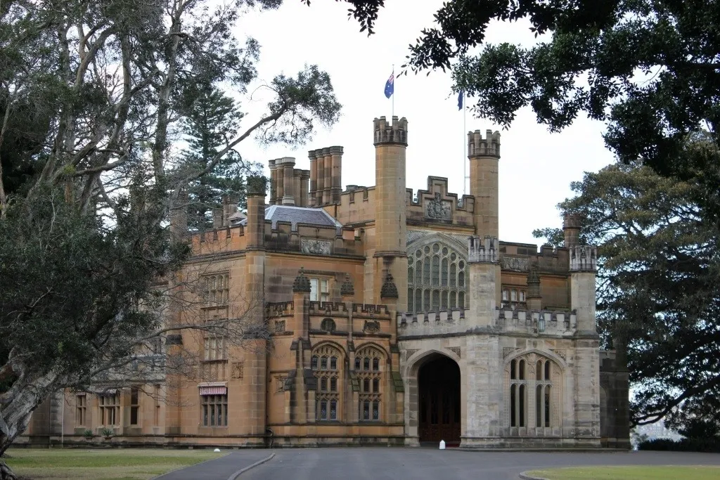
Government House
Built in the Gothic Revival style in the 1840s, the Government House is the vice-regal residence of the New South Wales’ Governor. The grand interior is open to visitors, as is the garden, which provides stunning views of the harbor and Sydney Opera House.
Note: If the Government House is closed for official business, visitors can take in the view from Tarpeian Precinct – a small elevated park between the Government House and the Opera House.

Slide 20
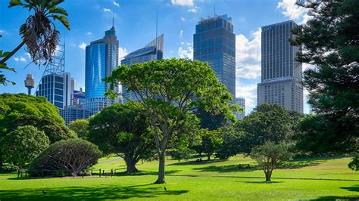
Royal Botanic Gardens
Established in 1816, the Sydney Royal Botanic Gardens feature an array of plant life.
Highlights include the Palace Rose Garden and summer meadow.
Free for visitors to stroll
and admire, the park also
offers a range of programs
and tours.

Slide 21
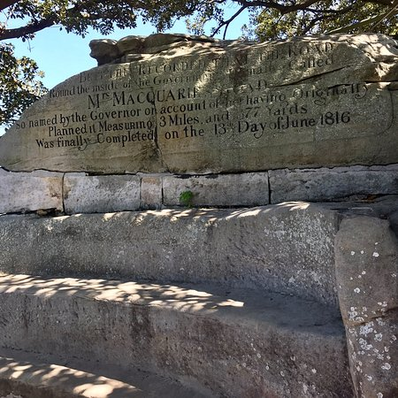
Mrs. Macquarie’s Chair
Hand-carved by convicts in 1810, the stone bench – now known as Mrs. Macquarie’s Chair – was a gift to the wife of the New South Wales governor.
The viewpoint of the harbor – and especially of the Opera House and Bridge

Slide 22
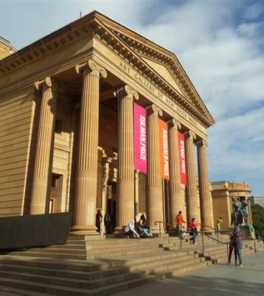
Art Gallery of New South Wales
From its magnificent site on Sydney Harbor, the Art Gallery of New South Wales is one of Australia’s flagship art museums and the state’s leading visual arts institution.
The Art Gallery is one of the finest tourism destinations in Australia and an absolute must-see for an art and cultural experience in Sydney.
Located within beautiful parklands overlooking Sydney Harbor and only a 15-minute walk from the city centre. Admission is free, as are most of the exhibitions and events.
Admission is free

Slide 23
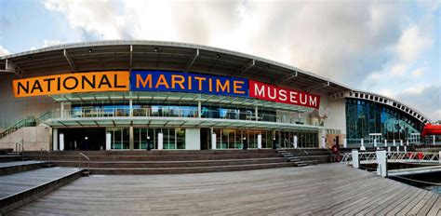
Australian National Maritime Museum
Located at the waterfront of Darling Harbor, the Maritime Museum is a distinctive indoor/outdoor attraction and great entertainment for the whole family.
The museum has one of the largest and most diverse in-water fleets in the world, including the cold war submarine HMAS Onslow, naval destroyer HMAS Vampire, and the stunning replica of Captain Cook's tall ship HMB Endeavour. Explore the danger and drama of military life at sea inside the interactive Action Stations experience that shows the inner workings of the Royal Australian Navy like never before.
The museum also hosts six permanent galleries, and an ever-changing program of temporary exhibitions, ensuring something for everyone.
Adults: $25
Children: 4 -15: $15
Children Under 4 - FREE

Slide 24
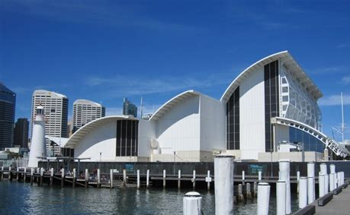
Australian National Maritime Museum
The museum has one of the largest and most diverse in-water fleets in the world, including the cold war submarine HMAS Onslow, naval destroyer HMAS Vampire, and the stunning replica of Captain Cook's tall ship HMB Endeavour. Explore the danger and drama of military life at sea inside the interactive Action Stations experience that shows the inner workings of the Royal Australian Navy like never before.
The museum also hosts six permanent galleries, and an ever-changing program of temporary exhibitions.
See it all Adult | $25
Concession | $20
Child (under 15) | $15
Child (under 4) | FREE

Slide 25
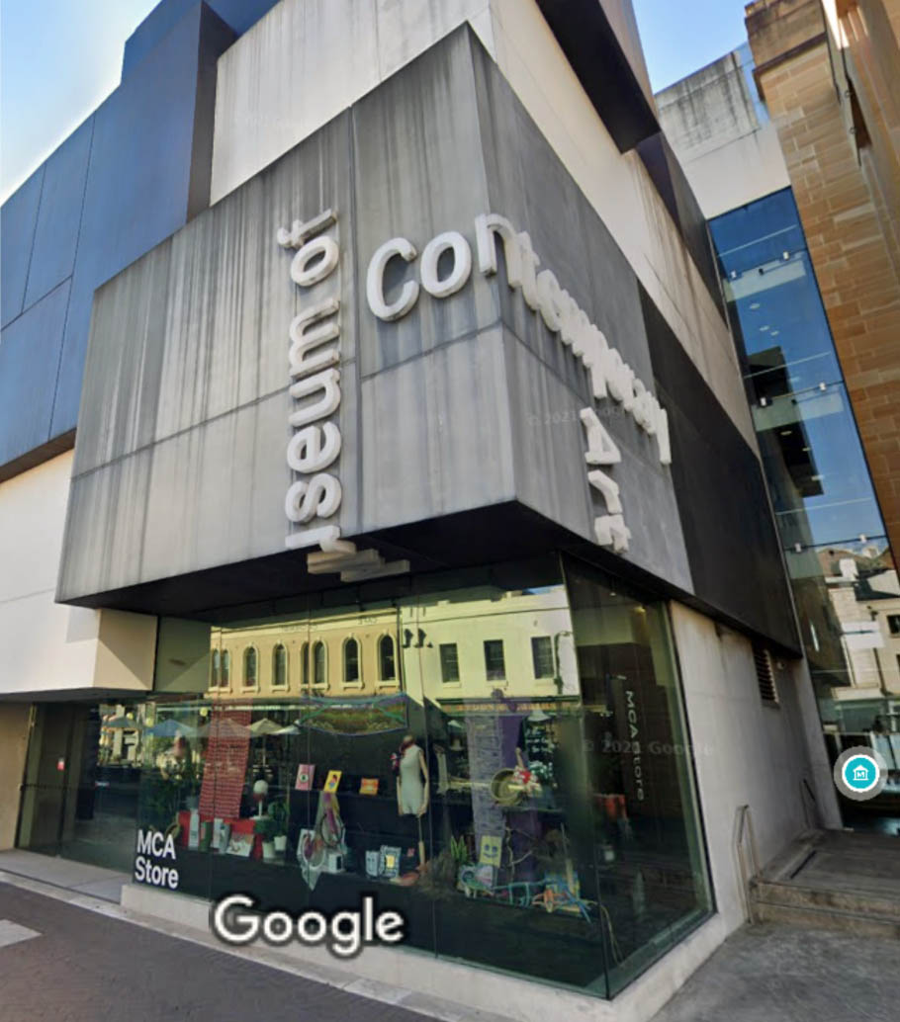
Museum of Contemporary Art Australia
The Museum of Contemporary Art Australia is Australia's leading museum dedicated to exhibiting, interpreting and collecting contemporary art from across Australia and around the world.
Located at Circular Quay, the MCA is housed in the former Maritime Services building, a fine example of late Art Deco architecture.
MCA features more than 4,000 works of Australian artists, including a strong emphasis on works by Aboriginal and Torres Strait Islander artists. In addition to its permanent collection, the museum hosts a continually changing range of modern art exhibitions.

Slide 26
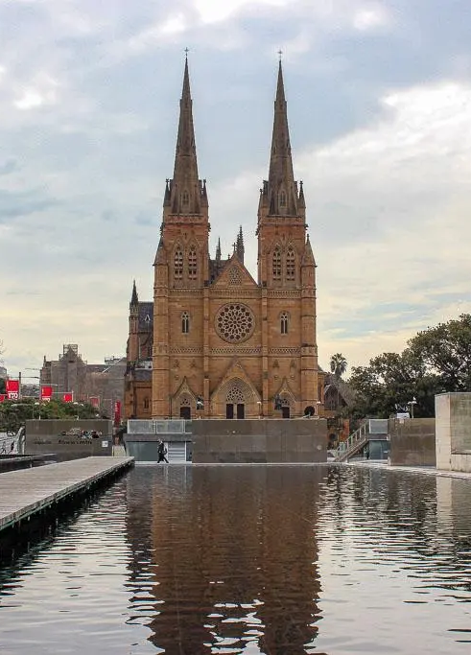
St. Mary’s Cathedral
The grand façade of St. Mary’s Catholic Cathedral in Sydney features two Gothic spires. The towers stand at 245 feet – and make St. Mary’s one of the tallest churches in Australia.
Building commenced in 1868 after previous churches on the site were destroyed by fire. In 2008, Pope Benedict XVI visited St. Mary’s for World Youth Day.

Slide 27
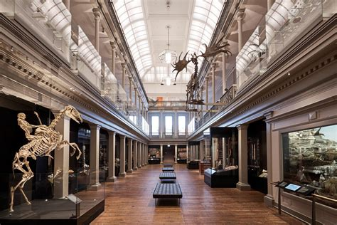
Australian Museum
Australia’s first museum, founded in 1827, with over 21 million scientific specimens and cultural objects in their collections.
Complete with immersive exhibitions and interactive experiences, a visit to the Australian Museum is the perfect day out for families, kids of all ages and the young at heart, plus General Admission is now free!
The Australian Museum is located in the center of Sydney city, opposite Hyde Park, with easy access from public transport and a short walk from other popular attractions in the CBD and surrounds.
General Admission - Free

Slide 28
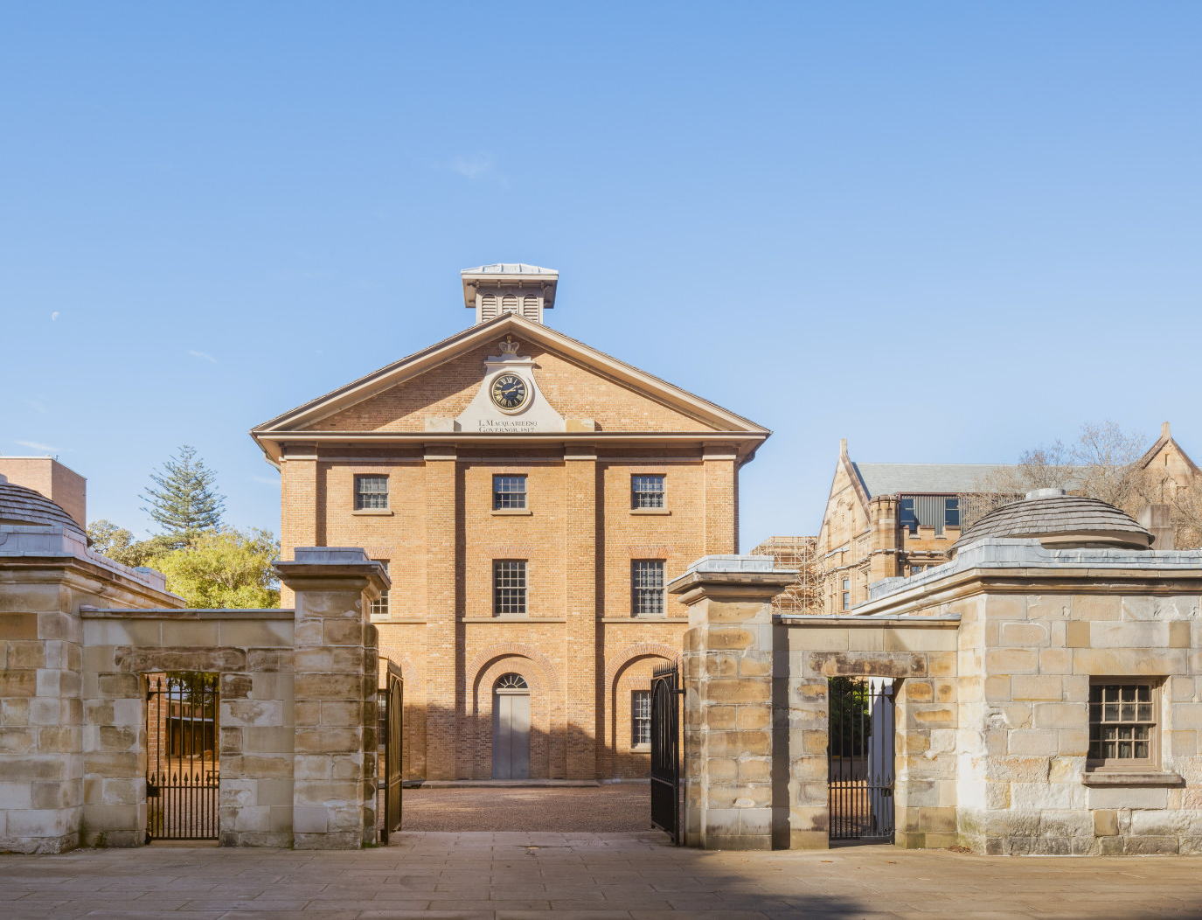
Hyde Park Barracks Museum
Hyde Park Barracks Museum is a World Heritage Listed site in Sydney, and one of its most popular attractions. The museum was once a convict site and played a vital role in the world’s largest system of transporting convicts.
The museum’s design was the brainchild of Francis Greenway, a convict architect who breathed life into the barracks’ structure.
Between 1819 and 1848, the barracks provided housing for 15,000 male convicts who were, at the time, government employees.
Adult | $12
Child (under 15) | $10
Child (under 4) | FREE

Slide 29
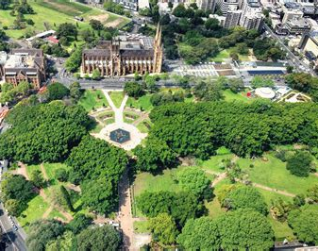
Hyde Park
Since the first European settlers arrived in Australia, the park was used as a recreational space. However, it was in 1810 that Governor Macquarie dedicated the space as Hyde Park (naming it after Hyde Park in London).
The green space has been used as a Cricket Ground, a horse racetrack, an outdoor boxing ring, a rugby field and military exercise grounds.
At the north end of Hyde Park is Archibald Fountain, which celebrates the relationship between France and Australia during World War I.

Slide 30
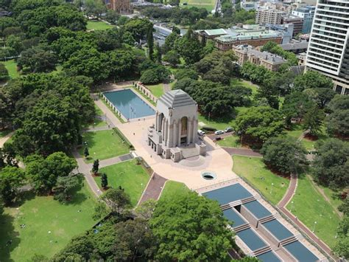
ANZAC War Memorial
At the south end of Hyde Park is Sydney’s ANZAC Memorial.
Opened in 1934 to remember the Australians who fought and died in World War I (the Great War).
The memorial now stands to honor all Australians and New Zealanders who have served in military forces.

Slide 31
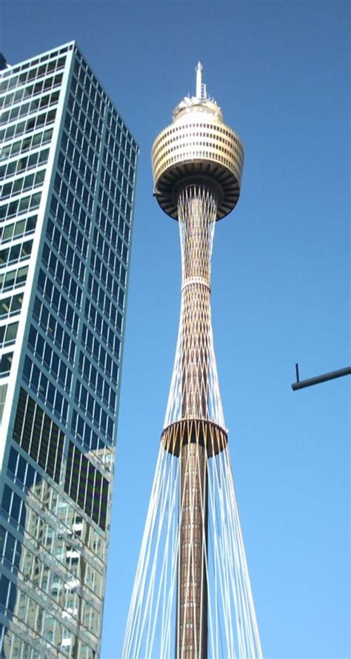
Sydney Tower
A popular tourist attraction since it was completed in 1981, the Sydney Tower stands at 1,014 feet in the center of the city. The tower features dining options, event space and an observation deck, called the Sydney Tower Eye.
Located at 820 feet, the enclosed viewing deck provides 360-degree views of Sydney.
Adult $40
Child (under 15) $30
Child (under 4) FREE

Slide 32
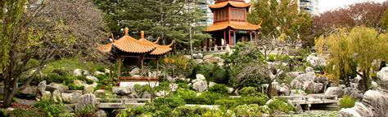
Chinese Garden of Friendship
The Chinese Garden of Friendship is a tranquil retreat in the middle of the city, and one of the best things to do in Sydney.
Located in the southern end of Darling Harbor, nestled between Darling Quarter and Darling Square, the Chinese Garden of Friendship is a collaborative effort between Sister States of NSW and Guangdong of China.
The Chinese Garden of Friendship is a traditional Chinese garden in Sydney’s Central Business District.

Slide 33
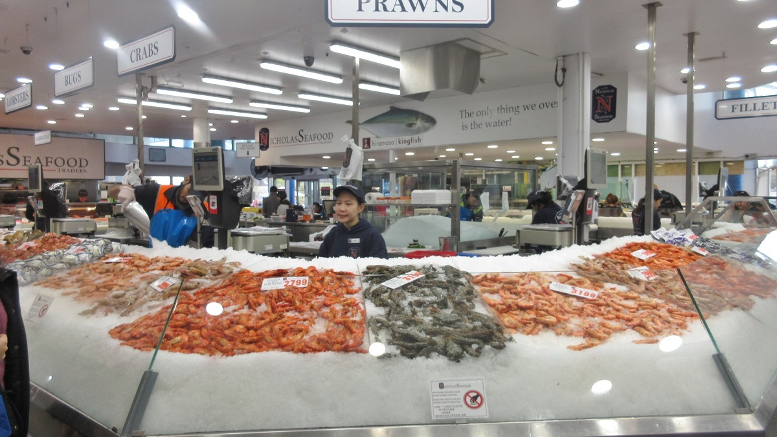
Sydney Fish Market
The Sydney Fish Market takes it up a notch on the sensory overload scale. The pungent scent of gutted fish wafts through the air at every turn – yet, the Sydney Fish Market is actually more civilized than Paddy’s Market.
The market only has a handful of vendors – but a seemingly endless choice of seafood. Fresh caught fish, prawns, oysters and live crabs are appealingly displayed on ice. Less appealing options of salmon fish heads and slimy octopus are also for sale.
The food court stalls sell everything from fried fish to sashimi, which can be eaten inside or under umbrellas on the docks.

Slide 34
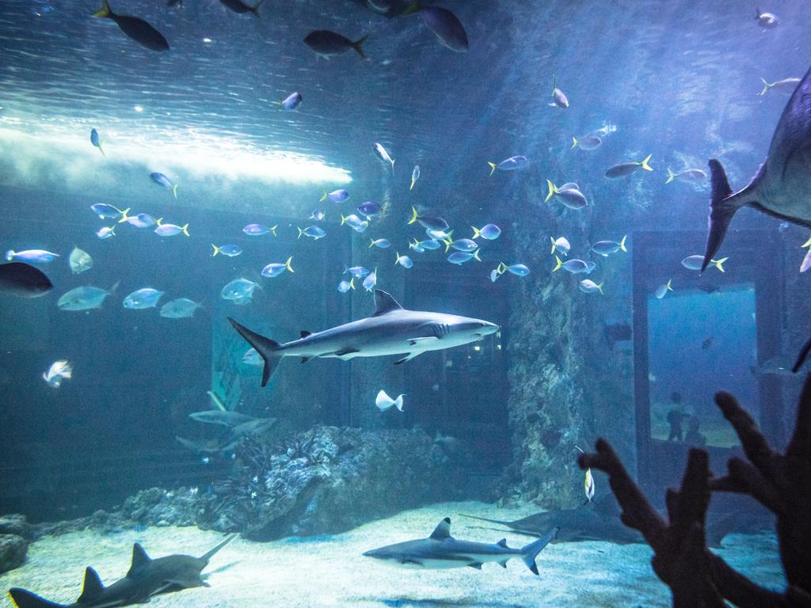
SEA LIFE Sydney Aquarium
SEA LIFE Sydney Aquarium provides a home to more than 13,000 sea creatures.
The aquarium displays are sectioned into themes, including the world’s largest Great Barrier Reef exhibit.
Adult | $53
Child (under 15) | $38
Child (under 4) | FREE

Slide 35
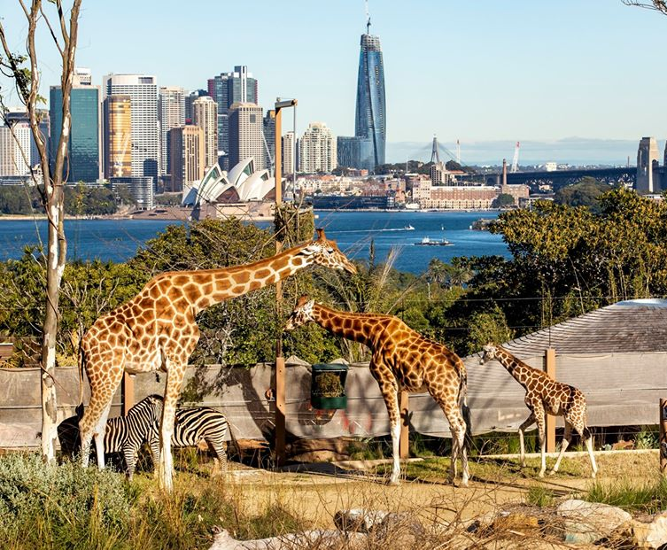
Taronga Zoo
If you are a fan of secrets of the zoo down under, it is filmed at Taronga Zoo.
Take the ferry directly from Circular Quay to Taronga Zoo.
Once there, the leisurely trails and opportunity to see some of Australia's distinct wildlife become apparent, as does the striking view of the Harbor Bridge from the seating at the aerial bird show.
Adult | $45.90
Child (under 15) | $27
Child (under 3) | FREE

Slide 36
Conclusion
Sydney is a beautiful City with a rich history and numerous attractions. Regardless of what you're looking for, Sydney has something for everyone.
I hope this presentation will help when we visit Sydney!

Slide 37
Thanks For Coming
If you have any more questions, please ask.
I will do my best to answer them for you.
Have a great visit to Sydney!

Slide 38
Acknowledgement
My seminars are the result of many years of travel experience combined with many hours of research over the internet.
I would like to acknowledge the many source I have accessed.
These include: Wikipedia.com, Britannica.com, and the
various Museum, Park and Government websites.

