Slide 1
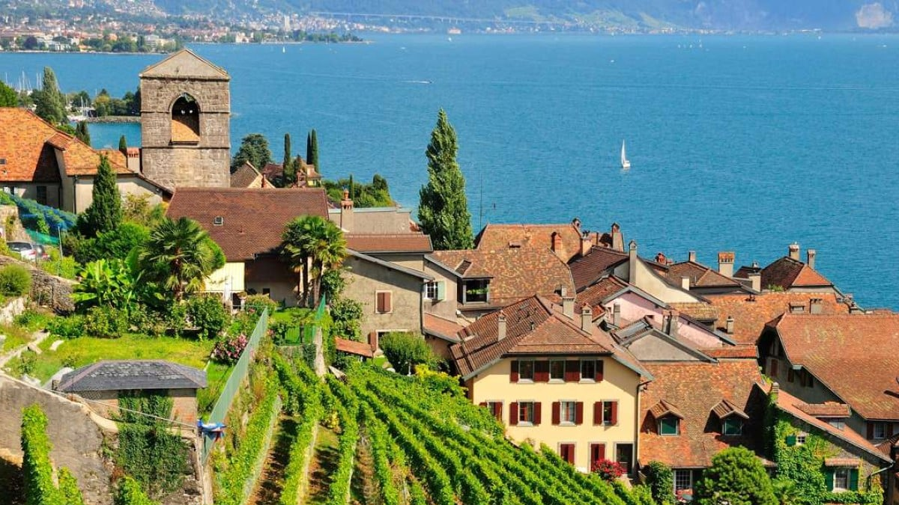
Wine Regions of the World An Introduction to Wine in Switzerland Presented by Marc Silver

Slide 2

An Introduction to Wine in Switzerland
Switzerland might not be the first country that comes to mind when you think of wine, but it’s got a surprisingly rich winemaking history and diverse regions that deserve attention.
Nestled between more famous wine-producing countries like France, Italy, and Germany, Switzerland’s wine culture is unique, with a focus on small-scale, high-quality production.
So, let’s take a journey through the history, regions, and varieties that make Swiss wine special.

Slide 3
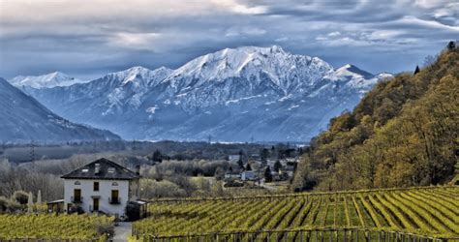
History of Switzerland’s Wine
From Ancient Roots to Modern Glory
The history of wine in Switzerland is a fascinating journey that spans thousands of years. Though small in production compared to some of its neighbors, Switzerland has always maintained a steady, high-quality winemaking tradition.
This section will explore how Swiss wine evolved through the centuries, focusing on key eras of change and development, and why these shifts were significant to the country’s viticultural landscape.

Slide 4
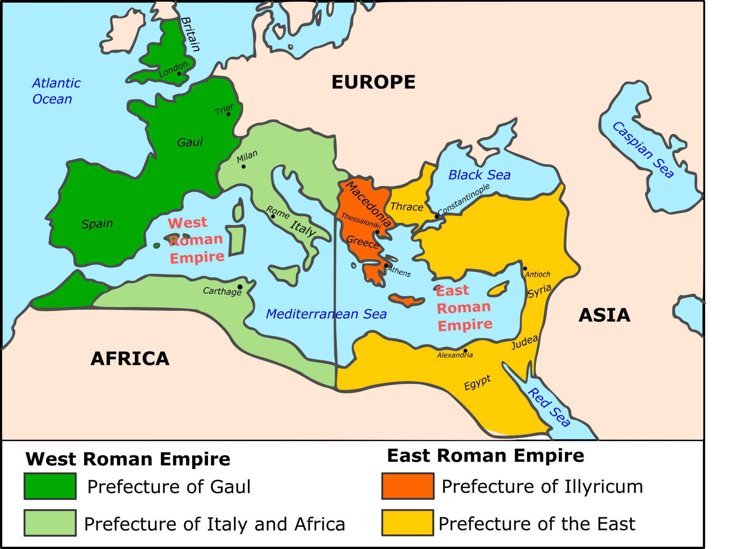
Roman Era (2nd Century B.C. – 5th Century A.D.)
The Birth of Swiss Viticulture
Swiss winemaking began with the Roman Empire’s expansion into the region. The Romans, known for their wine culture, introduced grape cultivation to many parts of Europe, including present-day Switzerland. The first vineyards were planted along the shores of Lake Geneva and the Rhône Valley, where the mild climate and fertile soils provided ideal growing conditions.
Introduction of grapevines and winemaking techniques to Swiss lands.
Establishment of vineyards, particularly near Roman settlements along lakes and rivers.
Significance: This era marks the birth of Swiss wine, laying the groundwork for viticulture in the country. The Romans brought both vines and knowledge, allowing early Swiss communities to cultivate grapes and produce wine, primarily for local consumption.

Slide 5
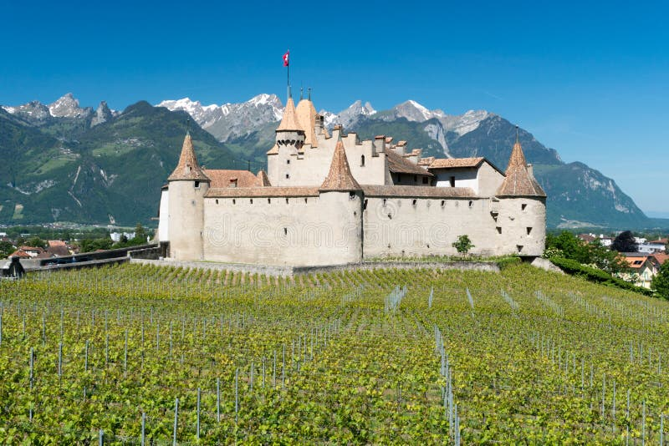
Monastic Influence and the Growth of Viticulture
Middle Ages (5th Century – 15th Century)
With the fall of the Roman Empire, the responsibility for preserving winemaking traditions fell to the Christian monasteries that dotted the European landscape. In Switzerland, monastic orders played a crucial role in not only maintaining but expanding viticulture.
Monasteries became the custodians of vineyards, producing wine for religious ceremonies and daily consumption.
Expansion of vineyards into new regions, particularly around monasteries in Vaud and Valais.
Development of early winemaking techniques and some varietal selections based on regional climate and soil.
Significance: The Middle Ages saw a significant growth in vineyard area and production. Monks were among the most educated members of society and dedicated themselves to improving agricultural practices, including viticulture.

Slide 6
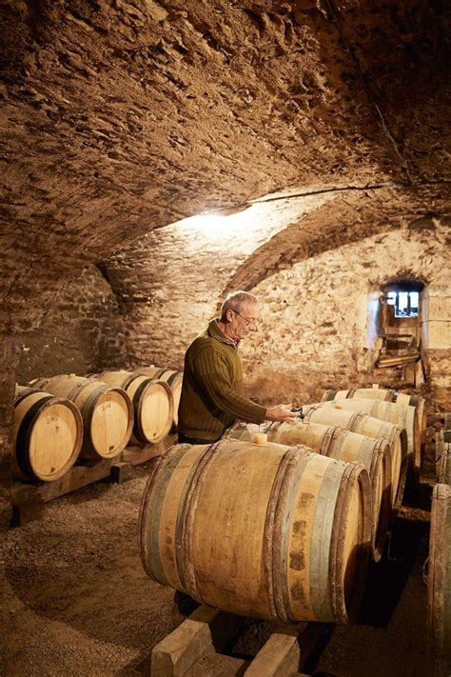
Renaissance to 18th Century
Expanding the Trade and Local Reputation
During the Renaissance, viticulture continued to grow in Switzerland, with vineyards becoming an essential part of the rural economy.
By the 16th and 17th centuries, wine was a staple in the daily diet, and grape growing became a more widespread agricultural activity.
Wealthy landowners began to cultivate more vineyards, recognizing the profitability of wine.
Expansion of vineyards, particularly in the Lake Geneva region (Vaud) and the Rhône Valley (Valais).
Local trade in wine flourished, with Swiss wine being sold in neighboring regions, especially to France and Germany.
Grapes became a valuable agricultural commodity, and viticulture was increasingly tied to the landowning class.
Significance: This era marked a shift from winemaking being solely a monastic or small-scale activity to a more commercially oriented enterprise.

Slide 7
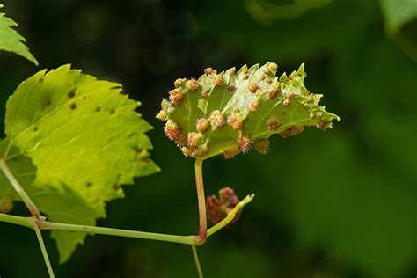
Phylloxera and Industrialization
19th Century: The Crisis and Recovery Era
The 19th century was a period of immense challenge and transformation for Swiss wine. The twin forces of industrialization and the phylloxera epidemic reshaped the landscape dramatically.
Industrialization: As Switzerland urbanized, the domestic demand for wine grew, but this also led to competition from cheaper imported wines, especially from France and Italy.
Phylloxera Epidemic (late 1800s): This tiny insect devastated vineyards across Europe, including Switzerland. The phylloxera pest attacks the roots of grapevines, leading to widespread vineyard destruction.
Replanting with Grafted Vines: In response to phylloxera, Swiss winemakers began replanting their vineyards with vines grafted onto phylloxera-resistant American rootstocks.
Significance: Phylloxera caused the near-collapse of Swiss wine production, but it also sparked innovation. The replanting process gave winemakers an opportunity to experiment with new grapes.

Slide 8
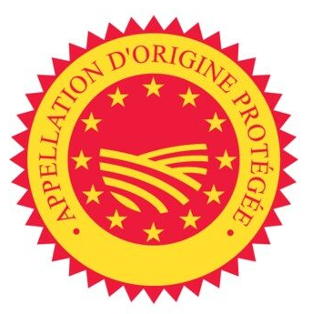
20th Century
Modernization and the Shift to Quality
The 20th century brought sweeping changes to Swiss winemaking, with modernization taking center stage.
During this period, Swiss winemakers adopted new technologies and embraced a more scientific approach to viticulture and vinification.
Introduction of modern viticultural practices, including temperature-controlled fermentation and improvements in vineyard management.
Focus on quality over quantity as Swiss producers moved away from mass production towards artisanal, high-quality wines.
The creation of Appellation d'Origine Contrôlée (AOC) laws in the latter half of the century, mirroring the French model, to protect the origin and quality of Swiss wines.
Growth in the use of indigenous Swiss grape varieties like Chasselas, Cornalin, and Petite Arvine, alongside international varieties such as Pinot Noir and Merlot.
Significance: This period marked a turning point where Swiss wine began to gain recognition for its quality. The adoption of AOC regulations helped to elevate Swiss Wine.

Slide 9

21st Century
A Focus on Sustainability and Global Recognition
In the 21st century, Swiss winemaking is undergoing another transformation, driven by a combination of climate awareness, sustainability, and increasing international recognition.
A growing focus on organic and biodynamic farming practices as Swiss winemakers respond to climate change and a rising demand for sustainable products.
Increasing international recognition as Swiss wines win more awards and export markets expand, though Swiss wine remains largely consumed domestically (only about 2% is exported).
Advances in winemaking technology, including precision agriculture and low-intervention winemaking techniques.
Significance: Today, Switzerland is carving out a niche in the global wine industry as a producer of small-batch, high-quality wines. While Swiss wine still has a relatively low profile outside of Europe, it is gaining recognition among wine enthusiasts and critics for its unique expressions, especially from indigenous varieties and distinctive terroirs. The focus on sustainability and quality ensures that Switzerland’s wine tradition continues to evolve with modern demands.

Slide 10
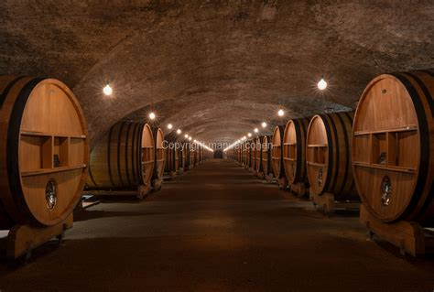
A Tradition of Resilience and Innovation
From its ancient Roman roots to the modern focus on quality and sustainability, Switzerland’s wine history is one of resilience and innovation.
Each era brought its own challenges, from medieval expansion to the devastation of phylloxera, but Swiss winemakers have always adapted and evolved, ensuring that this small country remains an important, though often overlooked, player in the world of wine.
Today, Switzerland’s wines are a testament to the country's unique terroir, forward-thinking practices, and long-standing commitment to excellence.
Chateau de la Chaize

Slide 11
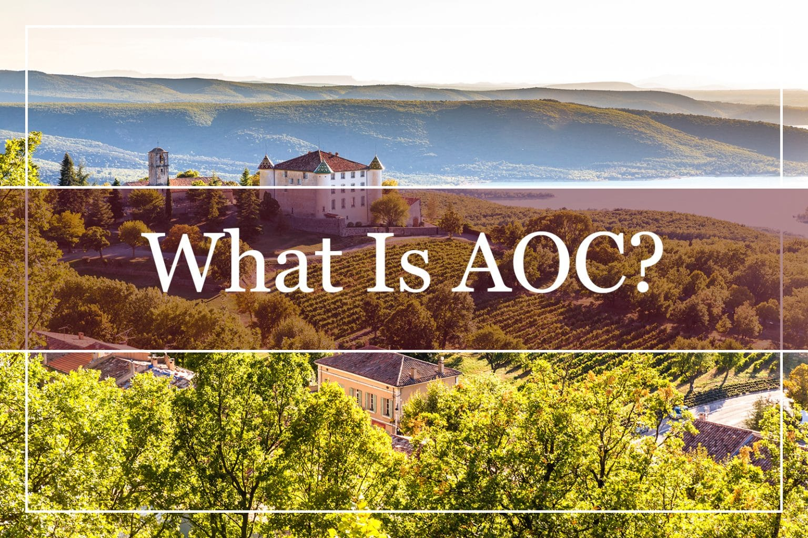
Switzerland’s Wine Classification System
Unlike neighboring France or Germany, Switzerland doesn’t have a wine classification system that’s widely recognized internationally.
Each of the country’s wine-producing cantons has its own regulations, which can make things a bit tricky to navigate.
However, certain regions follow stricter quality controls, and wines labeled with "AOC" (Appellation d’Origine Contrôlée) guarantee that the wine comes from a specific area and meets local production standards.
This system helps protect the reputation of Swiss wines and ensures quality.

Slide 12
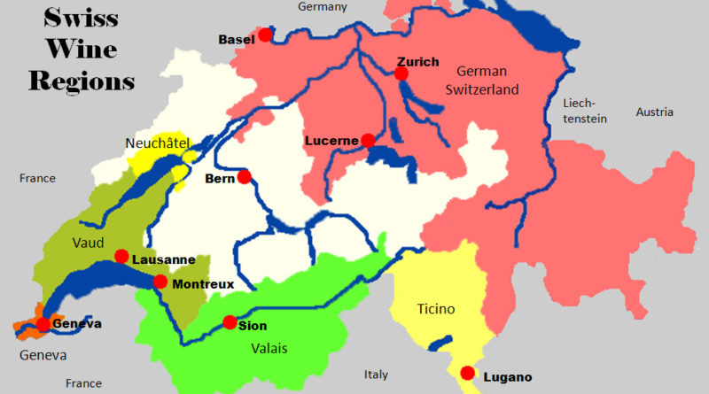
Wine Regions in Switzerland
Despite its small size, Switzerland has an incredibly diverse range of wine regions, each with its own distinct climate and terroir. Here are the most important ones:
Valais
Vaud
Geneva
Ticino
Wines are mainly produced in the west and in the south of Switzerland, in the cantons of Geneva, Neuchâtel, Ticino, Valais and Vaud.
White grape varieties are grown on 43% of the country's vineyard area, and red grape varieties on 57%.

Slide 13
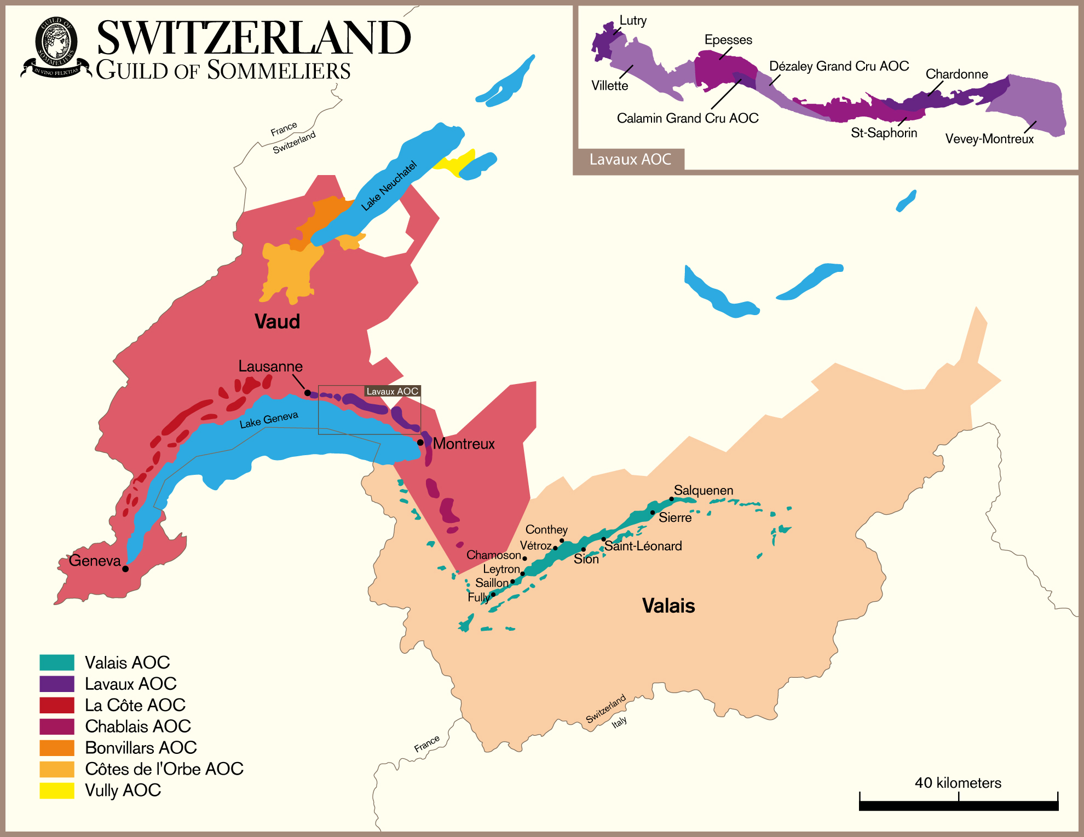
Wine Regions in Switzerland
Valais
The Valais region, stretching along the Rhône River in southern Switzerland, is the country’s largest and most significant wine-producing area. Known for its sun-drenched slopes, Valais benefits from a dry, continental climate, which is ideal for grape growing. The vineyards here cling to steep terraces, and the altitude creates a distinct microclimate.
Terroir: Rocky, mineral-rich soils with great sun exposure.
Grapes: Pinot Noir and Chasselas are the dominant varieties, but the region also produces unique local varietals like Cornalin and Petite Arvine. These indigenous grapes are making a name for themselves with rich, fruity profiles.
Wine Characteristics: Wines from Valais often have great depth and complexity, with white wines tending toward fresh, mineral-driven styles and reds having robust, ripe flavors.

Slide 14
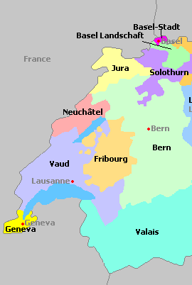
Wine Regions in Switzerland
Vaud
Located on the northern shores of Lake Geneva, Vaud is the second-largest wine region in Switzerland. With stunning vineyard terraces (some UNESCO-listed) overlooking the lake, this region is famous for its elegant, crisp white wines.
Terroir: Limestone and clay soils contribute to the region’s fresh, zesty white wines.
Grapes: Chasselas reigns supreme here, producing delicate, floral whites that are perfect for sipping while taking in the breathtaking lake views.
Wine Characteristics: Light, refreshing, and subtly aromatic, the wines of Vaud are ideal for pairing with fish or simply enjoyed on their own.

Slide 15
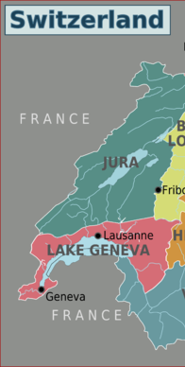
Wine Regions of Switzerland
Geneva
Though one of Switzerland’s smaller regions, Geneva punches above its weight in wine production. The vineyards are spread across gentle hills and valleys, benefiting from the moderating influence of Lake Geneva.
Terroir: Alluvial soils mixed with clay.
Grapes: Pinot Noir, Gamay, and Chasselas dominate, but Geneva is also known for producing some excellent blends using international varieties like Merlot and Cabernet Sauvignon.
Wine Characteristics: Wines from Geneva tend to be softer, with red wines showing a fruit-forward character and whites offering a pleasant minerality.

Slide 16
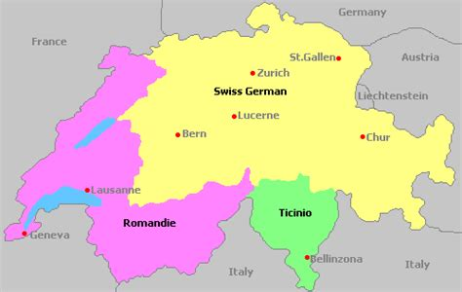
Wine Regions of Switzerland
Ticino
This Italian-speaking region on the southern side of the Alps offers something completely different from other Swiss regions: Merlot. With a Mediterranean climate, Ticino is warmer and wetter than the rest of the country, making it perfect for bold reds.
Terroir: Rich, clay-heavy soils with good drainage.
Grapes: Merlot is the king here, making up about 85% of the region’s production.
Wine Characteristics: Full-bodied and rich, Merlot from Ticino often features ripe black fruit flavors, with a smooth, velvety texture.

Slide 17
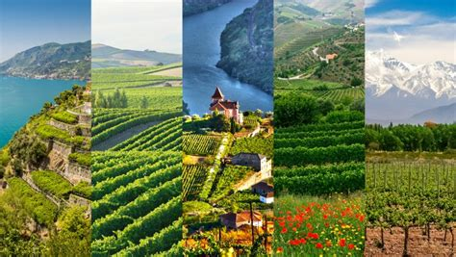
Switzerland’s Unique Terroir
One of the things that makes Swiss wine so distinctive is the terroir. The varied geography, from the alpine slopes to the lakefront vineyards, creates microclimates that give each region a unique flavor profile.
The soils range from limestone and clay to mineral-rich alluvial deposits, all contributing to the complexity of the wines.
The altitude plays a huge role too, especially in areas like Valais, where the vineyards are often terraced on steep slopes, allowing for excellent sun exposure and drainage.

Slide 18

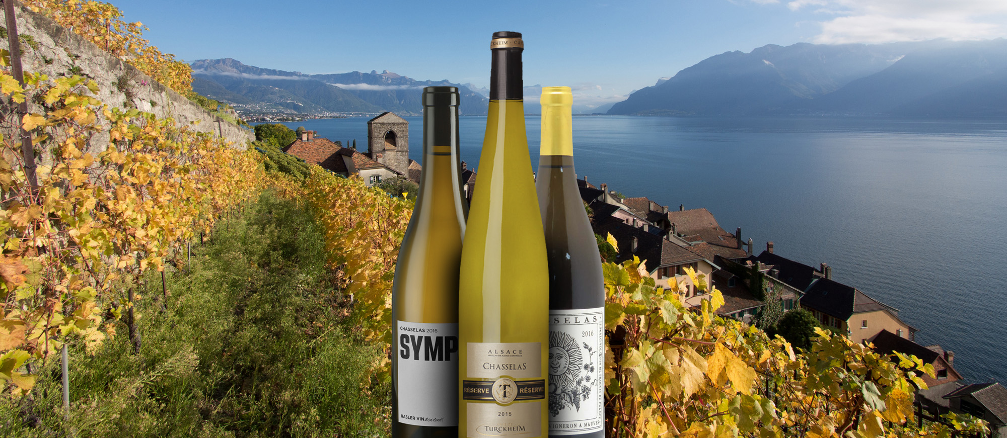
Major Varietals of Switzerland
Though Switzerland grows a wide variety of grapes, there are a few that really stand out:
Chasselas: The signature white grape of Switzerland, especially in Vaud. It produces light, crisp wines with subtle floral notes and a mineral finish. Perfect with fondue or fresh fish.

Slide 19
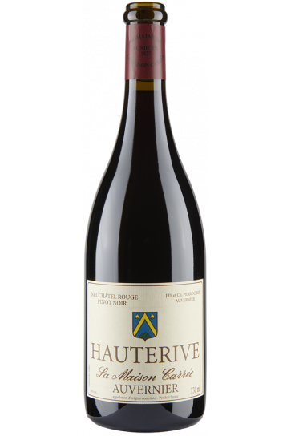
Major Varietals of Switzerland
Pinot Noir thrives in Switzerland, especially in regions like Valais and Vaud.
Its delicate, thin-skinned grapes are sensitive to the Swiss climate, producing elegant, light-bodied wines.
These wines typically feature fresh red fruit notes like cherry and raspberry, balanced by a subtle spiciness.
The versatility of Pinot Noir makes it popular for pairing with a variety of foods, and it’s Switzerland’s most widely cultivated red varietal.

Slide 20
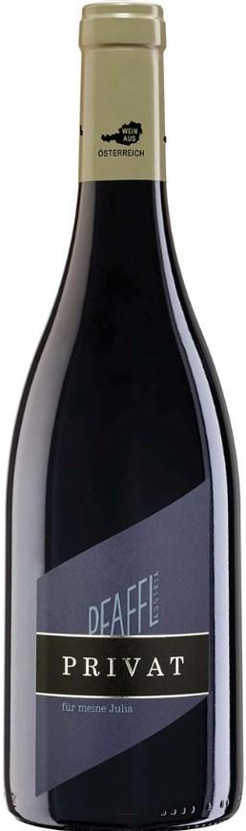
Major Varietals of Switzerland
Merlot thrives in Ticino, Switzerland’s southern wine region.
Here, it produces bold, full-bodied red wines with rich black fruit flavors like plum and blackberry, complemented by smooth tannins.
These wines are versatile—suitable for both aging, where they develop complexity, and for enjoying while young, offering immediate approachability.
Merlot’s dominance in Ticino reflects the region's unique terroir, which is ideal for this classic varietal.

Slide 21
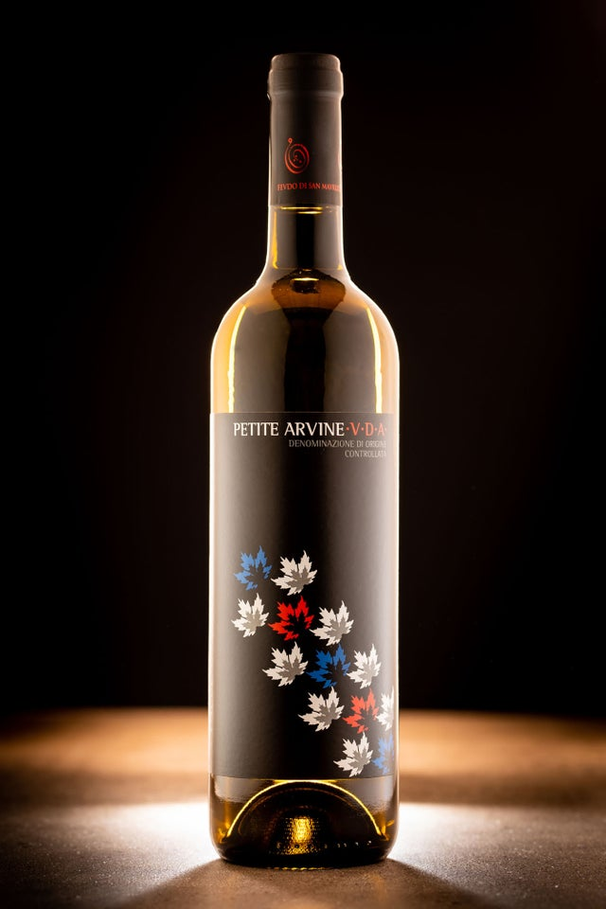
Major Varietals of Switzerland
Petite Arvine, a prized white varietal from Valais, is celebrated for its vibrant acidity and aromatic complexity.
Known for exotic fruit flavors like grapefruit, passionfruit, and sometimes hints of rhubarb or pineapple, it also offers a distinctive saline or mineral finish, a nod to the alpine terroir.
With its refreshing acidity and layered profile, Petite Arvine pairs beautifully with seafood, raclette, or even spicy dishes, and is equally enjoyable as a stand-alone wine due to its bright, expressive character.

Slide 22
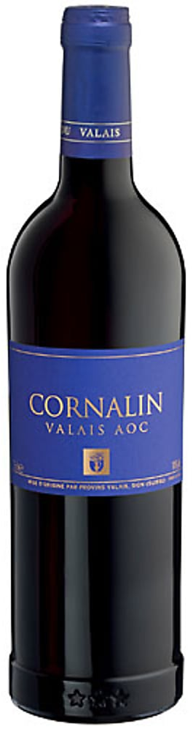
Major Varietals of Switzerland
Cornalin, an ancient red grape native to Valais, is known for producing deep, complex wines with rich flavors.
It often delivers notes of dark fruits like blackberry and black cherry, complemented by a spicy, earthy character that adds depth.
Cornalin wines tend to have a bold structure with firm tannins, yet maintain a certain elegance, making them ideal for aging.
These wines pair beautifully with hearty dishes like game, stews, or roasted meats, showcasing the grape's robust and flavorful profile.

Slide 23
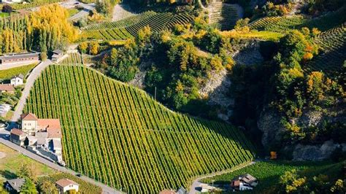
Notable Wineries of Switzerland
Domaines Rouvinez, based in Valais, is renowned for crafting some of the region’s finest wines, particularly with native varietals like Petite Arvine and Cornalin.
Their Petite Arvine is celebrated for its vibrant acidity and exotic fruit notes, while their Cornalin offers deep, bold flavors of dark berries and spices.
The winery, a family-run operation since 1947, combines traditional techniques with modern innovation, focusing on sustainable practices in their terraced vineyards.
Rouvinez's wines reflect the unique terroir of Valais, from its alpine slopes to its mineral-rich soils, making them a benchmark for quality in Swiss winemaking.

Slide 24
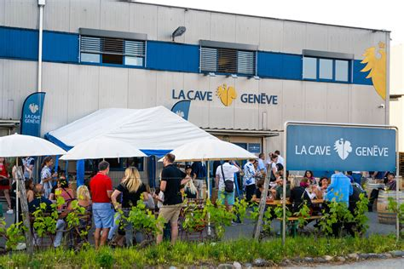
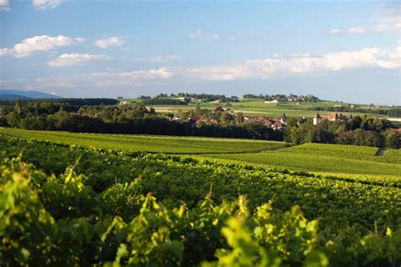
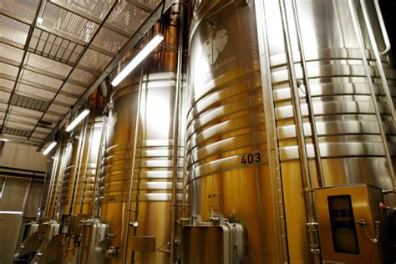
Notable Wineries of Switzerland
Cave de Genève, a renowned cooperative in the Geneva region, is celebrated for producing high-quality wines, particularly Pinot Noir and Gamay.
Their Pinot Noir is known for its elegance and bright red fruit flavors, while their Gamay offers vibrant, juicy profiles with a touch of spice.
Combining the expertise of local growers, Cave de Genève emphasizes sustainability and innovation in winemaking, ensuring their wines consistently reflect the unique terroir and high standards of the Geneva region.

Slide 25
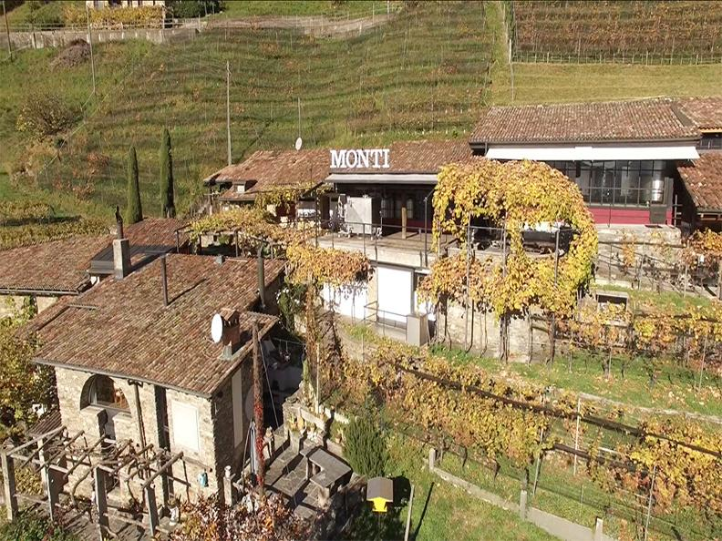
Notable Wineries of Switzerland
Cantina Monti, a small, family-run winery in Ticino, is highly regarded for its exceptional Merlot, often ranked among the best in the region.
Their Merlot showcases rich, full-bodied flavors with dark fruit notes and smooth tannins, embodying Ticino’s unique terroir.
With a focus on craftsmanship and quality, Cantina Monti combines traditional methods with a dedication to sustainable practices, producing wines that capture both the character of the grape and the distinctiveness of this southern Swiss region.

Slide 26
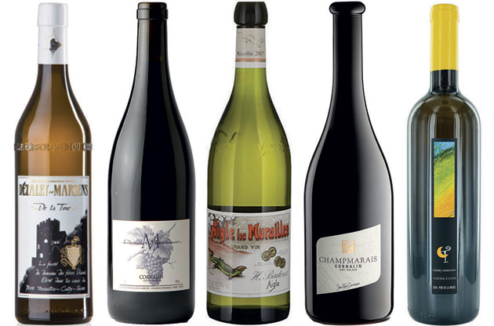
Why Switzerland Wine Deserves Your Attention
You might be thinking, “Why should I care about Swiss wine?” Let me break it down for you:
Great Value: Swiss wines often punch above their price, offering excellent quality without breaking the bank. Who wouldn’t love that?
Unique Flavors: With indigenous grapes and a variety of terroirs, Swiss wines bring flavors that are truly one-of-a-kind.
The Next Big Thing: Swiss wine is gaining recognition fast. Getting in now means you’ll be ahead of the trend—and have bragging rights!

Slide 27
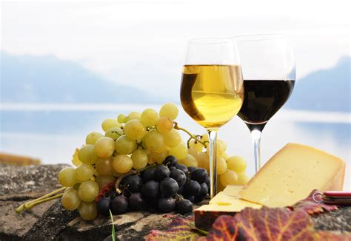
Conclusion
Switzerland’s wine scene is truly a hidden gem, offering a diverse selection that reflects its unique terroirs and centuries of winemaking expertise.
From the sun-drenched vineyards of Valais producing robust reds and crisp whites, to the mineral-driven, elegant wines of Vaud, there’s a bottle for every wine lover.
Whether you're drawn to bold reds, refreshing whites, or something in between, Swiss wine has something to offer.
So, next time you're searching for a new wine experience, explore Switzerland’s offerings—you might just uncover your new favorite bottle.

Slide 28
Acknowledgement
My seminars are the result of many years of experience combined with many hours of research over the internet.
I would like to acknowledge the many source I have accessed.
These include Wine Spectator, Wine Enthusiast, BKWine Magazine, Wine & Spirits Magazine, American Vineyard Magazine, The Grapevine Magazine, Wikipedia.com, Britannica.com, and the various Government websites.

Slide 29
Citations and References
Websites

