Slide 1

Kingstown St. Vincent Presented by Fellow Cruiser Marc Silver

Slide 2
What I Will Cover
My Port Philosophy
Don’t Miss the Ship
Money
About St. Vincent
History of St. Vincent
Transportation
Points of Interest
Places to see or at least consider
A few restaurant recommendations
Conclusion

Slide 3
My Port Philosophy
I have been cruising for over 45 years and have taken over 100 cruises. So, I consider myself an experienced cruiser.
This cruise port talk is based on my many years of experience plus some help from the internet.
If I am on a cruise where the destination city is away from the port, I always recommend taking a ship’s tour.
But when I am in a port with multiple attractions nearby that are easy to see and access - I will do it on my own.
This presentation is for those of you who want to do it on your own.

Slide 4
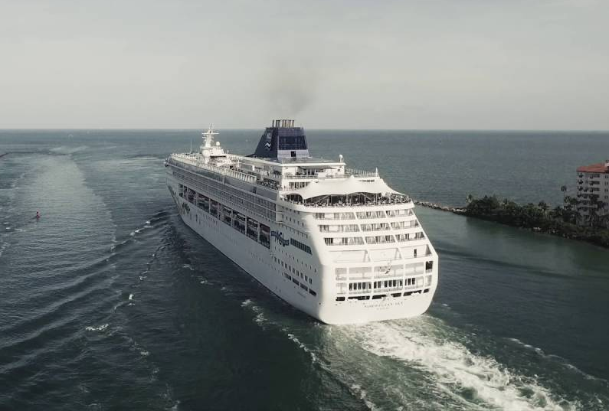
Don’t Miss the Ship
How to Avoid Missing Your Ship
Pay attention to the time. - Ship time and local time are often different.
Put a return-to-ship reminder on your phone.
Choose excursions wisely.
If a ship-sponsored excursion is late returning to port for, the ship will wait for you. If you are on your own???
Be Prepared
Have your Passport, Credit Card and phone numbers for your ship port agent.
What to Do If You Miss the Ship Most cruise lines have port agents stationed in the port area to assist if your ship has left without you. If you’re lucky, when cruisers are late returning to the vessel, the ship's crew will often remove the passengers' essential items -- passports, cell phones and medication -- from the ship to leave with the port agents.
The Port Officials can help you with contacting your ship and making necessary travel arrangements.

Slide 5
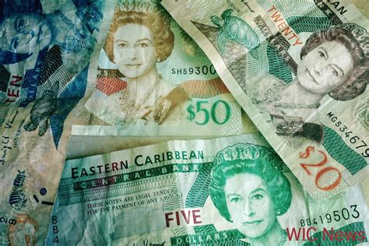
St. Vincent Money
The official currency of St. Vincent is the East Caribbean dollar, with the symbol EC$.
The official Exchange is 1EC$ = $0.36 USD
2.7 XCD to $1 USD

Slide 6
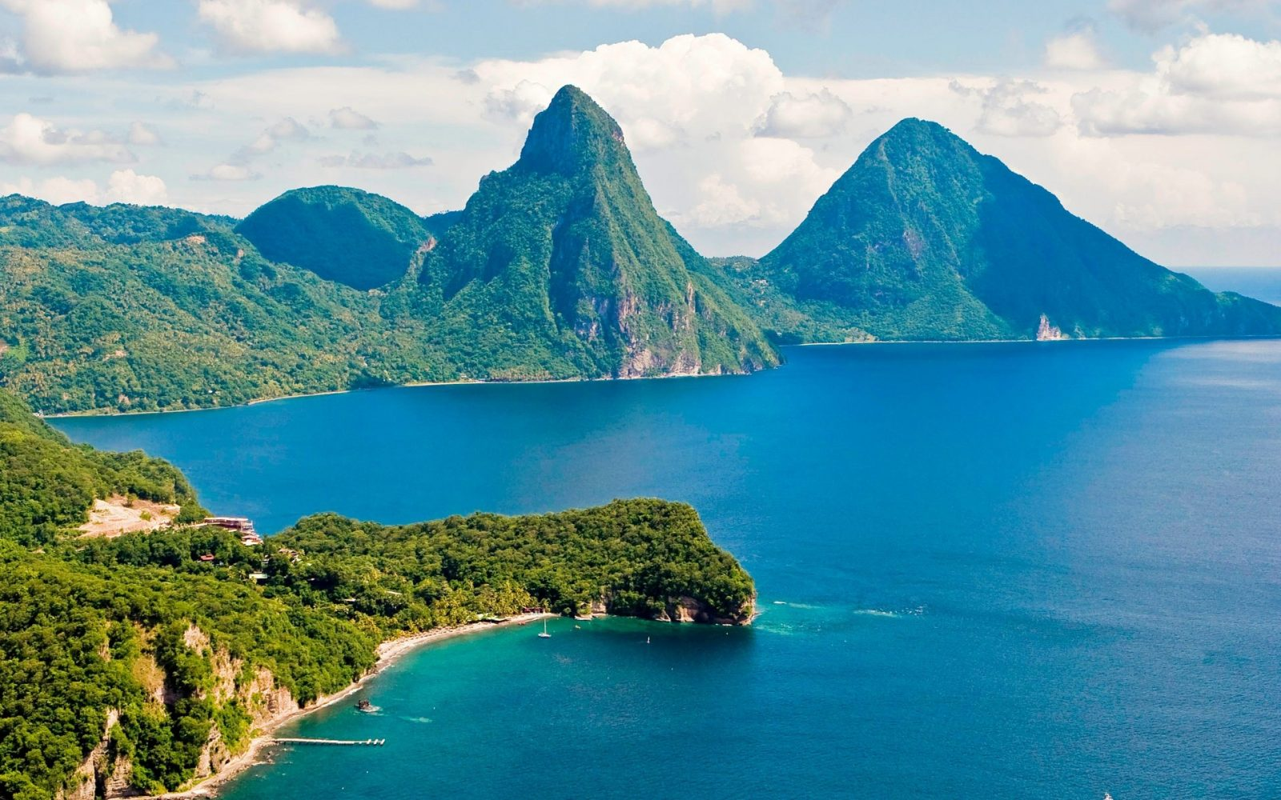
St. Vincent and the Grenadines
St. Vincent and the Grenadines are a group of islands located in the Caribbean Sea and the North Atlantic Ocean. Covering a total area of 389 sq. km (150 sq mi), the island country of St. Vincent and the Grenadines comprises of the larger St. Vincent Island and the northern Grenadine islands, along with some 32 islands and hundreds of islets, all stretching southward (about 48 miles) to Grenada.
St. Vincent is a volcanic island with rugged mountainous terrain covered by lush forests with very little level ground. There are a few very small rivers that flow down the mountain slopes.
Mt. Soufrière is 4,048 ft. tall and located in the northern part of St. Vincent Islands.
The Grenadines include the main islands of Bequia, Balliceau, Canouan, Mayreau, Mustique, Isle D'Quatre, Petit Saint Vincent, and Union Island, and over 600 rocky islets, all low-lying and ringed by coral reefs.

Slide 7
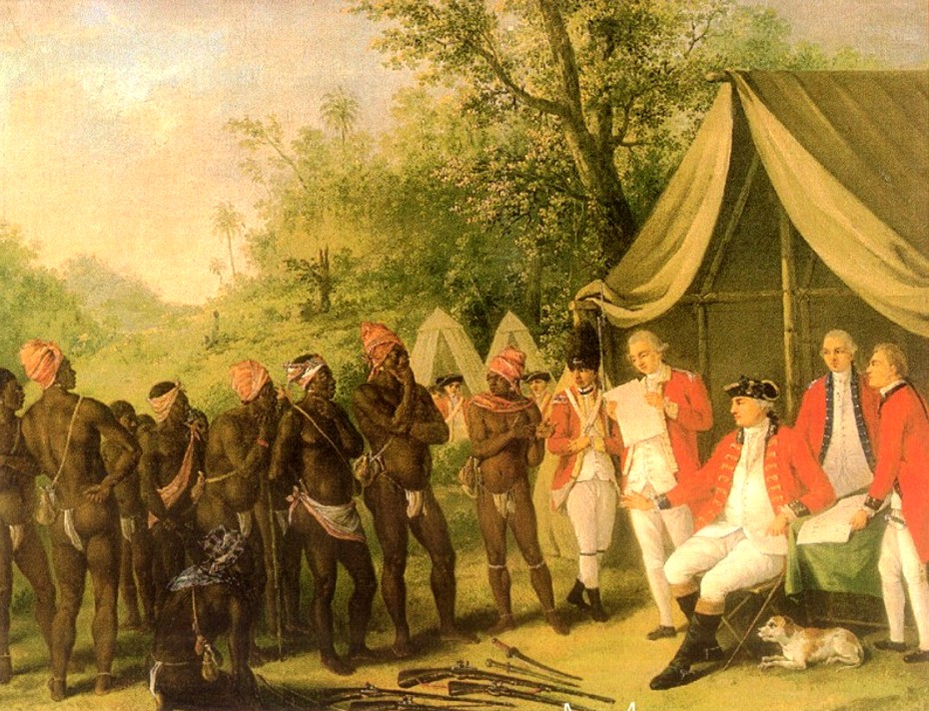
Historical St. Vincent Island
The indigenous inhabitants of the islands were various Amerindian groups. The arrival of Europeans in the early 16th century did not lead to long-term settlement, but in 1717 the French occupied the island of Barrouallie, though the English laid claim on St. Vincent in 1627.
The Treaty of Paris (1763) saw St. Vincent ceded to Britain. Frictions with the British led to the First and Second Carib War in the mid- to late-18th century but the British held on to the islands.
A Crown Colony government was installed in 1877, and universal adult suffrage was granted in 1951. Following a referendum in 1979, St. Vincent and the Grenadines became the last of the Windward Islands to gain independence on 27 October 1979.

Slide 8
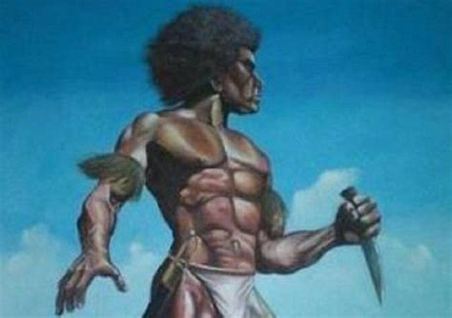
Garifuna St. Vincent Island
In or around 1635, two Spanish ships transporting enslaved Africans from West Africa shipwrecked between St. Vincent and Béquia. Many Africans survived and made it safely to land. They escaped slavery by seeking refuge and becoming allies with the local Carib Indians on the far side of the island.
These Africans willingly learned the language, and customs and started families with the indigenous Carib population.
From this union, an Afro-indigenous culture developed and existed independent of colonial slavery. The British colonial administration used the terms Black Carib and Garifuna to distinguish this new ethnic group from the native population who did not intermarry with Africans.
In 1797 the British deported nearly 5,000 Garifuna to Roatan Island, off of the northern coast of Honduras.

Slide 9
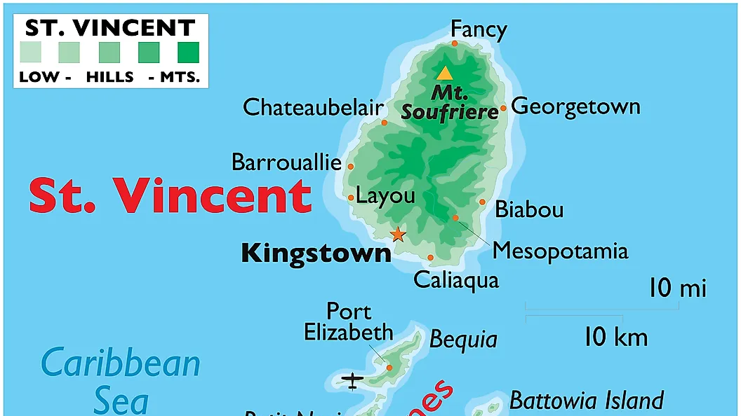

Slide 10
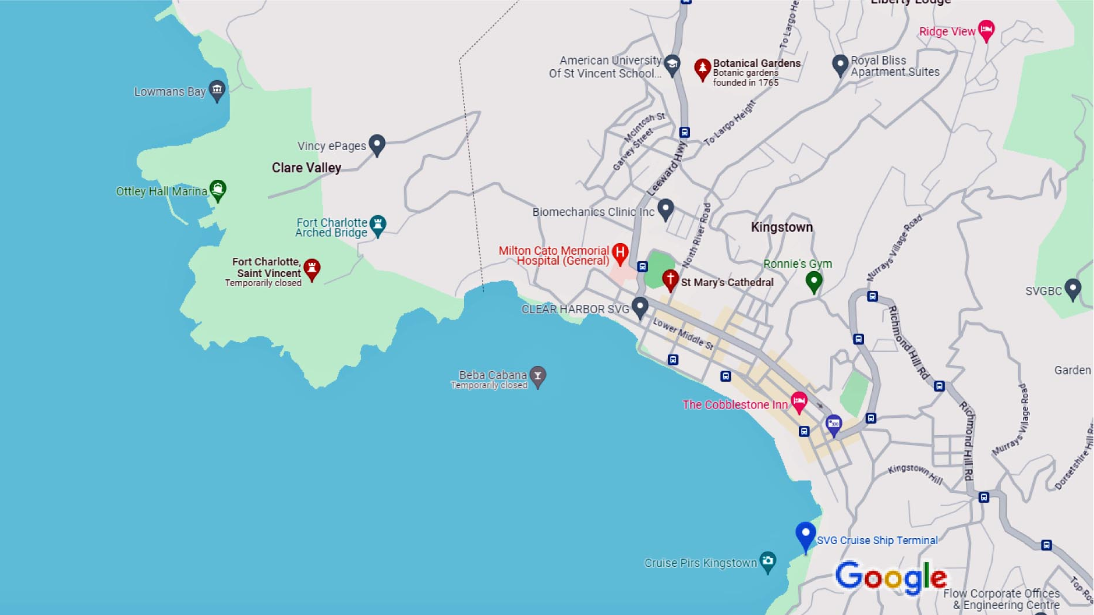
Map of Kingston
Map of Kingston

Slide 11
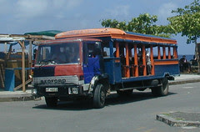
St. Vincent Island Bus System
If you don't want to deal with the hassle of dealing with a Taxi, you'll find buses provide an easy and affordable way of getting around St. Vincent.
However the buses are far from modern or comfortable.
Be prepared for slow speeds and crowded conditions.
Buses depart from New Kingstown Fish Market along the waterfront. Fares cost between EC$1.50 (roughly $0.35) and EC$3 (about $1).

Slide 12

Taxis in St. Vincent
The best way to get around St. Vincent is by taxi. Taxis are plentiful on St. Vincent, and fares are reasonable for short trips. Taking a cab is probably the easiest way to get to go.
Taxis are not metered, so negotiate a price before getting in the vehicle.
Expect the fares to run about $1 per mile.

Slide 13
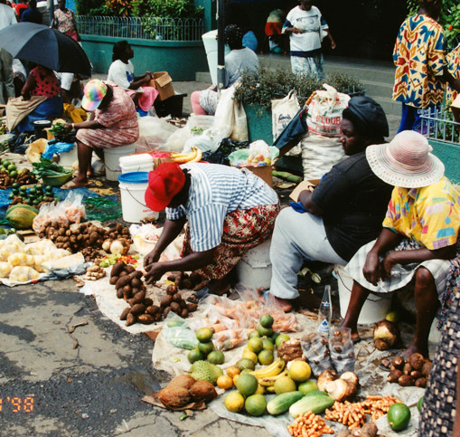
Kingstown Market
This three-story New Central Market in Kingstown is where locals come to shop for fruit and vegetables, and it offers plenty of photo opportunities of vendors selling colorful tropical produce.
If you are looking for something more substantial than a snapshot, spices, and sugar are good gifts for friends who love to cook. There are also stalls selling other sou
venirs, from straw baskets to T-shirts.

Slide 14
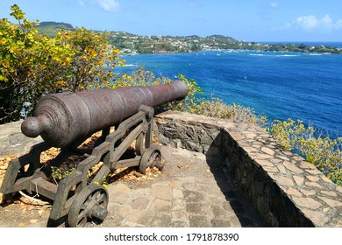
Fort Duvernette
Perched atop a large volcanic rock offshore from Villa, this eerie fort was constructed to defend the town of Calliaqua and affords fantastic 360-degree views of the southern shoreline. 225 steps in the spiral staircase have been carved into the rock; take care as it can be slippery, with small stones often covering the walkway – bring footwear. At the top, 200ft above sea level, you'll find two batteries of cannon and a picnic area.
Fort Duvernette is only accessible by boat.
Ask for Nato in Indian Bay, who will take you over in his little rowboat for EC$27 per visitor.
Alternatively, motorboat operators hang out at the Young Island dock and charge around EC$100 round trip.

Slide 15
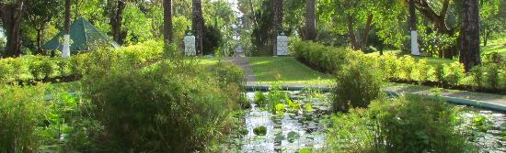
Botanical Gardens
The Botanical Gardens are one of the most important and popular sites in St Vincent. They are the oldest botanical gardens in the Western Hemisphere (established in 1765) and are also an important conservation site (particularly for the St Vincent parrot).
The Botanical Gardens are in Kingstown, a short walk from the town center.

Slide 16
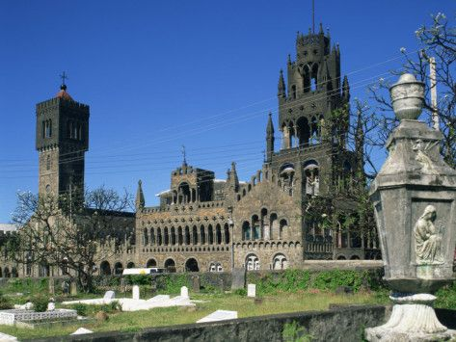
Assumption Cathedral
The Assumption Cathedral, also called Catholic Cathedral of Kingstown or Cathedral of Our Lady of the Assumption, or simply St. Mary's Cathedral, is a Catholic cathedral located in Kingstown. It is the cathedral church of the Diocese of Kingstown.
Its history dates back to the first structure erected in stages from 1823 although the the present building was completed in 1930.
It was declared Co-cathedral of the Diocese of Bridgetown-Kingstown in 1971 and since 1989 is Kingstown's Cathedral.
It stands out for its striking architecture which is a combination of styles (Moorish, Romanesque, Byzantine, Venetian and Flemish) that strongly contrasts with the rest of the city.

Slide 17
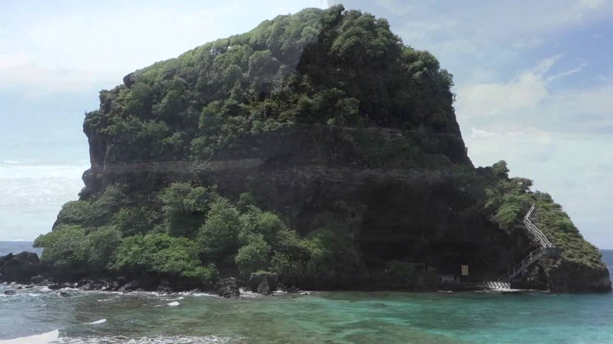
Fort Duvernette
Perched atop a large volcanic rock offshore from Villa, this eerie fort was constructed to defend the town of Calliaqua and affords fantastic 360-degree views of the southern shoreline.
225 steps in the spiral staircase have been carved into the rock; take care as it can be slippery, with small stones often covering the walkway.
At the top, 200ft above sea level, are two batteries of cannon and a picnic area.
Fort Duvernette is only accessible by boat. Ask for Nato in Indian Bay, who will take you over in his little rowboat for EC$27 per visitor.
Alternatively, motorboat operators hang out at the Young Island dock and charge around EC$100 round trip.

Slide 18
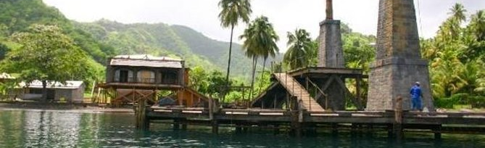
Wallabou Heritage Park
Wallilabou Heritage Park is a lovely, peaceful place with a picnic spot, restaurant, pool, and small waterfall. It sits on the Wallilabou River on the Leeward coast of St. Vincent, near Wallilabou Bay and the site of the film Pirates of the Caribbean.
Large Samaan trees cover the pool and its adjacent areas, creating a relatively cool micro-climate for the core area of the park. These and other plants create a habitat for several species of birds.
The two streams flowing from the waterfall pass through a hole in the stone wall from the original plantation.
Admission Fees: $5 Eca

Slide 19
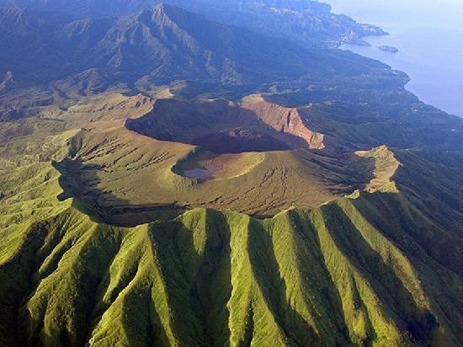
La Soufriere Volcano
Soufrière Saint Vincent is an active volcano on the Caribbean island of Saint Vincent in Saint Vincent and the Grenadines. It is the highest peak in Saint Vincent and has had eight recorded eruptions since 1718.
It’s been 42 years since La Soufrière volcano (French for sulfur outlet) erupted. The 4,094-foot stratovolcano is now making up for lost time, blasting ash and debris miles into the air and neighboring islands.
Increased seismic activity was detected in December 2020, and an effusive eruption began to form a new lava dome inside the summit crater on 27 December.
If you can arrange to see it even from afar it’s worth the trip.

Slide 20
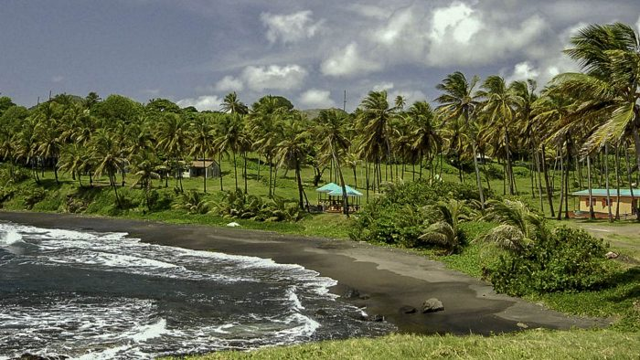
Rawacou Recreational Park
Rawacou Recreation Park is a major beach recreation site that features two beaches separated by a rocky headland with a man-made pool. Coconut trees and sea grapes provide a distinct tropical look and feel to the beach, while dune vegetation helps to maintain the balance and resilience of the beach. It is an exposed beach, well known for strong currents.
Facilities: Parking, food and drink kiosks, gazebos, washrooms, change rooms, fire pits, a volleyball court, and a welcome booth and office.
Safety: Sea bathing is not encouraged - visitors to this site are asked to use the man-made pool.
Fees: $5 EC
Distance from Kingstown: 8.5 miles - about 25 minutes drive.

Slide 21
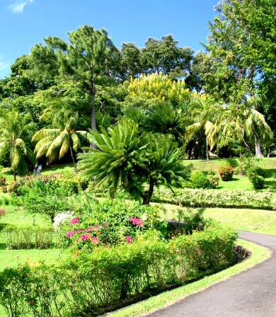
Montreal Gardens
Tucked away at the end of a rough road at the top of the valley above Mesopotamia is St. Vincent's other botanical garden.
Some believe it is superior to its more famous Kingstown counterparts.
Surrounded by craggy mountains and rolling hills, the setting is spectacular and the gardens themselves are a deliciously lush and colorful affair awash with birdsong.

Slide 22
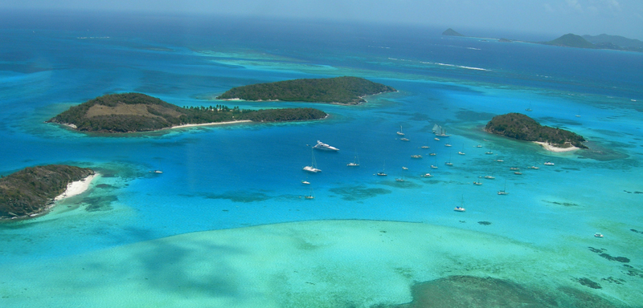
Tobago Keys
The Tobago Cays Marine Park, houses a series of globally significant habitats including coral reefs, sea turtle nesting sites and feeding areas, and small systems of mangroves.
The marine portion of the park surrounds five uninhabited cays, the populated island of Mayreau, and three islets. The four-kilometer-long Horseshoe Reef, the longest of the four main reef systems in the TCMP, encloses four of the cays with the fifth cay lying just outside the reef to the east.
The Tobago Cays are known as the “Jewel in the Crown” of the Southern Grenadines and are of significant economic, cultural, social, and environmental value to St. Vincent and the Grenadines.
The Reef provides a home to a wide variety of animals and plants that thrive on the Cays and in the protected waters. The Caribbean version of the Great Barrier Reef.
Local Tours are around US$ 130 pp

Slide 23
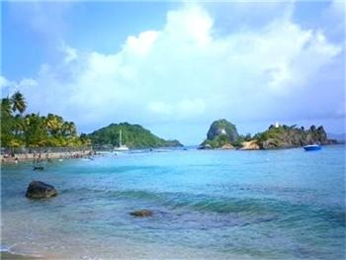
Indian Bay Beach
Indian Bay Beach is a popular white sand beach on the south coast of St Vincent. It is 5.5 km or 3.4 miles from the capital Kingstown.
The beach is within walking distance of the main windward highway and is accessible using public transportation.
Facilities: Restroom, Shower & Gazebo
Park Fee: EC$2.00

Slide 24
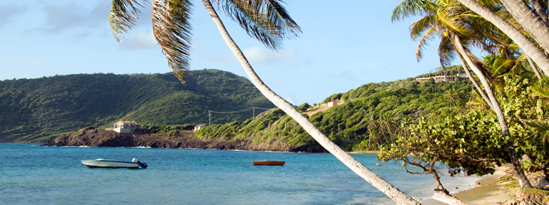
Breakers Beach
About 6 miles SE of the pier is Breakers Beach.
You can take the bus from Kingstown get off at The Magnolia Spa and walk down the road toward the beach.

Slide 25
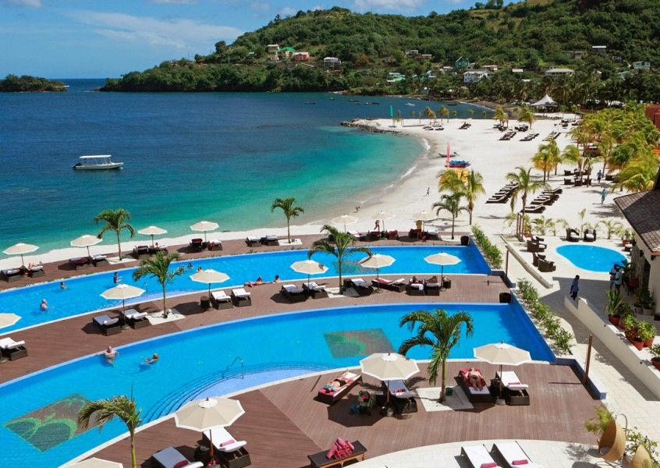
Buccament Bay
Buccament Bay Resort offers an all-inclusive day pass that includes, food and drinks at five restaurants and bars on the property.
They also have some out-of-the-ordinary activities, including rugby, an all-weather soccer pitch, and cricket.
There are three pools and an expansive stretch of beach keeps the resort gloriously crowd-free.
Eight-hour passes cost $150 for adults and $75 for children.

Slide 26
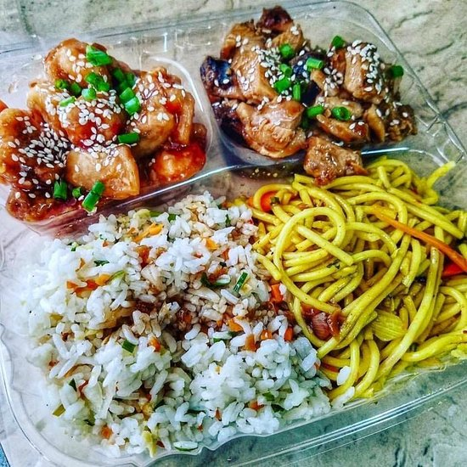
Restaurants in Kingston
St. Vincent has many excellent restaurants. Many of us on the ship are foodies, so naturally, we’re always on the hunt to eat at the most exclusive spots anytime we travel.
Here are a few of the best restaurants to consider in Kingston.
Basil's Ocean Side Restaurant $$ - $$$ Halifax Street, Kingstown
Veejays $ Caribbean, Bar, Vegetarian, Bay Street, Kingstown
Mangoz Restaurant & Bar $$ - $$$ Mexican, Indian, Caribbean
Villa 784, Calliaqua VC0274 St. Vincent
Shells Fish Joint $ Caribbean, Seafood, Windward Highway, Calliaqua
The Cobblestone Inn $$ - $$$ Caribbean, Bar, Vegetarian, Bay St, Kingstown
Melting Pot $ American, Caribbean, Seafood, Cruise Ship Terminal, Kingstown
For those of you who just like good food, you can’t go wrong just about anywhere you go in St. Vincent.
GOOD EATING

Slide 27
Conclusion
St. Vincent is a beautiful City with a rich history and numerous attractions. Whether you're looking for stunning beaches, historic sites, or unique attractions, St. Vincent has something for everyone.
I hope this presentation will help when we visit St. Vincent!

Slide 28
Thanks For Coming
If you have any more questions, please ask.
I will do my best to answer them for you.
Have a great visit in St. Vincent!

