Slide 1

St. Johns, Newfoundland, Canada
Presented by
Marc Silver

Slide 2
What I Will Cover
My Port Philosophy
Don’t Miss the Ship
Money
Exchanging Money
A Brief History of St. John
Maps
Transportation
Top Attractions & Points of Interest
Local Cuisine & Dining Options
Important Tips & Practical Advice
Conclusion

Slide 3
My Port Philosophy
I have been cruising for over 46 years and have taken over 100 cruises.
So, I consider myself an experienced cruiser.
The information I will present is based on those many years of
experience.
When I am on a cruise where the city, I want to visit is not the port city,
I always recommend taking a ship’s tour.
But when I am in a port with multiple attractions nearby and easy to see
on my own -
I will do it on my own.
This presentation is not like that.

Slide 4

Don’t Miss the Ship
How to Avoid Missing Your Ship
Pay attention to the time. - Ship time and local time are often
different.
Put a return-to-ship reminder on your phone.
Choose excursions wisely.
If a ship-sponsored excursion is late returning to port, the ship will
wait for you. If you are on your own???
Be Prepared
Have your Passport, Credit Card, and phone numbers for your ship
port agent.
What to Do If You Miss the Ship
Most cruise lines have port agents stationed in the port area to assist if your ship has left without you. If your are lucky, when cruisers are late returning to the vessel, the ship’s crew will often remove the passengers’ essential items – passports, cell phones, and medication -- from the ship to leave with the port agents.
The Port Officials can help you with contacting your ship
and making necessary travel arrangements.

Slide 5

Money
Canada uses the Canadian dollar as its official
currency.
The exchange rate between the U.S. Dollar (USD)
and the Canadian Dollar is about:
1 USD = 1.37 CAD
This means U.S. travelers should anticipate slightly
lower prices in terms of conversion.
When exchanging money, it’s best to avoid doing so at the port exchange kiosks, as they tend to have higher fees and less favorable rates.
Instead, use your credit and debit cards which are widely accepted everywhere.
Having some cash on hand is always a good idea for smaller purchases or tips.

Slide 6
Exchanging Money
When exchanging money, it’s best to avoid doing
so at the port exchange kiosks, as they tend to
have higher fees and less favorable rates.
Instead, consider using ATMs to withdraw Euros
directly, as they often offer better rates.
Additionally, credit and debit cards are widely accepted throughout Italy, though having some cash on hand is always a good idea for smaller purchases.

Slide 7
A Brief History of St. John
St. John’s is one of the oldest European-established settlements in North America. Its history goes back more than 500 years, tied directly to fishing, the North Atlantic, and strategic military importance.
The harbor is deep, narrow, and well protected, which made it ideal for fishing fleets and naval defense. Because of that, St. John’s was fought over repeatedly by British, French, and Dutch forces.
Signal Hill, overlooking the harbor, played a key role in defending the city. It is also where Guglielmo Marconi received the first transatlantic wireless signal in 1901.
Today, St. John’s blends that rugged maritime past with a lively music scene, colorful row houses, and a strong local identity you will notice almost immediately.

Slide 8
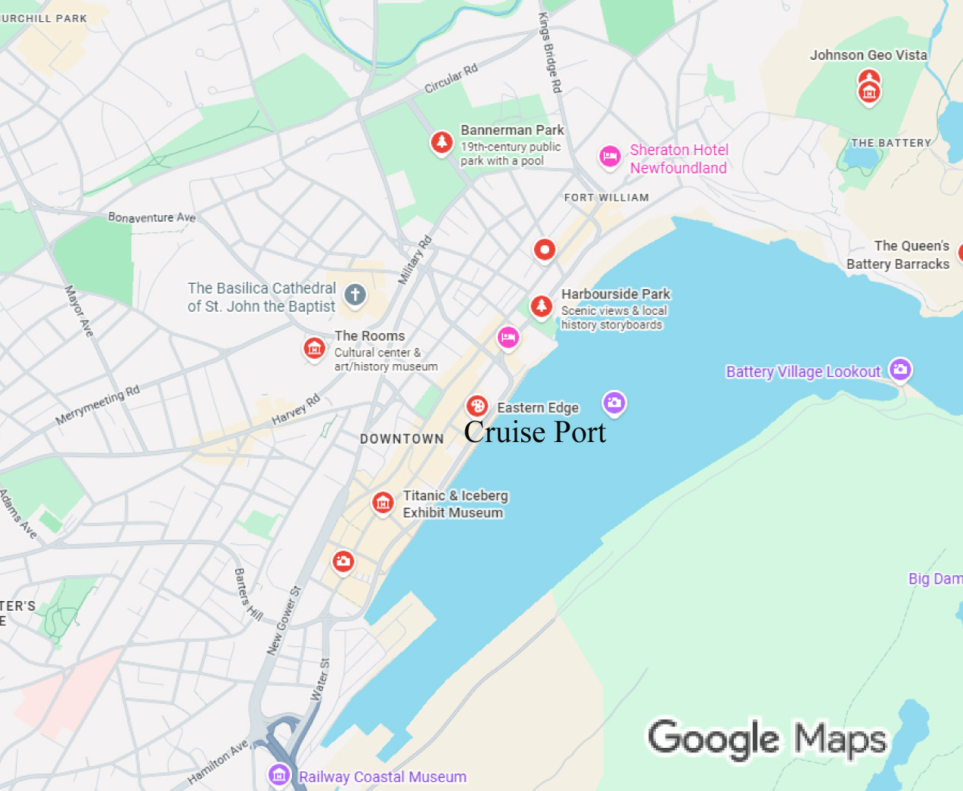
City Map
The cruise pier is very close to downtown.
When you exit the terminal, you are already within walking distance of:
Water Street, one of the oldest commercial streets in North America
The downtown shops and pubs
Museums and historic buildings
The base of Signal Hill St. John’s is hilly,
so expect some uphill walking.
Comfortable shoes matter here more
than almost anywhere else in Canada.

Slide 9
Transportation
Walking
If you are comfortable walking hills, you can see a lot of St. John’s on foot. Downtown is compact and very manageable.
Taxis
Taxis are easy to find near the port and downtown hotels. Rides within the city are reasonably priced and often the best option if mobility is an issue or weather turns quickly.
Hop-On Hop-Off Tours
These are available and can be useful for overview sightseeing, especially if you want to reach Signal Hill or Cape Spear without worrying about directions.

Slide 10

Top Attractions & Points of Interest
Signal Hill National Historic Site
This is the most famous viewpoint in the city. You get sweeping views of the harbor and coastline. It’s also where Marconi received that historic radio signal.

Slide 11
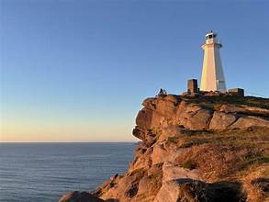
Top Attractions & Points of Interest
Cape Spear
This is the easternmost point in North America.
It’s about a 20-minute drive from the port and offers dramatic coastal views.

Slide 12
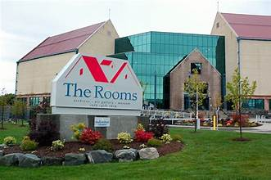
Top Attractions & Points of Interest
The Rooms
This modern museum and cultural center combines art, history, and archives in one location.
It’s an excellent introduction to Newfoundland and Labrador.

Slide 13
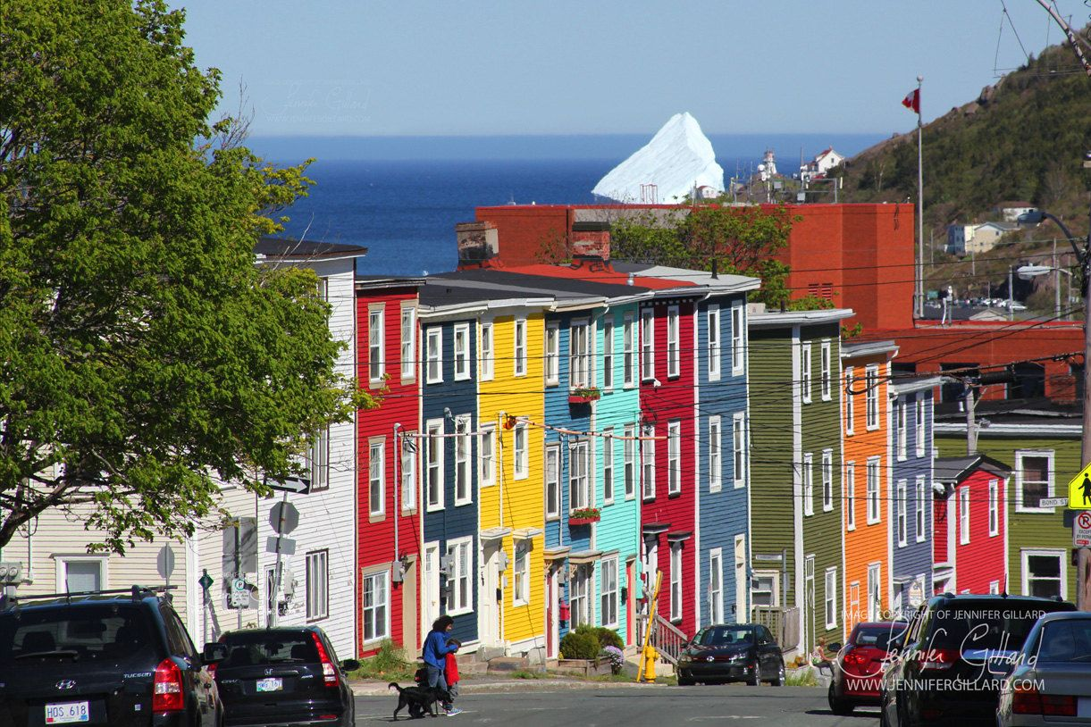
Top Attractions & Points of Interest
Jelly Bean Row Houses
These brightly painted homes are one of the most photographed sights in the city.
You’ll see them throughout downtown.

Slide 14
Local Cuisine & Dining Options
Newfoundland food is hearty, local, and closely tied to the sea.
What to Try
Fish and chips made with fresh cod
Seafood chowder
Jiggs’ dinner, a traditional boiled meal with salt beef and vegetables
Bakeapple desserts, made from cloudberries
Where to Eat
Downtown and the harbor area offer plenty of good choices. Follow the locals, not the menus with photos.
Avoid places right next to major tourist stops if the menu feels generic.
Tipping is similar to the U.S., about 15 to 20 percent for good service.

Slide 15
Important Tips & Practical Advice
Weather changes quickly. Bring a light jacket even on sunny days.
St. John’s is safe, but like any port city, stay aware in crowded areas.
Tap water is safe and excellent.
Plan your return to the ship earlier than you think you need to. Traffic and weather can slow things down.

Slide 16
Final Thoughts
St. John’s is one of those rare ports where history, scenery, music, and food all come together within a small area. It rewards wandering, listening, and slowing down a bit.
Enjoy the city, enjoy the people, and most importantly, give yourself enough time to get back to the ship relaxed and unhurried.
Thank you for coming. If you have questions, I’ll be happy to help.

Slide 17
Thanks For Coming
If you have any more questions, please ask.
I will do my best to answer them for you.
Have a great visit in Le Havre!

