Slide 1
St. Johns, Newfoundland, Canada
Port Guide
Presented by
Marc Silver

Slide 2
What I Will Cover
My Port Philosophy
Don’t Miss the Ship
Money
Exchanging Money
A Brief History of Civitavecchia
Maps
Transportation
Top Attractions & Points of Interest
Local Cuisine & Dining Options
Important Tips & Practical Advice
Conclusion

Slide 3
My Port Philosophy
I have been cruising for over 45 years and have taken over 100 cruises.
So, I consider myself an experienced cruiser.
The information I will present is based on those many years of
experience.
When I am on a cruise where the city, I want to visit is not the port city,
I always recommend taking a ship’s tour.
But when I am in a port with multiple attractions nearby and easy to see
on my own -
I will do it on my own.
This presentation is not like that.

Slide 4

Don’t Miss the Ship
How to Avoid Missing Your Ship
Pay attention to the time. - Ship time and local time are often
different.
Put a return-to-ship reminder on your phone.
Choose excursions wisely.
If a ship-sponsored excursion is late returning to port, the ship will
wait for you. If you are on your own???
Be Prepared
Have your Passport, Credit Card, and phone numbers for your ship
port agent.
What to Do If You Miss the Ship
Most cruise lines have port agents stationed in the port area to assist if your ship has left without you. If your are lucky, when cruisers are late returning to the vessel, the ship’s crew will often remove the passengers’ essential items – passports, cell phones, and medication -- from the ship to leave with the port agents.
The Port Officials can help you with contacting your ship
and making necessary travel arrangements.

Slide 5
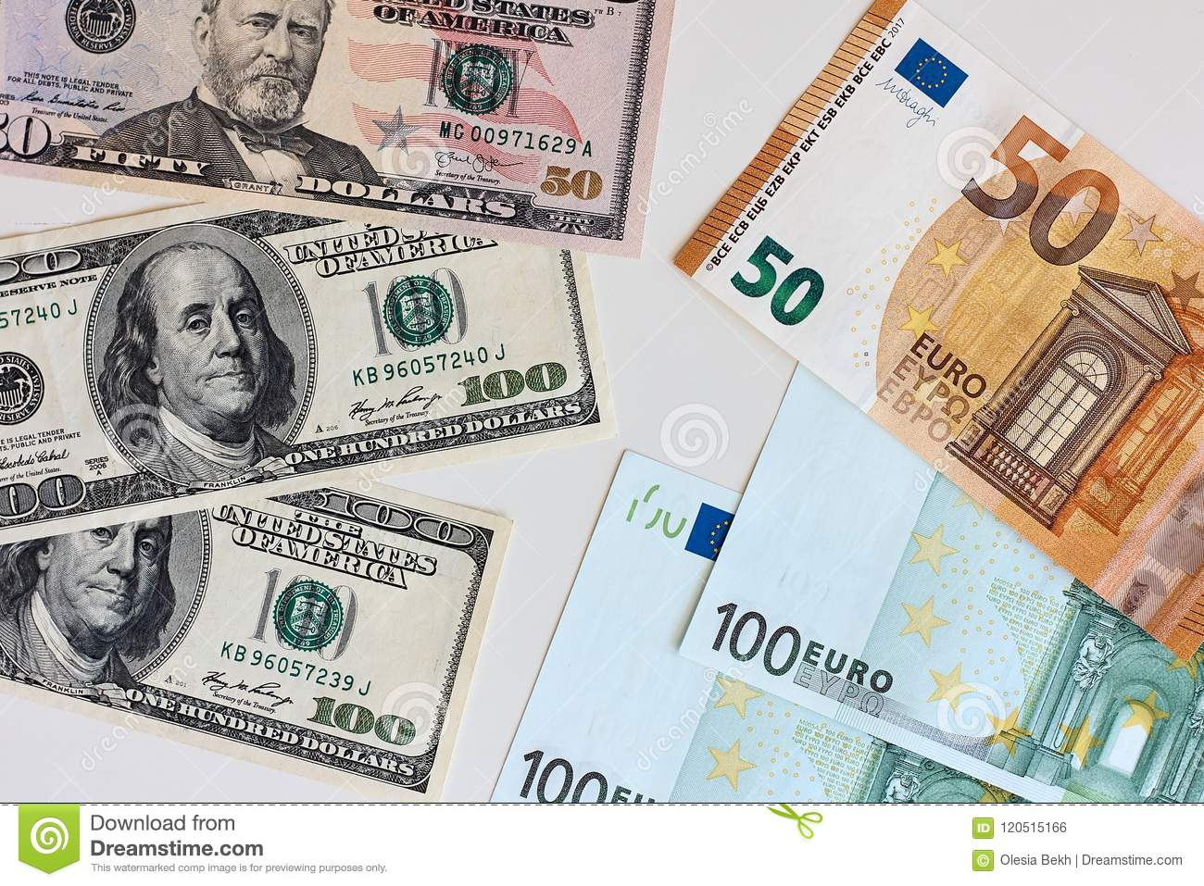
Money
Italy uses the Euro (€) as its official currency.
As of October 2024, the exchange rate between
the Euro and the U.S. Dollar (USD) is about
1 EUR = 1.05 USD.
This means U.S. travelers should anticipate slightly
higher prices in terms of conversion, but Spain remains a relatively affordable destination compared to many other Western European countries.
When exchanging money, it’s best to avoid doing so at the port exchange kiosks, as they tend to have higher fees and less favorable rates.
Instead, consider using ATMs to withdraw Euros directly, as they often offer better rates. Additionally, credit and debit cards are widely accepted throughout Alicante, though having some cash on hand is always a good idea for smaller purchases or tips.

Slide 6
Exchanging Money
When exchanging money, it’s best to avoid doing
so at the port exchange kiosks, as they tend to
have higher fees and less favorable rates.
Instead, consider using ATMs to withdraw Euros
directly, as they often offer better rates.
Additionally, credit and debit cards are widely accepted throughout Italy, though having some cash on hand is always a good idea for smaller purchases.

Slide 7
A Brief History of Civitavecchia
Fortress and a bustling modern port. It serves millions of tourists yearly, particularly those embarking or disembarking from Mediterranean cruises.

Slide 8
Area Map

Slide 9
Transportation
Getting from Shuttle buses: These are available but less frequent and not as direct as trains

Slide 10
Transportation
Transportation Options for Tourists
Getting : You can also hire a taxi or pre-book a car service. Prices range from 100-150€, depending on your destination in Rome.
Airport transfer: Direct shuttles are available, but the train is often faster and cheaper if you don't have much luggage.

Slide 11
Top Attractions & Points of Interest
Top Attractions & Points of Interest
The Colosseum: Hill: Combo tickets with the Colosseum cost 16€
Piazza Navona and the Pantheon: Both are free to visit and offer a fantastic glimpse of Rome’s Baroque architecture.

Slide 12
Local Cuisine & Dining Options
Must-try dishes: Start with Cacio e Pepe (pasta with cheese and pepper) or Carbonara. Don't forget supplì (fried rice balls) for a quick snack.
Where to eat:
  Trastevere: Great for authentic Roman food in a lively neighborhood.
  Campo de' Fiori: A bit touristy but with several excellent spots if you explore beyond the square.
  Avoid restaurants near major attractions: These often overcharge tourists for subpar meals.
Tipping culture: It’s not mandatory, but rounding up the bill or leaving a couple of euros for good service is appreciated.

Slide 13
Important Tips & Practical Advice
Time to visit attractions: Most of the major sites can be visited in 1-2 hours, but plan for 3-4 hours at the Vatican if you want to see it all.
Booking excursions: Cruise lines offer packages, but you’ll find better value booking independently through reputable tour companies.
Safety: Rome is generally safe, but watch out for pickpockets in crowded tourist areas. Stick to tap water—it's safe to drink and widely available.

Slide 14
Thanks For Coming
If you have any more questions, please ask.
I will do my best to answer them for you.
Have a great visit in Le Havre!

