Slide 1

St. Thomas
Virgin Islands
Presented by
Marc Silver

Slide 2
What I Will Cover
My Port Philosophy
Don’t Miss the Ship
Money
About St. Thomas
Area Map of St. Thomas
Map of St. Thomas
St. Thomas Transportation
Places to see or at least consider
A few restaurant recommendations
Conclusion

Slide 3
My Port Philosophy
I have been cruising for over 45 years and have taken over 100 cruises.
So, I consider myself an experienced cruiser.
The information I will present is based on those many years of
experience.
When I am on a cruise where the city, I want to visit is not the port city,
I always recommend taking a ship’s tour.
But when I am in a port with multiple attractions nearby and easy to see
on my own -
I will do it on my own.
This presentation is for that type of port.

Slide 4

Don’t Miss the Ship
How to Avoid Missing Your Ship
Pay attention to the time. - Ship time and local time are often
different.
Put a return-to-ship reminder on your phone.
Choose excursions wisely.
If a ship-sponsored excursion is late returning to port, the ship will
wait for you. If you are on your own???
Be Prepared
Have your Passport, Credit Card, and phone numbers for your ship
port agent.
What to Do If You Miss the Ship
Most cruise lines have port agents stationed in the port area to assist if your ship has left without you. If your are lucky, when cruisers are late returning to the vessel, the ship’s crew will often remove the passengers’ essential items – passports, cell phones, and medication -- from the ship to leave with the port agents.
The Port Officials can help you with contacting your ship
and making necessary travel arrangements.

Slide 5
Money
St. John is a US territory and therefore uses the US Dollar.
But for foreign travelers here are some international exchange rates:
US Dollar | 1.00 USD | inv. 1.00 USD
Euro | 0.928324 | 1.077210
British Pound | 0.791784 | 1.262971
Indian Rupee | 82.994609 | 0.012049
Australian Dollar | 1.531256 | 0.653059
Canadian Dollar | 1.345123 | 0.743426
Singapore Dollar | 1.344726 | 0.743646
Swiss Franc | 0.875639 | 1.142023
Malaysian Ringgit | 4.765044 | 0.209862
Japanese Yen | 149.335187 | 0.006696
Chinese Yuan Renminbi | 7.192832 | 0.139027

Slide 6
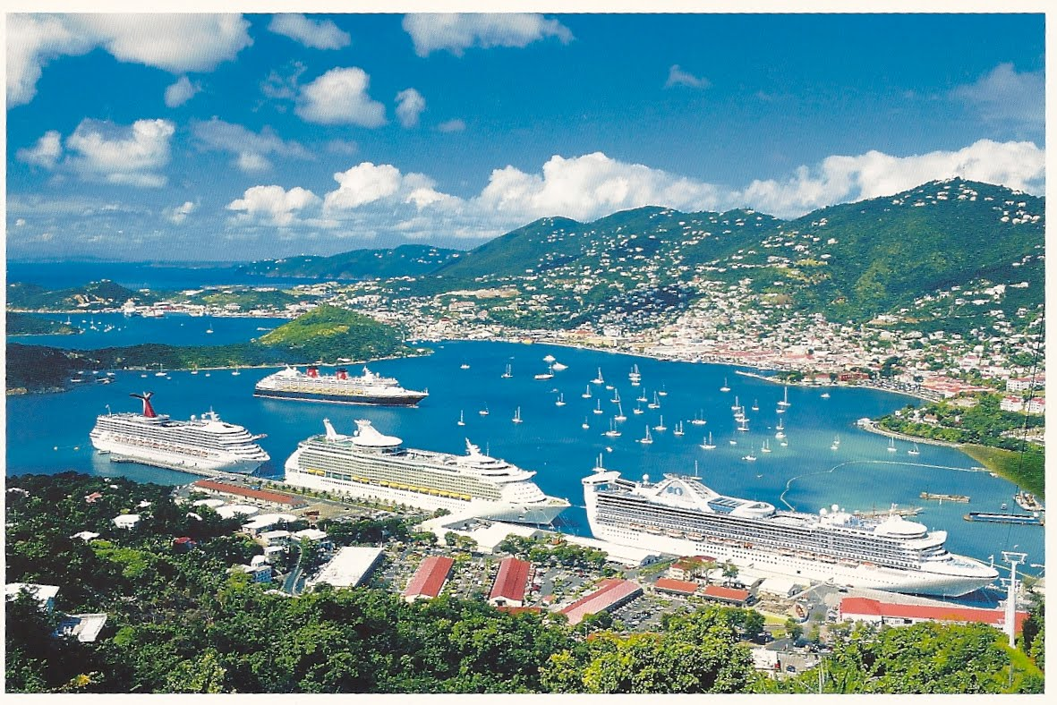
About St. Thomas
Saint Thomas, the main island of the U.S. Virgin Islands, in the eastern Caribbean Sea. It lies 40 miles east of Puerto Rico. The capital is Charlotte Amalie, which is situated halfway along the southern coast on hill slopes. Its well-sheltered harbor is in the crater of an extinct volcano. Sighted in 1493 by Christopher Columbus, St. Thomas was later colonized, first by the Dutch (1657) and then by the Danish (1666). In 1672 it passed into the hands of the newly chartered Danish West India Company and subsequently, in 1685, of the Brandenburg Company. After 1673, when slavery
was introduced, the island became the chief sugar
producers of the Caribbean and was very prosperous.
Most of the inhabitants are of African origin, though
many also have Spanish, Portuguese, Scottish,
Danish, English, French, and Puerto Rican ancestry.

Slide 7
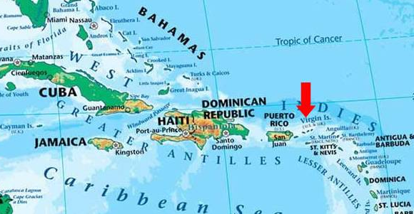
Virgin Islands Area Map

Slide 8
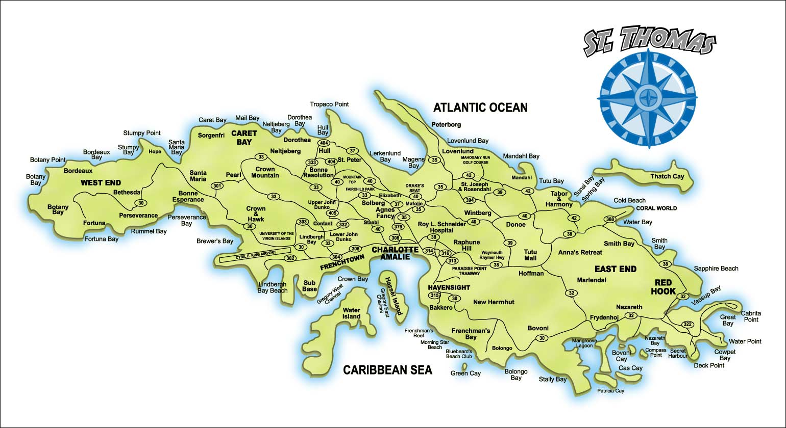
Map of St. Thomas

Slide 9
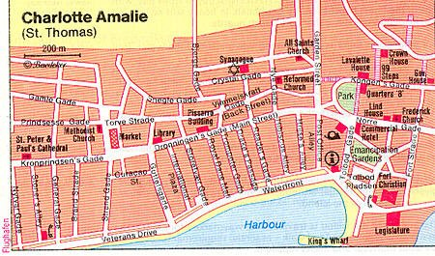
Map of Charlotte Amalie

Slide 10
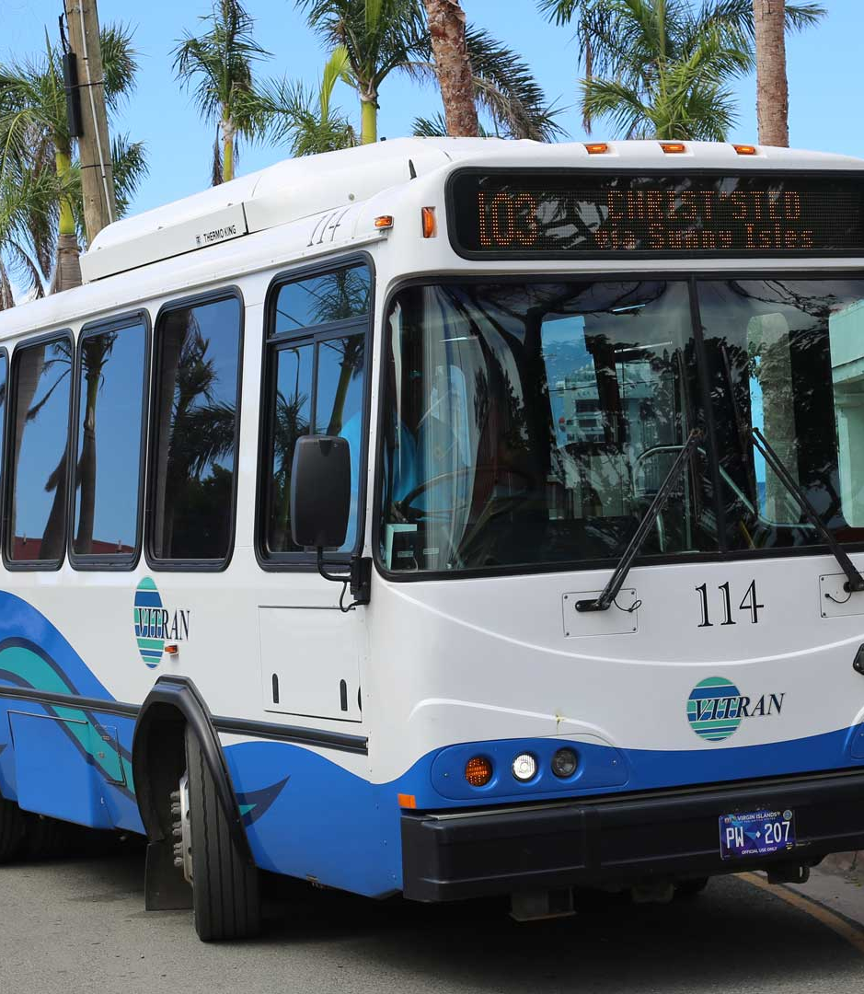
St. Thomas $1 Bus
The Virgin Islands public transit system in St. Thomas is called VITRAN. The bus fare is $1, and there are discounted fares for seniors and students with ID. VITRAN routes travel through main commercial areas which include some resorts and attractions, though a short walk from the bus stop may be required.
VITRAN buses are easy to spot. They are generally blue and white, have VITRAN in big letters, and a destination indicator with route number above the windshield. Public buses in St. Thomas are a good option for travelers on a budget, those who support the environmental benefits of public transit, and those who like the opportunity to chat with residents while on vacation.

Slide 11
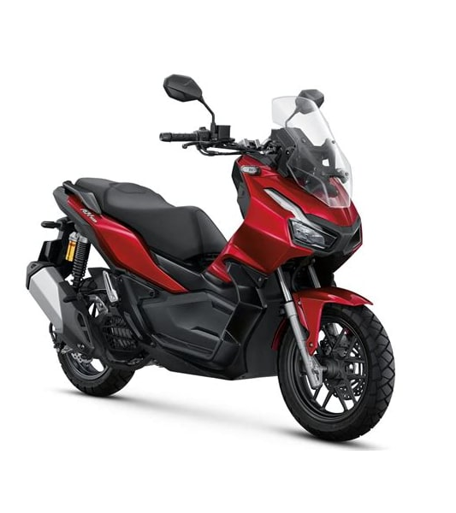
Scooter, Motorcycle Rental
Charlotte Amalie has few options when it comes to scooter and motorcycle rentals.
But for the more adventurous it is a good option to consider.
You can rent from Harley-Davidson of St. Thomas downtown or Rent A Motion which is a short walk from the pier. A scooter runs about $75/day.

Slide 12

Car Rental
When we dock in Charlotte Amalie the closest car rental location is ½ mile walk north of the pier, called 360 Car Rental.
Convenance will cost you, however.
If you rent from one of the major companies with Pickup at the airport, the car rental may be significantly lower.
Car Rental run from about $90/day.

Slide 13
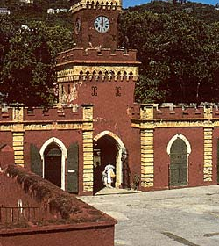
Fort Christian
Fort Christian, a National Historical Landmark is located between Veterans Dr. and Emancipation Garden in Charlotte Amalie. Virgin Islands.
Although currently being restored, the fort is open Monday-Friday, 8:30 am to 4:30 pm.
The museum has exhibits on the history of the Virgin Islands from the Stone Age to the present, as well as a natural history section, a furniture collection from the Danish period, and an art gallery.

Slide 14
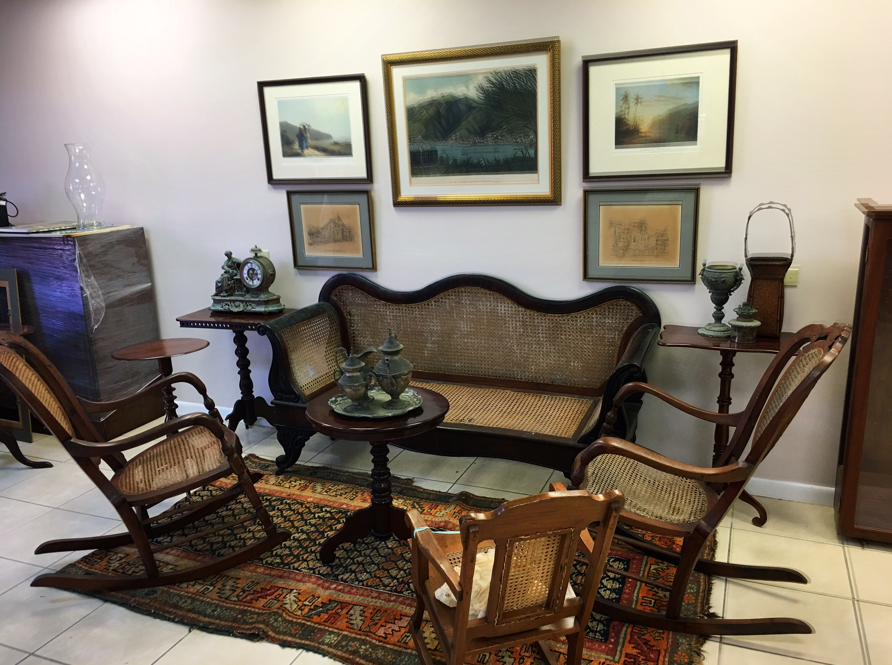
St. Thomas Museum
St. Thomas Historical Trust Museum is located at 5332 Raadets Gade, between Main and Waterfront.
A group of concerned citizens established The Trust in 1966 to capture interest and focus energies on preserving the heritage of St. Thomas’ archeological and cultural past.
On display at the museum are collections of West Indian art and antiques, some pieces dating back to the 1600s, and Artifacts recovered from shipwrecks in Charlotte Amalie harbor and from archaeological digs from around the island.
Admission: Free

Slide 15
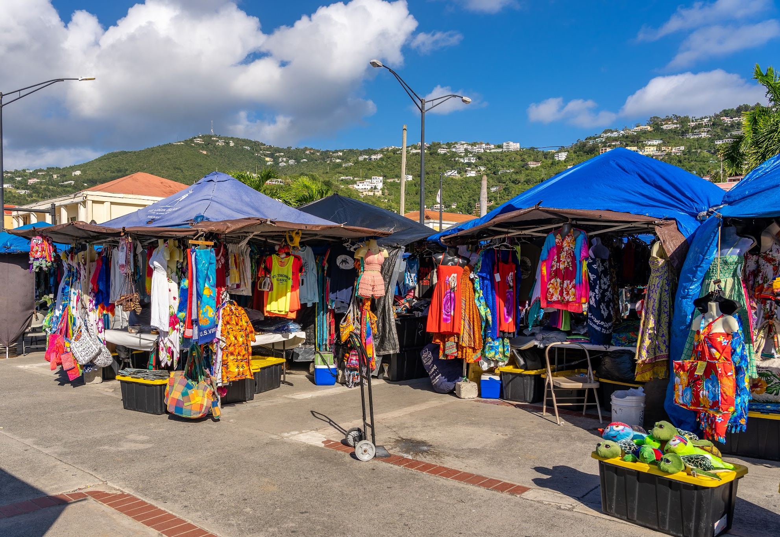
Vendors' Plaza
Vendors Plaza is an outdoor marketplace next to Fort Christian and the Legislature building, just at the edge of downtown Charlotte Amalie. Local vendors set up tents and booths to sell an assortment of hats, knockoff designer bags, inexpensive jewelry, t-shirts, sundresses, and various cheap trinkets.
You can also get your hair braided or buy some West Indian food and ice cream from the food vendors who set up around the perimeter.
The plaza is open from 7:30 a.m. to 5:30 p.m., mostly on days when cruise ships are in port. Bring cash with you - these are small-time merchants, and few, if any, accept charge cards.

Slide 16
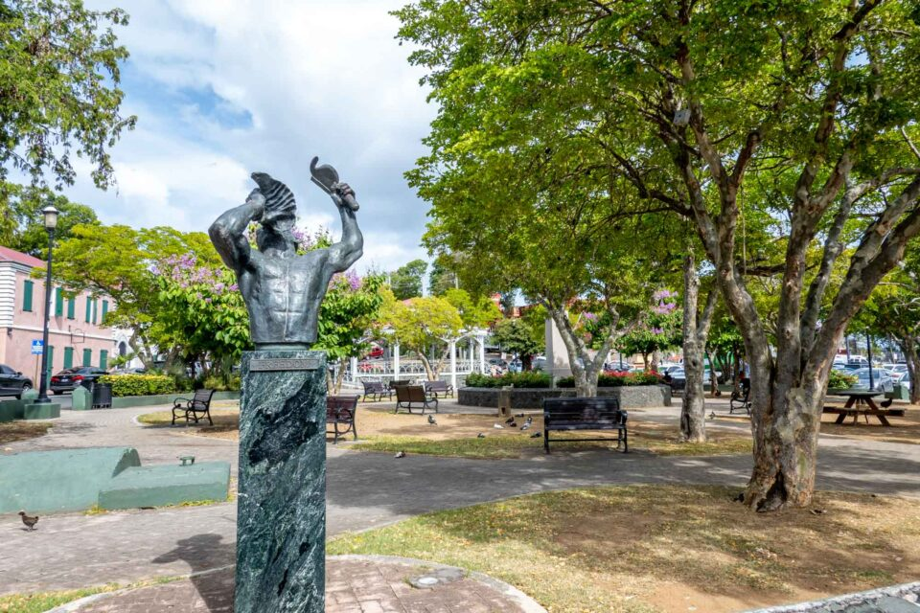
Emancipation Garden
The park was built to commemorate the freeing of the slaves which took place on July 3, 1848. A commemorative plaque, a bronze bust of a freed slave blowing a conch shell, and a replica of the Liberty Bell are featured. The park was also ringed with a fence of old ships' anchor chains and cannons recovered from the harbor.
The park is surrounded by historical buildings,
including the Emancipation Garden Post Office and
Government House. Official government ceremonies
are frequently held here
The trees shading the park are lignum vitae, one of
the hardest and slowest growing trees on earth, and
commonly used in colonial times as foundation posts
for island buildings.
The gazebo hosts concerts and other activities
throughout the year, including a free concert by Jimmy Cliff in 1980.

Slide 17
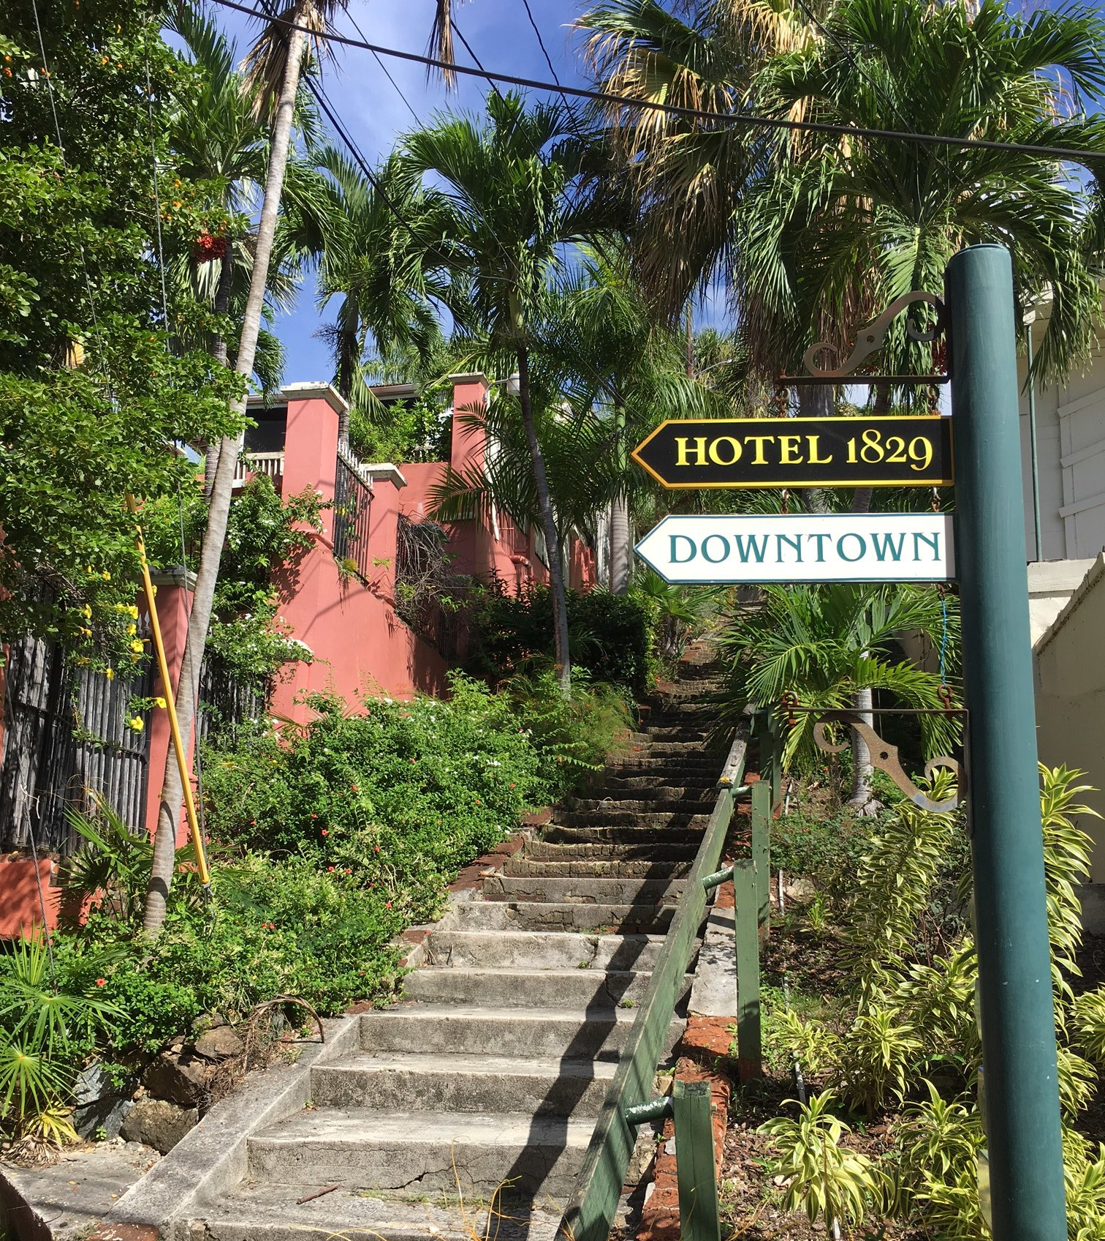
99 Steps
There are actually 103 steps. The 99 Steps are one of the most well-known landmarks in St. Thomas. The hills rising around Charlotte Amalie are full of steep streets. Perhaps the most visited by tourists are the 99 Steps, which were built by the Danes in the 1700s.
Not far from historic Fort Christian and the Emancipation Garden, they lead visitors to a nice view of the island and close to the foot of Blackbeard’s Castle.

Slide 18
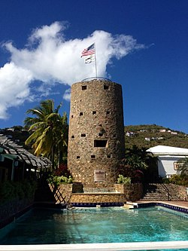
Blackbeard's Castle
Blackbeard's Castle is one of five National Historic Landmarks in the U.S. Virgin Islands. It is located in the city of Charlotte Amalie, on the island of St. Thomas. Erected in 1679 by the Danes as a watchtower to protect the harbor as well as Fort Christian, Blackbeard's Castle was originally called Skytsborg (meaning protection castle).
It is located at the highest point of Government Hill. Skytsborg served as a very effective vantage point for Danish soldiers to spot enemy ships. Fort Christian is at sea level, thus making it ideal for thwarting attackers with cannon fire; however, the fort itself did not provide an ideal view of incoming ships entering the harbor.
It was the centerpiece of a private residence for many years, and was turned into a hotel, but is no longer open to the public.
When open Admission is $10.00

Slide 19
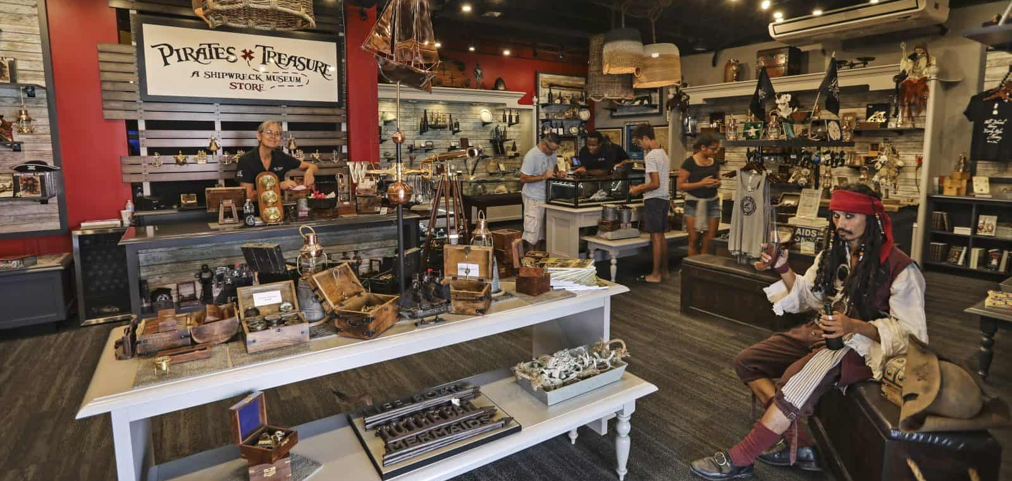
Pirates Treasure Museum
Located about a ½ mile from the cruise port, the Pirates Treasure Museum is a Shipwreck Museum showcasing authentic artifacts and treasures from the world-famous deep-ocean discoveries of Odyssey Marine Exploration.
The museum also highlights Virgin Islands shipwrecks and artifacts. The two-story museum incorporates history and interactive exhibits to immerse visitors in the world of pirates and the deep-ocean exploration technology used to recover treasures that were once thought lost forever.
These stories and artifacts offer
insight and a physical
connection to the Caribbean and
the world, as it was hundreds or
even thousands of years ago!
Adult admission $16, children $12, under 6 years old are free!

Slide 20
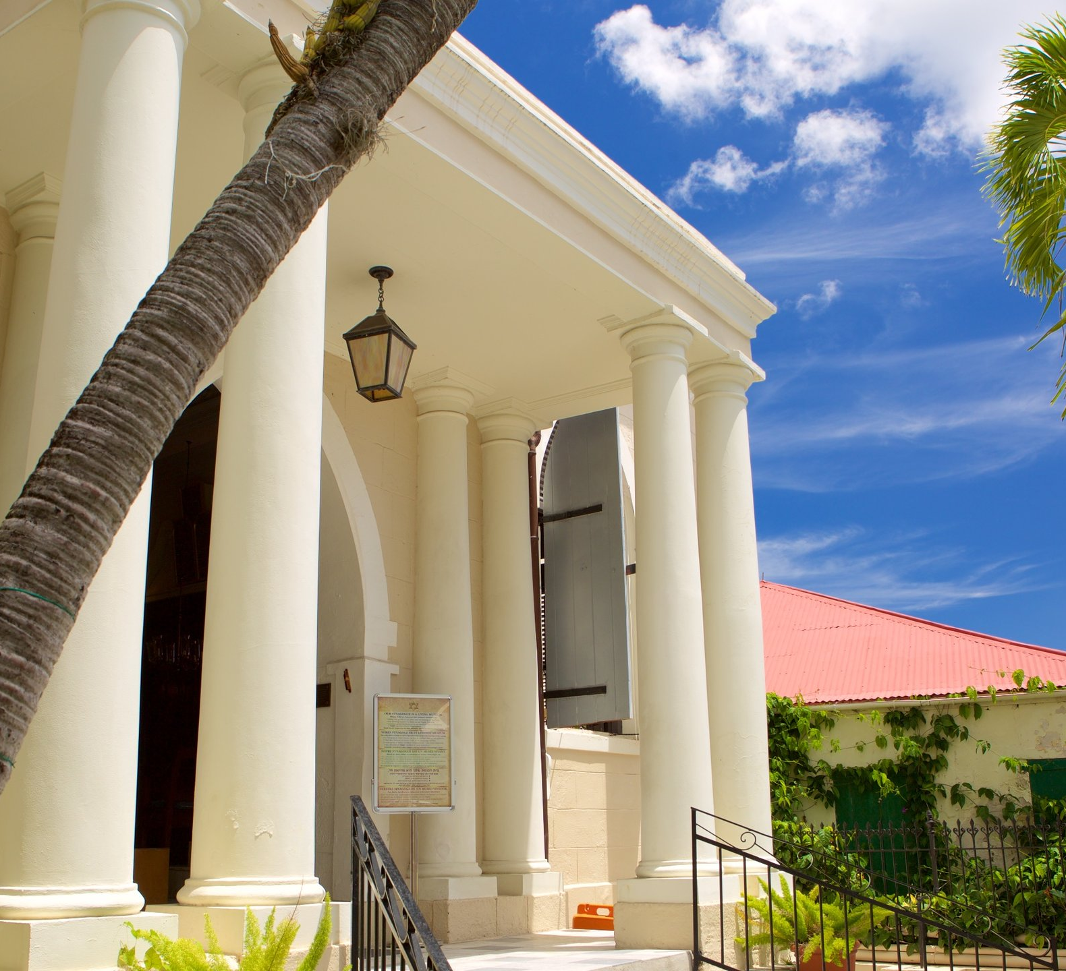
Jewish Synagogue
There have been individual Jews in St. Thomas since the 1600’s.
The first Jewish cemetery here dates from the mid-18th century.
The Synagogue is Congregation Beracha Veshalom Vegmiluth Hasadim. The congregation was founded in 1796 by Spanish and Portuguese Sephardic Jews who had come to the Caribbean Basin to finance trade between Europe and the New World.
The building was constructed in 1833 and is the second oldest synagogue in the United States (after Touro Synagogue in Newport, Rhode Island built in 1763).

Slide 21
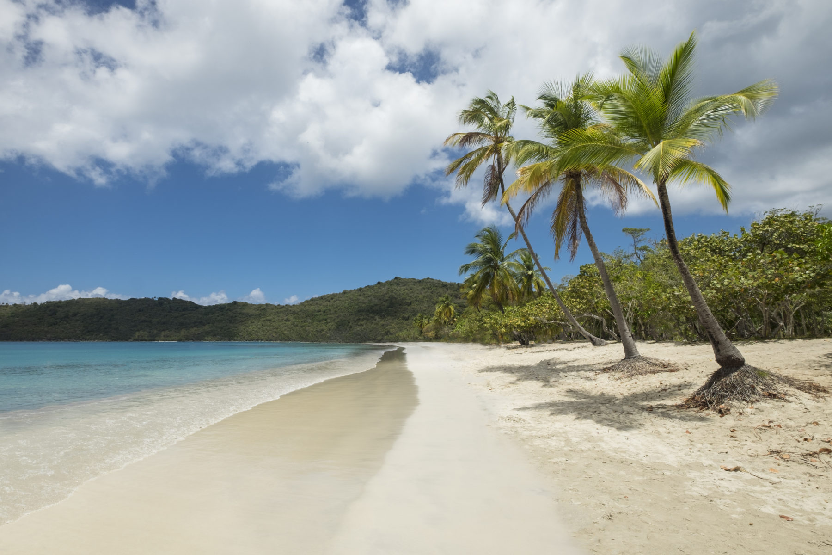
The Beaches of St. Thomas
Going to the beach is one of the best things to do in St. Thomas. Visit one or more of the island’s stunning beaches.
They range from a pristine park with white sand at Lindquist Beach to the tourist favorite Magens Bay Beach, which features rental chairs and a full beach bar and restaurant.
Some spots like Coki Beach offer chances for great shore diving, or you can head to Sapphire Beach for snorkeling and gorgeous views. It is impossible to go wrong here.

Slide 22
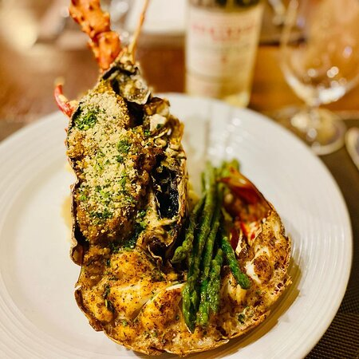
Restaurants
There are a lot of excellent restaurants in Charlotte Amalie. Especially for seafood.
Here are some recommendations:
Restaurants in St. Thomas:
French Quarter Bistro $$ - $$$ French, American , Seafood
Rue De St Barthelemy Frenchtown, Charlotte Amalie
French Quarter Bistro $$ - $$$ French, American , Seafood
Rue De St Barthelemy Frenchtown, Charlotte Amalie
Sugarcane Grille $$ - $$$ Caribbean, Bar , Seafood
2307 Commandant Gade Bunker Hill Hotel, Charlotte Amalie
Ideal Restaurant $ Caribbean, Vegetarian Friendly, Vegan
2329 Commandant Gade, Charlotte Amalie
For those of you who just like good food, you can’t go wrong just about anywhere you go in St. Thomas. GOOD EATING

Slide 23
Conclusion
St. Thomas is a beautiful City with a rich history and numerous attractions. Regardless of what you're looking for, St. Thomas has something for everyone.
I hope this presentation will help when we visit St. Thomas!

Slide 24
Thanks For Coming
If you have any more questions, please ask.
I will do my best to answer them for you.
Have a great visit to St. Thomas !

