Slide 1
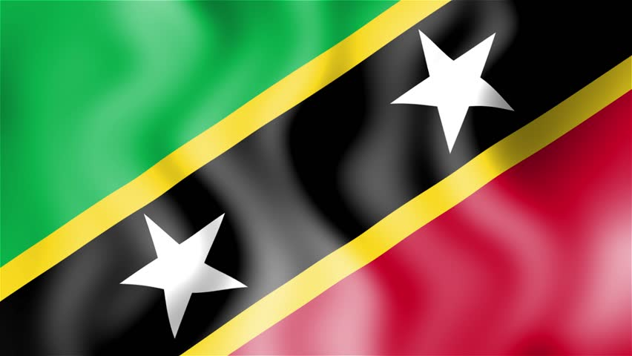
Basseterre St. Kitts & Nevis Presented by Marc Silver

Slide 2
What I Will Cover
My Port Philosophy
Don’t Miss the Ship
Money
About St. Kitts & Nevis
Area Map of St. Kitts & Nevis
Map of St. Kitts & Nevis
St. Kitts & Nevis Transportation
Places to see or at least consider
A few restaurant recommendations
Conclusion

Slide 3
My Port Philosophy
I have been cruising for over 45 years and have taken over 100 cruises. So, I consider myself an experienced cruiser.
The information I will present is based on those many years of
experience.
When I am on a cruise where the city, I want to visit is not the port city,
I always recommend taking a ship’s tour.
But when I am in a port with multiple attractions nearby and easy to see
on my own - I will do it on my own.
This presentation is for that type of port.

Slide 4

Don’t Miss the Ship
How to Avoid Missing Your Ship
Pay attention to the time. - Ship time and local time are often different.
Put a return-to-ship reminder on your phone.
Choose excursions wisely.
If a ship-sponsored excursion is late returning to port, the ship will wait for you. If you are on your own???
Be Prepared
Have your Passport, Credit Card, and phone numbers for your ship port agent.
What to Do If You Miss the Ship Most cruise lines have port agents stationed in the port area to assist if your ship has left without you. If your are lucky, when cruisers are late returning to the vessel, the ship’s crew will often remove the passengers’ essential items – passports, cell phones, and medication -- from the ship to leave with the port agents.
The Port Officials can help you with contacting your ship and making necessary travel arrangements.

Slide 5
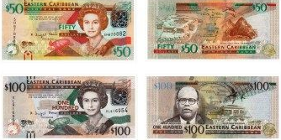
St. Kitts & Nevis Money
The official currency of Saint Kitts and Nevis (country code: KN) is the East Caribbean dollar, with symbol EC$ and currency code XCD.
$1USD = 2.7026EC$

Slide 6
About St. Kitts
Although founded by the French in 1627, St. Kitts is a very British paradise where cricket and tea are the norm.
Basseterre is the capital and largest city of Saint Kitts and Nevis with an estimated population of 14,000.
Saint Kitts, officially Saint Christopher, is an island in the West Indies. The west side borders the Caribbean Sea, and the eastern coast faces the Atlantic Ocean.
Saint Kitts and the neighboring island of Nevis constitute one country: the Federation of Saint Kitts and Nevis. Saint Kitts and Nevis are separated by a shallow 3-kilometre channel known as "The Narrows“
The dramatic mixed island landscape is rimmed in gold-sand beaches and dotted with well-preserved plantations left over from when the island was covered with sugar cane.

Slide 7
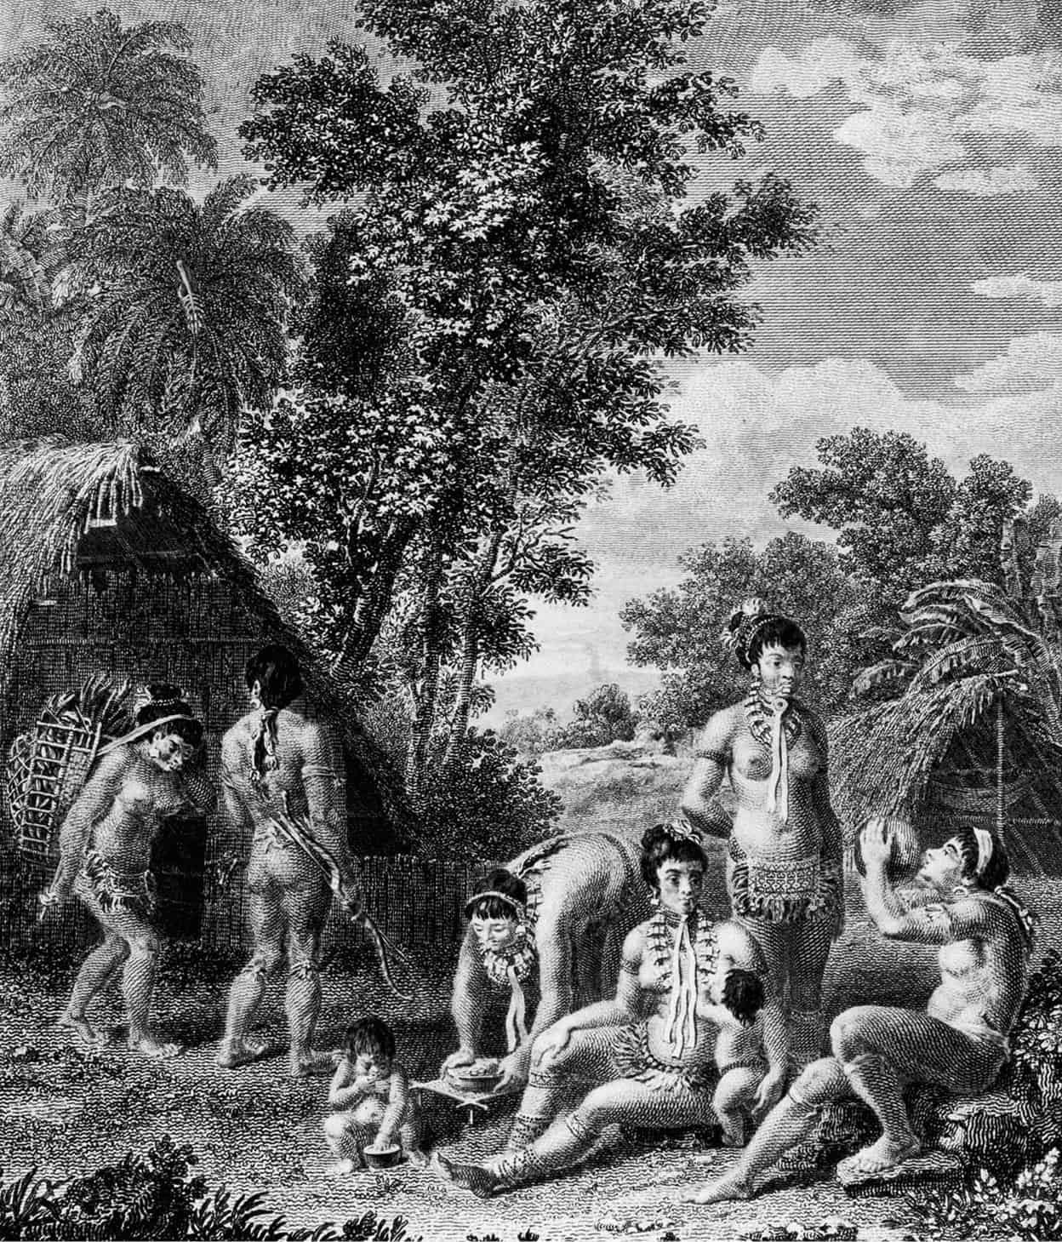
History of St. Kitts
Various waves of early ceramic-age people, sometimes called Saladoid started entering the Caribbean from South America. They traveled to the Virgin Islands, the Leeward Islands, and to the eastern part of Puerto Rico
In 1493, while on his second voyage through the Caribbean, Christopher Columbus sighted and named various islands.
The names given to them by the Kalinago were erased from history.
In 1590 a group of loggers who stopped to cut wood at St. Kitts found the island completely uninhabited.

Slide 8
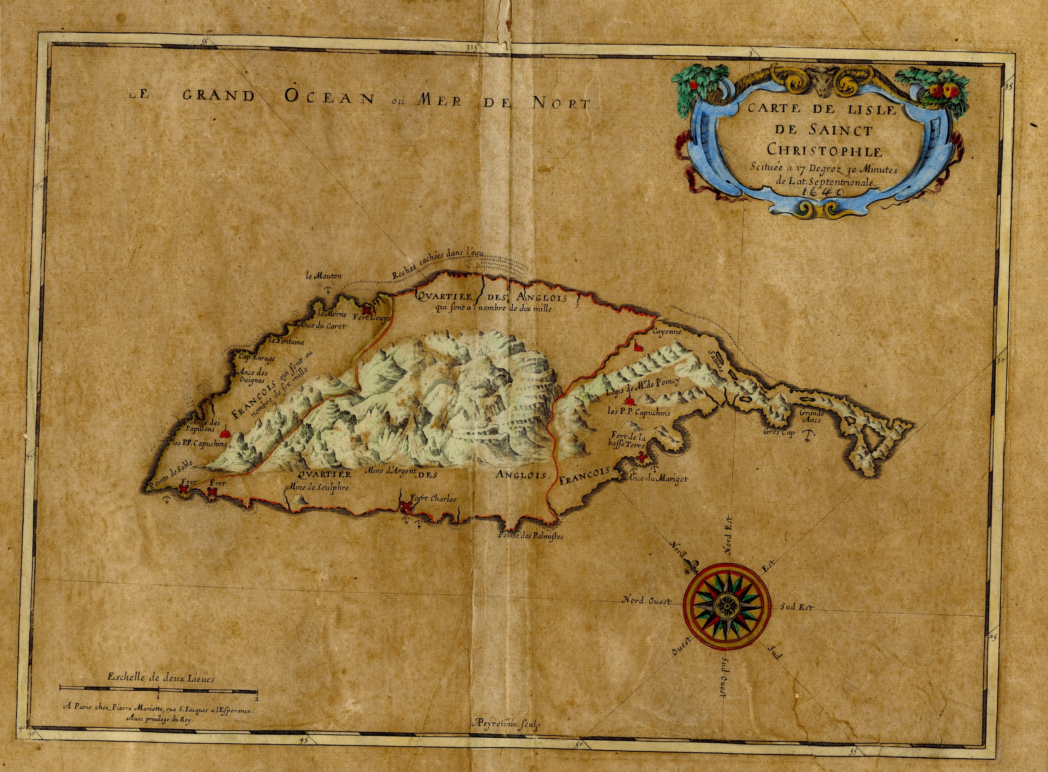
History of St. Kitts
Around 1600 members of the Kalinago ethnic group set up a community on St. Kitts and on Nevis.
In 1623 the islands were originally settled by the English, but in 1626 (according to an English account) a woman, who was part of the Kalinago community, warned Thomas Warner of an impending attack. The English and French joined forces and repelled the group from the islands.
In 1627 the English and French Settlers agreed to divide the island between them. The French took t he two ends and the English settled in the middle probably based on their settlements.
In 1639 sugar cane cultivation was introduced to the island.

Slide 9
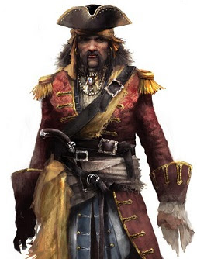
History of St. Kitts
On Sept 27 1720, Black Bart Robert’s Royal Rover was set on fire by his disloyal crew. Unaware of this he blamed Governor Mathew and threatened Basseterre. He later sailed away without causing the destruction he had promised.
In 1783 an act passed prohibiting the mutilation of enslaved workers. Punishment consisted of a fine of £500 and six months imprisonment. Those enslavers who could not pay the fine were liable to twelve months imprisonment. Mutilated enslaved persons were to be forfeited to the use of the island and publicly sold. This was the first law in the British West Indies that afforded the slaves some measure of protection against their masters.
The 524 Act of 1830 granted the free coloreds named in the Act the right to enjoy all civil rights, privileges, and immunities of other free citizens.

Slide 10
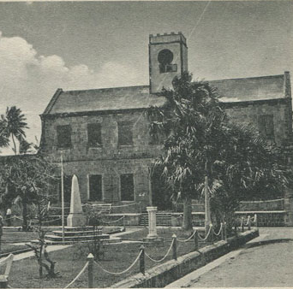
Modern St. Kitts
The islands of Saint Kitts, Nevis, and Anguilla were united by the federal act in 1882 and became an independent state in association with the United Kingdom on February 27, 1967.
The islands were granted full internal self-government, with the United Kingdom retaining responsibility for defense and foreign affairs.
After the islands had assumed the status of associated states, Anguilla complained of domination by the Saint Kitts administration.
In May 1967, the Anguillans ejected the Saint Kitts police and established their own council. In July of the same year, they proclaimed their independence.
After unsuccessful negotiations, the Anguilla Act of July 1971 placed Anguilla directly under British control. On February 10, 1976, Anguilla was granted a constitution, and its union with Saint Kitts and Nevis was severed in 1980.

Slide 11
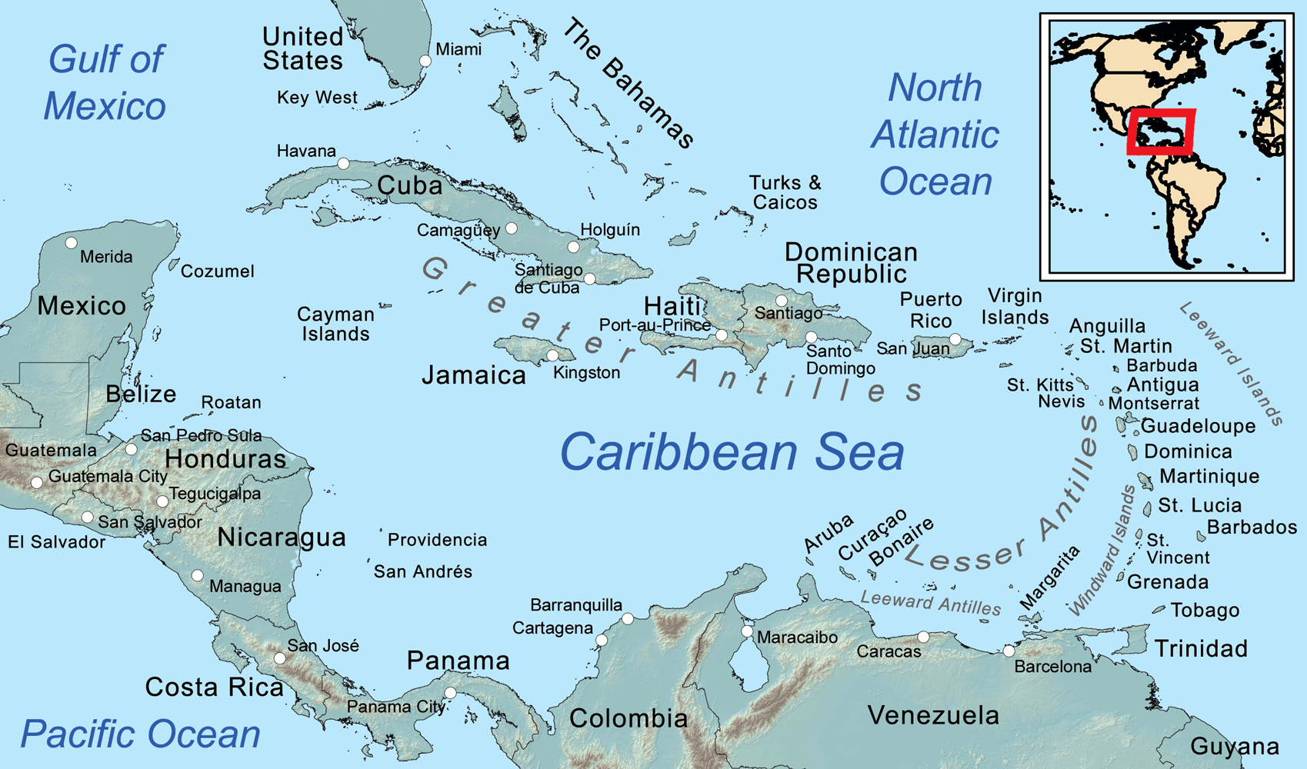

Slide 12
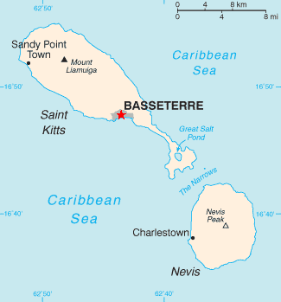
Map of St. Kitts & Nevis

Slide 13
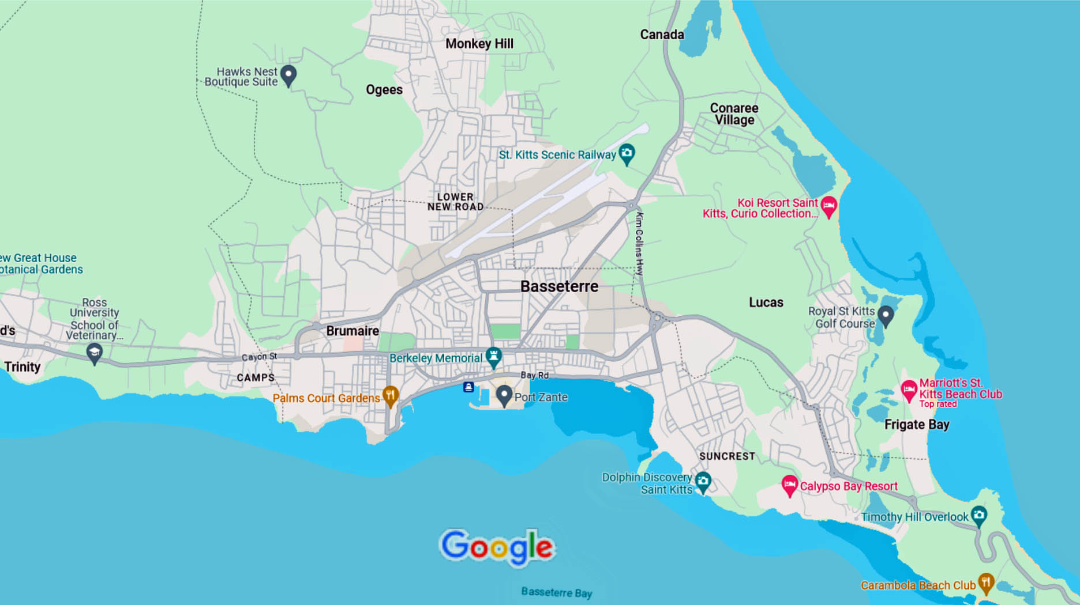
Map of Basseterre

Slide 14
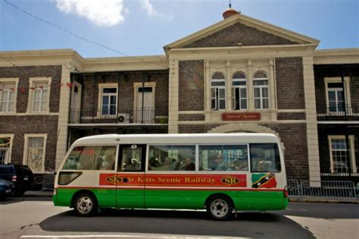
Basseterre Transportation
Public transport here consists of “H Buses”, these are minibusses, named after the green number plate they carry which starts with an “H”. There are two bus stations in Basseterre serving the east and west sides of the island.
Fares are in EC$ and are not at all expensive. Bus stops are in town only, elsewhere buses stop on demand. There is no bus service between Basseterre and Frigate Bay or the SE Peninsula, as these are the main tourist areas on the island and most visitors prefer to use taxis.
All bus fees (in Eastern Caribbean or EC dollars) are $2.50 for a trip of 5 miles or under, $3.00 for trip of 5 to 10 miles, and $3.75 for a trip over 10 miles. ($1 US = $2.7 EC)
Taxis from the cruise port to the beaches run about US$10 per person.

Slide 15
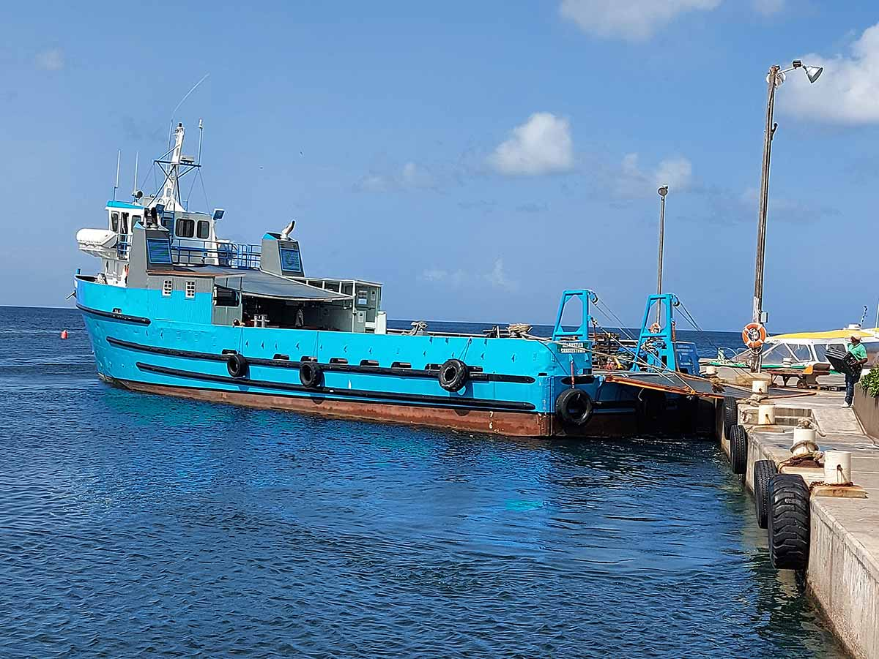
Water Taxi
Water Taxis from Cockleshell Bay (Reggae Beach) St Kitts to Nevis. There are a number of water taxis that operate from Cockleshell Bay (Reggae Beach) to Nevis.
These are primarily used by tourists and the fare is around US$20.00 one way.
Operating most days, some on a specific schedule, the journey time can be as little as 10 minutes.

Slide 16
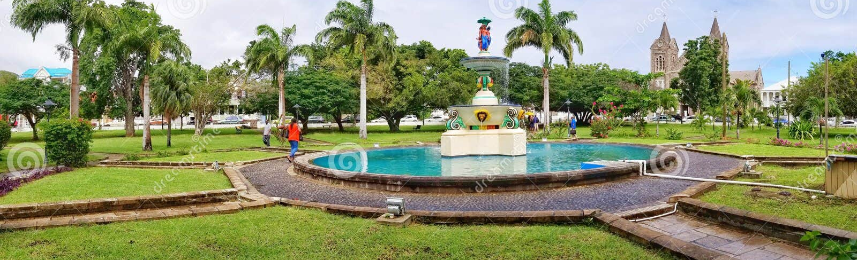
Independence Square
Independence Square got its name in 1983 when St. Kitts and Nevis gained their independence from the United Kingdom. Before then, the square was known as Pall Mall Square, a name that did not have any significant meaning. It has remained an important landmark in Basseterre.
The Square features a giant clock tower that was built in the early 1800s. It is known as the "Berkley Memorial Clock" and stands as a held the post of chief magistrate.

Slide 17
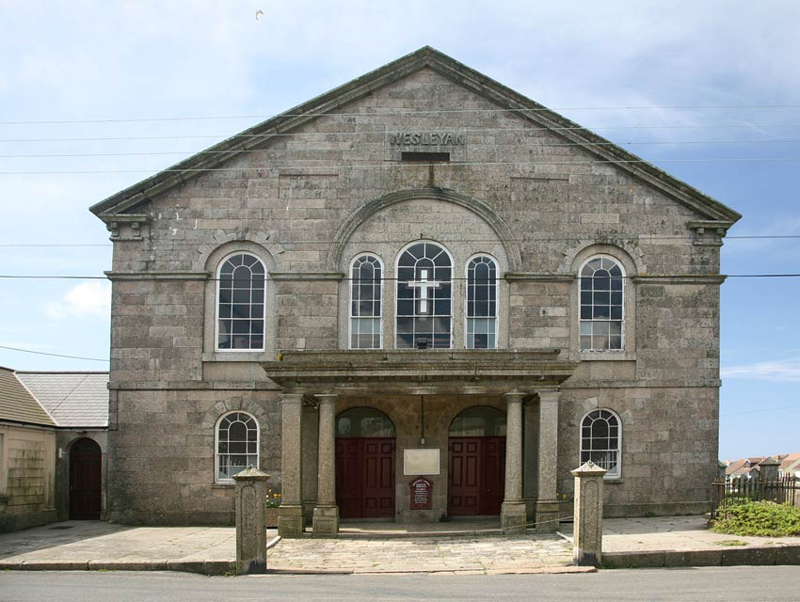
Wesleyan Chapel
The Westley Chapel, also referred to as the Methodist church, is a solid square stone building located on Seaton Street just off of Victoria Road. It is slightly to the north of St. George’s Anglican Church.
Methodism arrived in St. Kitts late in the 18th century. On the 18th of January 1787, Thomas Coke and three Methodist missionaries arrived in St. Kitts from Dominica.
News of their intended visit had preceded them and they were provided with accommodation by Antiguans of mixed race who adopted the Methodist philosophy and later moved to Basseterre, St. Kitts. The visitors were all invited to address an audience at the Court House, then still on Church Street. Attendance was encouraging and later several prominent gentlemen, including the Anglican clerics in charge of St. George’s welcomed them to their homes.

Slide 18
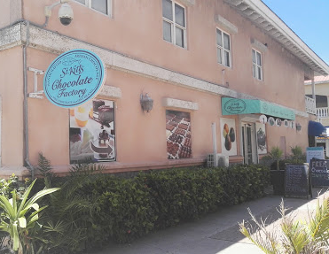
St. Kitts Chocolate Factory
The Chocolate Factory is in a new location in the port about 100 ft to the left as you step off the dock. It is in a beautiful and newly renovated space.
There are a wide variety of chocolates and they taste delicious!
There's even a coffee bar serving Starbucks coffee, juices, tea, etc.
Definitely would recommend you check it out while you are in port.

Slide 19
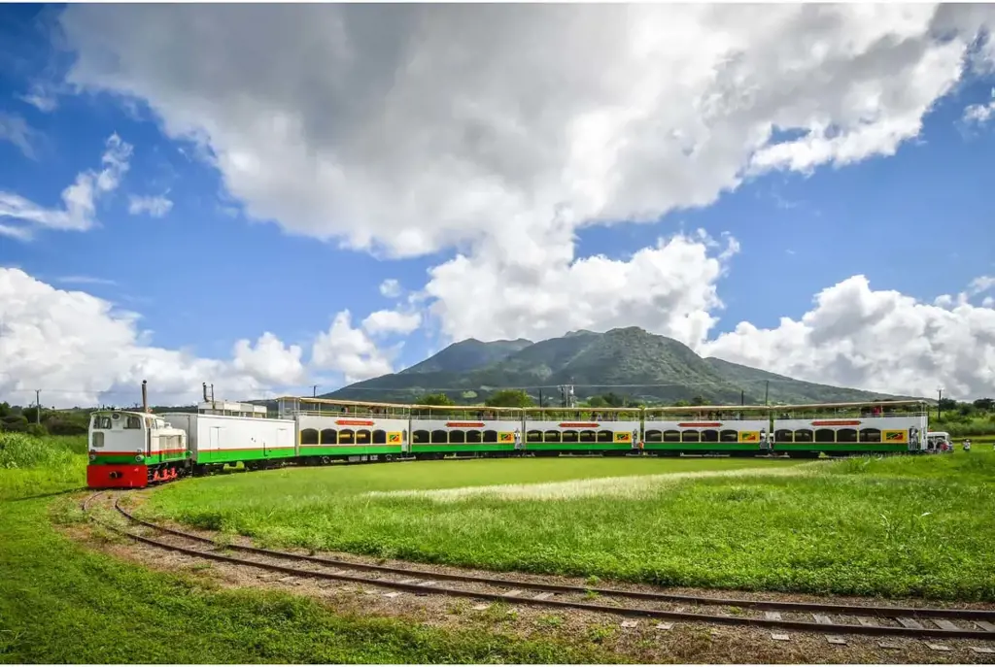
St. Kitts Scenic Railway
One activity you must add to your itinerary is a scenic railway tour of the island. This unique experience will allow you to see some of the best sights Saint Kitts has to offer, all from the comfort of a railway car.
The railway is an 18-mile-long narrow-gauge railway line along the coastline on the island of St Kitts that takes about 2.75 hours.
The railway in Saint Kitts was originally built in the early 1900s to transport sugar cane from the fields to the processing plant. Today, the railway has been converted into a popular tourist attraction that allows visitors to see the island's stunning scenery and learn about its history. Price From: $120.00

Slide 20
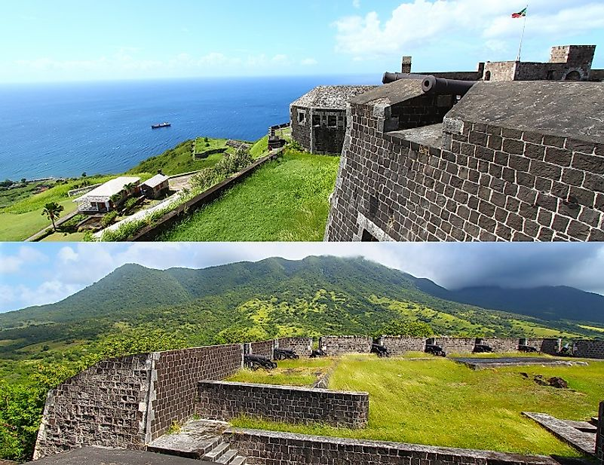
Brimstone Hill Fortress
Also referred to as the "Gibraltar of the West Indies" the fortress should be added to your itinerary for its view and photo op.
If you climb to its top slopes on a clear day, you can see up to six other islands in the distance. You can tour the fort's interior, stroll the grounds, and snap images of nearby towns in the distance or the views of the Caribbean Sea.
If history is more your forte than photography, then you should note that Brimstone Hill Fortress is one of the best-preserved forts of the Americas. It was designated a national park in 1985 and became a UNESCO World Heritage Site in 1999.
Admission $10 for adults and $5 for children.

Slide 21
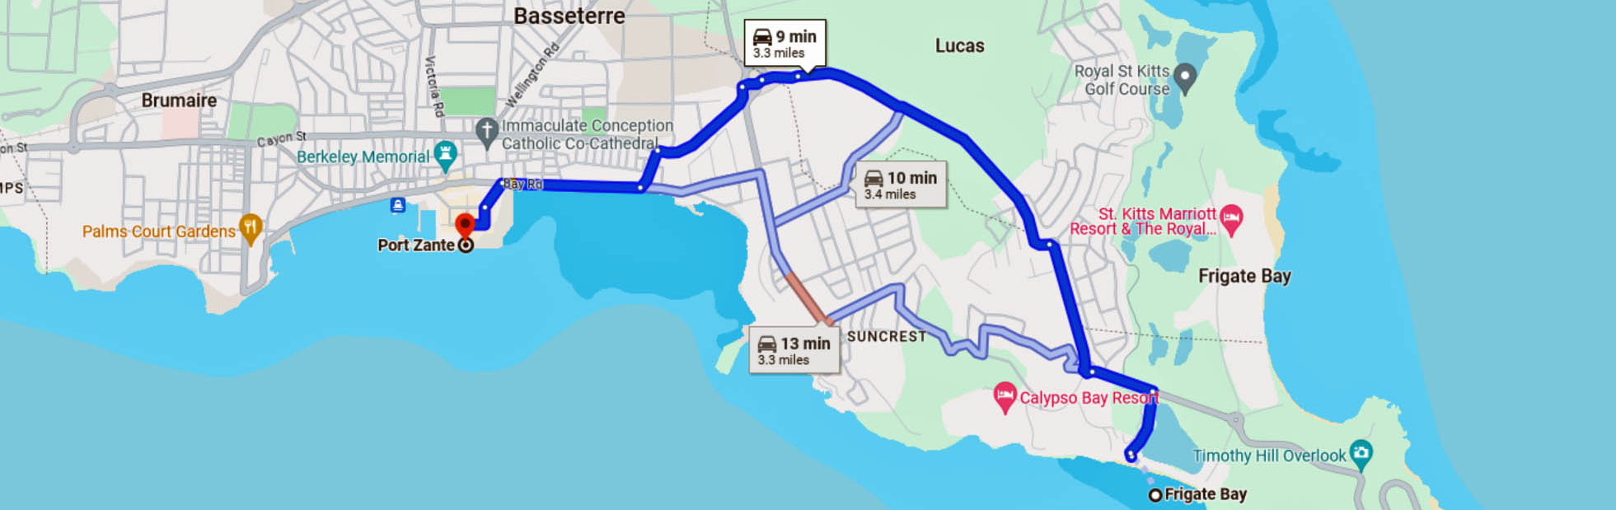
The Beaches of Frigate Bay
Frigate Bay is located on the southern coast of Saint Kitts just 3.5 miles east of the dock. It is home to two beautiful beaches, separated by a tiny peninsula.
The northern beach is called North Frigate Bay, and the southern beach is called South Frigate Bay. Both beaches are stunningly beautiful and offer plenty of opportunities to relax and unwind in the sun, sand, and sea.

Slide 22
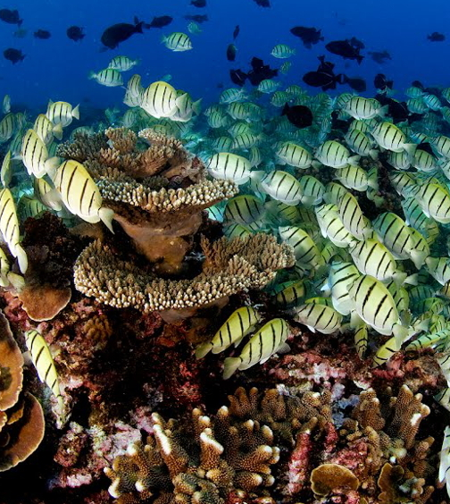
Shitten Bay Marine Reserve
One of the most famous snorkeling and diving spots in Saint Kitts is the Shitten Bay Marine Reserve. This reserve has a reef system that is home to an amazing variety of marine life, including sea turtles, stingrays, schools of colorful fish, and even octopuses!
Several local companies offer snorkeling and diving excursions for all skill levels. These companies provide all the necessary equipment, including snorkeling masks, fins, and life vests. Be sure they include transportation to and from the dock to the dive sites, boat rides, and snacks on board.

Slide 23
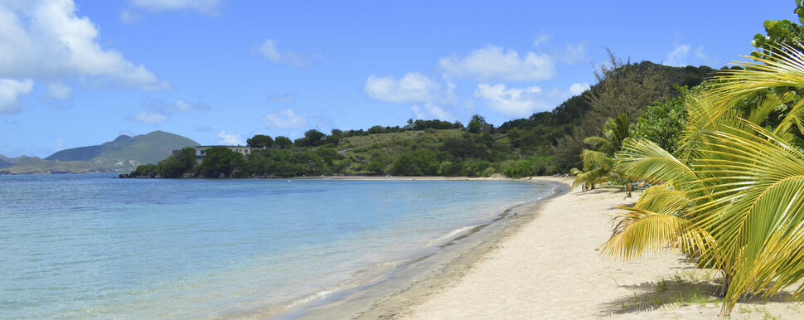
Oualie Beach
Oualie Beach pronounced "wah-lee“ is a black-sand beach on Nevis. It is about 15 miles SE of the port and you also need to take the ferry to get there.
It is an excellent beach for water sports.

Slide 24
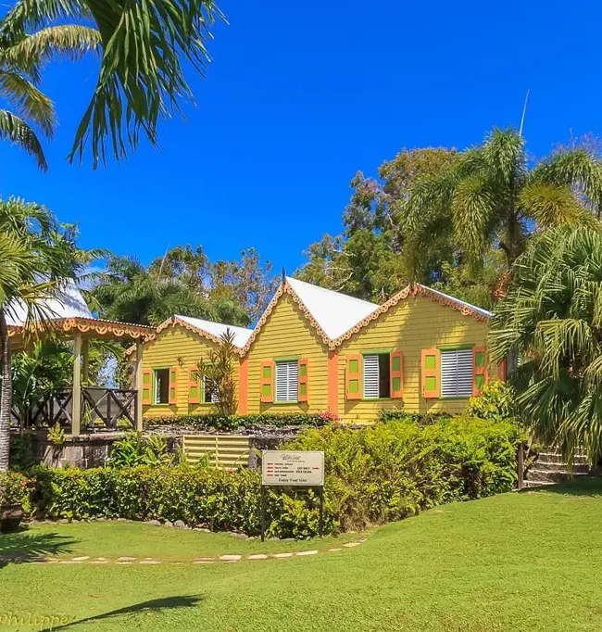
Romney Manor
Located in Old Road Town, the Romney Manor was once a sugar plantation that has since been transformed into a sprawling garden oasis.
The modest house, once named the "red house" to reflect Jeffreson's Quaker roots, was renamed Romney Manor upon its mid-17th-century acquisition by the Earl of Romney. In 1834, contrary to the instruction of the British Parliament, Lord Romney declared his enslaved Africans free men, becoming the first estate in St. Kitts to do so.
Distance is just under 7 miles.

Slide 25
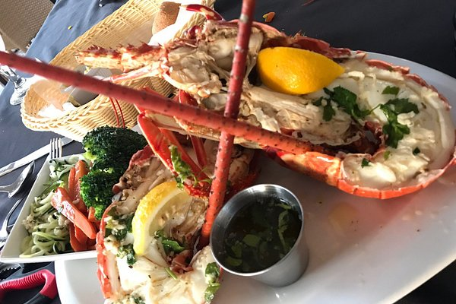
Restaurants
There are a lot of excellent restaurants in Basseterre. Especially for seafood.
Here are some restaurant recommendations:
The View at Palms Court Gardens $$ - $$$ Caribbean, International, Mediterranean
Wilkin Street, Basseterre $$$$ Caribbean, Seafood, Vegan
Christophe Harbour, Basseterre
Serendipity $$$$ Caribbean, Seafood, International
3 Wigley Avenue Fortslands, Basseterre
Marshalls $$$$ Caribbean, Seafood, Vegetarian
Horizons Villa Resort Fort Tyson Rise, Basseterre
Rock Lobster $$ - $$$ Caribbean,Bar, Seafood
Frigate Bay St Christopher Club, Basseterre
Poinciana Restaurant $$ - $$$ Caribbean, Seafood, International
419 Gulf View Frigate Bay, Basseterre
For those of you who just like good food, I am sure you will enjoy Basseterre.

Slide 26
Conclusion
Basseterre is a beautiful City with a rich history and numerous attractions. Regardless of what you're looking for, St. Kitts & Nevis has something for everyone.
I hope this presentation will help when we visit St. Kitts!

Slide 27
Thanks For Coming
If you have any more questions, please ask.
I will do my best to answer them for you.
Have a great visit to St. Kitts & Nevis!

