Slide 1

St. John
US Virgin Islands
Presented by
Marc Silver

Slide 2
What I Will Cover
My Port Philosophy
Don’t Miss the Ship
Money
About St. John
Area Map of St. John
Map of St. John
St. John Transportation
Places to see or at least consider
Conclusion

Slide 3
My Port Philosophy
I have been cruising for over 45 years and have taken over 100 cruises.
So, I consider myself an experienced cruiser.
The information I will present is based on those many years of
experience.
When I am on a cruise where the city, I want to visit is not the port city,
I always recommend taking a ship’s tour.
But when I am in a port with multiple attractions nearby and easy to see
on my own - I will do it on my own.
This presentation is for that type of port.

Slide 4

Don’t Miss the Ship
How to Avoid Missing Your Ship
Pay attention to the time. - Ship time and local time are often
different.
Put a return-to-ship reminder on your phone.
Choose excursions wisely.
If a ship-sponsored excursion is late returning to port, the ship will
wait for you. If you are on your own???
Be Prepared
Have your Passport, Credit Card, and phone numbers for your ship
port agent.
What to Do If You Miss the Ship
Most cruise lines have port agents stationed in the port area to assist if your ship has left without you. If your are lucky, when cruisers are late returning to the vessel, the ship’s crew will often remove the passengers’ essential items – passports, cell phones, and medication -- from the ship to leave with the port agents.
The Port Officials can help you with contacting your ship
and making necessary travel arrangements.

Slide 5
Money
St. John is a US territory and therefore uses the US Dollar.
But for foreign travelers here are some international exchange rates:
US Dollar | 1.00 USD | inv. 1.00 USD
Euro | 0.928324 | 1.077210
British Pound | 0.791784 | 1.262971
Indian Rupee | 82.994609 | 0.012049
Australian Dollar | 1.531256 | 0.653059
Canadian Dollar | 1.345123 | 0.743426
Singapore Dollar | 1.344726 | 0.743646
Swiss Franc | 0.875639 | 1.142023
Malaysian Ringgit | 4.765044 | 0.209862
Japanese Yen | 149.335187 | 0.006696
Chinese Yuan Renminbi | 7.192832 | 0.139027

Slide 6
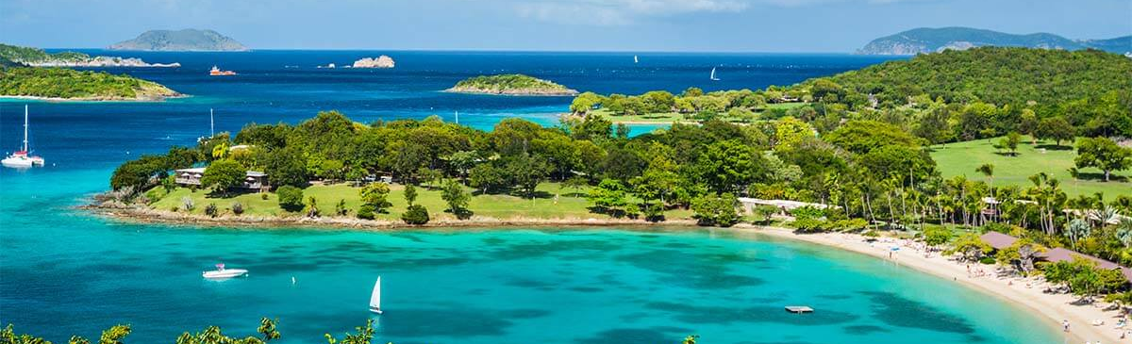
About St. John
Saint John is one of the U.S. Virgin Islands in the Caribbean Sea and a constituent district of the United States Virgin Islands, an unincorporated territory of the United States.
Saint John is the smallest of the three main US Virgin Islands. It is located about four miles east of Saint John, the location of the territory's capital, Charlotte Amalie. It is also four miles southwest of Tortola, part of the British Virgin Islands.

Slide 7
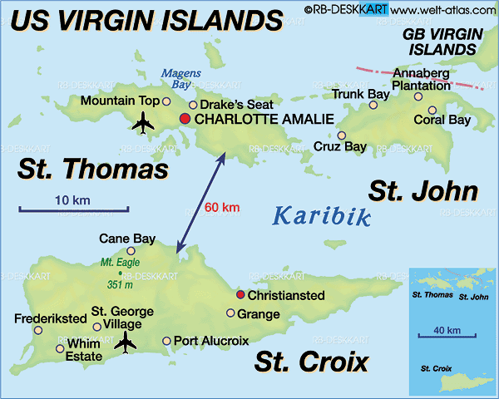
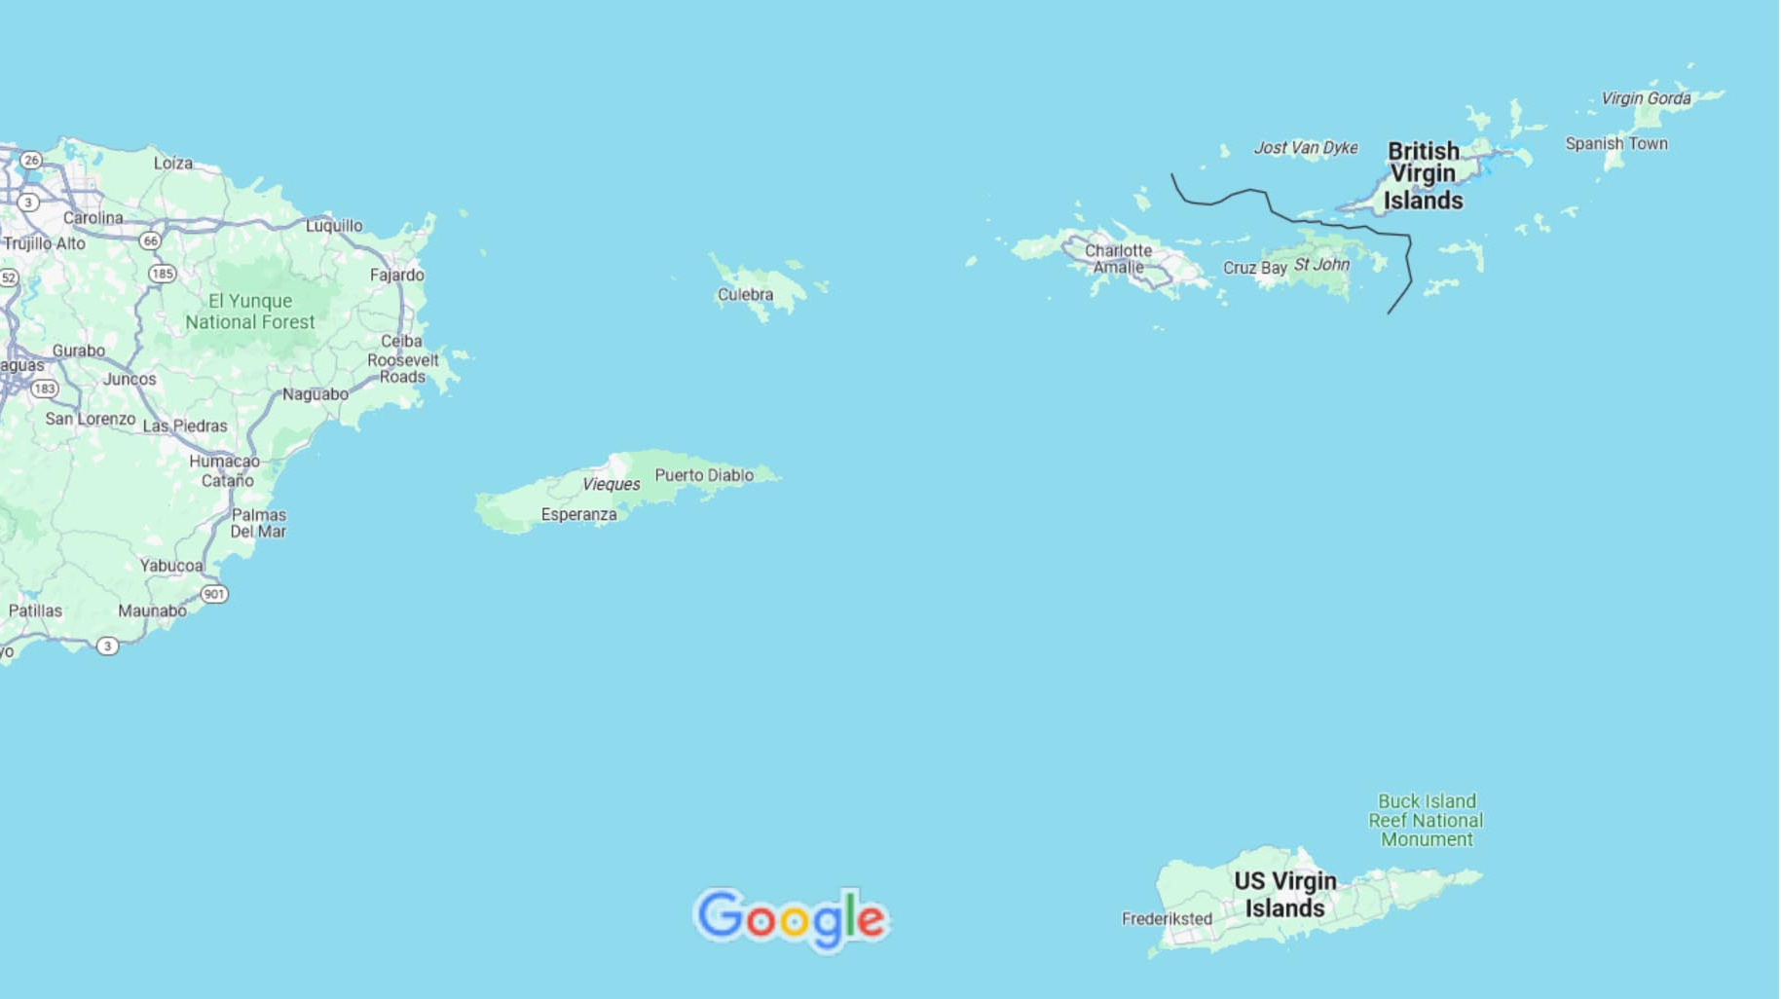
Area Map of St. John
US Virgin Islands

Slide 8
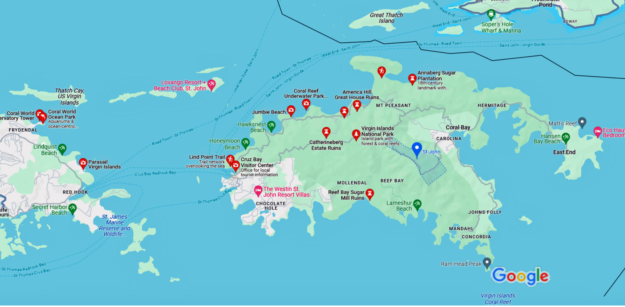
Map of St. John
St. John

Slide 9
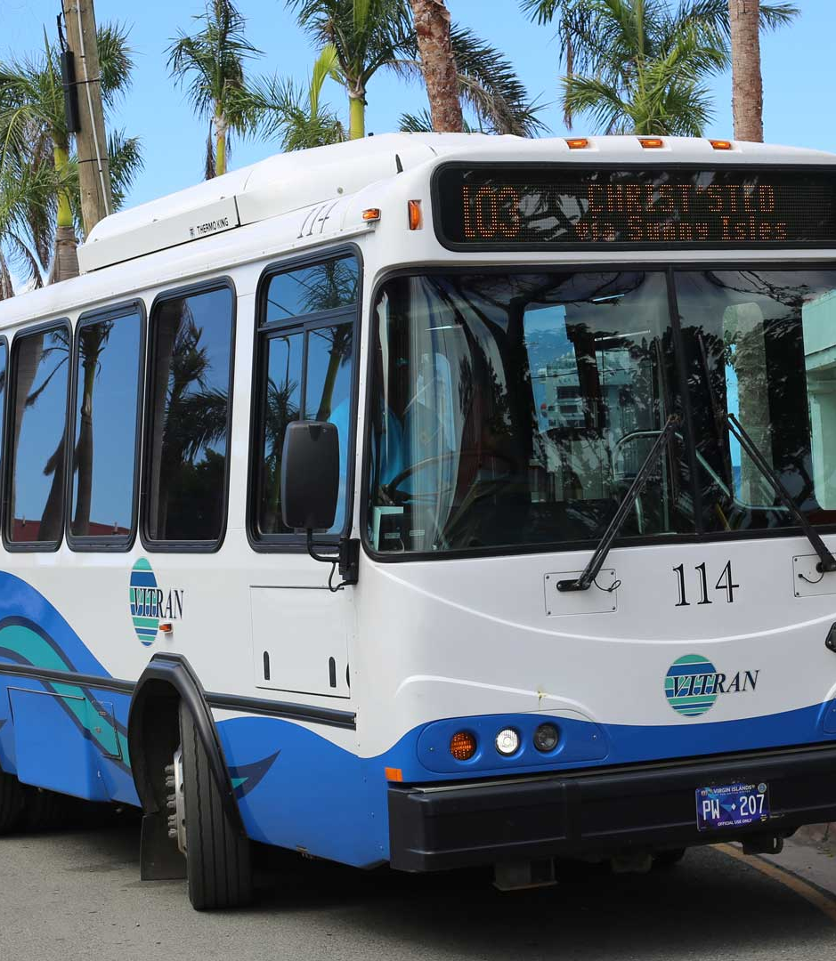
St. John $1 Bus
The Virgin Islands public transit system in St. John is called VITRAN. The bus fare is $1, and there are discounted fares for seniors and students with ID.
Public bus routes on St. John travel through main commercial areas and some residential areas. A short walk from the bus stop to your destination may be required. VITRAN buses are easy to spot. They are generally blue and white, have VITRAN in big letters, and a destination indicator with route number above the windshield.
Public buses in St. John are a good option for travelers on a budget.

Slide 10
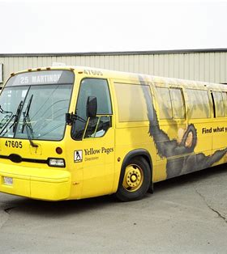
St. John $1 Bus
Three things to be aware of, VITRAN does not cover the entire island of St. John, so check the routes to see if it can work for you.
Second, VITRAN has a reputation for being late, so leave extra time or use another transportation option if on a tight schedule.
Thirdly, a VITRAN Plus service is available for passengers with disabilities. Documentation that the passenger is ADA paratransit eligible in the state or jurisdiction in which they reside is required along with completing an application (which should be done before arrival to St. John).

Slide 11

Taxi on St. John
Taxi service on St. John is well organized and there is a good availability. Popular locations like the ferry dock, Trunk Bay and Cinnamon Bay have a taxi dispatcher on-site and a taxi waiting area.
You can call for a taxi to pick you up at other locations.
St. John taxis charge per person and by destination. There are no metered taxis. Due to limited parking on St. John, particularly at some of the smaller beaches and at most trailheads, taking a taxi is a top choice for getting around the island.
Hourly Rates: For 1-4 passengers, Sedan/Mini Van $60; Van/Safari (14 pax capacity) $70; Safari $90. Rates for additional passengers will be negotiated between the taxi operator and passenger(s).
Sightseeing Tours: One passenger is $70; two or more passengers are $35 per person. The limited time of tours is 2 hours.

Slide 12

Scooter, Motorcycle Rental
St. John does not have options for renting a bicycle, scooter, or motorcycle.
St. John is a challenge for anyone who wants to use two-wheeled transport to get around.
It is a mountainous island, with narrow roads and no designated bike lanes or trails.

Slide 13
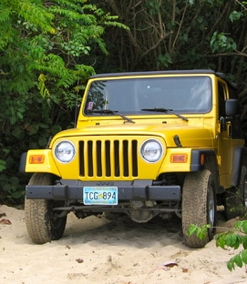
Rent a Jeep
Renting a jeep on St. John is a popular choice. Car rental agencies on St. John are locally owned businesses, and the majority are in Cruz Bay.
There are several agencies to choose from. Jeeps are the most popular vehicle type because St. John is mountainous, and many of the island’s villas have steep access roads and driveways.
Average prices on rentals range from $65 to $100 a day and differ depending on the time of year or season.
A Jeep Wrangler will run around $70 to $80. Larger vehicles go for $80 to $100. The latter price is for a 7-passenger minivan.

Slide 14
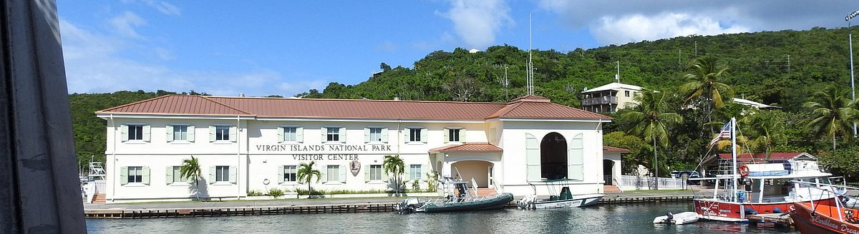
Cruz Bay Visitor Center
The National Park Visitor Center, in Cruz Bay, is the place to start your exploration of St. John. The exhibits presented will introduce you to the park's history, hiking trails, historical sites, and local flora and fauna.
Park rangers can help answer questions about trails and hikes. Brochures about the Park, maps and books are also available. The Visitor Center is open daily from 8 am to 4:30 pm.

Slide 15
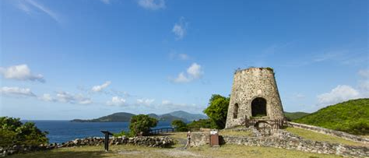
Virgin Islands National Park
Two-thirds of St. John’s 19 square miles is designated as protected national park land. Laurence Rockefeller deeded approximately 9,500 acres of rolling green hills and underwater preserve to the federal government more than 40 years ago.
There are 22 self-guided hiking trails within the Virgin Islands National Park, where visitors can discover ancient petroglyphs and beautiful foliage along the way.

Slide 16
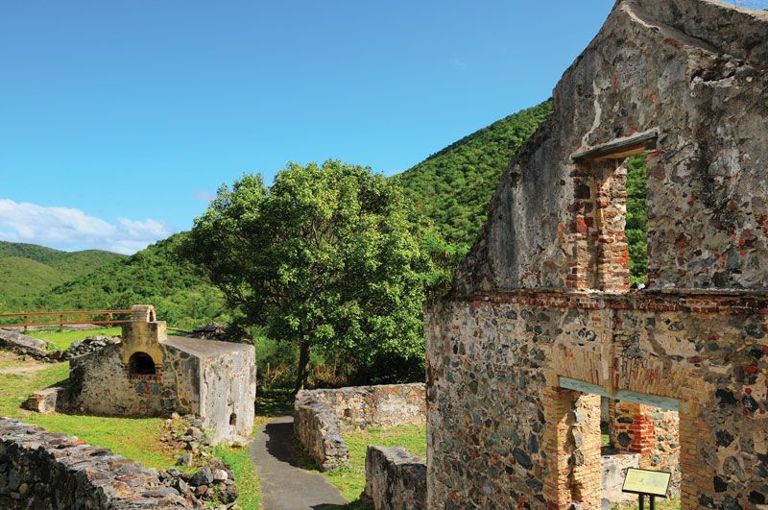
Annaberg Ruins
The Annaberg Plantation is one of several St. John's plantations owned in the 1720s and 1730s by Frederick Moth, the first Danish Governor of St.Croix and, later, the Governor General of the Danish West Indies.
By the early 19th century, Annaberg, one of St. John's biggest sugar producers, also produced molasses and rum for export.
The historic district's extensive ruins include a windmill tower, factory, slave quarters, and structures associated with sugar production.
This former sugar plantation maintains a wealth of history and cultural folklore.
Travelers can revisit the remnants of plantation life and the occupation of slaves during the 18th century. Park rangers conduct demonstrations of early cultural traditions.

Slide 17
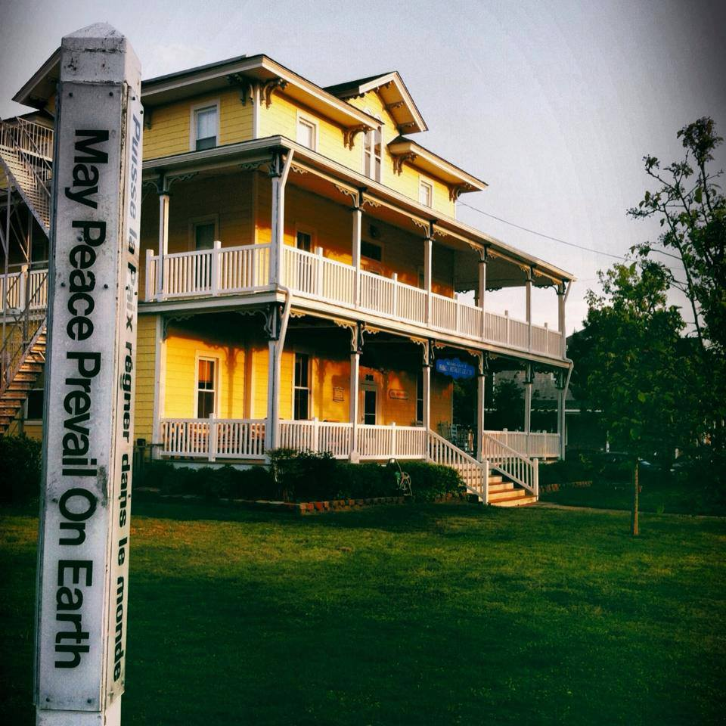
Mary Point Great House and Factory
The Mary Point Great House and Factory, cultivated cotton and raised cattle. The land on which Mary Point Estate is located was originally held by Danish West India and Guinea Company officials during the early years of Danish settlement. Not being prime land for planting, the land was held until new settlers needed property. The van Stell family was the first to control landholding on Mary's Point.
In the aftermath of the 1733 slave insurrection on St. John, Franz Claasen was deeded the Mary's Point estate for alerting the family of the rebellion and assisting in their escape to St. Thomas, a nearby island. Claasen was the first "Free Colored" landowner on St. John.
The plantation itself, under cultivation before 1780, grew in the 19th century to include an L-shaped factory located 300 feet northwest of the Great House. The original one-story masonry of the Great House dates from the mid-19th century.

Slide 18
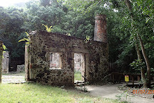
Cinnamon Bay Plantation
Established by the Danes in 1717, Cinnamon Bay Plantation is one of the earliest sugar plantation settlements on St. John. In 1733 the owner of the plantation, Daniel Jensen, played a pivotal role in the slave rebellion that swept the island.
The uprising shook the Caribbean, and the final stages saw the participation of French and English forces to suppress it. The ruins of the former plantation buildings are clustered around the North Shore Road, including the
horse mill and "Bagasse Shed," where crushed
cane stalks were dried before use as a fuel in the
boiling process of the cane juice.
The plantation includes the factory building,
containing the boiling bench and crystallizing
pan, plantation house, cook house, slave quarters,
two cemeteries and a warehouse.

Slide 19
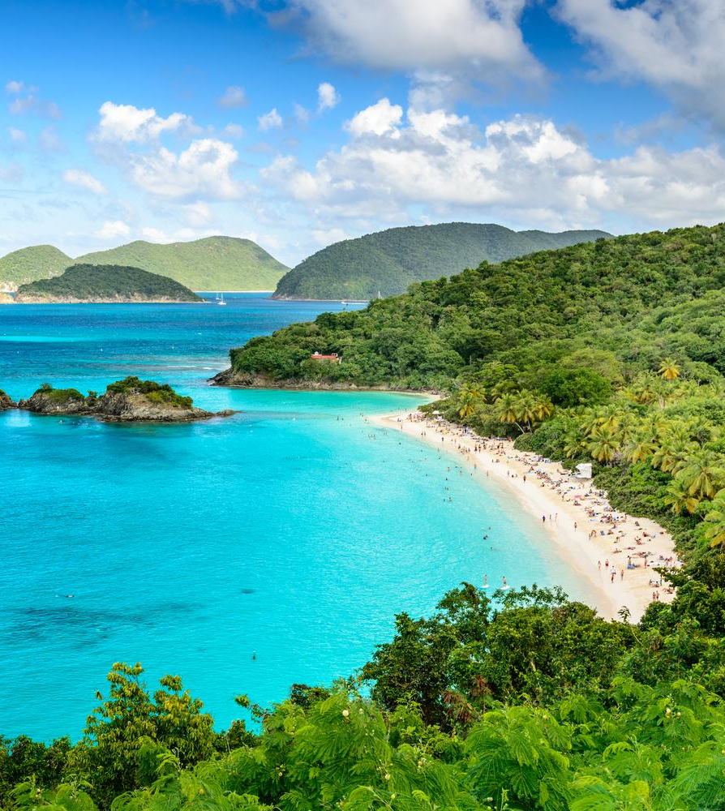
Beautiful Beaches
St. John offers some of the most beautiful beaches in the Caribbean. Nearby beaches including Cruz Bay Beach and Salomon Beach.
Trunk Bay and Hawkesnest Bay are also very popular. No matter where you go the drive is less than 12 miles.

Slide 20
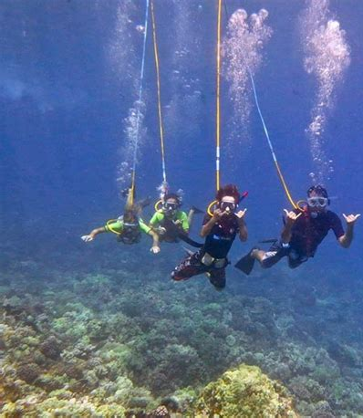
Water Activities
Snorkeling, snuba, and scuba diving are ways to explore St. John’s underwater paradise.
Coral Reef Underwater Park Trail visitors interact with extraordinary flora and fauna at Trunk Bay, where underwater placards placed on the snorkeling trail describe the surrounding ecology.
Colorful fish and coral are abundant in the waters off this island.
Snuba, an activity that combines the skills of snorkeling and introductory diving skills, is an option for visitors not quite ready for scuba diving, but interested in exploring the island up to 20 feet beneath the surface.

Slide 21
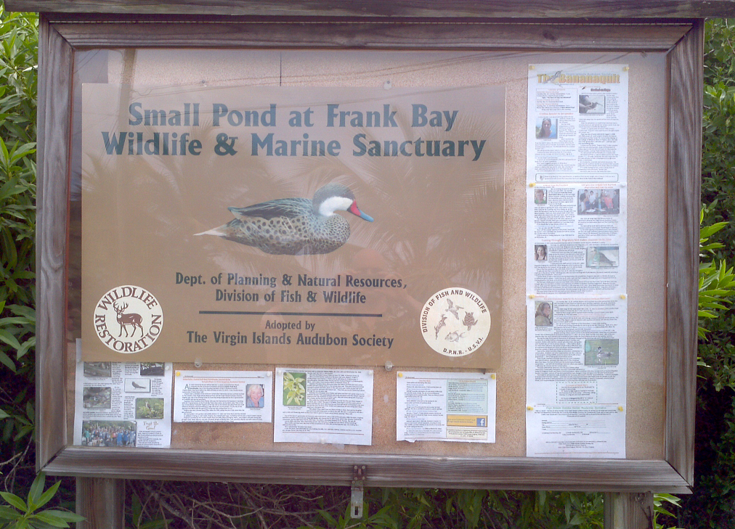
Frank Bay Wildlife and Marine Sanctuary
The U.S. Virgin Islands is building a new observation pier at a wildlife sanctuary in St. John for bird lovers.
Gov. John de Jongh Jr. said that the local Audubon Society will help build the pier at the Frank Bay Marine Reserve and Wildlife Sanctuary. The site draws thousands of tourists a year. For the first time, the pier will also give visitors a full view of the area’s pond near Cruz Bay.
From Cruz Bay head west toward towards Wharfside Village or walk along the beach towards Gallows Point. When the beach ends you’ll walk up the hill, past the old cemetery. As you crest the hill, Gallows Point will be on your right and Frank Bay will be in front of you. Take your first right. The narrow road drops down to the beach.

Slide 22
Conclusion
St. John is a beautiful City with a rich history and numerous attractions. Regardless of what you're looking for, St. John has something for everyone.
I hope this presentation will help when we visit St. John!

Slide 23
Thanks For Coming
If you have any more questions, please ask.
I will do my best to answer them for you.
Have a great visit in St. John!

