Slide 1

St. Croix
Virgin Islands
Presented by
Marc Silver

Slide 2
What I Will Cover
My Port Philosophy
Don’t Miss the Ship
Money
About St. Croix Islands
Area Map of St. Croix
Map of St. Croix
St. Croix Transportation
Places to see or at least consider
A few restaurant recommendations
Conclusion

Slide 3
My Port Philosophy
I have been cruising for over 45 years and have taken over 100 cruises.
So, I consider myself an experienced cruiser.
The information I will present is based on those many years of
experience.
When I am on a cruise where the city, I want to visit is not the port city,
I always recommend taking a ship’s tour.
But when I am in a port with multiple attractions nearby and easy to see
on my own - I will do it on my own.
This presentation is for that type of port.

Slide 4

Don’t Miss the Ship
How to Avoid Missing Your Ship
Pay attention to the time. - Ship time and local time are often
different.
Put a return-to-ship reminder on your phone.
Choose excursions wisely.
If a ship-sponsored excursion is late returning to port, the ship will
wait for you. If you are on your own???
Be Prepared
Have your Passport, Credit Card, and phone numbers for your ship
port agent.
What to Do If You Miss the Ship
Most cruise lines have port agents stationed in the port area to assist if your ship has left without you. If your are lucky, when cruisers are late returning to the vessel, the ship’s crew will often remove the passengers’ essential items – passports, cell phones, and medication -- from the ship to leave with the port agents.
The Port Officials can help you with contacting your ship
and making necessary travel arrangements.

Slide 5
Money
St. Croix is a US territory and therefore uses the US Dollar.
But for foreign travelers here are some international exchange rates:
US Dollar | 1.00 USD | inv. 1.00 USD
Euro | 0.928324 | 1.077210
British Pound | 0.791784 | 1.262971
Indian Rupee | 82.994609 | 0.012049
Australian Dollar | 1.531256 | 0.653059
Canadian Dollar | 1.345123 | 0.743426
Singapore Dollar | 1.344726 | 0.743646
Swiss Franc | 0.875639 | 1.142023
Malaysian Ringgit | 4.765044 | 0.209862
Japanese Yen | 149.335187 | 0.006696
Chinese Yuan Renminbi | 7.192832 | 0.139027

Slide 6
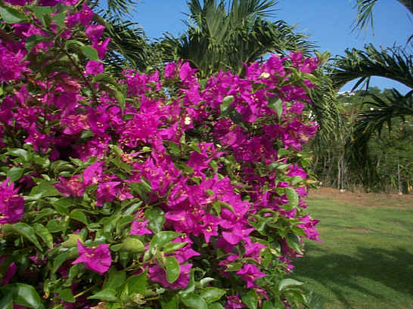
About St. Croix
St. Croix's history spans the rule of seven nations, each influencing the customs, character, language, and architecture of the island. Even today, with modern conveniences, St. Croix retains the old-world charm that has vanished on many other islands.
The island is on the same latitude as Acapulco and Hawaii, where it is eternal summer caressed by cooling Tradewinds.
The average temperature is in the mid-80s, and there’s just enough rain to keep the hibiscus, and bougainvillea in bloom year-round
The eastern end is dry, with giant cactus and yucca clusters. The middle is flat fertile land, once the site of massive sugar cane plantations, while the western end rises to a height of 1,096 feet on Blue Mountain, culminating in a rainforest of giant mahogany, saman, and Tibet trees.

Slide 7
About Christiansted
One of two towns on the island, and a National Historic Site, Christiansted was once the Capital of the Danish West Indies and was founded in 1734.
The architectural quality of the town is remarkable, with cobblestone walkways shaded by large arched galleries. Many buildings and homes on St. Croix are not air-conditioned thanks to this ingenious practical design. The buildings were constructed from cut coral blocks and Danish brick brought as ballast.
Thick walls keep the interiors cool, and courtyards and arcades provide shaded retreats. Narrow streets were wide enough for the mule carts of the 1800s!
Ongoing interest continues and plans are underway for the historic restoration of old buildings on the outskirts of town.
Historic churches, charming courtyards, shaded walkways, stone arches, antique lampposts and rows of restored townhouses add to the city's appeal. Relax on a tranquil, white sand beach or float in the aquamarine water. Enjoy the many shops, boutiques, galleries, cafes and restaurants, or visit attractions like Fort Christianvaern, the Customs House and the Old Scale House.

Slide 8
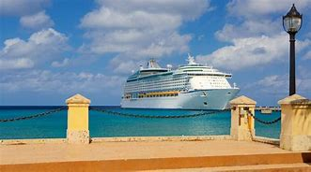
About Frederiksted
Victorian Gingerbread, wide streets, and a picturesque waterfront the full length of the town make Frederiksted one of the most beautiful in the Caribbean. Freedom City, as it is known, has a rich history.
Smugglers and pirates of the mid-1700s necessitated the construction of Fort Frederik in 1752. The city was destroyed by fire in 1758, and rebuilt in the Victorian style of the era. Time seems to have passed the city by, but the beautiful park, and open-air vendors mart come alive on the days the sleek cruise ships dock at the new pier.
On those evenings, Harbor Night turns Strand Street into a festival, with mocko jumbie stilt dancers, steel pan bans, and street vendors offering local food and drink. Navy ships and subs from the US and foreign fleets dock here often for R&R and frequently give tours of the vessels.

Slide 9
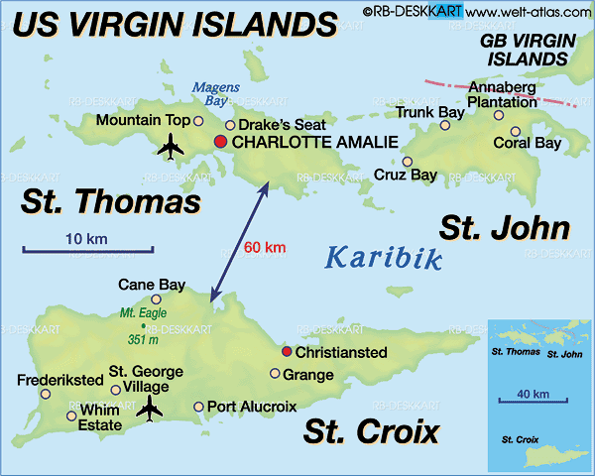
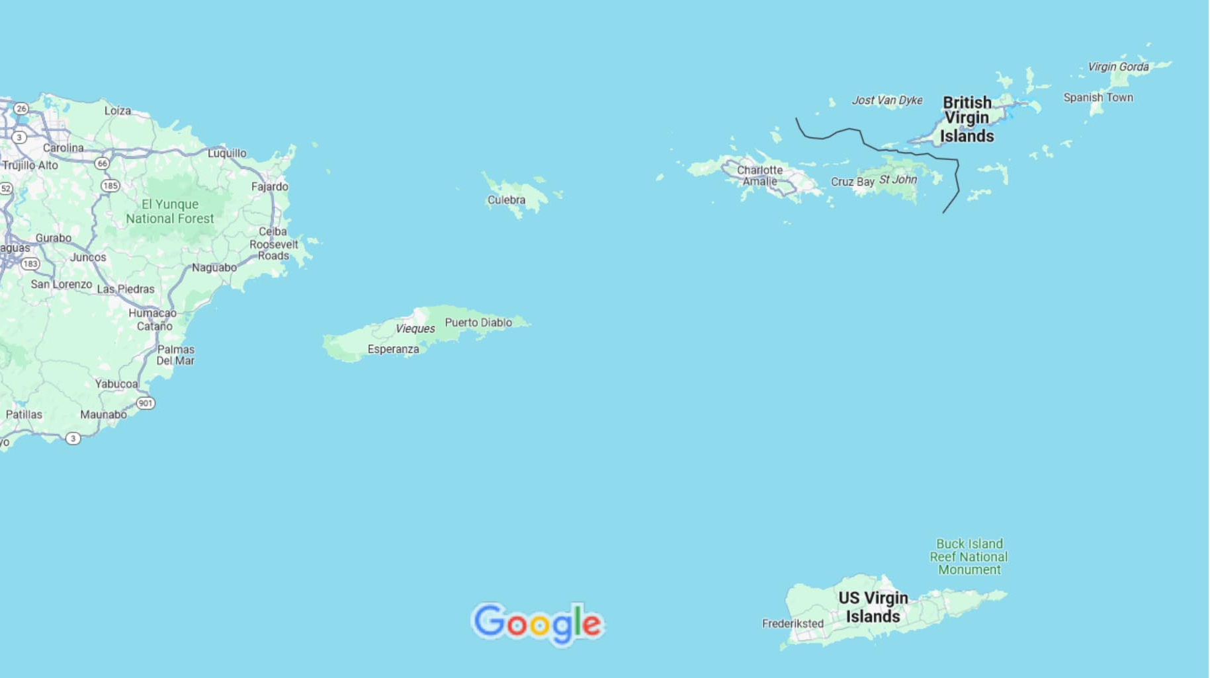
Area Map of St. John
US Virgin Islands

Slide 10
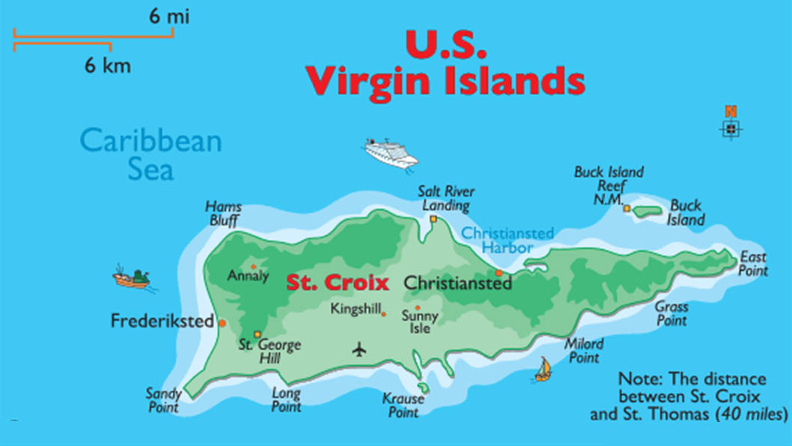

Slide 11
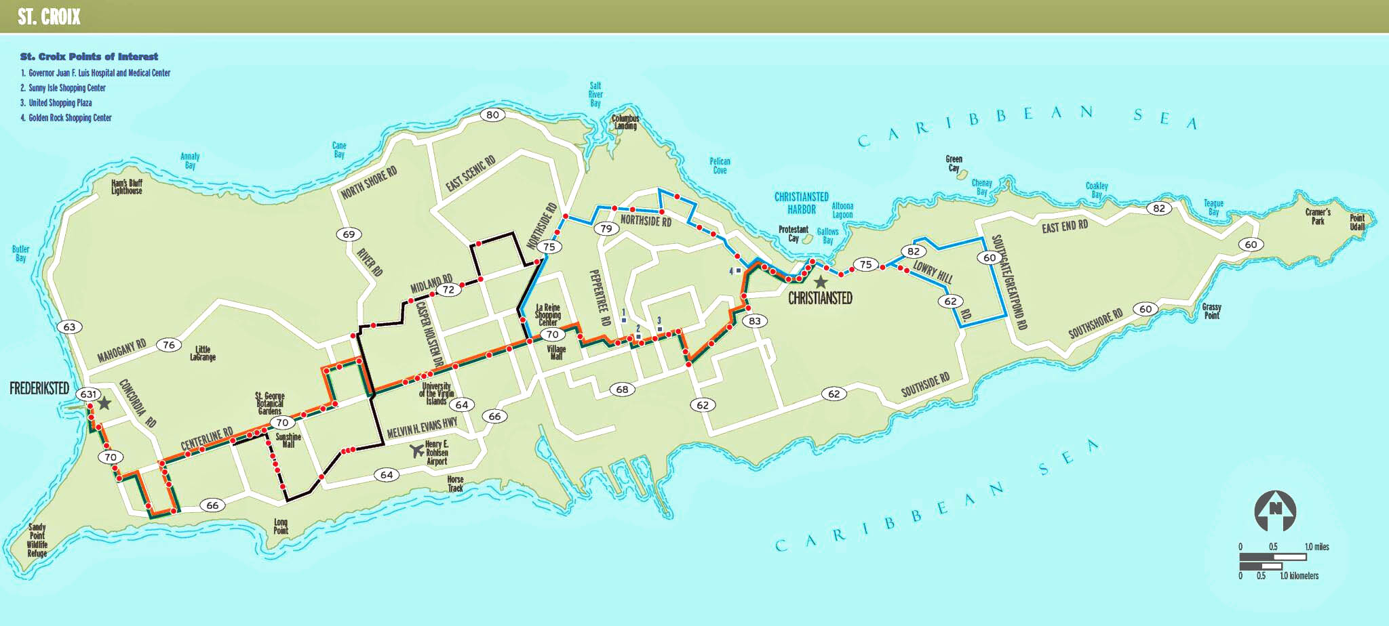
St. Croix Buses
The Vitran Public Bus System services various areas of the island with Air-conditioned buses running between Christiansted and Frederiksted about every 2 hours. No service on Sundays.
They start at Tide Village, to Christiansted, and travel along Route 75 to Golden Rock shopping center. Stops at Sunny Isle Shopping Center, La Reine Shopping Center, St. George’s Botanical Gardens, and Whim Plantation before getting to Frederiksted.
Bus service fare is $1 a person. Senior Citizens receive a discounted fare of $.55.

Slide 12
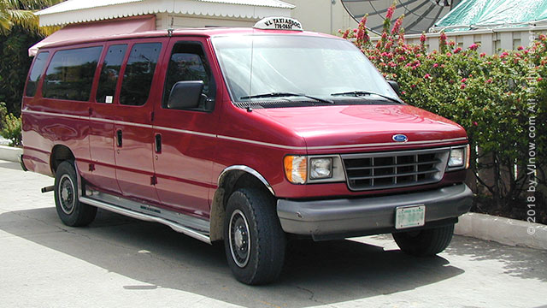
St. Croix Taxis
Taxi Service is easy to use in St. Croix. The Frederiksted cruise ship pier always has taxis waiting to assist you. Taxis can be called to pick you up at other destinations.
Taxis charge per person by destination, there are no metered taxis.
Hourly Rates: Sedan/Mini Van $60, Van/Safari (up to 14) - $83, Safari - $120. Rates for additional passengers will be negotiated between the taxi operator and passengers.
Sightseeing Tours last about 3 hours, and rates are as follows: 1-4 passengers - $150; additional passengers at $30 each.
Confirm your price before tour.

Slide 13

Car Rental in
When renting a car in Frederiksted, Saint Croix, there are a few different vehicle models that are particularly convenient for the region. You can always choose to rent a convertible to enjoy the sunshine.
If you need more room for a large family, you may wish to opt for an SUV or van so you can have enough room for everyone.
When going on long road trips or driving in
the mountains, consider renting a car with
four-wheel drive.
On average a rental car in Saint Croix costs
about $86 per day.

Slide 14
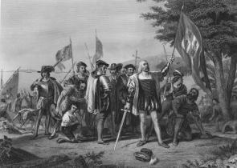
Columbus Landing Site
This engraving depicts Columbus’s first landing in the New World, on the island he called San Salvador, on October 12, 1492. Columbus is surrounded by his men on the beach. Discussing the landing in his journal, Columbus wrote that he "leaped on shore, and . . . took, possession of the said island for the King and for the Queen."
In the engraving, he holds a sword in one hand and the royal banner of Aragon and Castile in the other, declaring the discovery for
Spain. To the side, Native Americans watch the
Europeans from behind a tree. In his journal,
Columbus recorded that they "asked us if we had
come from heaven" and called them "the best
|people in the world, and the gentlest.
He also, however, made note of his plan to "with
force . . . subjugated the whole island."

Slide 15
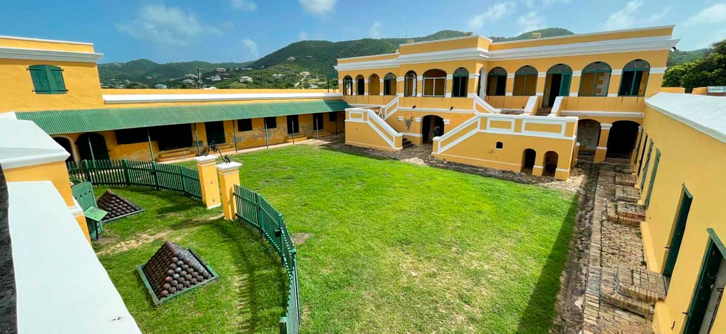
Founded on the site of an earlier French settlement, Christiansted was laid out in a grid pattern with two marketplaces.
Christiansted Historical District
Market Square is located between Company and King Streets in the west end of town and Sunday Market is bounded by King's Cross and Queen's Cross Streets on the south side of Company Street.
The Christiansted Historic District, which includes the Christiansted National Historic Site, illustrates a continuation of building activity since the Danish colonial era.
Christiansted was laid out by Frederick Moth, later the first Danish governor of St. Croix. Moth planned streets, subdivided the town, built an eastern fort for protection, and established a series of building restrictions and codes.
The Christiansted National Historic Site, administered by the National Park Service, includes buildings along the waterfront that illustrate the life of a colonial society based on a sugar-producing plantation economy. Notable buildings located within the Christiansted National Historic Site include Fort Christiansvaern and the Old Danish Customs House.

Slide 16
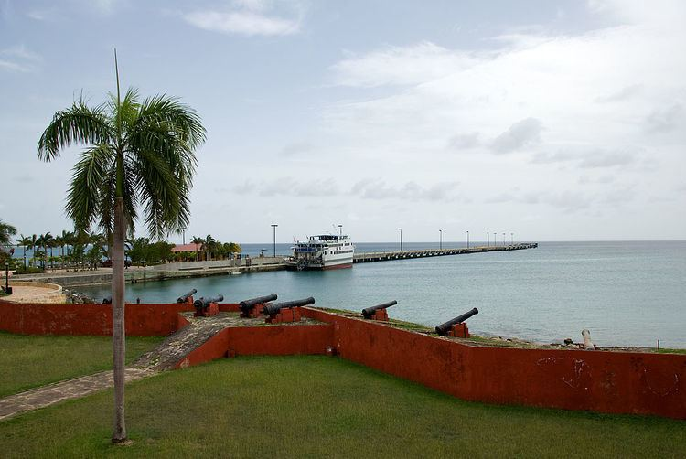
Frederiksted Historic District
The Frederiksted Historic District symbolizes 200 years of western St. Croix's political history. Fort Frederik constructed by the Danes the following year to protect them from pirates, was the focal point of the town plan.
Building codes resulted in the characteristic low buildings, with overhanging galleries supported by arched arcades on slender wood posts.
By 1800, the town's population included dock and warehouse workers, white and free-African craftsmen, house servants, merchants, planters, and government officials.
In 1878, plantation workers dissatisfied with low wages, set fire to much of the town.
Important buildings in the district include the fort, the
Customs House and the Victoria Home, one of the most
elaborately detailed buildings in the Virgin Islands and
St. Patrick's Roman Catholic Church was built in 1848.
The Benjamin House, at 48 Queen Street, is a fine example
of early 19th-century Danish residential design.

Slide 17
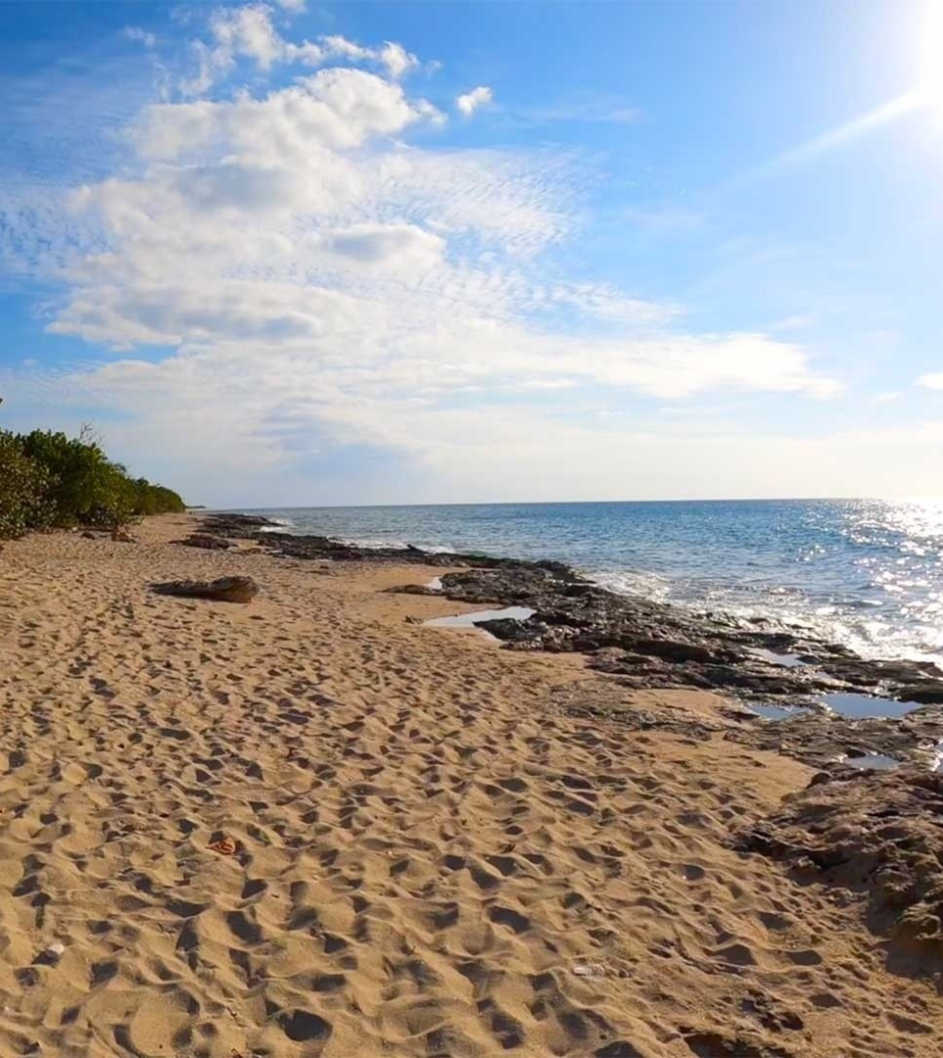
Explore Nearby Beaches
The east side of the island has the best beaches. But there are excellent beaches to enjoy everywhere on the island.
West Beach in St. Croix is located on the West side of the island, just 1.3 miles south of the peir.
This beautiful beach is great for a long walk or just sitting and enjoying the views and has both soft sand and amazing rocky areas.
Coconuts Beach is just a short .6 miles walk north of the pier, and offers a great place to relax close to the ship.

Slide 18
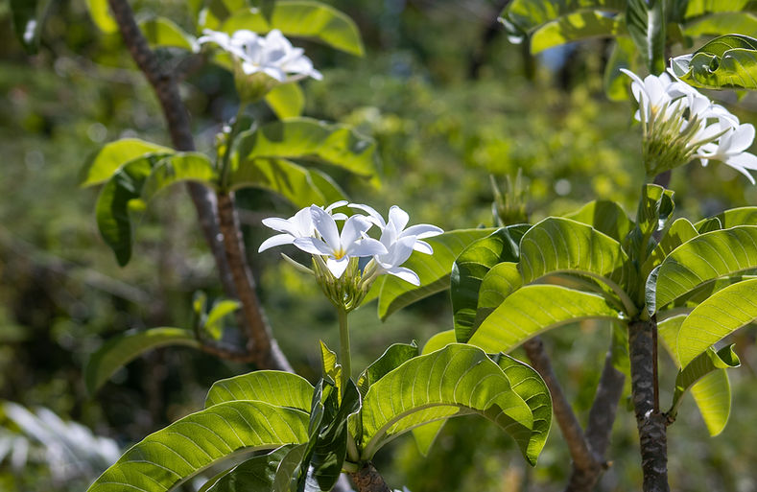
St. Croix’s Botanical Garden
Over 1,000 species of tropical plants await at the St. George Village Botanical Garden; it's an ideal stop for visitors looking for a serene and shady escape in St. Croix. Covering over 16 acres on the ruins of one of the island's many former sugar plantations, this lush garden is just a short drive from Frederiksted and it brings new life to a historic destination.
The Herbarium is a collection of over 6,000 dried and pressed plant specimens representing about 80 percent of the plant species known to be growing in the U.S. Virgin Islands.
General Admission
Adults: $10
Seniors: $8
Children Under 10: $2

Slide 19
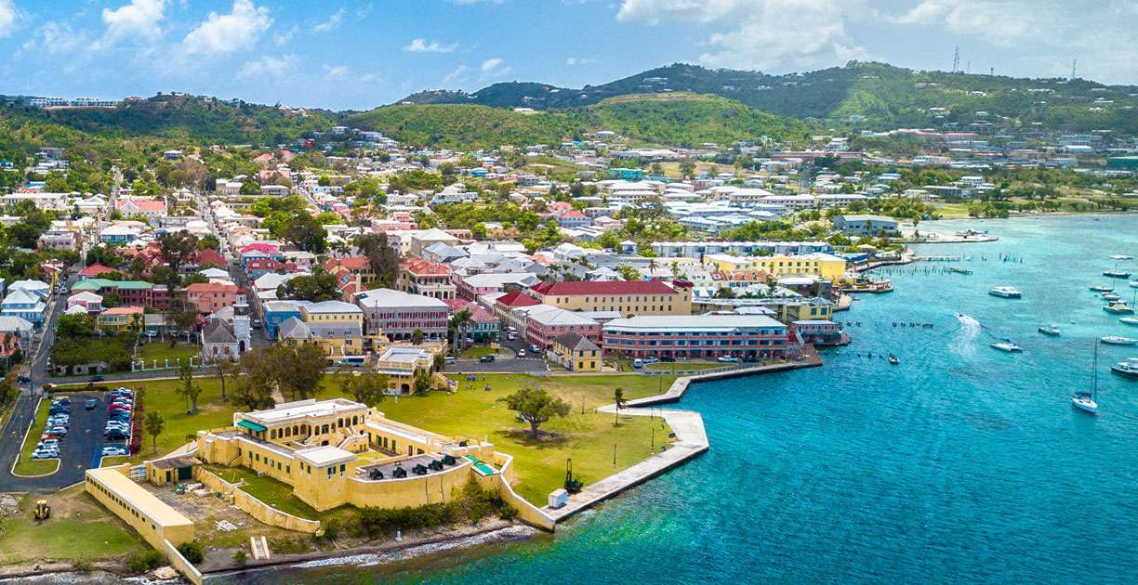
Christiansted National Historic Site
Established in 1952, Christiansted National Historic Site spans seven acres and comprises multiple historic buildings, including customs and government structures from the colonial area.
The fort was constructed in 1738 on the remains of an earlier French fortification destroyed by a hurricane. The fort protected commerce from piracy and privateers, and local citizens from slave revolts. The first Danish governors were also housed there.
The British occupied the colony from 1801 to 1803 and from 1807 to 1815. The fort housed the police headquarters, court offices, courthouse, and archives starting in 1878
Fort Christiansvaern is the centerpiece of the site and the best-preserved of the Danish-built forts in the U.S. Virgin Islands.
It's the perfect destination for history buffs, and plenty of locals and visitors make use of the area's well-kept lawns for picnics and events.

Slide 20
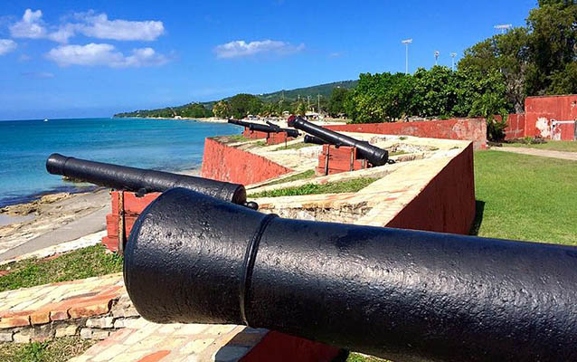
Fort Frederik
Completed in 1760, Fort Frederik is one of St. Croix's most important historic sites from its Danish colonial period. It was also the site where the island's governor declared emancipation in 1848.
Located on the west side of the island Fort Frederik, was built out of necessity by the Danish government to protect St. Croix against invasion of European powers, smugglers and pirates!
During the twentieth century, Fort Frederik served as
a police station, jail, court, fire department, public
library, and telephone exchange. The structure was
vacated in 1973 and restoration as a historic site was
completed by the Virgin Islands government in 1976.
At that time the fort was restored to its 1780
configuration, and it currently serves as an
interpreted facility and local, history museum.
The fort also features a rotating art exhibit.

Slide 21
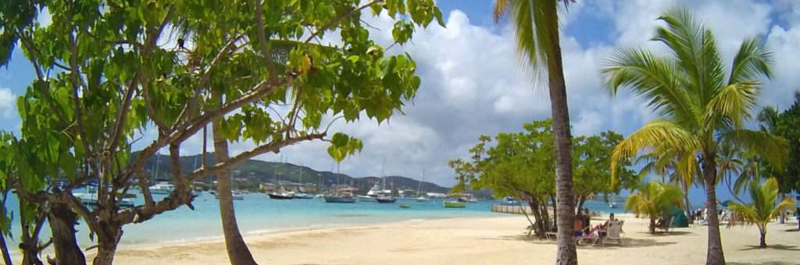
Protestant Cay
A water taxi to and from the Christiansted pier can take you to the white-sand beaches of Protestant Cay all day long. It's the most easily accessible beach for visitors to Christiansted.
This beautiful cay gets its name from its past as an age-old Protestant burial ground.

Slide 22
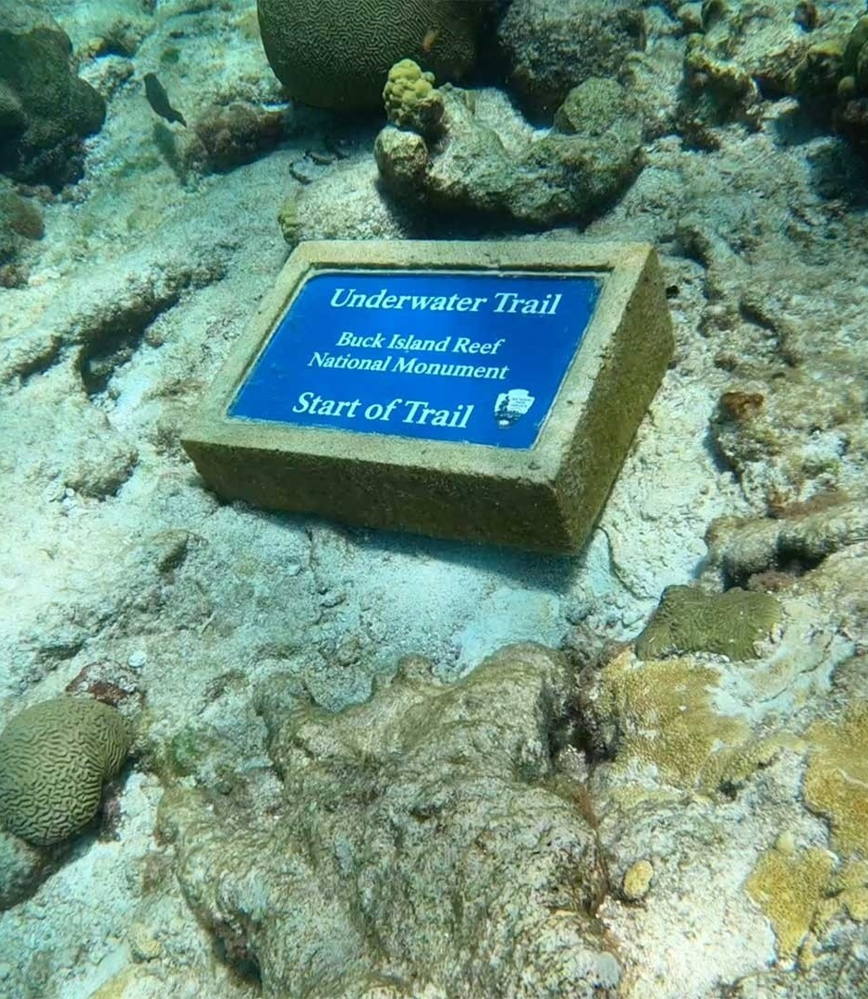
Buck Island Reef National Monument
Buck Island is a 176-acre island surrounded by a stunning (and well-protected) coral reef ecosystem.
This is a protected sanctuary for endangered sea turtles, a wide variety of fish, beautiful corals, and more. I even spotted a shark while I was snorkeling through the reef!
Not only can you relax on Turtle Beach, but you can also snorkel and scuba dive to fully explore the beauty of the coral reef. Snorkeling the reef offers an incredible experience without needing a scuba certification.

Slide 23
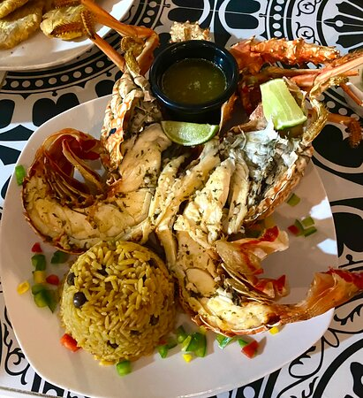
Restaurants
There are a lot of excellent restaurants in St. Croix. Especially for Caribbean seafood.
Here are some recommendations:
Rhythms at Rainbow Beach $$ - $$$ American, Caribbean, Bar
Rainbow Beach, Frederiksted $$ - $$$ American, Caribbean, Bar
127 Smithfield Rd Sand Castle on the Beach Hotel, Frederiksted
Cibone $$$$ Caribbean, Seafood, Vegetarian
227 King St, Frederiksted
Rhythms at Rainbow Beach $$ - $$$ American, Caribbean, Bar
Rainbow Beach, Frederiksted $$ - $$$ American, Caribbean, Bar
127 Smithfield Rd Sand Castle on the Beach Hotel, Frederiksted
Alba's Restaurant Caribbean, Latin Spanish, Puerto Rican
60 Queen St, Frederiksted

Slide 24
Conclusion
St. Croix is a beautiful Island with a rich history and numerous attractions. Regardless of what you're looking for, St. Croix has something for everyone.
I hope this presentation will help when we visit St. Croix!

Slide 25
Thanks For Coming
If you have any more questions, please ask.
I will do my best to answer them for you.
Have a great visit to St. Croix!

