Slide 1
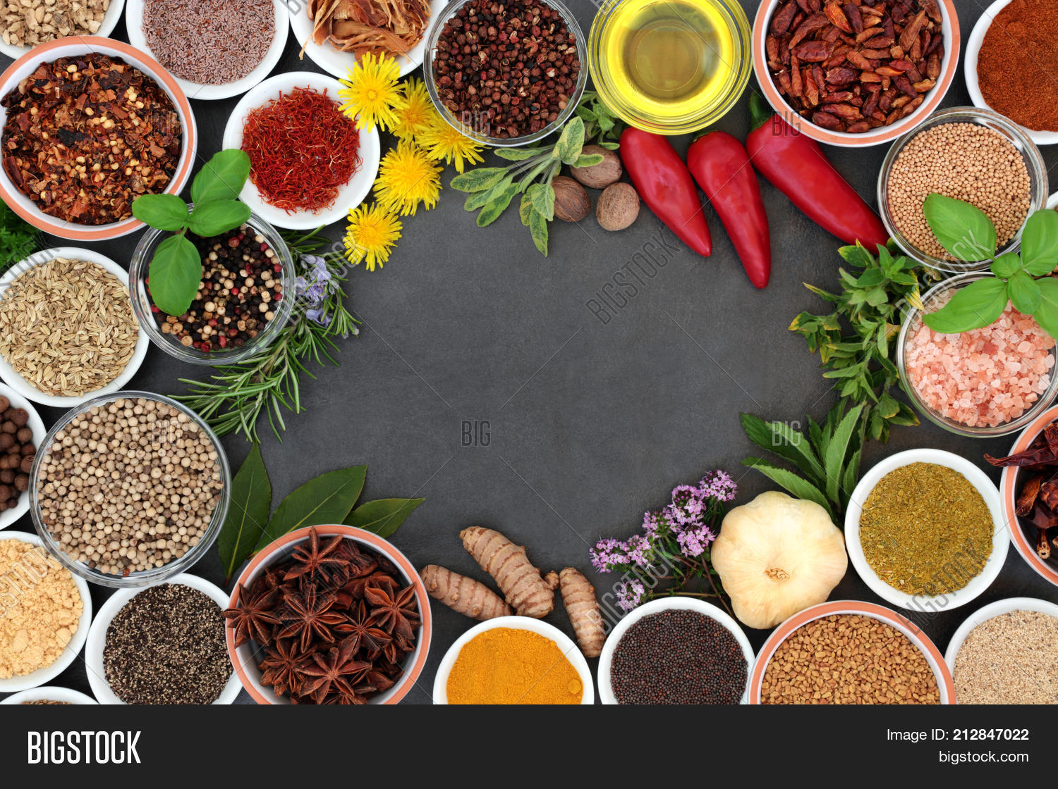
The Spice Trade
How a Few Tiny Islands
Changed the World
By Marc Silver
Notes:
Greetings
Let me start with a simple question.
What would you be willing to travel halfway around the world for?
Adventure? Fortune? A new life?
Five hundred years ago European nations were willing to risk ships, fortunes, and lives for something far smaller. Spices.
Tiny dried seeds and flower buds that today sit quietly in our kitchen cabinets.
Yet those spices launched global exploration, created powerful trading empires, and helped shape the modern world.

Slide 2
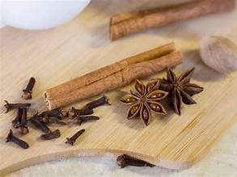
A Simple Question
Cloves and nutmeg.
Most of us recognize them instantly. They show up in holiday baking, pumpkin pie, or mulled wine.
Today they are ordinary.
But there was a time when spices like these were among the most valuable commodities on Earth.
Merchants guarded them like treasure.
Kings taxed them.
And sailors risked storms, disease, and shipwreck just to reach the places where they grew.
So the obvious question is… why?
Why did these tiny ingredients become so important?
Notes:
Cloves and nutmeg.
Most of us recognize them instantly. They show up in holiday baking, pumpkin pie, or mulled wine.
Today they are ordinary.
But there was a time when spices like these were among the most valuable commodities on Earth.
Merchants guarded them like treasure.
Kings taxed them.
And sailors risked storms, disease, and shipwreck just to reach the places where they grew.
So the obvious question is… why?
Why did these tiny ingredients become so important?

Slide 3
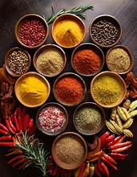
Why Were Spices So Valuable?
To understand that, we have to think about life before modern refrigeration.
In medieval Europe food spoiled quickly.
Meat especially could become dangerous within a few days.
Spices played several roles.
They helped preserve food.
They masked unpleasant flavors when food began to turn.
They were used in medicine and herbal remedies.
Spices were also used in perfumes and religious rituals.
And beyond practical uses, they became symbols of wealth.
Serving heavily spiced dishes at a banquet signaled status and prosperity.
Spices were both useful and fashionable.
And that combination created enormous demand.
Notes:
Why Were Spices Valuable?
Speaker Script
To understand that, we have to think about life before modern refrigeration.
In medieval Europe food spoiled quickly.
Meat especially could become dangerous within a few days.
Spices played several roles.
They helped preserve food.
They masked unpleasant flavors when food began to turn.
They were used in medicine and herbal remedies.
Spices were also used in perfumes and religious rituals.
And beyond practical uses, they became symbols of wealth.
Serving heavily spiced dishes at a banquet signaled status and prosperity.
Spices were both useful and fashionable.
And that combination created enormous demand.

Slide 4
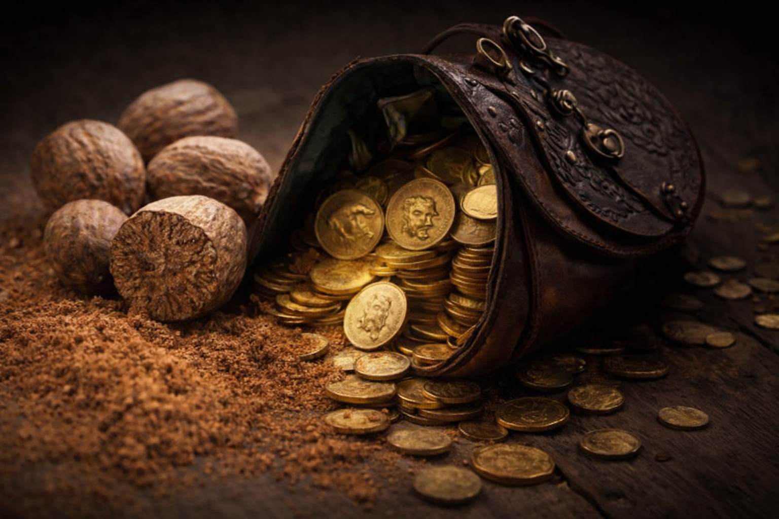
Worth More Than Gold
Now here is the part that almost sounds unbelievable.
At times, nutmeg sold in Europe for more than gold by weight.
Notes:
Now here is the part that almost sounds unbelievable.
At times, nutmeg sold in Europe for more than gold by weight.
Imagine that.
A small seed from a tropical tree worth more than a precious metal.
How could that happen?
The answer lies in rarity and distance.
Nutmeg only grew naturally in one place on Earth.
A small group of islands thousands of miles away from Europe.
Every pound of nutmeg traveled through multiple trading networks before reaching European markets.
And every step increased the price.

Slide 5
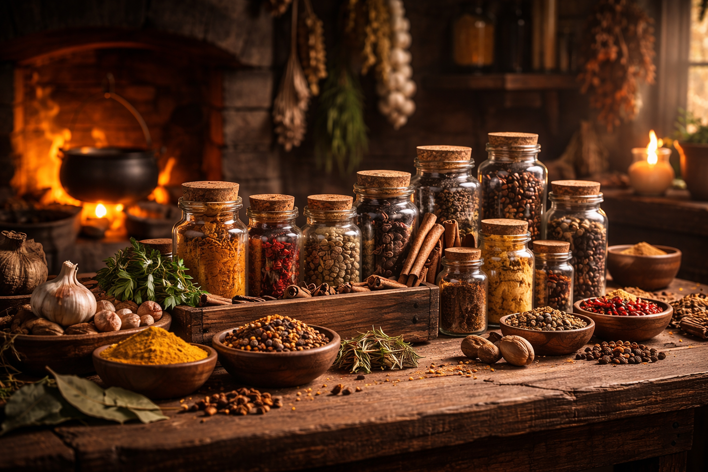
Spices in Daily Life
For centuries Europeans had very little idea where spices actually came from.
They simply appeared in markets through layers of traders.
Arab merchants transported them across the Indian Ocean.
Caravans moved them through the Middle East.
Venetian merchants distributed them throughout Europe.
Each link in that chain added cost.
By the time spices reached European kitchens they had already traveled thousands of miles.
And the original source remained a closely guarded secret.
Notes:
For centuries Europeans had very little idea where spices actually came from.
They simply appeared in markets through layers of traders.
Arab merchants transported them across the Indian Ocean.
Caravans moved them through the Middle East.
Venetian merchants distributed them throughout Europe.
Each link in that chain added cost.
By the time spices reached European kitchens they had already traveled thousands of miles.
And the original source remained a closely guarded secret.

Slide 6
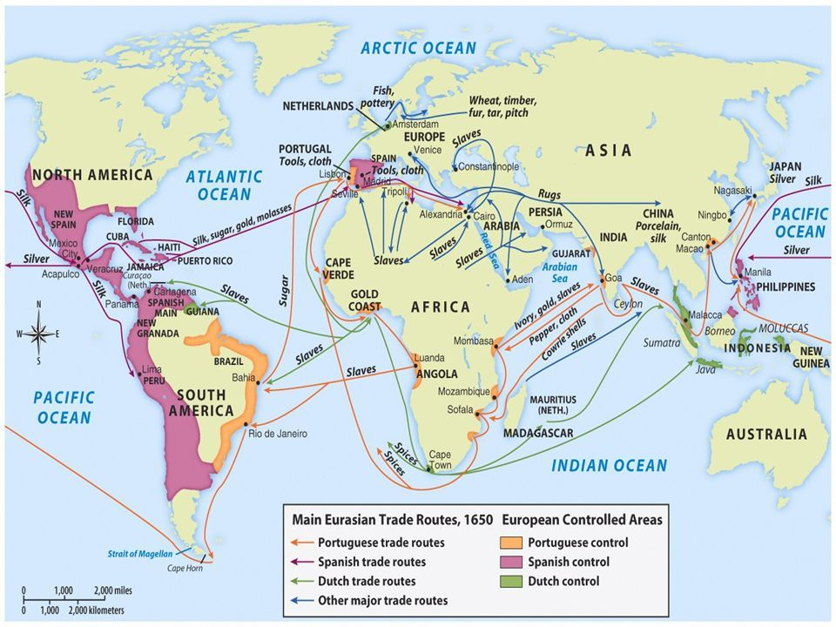
Europe Wants Direct Access
By the 1400s European rulers became increasingly frustrated with this system.
Spices were incredibly expensive.
And European powers suspected that middlemen were taking most of the profit.
If they could reach the spice-producing regions directly, they could bypass those traders.
And that idea launched one of the most important periods in world history.
The Age of Exploration.
Ships began sailing farther than ever before in search of direct sea routes to Asia.
Notes:
By the 1400s European rulers became increasingly frustrated with this system.
Spices were incredibly expensive.
And European powers suspected that middlemen were taking most of the profit.
If they could reach the spice-producing regions directly, they could bypass those traders.
And that idea launched one of the most important periods in world history.
The Age of Exploration.
Ships began sailing farther than ever before in search of direct sea routes to Asia.

Slide 7
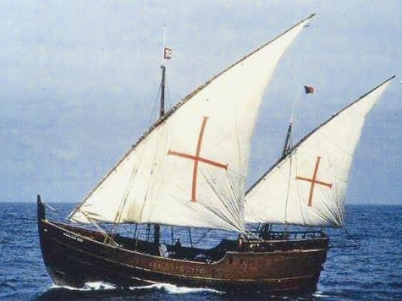
New Portuguese Ships
Portugal led the way.
In the early 1400s the Portuguese crown invested heavily in navigation and shipbuilding.
They developed new types of ships capable of long ocean voyages.
They improved navigation techniques using maps, compasses, and celestial navigation.
The goal was simple.
Find a sea route to the spice markets of Asia.
Notes:
Portugal led the way.
In the early 1400s the Portuguese crown invested heavily in navigation and shipbuilding.
They developed new types of ships capable of long ocean voyages.
They improved navigation techniques using maps, compasses, and celestial navigation.
The goal was simple.
Find a sea route to the spice markets of Asia.

Slide 8
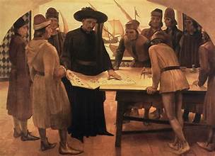
Prince Henry the Navigator
One of the most important figures in this story was Prince Henry of Portugal.
He never actually made long voyages himself.
But he sponsored exploration and encouraged the development of navigation schools and ship technology.
Under his influence Portuguese sailors slowly pushed farther down the west coast of Africa.
Each voyage added new knowledge to European maps.
And slowly the outline of Africa began to emerge.
Notes:
One of the most important figures in this story was Prince Henry of Portugal.
He never actually made long voyages himself.
But he sponsored exploration and encouraged the development of navigation schools and ship technology.
Under his influence Portuguese sailors slowly pushed farther down the west coast of Africa.
Each voyage added new knowledge to European maps.
And slowly the outline of Africa began to emerge.

Slide 9
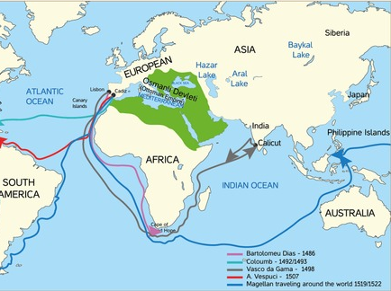
Rounding Africa
In 1488 a Portuguese explorer named Bartolomeu Dias accomplished something extraordinary.
He sailed around the southern tip of Africa.
For the first time Europeans had proof that the Atlantic Ocean connected with the Indian Ocean.
The route to Asia might actually exist.
This discovery changed everything.
Notes:
In 1488 a Portuguese explorer named Bartolomeu Dias accomplished something extraordinary.
He sailed around the southern tip of Africa.
For the first time Europeans had proof that the Atlantic Ocean connected with the Indian Ocean.
The route to Asia might actually exist.
This discovery changed everything.

Slide 10
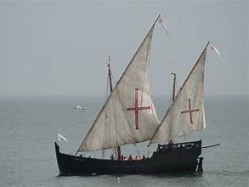
The Age of Exploration
Vasco da Gama - Ten years later another Portuguese explorer completed the journey.
In 1498 Vasco da Gama sailed around Africa and reached India.
Europe finally had a direct sea route to the spice markets of Asia.
But even then the story was not finished.
Because the most valuable spices did not actually come from India.
They came from somewhere else entirely.
Notes:
Vasco da Gama - Ten years later another Portuguese explorer completed the journey.
In 1498 Vasco da Gama sailed around Africa and reached India.
Europe finally had a direct sea route to the spice markets of Asia.
But even then the story was not finished.
Because the most valuable spices did not actually come from India.
They came from somewhere else entirely.

Slide 11
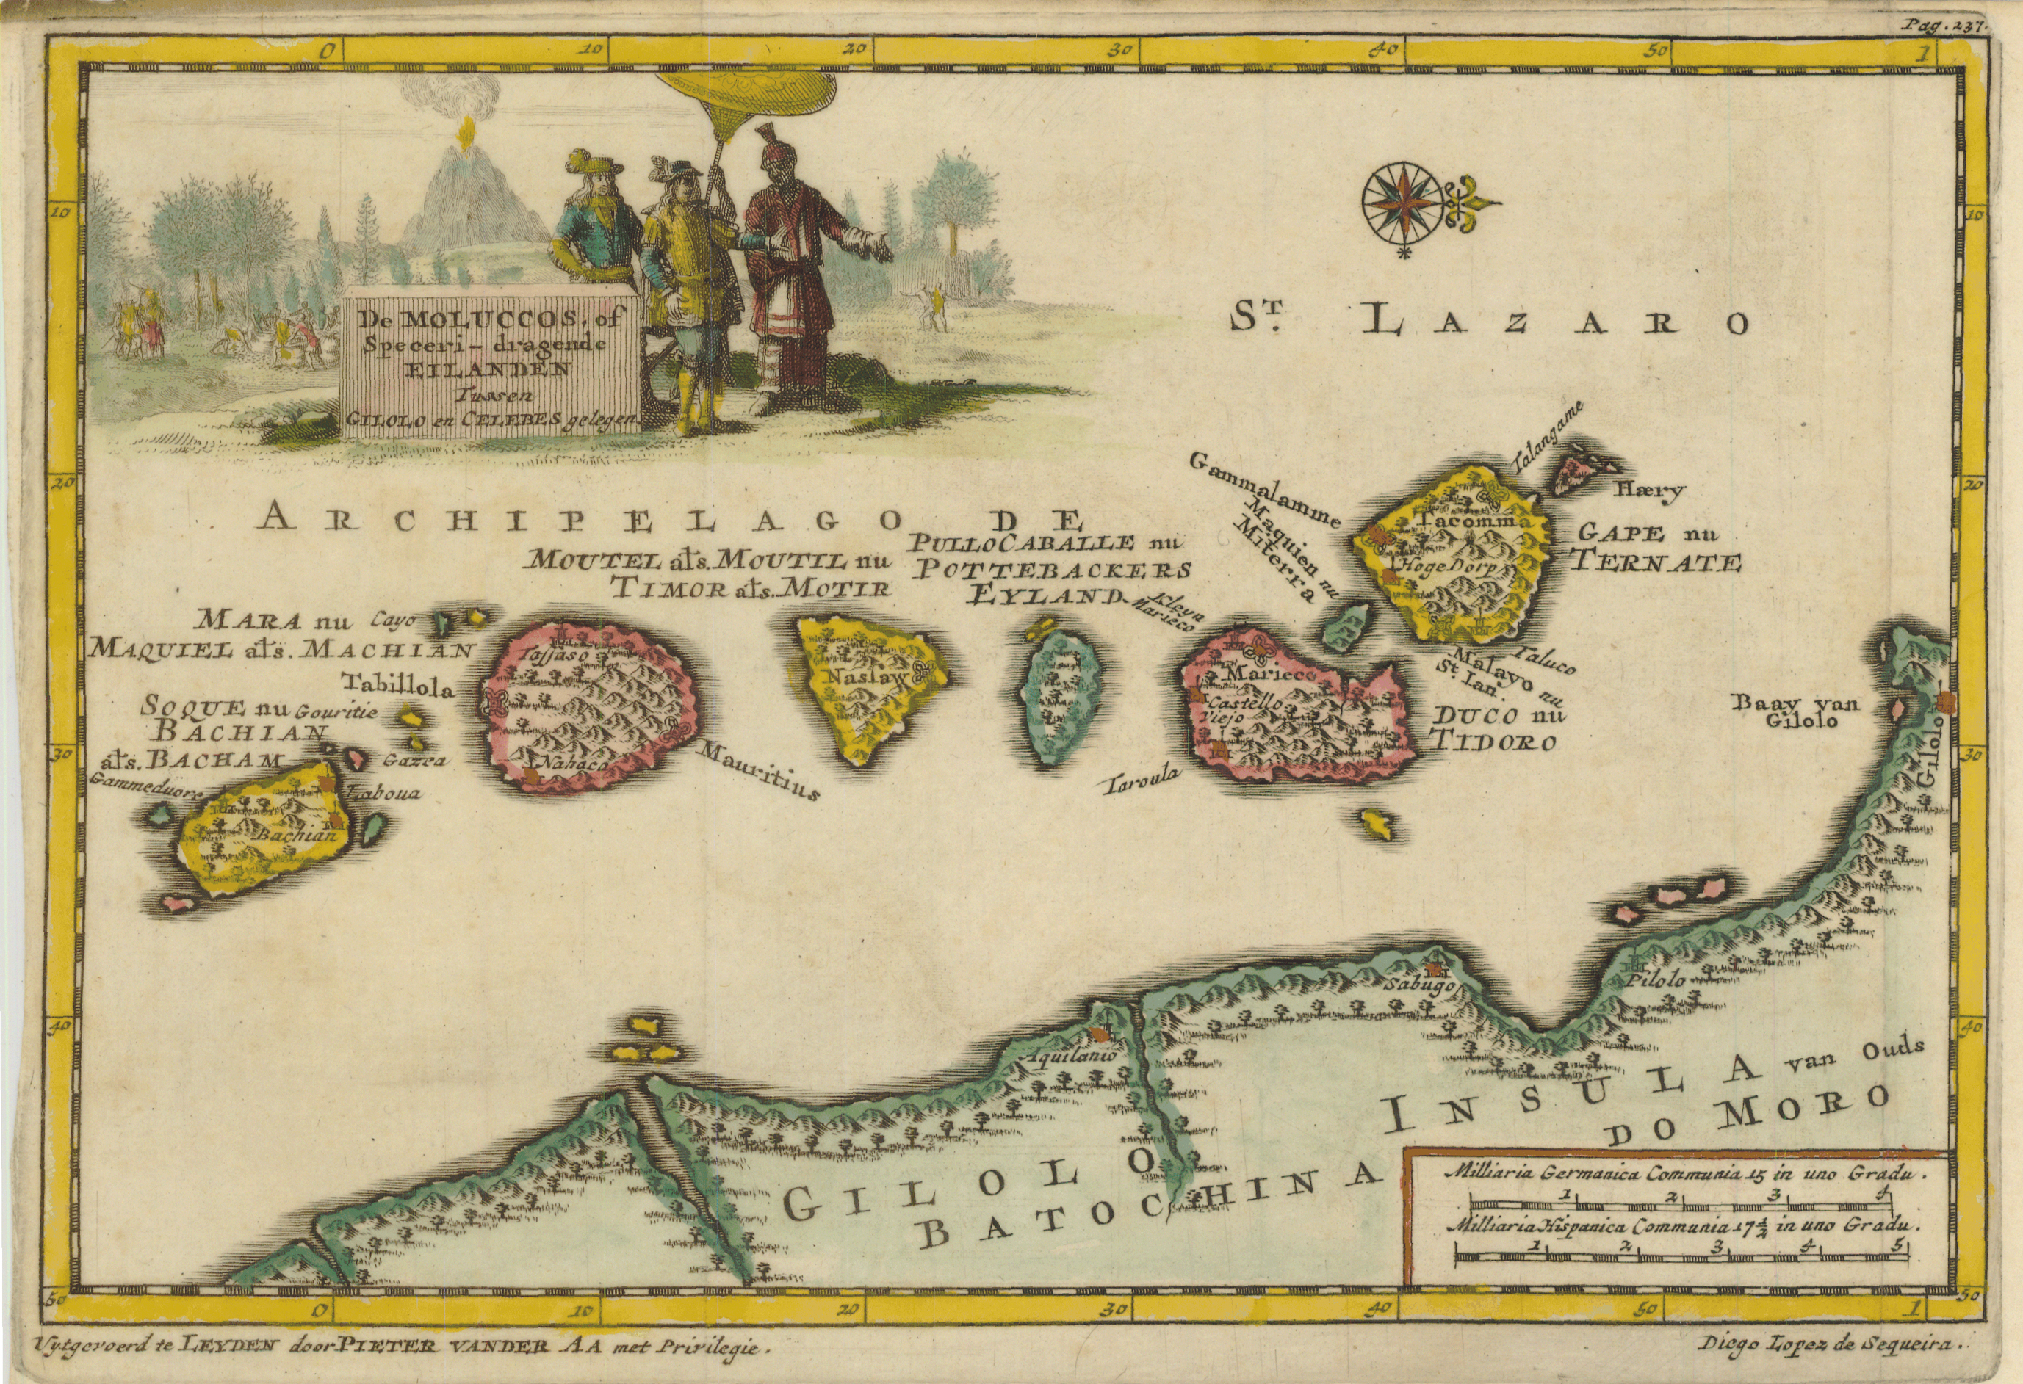
The Spice Islands
Far to the east of India lies a region now part of Indonesia.
A chain of islands known historically as the Spice Islands.
These islands produced cloves, nutmeg, and mace.
And for centuries they were the only place on Earth where some of these spices grew naturally.
Whoever controlled these islands controlled the global spice trade.
Notes:
Far to the east of India lies a region now part of Indonesia.
A chain of islands known historically as the Spice Islands.
These islands produced cloves, nutmeg, and mace.
And for centuries they were the only place on Earth where some of these spices grew naturally.
Whoever controlled these islands controlled the global spice trade.

Slide 12
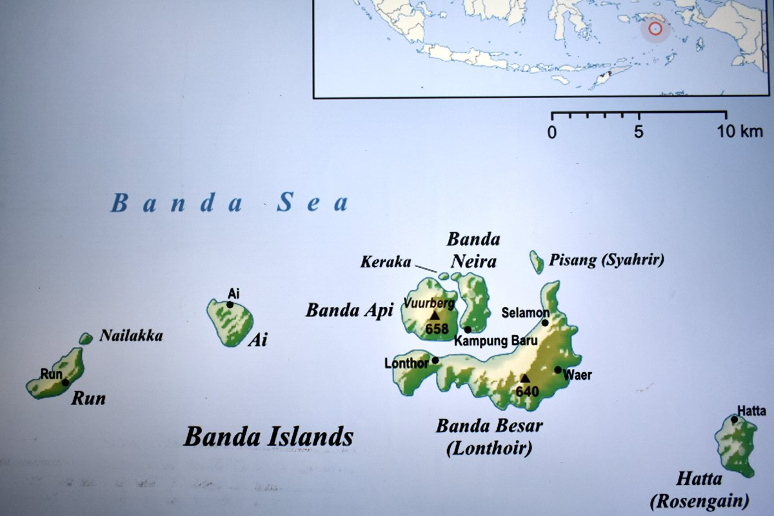
The Banda Islands
The Banda Islands were particularly important.
This tiny group of volcanic islands was the only place where nutmeg grew naturally.
Imagine the economic power that creates.
Control the islands, control the world’s supply of nutmeg.
That made these islands one of the most valuable pieces of real estate on Earth.
Notes:
The Banda Islands were particularly important.
This tiny group of volcanic islands was the only place where nutmeg grew naturally.
Imagine the economic power that creates.
Control the islands, control the world’s supply of nutmeg.
That made these islands one of the most valuable pieces of real estate on Earth.

Slide 13
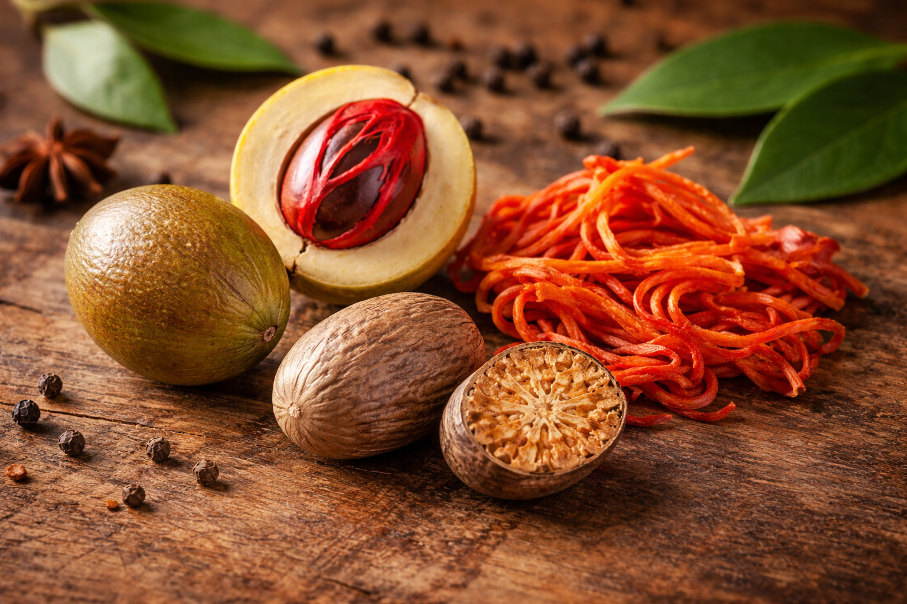
Nutmeg and Mace
Once Europeans learned where these spices came from, competition exploded.
The Portuguese arrived first.
Soon the Dutch and the English followed.
These nations were not just traders.
They were rivals competing for enormous wealth.
And the Spice Islands became the center of that struggle.
Notes:
Once Europeans learned where these spices came from, competition exploded.
The Portuguese arrived first.
Soon the Dutch and the English followed.
These nations were not just traders.
They were rivals competing for enormous wealth.
And the Spice Islands became the center of that struggle.

Slide 14
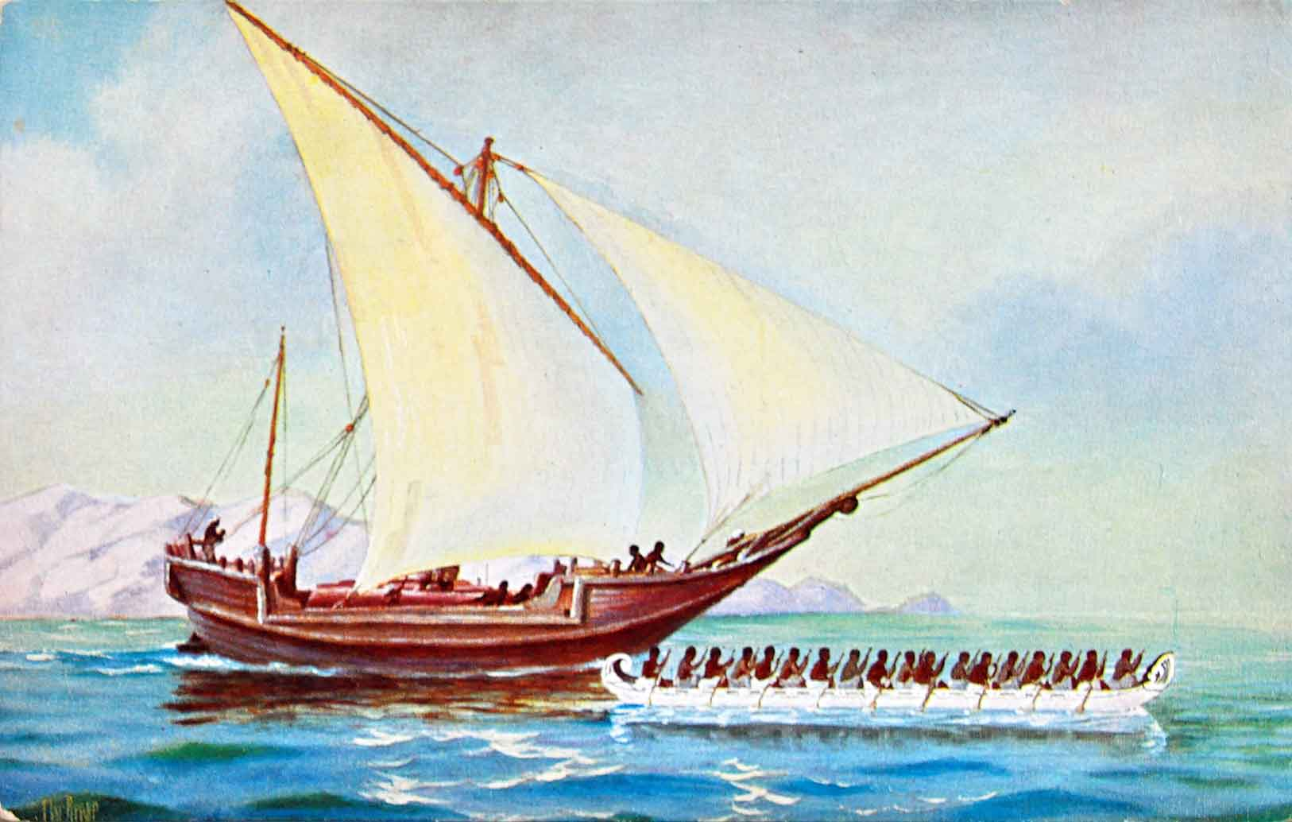
Europeans Reach the Spice Islands
By the early 1500s European ships finally reached the region we now call the Spice Islands.
For the first time Europeans saw where these famous spices actually grew.
Clove trees and nutmeg trees growing on small tropical islands in what is today eastern Indonesia.
And here is the surprising part.
The people living on these islands had been trading spices for centuries.
Arab, Chinese, and Asian traders had visited regularly.
The islanders were experienced merchants. They were used to trading with many different buyers.
And that would soon become a problem.
Notes:
By the early 1500s European ships finally reached the region we now call the Spice Islands.
For the first time Europeans saw where these famous spices actually grew.
Clove trees and nutmeg trees growing on small tropical islands in what is today eastern Indonesia.
And here is the surprising part.
The people living on these islands had been trading spices for centuries.
Arab, Chinese, and Asian traders had visited regularly.
The islanders were experienced merchants. They were used to trading with many different buyers.
And that would soon become a problem.

Slide 15
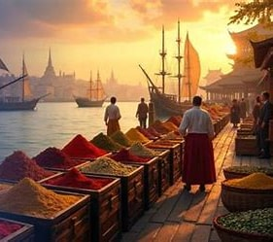
A Different Idea of Trade
The islanders believed in open trade.
They wanted to sell their spices to whoever offered the best price.
Portuguese traders.
English traders.
Dutch traders.
Competition meant better profits.
But the Europeans arriving in the region had a very different idea.
They didn’t just want to trade.
They wanted control.
Notes:
The islanders believed in open trade.
They wanted to sell their spices to whoever offered the best price.
Portuguese traders.
English traders.
Dutch traders.
Competition meant better profits.
But the Europeans arriving in the region had a very different idea.
They didn’t just want to trade.
They wanted control.

Slide 16
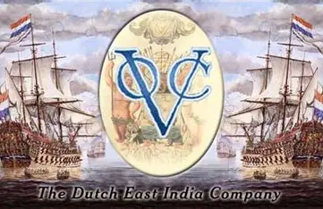
Enter the Dutch
In the early 1600s the Dutch arrived with a clear goal.
Control the spice trade completely.
The Dutch East India Company had enormous power and financial backing.
Their strategy was simple.
If they could control nutmeg production in the Banda Islands, they could control the global
Notes:
In the early 1600s the Dutch arrived with a clear goal.
Control the spice trade completely.
The Dutch East India Company had enormous power and financial backing.
Their strategy was simple.
If they could control nutmeg production in the Banda Islands, they could control the global

Slide 17
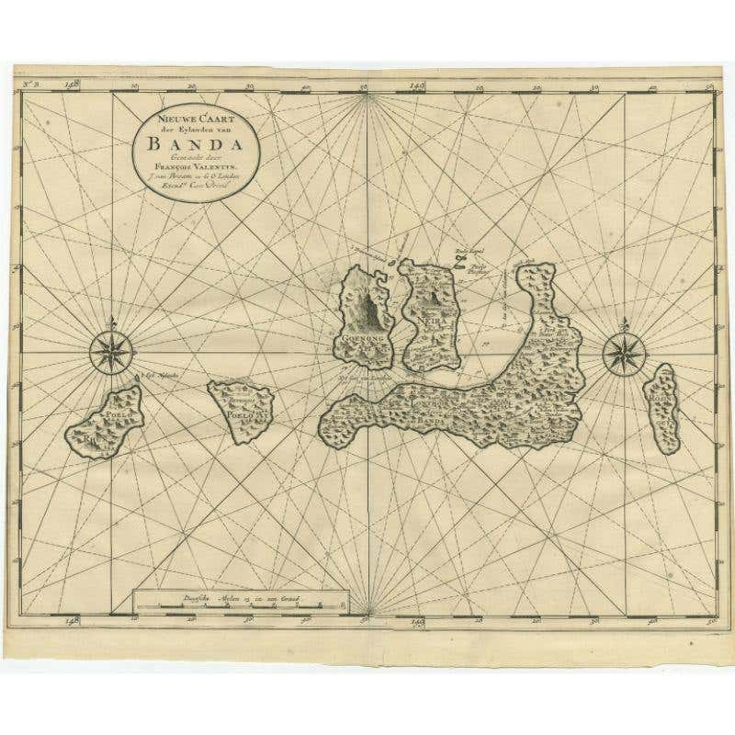
The Banda Islands
The Banda Islands were the only place on Earth where nutmeg grew naturally.
Just a handful of small volcanic islands.
But these islands produced one of the most valuable commodities in the world.
If the Dutch controlled Banda, they controlled nutmeg.
And that meant enormous wealth.
Notes:
The Banda Islands were the only place on Earth where nutmeg grew naturally.
Just a handful of small volcanic islands.
But these islands produced one of the most valuable commodities in the world.
If the Dutch controlled Banda, they controlled nutmeg.
And that meant enormous wealth.

Slide 18
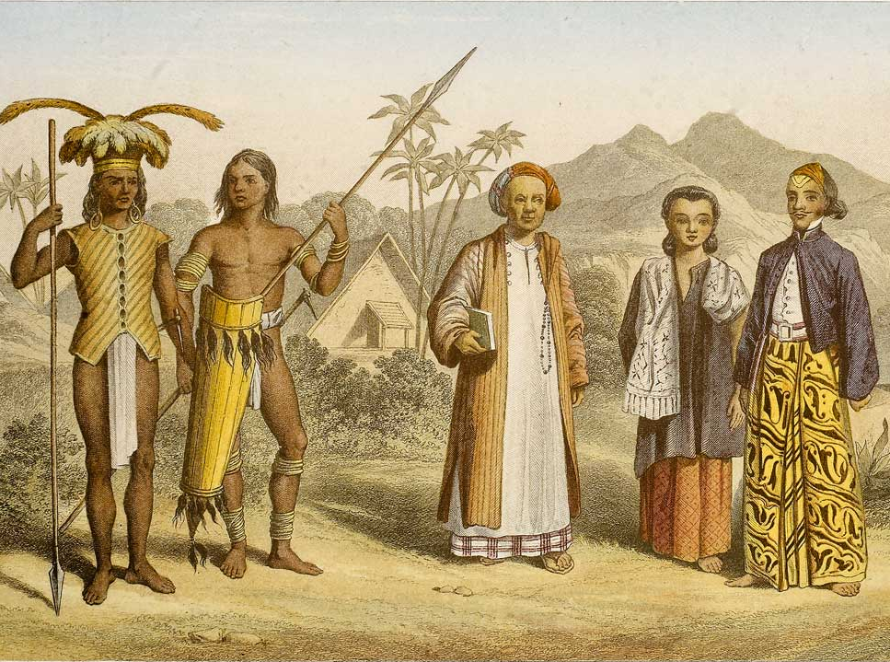
The Banda Islanders Resist
The Banda islanders refused to grant the Dutch an exclusive monopoly.
They wanted to continue trading with multiple buyers.
From their perspective that made perfect sense.
More buyers meant higher prices.
But the Dutch saw this as a threat to their plan.
So they decided to enforce their monopoly by force.
Notes:
The Banda islanders refused to grant the Dutch an exclusive monopoly.
They wanted to continue trading with multiple buyers.
From their perspective that made perfect sense.
More buyers meant higher prices.
But the Dutch saw this as a threat to their plan.
So they decided to enforce their monopoly by force.

Slide 19
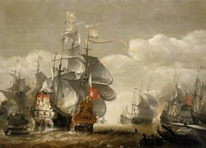
The Nutmeg Wars
What followed became one of the darkest chapters in the history of the spice trade.
Dutch forces invaded the Banda Islands in the early 1600s.
The goal was simple.
Break local resistance and impose Dutch control over nutmeg production.
The conflict was brutal.
By the end of it the Dutch had effectively taken control of the islands.
Notes:
What followed became one of the darkest chapters in the history of the spice trade.
Dutch forces invaded the Banda Islands in the early 1600s.
The goal was simple.
Break local resistance and impose Dutch control over nutmeg production.
The conflict was brutal.
By the end of it the Dutch had effectively taken control of the islands.

Slide 20
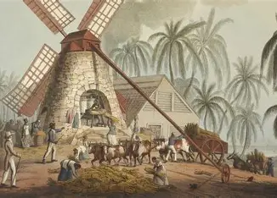
A Dutch Monopoly
Once the Dutch secured control of the Banda Islands, they imposed a strict monopoly.
Nutmeg production was tightly controlled.
Plantations were managed under Dutch supervision.
Spices were shipped to Europe where they sold for enormous profits.
For decades the Dutch dominated the global nutmeg trade.
But they still faced one stubborn rival.
The English.
Notes:
Once the Dutch secured control of the Banda Islands, they imposed a strict monopoly.
Nutmeg production was tightly controlled.
Plantations were managed under Dutch supervision.
Spices were shipped to Europe where they sold for enormous profits.
For decades the Dutch dominated the global nutmeg trade.
But they still faced one stubborn rival.
The English.

Slide 21
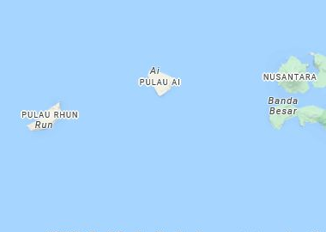
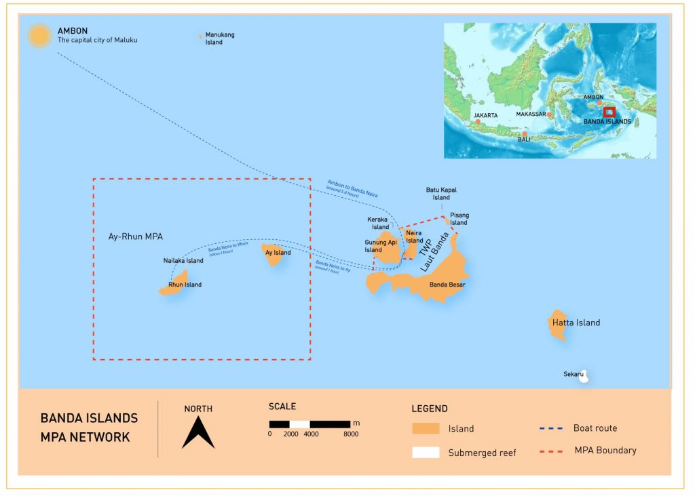
The Island of Run
A small island called Run became the center of a strange geopolitical struggle.
Run was tiny.
Barely visible on a map.
But it had one thing the Dutch desperately wanted.
Nutmeg trees.
And the English had managed to gain control of it.
Notes:
A small island called Run became the center of a strange geopolitical struggle.
Run was tiny.
Barely visible on a map.
But it had one thing the Dutch desperately wanted.
Nutmeg trees.
And the English had managed to gain control of it.

Slide 22
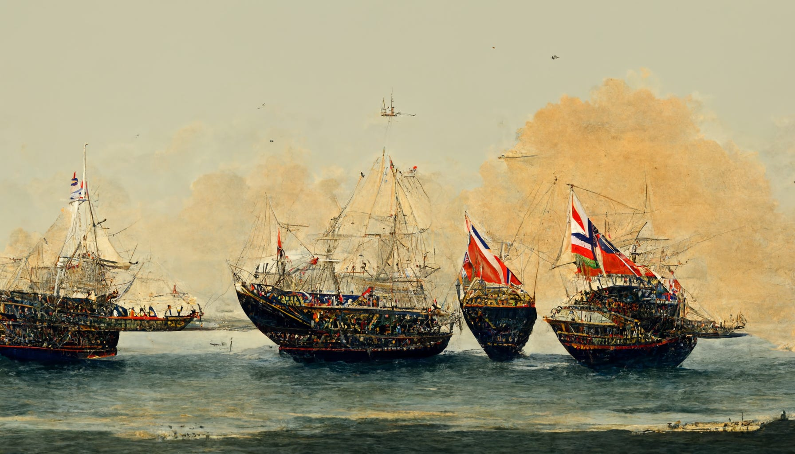
English Defiance
From the Dutch perspective, English control of Run Island was a major problem.
As long as the English had access to nutmeg, the Dutch monopoly was incomplete.
So, the two nations fought for control of this small island for years.
This struggle would eventually lead to one of the most unusual deals in world history.
Notes:
From the Dutch perspective, English control of Run Island was a major problem.
As long as the English had access to nutmeg, the Dutch monopoly was incomplete.
So the two nations fought for control of this small island for years.
This struggle would eventually lead to one of the most unusual deals in world history.

Slide 23
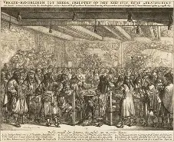
Treaty of Breda
In 1667 the Dutch and English finally negotiated a peace agreement.
It became known as the Treaty of Breda.
As part of that treaty, the two nations agreed to exchange territories.
The Dutch would keep Run Island.
The English would gain control of a small colony in North America.
Notes:
In 1667 the Dutch and English finally negotiated a peace agreement.
It became known as the Treaty of Breda.
As part of that treaty, the two nations agreed to exchange territories.
The Dutch would keep Run Island.
The English would gain control of a small colony in North America.

Slide 24
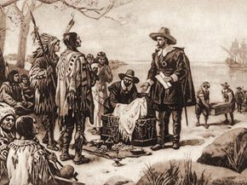
The Trade That Built New York
That colony was called New Amsterdam.
Today we know it by another name.
New York.
In effect the Dutch traded Manhattan for nutmeg.
At the time it seemed like a reasonable deal.
Run Island produced extremely valuable spices.
New Amsterdam was a small colonial settlement.
History would judge the deal very differently.
Notes:
That colony was called New Amsterdam.
Today we know it by another name.
New York.
In effect the Dutch traded Manhattan for nutmeg.
At the time it seemed like a reasonable deal.
Run Island produced extremely valuable spices.
New Amsterdam was a small colonial settlement.
History would judge the deal very differently..

Slide 25
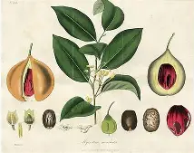
Smuggling the Trees
Eventually the Dutch monopoly began to weaken.
Other nations began smuggling nutmeg plants out of the islands.
Once nutmeg trees could be grown in other tropical regions, the monopoly collapsed.
Nutmeg plantations began appearing in places like Sri Lanka and the Caribbean.
Notes:
Eventually the Dutch monopoly began to weaken.
Other nations began smuggling nutmeg plants out of the islands.
Once nutmeg trees could be grown in other tropical regions, the monopoly collapsed.
Nutmeg plantations began appearing in places like Sri Lanka and the Caribbean.

Slide 26
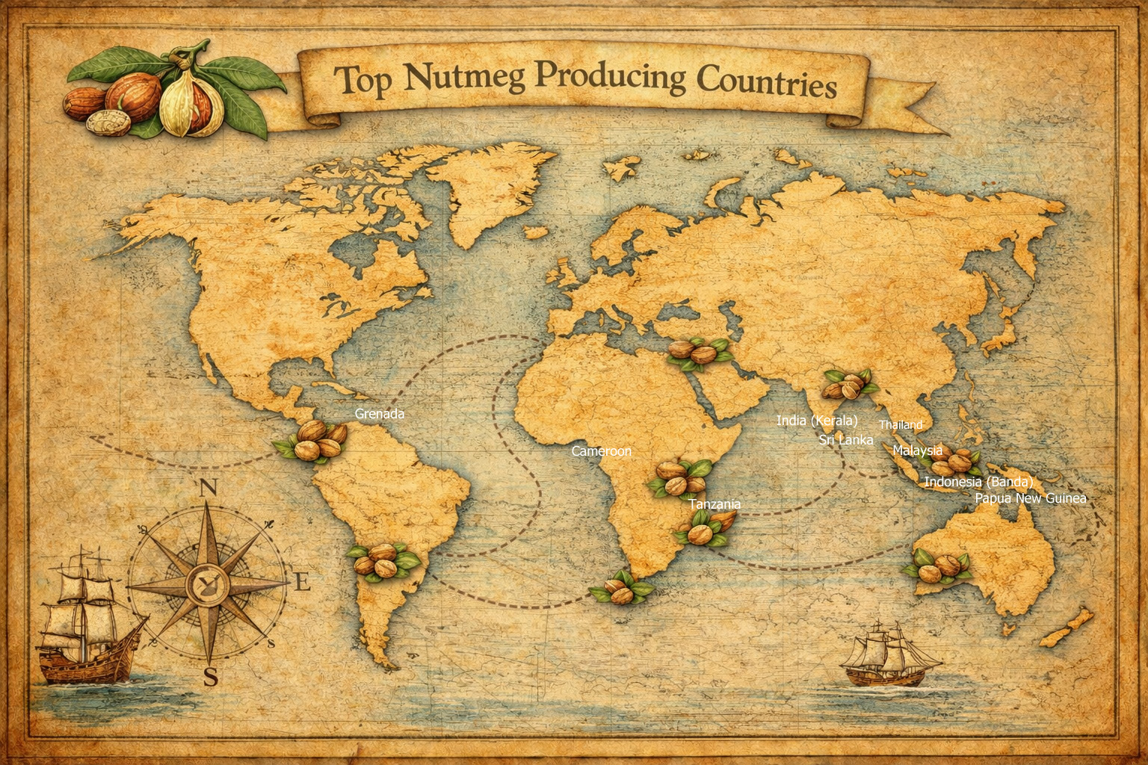
Today nutmeg is grown in many parts of the world.
Grenada in the Caribbean is one of the largest producers.
What was once incredibly rare eventually became widely available.
And prices fell dramatically.
Notes:
Today nutmeg is grown in many parts of the world.
Grenada in the Caribbean is one of the largest producers.
What was once incredibly rare eventually became widely available.
And prices fell dramatically.

Slide 27
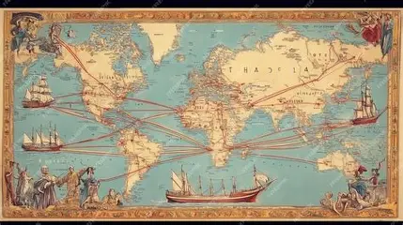
The Rise of Global Trade
The spice trade helped create something new in world history.
A truly global trading network.
Ships connected Europe, Asia, Africa, and the Americas.
Goods, people, and ideas began moving across oceans in ways that had never happened before.
Spices played a surprisingly important role in building that system.
Notes:
The spice trade helped create something new in world history.
A truly global trading network.
Ships connected Europe, Asia, Africa, and the Americas.
Goods, people, and ideas began moving across oceans in ways that had never happened before.
Spices played a surprisingly important role in building that system.

Slide 28
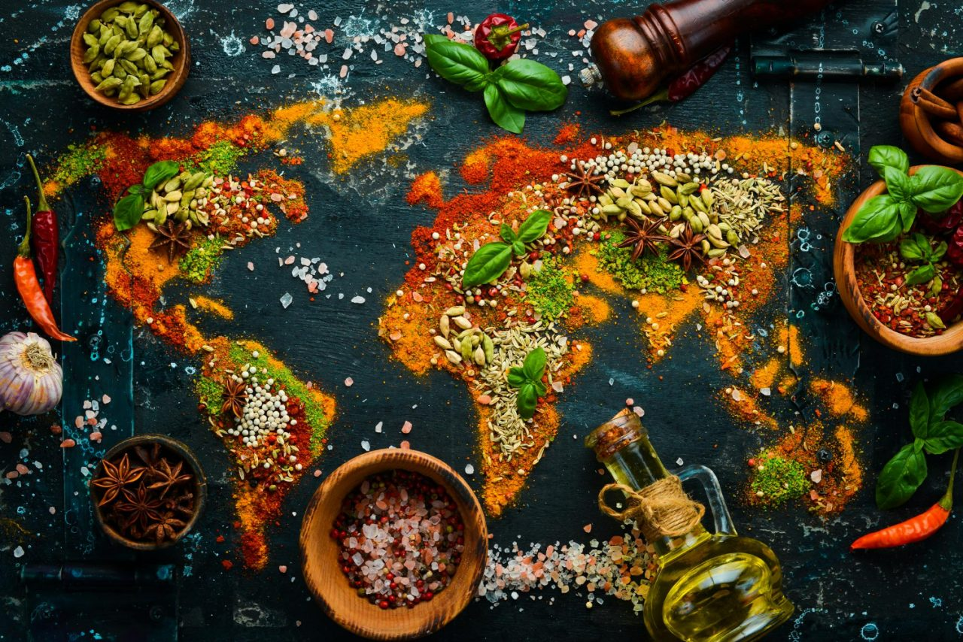
Spices and Culture
Spices also changed how people cooked and ate.
Recipes evolved.
New flavors spread across continents.
Many dishes we enjoy today reflect centuries of cultural exchange driven by the spice trade.
Notes:
Speaker notes: Tell the story behind this slide. Do not read the slide.

Slide 29
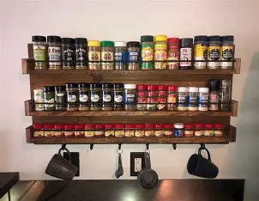
From Luxury to Everyday
Today spices are inexpensive and easy to find.
We buy them at grocery stores without thinking twice.
But for most of history they were rare and precious.
Tiny ingredients that influenced the decisions of kings and merchants.
Notes:
Today spices are inexpensive and easy to find.
We buy them at grocery stores without thinking twice.
But for most of history they were rare and precious.
Tiny ingredients that influenced the decisions of kings and merchants.

Slide 30
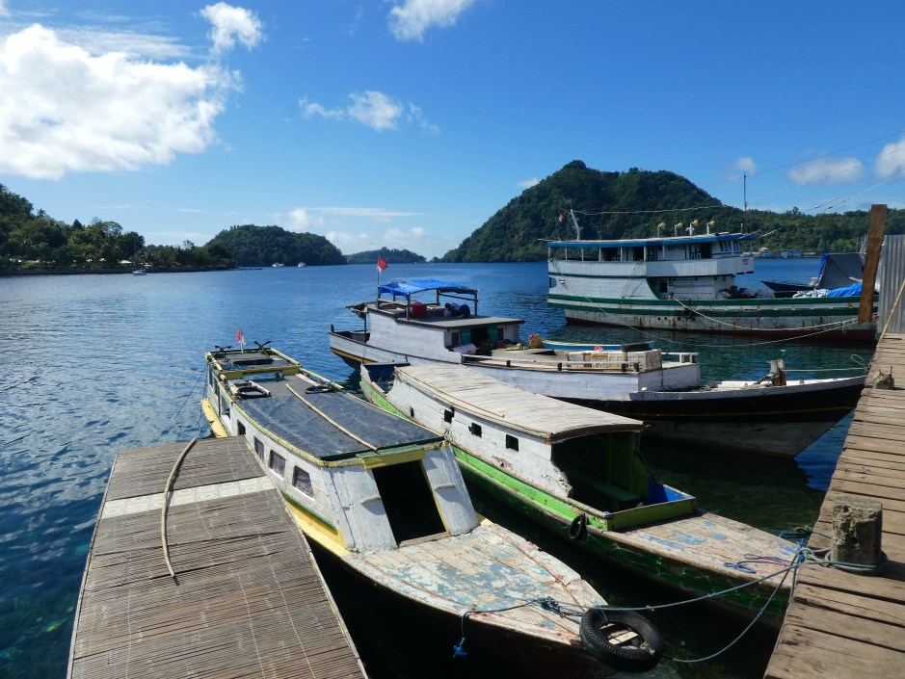
Banda Islands Today
The Banda Islands remain small and relatively remote.
Few travelers visit them today.
Yet these quiet islands once stood at the center of global economic competition.
They played an extraordinary role in shaping world history.
Notes:
The Banda Islands remain small and relatively remote.
Few travelers visit them today.
Yet these quiet islands once stood at the center of global economic competition.
They played an extraordinary role in shaping world history.

Slide 31
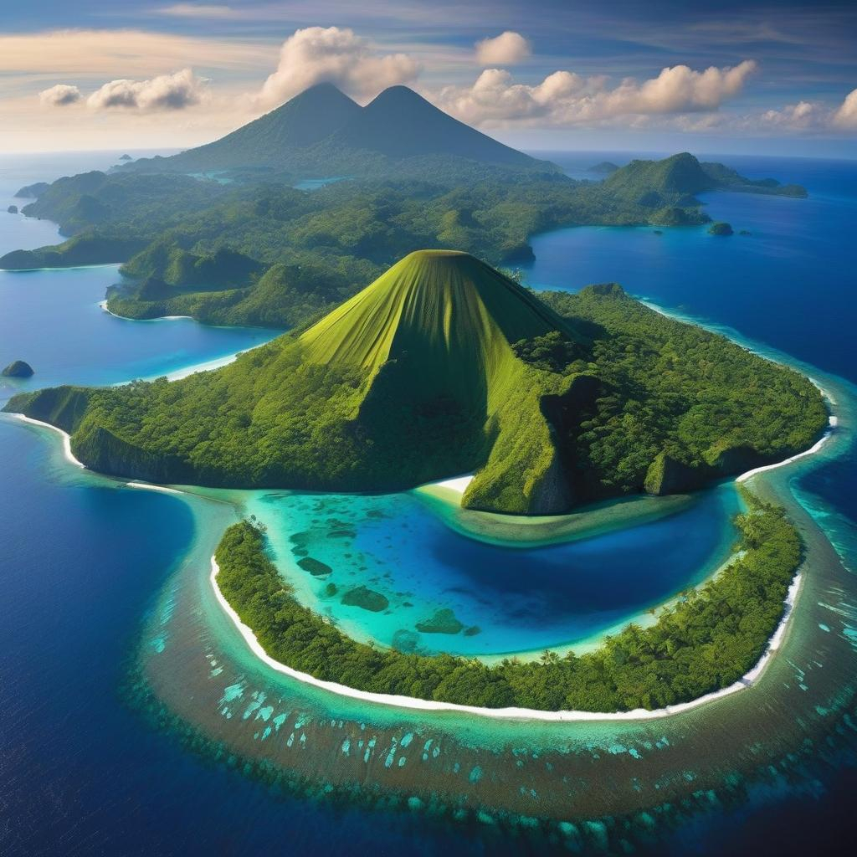
Small Islands Big Impact
Sometimes the forces that reshape the world begin in very small places.
A handful of islands.
A few trees producing fragrant seeds.
Yet the consequences touched every continent.
Notes:
Sometimes the forces that reshape the world begin in very small places.
A handful of islands.
A few trees producing fragrant seeds.
Yet the consequences touched every continent.

Slide 32
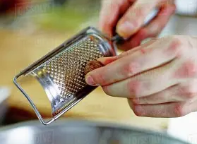
A Spice Rack Reminder
The next time you reach for nutmeg or cloves in your kitchen, it’s worth remembering the journey those spices represent.
Exploration.
Conflict.
Global trade.
And centuries of history packed into a tiny seed.
Notes:
The next time you reach for nutmeg or cloves in your kitchen, it’s worth remembering the journey those spices represent.
Exploration.
Conflict.
Global trade.
And centuries of history packed into a tiny seed.

Slide 33
Questions
History is often shaped by great leaders and dramatic battles.
But sometimes the story begins with something far smaller.
In this case, a spice.
Thank you for coming.
I’d be happy to take any questions.
Notes:
History is often shaped by great leaders and dramatic battles.
But sometimes the story begins with something far smaller.
In this case, a spice.
Thank you.
I’d be happy to take any questions.

