Slide 1
Speaker Technology Seminar
Marc Silver
Retired Founder & President of
Soundscape
Audio and Video
Marc has over 58 years of experience
as an Audio/Video Consultant and Designer.
  1
Notes:
1

Slide 2
What I will discuss!
What is a speaker?
Speaker Enclosures
Early Development of Speakers
Speaker Technology Design
Unique Technology
Q&A
  2
Notes:
2
`

Slide 3
History
I am sure everyone is familiar with the idea of what a speaker is, but just so we are all on the same page let me define what a loudspeaker is:
A loudspeaker is any device that converts an electrical signal and turns it into audible sound.
  3
Notes:
It all started with the Faraday’s work on electromagnitism in 1831
3

Slide 4
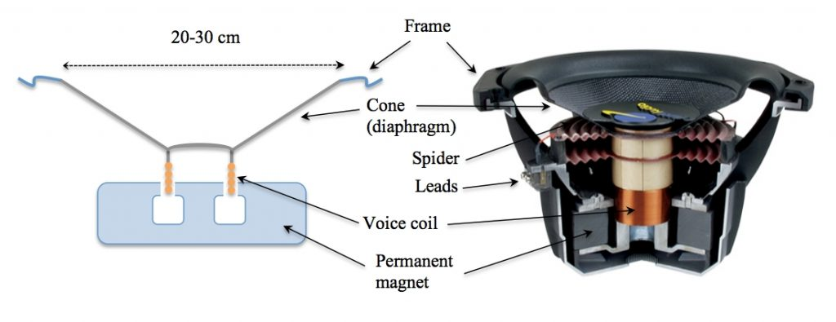
What is a speaker?
Basic parts of a dynamic driver
  4

Slide 5
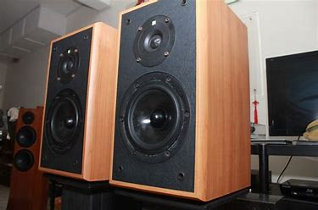
What is a speaker? continued
Many speaker systems are typically housed in a speaker enclosure or speaker cabinet which is often a rectangular or square box made
of several forms
of wood.
  5
Notes:
5

Slide 6
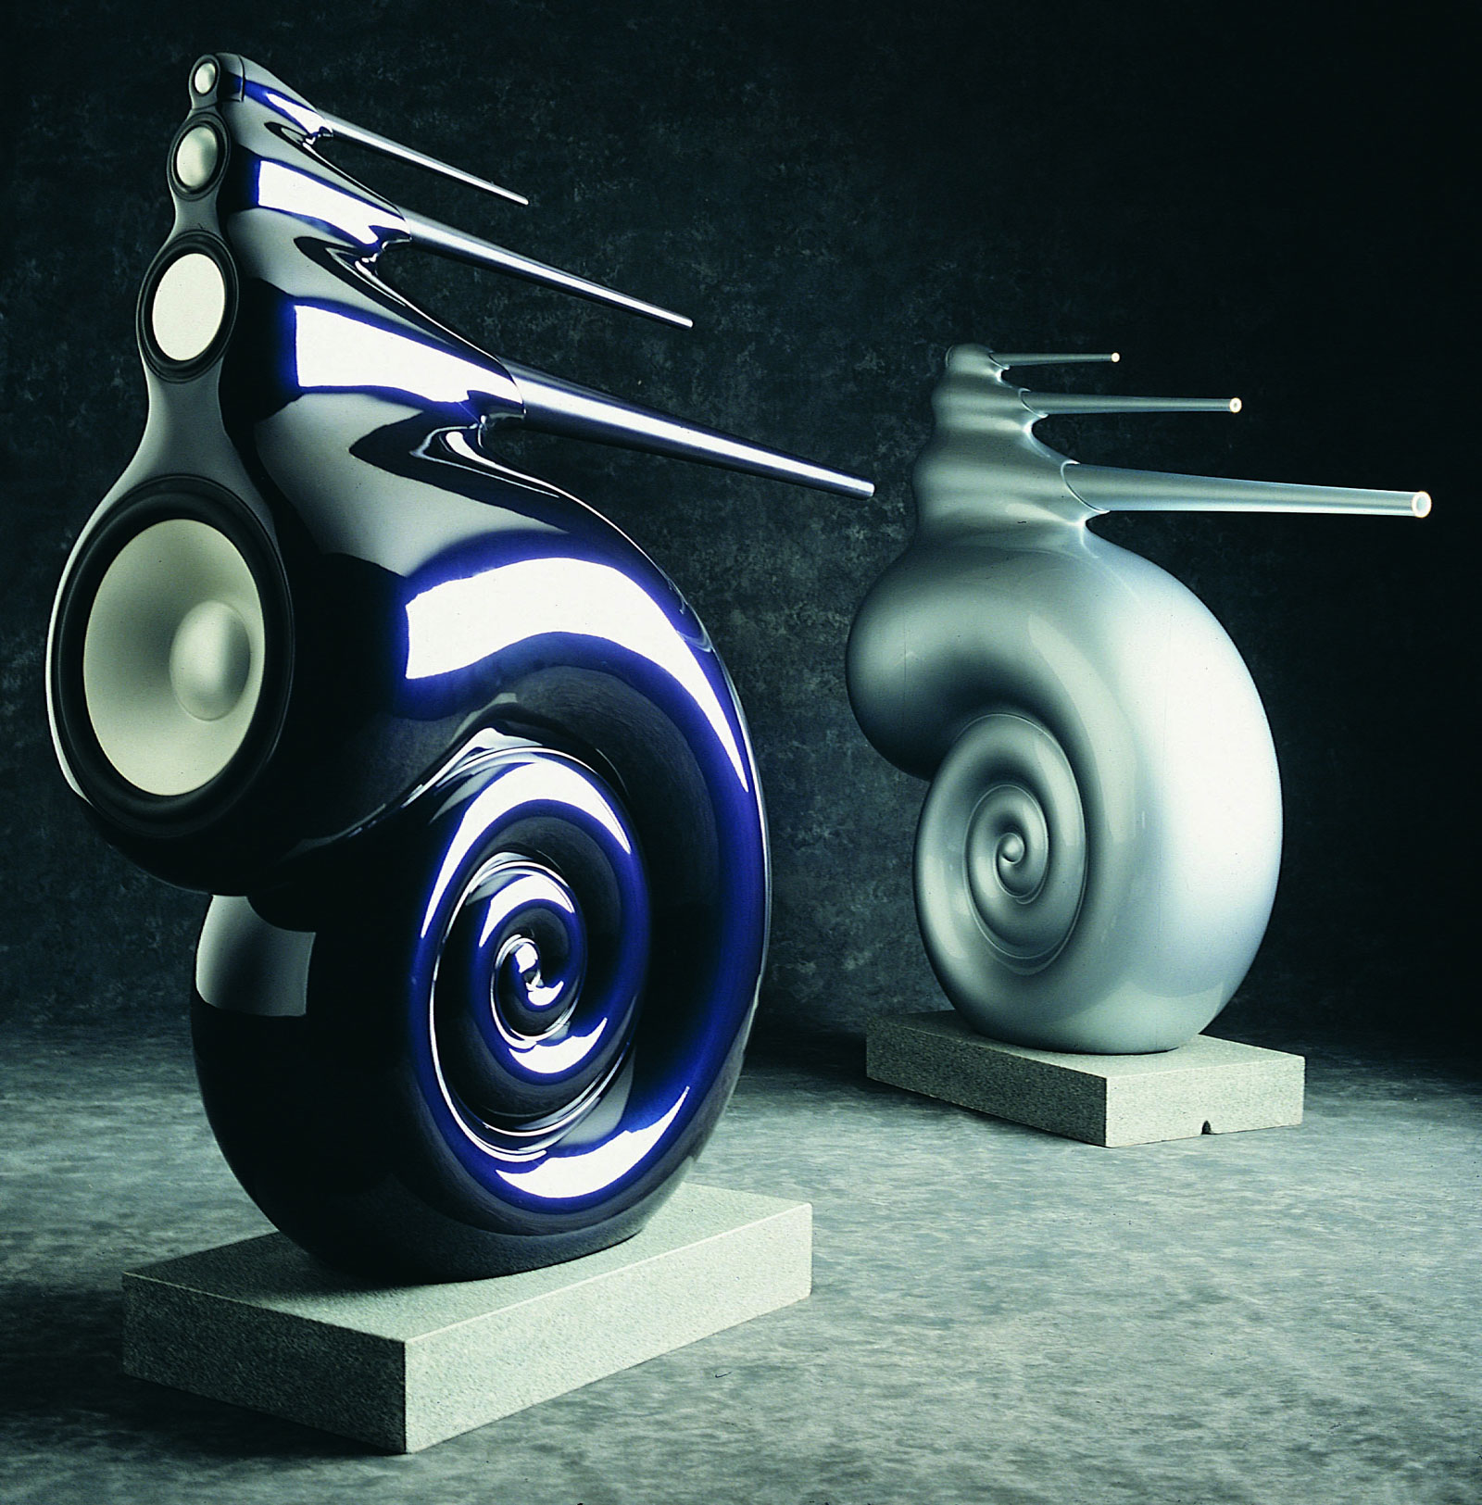
What is a speaker? continued
There are some designs that use more exotic materials
such as Concert,
glass, Lexan,
composites of rock,
polymer and
sometimes plastic.
  6
Notes:
In 1926 the first television image is produced. Crude and black and white, but it was television.
6

Slide 7
Early Speaker Development
1861 - The first loudspeaker was invented in Germany by Johann Philipp Reis for use in a telephone, but this design only produced acoustic tones and barely discernable speech.
1876 - Alexander Graham Bell was issued a patent based on Reis's work in 1876 for a speaker that reproduced intelligible sound. This was part of his patent for the telephone
  7
Notes:
7
A year later the syse was put to the test.
That same year Philo Fransworth, files for a patent on the first complete electronic television system, which he called the Image Dissector.

Slide 8
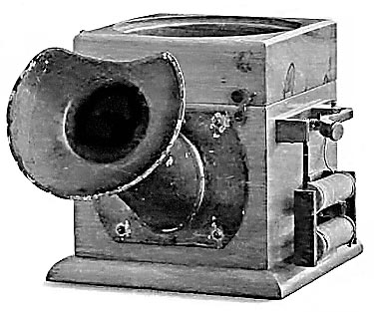
Early Speaker Development continued
1877 Werner Von Siemens created an improved design the following year when he developed the concept of an electromagnetic coil driven speaker. These improvements on the basic design continues to this day.
  8
Notes:
8

Slide 9
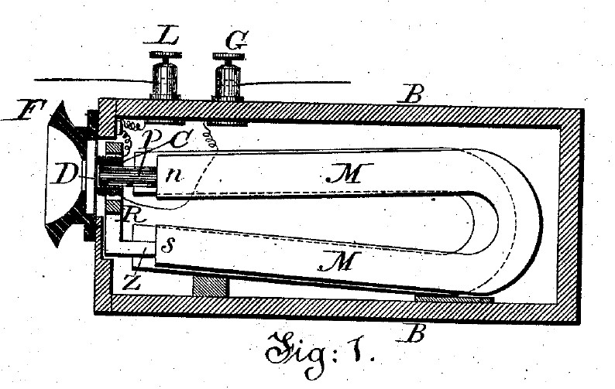
Early Speaker Development continued
1898 Oliver Lodge produced a dynamic (moving coil) loudspeaker
  9
Notes:
9

Slide 10
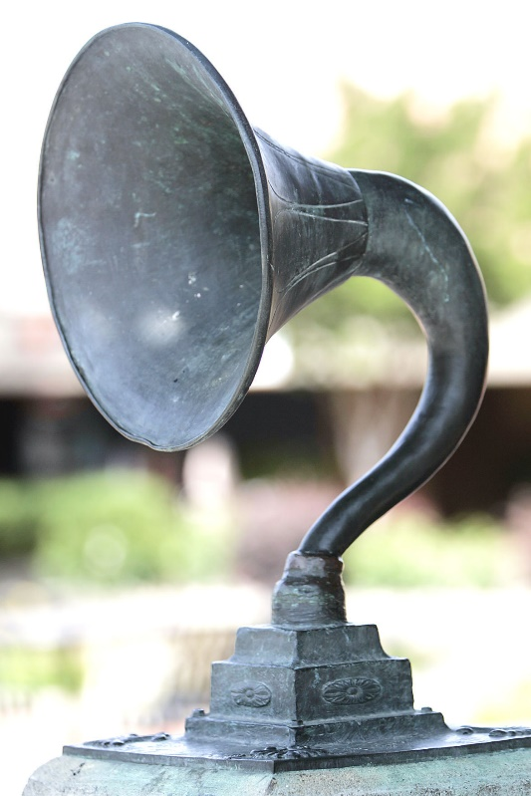
Early Speaker Development continued
1915 – The first practical design came from Danish inventors, Peter Jensen and Edwin Pridham in 1915. Interestingly they were living in Napa California at the time.
  10
Notes:
10

Slide 11
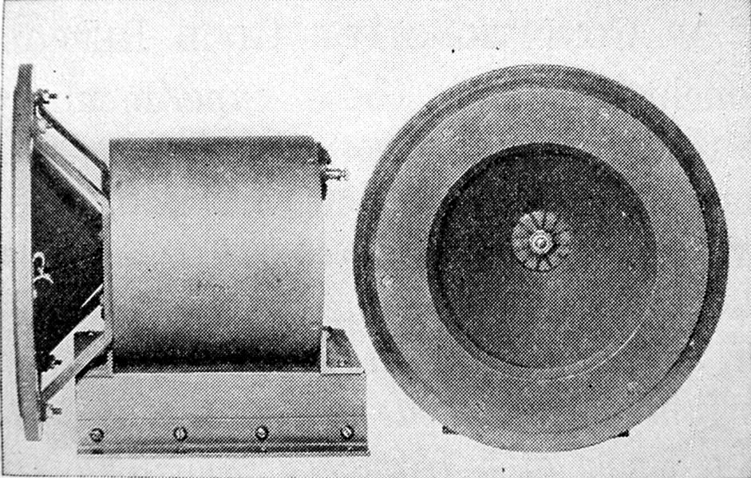
Early Speaker Development continued
1924 - Inventor Chester Rice and Edward W. Kellogg were issued a patent for the direct radiator speaker, what now is the moving coil design that has become the most widely accepted design sets.
  11
Notes:
11

Slide 12
Early Speaker Development continued
1925 - Rice and Kellogg solved the final problems which led to sound that could eventually be called High Fidelity.
Their designs had acceptable frequency range and played loud enough to be considered superior to the mechanical horns of the day.
RCA introduced the first commercial product called the Radiola Loudspeaker
  12
Notes:
12

Slide 13
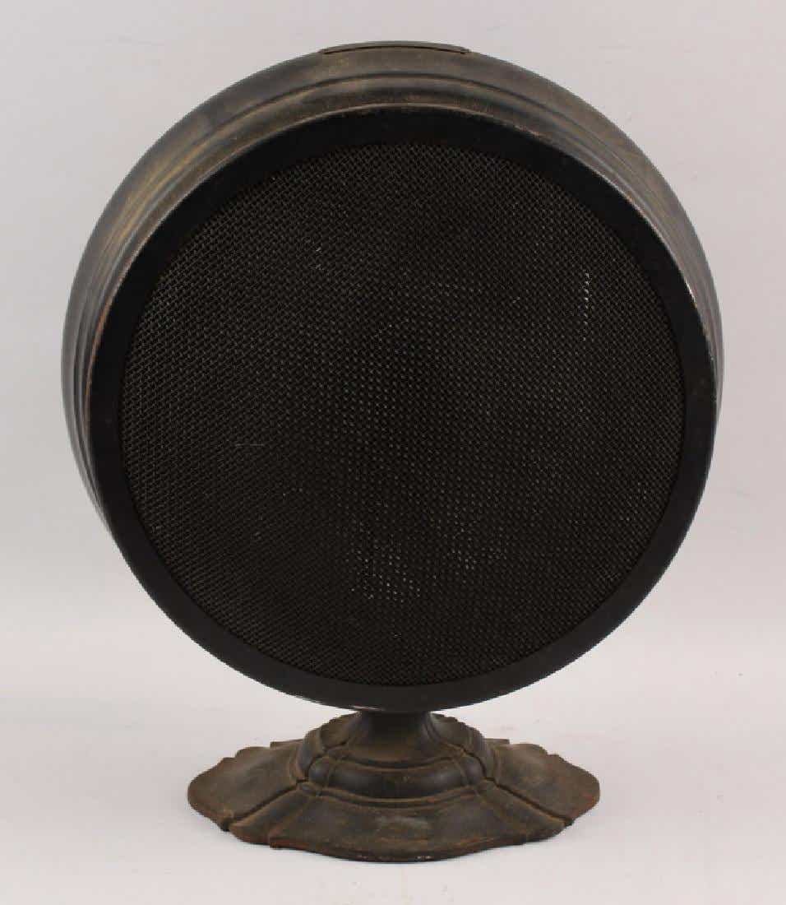
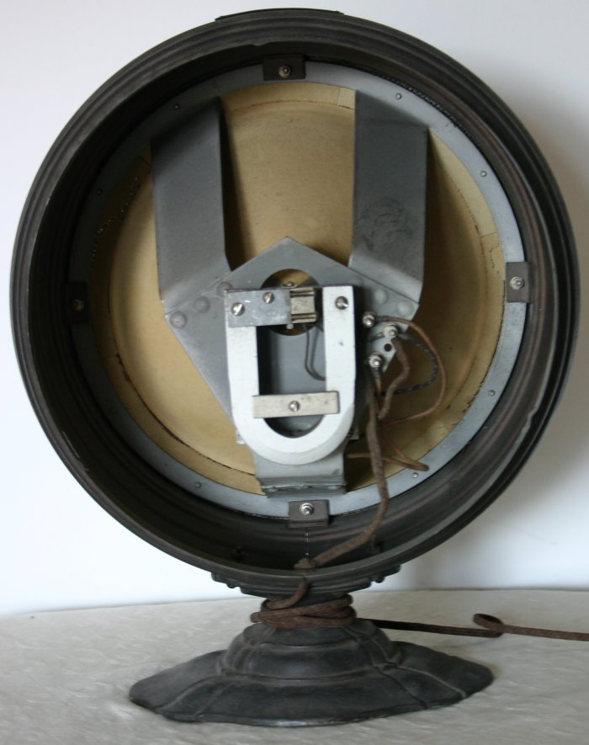
Early Speaker Development continued
RCA Radiola Loudspeaker.
  13
Notes:
13

Slide 14
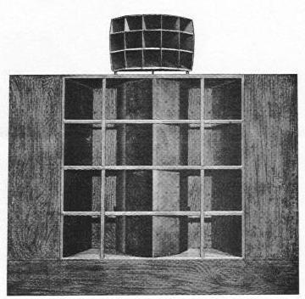
Speaker Types - Horns
1937 - Metro-Goldwyn-Mayer introduced the "The Shearer Horn System” for use in movie theatres.
Similar to today’s designs it was a two-way speaker system utilizing four 15″ low-frequency woofers and a multi-cellular horn with dual compression drivers providing the high frequencies. The trio of engineers to develop this system included James B Lansing..
  14
Notes:
Cable television, formerly known as Community Antenna Television or CATV, was born in the mountains of Pennsylvania in the late 1940's.
14

Slide 15
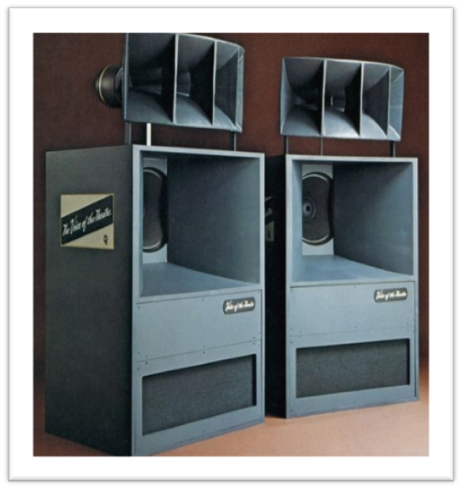
Speaker Types - Direct Horn Designs
By mounting a direct radiating speaker at the base (or throat) of a horn a speaker gets an increase in the dynamic capability, and image size. The advantage of all horn designs is efficiency. You get more output with less power with these designs.
There are currently many horn speakers that achieve greater than 100db of output with just one watt of power.
  15
Notes:
15
1956 Ampex introduces the first practical videotape system of broadcast quality.
1956 Robert Adler invents the first practical remote control called the Zenith Space Commander. It was proceeded by wired remotes and units that failed in sunlight. (then known as Zenith Radio Corporation).

Slide 16
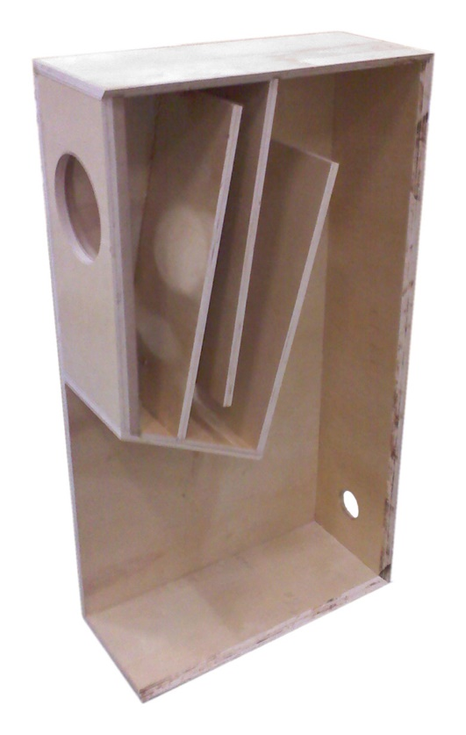
Speaker Types - Folded Horn / Transmission Line Designs
The principle behind a folded horn is it allows the waveform to travel further and propagate lower bass frequencies while increasing efficiency.
The engineering that goes into the multitude of these designs is amazing.
  16
Notes:
16

Slide 17
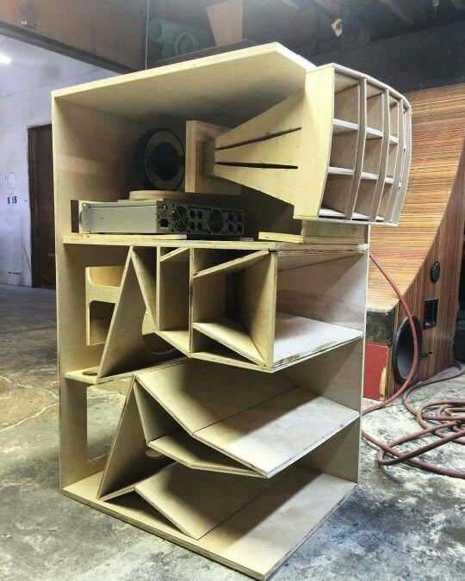
Speaker Types - Folded Horn / Transmission Line Designs
  17
Notes:
17

Slide 18
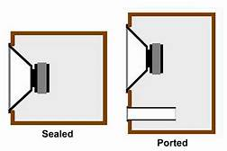
TRADITIONAL BOX SPEAKER DESIGNS
Vented Loudspeakers
Vented designs include both ported and slot loaded speaker designs. There are variations to each of these designs including Venturi designs from BIC, “Flowport” from B&W, and many others. Conceptually, companies are working to minimize the flow of air through the port or vent. Poorly designed versions have issues with port chuffing caused by uncontrolled air moving in and out of the port. The advantages of ported speakers are many including greater efficiency and bass extension. The disadvantages include difficulty controlling the woofer movement and cabinet resonance issues.
  18
Notes:
18

Slide 19
TRADITIONAL BOX SPEAKER DESIGNS
Acoustic Suspension Loudspeakers
Up until the early 1950s if you wanted to produce big sound you needed big speakers. But in 1954 Edgar Villchur developed the acoustic suspension speaker design. Villchur along with Henry Kloss founded Acoustic Research Speaker Company in Cambridge, Massachusetts. The original Model 1 utilized a single 12” woofer mounted in an airtight enclosure. It was most commonly paired with the JanZen model 1-30 electrostatic tweeter array to make a complete full range speaker system.
  19
Notes:
19

Slide 20
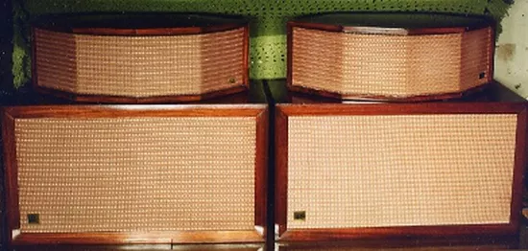
TRADITIONAL BOX SPEAKER DESIGNS
JanZen model 1-30 Electrostatic Array w/ AR1
  20

Slide 21
PLANAR TYPES
Electro-dynamic Planar Speakers
Ribbon Speakers
Multi-cell Flat Diaphragm Speakers
Electrostatic Speakers
  Exotics
  21

Slide 22
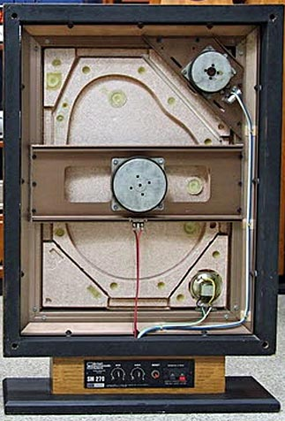
ELECTRO-DYNAMIC PLANAR SPEAKERS
There are numerous designs of this type. Typically, they use a conventional voice coil motor assembly attached to some form of flat diaphragm. Back in the late 70s I worked with Jose Bergagni founder of BES speakers.
  22

Slide 23
ELECTRO-DYNAMIC PLANAR SPEAKERS
Bertagni patented a system that used a Styrofoam panel of varying densities that when excited by a magnet/voice coil driver which allowed the panel to resonate at different frequencies depending upon the density of the panel. What is truly unusual about this variant is it produced a omni-polar dispersion pattern because the entire panel acted as a point source.
  23

Slide 24
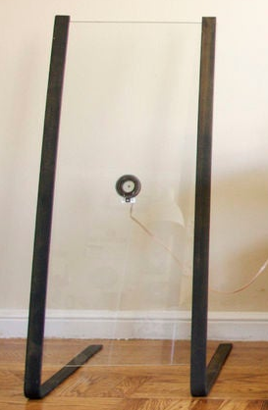
ELECTRO-DYNAMIC PLANAR SPEAKERS
Other companies have produced variants of this design using anything from PET foam, polypropylene foam, polypropylene, ABS, glass fiber and carbon fiber, flat Styrofoam, as well as everything from glass, to plastic, to wall board. Each with some success
  24

Slide 25
RIBBON LOUDSPEAKERS
The early Ribbon loudspeakers used electromagnets to energize coils. The energy then went through these coils into a second pair of connections to the driver in the system. This worked as a power supply and amplifier for the loudspeaker.
  25

Slide 26
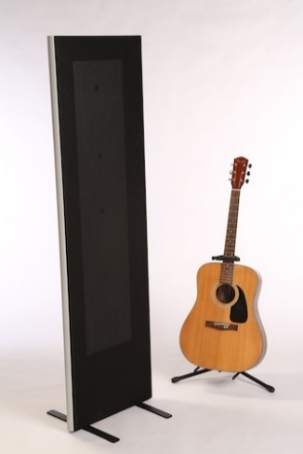
RIBBON LOUDSPEAKERS
Probably the most notable modern design is from Magnapan. They use a super light (low mass) aluminum foil film securely glued to a mylar diaphragm stretched tight over a frame and in close proximity to a series of bar magnets. The power amplifier applies signal to the aluminum coil causing the diaphragm to move and produce music.
  26

Slide 27
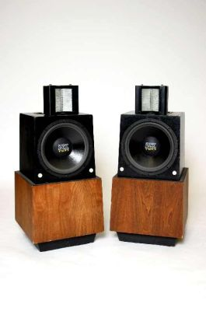
RIBBON LOUDSPEAKERS
One of the most famous early ribbon designs was the Air Motion Transformer invented by Dr. Oskar Heil’s in the 1970’s. This design used a flat wire voice coil positioned between mylar material and folded into an accordion shape that slipped between the pole piece of the magnet assembly. This was a dipole resonator producing equal signal output from both the front and back of the speaker. Versions of the original AMT1 are still available today by ESS.
  27

Slide 28
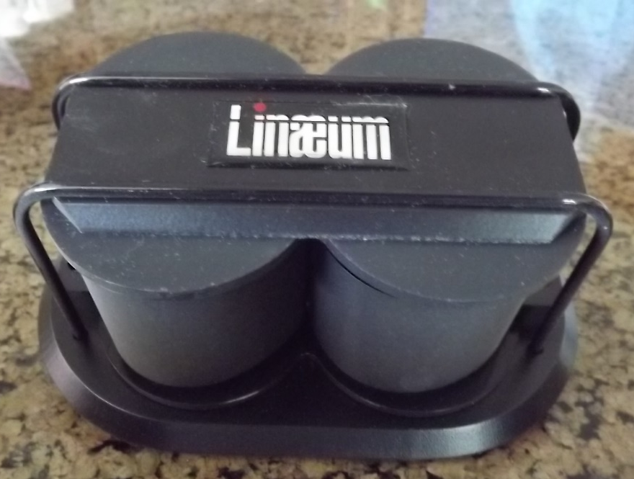
RIBBON LOUDSPEAKERS
A version of this design is currently available as a mono-pole design from both Martin Logan and Golden Ear.
Another variant of some note was the Linaeum Tweeter. It was very unique dipole ribbon tweeter. Here the voice coil was attached to sets of opposed half domes that are slotted between dual fixed magnets. As the polarity changes the ribbon moves back and forth through the gap causing the energy to be transmitted across the diaphragm, producing sound.
  28

Slide 29
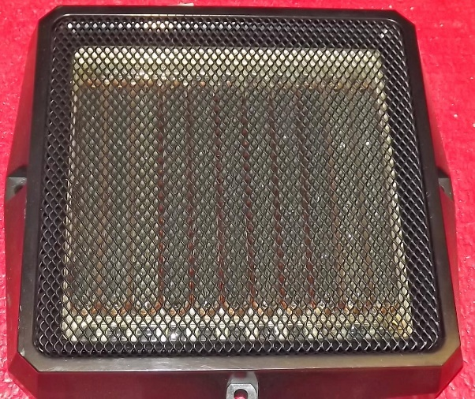
Multi-cell Flat Diaphragm Speakers
This speaker is related to the electrodynamic loudspeaker in that it uses magnetic fields to move an element, however its shape is different. This speaker has the coil directly mounted on the diaphragm. Some years ago, I acquired a pair of these mid/tweeter drivers. The copper coils have been wrapped around the base of the clear plastic bulges in the photos below. The long permanent magnets create separate 'cells' and the whole diaphragm ends up moving uniformly. This is a heavier speaker than the flat panel speakers above. This type of speaker requires a transformer because each small cell has a lower impedance than a standard speaker with single exciter.
  29

Slide 30
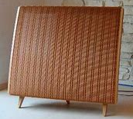
ELECTORSTATIC LOUDSPEAKERS
I became a Quad dealer back in 1976 and have had either Quad or Acoustat electrostatics as my primary listening speakers in my home system ever since. I have also sold almost every electrostat produced with very few exceptions over my 54 years in the audio industry. The history and technology are fascinating, and I could go on far deeper into the history and technology of the design, but I will attempt to keep this section informative and relatively short.
  30

Slide 31
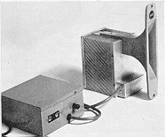
Unique Technology - Exotics
IONOVAC
My choice for the most unusual speaker design goes to the Ionovac.
According to physics the perfect speaker has no mass, is an infinitely small point source and can be moved without resistance. The original concept dates back to the late 1800s when Paulson demonstrated what he called his singing arc. But it wasn’t until 1954 when DuKane developed the DUKE-30 ionic tweeter. Electro-Voice marketed the Ionovac in 1958 under a temporary agreement with DuKane.
  31

Slide 32
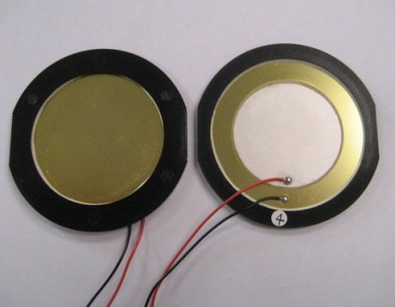
Piezoelectric
Some people may question my putting Piezoelectric speakers in the Unique Technology section, but as simple a device as they are they are defiantly a unique device. They work by using an expanding and contracting crystal to vibrate the air and produce sound. Piezoelectric speakers are limited in frequency response. Typically limited to very high frequencies. Therefore, they are only used as tweeters or in small electrical devices like watches/clocks to make simple sounds.
  There are some advantages to Piezo electronics. Since thy are a solid-state device, this technology makes them durable and good for use in devices that need to be durable and used in unusual environments not suitable to traditional speakers.
  32

Slide 33
Conclusion
This has been a rather condensed version of what can easily be expanded into a several hundred-page book. I may one day get around to writing such a volume, but for now I hope I covered enough that may have spurred some interest into a subject that I have always been fascinated by.
Needless to say, I have dedicated most of my 57 years in the audio industry to loudspeaker technology and product development.
Additionally, I am fortunate to say I have gotten to meet and know some of the world’s finest speaker designers and engineers. I have also had the good fortune of influencing some of the speaker’s designs on the market as well.
Also, I have been developing a new speaker design of my own that, with any luck, I will be able to produce a prototype of this design concept, to see if it will actually work. But until then I hope to continue to produce articles of interest. Or if you have an interest or question please let me know and I will be happy to answer your inquiry to the best of my ability.
  33

Slide 34
Q&A
WHAT ELSE DO YOU WANT TO KNOW!
  34
Notes:
34

Slide 35
Summary
I hope I’ve educated and entertained you today.
I can be contacted by e-mail at:
marc@seminarsatsea.org
  35
Notes:
35

