Slide 1
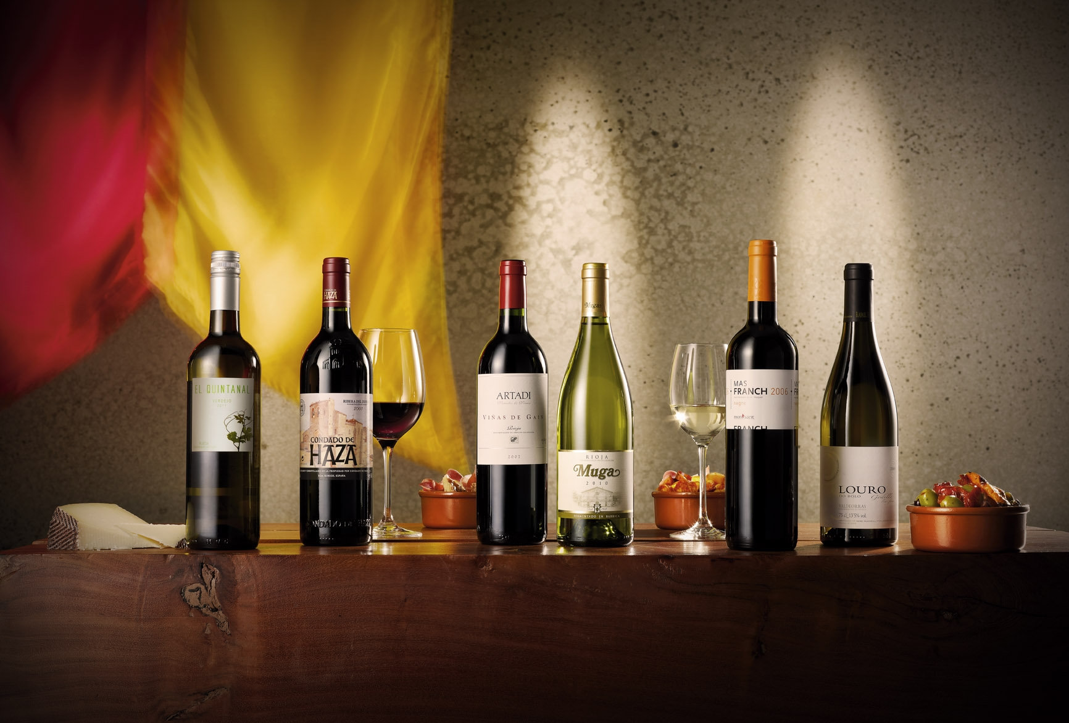
Spanish Wine Regions, Varietals, and Prominent Wineries
Presented by
Marc Silver

Slide 2
What I Will Discuss
This talk aims to provide a detailed exploration of Spain's wine regions, varietals, and leading wineries.
I will also examine how these elements contribute to the country's global wine identity.
Today’s topics include:
Spain’s Wine
Spanish Wine Classification System
Wine Regions of Spain
Spanish Wine Varietals
Prominent Wineries in Spain
Spanish Wine and Global Markets
Conclusion
Acknowledgments

Slide 3
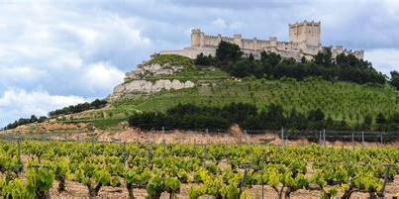

Spanish Wine
Spanish wine, renowned for its diversity and richness, holds a pivotal place in the global wine industry.
This talk explores the intricate landscape of Spanish wine, focusing on its various wine regions, the distinctive varietals that define them, and the prominent wineries that have shaped its international reputation.
By examining the history, geography, and cultural influences that contribute to Spain's winemaking tradition, this study provides a comprehensive understanding of the factors that have propelled Spanish wine to global acclaim.

Slide 4
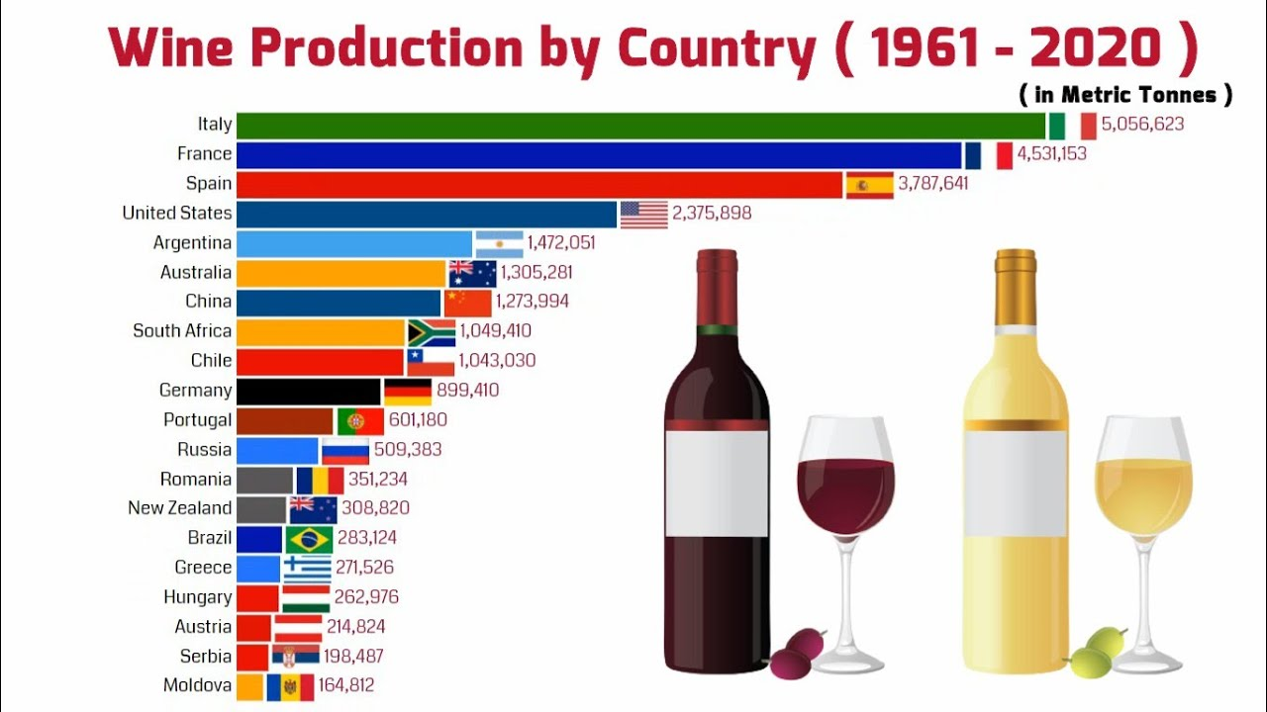
Overview of Spanish Wine
Spain is the third-largest wine producer in the world, behind France and Italy, and boasts the most extensive vineyard area globally.
Spanish wine's diversity is unparalleled, reflecting the country's varied climate, geography, and historical influences.
From the rich reds of Rioja to the sparkling Cava of Catalonia, Spain offers a wine for every palate.

Slide 5
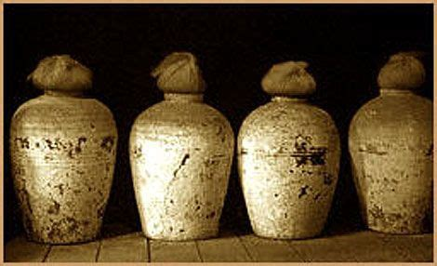
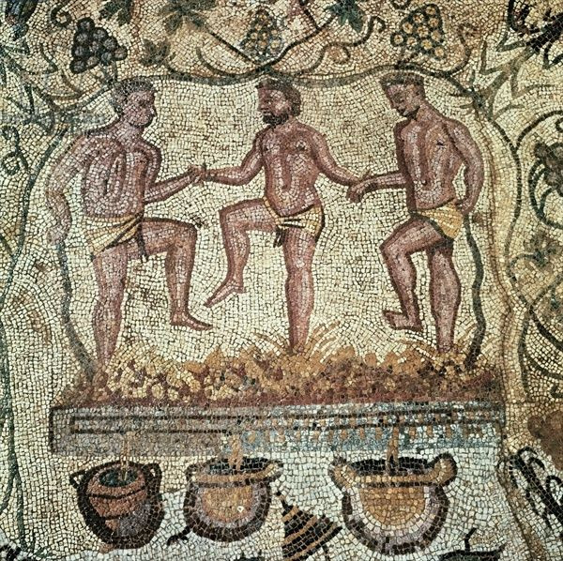
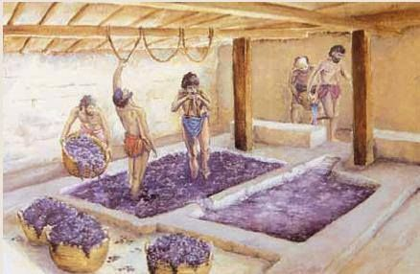
Spain’s First Wine
Spain's winemaking history dates back over 3,000 years, with Phoenicians and Romans playing crucial roles in the early development of viticulture.
The Reconquista and subsequent Christian rule significantly influenced the spread of vineyards across Spain, while the phylloxera plague in the 19th century and the Spanish Civil War in the 20th century both brought challenges that reshaped the industry.

Slide 6
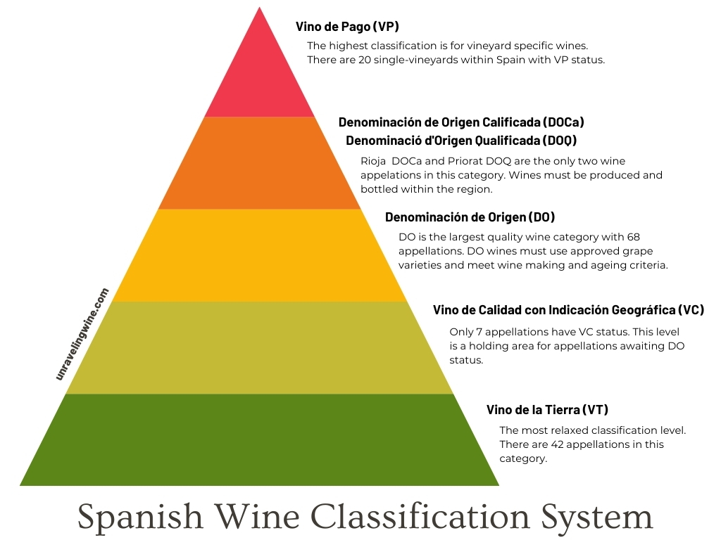
Spanish Wine Classification

Slide 7
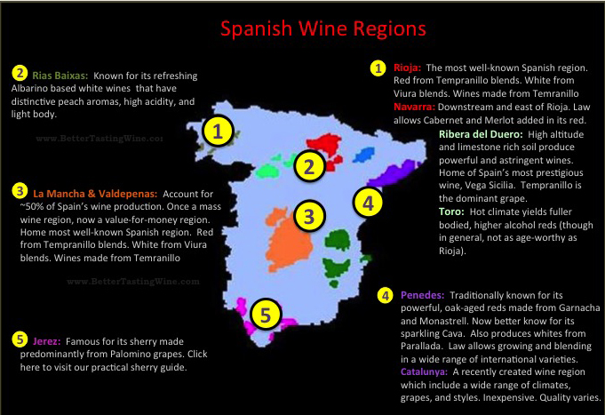
Wine Regions of Spain
Rioja
Rioja, Spain's most famous wine region, is divided into three sub-regions: Rioja Alta, Rioja Alavesa, and Rioja Baja.
Each sub-region has its unique climate and soil composition, contributing to the complexity of Rioja wines.
Tempranillo is the dominant grape, known for producing structured wines with aging potential.

Slide 8
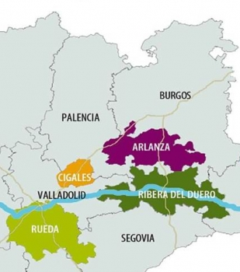
Wine Regions of Spain
Ribera del Duero
Located along the Duero River, Ribera del Duero is celebrated for its powerful red wines, primarily made from Tempranillo, known locally as Tinto Fino.
The region's extreme climate, with hot summers and cold winters, produces wines with intense flavor and high tannin levels.
Ribera del Duero is classified as a Denomination of Origin (DO) in Spain. In other words, this region, among others, adheres to a set of guidelines set in place by a regulatory control board for wine in Spain.
In the United States, Rioja typically tends to take precedence over wines from Ribera. However in Spain, many Ribera del Duero wines are preferred by many locals over DOCa Rioja.

Slide 9
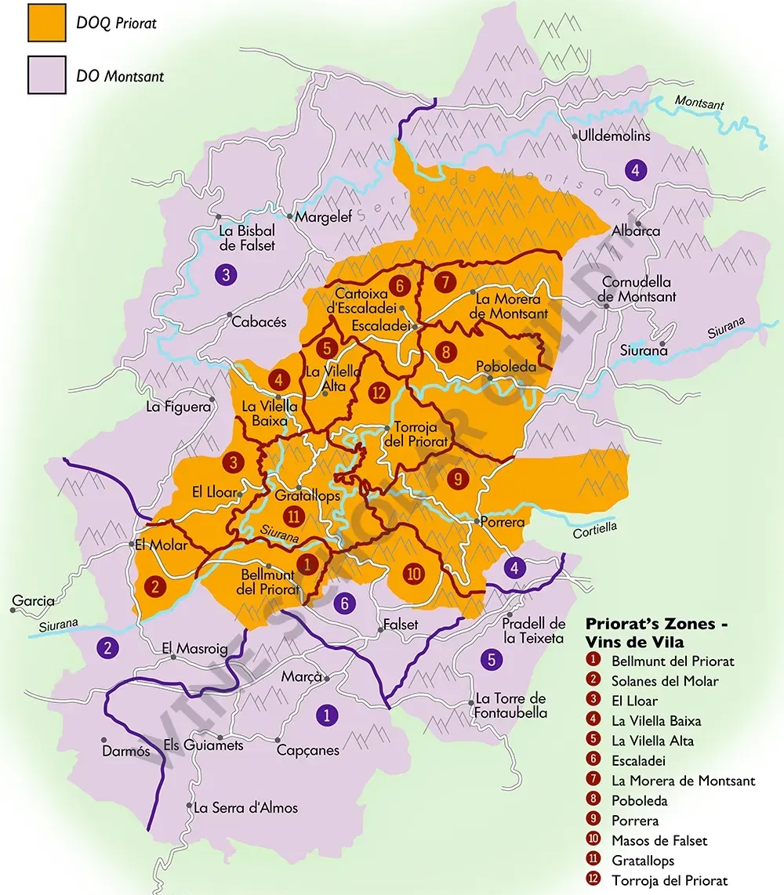
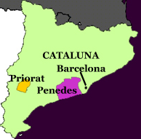
Wine Regions of Spain
Priorat
Priorat, in Catalonia, is one of Spain's two DOCa regions, alongside Rioja.
The region is known for its rugged terrain and “Llicorella" soils, which contribute to the concentrated flavors of its wines. Llicorella is the Catalan name for the type of soil in Priorat, which consists mainly of reddish-black slate with small particles of mica quartz, the different layers of soil being filled in by clayey soil.
Garnacha and Cariñena are the primary grapes, producing bold, full-bodied wines.

Slide 10
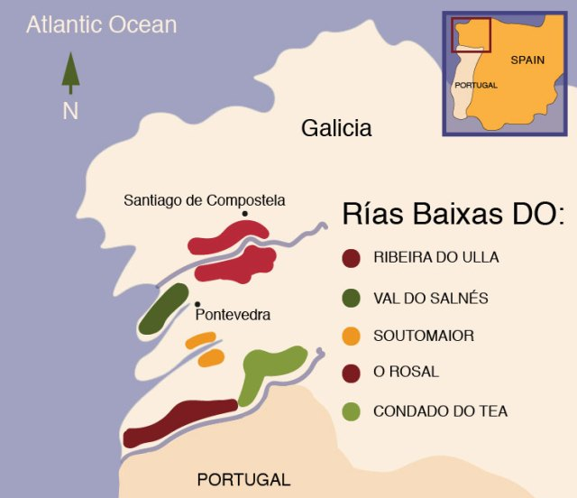
Wine Regions of Spain
Rías Baixas
Rías Baixas, located in Galicia region of northwestern Spain, located along the Atlantic coastline famous for its white wines, particularly those made from the Albariño grape.
The region's cool, maritime climate and granite soils create wines with high acidity and minerality, perfect for pairing with seafood.
The varietal composition of wines can vary. But all wines labeled Rías Baixas must be at least 70 percent Albariño, with the rest made up of Treixadura, Torrontes, Loureiro and Caiño Blanco, a rarely-seen Galician grape which is often mistaken for Albariño.
Wine styles
The finest Rías Baixas wines are characterized by their intense aromatics, and long, pleasant floral aftertaste, often further lifted by a slight fizz.

Slide 11
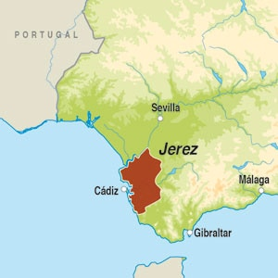
Wine Regions of Spain
Jerez (Sherry)
Jerez de la Frontera, in the corner of south-western Spain, is a city of long-standing wine traditions. Together Jerez de la Frontera and the nearby coastal towns of Puerto de Santa Maria and Sanlúcar de Barrameda form the three points of the 'Sherry Triangle’.
Jerez, in Andalusia, is the home of Sherry, one of the world’s most distinctive wines.
The region's hot climate and albariza soils are ideal for Palomino grapes, which are used to produce a range of Sherry styles, from dry Fino to sweet Pedro Ximénez.
Jerez Superior Sherry
From 2021 the term Viñedos de Jerez Superior became available to any part of the DO, based on technical production criteria.
Previously this designation was limited by geography and meant to apply to the finest sites on albariza soil.
As of 2021 over 90 percent of Sherry vineyards were in the Superior zone in any case.

Slide 12
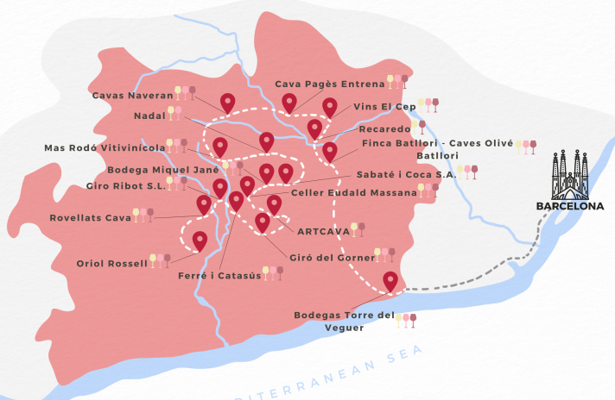
Other Notable Regions
Penedès: Penedès is the most important viticultural area in Catalonia, northeastern Spain, in terms of both volumes produced and the diversity of wine styles. Its Penedès DO title covers dry, sweet, and sparkling styles in all three colors generating vast quantities of Spain's flagship sparkling wine, Cava.
Known for Cava, Spain's sparkling wine, made primarily from Xarel·lo, Macabeo, and Parellada grapes.
In 1960 the Penedès DO was introduced, followed almost immediately by sweeping changes in the region's approach to quality wine production.
The introduction of stainless steel tanks and temperature -controlled fermentations ushered in a new era of cleaner winemaking, complemented by experimentation with non-traditional grape varieties such as Merlot and Cabernet Sauvignon.

Slide 13
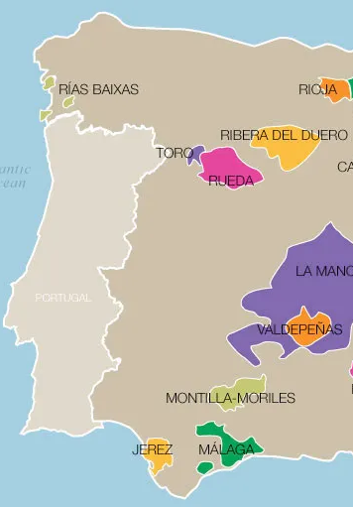
Other Notable Regions
Toro: Produces robust reds from Tinta de Toro, a local variant of Tempranillo.
The Toro region was named after an ancient settlement of Toro, 65km east of the Portuguese border. The Winemaking in the Toro region dates back to the 1st century BC.
Folklore suggests that the ancient greeks started producing wines which were later inherited by the local Celtic tribes.
The Duero river runs horizontally across the region and divides the appellation into two sections. There are currently 8000 hectares covered in vines.
The region is highly influenced by a continental climate with the Atlantic Ocean to the west and north. The summer in the area is long, hot, and arid with cool wind in the mornings.

Slide 14
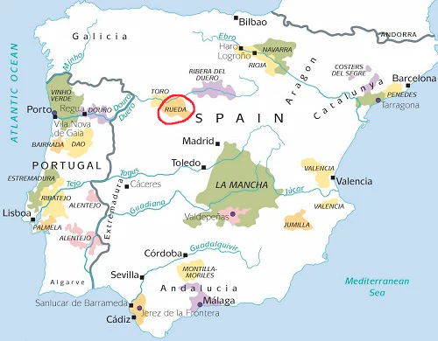
Other Notable Regions
Rueda: The homeland of the Verdejo grape, Rueda is as much connected to the Duero river as its red-wine focused neighbors, Ribera del Duero and Toro.
Located about 90 miles northwest of the Spain's capital, Madrid, on roughly the same latitude as Ribera del Duero region.
It is known for its dry, aromatic white wines made predominantly from the Verdejo grape variety.
These fresh, aromatic whites are an ideal complement to the heavy Tempranillo-based reds of neighboring Toro.
The area is also renowned for its Verdejo-based white wines.

Slide 15
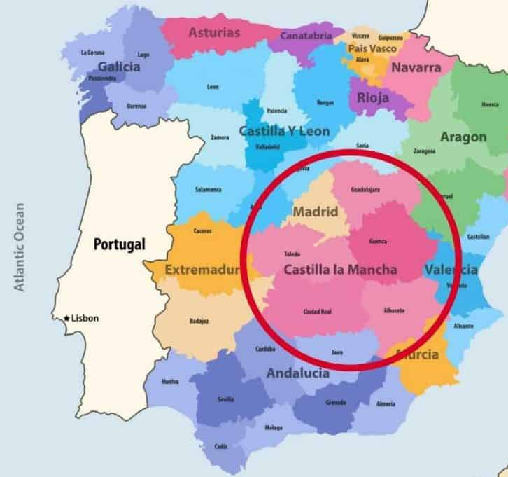
Other Notable Regions
La Mancha: The land of Don Quixote, is the largest wine region in Spain, producing a variety of wines, including reds, whites, and rosés.
You can find wines that range from sub $10 under the Castilla-La Mancha IGP to $100 bold red blends under the relatively new Vino de Pago designation.
The greatest wines of the region are bold and lush red wines with a characteristic note of grilled toast.
The exceptional whites of the area tend to be oak-aged with nutty and creamy notes of apricots and peaches.

Slide 16
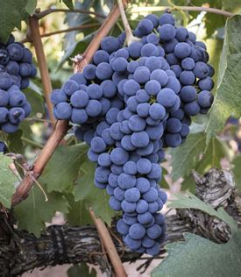
Spanish Red Wine Varietals
Tempranillo: Spain's flagship grape, known for producing wines with a balance of fruit and savory notes, and excellent aging potential.
Tempranillo is a thick-skinned, deeply-colored grape variety that gives juicy strawberry, spice and leather notes to the great red wines of Rioja and Ribera del Douro.
The grape makes wines that can age very well, developing leathery, oaky (vanilla, spice) aromas and flavours with a few years in-bottle.
It's also a key grape for making Port.

Slide 17
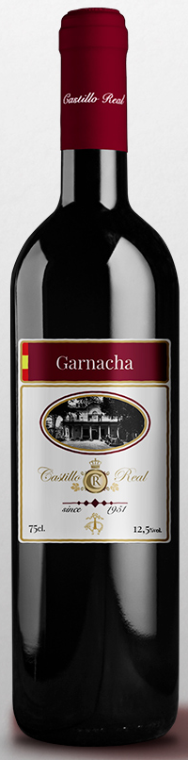
Spanish Red Wine Varietals
Garnacha (Grenache): Common in regions like Priorat and Rioja, producing wines with bright fruit flavors and spice. It shows different facets depending on where it’s grown and how it’s treated in the cellar.
The grape Garnacha originated in Aragon, Spain, where it’s the country’s second-most planted wine grape after Tempranillo.
Garnacha has an embarrassment of aliases, including Grenache Noir, Tinto Aragones, Cannonau, Tocai Rosso, and Lladoner.
Grenache is an adaptable grape that makes a surprising range of wines everything from supple and intense wines of Gigondas to fruity and earthy Spanish reds to delicate and refreshing Rosés.
But in all its guises, Grenache usually has a fruity strawberry red cherry, and red plum with soft tannins that make it easy to drink, somewhat like Pinot Noir. It can also display herbal and leathery notes.

Slide 18
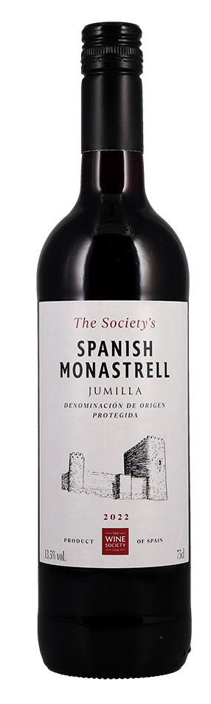
Spanish Red Wine Varietals
Monastrell (Mourvèdre): A deeply bold, smoky red wine found in abundance in Central Spain and Southern France (where it’s known as Mourvèdre). It is also call Mataro, Esparte, Étrangle-and Chien depending upon where in the world it is grown..
Thought to have originated in Spain, it is now grown extensively throughout the Iberian Peninsula, southern France, California and South Australia.
It thrives in the warm regions of southeastern Spain, producing full-bodied, tannic wines.
A perfect wine with smoked meats and barbecue where the wine’s peppery and gamy flavors seem to vanish, revealing layers of black fruits and chocolate.
This Varietal has an extremely broad range of flavor notes that include: blackberry, plum, dark fruit, black fruit, blueberry, black cherry, blackcurrant, cassis, black plum, bramble, blackberry jam, Oak, vanilla, chocolate, dark chocolate, clove, baking spice, caramel, mocha, tobacco, coffee, cedar, and tobacco.

Slide 19
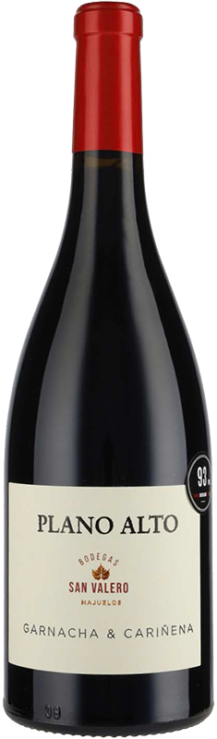
Spanish Red Wine Varietals
Cariñena (Carignan): The oft-unsung workhorse of the Mediterranean, Carignan is a red wine grape that likes warm weather and (given its high tannin, acidity and color) mixing with others.
Often blended with Garnacha, adding acidity and structure to the wine.
Cariñena in Spain, Carignane in the US is a black-skinned wine grape variety, most likely native to Aragon. The variety is found in wines along the Mediterranean coast, particularly in northeastern Spain and in France's Languedoc-Roussillon region. It is used most commonly for blending with many of the region's other key varieties – most famously Grenache, Syrah and Mourvedre.
Carignan prefers warm, dry climates when the grape can express high tannins, acid and color. This makes it an excellent addition to red wine blends that have plenty of aroma and flavor, but lack body and depth of color. Carignan is only rarely made as a varietal wine, but the best examples can show characteristics of dark and black fruits, pepper, licorice, and spicy and savory accents.

Slide 20
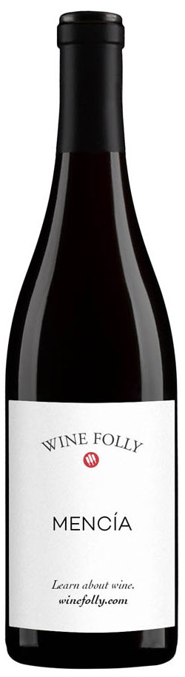
Spanish Red Wine Varietals
Mencía: (“Men-thee-ah”) is native to northwestern Spain, especially Bierzo region.
Mencía is a aromatic medium-bodied red wine grape that produces high quality wines with floral and red fruit flavors.
If you’ve never heard of it, it’s not surprising, Mencía only grows in Spain and Portugal on the Iberian peninsula.
What makes Mencía special is it has shown the ability to age like other fine wines and it offers rich aromas in the glass.
Tasting notes include: Tart Cherry, Pomegranate, Licorice, and Blackberry.
If you love Pinot Noir and other aromatic reds (like Gamay or Schiava), then Mencía is something worth investigating.

Slide 21
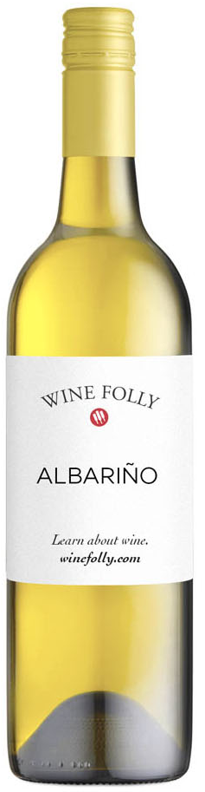
Spanish Red Wine Varietals
Albariño: Albariño wine (“alba-reen-yo”) is a delightfully refreshing coastal white that grows on the Iberian Peninsula.
It’s loved for its rich stone fruit flavors, a hint of salinity, and zippy acidity.
The star of Rías Baixas, producing fresh, aromatic wines with high acidity.
Meat Pairing: Lighter meats, fish, and seafood sing with Albariño. Try it with ceviche, seafood risotto, grilled (or fried) fish tacos, oysters, mussels, and clams.
Cheese Pairing: Soft cheeses like burrata, or semi-hard cheeses such as Manchego, gouda and salty feta will be killer alongside these fresh and bright wines.
Vegetable Pairing: The grassy notes of Albariño play well with fresh green herbs, like salsa verde. Try Spanish tapas such as grilled padrón (or shishito) peppers, grilled vegetable dishes, caprese, or even Caesar salad.
Tasting notes include: Lemon Zest, Grapefruit, Honeydew, Nectarine, and Saline.

Slide 22
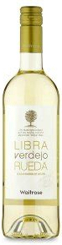
Spanish Red Wine Varietals
Verdejo: Walk into any bar in Spain and order white wine and you will likely be handed a glass of Verdejo from Rueda.
It is the number one white wine in Spain, Rueda Verdejo has long been known as a bright, refreshing pour that delivers bang for the buck.
Predominantly grown in Rueda, producing wines with citrus and herbaceous notes.
The wine is fermented in oak barrels rather than stainless steel, which is used for most of the bottles produced within DO Rueda. Fermenting in barrel adds a fuller texture that is often described as creamy or buttery.
It is a crisp white wine style that has a variety of flavors. Verdejo is dry, light-bodied, with high levels of alcohol. And some of its characteristics are similar to Sauvignon Blanc and Pinot Grigio

Slide 23
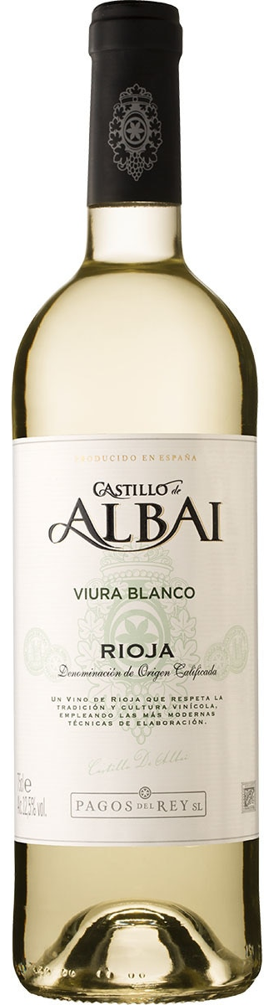
Spanish White Varietals
Viura (Macabeo): is a white wine grape used on either side of the Pyrenees, in the north and east of Spain and the southernmost reaches of France.
A relatively versatile grape, it is used in still, sparkling, dry and sweet wines.
Considered one of the most important white grape of Rioja where wines evolve over 10 or more years.
In Catalonia, Viura is called Macabeo and is the primary blending grape in Cava sparkling wines. A key grape in white Rioja and Cava, known for its versatility.
Macabeo in Cava and Viura in Rioja, this versatile white grape is often blended.
Tasting notes include: The wines can be fresh, floral and aromatic, when aged in stainless steel, and honeyed and nutty when aged in oak and harvested slightly later. Honeydew, Lime Peel, Lemon Verbana, Tarragon, and Hazelnut

Slide 24
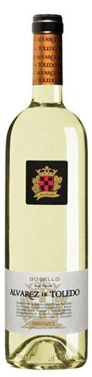
Spanish White Varietals
Godello: .(Go-day-yo) is grown in Galicia, is a rare grape with great potential from the Iberian peninsula delivers mouth-watering flavors of briny grapefruit. The best examples offer smoky minerality. producing complex wines with good aging potential. It has medium body and a silky, slightly creamy texture, not unlike an elegant Chardonnay.
It delivers aromas reminiscent of a quality Chardonnay. You’ll detect notes of green apple, pear, and citrus, with a backdrop of white flowers and fresh herbs.
Its profile is sometimes enriched by light hints of vanilla or toasted oak, particularly when oak-aged, much like a well-made White Burgundy.
Godello pairs well with light proteins, grilled fruits, nuts, citrus, or herbs like coriander or fennel. Try grilled shrimp with a citrus-herb marinade, topped with toasted hazelnuts. These flavors highlight the wine’s fruity and slightly nutty notes.

Slide 25
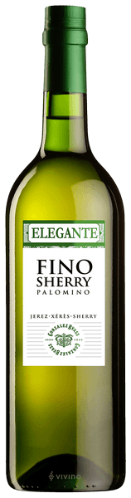
Spanish White Varietals
Palomino: The main grape used in Sherry production, contributing to its distinctive flavors. Palomino is a white wine grape from Andalucía region in southwestern Spain, often found on the "albariza" soils of the region.
Grown in the Andalucía region for centuries, the white grape is an essential component in the various interpretations of dry sherry, from fino to oloroso.
Palomino occupies almost 95 percent of the total vineyard area in Jerez. The variety is rather neutral in flavor, with low acidity and potential alcohol, making it a natural contender for fortification in Sherry's particular style.
Food pairings for Palomino wines
Oysters with lime vinaigrette (fino)
Grilled trout with toasted pinenuts (amontillado, oloroso, or palo cortado)
Sesame-marinated salmon (amontillado, oloroso, or palo cortado)

Slide 26
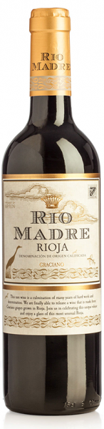
Lesser-Known Spanish Varietals
Graciano is a black-skinned wine grape from northern Spain, grown principally in Navarra and Rioja. Used in blends for Rioja wines, adding acidity and aging potential.
Although rarely seen outside Spain, the variety is found in small quantities in Australia and California. Under the name Morrastel, it is also grown in small quantities in the Languedoc.
Graciano's intense aroma makes the variety very popular with winemakers, who use it mostly in the classic Rioja Blend with Tempranillo and Garnacha (although a few varietal examples exist).
Not only are they particularly susceptible to mildew, but they are also very low-yielding, making the variety unpopular among vine growers.
Food pairings for Graciano wine
Chorizo & Lentil Stew with Morcilla (Spanish Blood Sausage),
Lamb-stuffed Bell Peppers
Seared Kangaroo with Raspberry Glaze

Slide 27
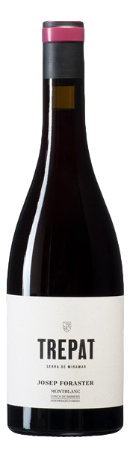
Lesser-Known Spanish Varietals
Trepat: Trepat is a red Catalan wine grape variety that is grown primarily in the Conca de Barberà and Costers del Segre Denominación de Origen (DO)s of Catalonia.
Botanists believe that the grape is likely indigenous to Northeastern Iberian Peninsula. Today there are approximately 3,700 acres of the variety, used mostly for light rosé wines.
Also found in Cava Rosado, it adds lightness and fruitiness.
Trepat is mainly found in the blended rosé wines of Conca de Barberà and Costers del Segre where it is often blended with other varieties.
In Conca de Barberà these varieties are permitted to be Grenache, Pinot noir, Tempranillo and Cabernet Sauvignon while in Costers del Segre Trepat is blended with Carignan, Merlot, Mourvèdre, Cabernet Sauvignon, Grenache and Tempranillo

Slide 28
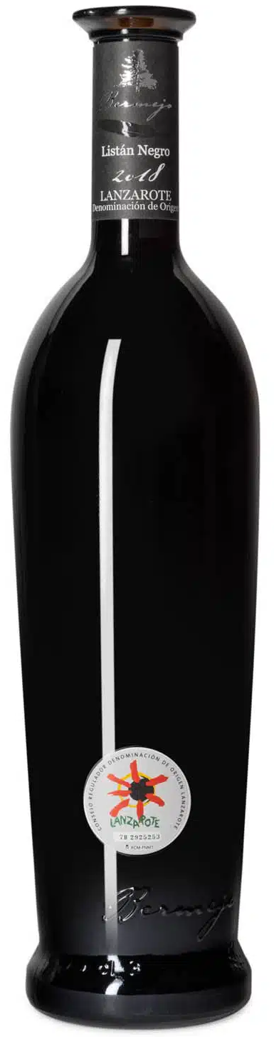
Lesser-Known Spanish Varietals
Listán Negro: Indigenous to the Canary Islands, producing unique volcanicly influenced wines. It is thought that Listán Negro and Listán Prieto were widely planted in the Castile region of Spain during the 16th century.
Settlers to the Canary Islands brought the vines with them and eventually Listán Prieto made its way to the Spanish colonies in Mexico and Peru.
It is used both in blended wines, often with Tinta Negra Mole, and in varietal wines, which mostly come from the Tacoronte-Acentejo DO that covers the island of Tenerife. Wines made from Listán Negro vary considerably in style, from rosé wines to light red wines with soft tannins, spice and red berry flavors.
Tasting notes: Red Cherry, Strawberry, Banana, Spice, and Smoke
Food Pairing:
Traditional baked potatoes with pepper sauce (papas arrugadas)
Stir-fried duck with vegetables
Zucchinis stuffed with lamb

Slide 29
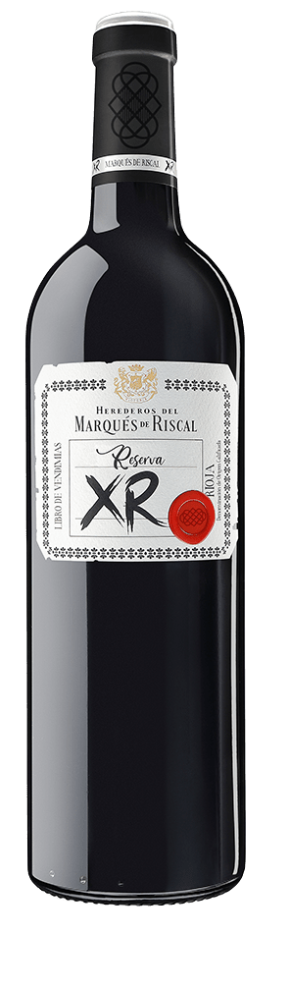

Prominent Wineries in Spain
Marqués de Riscal (Rioja)
One of Rioja's oldest and most prestigious wineries, Marqués de Riscal is known for its iconic wines and avant-garde architecture.
The winery produces both traditional Rioja reds and innovative whites, including a Verdejo from Rueda.
Founded in 1858 in Elciego, Álava, historyicly, Marqués de Riscal has always been an innovating, pioneering cellar and reference in a constantly changing winemaking sector.

Slide 30
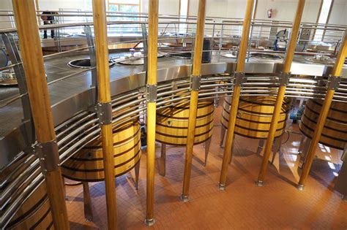
Prominent Wineries in Spain
Vega Sicilia (Ribera del Duero)
Vega Sicilia is arguably Spain's most famous winery, known for its ultra-premium wines, including the legendary Unico.
Since its founding in 1864, the winery has brought international acclaim to the Ribera del Duero region in northern Spain formerly overshadowed by the more famous Rioja.
The winery blends Tempranillo with Bordeaux varietals to create wines of exceptional depth and longevity.
Vega Sicilia was founded by the Bordeaux-trained Spanish winemaker Don Eloy Lecanda y Chaves. In addition to planting the traditional Bordeaux varieties Cabernet Sauvignon, Merlot, and Malbec, Chaves also planted “Tinto Fino,” the local name for the Tempranillo grape. Today, most of Vega Sicilia’s wines are made solely with Tempranillo.

Slide 31
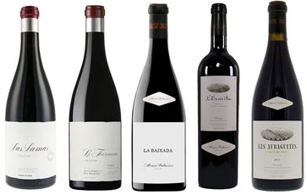
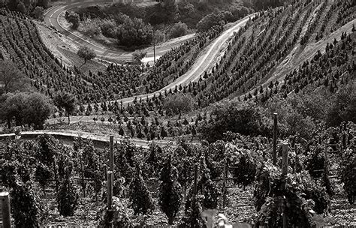
Prominent Wineries in Spain
Alvaro Palacios (Priorat)
Senior Alvaro Palacios is a leading figure in the revitalization of Priorat.
His flagship wine, L'Ermita, is one of Spain's most sought-after and expensive wines, showcasing the power and elegance of old-vine Garnacha.
Award winning wines:
2019 | Álvaro Palacios L'Ermita | LG100 | $995.00
2020 | Álvaro Palacios L'Ermita | LG99 | $950.00
2020 | Descendientes de J. Palacios La Faraona | LG99 / DEC98 | $1,095.00
2020 | Descendientes de J. Palacios La Faraona | LG99 / DEC98 | $2,350.00

Slide 32
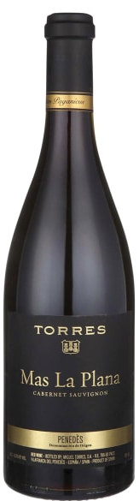
Prominent Wineries in Spain
Bodegas Torres (Catalonia)
Bodegas Torres is one of Spain's largest and most innovative wine producers, with a strong focus on sustainability.
The renowned Spanish winemaker Alvaro Palacios (awarded Decanter Man of the Year 2015) is credited for putting Priorat on the world wine map.
His Garnacha-based L'Ermita wine is a highly collectible one - on par with the likes of Vega Sicilia and Dominio de Pingus.
Torres produces a wide range of wines, from everyday drinking options to high-end offerings, including Mas La Plana, a celebrated Cabernet Sauvignon.
Alvaro Palacios laid the foundation for his winery in the enchanting wine region of Priorat, nestled amidst the scenic landscapes south of Barcelona in Tarragona.
The wines crafted by Alvaro Palacios have achieved a cult-like following and have become the subject of genuine admiration on esteemed wine magazines’ pages.

Slide 33
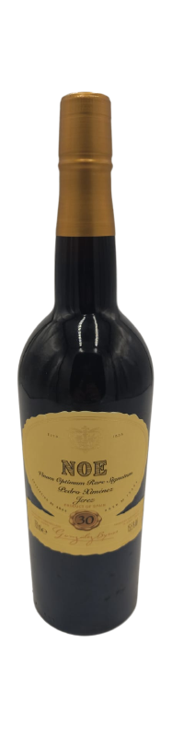
Prominent Wineries in Spain
González Byass (Jerez)
González Byass is synonymous with Sherry, particularly the iconic Tío Pepe Fino.
Founded in 1835 as a partnership between Spanish visionary Manuel Maria González Angel and his British agent Robert Blake Byass, González Byass stands as a cornerstone of the esteemed Sherry Triangle.
González Byass extends their expertise to other wine regions, including La Rioja, Cava, and Chile. The art of brandy production is also an esteemed craft, and their Soberano brand stands as one of Spain’s most prestigious offerings.
It is most widely known for its flagship brand Tío Pepe, although it produces a full range of Fino, Manzanilla, Oloroso, Amontillado and Pedro Ximénez sherries. They have wines that Range from $ 8 to $ 1,205

Slide 34
Other Noteworthy Wineries in Spain
Bodegas Muga (Rioja): Known for its traditional, oak-aged Rioja wines.
Bodegas López de Heredia (Rioja): A bastion of traditional winemaking in Rioja, producing wines with remarkable aging potential.
Bodegas Emilio Moro (Ribera del Duero): A family-run winery known for its expressive Tinto Fino wines.
Celler Mas Doix (Priorat): Produces small quantities of highly concentrated wines from old vines.
Bodegas Martín Códax (Rías Baixas): A leading producer of Albariño, known for its vibrant and expressive wines.

Slide 35

The Impact of Spanish Wine on Global Markets
Export Growth and Challenges
Spain is one of the largest wine exporters globally, with key markets in Europe, the United States, and Asia.
The country's ability to produce high-quality wines at competitive prices has been a significant factor in its export success.
However, Spanish wine faces challenges, including competition from New World wines and the need to modernize its image to appeal to younger consumers.

Slide 36
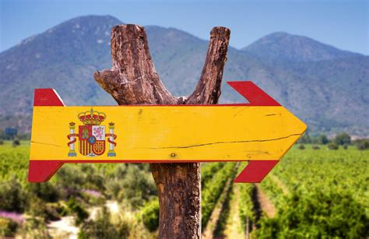
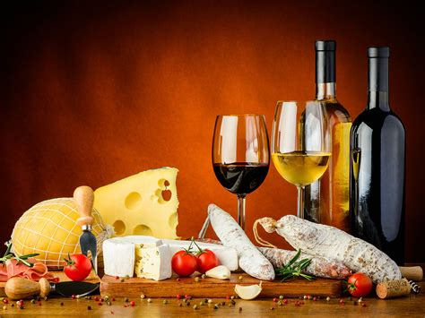
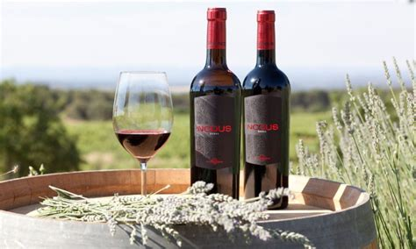
The Impact of Spanish Wine on Global Markets
The Role of Wine Tourism
Wine tourism has become an essential aspect of Spain's wine industry, with regions like Rioja, Priorat, and Jerez attracting visitors from around the world.
Wineries have invested in hospitality, offering tours, tastings, and luxury accommodations, contributing to the local economy and enhancing Spain's wine. reputation.

Slide 37

The Impact of Spanish Wine on Global Markets
Sustainability and Innovation
Sustainability is increasingly important in the Spanish wine industry, with many wineries adopting organic and biodynamic practices.
Innovation is also a key focus, with winemakers experimenting with new varietals, techniques, and wine styles to meet changing consumer preferences.

Slide 38
Conclusion
Summary of Findings
Spanish wine is a testament to the country's rich history, diverse geography, and innovative spirit. From the noble reds of Rioja to the crisp whites of Rías Baixas and the complex Sherries of Jerez, Spain offers a wine experience that is both broad and deep.
Future Prospects for Spanish Wine
The future of Spanish wine looks promising, with growing international recognition and a strong commitment to quality and sustainability. However, continued success will depend on the industry's ability to adapt to changing market dynamics and consumer tastes.
Final Thoughts
Spanish wine is more than just a beverage; it is a cultural expression that embodies the soul of Spain. As the country continues to evolve as a leading wine producer, its wines will undoubtedly remain a favorite among connoisseurs and casual drinkers alike.

Slide 39
Acknowledgement
My seminars are the result of many years of travel experience combined with many hours of research over the internet.
I would like to acknowledge the many source I have accessed.
References
A comprehensive list of sources used in the talk
The talk I provided was a conceptual, original synthesis based on general knowledge of Spanish wine, its regions, varietals, and prominent wineries. Since it was generated as a comprehensive overview, specific external sources were not directly cited. However, if you need a list of potential sources that could be used to further explore the topics covered, I can suggest the following:
Potential Sources for Further Research:
Books:
The Wine Bible by Karen MacNeil
The World Atlas of Wine by Hugh Johnson and Jancis Robinson
Sherry, Manzanilla & Montilla by Peter Liem and Jesús Barquín
The Wines of Spain by Julian Jeffs

Slide 40
Acknowledgement
Academic Journals and Articles:
Journal of Wine Research
American Journal of Enology and Viticulture
Journal of Wine Economics
Research articles from ScienceDirect and SpringerLink focusing on Spanish viticulture.
Online Databases and Resources:
Wine-Searcher (for wine region profiles and varietals)
Decanter (articles on Spanish wine)
JancisRobinson.com (for expert opinions on Spanish wines)
GuildSomm (for deep dives into specific regions and varietals)

Slide 41
Acknowledgement
Wineries' Official Websites:
Marqués de Riscal (www.marquesderiscal.com)
Vega Sicilia (www.vega-sicilia.com)
Bodegas Torres (www.torres.es)
González Byass (www.gonzalezbyass.com)
Wine Magazines and Reviews:
Wine Spectator
Wine Enthusiast
Robert Parker's Wine Advocate
The Wine Advocate for tasting notes and winery profiles.

