Slide 1
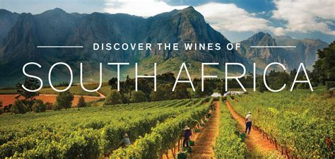
Presented by
Marc Silver

Slide 2
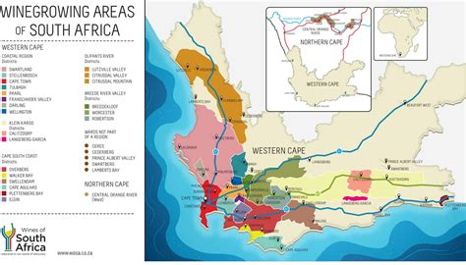
The Rich Legacy and Significance of
South African Wine
South Africa, renowned for its stunning landscapes and diverse cultures, is also celebrated for its vibrant wine industry, which boasts a history as rich and complex as the wines it produces.
From the rolling vineyards of Stellenbosch to the coastal plains of the Western Cape, South African wine has become a symbol of the country’s resilience, innovation, and deep connection to the land.

Slide 3
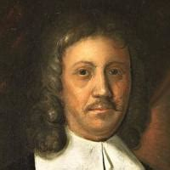
A Historical Journey
The history of South African wine dates to 1659, when the first bottle of wine was produced in the Cape by Dutch settlers under the guidance of Johan Anthoniszoon "Jan" van Riebeeck a Dutch navigator, ambassador and colonial administrator of the Dutch East India Company.
The early years were challenging, as the settlers struggled to cultivate European grape varieties in unfamiliar soils and climates.
However, with persistance and the arrival of French Huguenot refugees in the late 17th century, who brought with them viticultural knowledge, the industry began to expand and thrive.

Slide 4
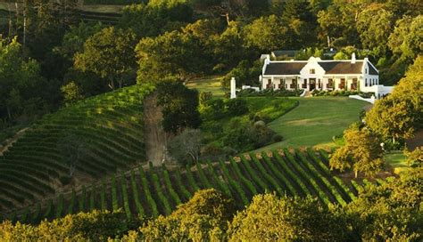
A Historical Journey
One of the most notable historical wines is Constantia, produced at the Groot Constantia estate.
The Dutch East India Company appointed Simon van der Stel in 1679 to govern the Cape of Good Hope.
In 1685 he fell in love with the soil and chose about 1885 acres situated behind Table Mountain for its wine-growing potential and magnificently beautiful scenery.
Consequently, over the years the wines produced on this estate, due to their impressive quality caught the attention of influential people across the globe.

Slide 5
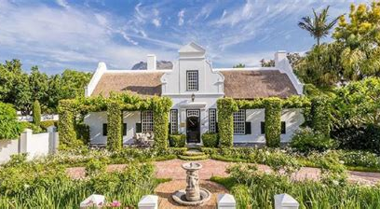
A Historical Journey
In recognition of his assistance and support in obtaining the farmland, Van der Stel possibly named the farm after Van Goens’daughter.
Also, there is the theory that the farm was named after the VOC ship “Constantia.” He likely named the farm after the Latin word for constancy or steadfastness, attributes Van der Stel valued greatly.
In the 18th and 19th centuries, this sweet wine gained international acclaim, becoming a favorite of European royalty and literary figures such as Napoleon Bonaparte and Charles Dickens.
The reputation of Constantia wine helped put South Africa on the global wine map.

Slide 6
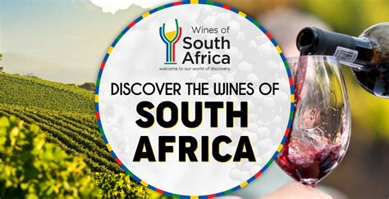
The Evolution of South African Wine
The history of South African wine is a fascinating story that spans over three and a half centuries, deeply intertwined with the country’s broader
socio-political landscape.
From its humble beginnings
under the Dutch East India
Company to its current status as a
global wine producer, the evolution of South African wine reflects the nation’s resilience, innovation, and rich cultural diversity.

Slide 7
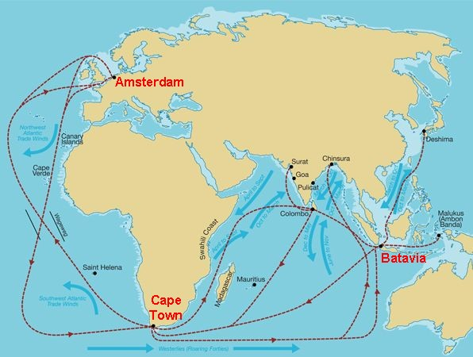
Dutch Beginnings (1650s-1700s)
South African wine history begins with the arrival of the Dutch East India Company at the Cape of Good Hope in 1652.
The Cape was initially established as a refreshment station for ships traveling between Europe and the East Indies.
Jan van Riebeeck, the first commander of the Cape, recognized the need to produce wine to help sailors combat scurvy during their long sea voyages.

Slide 8
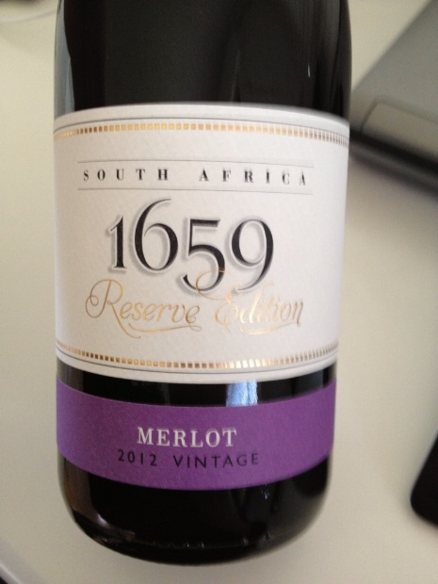
Dutch Beginnings (1650s-1700s)
On February 2, 1659, Van Riebeeck recorded the first wine produced from grapes grown in the Company’s Garden in Cape Town, marking the birth of the South African wine industry.
However, the early years were fraught with challenges.
The settlers faced difficulties in cultivating European grape varieties due to the unfamiliar soils, climate, and diseases.
Despite these struggles, they persevered, and by the end of the 17th century, vineyards had spread across the Cape, with the arrival of French Huguenots playing a pivotal role in the industry’s development.

Slide 9
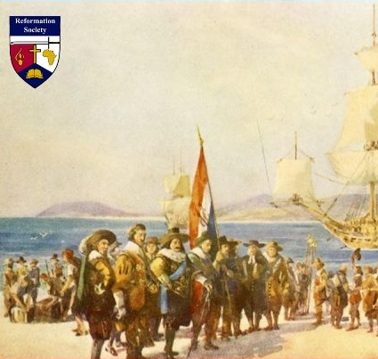
Dutch Beginnings (1650s-1700s)
On December 31, 1687 a group of Huguenots fled from France. This was part of the first of the large-scale emigration of Huguenots to the Cape of Good Hope, which took place between 1688 and 1689.
In total some 180 Huguenots from France, and 18 Walloons from present-day Belgium, eventually settled at the Cape of Good Hope.

Slide 10
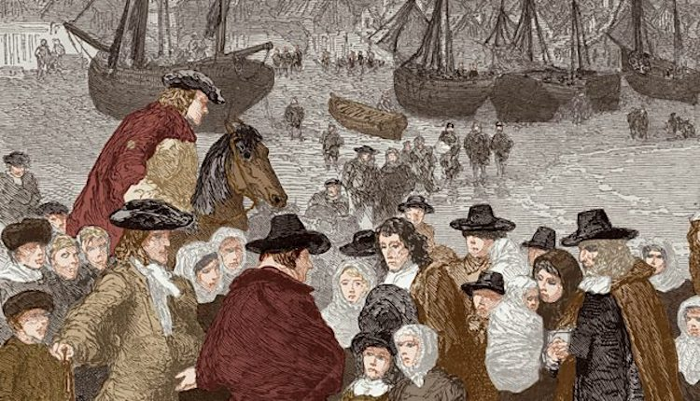
The Huguenot Influence and the Rise of Constantia (1680s-1800s)
The French Huguenots, who fled religious persecution in France and arrived at the Cape in the late 17th century, significantly influenced the South African wine industry.
Many of these refugees were skilled viticulturists, and their expertise helped improve the quality of wine production in the region.
They settled in areas such as Franschhoek, a name that translates to “French Corner,” which remains one of South Africa’s most famous wine regions today.

Slide 11
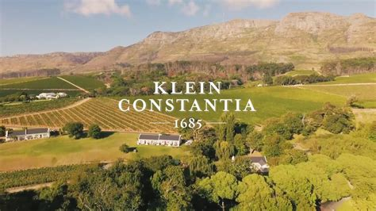
The Huguenot Influence and the Rise of Constantia
(1680s-1800s)
The establishment of the Constantia estate in 1685 by Simon van der Stel, the governor of the Cape, was a landmark moment in the history of South African wine.
Located just outside Cape Town, the estate quickly gained a reputation for producing high-quality wines.
Klien Constantia is particularly known for its sweet dessert wine, which became known simply as "Constantia."
By the 18th century, Constantia wines had gained international fame, enjoyed by European royalty, including King Louis Philippe of France and King George IV of England, as well as literary figures such as Jane Austen and Charles Baudelaire.

Slide 12
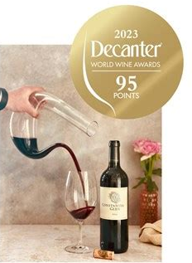
The Huguenot Influence and the Rise of Constantia (1680s-1800s)
Constantia’s success helped solidify the Cape’s reputation as a wine-producing region of note.
In 1705, Naturalist François Valentyn called Constantia’s wine "The choicest wine to be found at the Cape...so divine and enticing in taste.” But it was Hendrik Cloete, who bought the homestead in 1778 and expanded the winery and is considered the Father of South African Wine.
However, the 19th century brought new challenges, as the industry faced devastating setbacks due to the arrival of vine diseases such as phylloxera and powdery mildew, which decimated vineyards across the Cape.

Slide 13
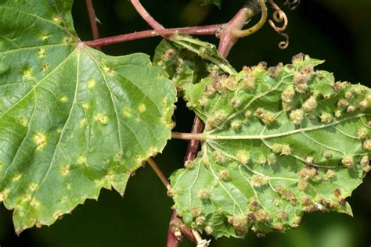
The Struggles and Transformations of the 19th Century
The 19th century was a tumultuous period for the South African wine industry. The discovery of gold and diamonds in the late 1800s shifted the country’s economic focus away from agriculture, including viticulture.
The introduction of British colonial rule also had significant impacts, as the British initially preferred spirits and fortified wines, leading to a decline in the production of table wines.
The arrival of phylloxera, a vine-destroying insect, in the 1880s, followed by powdery mildew, caused widespread devastation to South African vineyards.
Many farmers were forced to turn to other crops or abandoned farming altogether. This period of hardship led to a decline in the quality and quantity of South African wine, and it took years for the industry to recover.

Slide 14
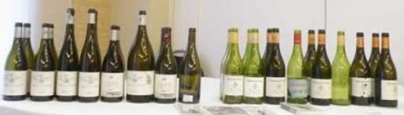
The Establishment of KWV and the Industry's Revival (20th Century)
The early 20th century marked the beginning of a new era for South African wine, as the industry sought to recover from the challenges of the previous century.
The Koöperatieve Wijnbouwers Vereniging van Zuid-Afrika (KWV) which translates to: Cooperative Wine Growers Association of South Africa, was established by wine farmers as a cooperative aimed at stabilizing the industry.
KWV, Wine & Spirits producers in South Africa was founded in 1918. Today KWV’s co-operative is still active and represents 29 brands.
In 1924 the KWV Act is passed, and
specific administrative responsibilities,
as well as the sole exporting and
importing of surplus alcohol, were
assigned to KWV.

Slide 15
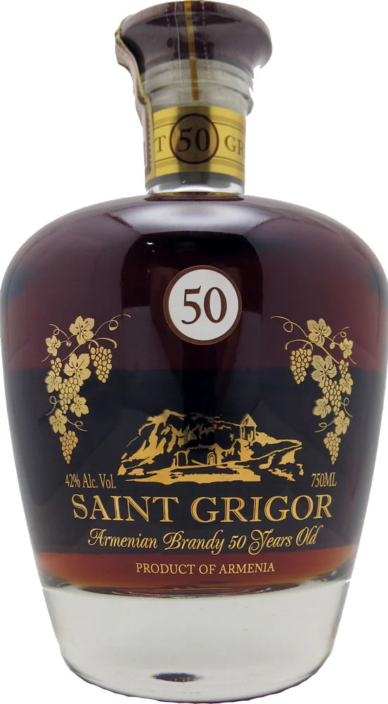
The Establishment of KWV and the Industry's Revival (20th Century)
The KWV played a crucial role in regulating wine production, controlling prices, and improving quality standards. It also introduced measures to combat overproduction, which had been a persistent problem.
Under the KWV’s guidance, the South African wine industry began to regain its footing, with a renewed focus on quality over quantity. However, the country’s isolation due to apartheid-era sanctions in the latter half of the 20th century limited its access to international markets, which hindered growth and innovation.
In 1939 with the outbreak of World War II causes exports to decline and domestic brandy consumption to increase. KWV expands its export market to the rest of Africa and the East.
Saint Grigor Armenian Brandy
50 Year Old Timeless 700ml $389.99

Slide 16

The Post-Apartheid Renaissance and
Global Recognition (1990s-Present)
The end of apartheid in 1994 marked a turning point for South Africa, both politically and economically, including its wine industry.
With the lifting of international sanctions, South African wines were reintroduced to the global market, where they quickly gained recognition for their quality and diversity.
This period saw an influx of investment, both local and international, which spurred significant advancements in viticulture and winemaking techniques.

Slide 17
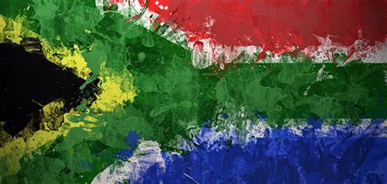
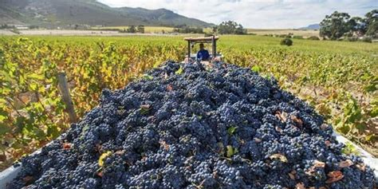
The Post-Apartheid Renaissance and
Global Recognition (1990s-Present)
The post-apartheid era also brought a wave of new, dynamic winemakers who were eager to experiment with different grape varieties, terroirs, and styles.
Regions such as Stellenbosch, Franschhoek, and the Swartland emerged as centers of innovation, producing wines that reflected the unique characteristics of the South African landscape.

Slide 18
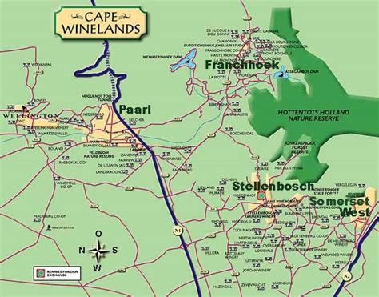
The Post-Apartheid Renaissance and
Global Recognition (1990s-Present)
In addition to traditional varieties like Cabernet Sauvignon, Chardonnay, and Shiraz, South Africa began to make a name for itself with indigenous grapes like Pinotage, a cross between Pinot Noir and Cinsaut developed in the 1920s. Pinotage, once considered an oddity, has since become a symbol of South African viticultural identity.
Today, South Africa is recognized as one of the world’s top wine producers, known for its ability to produce wines that offer exceptional value and quality.
The industry continues to evolve, with a growing emphasis on sustainability, fair labor practices, and the preservation of its rich cultural heritage.

Slide 19
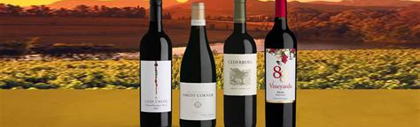
A Legacy of Resilience and Innovation
The history of South African wine is a testament to the resilience and innovation of its people.
From the first vineyards planted by Dutch settlers to the internationally acclaimed wines of today, South Africa’s wine industry has weathered numerous challenges, emerging stronger with each new era.
As it continues to grow and adapt in the global market, South African wine remains a vital part of the country’s cultural and economic landscape, offering a taste of its history, diversity, and spirit to wine lovers around the world.

Slide 20
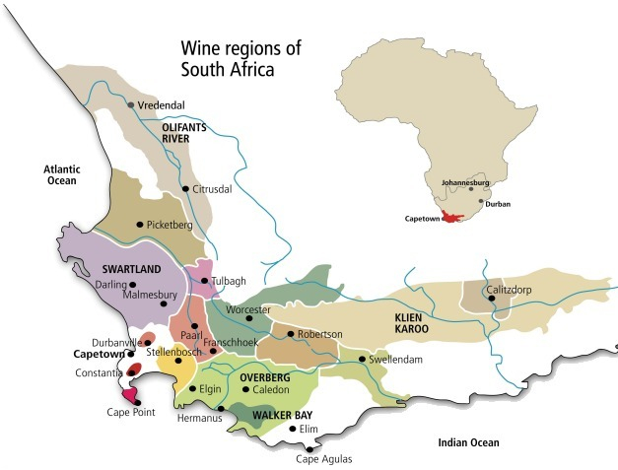
The Varied Terroir
South Africa’s diverse geography provides a range of terroirs, allowing for the cultivation of a wide variety of grape types.
The Western Cape, where most of the country’s vineyards are located, benefits from a Mediterranean climate with wet winters and dry summers, ideal for wine production.
The influence of the Atlantic and Indian Oceans moderates temperatures, contributing to the unique character of South African wines.

Slide 21
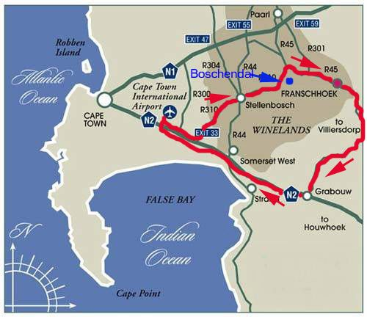
The Varied Terroir
Stellenbosch, perhaps the most famous wine-producing region, is known for its Cabernet Sauvignon, Merlot, and Pinotage—a uniquely South African variety created in 1925 by crossing Pinot Noir and Cinsaut. The region’s varied soil types, from granite to sandstone, allow for the production of wines with distinct profiles.
Other regions like Franschhoek, Paarl, and the Swartland are also significant. Franschhoek, with its French heritage, is known for its Chardonnay and Sauvignon Blanc, while the Swartland has gained a reputation for its innovative winemakers who produce natural wines from old bush vines.

Slide 22
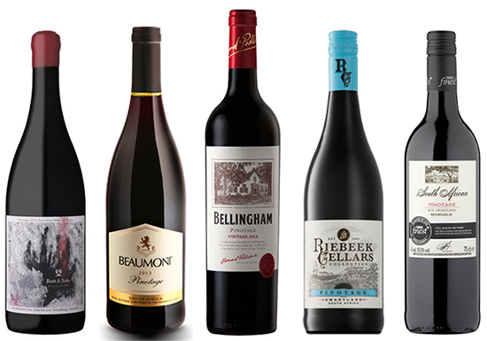
Pinotage: A Symbol of South African Innovation
Pinotage, South Africa’s signature grape, embodies the country’s innovative spirit.
Developed by Professor Abraham Perold in the early 20th century, Pinotage combines the best qualities of Pinot Noir and Cinsaut, resulting in a wine that is deeply colored, with flavors ranging from red fruit and berries to earthy and smoky notes.
Despite initial criticism, Pinotage has grown in popularity and is now a point of national pride, representing the country’s ability to create something truly unique.

Slide 23
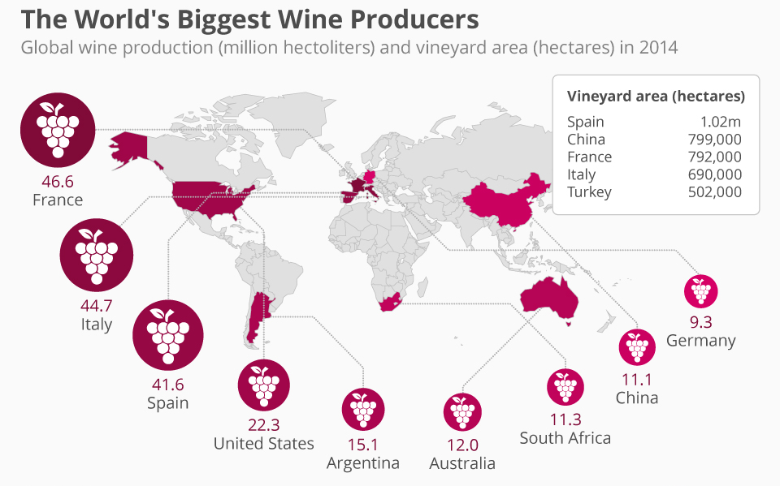
The Industry’s Modern Renaissance
The end of apartheid in the 1990s marked a significant turning point for the South African wine industry. As international sanctions were lifted, South African wines began to reach global markets, where they quickly gained recognition for their quality and value. This period also saw a surge in investment, both local and international, leading to advancements in winemaking techniques and the revitalization of old vineyards.
Today, South Africa is the eighth largest wine producer in the world, with its wines exported to over 100 countries.
The industry has also become a major contributor to the country’s economy, providing employment to thousands of people and attracting tourists from around the globe.

Slide 24

Sustainability and Social Responsibility
In recent years, the South African wine industry has made significant strides in sustainability and social responsibility. Many wine estates have adopted environmentally friendly practices, such as organic farming and water conservation, to protect the land for future generations.
The industry also faces the challenge of addressing the socio-economic disparities that exist within the sector, particularly the historical injustices experienced by farm workers.
Initiatives such as the Fairtrade certification and the Wine and Agricultural Ethical Trade Association (WIETA) have been established to promote fair labor practices and improve the living conditions of workers.
These efforts are crucial in ensuring that the
industry’s growth benefits all stakeholders.

Slide 25
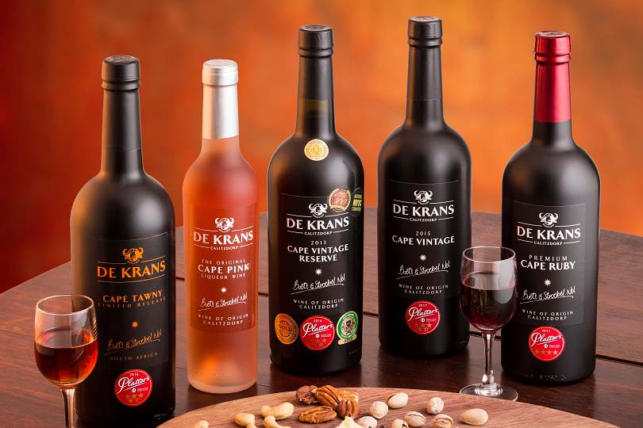
A Global Influence
South African wines have earned a place on the global stage, not only for their quality but also for their ability to express the country’s unique terroir and cultural heritage.
From the bold and complex reds to the crisp and refreshing whites, South African wines offer something for every palate, often at a value that surpasses many of their international counterparts.
Wine enthusiasts around the world now recognize South Africa as a producer of premium wines, with some estates consistently receiving top awards at international wine competitions.
The country’s winemakers, a blend of seasoned veterans and young innovators, continue to push the boundaries, experimenting with new styles and techniques while honoring traditional methods.

Slide 26
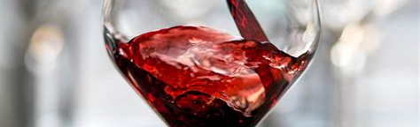
A Tapestry of Terroirs
South Africa’s wine regions offer a diverse array of terroirs, each contributing to the country’s rich and varied wine production.
From the bold reds of Stellenbosch to the crisp whites of Elgin and the innovative blends of Swartland, South African wine is a testament to the country’s dynamic and evolving wine industry.
Each region, with its unique combination of climate, soil, and grape varietals, adds a distinct thread to the vibrant tapestry of South African wine, making it one of the most exciting wine destinations in the world.

Slide 27
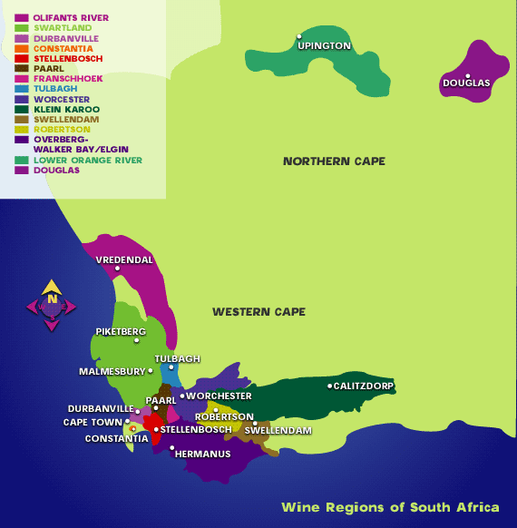
Exploring South Africa’s Wine Regions and Their Signature Varietals
South Africa’s wine regions are as diverse as the country’s landscapes, each offering unique terroirs that contribute to the distinctive character of the wines produced.
The country’s wine-growing areas are primarily concentrated in the Western Cape, benefiting from a Mediterranean climate with coastal influences that create ideal conditions for viticulture.
New we’ll discuss the key wine regions in South Africa and the varietals that define them.

Slide 28
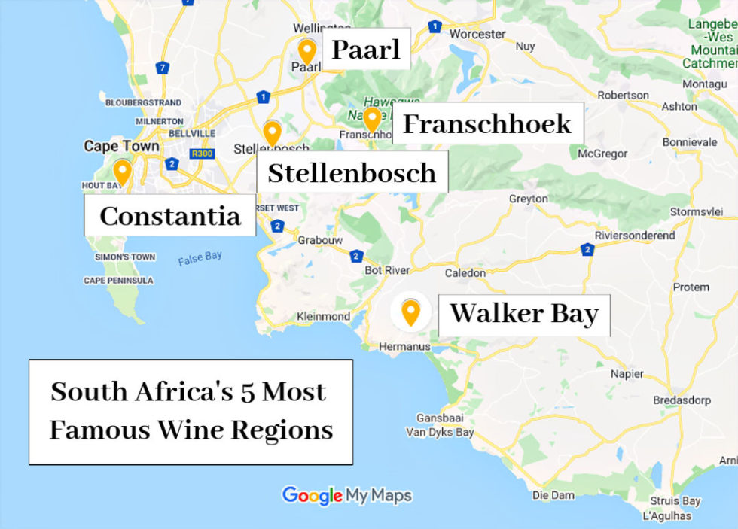
Exploring South Africa’s Wine Regions and Their Signature Varietals

Slide 29
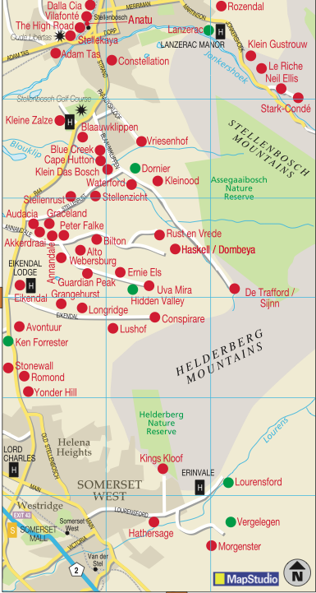
Stellenbosch:
The Heart of South African Wine
Stellenbosch is arguably the most famous wine region in South Africa, known for its rich history, scenic vineyards, and prestigious wine estates.
Located just east of Cape Town, Stellenbosch boasts a variety of soils, including granite, sandstone, and alluvial deposits, which allow for the cultivation of a wide range of grape varieties.
Many of the photos we see of South African vineyards –positioned in front of striking granite mountains, –are from the Stellenbosch area.
It contains the most developed winelands and is home to an important wine University (University of Stellenbosch).
It is widely considered the center of wine tourism. In short, Stellenbosch is to South African wine much like Napa is to Californian wine.

Slide 30
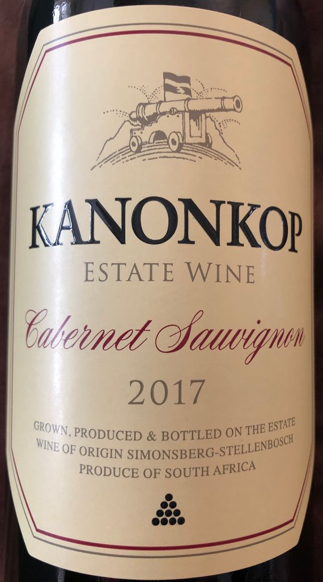
Stellenbosch: The Heart of South African Wine
Key Varietals:
Cabernet Sauvignon: Stellenbosch is renowned for its world-class Cabernet Sauvignon, which is often rich, full-bodied, and age-worthy, with flavors of blackcurrant, cedar, and spice.
Merlot: Often blended with Cabernet Sauvignon to create Bordeaux-style blends, Merlot from Stellenbosch is known for its smooth texture and flavors of plum, chocolate, and herbs.
Chenin Blanc: Although more commonly associated with the Loire Valley in France, Chenin Blanc thrives in Stellenbosch, producing wines that range from dry and crisp to rich and honeyed.
Pinotage: As a signature South African grape, Pinotage is widely planted in Stellenbosch, producing wines with flavors of dark fruit, smoke, and earthy notes.

Slide 31
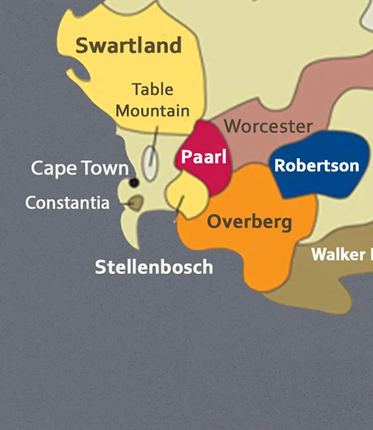
Paarl: Home to Iconic Estates
Paarl, located to the north of Stellenbosch, is another significant wine-producing region. The area’s warm climate is tempered by cooling breezes from the Atlantic Ocean, and its granite and shale soils contribute to the complexity of the wines.
Key Varietals:
Shiraz (Syrah): Paarl is known for its bold and spicy Shiraz, which often exhibits flavors of dark berries, pepper, and smoky oak.
Chardonnay: The region produces some excellent Chardonnays, which range from crisp and unoaked to rich and buttery, with notes of citrus, apple, and tropical fruit.
Viognier: Paarl has become a notable region for Viognier, a white varietal known for its aromatic qualities, with flavors of peach, apricot, and floral notes.

Slide 32
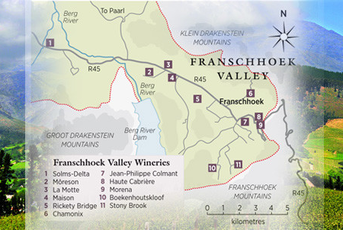
Franschhoek: The French Corner
Franschhoek, meaning “French Corner,” is a small but influential wine region with a rich history rooted in the French Huguenot settlement of the 17th century. The region’s terroir is diverse, with a combination of alluvial soils on the valley floor and sandstone on the slopes.
Key Varietals:
Sauvignon Blanc: Franschhoek produces elegant Sauvignon Blancs with crisp acidity and flavors of green apple, lime, and gooseberry.
Cabernet Franc: Known for producing structured, medium-bodied wines, it often features notes of red berries, herbs, and a hint of spice.
MCC (Méthode Cap Classique): Also famous for
sparkling wines made in the traditional Méthode
Champenoise. These wines, made from Chardonnay and
Pinot Noir, are celebrated for their fine bubbles and flavors
of brioche, citrus, and almond.

Slide 33
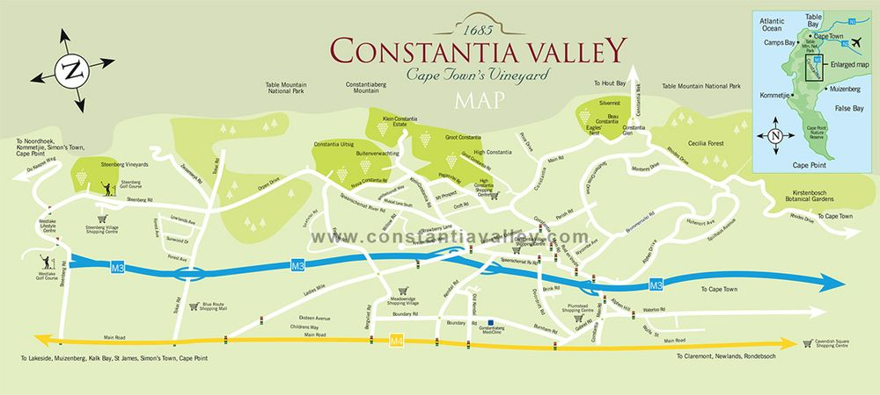
Constantia: The Cradle of South African Wine
Constantia, one of the oldest wine regions in the Southern Hemisphere, is located just outside Cape Town. The region’s cool climate, influenced by its proximity to the Atlantic Ocean, makes it ideal for producing elegant, aromatic wines.
Key Varietals:
Sauvignon Blanc: Constantia is famous for its Sauvignon Blanc, which is typically crisp, with flavors of tropical fruit, gooseberry, and a zesty minerality.
Muscat de Frontignan: Constantia’s Vin de Constance, a sweet dessert wine made from Muscat de Frontignan grapes, acclaimed for its luscious, honeyed flavors of apricot, orange peel, and spice.
Chardonnay: The region produces refined Chardonnays with a balance of citrus, stone fruit, and subtle oak influences.

Slide 34
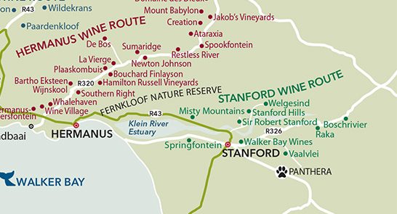
Walker Bay: Coastal Elegance
Walker Bay, located along the southern coast near Hermanus, is known for its cool maritime climate, making it ideal for the production of elegant, refined wines. The region’s vineyards benefit from the cooling influence of the Atlantic Ocean, which helps preserve acidity in the grapes.
Key Varietals:
Pinot Noir: Walker Bay is celebrated for its Pinot Noir, which often exhibits a silky texture and flavors of cherry, raspberry, and subtle spice.
Chardonnay: The region’s Chardonnays are highly regarded, offering a balance of citrus, stone fruit, and well-integrated oak.
Pinotage: Walker Bay also produces noteworthy Pinotage, with flavors of dark fruit, smoke, and a touch of earthiness.

Slide 35
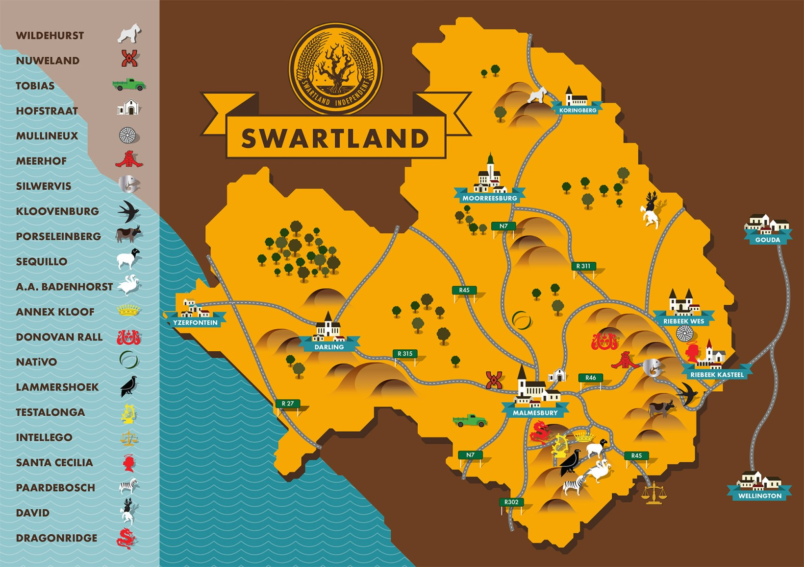
Swartland: The Maverick Region
Swartland, located to the north of Cape Town, is known
for its innovative winemakers who have embraced
minimal intervention and natural winemaking techniques.
The region’s hot, dry climate and ancient bush vines
contribute to the production of concentrated, expressive
wines.
Key Varietals:
Chenin Blanc: Swartland is renowned for its old-vine
Chenin Blanc, which often exhibits flavors of stone fruit,
honey, and a distinct minerality.
Grenache: This region has seen a resurgence in Grenache, producing wines with bright red fruit, spice, and earthy undertones.
Cinsaut: Often used in blends or as a single varietal, Cinsaut from Swartland is known for its juicy red fruit flavors and soft tannins.

Slide 36
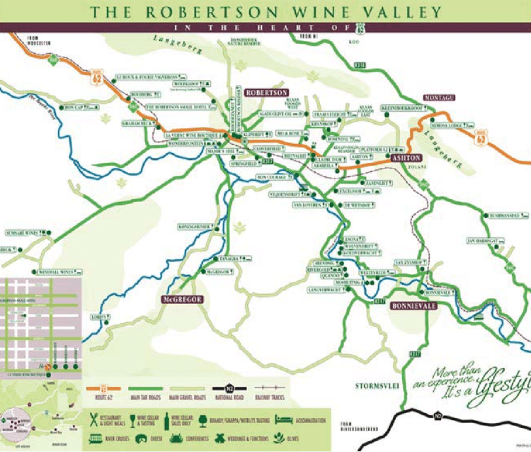
Robertson: The Valley of Wine and Roses
Robertson, situated in the Breede River Valley, is known for its fertile soils and a climate that ranges from cool to warm. The region is famous for producing both white and red wines of exceptional quality.
Key Varietals:
Chardonnay: Robertson is particularly well-regarded for its Chardonnay, which can range from fresh and unoaked to rich and buttery, with notes of tropical fruit, citrus, and vanilla.
Shiraz: The region’s Shiraz is often robust, with flavors of dark berries, spice, and a hint of chocolate.
Cabernet Sauvignon: Robertson also produces excellent Cabernet Sauvignon, known for its structure, depth, and flavors of cassis, blackberry, and tobacco.

Slide 37
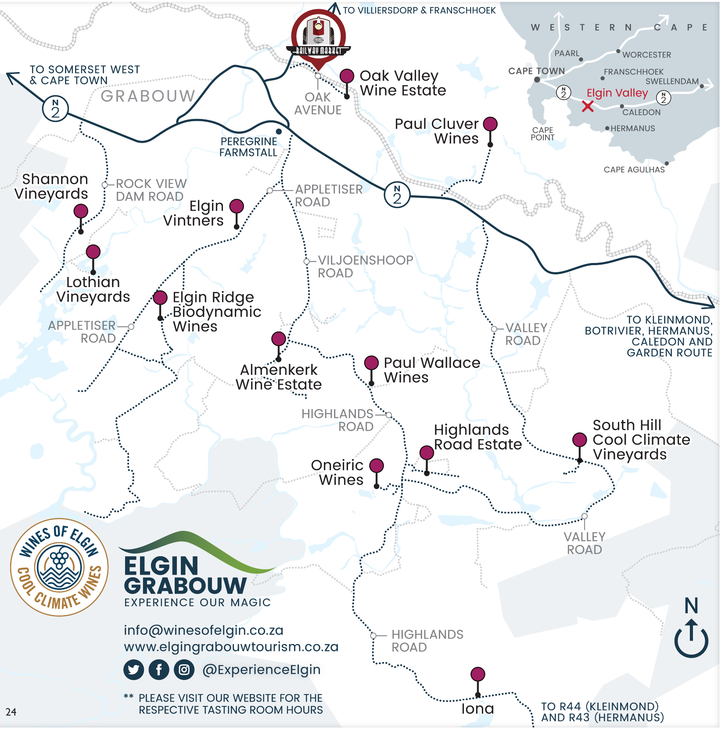
Elgin: The Cool Climate Region
Elgin, located in the Overberg region, is one of South Africa’s coolest wine-producing areas, with a climate similar to that of Burgundy or Oregon. This cool climate allows for the slow ripening of grapes, resulting in wines with exceptional acidity and finesse.
Key Varietals:
Pinot Noir: Elgin is recognized for its delicate Pinot Noir,
which often features flavors of red cherry, raspberry, and a
touch of earthiness.
Riesling: The region produces some of South Africa’s best
Rieslings, characterized by their vibrant acidity, floral aromas,
and flavors of lime, green apple, and stone fruit.
Sauvignon Blanc: Elgin’s cool climate Sauvignon Blancs are
crisp and zesty, with flavors of citrus, green pepper, and a
distinct minerality.

Slide 38
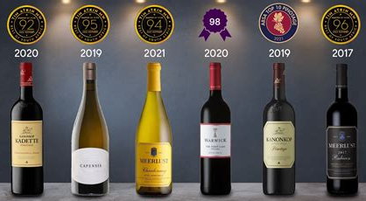
Conclusion
South African wine is more than just a beverage; it is a testament to the country’s history, diversity, and resilience.
Each bottle tells a story of the land, the people who work it, and the passion that goes into every step of the winemaking process.
As the industry continues to evolve, South African wine remains a symbol of the nation’s ability to overcome challenges and create something beautiful from the earth.
Whether enjoyed in a bustling city or a quiet vineyard, South African wine is a true expression of the country’s spirit.

Slide 39
Wine of South Africa
I hope you found these facts about South African Wine
interesting and informative.
Hopefully, you all get the opportunity to visit the beautiful and historic country for yourselves.
Thank you for coming!

Slide 40
Acknowledgement
My seminars are the result of many years of travel experience
combined with many hours of research over the internet.
I would like to acknowledge the many sources I have accessed.

Slide 41
Resources: Books and Guides
The article was crafted based on a broad understanding of the South African wine industry, drawing on general knowledge about the history, wine regions, and varietals of South Africa. Specific resources or citations were not directly referenced in creating this content. However, commonly referenced sources for information on South African wine include:
"Platter's South African Wine Guide" - A comprehensive guide to South African wines and wine regions.
WOSA (Wines of South Africa) - An industry organization that provides extensive resources on South African wine, including historical and regional information.

Slide 42
Resources: Books and Guides
The article was crafted based on a broad understanding of the South African wine industry, drawing on general knowledge about the history, wine regions, and varietals of South Africa. Specific resources or citations were not directly referenced in creating this content. However, commonly referenced sources for information on South African wine include:
"Platter's South African Wine Guide" - A comprehensive guide to South African wines and wine regions.
WOSA (Wines of South Africa) - An industry organization that provides extensive resources on South African wine, including historical and regional information.
Books on South African wine history - Such as "The Winelands of Cape Town" by David Hughes and "South Africa: History in a Bottle" by Meryl Weaver.
Wine industry reports and databases - Including data from organizations like the International Organization of Vine and Wine (OIV) and other wine-focused publications.
For academic or detailed writing, consulting these sources directly would provide a more in-depth understanding and specific details.

Slide 43
Owners of Groot Constantia
Groot Constantia is the oldest wine farm in South Africa and by some considered the finest winery on the Continent.
Simon van der Stel (1639-1712)
Contemporary documents describe Simon van der Stel, the first owner of what is now Groot Constantia, as having been born in Mauritius. In fact, he was born at sea while his parents were on their way to Mauritius from Batavia in 1639. His father, who was in the employ of the Dutch East India Company (VOC, as contracted in Dutch), had been posted there, but was eventually transferred back to Batavia, were Simon remained until the age of 20, having by then lost both parents.
Oloff Bergh and Anna de Koningh (1716-1734)
Oloff Bergh, who took possession of Constantia on 13 November 1716, was born in Göteborg, Sweden, in 1643 and joined the VOC in 1665. He spent a few years in Ceylon as a soldier and was a sergeant when he arrived at the Cape in 1676.

Slide 44
Owners of Groot Constantia
Carl George Wieser and Jacobus van der Spuij (1734 - 1778)
On 9 August 1734, Groot Constantia was acquired by Carl George Wieser. Wieser, a soldier in the service of the VOC who came from Heidelberg, Germany, arrived at the Cape in 1728. He was promoted to corporal 1730 and two years later married Johanna Jacoba Colijn, sister of Johannes Colijn, then owner of Klein Constantia. In 1724, Johanna owned a farm at Camps Bay and evidently had some farming experience. Their only child, a boy, was born in 1732. In the following year, Wieser resigned from the VOC to become a Free Burgher.
Jan Serrurier (1778)
Jan (or Johan) Serrurier, the son of a minister, Louis (or Lodewyk) Serrurier, and Esther de Vis, came from Hanau in the Netherlands. In 1747, he married Catharina Kretzschmar, the widow of Jan van der Swyn, who from 1738 had owned and lived on the farm Alphen, not far from Groot Constantia. Two sons were born from this marriage. In 1755, after Catharina’s death, Serrurier married Geertruyda (baptised 1736), daughter of the wealthy farmer Jacob van Reenen (died 1764), owner of Witteboomen, also near Groot Constantia. They had seven children.

Slide 45
Owners of Groot Constantia
Hendrik Cloete (Senior) (1778-1799)
Between 1778 and 1885, three generations of Cloetes owned Groot Constantia and a total of five Cloete generations were responsible for its viticulture.
The Cloete Era continues (1799-1885)
Hendrik Cloete junior had a close association with the estate starting 1778, the year that his father bought it and had given him the job of farm manager, for which his remuneration was a share of the produce.
Government (1885 - 1993)
Groot Constantia Trust (1993 till present)

