Slide 1
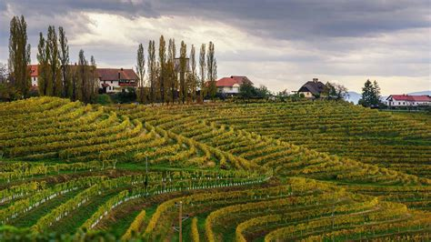
An Introduction to
Wine in Slovenia
Presented by
Marc Silver

Slide 2
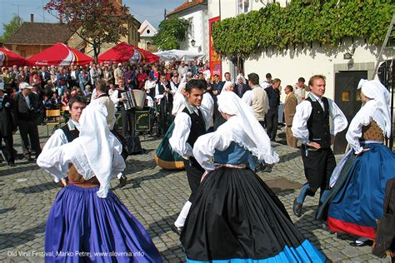
A Rich Winemaking History
Slovenia may be a small country, but it boasts one of the most diverse and dynamic wine landscapes in Europe.
Nestled between Italy, Austria, Hungary, and Croatia, Slovenia’s winemaking history is an integral art of their varied terroirs, and unique grape varieties that appeal to wine enthusiasts seeking something a little off the beaten path.
Whether you’re familiar with the wines of France, Italy, or Spain, or you’re simply looking to broaden your wine knowledge, Slovenia’s offerings are worth exploring.
Let’s take a deep dive into the fascinating world of Slovenian wine, starting from its historical roots to its current production, regional differences, notable grape varieties, and standout wineries.

Slide 3
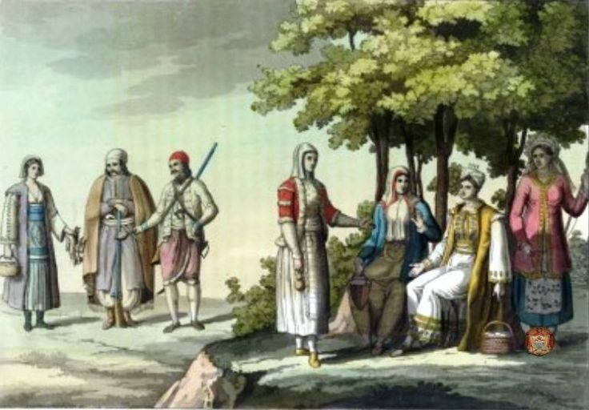
History of Slovenia’s Wine
Ancient to Modern
Slovenia's winemaking history stretches back millennia, influenced by ancient cultures and evolving through significant historical eras.
According to anthropologists and historians, winemaking in the region that is now Slovenia can be traced back to between 2000 and 3000 years ago.
However, it was during the Roman period, starting around the 1st century BC, when winemaking became more organized and widespread.
Archaeological finds, such as ancient amphorae and tools used in winemaking, support the idea that viticulture has deep roots in Slovenia’s history​
These findings suggest that winemaking was firmly established by the time the Romans began cultivating vines extensively, helping lay the foundation for the region’s enduring wine culture. Here's a breakdown of the key periods:

Slide 4

Ancient Times to Roman Era
Pre-500 AD
The first traces of viticulture in what is now Slovenia date back to Celtic and Illyrian tribes, who likely grew wild grapes. The first vine stock were planted about 2,400 years ago by the Celts.
I was the Romans who brought organized winemaking to the region. By the 1st century BC, they were planting vineyards, and wine became an important part of local culture.
Roman techniques, including the use of barrels and the domestication of grape varieties, laid the foundation for viticulture.

Slide 5
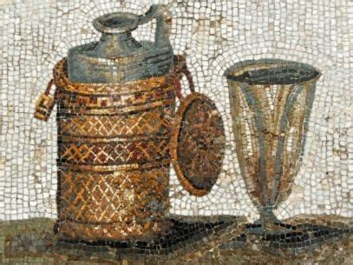
Medieval Period
500-1500 AD
The fall of the Roman Empire didn’t stop winemaking in Slovenia. Monastic orders kept the tradition alive throughout the Middle Ages, cultivating vineyards on church-owned land. Wine was not just a religious sacrament but also a local trade commodity.
The region's location along trade routes between Europe and the Mediterranean helped spread its wines beyond local borders.

Slide 6
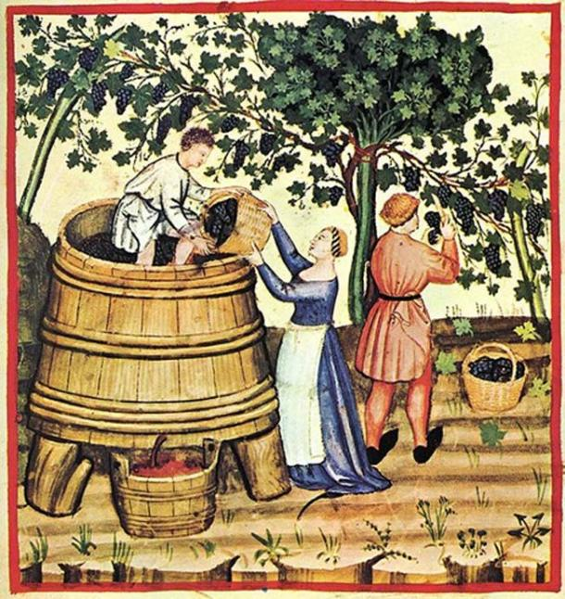
Habsburg Rule and the Renaissance
1500-1800
From the 16th century onward, Slovenia came under the rule of the Habsburg Monarchy, and viticulture flourished.
The introduction of new grape varieties and techniques from Italy and France improved wine quality. The establishment of structured wine estates, combined with innovations in wine production, led to increased exports.

Slide 7
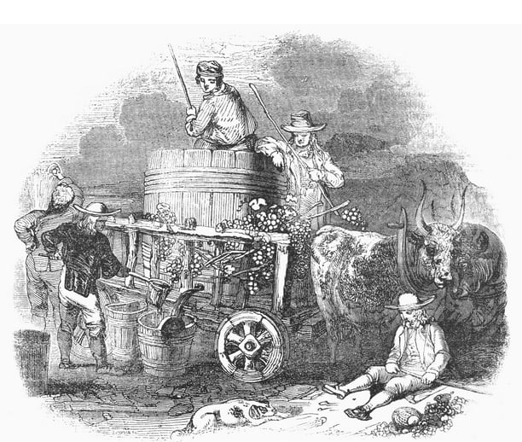
Modern Era
1800-Present
In the 19th century, Slovenian wine faced challenges, including phylloxera, which devastated vineyards across Europe.
However, the country rebuilt its wine industry by grafting European vines onto American rootstocks.
Post-World War II, under Yugoslav rule, production shifted toward bulk wines, but Slovenia's independence in 1991 sparked a renewed focus on quality.
Today, Slovenia’s winemakers are highly regarded for their artisanal approaches and natural, organic winemaking methods.

Slide 8
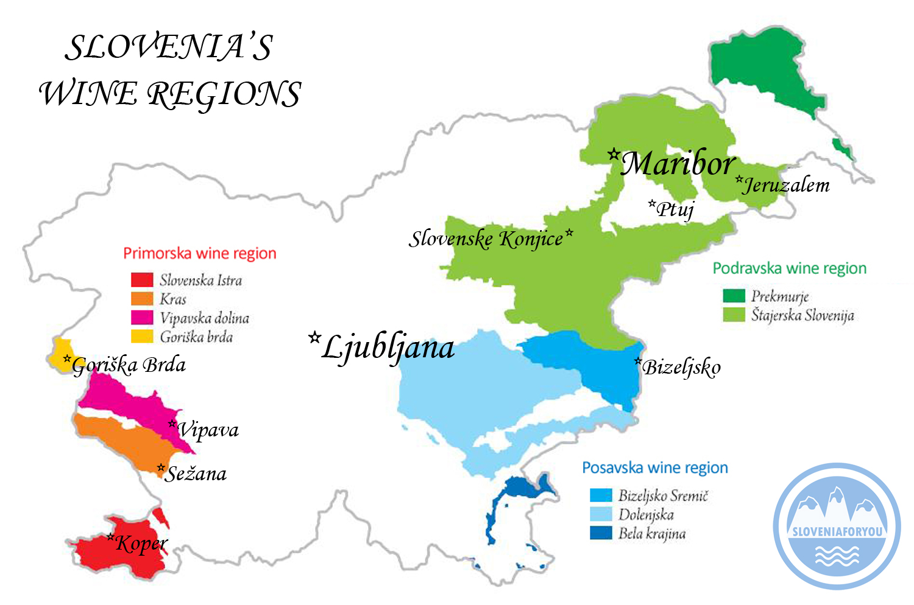
Wine Regions
Wine Regions in Slovenia (Ranked by Production Size)
Slovenia has three main wine regions, each with its unique characteristics. Here they are ranked by production size:
Podravje (Northeast Slovenia
– Drava Valley)
Posavje (Southeast Slovenia
– Sava Valley)
Primorska (Western Slovenia
- Coastal Region)
1.
2.
3.

Slide 9
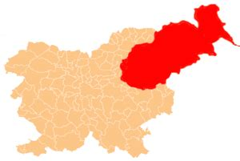
Wine Regions
Podravje (Northeast Slovenia) The Drava Wine-Growing Region (Podravska vinorodna dežela) is the largest wine region in Slovenia and is subdivided into 7 districts. The Radgona-Kapela district was the first Slovenia wine region to produce sparkling (penina) wine using the méthode champenoise in 1852.
Location: Podravje is Slovenia’s largest and most productive wine region,
located in the northeastern part of the country, near the Austrian border.
Terroir and Climate: Characterized by cooler continental climate, with
steep hills and fertile soil, including gravel, marl, and clay.
Predominant Grapes: White varieties dominate, with Riesling, Furmint, Sauvignon Blanc, and Traminer being prominent.
Wine Characteristics: The cooler climate results in wines with high acidity and vibrant fruitiness, especially in the white wines. Podravje is known for its aromatic whites and late-harvest dessert wines

Slide 10
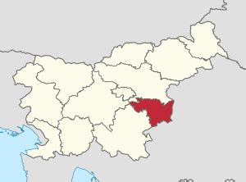
Wine Regions
Posavje (Southeast Slovenia) The Lower Sava Wine-Growing Region (Posavska vinorodna dežela) is the only Slovenian wine region that produces more red wine than white, though not by a large margin. The area is subdivided into three districts. The Bizeljsko-Brežice district is known for its sparkling wine production and acidic white wines made from the Rumeni Plavec grape.
Location: This region is located near the Croatian border and is known for producing the country’s bulk wine in the past, though quality is rising.
Terroir and Climate: With a mixed climate influenced by the Adriatic
Sea and the Alps, Posavje’s soil varies from limestone to sandstone.
Predominant Grapes: Known for its red blends and whites, particularly
Cviček, an unusual blend of red and white grapes, which creates a low-
alcohol, slightly tart wine. Other common varieties include Blauer
Portugieser and Welschriesling.
Wine Characteristics: Wines are typically lighter in alcohol, with reds offering soft tannins and whites having fresh acidity.

Slide 11
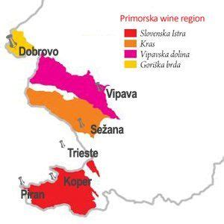
Wine Regions
Primorska (Western Slovenia) aka Littoral Region has two of Slovenia's most widely known and prominent wine districts, the Gorizia Hills (Goriška brda) and Koper districts.
Location: Primorska borders Italy and the Adriatic Sea, making it
the most Mediterranean of Slovenia’s wine regions.
Terroir and Climate: The climate here is warmer, with significant
sun exposure and a mixture of limestone and flysch soils.
The influence of the Mediterranean breeze helps create robust and
structured wines.
Predominant Grapes: Reds, including Refošk (Refosco) and
Merlot, dominate, with notable whites like Malvazija (Malvasia) and Pinela.
Wine Characteristics: Primorska’s wines are more robust and full-bodied compared to the other regions, with rich flavors, higher alcohol content, and greater aging potential.

Slide 12
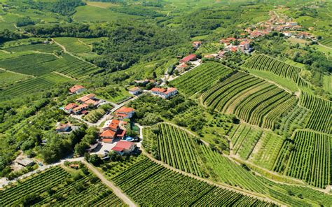
Slovenia’s Unique Terroir
Slovenia’s diverse landscape is reflected in its varied terroir, which significantly impacts the style and quality of its wines:
Podravje: The cooler climate and higher altitude help preserve acidity in the grapes, leading to crisp and aromatic wines.
Posavje: The mixed soil types and varied elevations offer a balance between freshness and fruit-forward wines, especially notable in lighter reds and whites.
Primorska: The warm Mediterranean influence and limestone soils contribute to fuller-bodied, rich wines with complex structures, especially in red varieties.

Slide 13
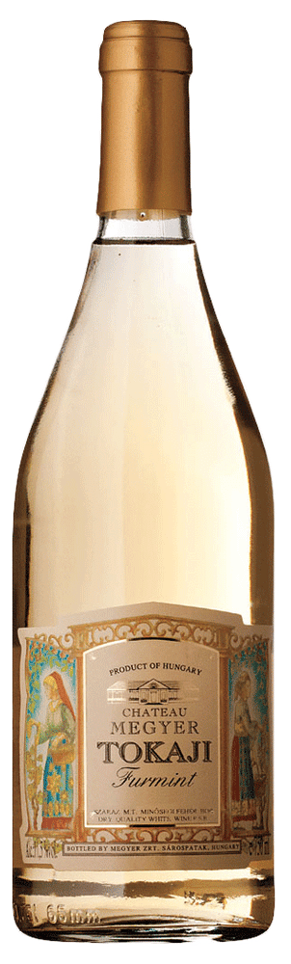
Major Grape Varieties and Characteristics
Here are some of Slovenia’s most important grape varieties and their characteristics:
Riesling: High acidity, citrus, and green apple flavors. Perfect for pairing with seafood, grilled vegetables, and lighter poultry dishes.
Furmint: Crisp, aromatic, with stone fruit and mineral notes. Pairs well with spicy foods or hard cheeses.
Refošk (Refosco): Dark berry flavors, with firm tannins and earthy undertones. Works wonderfully with grilled meats and rich pasta dishes.
Cviček: A unique low-alcohol blend, offering tart berry flavors and a light body. Ideal with lighter meals or as a refreshing aperitif.

Slide 14
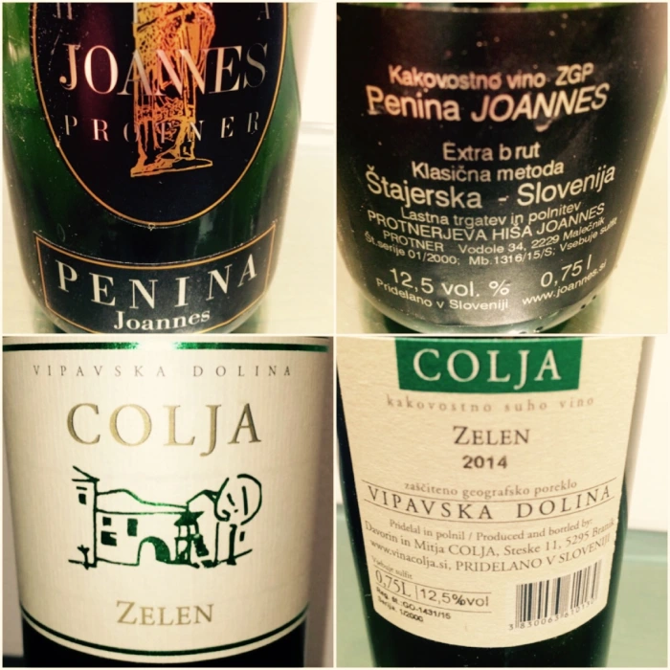
Wine Categories
In Slovenia, wine classifications are similar to those in Austria and Germany, with categories based on the must weight (the sugar content) of the grapes.
Labels must show the quantity of bottles or liters produced. Wine is categorized by sweetness levels: dry, semi-dry, semi-sweet, and sweet.
Significant changes came in August 2009 when the EU Wine Market Regulation redefined wine designations and quality levels. These new quality classifications include:
Vino (formerly Namizno Vino, or table wine): Basic wine.
PGO: Deželno Vino, or country wine.
ZGP: Kakovostno Vino, or quality wine.
VV z ZGP: Vrhunsko Vino, or premium quality wine.
PTP: Priznano Tradicionalno Poimenovanje, or traditional
wine.

Slide 15

Notable Wineries
Movia (Primorska) is one of Slovenia’s most iconic wineries, located in the Goriška Brda region of Primorska, near the border with Italy.
This family-owned estate has been making wine for more than three centuries, and today it’s renowned for its innovative, organic, and biodynamic approaches. Movia’s winemaking philosophy emphasizes minimal intervention, allowing the natural environment to play a significant role in the development of their wines.
One of Movia's most distinctive offerings is their Lunar wine.
This wine is famous for being produced using biodynamic principles, with grapes
harvested according to lunar cycles.
Lunar wine is unfiltered, which results in a more natural wine that contains
sediment, enhancing its complexity. It's often described as having layers of earthy,
floral, and fruit notes that evolve in the glass over time.
The extended skin contact used in its production gives it a richer texture and an
amber color, falling into the category of what many refer to as "orange wine."

Slide 16
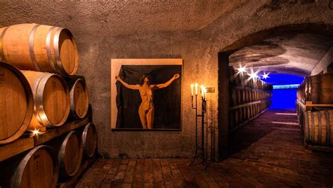
Notable Wineries
Movia's wines, including Lunar, have gained international recognition for their depth, purity, and unique expression of terroir. The estate’s commitment to biodynamics and natural winemaking has helped position them as leaders in the natural wine movement, with a loyal following among wine enthusiasts and critics globally​.
Movia has won numerous awards over the years, and their wines consistently receive high praise from global wine publications. The estate is particularly valued for its ability to merge traditional Slovenian viticulture with modern, organic practices, producing wines that are both rooted in history and forward-thinking.

Slide 17
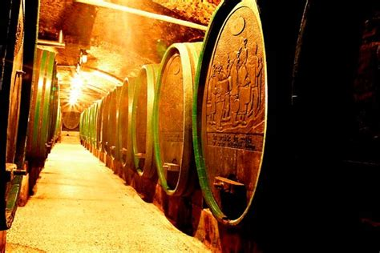
Notable Wineries
Ptujska Klet (Podravje) is one of the oldest continuously operating wineries in Slovenia, with a history dating back to the year 1239. Located in the city of Ptuj, this historic winery is a cornerstone of the wine culture in the Podravje wine region, which is famous for producing high-quality white wines.
Ptujska Klet is particularly known for its Rieslings
and dessert wines, both of which have garnered
significant acclaim. The winery's Rieslings are
celebrated for their elegance, vibrant acidity, and
complex flavor profiles, often showcasing notes of
citrus, apple, and minerals. These wines express the
unique terroir of the Podravje region, which is
characterized by cool climate conditions that help retain the freshness and aromatic intensity in the grapes.

Slide 18
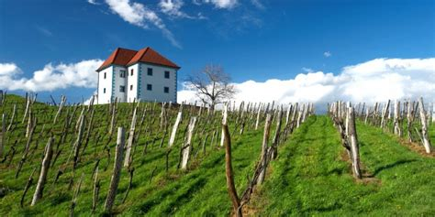
Notable Wineries
In addition to their exceptional Rieslings, Ptujska Klet has made a name for itself with its late-harvest dessert wines. These wines are often made from grapes affected by noble rot (Botrytis cinerea), which concentrates the sugars and flavors in the berries. The result is richly sweet wines with layers of honey, dried fruit, and floral notes, perfect for pairing with desserts or enjoyed on their own as a luxurious after-dinner drink.
The winery's long history, combined with its dedication to traditional winemaking techniques and modern innovation, has allowed Ptujska Klet to maintain its reputation as one of Slovenia’s top wine producers.
Over the years, they have received numerous awards for their wines, both locally and internationally, cementing their status as a key player in Slovenia’s wine industry​.

Slide 19
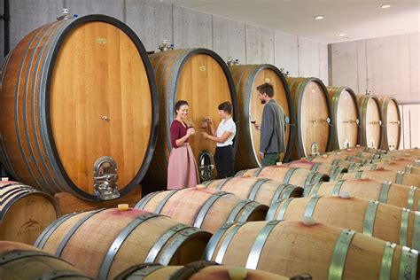
Notable Wineries
Zlati Grič (Posavje) is a well-known winery located in the Posavje wine region, particularly famous for producing Cviček, a unique and quintessential Slovenian wine. The wine itself is a blend of red and white grape varieties, a feature that sets it apart from many other wines, and it embodies the distinct characteristics of the Posavje terroir.
Cviček is unlike most other wines due to its low
alcohol content (usually around 8.5% to 10%), light
body, and a vibrant, zesty acidity. The wine is typically
a blend of grapes like Žametovka, a local red grape
known for its light, tart qualities, mixed with various
white varietals such as Kraljevina and Laški Riesling.
This combination gives Cviček its signature pale red
color and fresh, fruity profile with a pleasantly sour
edge. Despite being a red wine, it is often enjoyed chilled, much like a white or rosé, making it highly versatile and approachable for many types of food pairings, particularly Slovenian traditional dishes like sausages and cured meats.

Slide 20
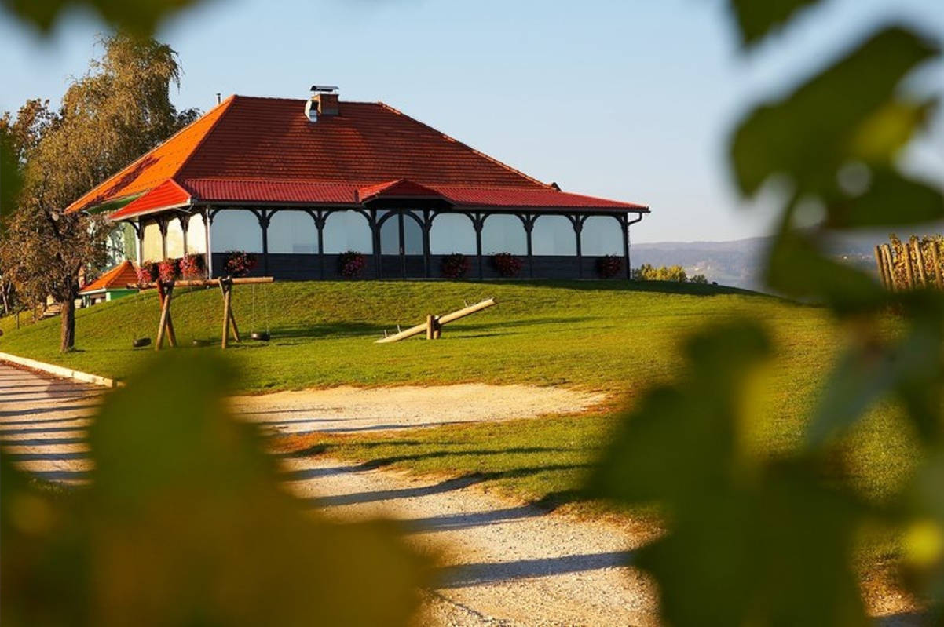
Notable Wineries
Zlati Grič is highly respected for its ability to showcase the quality and potential of Cviček, a wine that holds a special place in Slovenia’s cultural and wine heritage.
Their vineyards are located on rolling hills with limestone-rich soils, and the climate in Posavje—with its combination of warm days and cool nights—favors the development of the acidity and freshness that Cviček is known for. Zlati Grič also uses sustainable viticulture practices, ensuring that their wines reflect the natural beauty of the region.
The winery itself has a long history and is often praised for combining traditional winemaking methods with modern techniques.
Alongside Cviček, Zlati Grič also produces other noteworthy wines such as sparkling wines and varietal whites, but Cviček remains its flagship, celebrated for its uniqueness and deeply rooted connection to the Posavje region.

Slide 21
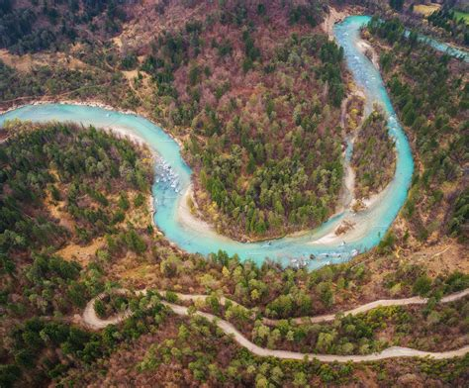
The Sava Valley
Posavje translates to "The Sava Valley" or "Sava Basin" in English, referring to the region surrounding the Sava River, which flows through southeastern Slovenia.
The name comes from "Sava," one of the longest rivers in the Balkans, and "vje" (valley or basin), indicating the geographic area influenced by this river.
The Posavje wine region benefits from the fertile
soils and moderate climate provided by the Sava
River, contributing to the distinct character of the
wines produced in this region, including its famous
Cviček

Slide 22
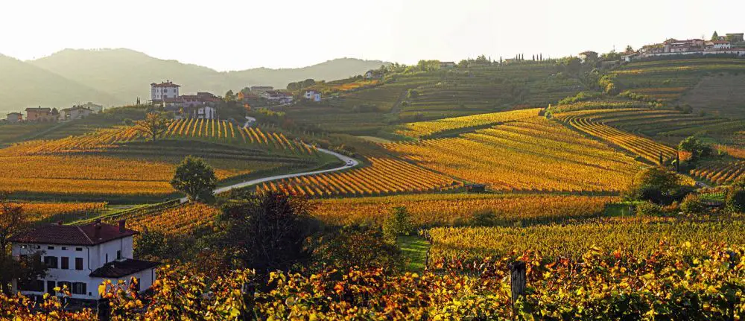
Final Thoughts
Slovenia offers a rich and diverse wine experience, with each region contributing something unique.
Whether it’s the crisp whites of Podravje, the light reds of Posavje, or the robust wines of Primorska, there’s something here for every wine enthusiast.
Exploring Slovenia’s wines is a journey through history, geography, and innovation—a journey well worth taking.

Slide 23
Acknowledgement
My seminars are the result of many years of experience combined with many hours of research over the internet.
I would like to acknowledge the many source I have accessed.
These include Wine Spectator, Wine Enthusiast, BKWine Magazine, Wine & Spirits Magazine, American Vineyard Magazine, The Grapevine Magazine, Wikipedia.com, Britannica.com, and the
various Government websites.

Slide 24
Citations and References
Resources and Citations:
The article on “An Introduction to Wine in Slovenia” used several key resources to ensure accuracy and depth, particularly around the history, regions, grape varietals, and notable wineries of the country.
I feel Slovenia: https://www.slovenia.info/en/things-to-do/food-and-wine/wines-of-slovenia
Wineguide: https://wineguide.wein.plus/wine-regions/slovenia
I Feel Slovenia: A government-run platform provided a comprehensive breakdown of the major wine regions in Slovenia, including Primorska, Podravje, and Posavje, with specific details on grape varieties like Teran, Rebula, and Cviček, as well as notable regional wines​..
Travel Slovenia: This resource detailed Slovenia's top wine-producing areas, such as Goriška Brda, Vipava Valley, and Slovenian Istria, emphasizing the terroir, climate, and the characteristic grapes, like Refošk and Malvazija​..
Wein.plus: A specialized wine guide provided in-depth information on Slovenia’s unique wine classification system and the predominant grape varietals grown in different regions, such as Furmint, Žametovka, and Malvazija​.

