Slide 1
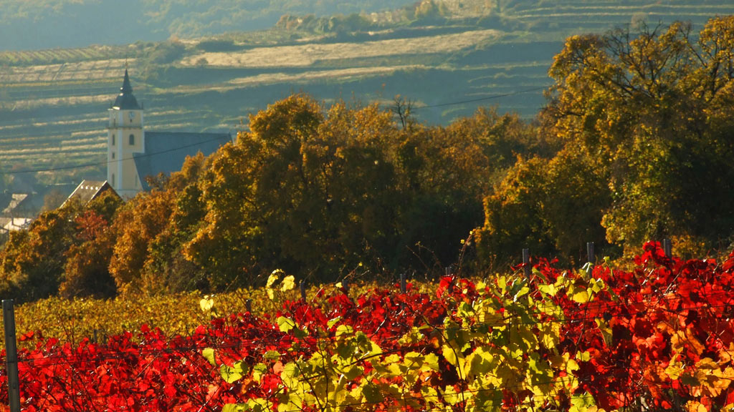
Wine Regions of the World An Introduction to Wine in Slovakia Presented by Marc Silver

Slide 2
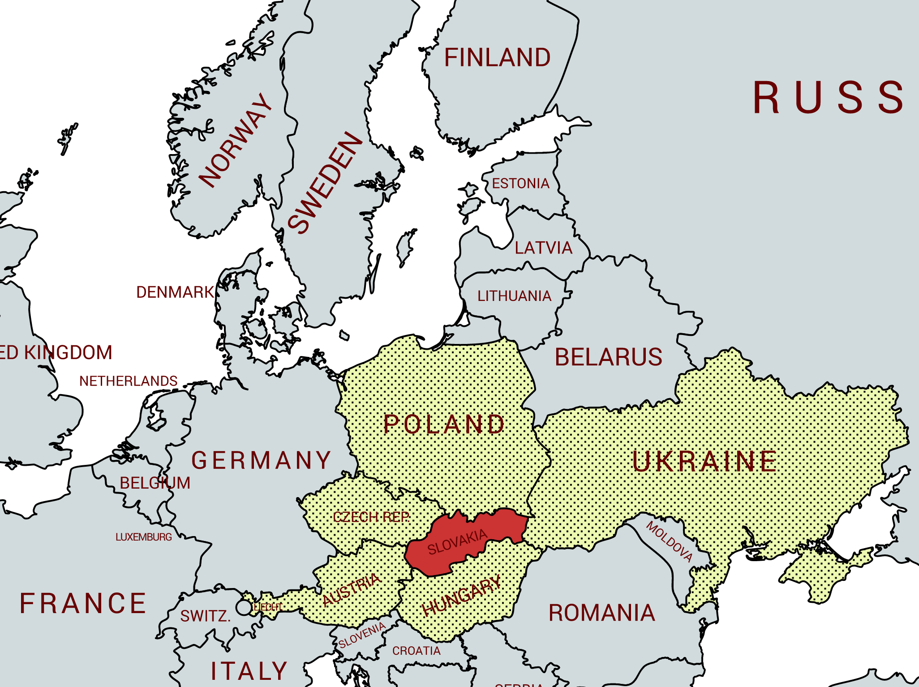
An Introduction to Wine in Slovakia
Slovakia, a hidden gem in Central Europe, boasts a rich and diverse wine culture that dates back over a thousand years.
Nestled within the scenic Carpathian Mountains, the country’s unique climate and varied topography create the perfect conditions for viticulture.
Slovakia is home to more than 74,000 acres of vineyards, primarily located in the regions of Tokaj, Nitra, and the Small Carpathians, where both indigenous and international grape varieties thrive.
Slovak wines, often overshadowed by their more famous neighbors, offer a delightful range of flavors and styles, from crisp whites to full-bodied reds and exquisite sweet wines.
As the industry continues to develop, winemakers are increasingly focused on quality and sustainability, drawing on traditional methods while embracing modern techniques. Let’s explore Slovakia’s captivating wine heritage, discover unique varietals, and appreciate the dedication of its passionate winemakers.

Slide 3

History of Slovak Wine
A Journey Through Time
The story of Slovak wine begins in antiquity, tracing its roots back to Roman times.
As the Romans expanded their empire, they brought with them their sophisticated winemaking techniques, establishing vineyards in the fertile valleys of what is now Slovakia.
The region's proximity to advanced winemaking cultures allowed for the exchange of knowledge, laying the groundwork for a vibrant viniculture that would flourish over the centuries.

Slide 4
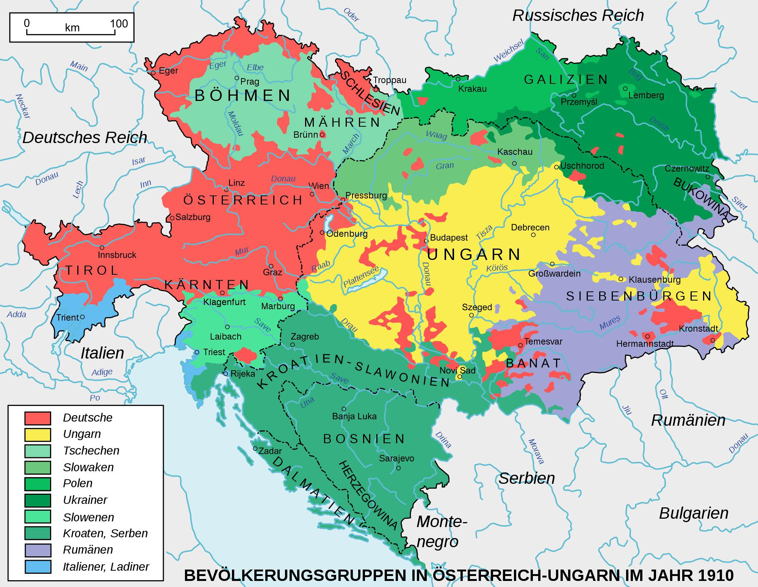
History of Slovak Wine
A Journey Through Time
Fast forward to the early modern period, where the influence of the Austro-Hungarian Empire made a profound impact on Slovak viticulture. During this time, winemaking practices were refined and standardized, leading to the establishment of renowned wine regions and a focus on quality. The empire's diverse culture fostered a unique blend of influences, resulting in an array of grape varieties and wine styles that showcased the region's potential.
The aftermath of World War I and the eventual rise of communist rule in the mid-20th century significantly affected the wine industry, with state-controlled production often prioritizing quantity over quality.

Slide 5

History of Slovak Wine
A Journey Through Time
After World War II, communism had a significant impact on wine making in Slovakia. During the decades of communist rule, vineyards were nationalized, leading to a focus on quantity over quality in winemaking. The emphasis on mass production resulted in a decline in the overall quality of Slovak wines as the priority shifted away from traditional winemaking practices and craftsmanship.
The fall of communism in 1989 marked the beginning of a gradual process to restore the winemaking industry in Slovakia. Privatization of vineyards, many of which were in poor condition due to neglect, allowed for a return to a more personalized and quality-oriented approach to winemaking.
The fall of communism in 1989 heralded a new era of possibility. The subsequent independence of Slovakia in 1993 marked a definitive turning point, igniting a renaissance in the country's wine production.

Slide 6
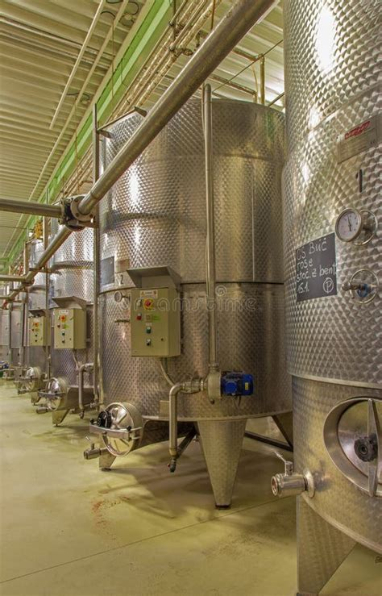
History of Slovak Wine
A Journey Through Time
In recent decades, Slovak winemakers have embraced modern viticulture, focusing on quality and regional distinctiveness.
Innovative techniques and a renewed emphasis on sustainable practices have elevated the standard of Slovak wines, allowing them to gain recognition on the international stage.
Today, wine enthusiasts can discover a diverse range of styles, from crisp whites that reflect the unique terroir to robust reds characterized by their richness and depth.
The journey of Slovak wine, full of twists and turns, continues to evolve, offering a captivating story that invites exploration and appreciation.

Slide 7
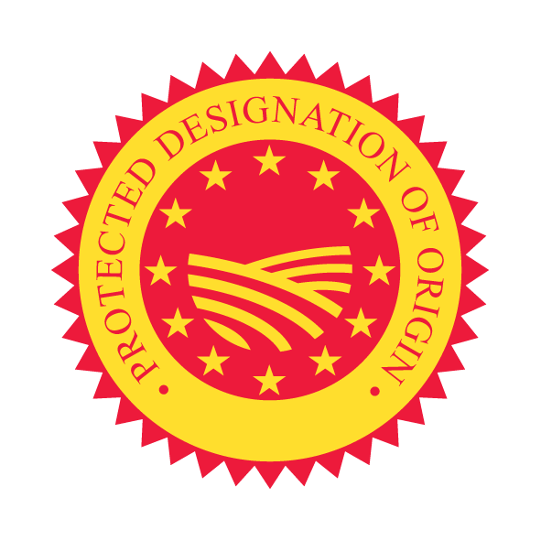
Slovakia’s Protected Designation of Origin System
The Protected Designation of Origin (PDO) and Protected Geographical Indication (PGI) systems were established as part of Slovakia’s integration into the European Union, ensuring that the country’s wines meet specific quality standards to ensure quality and origin authenticity. while also protecting regional identities.
Slovakia’s Protected Designation of Origin (PDO) and Protected Geographical Indication (PGI) system ensure quality and origin authenticity. This system mirrors those of its European neighbors like France’s AOC and Germany’s Prädikatswein.
The PDO designation is the highest standard, awarded to wines produced in specific, tightly regulated regions, where the entire winemaking process—from grape growing to bottling—takes place. The grapes must come exclusively from the designated area, ensuring the wine truly reflects its terroir. Strict rules are applied to grape varieties, viticulture techniques, and aging processes, all aimed at preserving the unique characteristics of Slovakia's wine regions.

Slide 8
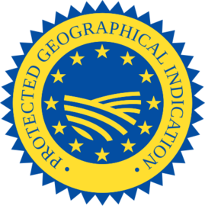
Wine Classification System
PGI, on the other hand, offers slightly more flexibility. Wines under this label are still linked to a geographic area but allow for a broader range of grapes and methods.
This designation is often applied to Slovakia’s more modern or experimental wines that still represent the region's essence but may not meet the stricter standards of the PDO.
These classifications ensure that Slovak wine producers maintain high-quality standards while also highlighting the rich diversity of wines across the country.
It also helps establish Slovakia’s reputation in the global wine market by ensuring authenticity and traceability, contributing to the growth of its wine exports.

Slide 9
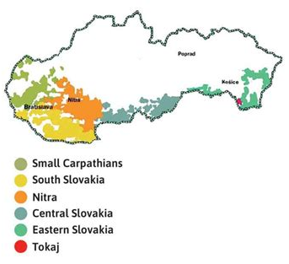
Wine Regions in Slovakia
Slovakia’s wine regions reflect a fascinating diversity, shaped by varied climates, soils, and geographical influences.
Each region contributes something unique to the national wine identity, from the volcanic soils of Tokaj to the fertile plains in the south. Whether you're exploring the familiar or discovering something new, Slovakia’s wine landscape offers a compelling array of flavors and styles.
Slovakia’s wine regions are defined by unique terroirs, climates, and grape varieties, contributing to their distinct wine profiles. The primary regions include:

Slide 10
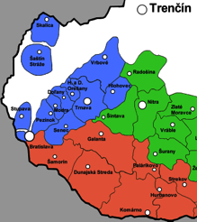
Wine Regions in Slovakia
Small Carpathians: Nestled along the western slopes of the Carpathian Mountains, the Small Carpathians region stretches from Bratislava in the south up to Trnava in the north, and it is Slovakia’s most renowned and oldest winemaking area.
The influence of mineral-rich soils and a cool, continental climate creates ideal conditions for cultivating a range of white grape varieties.
Here, the soil is a unique blend of limestone, clay, and sand, rich in minerals from the ancient seabed that once covered the area.
This soil composition imparts a distinct minerality to the wines, enhancing the vibrant acidity and subtle nuances of each varietal.
The cooler climate, moderated by the proximity of the mountains, leads to a long ripening period for the grapes, which helps preserve the natural acidity and brings out aromatic complexity, especially in white varietals.

Slide 11
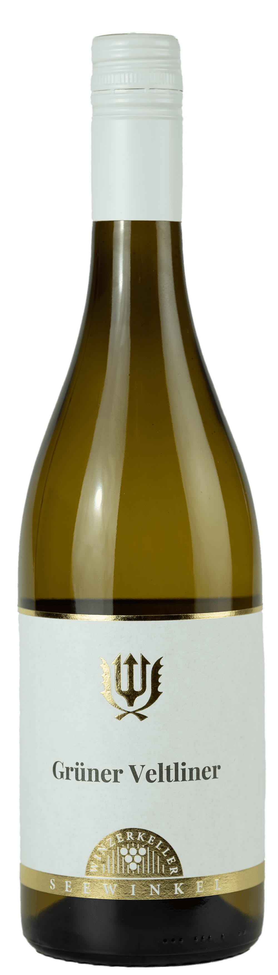
Wine Regions in Slovakia
Grüner Veltliner and Riesling are standouts here, with Grüner Veltliner offering peppery and herbaceous notes alongside hints of green apple, while Riesling from this region often reveals floral and citrusy aromas with a refreshing mineral finish.
Other popular white varietals in the Small Carpathians include Welschriesling and Müller-Thurgau, both producing light, fresh wines perfect for the region’s cuisine.
Beyond wine, the Small Carpathians region is celebrated for its deep-rooted wine culture and traditions, including historic wine cellars and annual festivals like the Small Carpathian Wine Route event, where local wineries open their doors for tastings.
With its breathtaking landscapes of vineyards cascading down mountain slopes and charming towns brimming with history, the Small Carpathians offer a truly immersive wine.

Slide 12
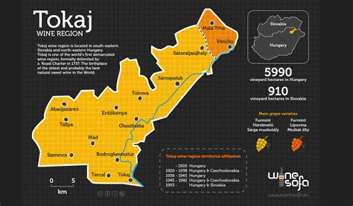
Wine Regions in Slovakia
Tokaj: Located in eastern Slovakia, the Tokaj region is synonymous with exquisite dessert wines that rival their renowned Hungarian counterparts. This small but storied area is one of the only two places globally permitted to use the “Tokaj” designation, highlighting its heritage and distinctiveness.
With a history of winemaking that dates back to the Middle Ages, the region offers a captivating blend of centuries-old tradition and modern viticultural expertise, evident in its carefully crafted wines that continue to draw admiration worldwide.
The unique terroir of Slovak Tokaj is shaped by its volcanic soils, which are rich in minerals, lending a remarkable structure and complexity to the wines.
The warmer climate, with long, sunny autumns and misty mornings, encourages the development of noble rot, or Botrytis cinerea, a natural process crucial to creating Tokaj's signature sweet wines.

Slide 13
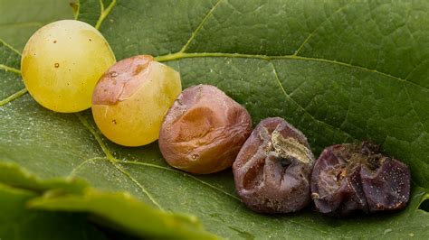
Wine Regions in Slovakia
This fungus concentrates the sugars and flavors in the grapes, leading to wines with unparalleled richness, vibrant acidity, and layered notes of honey, dried apricots, nuts, and spices.
Furmint, Lipovina, and Yellow Muscat are the primary grape varieties in Tokaj, each contributing to the characteristic sweetness and aromatic complexity of Tokaj wines.
Furmint, in particular, provides structure and acidity, while Lipovina and Yellow Muscat add floral and fruity notes. The wines are often aged in small, centuries-old cellars carved from volcanic rock, where they develop further depth and complexity over time.
Beyond its wines, Tokaj holds a cultural significance in Slovakia, with numerous local traditions, festivals, and customs celebrating its rich winemaking heritage.
Whether enjoyed in Slovakia or abroad, Tokaj wines represent a connection to the past and a testament to the region’s dedication to quality and craftsmanship.

Slide 14
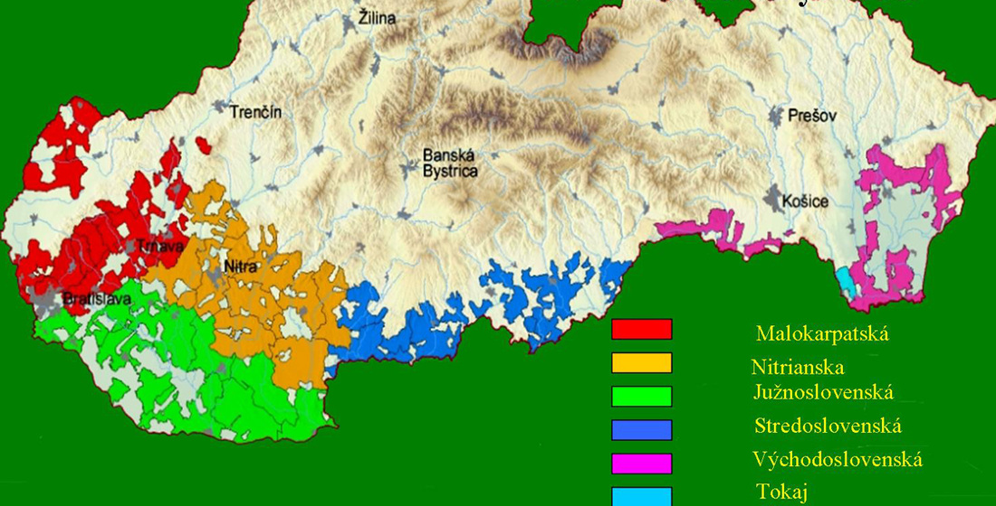
Wine Regions in Slovakia
Nitra's vineyards are truly a testament to the region’s ideal growing conditions, benefiting from fertile soils enriched by the Danube River's silt and a sunny climate that bathes the grapes in warmth.
This combination not only nurtures the vines but also enhances the flavors of the resulting wines. Among the reds, Blaufränkisch, known locally as Frankovka modrá, stands out with its vibrant acidity and berry-forward profile, captivating palates with layers of dark fruit and subtle spice.
On the white side, Sauvignon Blanc thrives in Nitra, offering a fresh and aromatic experience marked by zesty citrus notes and grassy undertones.
Winemakers in this region are dedicated to crafting high-quality wines that reflect their terroir, often experimenting with blends and innovative techniques while respecting traditional practices.
As the Nitra wine scene continues to grow, it invites enthusiasts to discover its unique offerings and appreciate the craftsmanship behind each bottle.

Slide 15
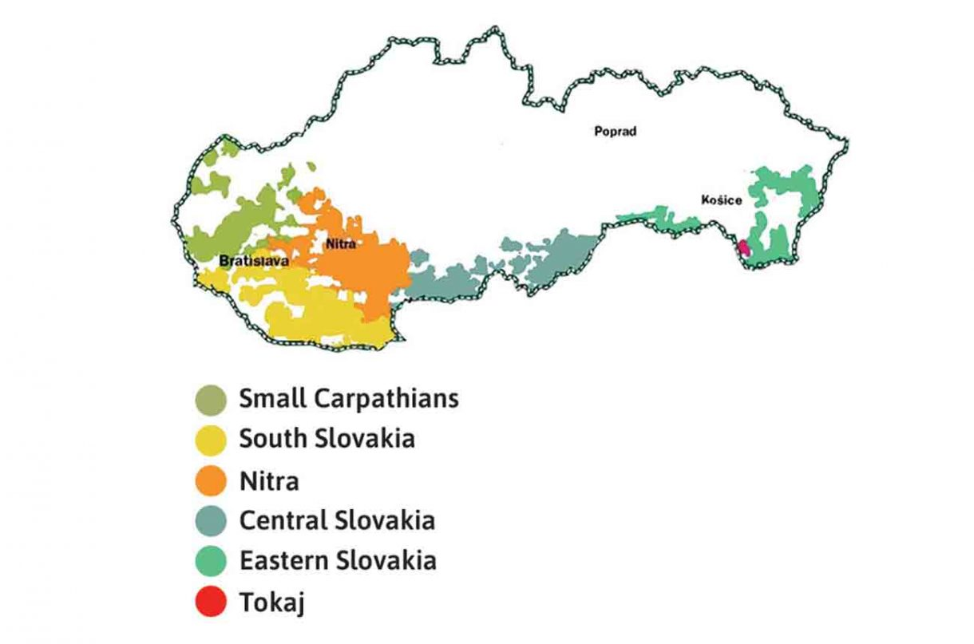
Wine Regions in Slovakia
South Slovak: The South Slovak wine region, located along the southern edge of Slovakia near the Hungarian border, is celebrated for producing robust and full-bodied wines, both red and white.
This area benefits from a warmer climate than other Slovak wine regions, with extended sunny days and hot summers, which foster ideal growing conditions for a range of grape varieties.
Stretching across the Danube lowlands, this region is one of Slovakia’s most significant in terms of production and diversity.
The soils in South Slovak vineyards are well-drained and mineral-rich, often featuring a mix of loam, clay, and sand over limestone and granite bedrock. These soil characteristics allow the vines to thrive, with deeper roots that access valuable minerals, adding complexity and depth to the wines.
The warm climate promotes full ripening, especially for robust red varieties like Cabernet Sauvignon, Merlot, and Blaufränkisch. These reds are known for their concentration of fruit flavors, bold tannins, and spice, with Cabernet Sauvignon expressing dark berry notes, while Blaufränkisch offers layers of black cherry, pepper, and earthiness.

Slide 16
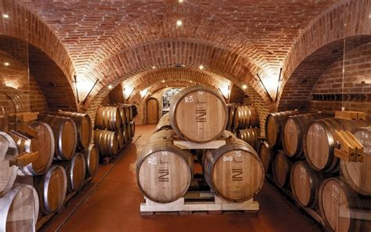
Wine Regions in Slovakia
South Slovak:
The whites in South Slovak are equally impressive, with Chardonnay and Sauvignon Blanc flourishing in the region’s microclimates.
The Chardonnay wines often exhibit ripe tropical fruit flavors with a balancing minerality and a creamy texture that develops with oak aging.
Sauvignon Blanc, on the other hand, retains bright acidity and showcases vibrant citrus and green fruit notes, reflecting the refreshing qualities of the local terroir.
The South Slovak region has seen a revival of viticultural innovation and experimentation, blending modern winemaking techniques with the area’s rich traditions.
With a combination of international varieties and a climate that enables full ripening, South Slovak wines offer a unique expression of the region’s terroir, making it a growing destination for wine enthusiasts.

Slide 17
Wine Regions in Slovakia
Central Slovak: Nestled in the heart of Slovakia, the Central Slovak wine region is known for its varied soil composition and picturesque landscapes, making it a unique terroir for producing wines that strike a fine balance between acidity and body.
The region’s vineyards are planted across gentle hills and valleys, where the soils are notably diverse, ranging from volcanic and mineral-rich types to clay, sandstone, and loess. This variety contributes complexity and depth to the wines, giving them unique mineral notes and a refined structure that distinguishes them from other Slovak regions.
The climate here is relatively mild, with a mix of warm summers and cooler autumns, allowing grapes to ripen gradually, enhancing the aromatic qualities and retaining vibrant acidity.
This environment is especially favorable for white varietals like Riesling and Welschriesling, which are the stars of Central Slovak’s offerings.
Riesling, in particular, shines with bright acidity, fresh citrus, and stone fruit notes, often accompanied by a subtle mineral edge from the volcanic soils. Welschriesling, while similar in name, produces wines with floral aromas, green apple notes, and a crisp, refreshing finish.

Slide 18
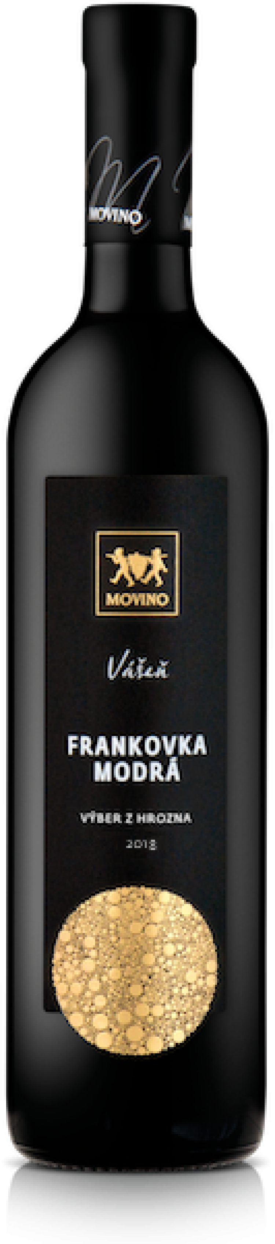
Wine Regions in Slovakia
Central Slovak: The red wines from Central Slovak also benefit from the region's balanced climate and diverse soils, resulting in smooth, elegant expressions.
Varieties like Pinot Noir and Blaufränkisch thrive here, producing reds with soft tannins and complex fruit profiles, often layered with earthy undertones that reflect the terroir.
This region is also celebrated for its focus on sustainable viticulture and traditional methods, which contribute to the purity and authenticity of its wines.
The winemaking communities here take pride in maintaining practices that respect the land and the legacy of Slovak wine.
For wine enthusiasts, Central Slovak offers a serene and scenic destination, with opportunities to explore local vineyards and cellars, taste the balanced and expressive wines, and experience the warmth of Slovak hospitality.

Slide 19
Wine Regions in Slovakia
Eastern Slovak: The Eastern Slovak wine region, although modest in size, is a hidden gem that produces a diverse range of both white and red wines.
Tucked into the eastern corner of Slovakia, near the borders of Hungary and Ukraine, this region benefits from a unique mix of continental and Eastern European climate influences.
The summers here are warm, while the cooler autumns provide a slower ripening period, which helps retain acidity and build nuanced flavors in the grapes. Though lesser-known internationally, the wines from Eastern Slovak vineyards reflect a dedication to quality and craftsmanship, often surprising visitors with their elegance and depth.
The soils in Eastern Slovak vineyards vary across the landscape, featuring fertile loams, sandstone, and volcanic soils that imbue the wines with subtle mineral and earthy qualities. These soils are particularly suited to cultivating both red and white varietals, with many of the vines being planted on gentle slopes that benefit from excellent sunlight exposure and drainage.

Slide 20
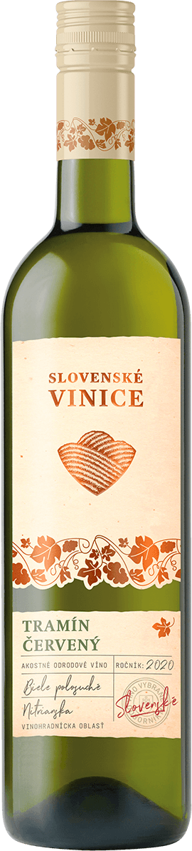
Wine Regions in Slovakia
Eastern Slovak: The white wines from Eastern Slovak stand out for their vibrant acidity and delicate aromas. Varieties like Riesling and Welschriesling offer crisp, citrusy notes with underlying hints of minerality and green apple.
Pinot Gris and Tramín Červený (Gewürztraminer) also perform well here, producing aromatic wines with floral and stone fruit characteristics, balanced by a fresh, zesty acidity.
Red wines in this region, while lesser-known, are gaining recognition for their smooth tannins and expressive fruit flavors.
Varietals like Blaufränkisch and St. Laurent are commonly grown, yielding wines with rich cherry and berry flavors, often accompanied by hints of spice and earthiness, with a soft, approachable structure, making them versatile and appealing for a range of palates.
Although Eastern Slovak wines remain relatively undiscovered on the global stage, this region is increasingly drawing attention for its commitment to quality over quantity.

Slide 21
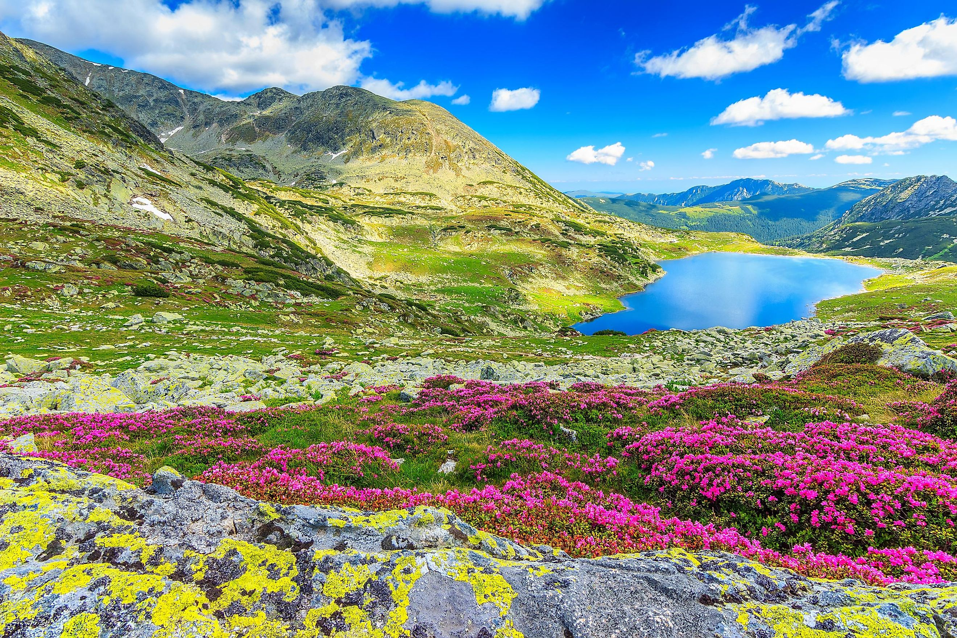
Slovakia’s Unique Terroir
Slovakia’s terroir is influenced by a mix of volcanic and mineral-rich soils, with mountainous terrain that provides varied elevations and microclimates.
The Carpathian Mountains in the west create ideal conditions for white varietals with distinct minerality, while warmer eastern regions like Tokaj favor fuller-bodied and often sweet wines.
The diversity of soil types and climates across the regions enhances the complexity and character of Slovak wines.

Slide 22
Slovakia’s Major Varietals
Slovakia is home to unique indigenous grape varieties that offer a distinct alternative to more commonly found varietals in France or California.
Little Carpathians wine region Grape varieties: Green Valteliner, Müller-Thurgau, Welschriesling, Rhine Riesling, Saint Laurent
Nitra wine region Grape varieties: Green Valteliner, Welschriesling, Müller-Thurgau, Saint Laurent
South Slovakia wine region Grape varieties: Cabernet Sauvignon, Green Valteliner, Welschriesling, Saint Laurent, Alibernet, Devin
Central Slovakia wine region Grape varieties: Green Valteliner, Rhine Riesling, Pinot blanc, Welschriesling
Wine region of Tokaj Grape varieties: Furmint, Harslevelu, Small-grained Muscat, Gewurztraminer, Pinot noir
East Slovakia wine region Grape varieties: Welschriesling, Gewurztraminer, Müller-Thurgau, Rhine Riesling

Slide 23
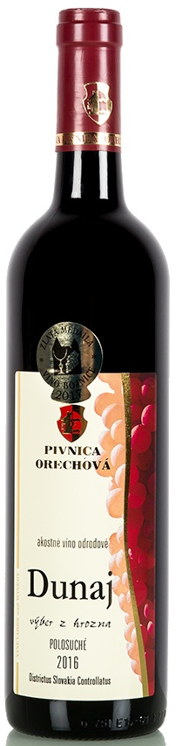
Slovakia’s Major Varietals
Dunaj: An indigenous red with dark fruit flavors and a spicy undertone, often compared to fuller-bodied reds.
Dunaj is a captivating red wine, born from an indigenous grape variety primarily cultivated in Slovakia.
Its deep, inky hue hints at the rich flavors within. On the palate, expect a symphony of dark fruits, such as ripe black cherry and plum, complemented by a subtle spicy undertone that adds complexity.
Its full-bodied nature and robust tannins make it a perfect companion to hearty dishes like grilled red meats, roasted game, and aged cheeses.
The wine's lingering finish leaves a lasting impression, making it a memorable choice for any wine enthusiast.

Slide 24
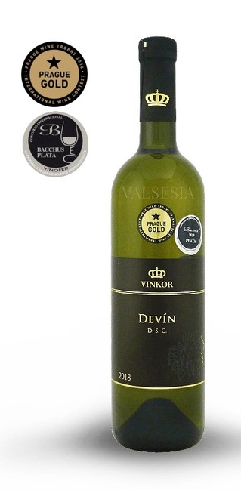
Major Varietals of Slovakia
Devín: A cross of Gewürztraminer and Roter Veltliner, Devín offers aromatic whites with floral and honeyed notes, perfect for spicy foods or Slovak cheese plates.
Tastine Notes: “Gewurztraminer is reflected in the wine spicy generosity and pleasant sharpness of Veltliner. Wine is so full of wonderful muscat honey-aromatic sensations with the dominance of yellow watermelon.”
“The flavor is typically varietal - is dominated by yellow fruits - overripe mango with nuances of white pepper in a beautiful long end.”

Slide 25
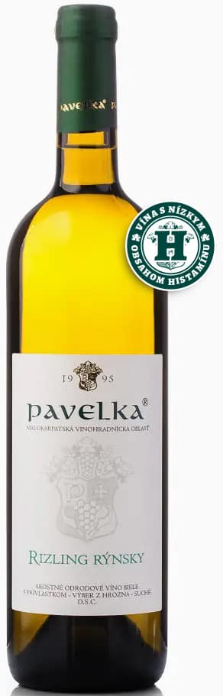
Major Varietals of Slovakia
Rizling rýnsky, or Riesling, is a versatile white grape variety renowned for its elegance and complexity. Grown in cooler climates with mineral-rich soils, Riesling produces wines that exhibit a wide range of styles, from crisp and dry to very sweet.
A hallmark of Riesling is its high acidity, which lends the wine its refreshing character and aging potential. Aromatic profiles vary widely, often featuring notes of citrus, such as lemon and lime, as well as floral nuances like honeysuckle and white peach.
Riesling's versatility makes it a food-friendly wine. Dry Riesling pairs well with seafood, poultry, and spicy Asian cuisine, while sweeter styles complement desserts or blue cheese. It’s refreshing acidity also makes it a great choice for aperitifs or summer sipping.

Slide 26
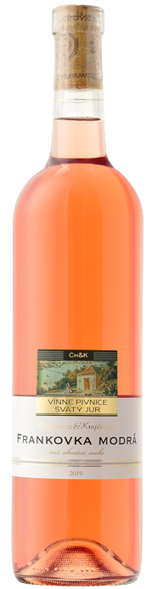
Major Varietals of Slovakia
Frankovka modrá, also known as Blaufränkisch, is a versatile red grape variety that produces elegant and age-worthy wines.
These wines often exhibit vibrant acidity and captivating berry notes, such as ripe cherry and blackberry.
The tannins are typically firm and structured, providing a firm backbone that balances the wine's fruitiness. As the wine ages, the tannins soften, and the flavors develop complexity, with hints of spice, leather, and earth emerging.
Frankovka modrá pairs exceptionally well with a variety of dishes, including hearty Slovak cuisine, roasted meats, and charcuterie.
Its refreshing acidity and bold flavors make it a delightful choice for wine enthusiasts seeking a sophisticated and food-friendly red.

Slide 27

Notable Wineries of Slovakia
Each region has notable wineries that showcase the best of Slovak terroir:
Elesko Winery, nestled in the picturesque Small Carpathians region of Slovakia, is a modern and forward-thinking producer committed to sustainable winemaking practices.
With a strong focus on showcasing the unique terroir of the region, Elesko primarily produces a range of elegant white wines, including Riesling, Chardonnay, and Pinot Blanc.
These wines often exhibit delicate floral and citrus aromas, balanced acidity, and a mineral-driven character that reflects the region's distinctive soil composition.
By embracing innovative techniques and respecting the environment, Elesko has established itself as a leading force in Slovak winemaking, producing wines that are both refreshing and complex.

Slide 28
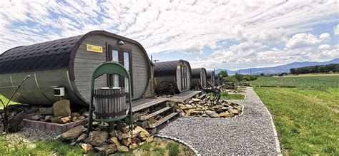
Notable Wineries of Slovakia
Tokaj Macik Winery is a renowned producer in the illustrious Tokaj region.
This family-owned winery specializes in crafting premium sweet wines, particularly Aszú, a style renowned for its intense sweetness, honeyed character, and complex flavors.
The unique volcanic soils of the region, combined with the meticulous selection of botrytized grapes, contribute to the distinctive taste profile of these wines.
With careful aging in oak barrels, Tokaj Macik wines develop layers of complexity, including notes of apricot, honey, and spice. These exceptional wines are a testament to the rich history and terroir of the Tokaj region.

Slide 29
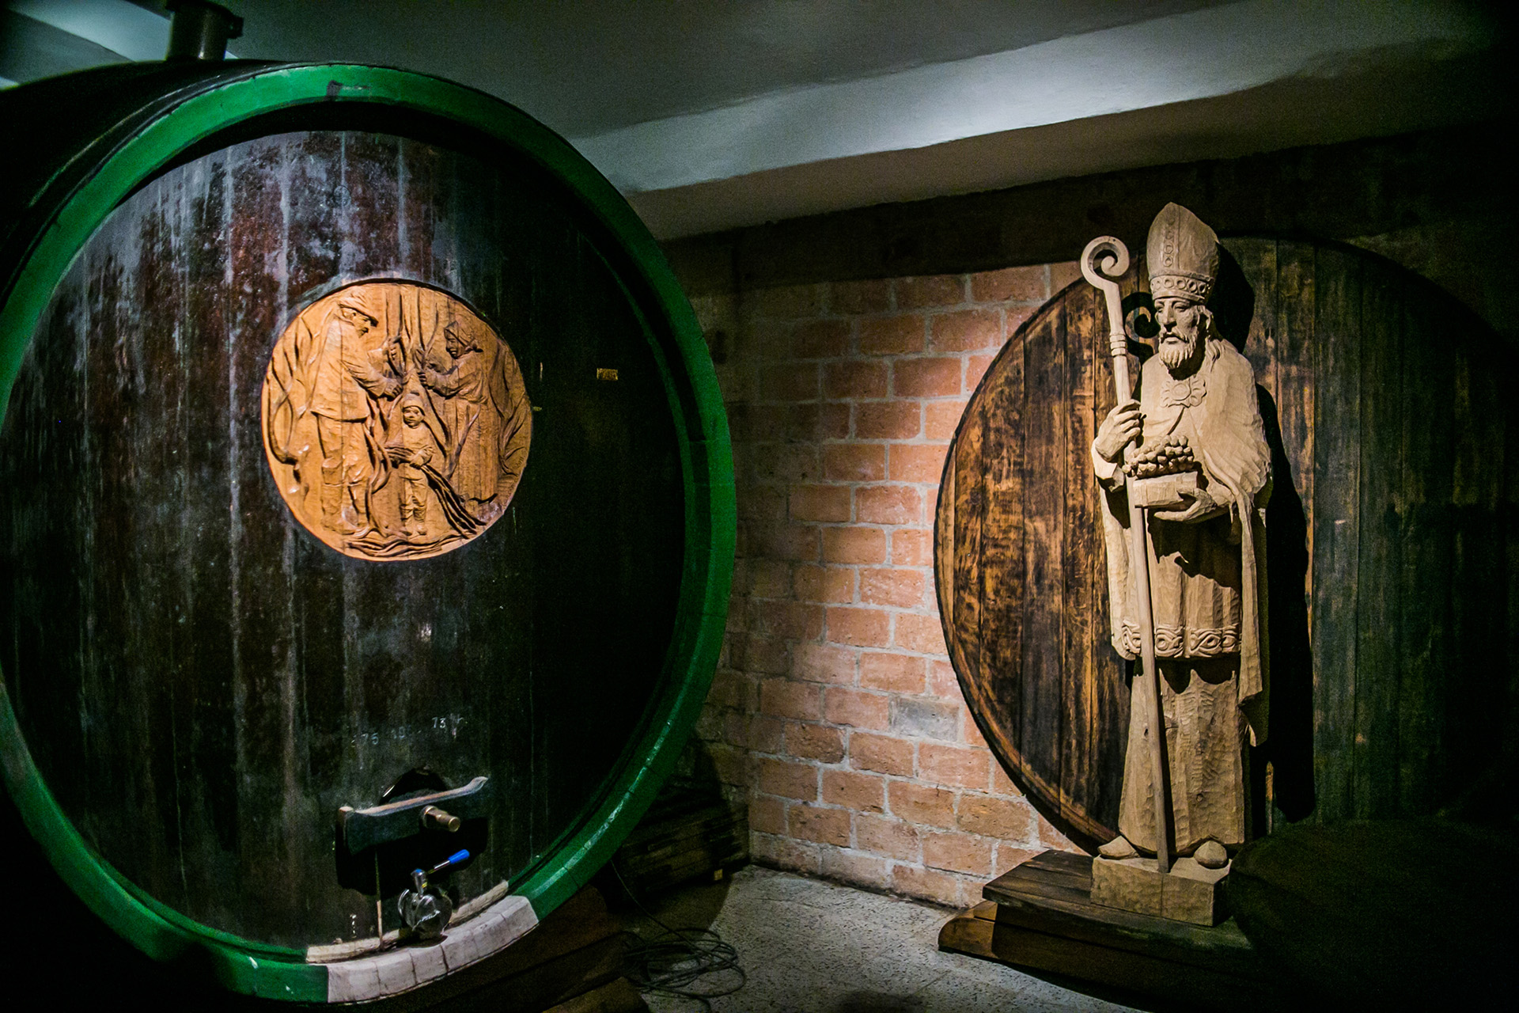
Notable Wineries of Slovakia
Chateau Topoľčianky is a historic winery steeped in tradition, yet embracing modern winemaking techniques.
Nestled in the Nitra region, the winery boasts a diverse portfolio, ranging from classic red varietals like Blaufränkisch to elegant white wines.
With a focus on quality and regional expression, Chateau Topoľčianky offers a harmonious blend of old-world charm and contemporary style.
Their wines are renowned for their balanced flavors, smooth tannins, and distinctive character, reflecting the unique terroir of the Nitra region.

Slide 30
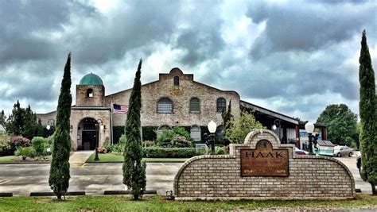
Notable Wineries of Slovakia
Hacaj Winery, nestled in the South Slovak region, is renowned for its robust and full-bodied red wines.
Committed to sustainable practices, the winery focuses on organic viticulture and traditional winemaking techniques.
Their portfolio highlights classic international varietals like Cabernet Sauvignon, as well as indigenous Slovak grapes. These wines are characterized by ripe fruit flavors, firm tannins, and a rich, complex character.
Hacaj's dedication to quality and authenticity has earned them a reputation as one of Slovakia's premier wine producers.

Slide 31
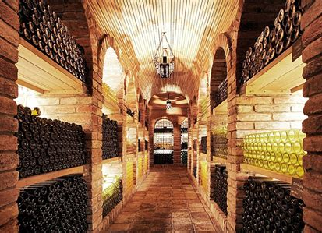
Why Slovakia Wine Deserves Your Attention
You might be thinking, “Why should I care about Slovak wine?” Let me break it down for you:
Great Value: Slovak wines often punch above their price, offering excellent quality without breaking the bank. Who wouldn’t love that?
Unique Flavors: With indigenous grapes and a variety of terroirs, Slovak wines bring flavors that are truly one-of-a-kind.
The Next Big Thing: Slovak wine is gaining recognition fast. Getting in now means you’ll be ahead of the trend—and have bragging rights!

Slide 32
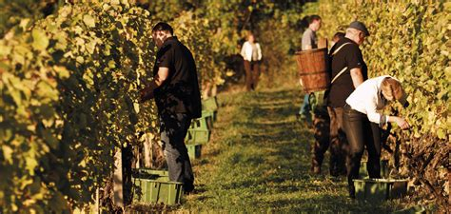
Conclusion
Slovakia’s wine landscape is both rooted in tradition and open to innovation.
From ancient winemaking techniques to modern advancements, Slovak wines reflect a commitment to quality and authenticity.
By exploring indigenous varietals and the unique terroir, wine enthusiasts gain a deeper appreciation for this region’s contributions to the global wine community.
Whether through the distinct reds of Nitra or the sweet wines of Tokaj, Slovakia offers a wine experience that’s rich in flavor, history, and culture.

Slide 33
Acknowledgement
My seminars are the result of many years of experience combined with many hours of research over the internet.
I would like to acknowledge the many source I have accessed.
These include Wine Spectator, Wine Enthusiast, BKWine Magazine, Wine & Spirits Magazine, American Vineyard Magazine, The Grapevine Magazine, Wikipedia.com, Britannica.com, and the various Government websites.

Slide 34
Citations and References
Vivino - An Introduction to the Wines of Slovakia
Books and Academic Articles: Books on Slovak wine history or viticulture in Central Europe would add depth to the historical and terroir sections. For example, references like The Wines of Slovakia: A Journey Through History and Terroir or similar academic studies.
Government and EU Publications: For information on the Protected Designation of Origin (PDO) and Protected Geographical Indication (PGI) classifications, official EU documentation or Slovak government sources are useful. These could include official Slovak or EU websites, detailing the PDO/PGI system for Slovakia.
Winery Websites: Each notable winery's website would be a primary source for specific information about its practices, notable wines, awards, and terroir.
Wine Review Sites and Magazines: Websites such as Wine Enthusiast, Decanter, and Wine Spectator often cover lesser-known wine regions and could provide valuable tasting notes, varietal profiles, and recommendations for Slovak wines.
Local Slovak Sources and Tourism Boards: The Slovak Tourism Board and regional wine associations can offer details about the wine regions and festivals that contribute to the Slovak wine culture.

