Slide 1

Sitka Alaska Presented by Fellow Cruiser Marc Silver

Slide 2
What I Will Cover
My Port Philosophy
Don’t Miss the Ship
Maps
About Sitka
Shuttle to Sitka
Getting Around Sitka
Points of Interest
Places to see or at least consider
Conclusion

Slide 3
My Port Philosophy
I have been cruising for over 45 years and have taken over 100 cruises. So, I consider myself an experienced cruiser.
The information I will present is based on those many years of
experience.
When I am on a cruise where the city, I want to visit is not the port city,
I always recommend taking a ship’s tour.
But when I am in a port with multiple attractions nearby and easy to see
on my own - I will do it on my own.
This presentation is for that type of port.

Slide 4
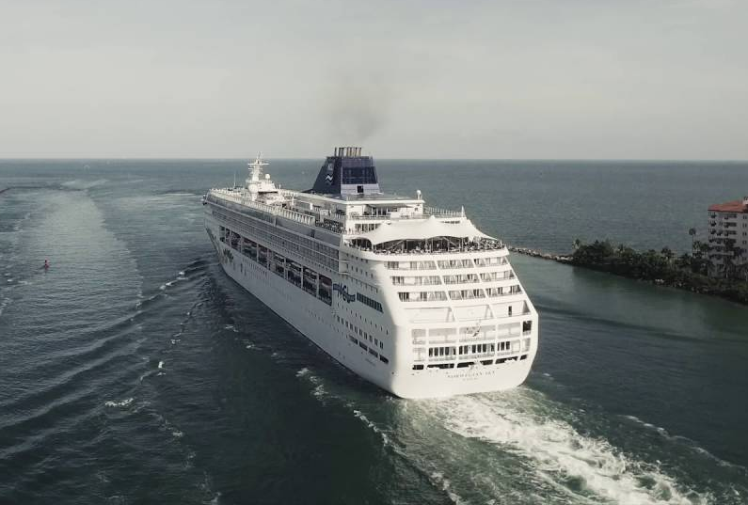
Don’t Miss the Ship
How to Avoid Missing Your Ship
Pay attention to the time. - Ship time and local time are often different. Put a return-to-ship reminder on your phone.
Choose excursions wisely.
If a ship-sponsored excursion is late returning to port for, the ship will wait for you. If you are on your own???
Be Prepared
Have your Passport, Credit Card and phone numbers for your ship port agent.
What to Do If You Miss the Ship
Most cruise lines have port agents stationed in the port area to assist if your ship has left without you. If you’re lucky, when cruisers are late returning to the vessel, the ship's crew will often remove the passengers' essential items -- passports, cell phones, and medication -- from the ship to leave with the port agents.
The Port Officials can help you with contacting your ship and making necessary travel arrangements.

Slide 5
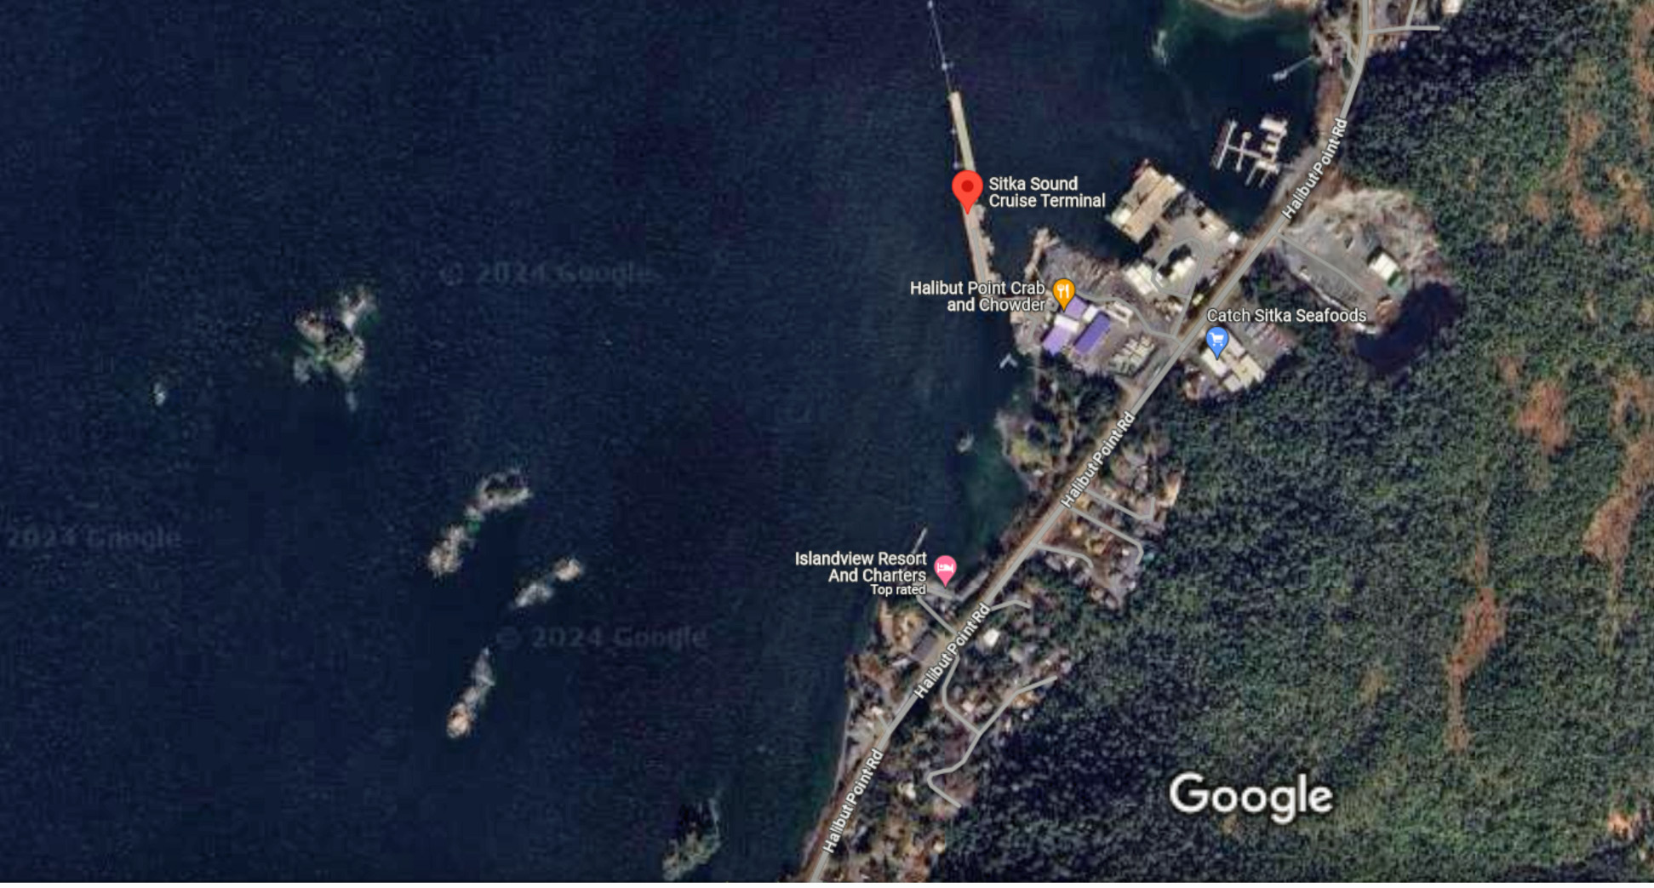
Port Dock

Slide 6
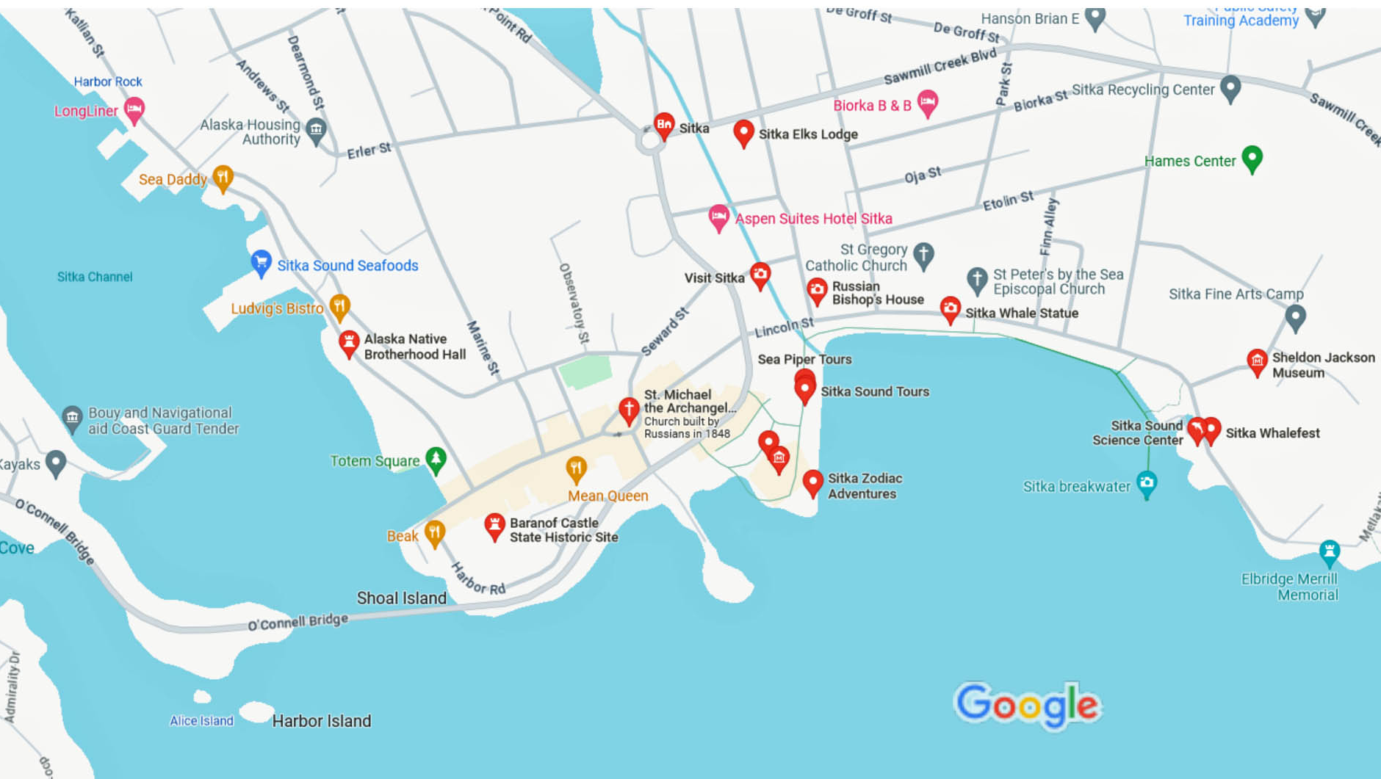
University of Alaska Southeast
Sitka

Slide 7
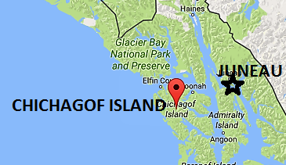
About Sitka
Sitka is the only Inside Passage community that fronts the Pacific Ocean. It sits in the shadow of Mount Edgecumbe and located on Sitka Sound.
The city of about 8,500 residents is known for its Tlingit culture and picturesque remnants of its Russian heritage, including the onion-shaped domes and gold-colored crosses of the beloved Saint Michael's Russian Orthodox Cathedral.
The city and borough limits include most of Baranof Island, where the city of Sitka is located.
Sitka was originally inhabited by the Tlingit people who called the area Sheet’Ká which means “people on the outside of Shee’," with Shee’ being the Tlingit name for Baranof Island.
When Russians arrived and claimed the area, they named the area New Archangel, and it became the capital of Russian Alaska in 1808. Russia sold Alaska to the United States on October 18, 1867

Slide 8
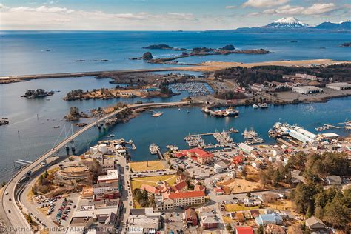
Downtown Sitka
Downtown Sitka features numerous art galleries, a fine bookstore, gift shops, several lodging options, and restaurants with great views and local seafood, all nestled between the mountains and the ocean.
You can pick up a map from the Sitka Visitor Information Center to embark on a walking tour highlighting the city’s history and culture.
There are 22 buildings in Sitka on the National Register.
They include:
The Russian Blockhouse, Russian Bishop's House, Princess Maksoutoff’s Grave, and Baranof Castle State Historic Site.
There’s plenty of history to explore on a walk-through town.

Slide 9
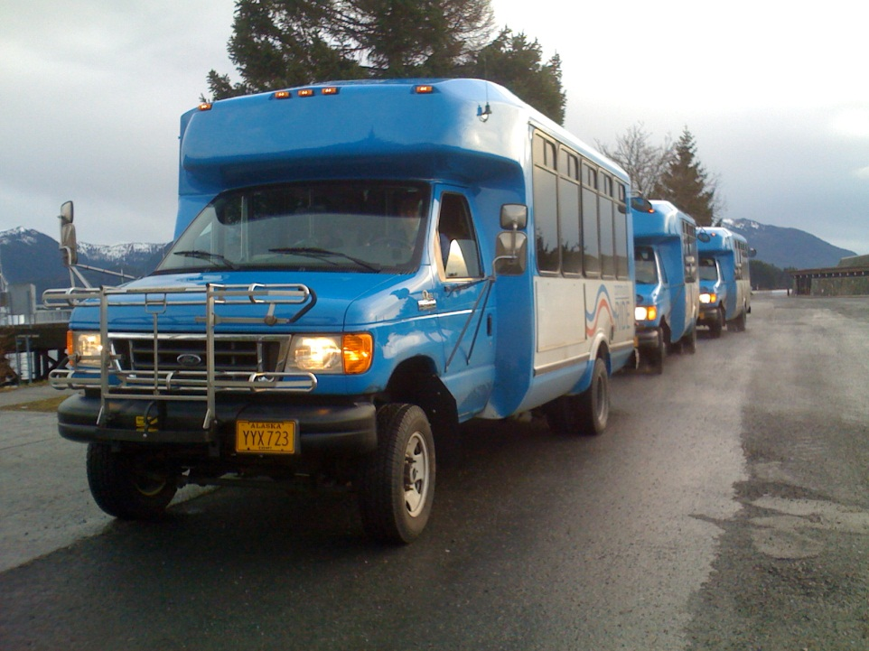
Free Shuttle
Ride the free shuttle to downtown Sitka to experience the many local shops, restaurants, and attractions.
Distance
Cruise Terminal is Located 6 miles from Sitka
Ride Duration
Shuttle Ride is 10-15 minutes to Downtown
Cost
The shuttle is free to all cruise ship passengers
Drop Off/ Pick Up Location
The shuttle drops off at and picks up at Harrigan Centennial Hall in Downtown Sitka.
Frequency
The shuttle departs at least every 15 minutes while your ship is at port.
Last Shuttle
The last shuttle from downtown is 30 minutes prior to your ship all aboard time.

Slide 10
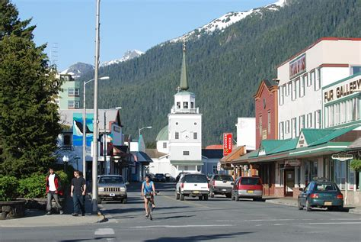
Getting Around Sitka
Sitka is compact and easy to navigate. The majority of activities and attractions are found within one mile of the boat harbor, so walking—especially along the waterfront path—are feasible.
In Sitka, everything is close which means less time walking and more time exploring.
Several hiking trails, are also close by.
A short drive will take you to attractions located outside of town.

Slide 11
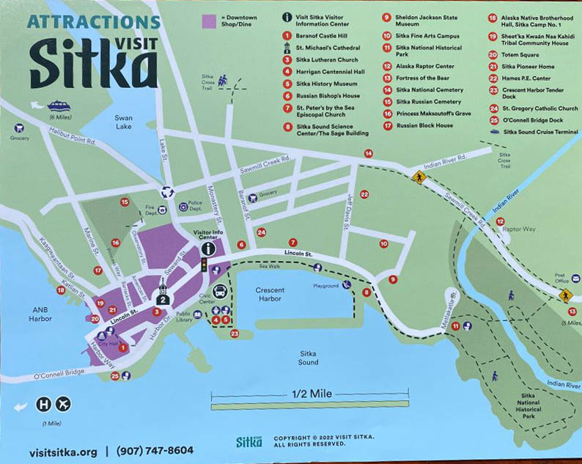
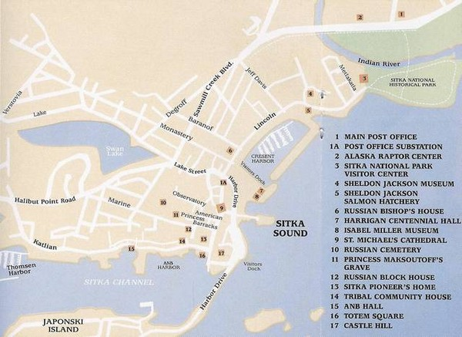
Sitka Walking Map

Slide 12
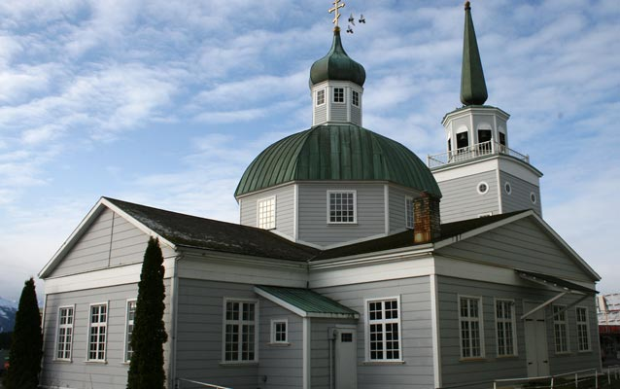
St. Michael Cathedral National Historic Landmark
Constructed between 1844 and 1848, the Cathedral of St. Michael the Archangel is the principal representative of Russian cultural influence in the 19th century in North America.
From 1840 to 1872, Sitka was the Seat of the Russian Orthodox Diocese which governed all of North America, and thereafter it continued as the Seat of the Diocese of Alaska.
This outstanding example of Russian church architecture was by far the largest and most imposing religious edifice in Alaska until well into the 20th century.
The present cathedral is a reconstruction of the original building which burned to the ground in January 1966.
St. Michael's Cathedral in Downtown Sitka

Slide 13
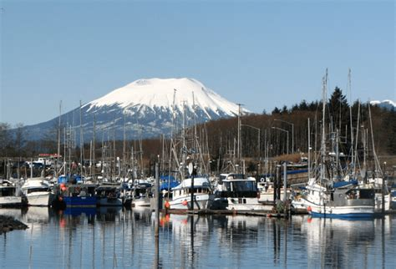
Sitka Boat Harbor
The Sitka boat harbor is a fun place to check out.
Great boats, beautiful views. Its fun to watch the boats come in with there catch of the days.
Walk along the pier that is lined with a few places to eat and place to shop or take a tour.
Great place to see and explore when you are in town.

Slide 14
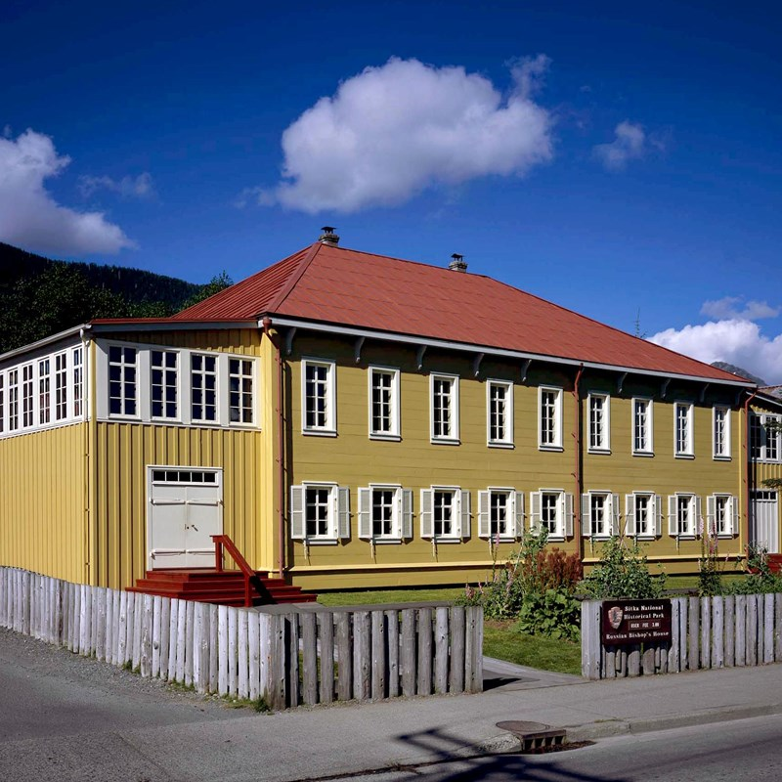
The Russian Bishop’s House is the oldest intact Russian building in Sitka.
Russian Bishop’s House
Built in 1842 by the Russian American Company as a residence for the Bishop of the Orthodox Church.
The house has been restored to the 1850s historic period when it functioned as a school, bishop's residence, and a chapel. The house is registered as a National Historic Landmark.
This is one of only four Russian period buildings left in North America.
Free tours are offered May to September. Hours of operation vary depending on staff availability.

Slide 15
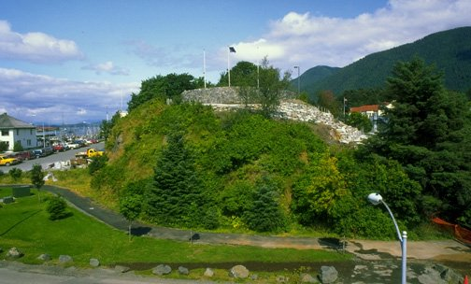
Baranof Castle State Historic Site
Commonly referred to as Castle Hill, this park is one of the most historically significant sites in Alaska.
Tlingit natives originally inhabited this area and built a strategic fortification at this site.
Between 1804-1867 Russians occupied this site. In 1867, on top of Castle Hill, Alaska was officially transferred from Russia to the United States. Today, Castle Hill is a state historic site and also designated as a National Historic Landmark.
A fully accessible walkway leads visitors to the top of the hill and provides outstanding views of downtown Sitka and waterfront. Interpretive panels provide opportunities to learn more about the history of this site.
The park is located in downtown Sitka.

Slide 16
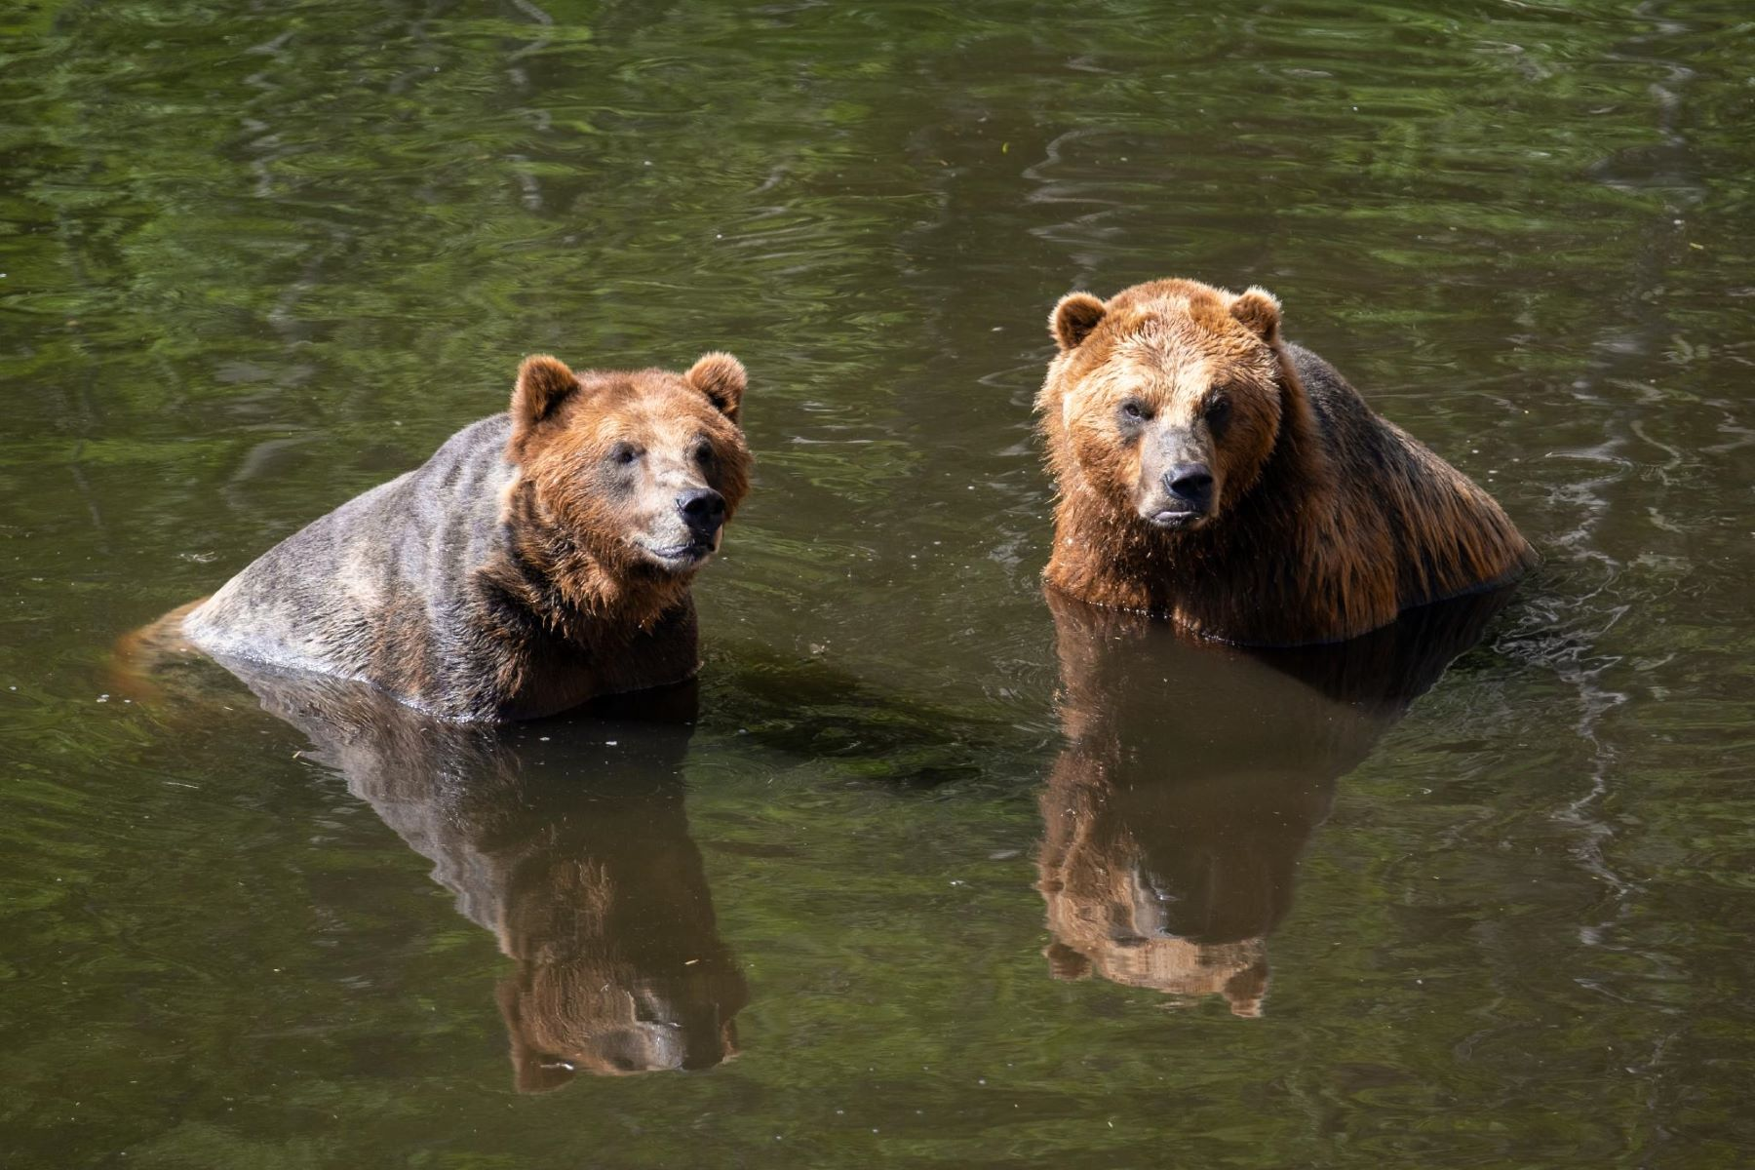
Fortress of the Bears
The Forest of the Bears is a non-profit bear sanctuary and educational center, dedicated to rescuing orphaned Alaskan bear cubs in need.
With no legal rehabilitation and release program available for bears in the state, orphans that lose their mothers at a young age are typically destroyed.
Enjoy viewing the bears as they play, explore and forage for food, while a team of naturalists tell you stories about their histories, personalities and seasonally changing diets and environments.
Admission:
Adult - $15
Child - $5 (aged 8-18)
Children under 7 Free

Slide 17
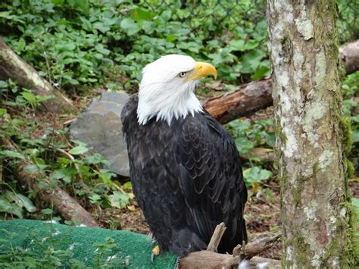
Alaska Raptor Center
A pioneering wildlife project, the Alaska Raptor Center has been dedicated for years in the effort to protect and rehabilitate birds of prey.
Their innovative veterinary medicine makes the life-or-death difference on Alaska’s raptors.
The center’s goal is to rehabilitate and release into the wild all bird patients.
A few never fully recover and remain housed at the center’s outdoor sanctuary.
This is one of Sitka’s most popular attractions, visitors are welcome at the Alaska Raptor Center’s facility that includes an impressive flight training enclosure.
Adult: $15 per person Youth (age 5-17): $6 per person Child (age 4 and under): FREE

Slide 18
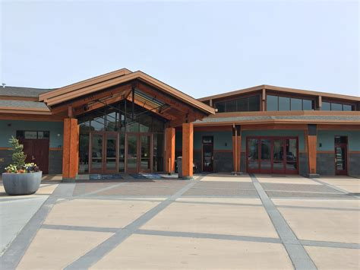
Sitka Historical Museum
The Sitka History Museum’s unique mission to tell the human history of Sitka and the surrounding area.
All elements of Sitka’s history converge in one place: The Sitka Historical Museum. Packed with displays, photographs, and artifacts from Sitka’s Tlingit, Russian, and American history, the museum is a worthwhile first stop!
It provides a perspective for almost everything else the traveler will see during his/her stay.
A gift shop, which supports the museum, includes many exclusives made only for the museum.

Slide 19
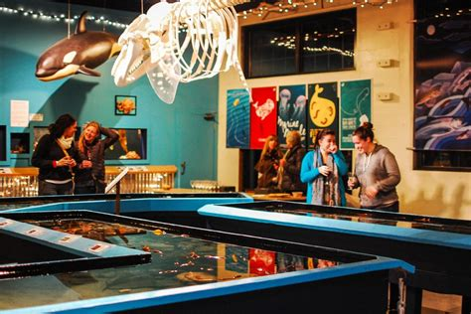
Sitka Sound Science Center
Located within easy walking distance of downtown the Sitka Sound Science Center is made up of a few distinct components: a salmon hatchery, an aquarium, research lab and an education outreach that encompasses preschoolers to college students and lifelong learners of all ages.
The Sitka Sound Science Center was formed in 2007, when the historic Sheldon Jackson College closed.
SSSC’s mission is to increase understanding and awareness of terrestrial and aquatic ecosystems of Alaska through research and education.
It’s also a fun place for any nature lover.
Admission:
Adults: $14, Seniors & veterans: $12 Children ages 5 to 12: $10 Children under 5 Free

Slide 20
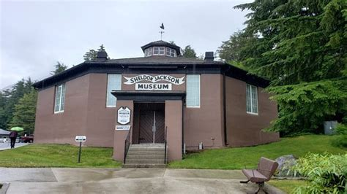
Sheldon Jackson Museum
The core of the Museum's collection comes from the Rev. Dr. Sheldon Jackson, a Presbyterian missionary who served as General Agent for Education in Alaska in the 1890s. In that capacity he made annual trips to Alaska, traveling extensively throughout the region. Dr. Jackson took collecting seriously, acquiring nearly 5,000 items during his travels.
While others were also collecting in Alaska and sending their items to noted museums, universities and societies around the world, Dr. Jackson was the only one who collected pieces for an Alaskan museum. The Sheldon Jackson Museum was founded in 1887, to house the collection and a growing library.
The first building was quickly outgrown and the second, present-day structure opened to the public in 1897.

Slide 21
Conclusion
Sitka is a beautiful City with a rich history and numerous attractions. Whether you're looking for stunning views, historic sites, or unique attractions, Sitka has something for everyone.
I hope this presentation will help when we visit Sitka.

Slide 22
Thanks For Coming
If you have any more questions, please ask.
I will do my best to answer them for you.
Have a great visit in Sitka!

Slide 23
Acknowledgement
My seminars are the result of many years of travel experience combined with many hours of research over the internet.
I would like to acknowledge the many source I have accessed.
These include: Wikipedia.com, Britannica.com, and the various Museum, Park and Government websites.

