Slide 1
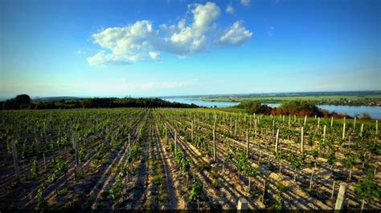
Wine Regions of the World An Introduction to Wine in Serbia Presented by Marc Silver

Slide 2
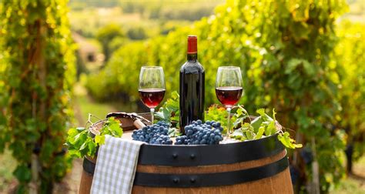
A Journey Through the Balkans
Allow me to start with an assumption, like me, you are all wine lovers!
Ever wondered what's happening in the world of wine beyond the usual suspects like France, Italy, or California?
Well, buckle up, because we're about to take a fascinating journey through Serbia's wine country.
You might be thinking, "Serbia? Really?" Trust me, you're in for a treat!

Slide 3
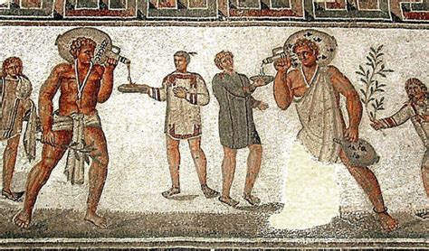
History of Serbia’s Wine
Ancient Beginnings: The Roman Influence on Serbian Wine
Serbia’s winemaking tradition began over 2,000 years ago when the Romans brought grape cultivation to the region. As they expanded their empire across Europe, they introduced viticulture wherever they went, and Serbia was no exception.
The area, known for its fertile soil and favorable climate, quickly became an ideal spot for growing grapes.
The Romans weren’t just passionate about wine—they considered it essential to their way of life.
It was central to their social gatherings, religious rituals, and even their economy.
As a result, they built extensive vineyards in what is now modern-day Serbia

Slide 4
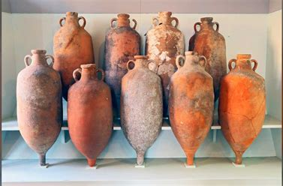
The Roman Influence on Serbian Wine
These vineyards supplied wine to soldiers, settlers, and officials across the empire, ensuring that the art of winemaking took root in the region.
Roman winemaking methods were advanced for their time. They utilized amphorae, large clay vessels, to ferment and store wine.
This practice not only influenced the development of Serbian wine but also helped preserve the knowledge of grape growing and fermentation long after the Romans left.
Archaeological evidence of ancient wine presses and amphorae in Serbia highlights the deep connection between the region and its winemaking past.

Slide 5
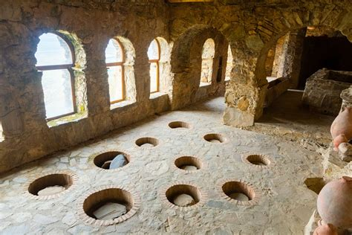
Medieval Monasteries
The Guardians of Serbian Winemaking
During the Middle Ages, Serbian monasteries took on a new role as the protectors and pioneers of winemaking.
While the rest of Europe was embroiled in conflicts and political shifts, these religious centers became the heart of Serbian viticulture. Monks were more than just men of faith; they were the winemakers who refined the art and science of wine production.
Much like the Romans, in medieval Serbia, wine was a necessity. It played a significant role in religious rituals, such as communion.
The monks, recognizing this importance, dedicated themselves to mastering the craft, and planted vineyards around their monasteries, cultivated grape varieties that suited the local climate, and developed techniques that would ensure a steady supply of wine year-round.

Slide 6
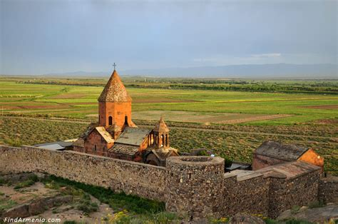
Medieval Monasteries
The Guardians of Serbian Winemaking
Serbian monasteries became winemaking hubs, passing down their expertise through generations of monks. They elevated Serbian wine, making it highly regarded in the region.
Monks' meticulous methods, from grape harvesting to fermentation, shaped modern winemaking in Serbia.
Monastic wine was traded, spreading Serbian wine culture and embedding viticulture into society.
Many modern wineries trace their roots to these monasteries, and some still produce wine today, connecting the present with a centuries-old legacy.

Slide 7
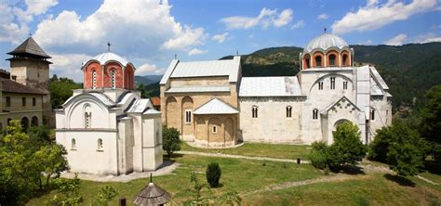
History of Serbia’s Wine
Medieval Influence
Monastic life in medieval Serbia didn’t just focus on prayer—it was also about perfecting winemaking. Monasteries became the backbone of viticulture, producing wine for religious ceremonies and daily consumption.
Monks were meticulous in refining their methods, passing down knowledge through generations. They played a vital role in preserving winemaking traditions during times of war and hardship.
As they honed their skills, Serbian wine began to evolve. The influence of the church ensured wine production spread far beyond monastery walls, reaching neighboring regions and embedding itself into Serbian culture. It wasn’t just a drink—it was a symbol of craftsmanship and devotion.

Slide 8
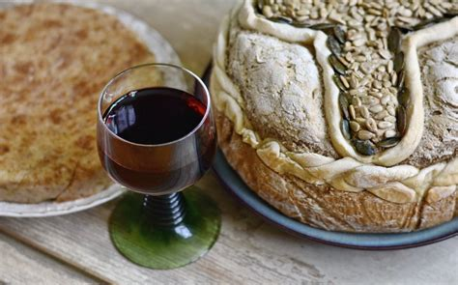
Ottoman Period
Wine Under Siege
The 15th to 19th centuries were a challenging period for Serbian winemaking, as the Ottoman Empire took control of the region. Under Ottoman rule, which lasted several centuries, wine production faced significant restrictions. The empire’s predominantly Islamic culture viewed alcohol consumption as contrary to religious principles, and while alcohol wasn’t completely banned, it was heavily regulated and taxed.
This created a hostile environment for Serbian winemakers. Many vineyards were abandoned, as large-scale production became economically unviable under the weight of these taxes and regulations. For the average Serbian vintner, producing wine openly was nearly impossible. However, despite these challenges, some vineyards managed to survive by operating discreetly.

Slide 9
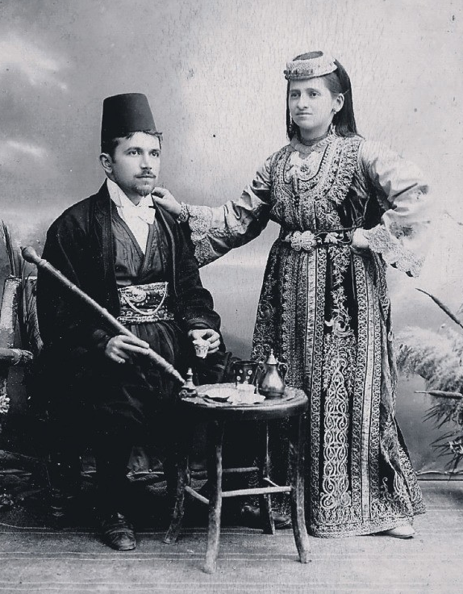
Ottoman Period
Monasteries once again played a crucial role in preserving Serbian winemaking during this time. Although most of the population faced strict limitations on wine production, monasteries continued to produce wine for religious purposes.
The church was allowed a certain level of autonomy, which enabled monks to keep the tradition alive, albeit in secret. These small, hidden operations ensured that the knowledge and practice of winemaking were not lost, even as the industry as a whole suffered.
Additionally, wine production persisted within non-Muslim communities, particularly among Christians and Jews. Although they were subject to the same restrictions, they found ways to maintain their winemaking traditions, often producing wine for personal consumption or religious ceremonies.

Slide 10
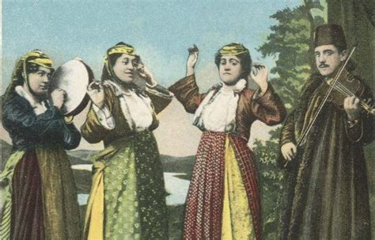
Ottoman Period
The resilience of these underground winemakers is what kept Serbian viticulture alive during the Ottoman period. Their determination to preserve this cultural heritage laid the foundation for a resurgence once Ottoman rule ended.
When Serbia eventually regained its independence, it was able to rebuild its wine industry on the knowledge and skills that had been carefully preserved for centuries.
Today, Serbian winemakers still honor those who defied the odds during the Ottoman era, acknowledging the vital role they played in ensuring that winemaking would survive through the darkest periods of history. This perseverance is a key part of Serbia’s wine legacy, reflected in the pride and passion of modern producers.

Slide 11
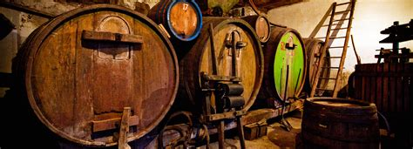
Rebirth and Revolution
The 20th Century and Beyond
Serbia’s wine industry faced yet another major shift in the 20th century, particularly during the communist era after World War II. The country, like much of Eastern Europe, underwent a period of industrialization and collectivization, which had a profound impact on winemaking. Under the communist regime, the focus turned to mass production, with quantity taking priority over quality.
Large, state-owned cooperatives were established, and individual winemakers lost control over their vineyards. This industrial approach to winemaking led to a decline in the craftsmanship that had once defined Serbian wine.
The emphasis was on producing large volumes of cheap wine, rather than on preserving the rich traditions and techniques that had been passed down through generations. This era saw the rise of generic, low-quality wine.

Slide 12

Rebirth and Revolution
The 20th Century and Beyond
The fall of communism in the late 20th century sparked a new chapter in Serbian wine. As the country transitioned to a market economy, private ownership of vineyards was restored, and winemakers began to shift their focus back to quality.
The 2000s marked the beginning of a wine renaissance in Serbia, as producers embraced modern techniques while reconnecting with their ancient winemaking heritage.
New vineyards were planted, old ones were revitalized, and winemakers began experimenting with indigenous grape varieties that had been largely forgotten during the communist era. This shift led to a resurgence of high-quality, artisanal wines that reflected the unique terroir of Serbia.

Slide 13
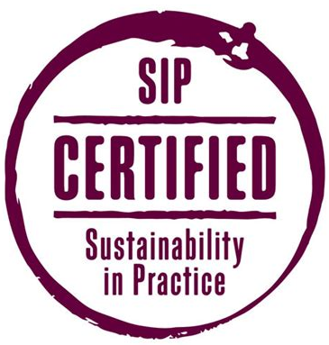
Rebirth and Revolution
The 20th Century and Beyond
Today, Serbian wine is known for its diversity and innovation, with winemakers combining traditional methods with cutting-edge technology to produce wines that stand out on the global stage.
Many Serbian wineries now focus on sustainability and organic practices, further enhancing the quality of their products. This new generation of winemakers is determined to rebuild Serbia’s reputation as a wine-producing country, and their efforts are paying off.
Serbian wines are increasingly gaining recognition in international competitions, and the country is once again being celebrated for its rich winemaking history.
In each bottle of Serbian wine today, you’ll find a blend of ancient tradition and modern innovation,

Slide 14
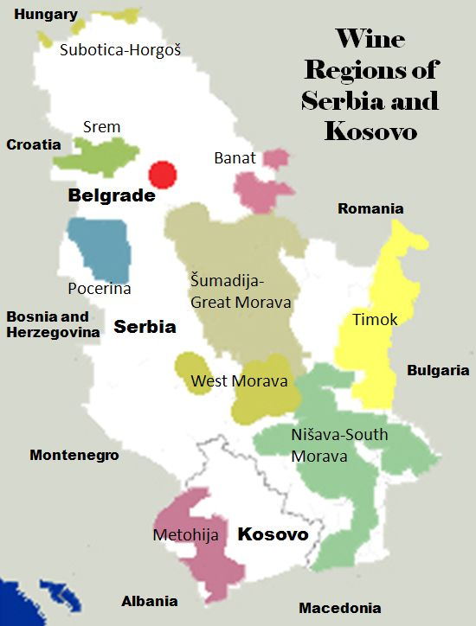
Wine Regions of Serbia
Where the Magic Happens:
So, where exactly is all this delicious wine coming from? Let's take a look at Serbia's main wine regions.
Wine Regions in Serbia
Serbia's wine regions are diverse, offering a broad spectrum of flavors and styles.
Each region has its own unique terroir, grape varieties, and winemaking traditions, making Serbia an exciting country to explore for wine enthusiasts.
Here’s a breakdown of Serbia’s key wine regions ranked by production size, highlighting what makes each one special

Slide 15
Wine Regions of Serbia
Where the Magic Happens:
Fruška Gora: This region is like the cool kid on the block. It's got hills, it's got forests, and it's got some seriously good white wines. Ever tried Riesling with a Serbian twist?
Župa: If Fruška Gora is the cool kid, Župa is the overachiever. It's Serbia's largest wine region and pumps out a variety of styles. Red, white, rosé – you name it, they make it.
Negotin: This eastern region is all about those bold reds. If you like your wine with a bit of attitude, Negotin's got you covered.
Subotica: Up north, near the Hungarian border, Subotica is making waves with its crisp whites and elegant reds. It's like the region can't make up its mind, so it decided to excel at both!

Slide 16
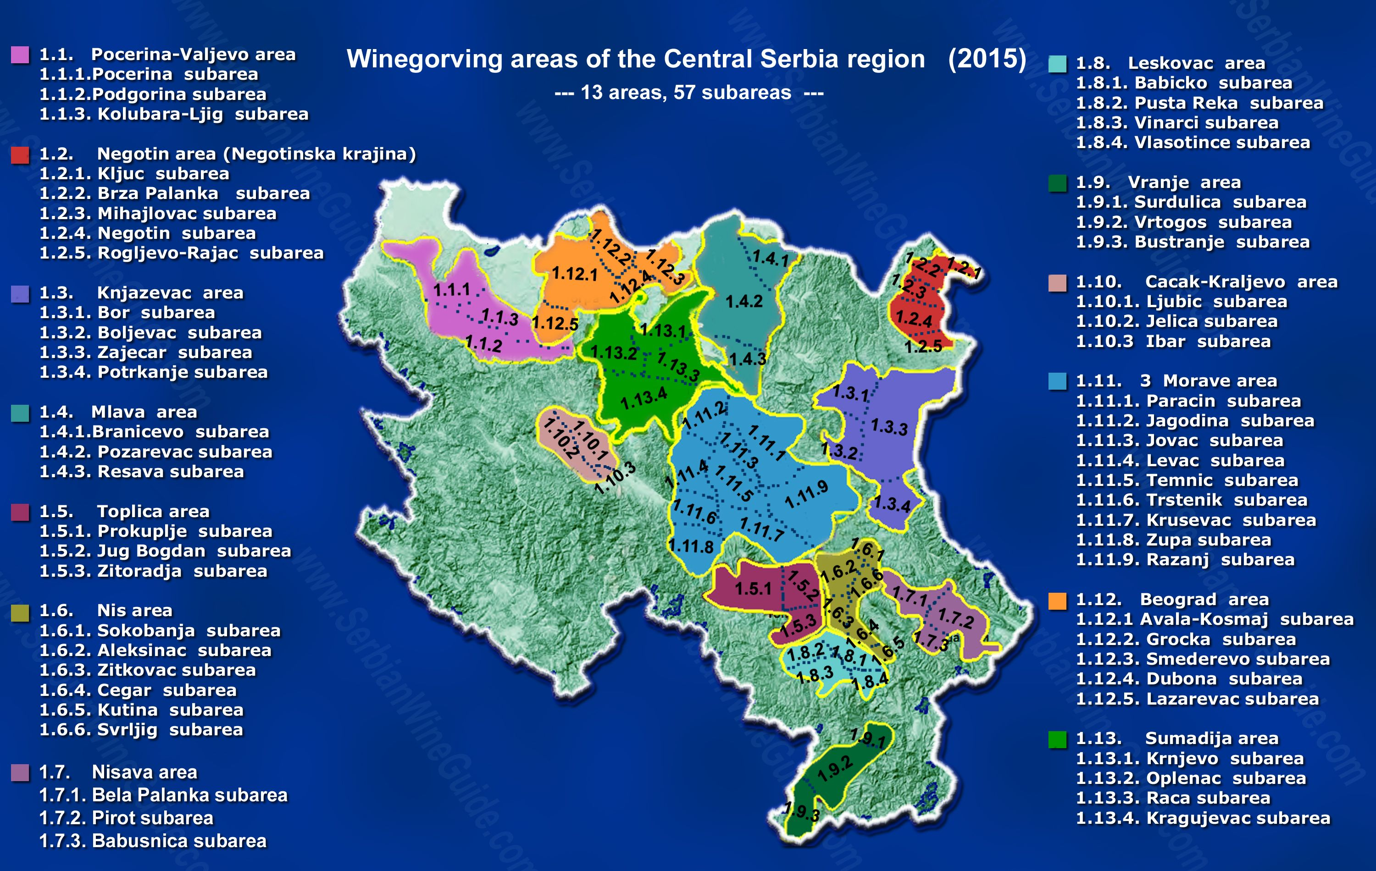

Slide 17
Wine Regions of Serbia
Šumadija: Production Size: As the largest and most renowned wine region in Serbia, Šumadija is the country's hub of viticulture, contributing significantly to both domestic consumption and exports.
Terroir: The region enjoys a mild climate with a mix of hilly and flat terrain, providing excellent growing conditions for a variety of grapes.
Grape Varieties: You’ll find Sauvignon Blanc, Chardonnay, and Cabernet Sauvignon thriving here, alongside indigenous varieties like Prokupac. The diversity of soil types and microclimates allows for the production of a broad range of wines.
What Makes It Special: : Šumadija is Serbia’s wine powerhouse, offering a diverse range of wines, from crisp, light whites to full-bodied reds. The region’s versatility makes it an ideal starting point for anyone new to Serbian wines, it combines tradition with modern winemaking techniques.
Visitors can sample everything from international varieties like Chardonnay to indigenous grapes like Prokupac​

Slide 18
Wine Regions of Serbia
Fruška Gora: This region is like the cool kid on the block. It's got hills, it's got forests, and it's got some seriously good white wines. Ever tried Riesling with a Serbian twist?
Production Size: Fruška Gora is one of Serbia’s most historic wine regions and plays a major role in national wine production. Its rolling hills and sunny slopes make it an ideal place for grapes.
Terroir: Fruška Gora’s limestone soils and sunny slopes provide ideal conditions for both red and white grape varieties. The region’s proximity to the Danube also moderates temperatures, allowing for slow, even ripening.
Fruška Gora
Grape Varieties: Merlot, Cabernet Sauvignon, and the indigenous Prokupac grape thrive here. The red wines of Fruška Gora are especially well-regarded, often characterized by their richness and complexity.

Slide 19
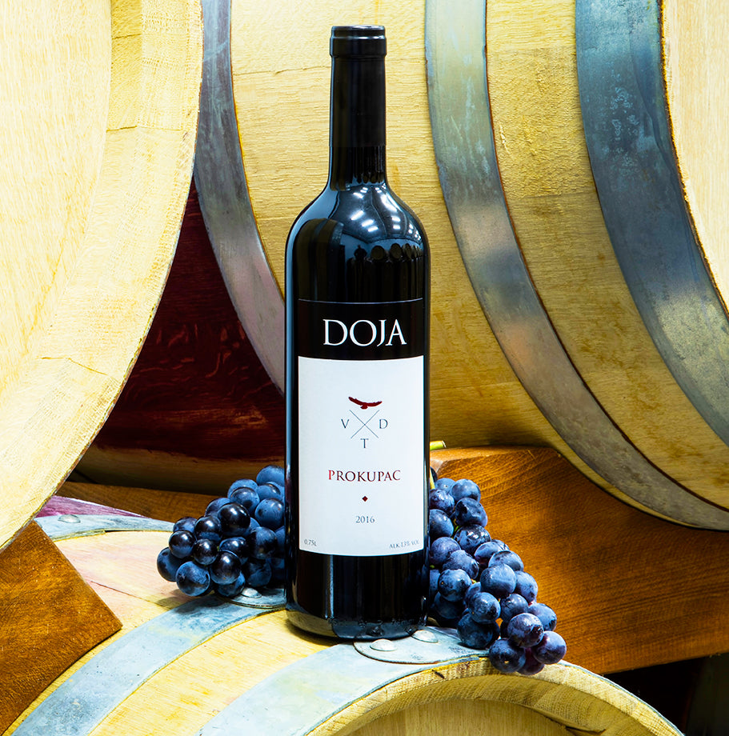
Wine Regions of Serbia
Fruška Gora:
What Makes It Special: Fruška Gora is often called the “Serbian Bordeaux” due to its ability to produce powerful, age-worthy red wines.
The indigenous Prokupac grape, with its bold, tannic structure, has been grown in the region for centuries and is gaining renewed attention.
Fruška Gora also produces high-quality white wines, making it a versatile wine region​.

Slide 20
Wine Regions of Serbia
Župa: Serbia’s Largest Wine Region
The Župa wine region, centered around Aleksandrovac, is one of Serbia’s most important and historic viticultural areas, spanning about 3,000 hectares.
This region has a deep-rooted winemaking tradition that goes back to the 12th century, when grapevines were cultivated for the Studenica Monastery under the rule of the Serbian medieval Nemanjić dynasty.
Župa, located in southern Serbia, is a Subarea in the country’s largest and one of its most historically significant wine regions. This area has been at the heart of Serbian viticulture for centuries, dating back to the Nemanjić dynasty in the 12th century, when local villages began producing wine for monasteries.
Today, Župa is a hub for traditional Serbian grape varieties like Prokupac and Tamjanika, producing a range of red, white, and rosé wines​.

Slide 21
Wine Regions of Serbia
Župa:
Terroir: Župa’s continental climate, with hot summers and cold winters, creates ideal conditions for grape growing. The region's varied soil types, including clay and limestone, contribute to the complexity and character of its wines, making them unique​.
Grape Varieties: The key grape varieties in Župa include Prokupac, which is Serbia’s flagship red variety, and Tamjanika, a local clone of Muscat Blanc à Petits Grains. Prokupac produces robust, deeply flavorful reds, while Tamjanika is known for its highly aromatic white wines, with floral and fruity notes that pair beautifully with desserts​.
Production Size: Župa’s wine production is renowned for its quality rather than sheer volume, despite its large vineyard area. It surpasses regions like Fruška Gora and Šumadija in size, making it vital to Serbia's wine industry​.
What Makes It Special: Known as the heartland of Serbian winemaking, Župa’s focus on indigenous grape varieties gives its wines a distinct identity.

Slide 22
Wine Regions of Serbia
South Serbia (NiSuva South Monovia)
Production Size: Although less prominent than the northern regions, South Serbia is gaining recognition for its quality-focused wine production.
Terroir: The warm, dry climate and higher altitudes of South Serbia create excellent growing conditions for robust red wines. The region’s soils are varied, with a mix of clay, sand, and limestone, contributing to the complexity of its wines.
Grape Varieties: Red grapes dominate here, with varieties like Prokupac and Cabernet Sauvignon leading the way. The wines from this region tend to be bold and full-bodied, with intense fruit flavors and firm tannins.
What Makes It Special: South Serbia is on the rise, producing increasingly acclaimed wines. Its combination of climate and terroir allows for the production of concentrated, age-worthy wines.
While still developing its reputation, the region’s winemakers are pushing boundaries and gaining recognition on the international stage​

Slide 23
Wine Regions of Serbia
Subotica, located in the northernmost part of Serbia near the Hungarian border, is a rising star in the country's wine scene.
The region benefits from a unique combination of continental and Pannonian climates, which creates excellent growing conditions for a variety of grapes.
This climate diversity allows Subotica to produce both crisp white wines and elegant red wines, showcasing its versatility.
The white wines from Subotica tend to be fresh, with bright acidity and fruity notes, often featuring local grape varieties like Grašac (Welschriesling).
The reds are typically more refined and elegant, with smooth tannins and a rich, complex flavor profile. This ability to excel at both styles makes Subotica an intriguing wine region, standing out for its high-quality offerings.

Slide 24
Wine Regions Final Thoughts
Serbia's wine regions are a fascinating mix of long-standing traditions and modern winemaking techniques.
Each region boasts distinct characteristics that reflect its climate, soil, and history. Fruška Gora, for example, is known for its robust red wines, especially from local grapes like Prokupac and international varietals such as Merlot and Cabernet Sauvignon.
These wines tend to be full-bodied, with deep flavors and complexity. Meanwhile, the Šumadija region, with its more moderate climate, produces aromatic white wines, including varieties like Sauvignon Blanc and Chardonnay.
These wines are often fresh and crisp, with delicate floral and fruit notes. Whether you prefer bold reds or light, refreshing whites, Serbia’s diverse wine regions offer something for every palate.

Slide 25
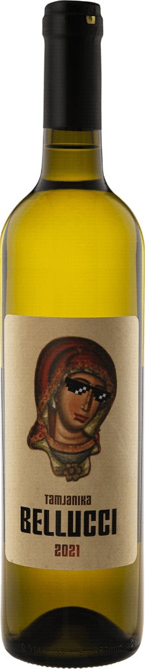
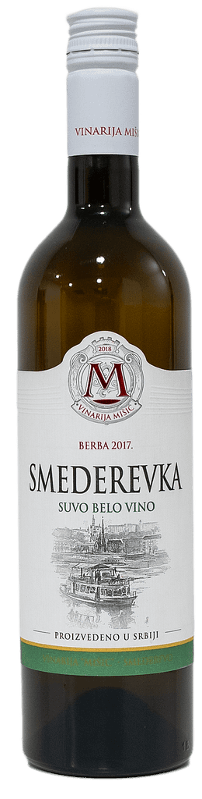
What's in the Bottle?
Serbia's Grape Varieties
Now, let's talk grapes. Serbia's got some varieties that might make you scratch your head, but trust me, your taste buds will thank you for trying them.
Whites
Tamjanika: This aromatic white is like Serbia's answer to Muscat. Floral, fruity, and oh-so-refreshing.
Smederevka: Light, crisp, and perfect for a summer day. It's like the Serbian version of a poolside sipper.
.

Slide 26
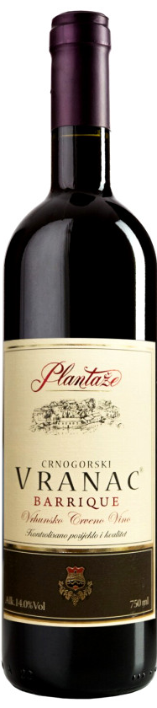
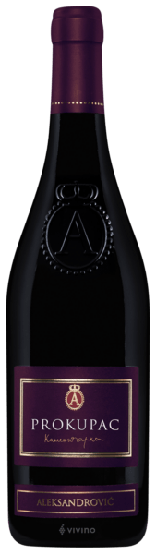
What's in the Bottle?
Reds
Prokupac: This is Serbia's pride and joy. It's a red grape that can produce anything from light, fruity wines to bold, age-worthy reds. Versatile much?
Vranac: Dark, intense, and full of character. If you like your reds big and bold, Vranac's your new best friend.

Slide 27
Why Serbian Wine Deserves Your Attention
You might be wondering, "Why should I care about Serbian wine?" Well, let me give you a few reasons:
Value for Money: Serbian wines often deliver way above their price point. Who doesn't love a bargain?
Unique Flavors: With indigenous grapes and diverse terroir, Serbian wines offer flavors you won't find anywhere else.
Up-and-Coming: Getting into Serbian wine now is like discovering a band before they hit the big time. You get bragging rights!

Slide 28
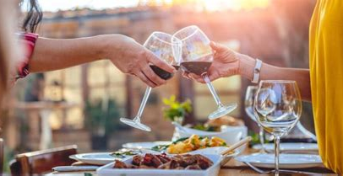
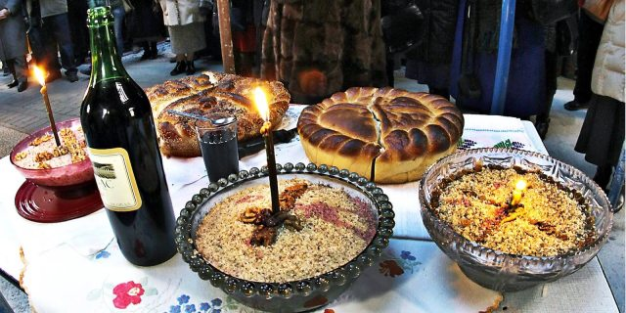
How to Enjoy Serbian Wine
So, you're sold on giving Serbian wine a try (and why wouldn't you be?). Here are some tips to get you started:
Start with what you know: If you're a Riesling fan, try a Serbian Riesling. It'll be familiar yet different.
Be adventurous: Don't be afraid to try those weird-sounding grapes. That's where the fun is!
Food pairings: Serbian wine goes great with... you guessed it, Serbian food! Think grilled meats, hearty stews, and fresh salads.

Slide 29
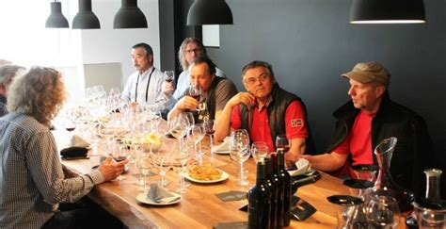
How to Enjoy Serbian Wine
Remember, wine tasting is all about personal preference. What matters most is what you enjoy. So why not grab a bottle of Serbian wine, gather some friends, and have your own tasting party? You might just discover your new favorite wine! So, there you have it – a whirlwind tour of Serbian wine.
Who knew this small Balkan country had so much to offer in terms of vino?
Next time you're at the wine shop, why not venture out of your comfort zone and give Serbia a try? Your taste buds might just thank you for the adventure!

Slide 30
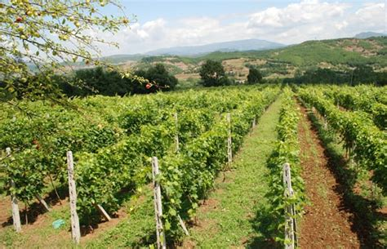
Serbia’s Unique Terroir
What’s the secret behind Serbia’s distinctive wines?
A mix of diverse soils, microclimates, and traditional grape varieties. The country’s vineyards benefit from:
Hills and valleys that create ideal sun exposure.
Rich soils ranging from limestone to loam.
Microclimates that allow for a broad spectrum of grape cultivation.
Serbia’s major varietals reflect the country’s diverse terroir and winemaking potential. Whether it’s the bold, structured reds like Prokupac, the aromatic sweetness of Tamjanika, or the crisp elegance of Riesling, Serbia offers a wide range of flavors for wine enthusiasts to explore.

Slide 31
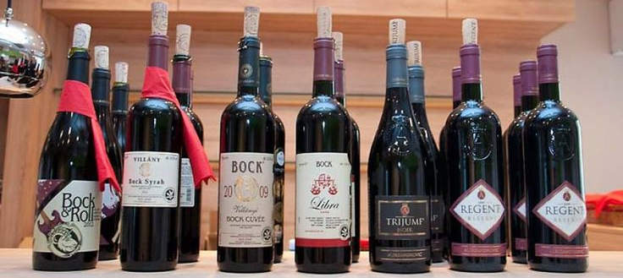
Serbia’s Major Varietals
Serbia’s rich winemaking tradition is anchored in both indigenous and international grape varieties, each bringing distinct qualities to the table. Here’s a deeper look into the major varietals that define Serbia’s wine landscape:

Slide 32
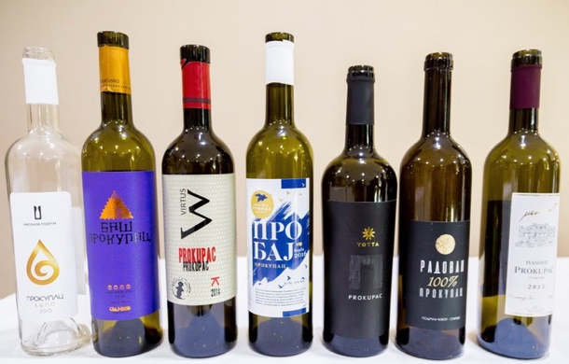
Serbia’s Major Varietals
Prokupac
Often referred to as the "backbone" of Serbian red wine production, Prokupac is a versatile, indigenous grape variety that has been cultivated in Serbia for centuries. It thrives particularly well in the warmer southern regions like Župa.
Characteristics: Prokupac is known for producing bold, full-bodied wines with deep ruby colors and rich flavors of dark fruits like plum, blackberry, and black cherry. In terms of structure, it has robust tannins, giving it a grip similar to Cabernet Sauvignon.
Food Pairings: The intensity of Prokupac makes it an excellent match for hearty dishes like roasted meats, game, or rich stews. Its firm tannins and dark fruit flavors also pair well with aged cheeses and barbecue.
Growing Regions: Fruška Gora and Župa are key regions for Prokupac, benefiting from warm days and cooler nights that allow the grape to develop its characteristics.

Slide 33
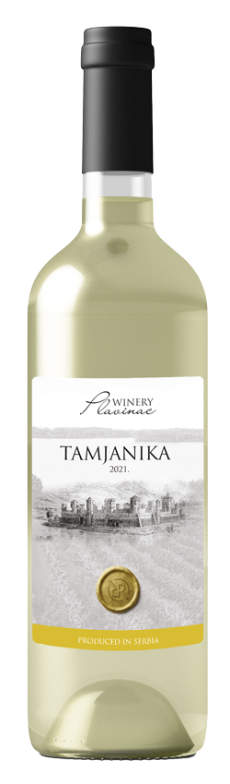
Serbia’s Major Varietals
Tamjanika
Tamjanika is a Serbian variation of the Muscat Blanc à Petits Grains grape, which is known for its distinctive aromatic qualities. This white grape variety has been cultivated in the Balkans since the 14th century and is particularly loved for its expressive aromas.
Characteristics: Tamjanika is highly aromatic, bursting with floral and fruity scents. It often features notes of elderflower, jasmine, and rose, with layers of ripe apricot, peach, and citrus on the palate. Despite its sweetness, Tamjanika wines are usually well-balanced with crisp acidity, which makes them feel refreshing rather than cloying.
Food Pairings: Given its aromatic and floral nature, Tamjanika is a fantastic match for desserts like baklava, fruit tarts, and creamy cheeses. Its balanced acidity also makes it a great partner for spicy dishes, as it can cool down the heat while complementing strong flavors​.
Growing Regions: The regions of Župa and Topola are particularly well-suited to Tamjanika due to their warmer climates, which allow the grape to fully develop its aromatic potential​.

Slide 34
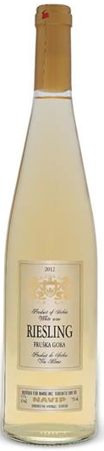
Serbia’s Major Varietals
Riesling: While Riesling is not native to Serbia, it has found a home in the cooler northern regions, particularly in Fruška Gora and the areas near the Danube. Serbia’s Rieslings are gaining international attention for their crispness and balance between sweetness and acidity.
Characteristics: Serbian Rieslings often showcase the classic balance between sweetness and acidity for which the grape is renowned. They tend to have vibrant acidity, which enhances their freshness, with flavors of green apple, lime, and stone fruits like peach and apricot. Over time, Riesling can also develop complex secondary notes such as petrol or minerality.
Food Pairings: Riesling’s acidity makes it a perfect match for foods that need a wine with good cut. It pairs well with lighter dishes like seafood, chicken, and salads, as well as spicy Asian cuisine, where its crispness can balance the heat.
Growing Regions: The northern regions of Serbia, especially Fruška Gora, are ideal for growing Riesling due to their cooler climates and limestone-rich soils.

Slide 35
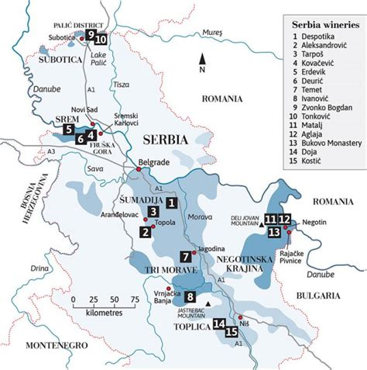
Notable Wineries
Vinarija Despotika (Central Serbia) #1
Vinarija Despotika has made a name for itself by focusing on Prokupac, Serbia’s indigenous red grape.
Specializing in rich, complex reds, Despotika showcases the potential of this underappreciated variety.
Their wines are known for deep berry flavors, earthy undertones, and a bold structure. The winery emphasizes sustainability and traditional methods, producing wines that reflect the unique terroir of Central Serbia.
If you’re looking to explore authentic Serbian reds, Despotika’s Prokupac is a must-try for its balance of history and innovation.

Slide 36
Notable Wineries
Want to explore Serbia’s wine firsthand? Here are a few top wineries that should be on your radar:
Aleksandrović Winery (Šumadija) #2
Aleksandrović Winery is one of Serbia's most renowned, especially for its Trijumf label, a white wine blend that’s won numerous international awards.
The winery’s roots date back over a century, and today, it’s known for combining modern techniques with traditional Serbian winemaking.
Their Trijumf blend, featuring Chardonnay, Sauvignon Blanc, and Rhine Riesling, delivers a complex yet balanced flavor with citrus and floral notes.
This winery has become a symbol of Serbia’s wine renaissance, continuing to raise the bar for local and global recognition.

Slide 37
Notable Wineries
Kovačević Winery (Fruška Gora) #4
Kovačević Winery is a leading name in Fruška Gora, particularly for its aromatic white wines like Riesling.
Their wines are praised for their fruit-forward profiles, with the Riesling offering crisp acidity and hints of green apple, citrus, and floral aromas.
The region’s cool climate and limestone-rich soil help cultivate the vibrant flavors in their whites. Kovačević also experiments with innovative techniques like barrel aging whites, delivering wines that are both fresh and complex.
It’s a top choice for lovers of bright, aromatic wines.

Slide 38
Final Thoughts
Serbia may not always be the first country that comes to mind when thinking about wine, but its rich history and dynamic wine regions make it an emerging player on the global wine stage. From ancient Roman vineyards to the resilience shown through the Ottoman Empire and Yugoslavia, Serbian wine culture has evolved into something truly unique. The country’s varied terroir and climate provide ideal conditions for both indigenous grape varieties like Prokupac and Tamjanika, as well as international ones like Chardonnay and Merlot. This combination offers a wide spectrum of wine styles, from bold reds to crisp, aromatic whites​ .
Serbia’s wine regions, especially Fruška Gora, Župa, and Negotin, are noteworthy for their high-quality wines and are rapidly gaining international attention. Wineries such as Aleksandrović and Kovačević are leading the charge in raising the profile of Serbian wine globally, producing exceptional vintages that reflect the country’s viticultural heritage and modern innovation​

Slide 39
Conclusion
Whether you're an avid wine enthusiast or a casual sipper, Serbian wines offer something unique to explore. The country’s diverse climate, rich soils, and centuries-old traditions have created wines that reflect both history and innovation.
Whether you're trying a bold Prokupac or a fragrant Tamjanika, the flavors of Serbia’s wines will not disappoint. Next time you're looking for a new wine experience, why not venture into the world of Serbian wines?
You may just discover your next favorite bottle of wine.

Slide 40
Acknowledgement
My seminars are the result of many years of experience combined with many hours of research over the internet.
I would like to acknowledge the many source I have accessed.
These include Wine Spectator, Wine Enthusiast, BKWine Magazine, Wine & Spirits Magazine, American Vineyard Magazine, The Grapevine Magazine, Wikipedia.com, Britannica.com, and the various Government websites.

Slide 41
Citations and References
Tourism Websites: National tourism websites or Serbia-specific wine tours may offer useful insights into the history and current state of the wine industry in the country.
Wine & More - This source provided insight into the historical significance of viticulture in Serbia, the country's unique grape varieties, and how regions like Fruška Gora and Župa are shaping modern winemaking in Serbia​
All Wines of Europe - It offered a detailed breakdown of Serbia's primary wine regions, such as Fruška Gora, Župa, and Negotin. Each region’s terroir, climate, and notable grape varieties were highlighted, adding depth to the article​

